Slide 1
Notes:
The resurrection of Jesus Christ is w/o a doubt the greatest evidence for the legitimacy of Christianity. Numerous miracles were performed during biblical times and people were raised from the dead. But for a man to raise Himself from the dead is irrefutable evidence that Christ is Lord. Paul recognized this in Rom 1:4 that – “[Jesus was] declared the Son of God with power by the resurrection from the dead, according to the Spirit of holiness, Jesus Christ our Lord”.
However if I were to choose the 2nd greatest evidence for Christianity, I do not believe that is found in science or archeology or bibliographical studies, as convincing as these evidences are. The 2nd greatest evidence to the resurrection itself is found in the conversion of Saul of Tarsus who came to be, as we know him today, the beloved Apostle Paul.

Slide 2
Relevance
One of the Greatest Evidences for Christianity
2nd only to the Resurrection of Christ
Holy Spirit emphasized by recording his conversion 3 separate places in scripture
Acts 9, 22, 26
Paul understood the significance of his conversion
1 Tim 1:15-16 – “¹⁵It is a trustworthy statement, deserving full acceptance, that Christ Jesus came into the world to save sinners, among whom I am foremost of all. ¹⁶Yet for this reason I found mercy, so that in me as the foremost, Jesus Christ might demonstrate His perfect patience as an example for those who would believe in Him for eternal life.”
Notes:
This was so significant to the Holy Spirit Himself that He records the account in 3 different areas of the NT. The first account is in Acts 9 where we find it in its proper chronological order as told by Luke the Historian. Then in Acts 22 and Acts 26, as Paul stands on trial for his life, he personally recounts the story of his conversion as a tool for the validity of Christianity. In 1 Tim 1, Paul himself realized that his own conversion was a significant event for other Christians to draw from – 1 Tim 1:15-16

Slide 3
Outline
Saul of Tarsus
Notes:
It is important to first consider who Saul of Tarsus was before he became the Apostle Paul.

Slide 4
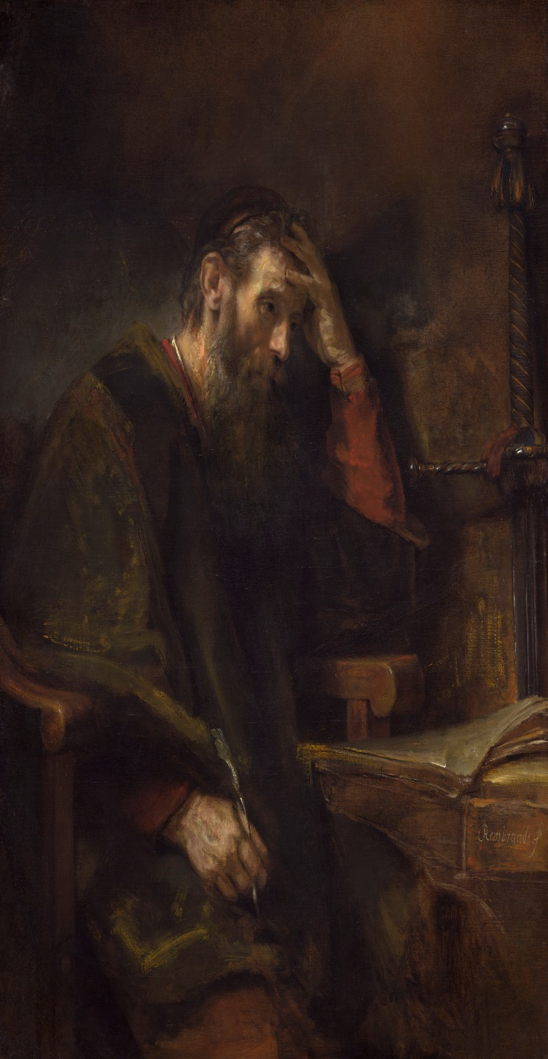
Saul of Tarsus
Born and raised in Tarsus, Cilicia of Asia Minor
Acts 22:3
University city known for it’s stoic philosophers and culture
Strabo the Geographer (63/64 BC - 24 AD) claimed Tarsus was greater than Athens and Alexandria in its education and philosophy
Studied under Gamaliel
Acts 22:3; 5:33-40
Notes:
In Acts 22:3, we learn that Saul was born and raised in Tarsus of Cilicia, which was a province of Asia Minor. Tarsus was a university city, filled with philosophers and orators. It was a cultural icon that stood out amongst other provinces. Historians have said that Tarsus was greater in regards to its education and its philosophy than even Athens and Alexandria. This is where Saul grew up.
We also learn that he studied under one of the wisest, intelligent Pharisees that ever lived in Gamaliel. In order to see why this is significant, consider what Gamaliel said in Acts 5 when the Pharisees were trying to decide what to do about this new sect called “Christianity” that had risen in popularity. While the other Pharisees were intent on killing the apostles just as they had Jesus, Gamaliel said this – Acts 5:33-40a – The point of mentioning this is that Gamaliel’s statement to the Pharisees shows the extent of his wisdom. Gamaliel was a very intelligent man. He was a very wise man whom other wise men listened and looked up to. And Saul grew up sitting at that feet of this man in one of the most philosophical and educational cities that existed at that time. And no doubt this intelligence and wisdom rubbed off on Saul.

Slide 5
Saul of Tarsus
A “pure blood” Jew
Circumcised on 8th day – Phil 3:5
Tribe of Benjamin – Phil 3:5
Named after first king of Israel
Advanced beyond colleagues
“A Hebrew of Hebrews” – Phil 3:5
A Pharisee – Phil 3:5; Acts 26:5
Zealous – Acts 7:58; 8:1,3; 9:1-2; 26:9-11; 1 Cor 15:9; Gal 1:13-14
“Blameless” – Phil 3:6
Notes:
(Phil 3) At the beginning of this chapter, Paul is giving us his credentials, who and what he was and what he possessed before becoming a Christian. In vs. 5, we read that Paul was circumcised the 8th day. This was absolutely essential for anyone to become a Jew but by the first century it wasn’t necessarily something that was practiced every time a baby boy was born. But it was practiced in Paul’s family. They strictly kept to their Jewish heritage and had him circumcised as God had first commanded Abraham in Gen 17.
We’re told he was from the tribe of Benjamin. You know, since the captivity and the intermingling of the Jews with other nations, a lot of Jews didn’t know what tribe they were from. But Paul did. He was from pure blood stock. He could trace his roots back to one of the very sons of Jacob himself, that is how much emphasis he and his family placed in their lineage.
Phil 3:5 tells us that Paul was named for the first king of Israel, Saul, who was also from the tribe of Benjamin and this is probably not a coincidence.
In vs. 5, he claimed to be a Hebrew of Hebrews, which I take to mean that he stood out among his Jewish contemporaries in his faith and his knowledge and keeping of the law.
Vs. 5 tells us he was a Pharisee. If he was a Pharisee, who do you think his friends were? Probably other Pharisees.
Vs. 6 tells us that Paul was extremely zealous for what he believed at the time to be God’s will. We remember that in Acts 7, he stood by the coats of those who had Stephen stoned, an act of 100% approval to the capital punishment taking place. He persecuted Christians door to door, obtaining letters of approval from the Sanhedrin to lock them up and put them on trial for their life because at the time Saul didn’t believe that Jesus Christ was the Son of God. You know, a lot of the Pharisees were content to just sit on their hands while Christianity grew and grew while letting others do the dirty work. Not Saul of Tarsus; he was active and engaged in trying to put a stop to what he thought was a false sect.
And then Phil 3:6, we’re told that he was blameless. This doesn’t mean that he was without sin, it just means that no one could lay a public charge against him because he stood out in his virtues and his loyalty to the Law of Moses.

Slide 6
Saul of Tarsus
Extremely Intelligent
Fluent in Hebrew, Greek, Aramaic
Acts 21:37, 40
Quoted from lesser known poets
Aratus/Cleanthes – Acts 17:28
Menander – 1 Cor 15:33
Epimenedes – Tit 1:12
Came from honorable family
“Son of Pharisees” – Acts 23:6
Acquired Roman citizenship, must likely due to his father being honored for service – Acts 22:5
Notes:
Other areas of the NT show us that Saul of Tarsus was an extremely educated individual who knew his stuff, which should be obvious considering where he grew up and who his teacher was. We know he spoke Hebrew, Greek, and Aramaic.
In his dealings with the stoics and the epicurean philosophers, he would often quote from lesser known poets/philosophers. Everybody has heard of Socrates and Plato. But has anyone ever heard of Aratus? Cleanthes? Paul quoted both of them in Acts 17:28 when he was trying to teach the Greeks. Have you ever heard of the philosopher Menander? Paul quoted him in 1 Cor 15:33. What about Epimenedes? Me neither. But Paul quoted him in Tit 1:12. These were lesser known philosophers. And yet Paul could quote them from memory.
Saul of Tarsus was also from a very prominent family. Acts 23:6 tells us that he was a son of Pharisees. So not only was he a Pharisee, but his father as well and most likely his grandfather.
Acts 22:5 tell us that Saul of Tarsus was a Roman citizen, most likely due to his father being honored for some service for the Roman Empire. And this citizenship afforded him certain privileges that many within the empire didn’t have.

Slide 7
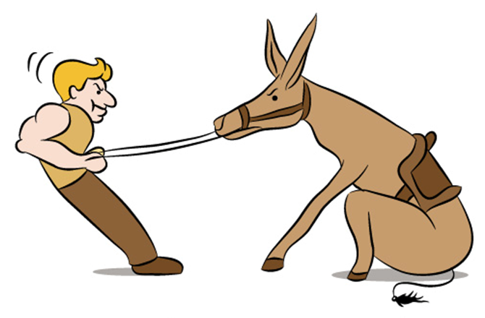
Saul of Tarsus
Obstacles To Conversion
Intelligence can foster pride
1 Cor 8:1
Loyalty to the law
Loyalty to his family
Loyalty to Jewish friends
Shame of killing Christians
Notes:
Well, what’s the point of mentioning all this about Saul of Tarsus? I want us to see how in a lot of ways it would have been difficult for a man with his pedigree and with these credentials to be converted away from Judaism to Christianity.
First of all, his education and extreme intelligence would be a hindrance. 1 Cor 8:1 tells us that knowledge brings forth arrogance. And those who are arrogant are less likely to accept the simple truths of the gospel. Sometimes these scientists with all of their intelligence and all their degrees can’t seem to bring themselves to accept the simplest truths about God. The reason this is the case is because their arrogance and confidence in their knowledge basically stupefies them from becoming believers.
Then there would be all of Saul’s competing loyalties. There was his loyalty to the law, his loyalty to his family, his loyalty to his Jewish and Pharisee friends. Sometimes becoming a Christian causes a separation in relationships, some of these relationships being very dear. And many people can’t make the break for the sake of Christ.
And then what about his shame? He had sanctioned the murder and the imprisonment of Christians. How much guilt do you support Paul must have felt? How worthless could he have deemed himself for the damage he had caused others due to his ignorance? A lot of people don’t become Christians simply because they don’t think they are worth anything to God. But what about Saul of Tarsus? He was a murderer of Christians, a persecutor of the church.

Slide 8
Saul of Tarsus
Character was questionable
“Forced” Christians to blaspheme
Acts 26:11
Some secular writings have suggested he was intolerant, bitter, proud, and temperamental
Notes:
And even though he was considered blameless, there were still some questionable episodes in his life before his conversion. In Acts 26:11, he admitted trying to force Christians to blaspheme. And though this is speculation, there is some biblical and secular evidence that Paul could be proud and a bit temperamental. What chance would you give a man such as this to not only obey the gospel, but to be one of the most faithful and devoted Christians that ever lived?

Slide 9
Outline
Saul of Tarsus
The Road To Damascus
Notes:
But then something happened to him…

Slide 10
Notes:
Something happened as Paul is traveling on the road to Damascus – Acts 9:1-22 – This is how Saul of Tarsus became a Christian; the man we have come to know and love called the Apostle Paul.

Slide 11
The Road to Damascus
Could Paul have rejected the vision?
Man is given free will
Josh 24:15
Miracles never enough to convict hearts
Ex 20:18-19; Matt 12:24
Heat exhaustion?
Notes:
He could have rejected the vision. The bible is very clear about the fact that man has been given free will by God to choose whether to obey or disobey Him. Some think that because Jesus appeared to Saul directly that he had no choice in the matter. And yet miracles of bible days were never enough to produce saving faith. Remember that great event on Mt. Sinai when God Himself spoke the 10 commandments and there was thunder and lightning and earthquakes and the people were so scared that they asked Moses to speak to them instead of God lest they die? After such a great display of power and might, you’d think there was no way those Israelites could fall, not after that great display of majesty. But what happened 40 days later? They were worshipping a golden calf and saying, “This is our god who led us out of Egypt”. The point is miracles have never been enough to produce saving faith. Paul could have rejected the vision. Or he could have just passed it off as heat exhaustion, as some skeptics have suggested.

Slide 12
Outline
Saul of Tarsus
The Road To Damascus
Paul The Apostle
Notes:
But he didn’t. He was convinced. He was truly converted, and he became our beloved Apostle Paul.

Slide 13
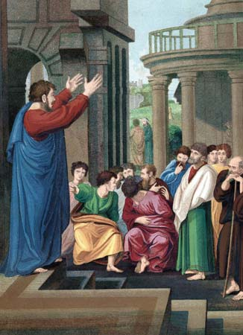
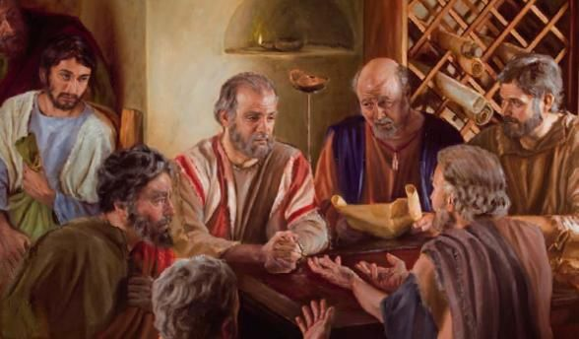
Paul the Apostle
Character transformed
Became patient, kind, enduring, and self-sacrificing
Forsook physical battles to fight spiritual battles
2 Cor 10:3-4
Relationships transformed
Immediately began associating with disciples
Acts 9:26
Fellowshipped with other apostles
Acts 9:29
Notes:
This proud and temperamental man became one of the kindest, patient, enduring, and self-sacrificing men to have ever served Jesus. He went from fighting physical battles from door to door as Acts 8:3 tells us he was dragging men and women from their houses, to fighting spiritual battles from town to town preaching the gospel of Jesus Christ. Saul of Tarsus is now dead. And rising in his place is the Apostle Paul, a man who dedicated his life to mimicking the character of Jesus.
In Acts 9:26 tells us that he immediately began associating and fellowshipping with other disciples. This was a difficult thing for him as the same verses tells us that initially the other disciples were terrified of him, not believing that he was a disciple. But Barnabas was a character witness for Paul so that he could enjoy having fellowship with those who shared his same commission. Men, who Saul would have loved to have gotten his hands on thrown in prison and even killed, where now his family, his brothers in Christ – his relationships were completely transformed.

Slide 14
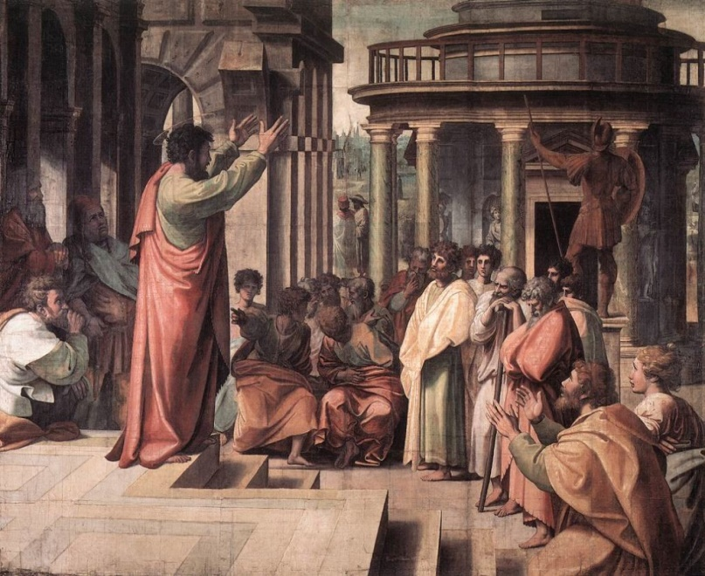
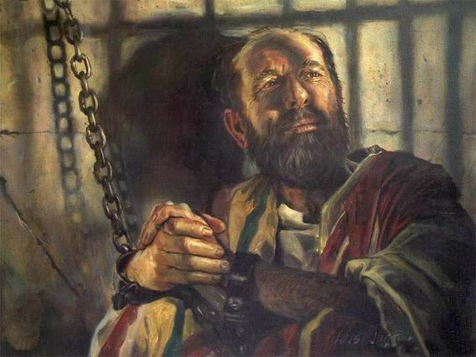
Paul the Apostle
Message transformed
Immediately preached Jesus
Acts 9:20
Understood OT fulfilled in NT
Acts 17:3
Perspective transformed
Gentile hater to Gentile preacher
Acts 13:46-47; 22:21
Forsook beliefs of his family, his friends, and former religion
Epitome of sacrifice
Notes:
When Saul became a Christian, he wasted no time doing what he knew he could do best - he immediately began preaching Jesus. He saw through the shadows of the OT that he had once devoted his life to and understood now that they were pointing to something better and of more substance in Christ. And now knowing it was true, he preached it and he preached and he preached it, so passionately that those Jews in Damascus and in Jerusalem as well wanted to kill him for who they believed was a turn coat. And when that could have frightened him away from his commission, perhaps caused him to have second thoughts one whether he should preach, he went right on doing it on the threat of death.
When Saul of Tarsus became the Apostle Paul, his entire perspective on life changed. He went from being a Gentile hater to a teacher and advocate of the Gentiles, converting hundreds if not thousands of them to Christ. He forsook the beliefs of his family, his friends, his religion, and he never once looked back, never once regretted the decision he had made. And he became the epitome of self-sacrifice, a model and example for every Christian to follow in that no matter how bad his circumstances were, he always found joy in being in Christ.

Slide 15
Outline
Saul of Tarsus
The Road To Damascus
Paul The Apostle
What’s The Point?
Notes:
What’s the point?

Slide 16
What’s The Point?
Paul overcame every obstacle to conversion
External Reasons
Loyalty to Family
Loyalty to Friends
Loyalty to Teacher/Preacher
Loyalty to a church/traditions
Notes:
First, Paul gave up all of the external distractions to faith. Every competing loyalty that might have distracted him from fully following Christ, he gave it up w/o hesitation.
He gave up loyalty to his family. How many people, when confronted with a truth from scripture, won’t obey God because it goes against what their family believes? That way is broad. Some people love their family more than they do Jesus. But not Paul. Jesus was everything to him – Matt 10:37 – Paul didn’t just know this verse, he lived it.
He gave up loyalty to his friends. Sometimes accepting and obeying the truth means you’re going to lose friends whether you want to or not. And it’s not merely that we might have to give up certain people in our life to remain faithful. A lot of times they’re giving us up because simply because they resent our new found faith. Those Jews testifying against Paul in the latter parts of Acts, the ones who were trying to ambush him to kill him, these would have likely been people he was close to before his conversion. But that didn’t hold him back. Christ was everything to him. What a friend he had in Jesus.
He gave up loyalty to his teacher. Gamaliel was one of the wisest men of that time, a respected man who had a profound influence on the early life of Paul. Sometimes it’s a popular preacher or personality that draws us to favor a particular religion. We’re attracted to a preaching style or a personality or it may be someone that has taught me in the past whom I have a connection with. And then what can happen is we learn things from the bible that are different than what my teacher or preacher has taught me. It’s at that point that my loyalty to this person will be challenged. Paul had this temptation with Gamaliel, but it didn’t prevent him from doing what was right because He found a greater teacher in Jesus.
Paul overcame loyalty to his religious traditions. Paul had plenty of Jewish traditions he’d known his whole life, as he enumerates through them in Phil 3. These were traditions that he not only practiced, but they were his life and in a lot of ways they defined him as a Jew. But when he learned the truth and understood that changes in his life were required, he fully embraced them for the one who died for him.

Slide 17
What’s The Point?
Paul overcame every obstacle to conversion
Internal Reasons
Conscience/Feelings
Preconceived Beliefs
Too much guilt
Notes:
And then there were the internal conflicts Paul had to contend with.
He had to confront the reality of his conscience. In Acts 23:1, as Paul is on trial for his life and begins to give his testimony, he says this – Acts 23:1 – In other words, when he was persecuting Christians and sanctioning their murders, he thought that was the right thing to do. He was sure of it. And many people, despite learning the truth, will stick w/their religion because it just seems/feels right to them. But as clear and clean as Paul’s conscience was as a Jew, when a conflict arose between the truth and his conscience, he went with truth because at that point it was not a matter of what he felt, it was a matter of principle, what is right.
Paul had to confront preconceived beliefs. The Jews were not expecting a crucified Messiah. They were expecting a Messiah that would come reign on a physical throne in Jerusalem, eradicating the Romans in the process, and returning Israel to its glory days as it was under Solomon. Paul said in 1 Cor 1:23 that to Jews a crucified Messiah was a stumbling block. And sometimes, people are taught things from a very early age and then as they learn more about the bible later, they see things differently. And what to do about that can become a challenge. As a matter of principle, Paul saw past his preconceived beliefs to the truth and humbly submitted himself to it for the sake of his Lord.
And what about his guilt? This is the real kicker, isn’t it? All those Christians Paul had dragged out of their homes and imprisoned; the deaths that he took part of. How could he face himself? I can almost picture him thinking, “Even if this is true, how can God ever accept me? How can I face all those families? How can I face the other Apostles? I can’t even face myself!” Have you ever felt that way? It may be that this is the same reasoning that goes on in your mind that has kept you from obeying the gospel. And even if you have obeyed the gospel, sometimes this is the type of thinking that keeps us from progressing as Christians and being what God created us to be. I don’t know what everyone in here has done, what your past is, or even who in here may be struggling with guilt. What I do know is that probably nobody in here has killed another Christian. No one in here has thrown another Christian in prison. And if God could take a man like Saul of Tarsus and mold him to be the Apostle Paul that we admire and love, imagine what he could do with you? If we could just stop with the self-pity and kick it the curb and put our faith in the power of the blood of Jesus Christ to wash away our sins and leave no streak, people with this kind of background more often than not make the best Christians. It’s like what Jesus said about the woman in Luke 7, that she loved much because she’d been forgiven much. If we know the truth and need to obey the gospel and we’re holding back, it’s not from God. It’s because we’re letting Satan play us for fools. It’s not that Paul never forgot the horrible things he had done. He just refused to let the devil pull his strings like a puppet. Rather, he let it inspire him toward greatness – 1 Cor 15:9-10

Slide 18
What’s The Point?
Authenticates Christianity
Evidence of the power and significance of Christianity
Only explanation for why Saul sacrificed so much
Phil 3:7-8 – “But whatever things were gain to me, those things I have counted as loss for the sake of Christ. More than that, I count all things to be loss in view of the surpassing value of knowing Christ Jesus my Lord, for whom I have suffered the loss of all things, and count them but rubbish so that I may gain Christ.”
Notes:
Next to the resurrection of Christ, no greater evidence authenticates Christianity like that of Saul’s conversion. And the evidence for Christianity is overwhelming. There is the proven archeological findings, the historical accuracies, the bibliographical evidence that enriches our trust in the hand copied manuscripts from the days before the printing press was invented. There are extra-biblical sources from the days of Rome, the testimony of early Christians that collaborate with scripture. And there is the abundance of scientific foreknowledge in the bible that makes you scratch your head and wonder how man could have known certain things w/o inspiration from God. So we have all this and more to substantiate the fact that Christianity is real. Why then is the conversion of Saul of Tarsus so important to Christianity? It is simply because despite every advantage and every opportunity Paul had to put confidence in the flesh, something much greater compelled him to give it up. Some have said before that if Saul of Tarsus had never converted to Christianity, he would have went down in history as the greatest Rabbi to have ever lived – that’s how impressive his Jewish credentials were. But he gave all of that up for Jesus Christ. Why would a man forsake so much if he wasn’t absolutely convinced beyond a shadow of a doubt that Jesus of Nazareth is truly Lord and Christ? But because he knew it was so, Paul had the gumption to overcome pretty much every obstacle that prevents people from dedicating their lives to Christ.

Slide 19
What’s The Point?
Shows how we too can become Christians
Believed
Acts 22:10 – “What shall I do…?”
Confessed
Acts 22:10 – “What shall I do, Lord?”
Repented
Acts 9:9 – “…three days…neither ate nor drank.”
Acts 9:11 – “…for he is praying…”
Baptized
Acts 22:16 – “Now why do you delay? Get up and be baptized, and wash away your sins, calling on His name.”
Notes:
But then finally, if you can agree that the his conversion is powerful evidence for Christianity, than surely we will mimic that gospel to which he obeyed:
In Acts 22:10, after he saw the Lord on the road to Damascus, we know he believed because he asked, “What shall I do?” But he still wasn’t saved.
We also know in the same verse that he confessed because he asked, “What shall I do, Lord?” But he still wasn’t saved.
Acts 9:9 says he fasted for 3 days and 3 nights. Acts 9:11 says he was praying. What do you suppose he was praying for? We’re not told, but if I were in his shoes having done the things he had done to the Lord and His disciples, I would repenting and praying for forgiveness – but he still wasn’t saved at that point
But then in Acts 22:16, the man Ananias approaches Paul and says, “Now why do you delay? Get up and be baptized, and wash away your sins, calling on His name.”. And that is the point Paul was saved.

