Slide 1
Notes:
In Josh 22, we find that the tribes of Reuben, Gad, and the half-tribe Manasseh have kept their word by helping their brothers take Canaan’s land. Joshua gives them permission to return to the east side of the Jordan, he blesses them, and then he instructs them not to depart from God’s law. But when Reuben, Gad, and Manasseh return, they build this large altar and the other tribes here about it and they think they’re given into idolatry and are so scared of God’s wrath that they’re ready to go to war with them. But when representatives of Israel went to talk to them, they found out that there was no intention of offering sacrifices on it, but that it simply be a memorial to remind both sides that they share a common inheritance in the Lord. Israel looked at it one way, because their past experiences almost dictated they do so. But when they examined the matter more closely, it wasn’t anything near reality.
This type of error in thinking is very much alive amongst Evolutions. They’ve trained their minds to view the world around them in one way and one way only. And it leads them to all kinds of misconceptions of which have gained popularity to such a degree that they are still taught in text books. We’re going to consider some of these misconceptions in this lesson, all of which have been debunked as proof of Evolution, and Evolutionists themselves admit these are not adequate proofs. However they are still taught in textbooks today.

Slide 2
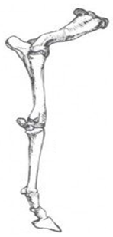
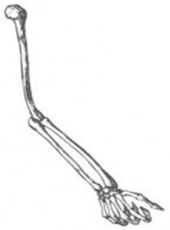
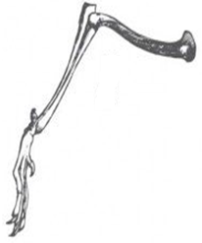
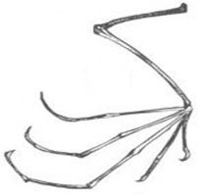
Animal Homology
Man
Horse
Penguin
Dog
Bat
Notes:
Animal Homology is one of the first things that schools teach children about evolution.
If you study the living species in our world, you will observe that there are some similar organs and features among these species. For example, if we compare the bones in the human arm to the forelimbs of horses and dogs, a penguin’s flipper, and a bat’s wing, we’ll see that they all share similarities in basic structural pattern. If we look at the skeletal anatomy of certain animals in nature, we’ll see many similarities. Now this is something that has been observed for hundreds of years, but Charles Darwin was the first person to draw materialistic conclusions from this observation.
What we’re taught in school is that animal homology is indisputable proof that these animals all evolved from a common ancestor. But what we need to be asking Biology teachers is, “Why does it have to mean that? Is this really the only viable explanation? Why can’t it mean they came from a common designer with a common plan?”
So these are the 2 hypotheses – either the similarities mean a common evolutionary ancestor, or they mean a common designer. Which is the better explanation?
Evolutionists will reason this way: “If someone designed these things, they’d all be different and there would be no similarities between them” which should elicit the following response: “How can someone who does not believe in God, and therefore does not know Him or His thoughts, presume to then understand His purposes and intentions?”
Creationists will reason this way: “If a common designer did in fact create the over 3 million species of animals we find on this planet, in 2 days time (day 5 and 6 of Creation), why would He not use similar blueprints and common elements in a world bound by static laws?”

Slide 3
Animal Homology
Notes:
Let’s think about it this way. Why do houses, that have so many differences, also have so many similarities? No matter how much you try to customize a house, if it is going to last on planet Earth, there are certain things you have to have, right? For a house to survive on planet Earth, what are some minimal requirements?
A roof, doors, load bearing walls, etc.

Slide 4
Animal Homology
Notes:
Why are cars so similar? Many of them are different, but every car has certain things in common in order for them to work efficiently, right? i.e. wheels, doors, and engine, etc. Why do all houses and cars share such similar features?
The answer is because we live in a universe bound by laws that do not change. And these laws limit how certain things are designed for maximum efficiency. The law of gravity is why every house must have a roof and load bearing walls. Humans are not liquids and gases, but solids, so we have doors that we open and close to enter and secure our homes. Cars have wheels because that is how they move constrained by laws of this universe such as gravity and inertia.
So, again, why does animal homology have to be proof of evolution? Why can’t it be proof that our Creator, God, designed similarities in basic structures of human and animal kind, knowing exactly how our bodies could work most efficiently while confined by scientific law? In other words, being constrained by the laws of our universe, it makes sense that God would use a common plan/blueprint,
Now, this argument doesn’t prove Creationism. We’re going to do that more thoroughly in just a moment. What I’m simply suggesting is that animal homology, similar structures in animal anatomy, is not blanket proof of naturalism and schools that teach that this is the only viable explanation without presenting the Creationist side is misleading.

Slide 5
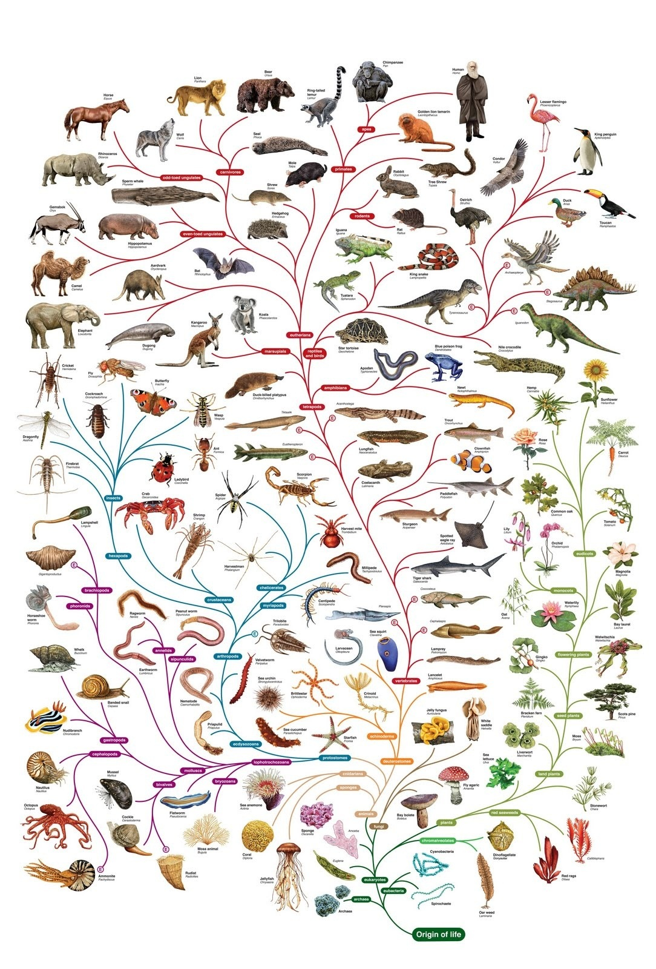
Animal Homology
Notes:
Fortunately, though, we don’t have to leave this dangling out there in a hypothetical nebulas. There are 2 very simple ways by which we can discredit Darwinian Evolution’s view of animal homology and show why a common Designer is the more plausible worldview. There are 2 primary reasons why the similarity between species cannot be due to Evolution.
First, Darwin’s idea of the tree of life is that we started out as a single-cell organism that started to branch and split into all these different kinds of species. Now suppose we were to follow down 2 different branches and by a happy coincidence we find that within these two different branches the exact same organs evolved. What should we conclude from this? We should conclude that they didn’t evolve from one another because they’re two different paths/branches. That would actually be evidence that a common designer put them in there because it is statistically impossible for 2 organs to evolve identically the same.
Richard Dawkins, famous atheist and the godfather of Evolution, actually admitted this. He claimed that if you could run one more iteration of human evolution that you’d never get another human again. It’s just what we happened to get the first time because Evolution is based on an accident (accumulation of mutations) and not purpose.
So the question is, then, are there 2 separate branches that have developed identical organs? The answer is “yes”.

Slide 6
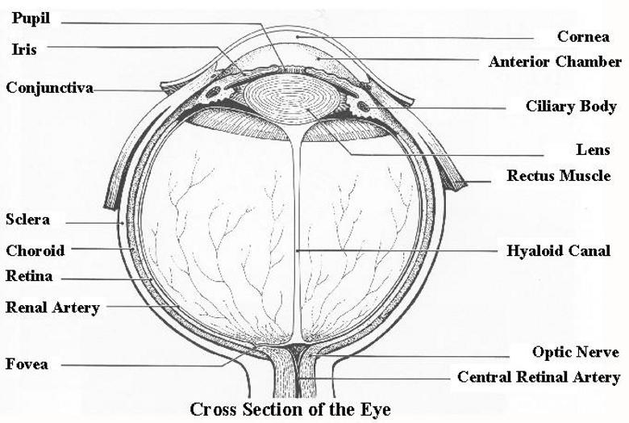
Animal Homology
Notes:
If you look at the octopus and the human, they come from separate branches along Darwin’s tree. Even evolutionists admit that humans do not evolve from the octopus. And yet, they have the exact same eye. The octopus, squid, and human have the exact same kind of eye – the same eye lids, cornea, pupil, iris, ciliary body, lens, retina, and optic nerves. An octopus and human, profoundly different species who live in profoundly different environments, have identical eyes.
Now how in the world did this happen? Coincidence? The chances of this are astronomical. And this is just one example of many organs that have managed to duplicate across separate branches. This is a reflection of intelligent design, not naturalistic evolution. This is the same intelligent Designer using the same parts in different species.

Slide 7
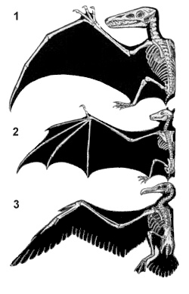
Animal Homology
Alan Feduccia – “In either case, the anatomical changes needed for flying must have evolved in a sequence of very small steps, because nothing we know about evolution allows us to believe that feathered wings could have appeared abruptly as an innovation in avian anatomy. Wings must have evolved over a very long time span. And each new modification of body plan or limbs during that period must have made some contribution to fitness long before the day when a jumping or gliding creature gave the first strong beat of its forelimbs and ceased simply falling back to earth.” (The Origin and Evolution of Birds, ch. 3, p. 93)
Notes:
This was the same argument used by George Jackson Mivart in 1860 when arguing against evolution. He tried to point out to Darwin that there were all these different animals that came from different branches yet they all developed the same means of flying. They all have this power thrust mechanism in their forearm – insect, mammals, birds, and the pterosaurs. Why didn’t some of them develop flight out of their legs? Why did it all come from the same location? The 3 animals in the top right picture are the pterosaur, the bat, and the bird who, according to evolutionists, branched down from different lines so they could not have inherited this from one another. So how did they?
Alan Feduccia, a Paleontologist and one of the leading experts on the evolution of birds, recognizes this problem in Evolution:
“In either case, the anatomical changes needed for flying must have evolved in a sequence of very small steps, because nothing we know about evolution allows us to believe that feathered wings could have appeared abruptly as an innovation in avian anatomy. Wings must have evolved over a very long time span. And each new modification of body plan or limbs during that period must have made some contribution to fitness long before the day when a jumping or gliding creature gave the first strong beat of its forelimbs and ceased simply falling back to earth.”
In other words, he believes in Evolution, but all the winged animals must have come from one another if Evolution is true yet he can’t prove it is true from Evolution.
And so, the fact that we find homologous organs in creatures belonging to kinds in different branches, which evolutionists admit have no evolutionary relationship, should cause us to question this so-called Evolutionary proof.

Slide 8
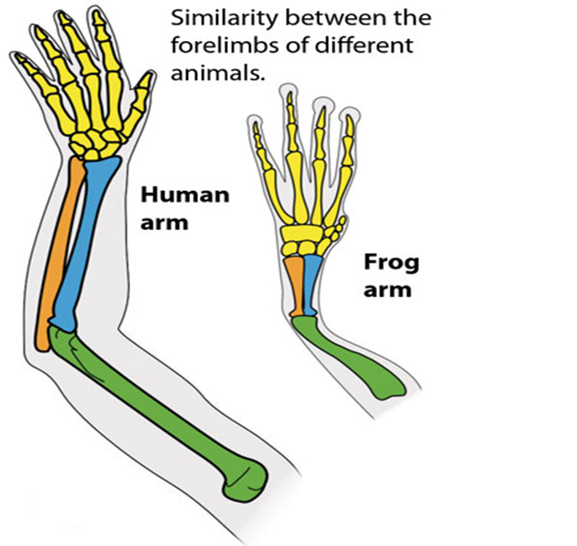
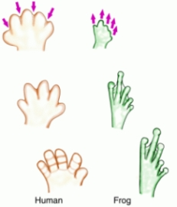
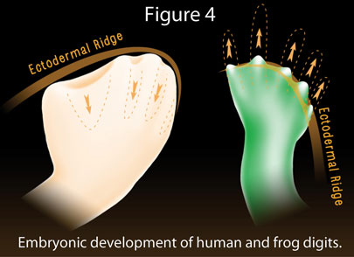
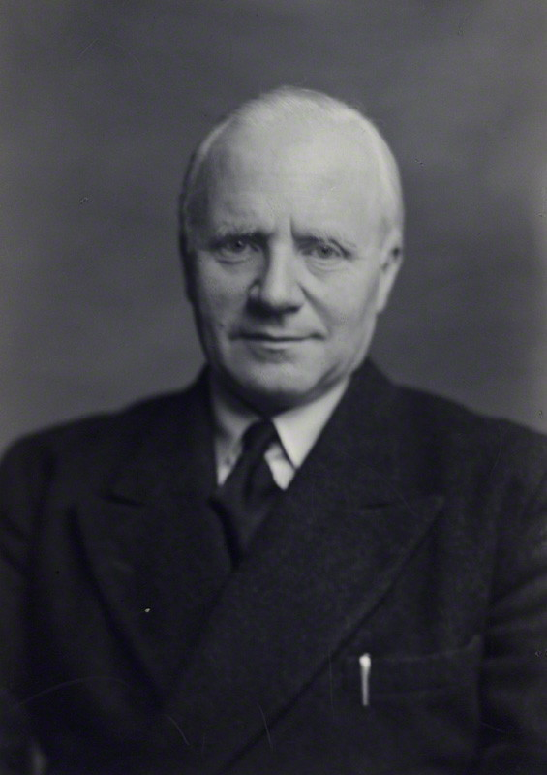
Animal Homology
Dr. Gavin de Beer – “What mechanism can it be that results in the production of homologous organs, the same ‘patterns’, in spite of their not being controlled by the same genes? I asked this question in 1938, and it has not been answered.” (Homology: An Unsolved Problem, Oxford University Press, London, 1971, p. 16)
Notes:
Secondly, we’re now at the point in our knowledge of science where we know inheritance is due to genetics. But keep in mind that when Darwin first proposed animal homology as evidence for evolution, he knew nothing about genetics. But now that we know inheritance comes from DNA, and we can observe DNA, what should we expect to see amongst species if Darwin was right? We should expect to see the same genes and the same DNA.
But what do we find? When we compare the genetics of species, organs and structures that appear to be homologous often develop from genes that are not homologous.
Example #1:
In humans, as our hands and feet begin to develop in our mother’s womb; they look like a spade. Then, the 5 digits (fingers and toes) develop as a result of the tissue between our fingers and toes resorbing and dissolving away. So in humans, the material between the digits is removed.
But in frogs it’s different. The digits grow outwardly and independently from buds (think of Wolverine). The material is added. If evolution were the correct explanation for why humans and frogs both have digits, we would expect their embryonic development to be similar—we would expect humans and frogs not only to have inherited the digits, but also because the similarity is supposed to be due to shared genes, we would expect the same process of digit development. Instead, though, we find different gene-enzyme mechanisms at work producing similar homologous patterns – profoundly different DNA making similar structures.
Structures in adult lobsters and crayfish are so similar that the same lab instructions can be used for dissecting either, yet the crayfish egg develops directly into the adult form while the lobster egg reaches the homologous pattern through a free-swimming larval stage.
Understand this: Evolutionists make the same argument I’m making. Sir Gavin de Beer was one of the foremost embryologists of the 20th century. He was a Fellow of the Royal Society, and went on to become the Director of the Natural History Museum in London. He was an Evolutionist; he believed in Darwin’s theory of evolution; but he couldn’t reconcile this with the facts of embryology. In 1971 he wrote a paper which he titled, Homology: an Unsolved Problem, and said the following:
“What mechanism can it be that results in the production of homologous organs, the same 'patterns', in spite of their not being controlled by the same genes? I asked this question in 1938, and it has not been answered.”
In his paper he gave examples of homologous structures that developed in very different ways, from different parts of the egg or embryo and under the control of different genes. It was a mystery to him because it flew in the face of what he expected to find as an evolutionist; hence the title of his paper calling homology ‘an unsolved problem’. He never solved this problem—and nor has anyone else.

Slide 9
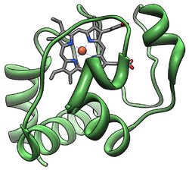
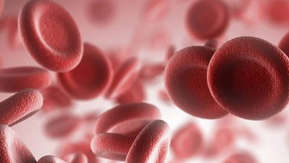
Animal Homology
Cytochrome C
Evolutionist Answers:
Convergence?
Divergence?
Homoplasy?
Hemoglobin
Terminology
Masquerading
As
Explanation
Notes:
Example 2:
There is a protein used for the utilization of oxygen in the body called “Cytochrome C”. If homology is correct, this protein should be very similar in animals that evolutionists say are related. Yet the Great Whale is more similar to the duck than it is to another animal, the monkey. The tuna is more related to the rabbit than it is the dogfish. The turtle is more related to the bird than it is another reptile, the snake. How do you explain that? Evolutionists are stumped.
Example 3:
Hemoglobin is the protein in your red blood cells that carries oxygen throughout the body. Animals that are so similarly related should have similar hemoglobin, right? And yet the crocodile is more related to the chicken than the viper, another reptile.
The point is that this lends evidence to a common designer, not an evolutionary ancestor. And if you ask Evolutionists for an answer to this, they’ll generally throw out theories with names like convergence, divergence, and homoplasy. But this is only terminology masquerading as an explanation, an arbitrary assumption that natural processes can explain everything. It is based on blind faith. But with the revolution in genetics, animal homology is better explained by Creationism than Evolution. Yet this is still one of the #1 evidences for Evolution taught in textbooks.

Slide 10
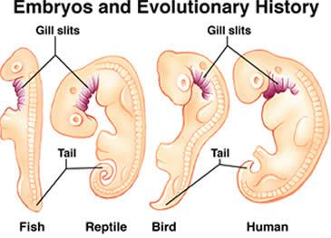
Embryology
Charles Darwin – “Embryology is to me is by far the strongest single class of facts in favor of change of forms”. (Letter to J. D. Hooker, cited in F. Darwin, 1887, Vol 2, p. 39)
Notes:
Some Evolutionists will argue that Darwin didn’t believe embryology was evidence of Evolution. That is not true. He did.
Darwin in 1860 – “Embryology is to me is by far the strongest single class of facts in favor of change of forms”.
So why is Embryology something Evolutionists like to turn to in order to support their position? Well, when an embryo begins to grow in a womb, whether it is human or animal, they develop these folds in their neck. So Evolutionists observe these folds and then, taking a page out of animal homology, say, “Look, gill slits! This proves that our ancestors used to be a fish. And, wow, look at those tails! This is the proof that we came from monkeys!”
We’ll talk about those things in more detail in a few minutes when we start discussing vestigial organs.

Slide 11
Embryology
Notes:
Now this is as unscientific as you can get. To say that just because it resembles something else, that must mean it was inherited. But this is a favorite “proof” of Evolutionists and it is still taught in textbooks today.
What about this guy on the left? Does the fact he has a double chin mean he evolved from a fish simply because it looks a little bit like gills? The guy on the right has more than a double chin, though he’s putting on a bit of a show. How would you feel if you were one of these gentlemen and you were compared to a fish? It wouldn’t feel too good. But this is a window into the so-called science of Evolution find something that looks like something else, and then spin it to fit your worldview. It is as unscientific as you can get.

Slide 12
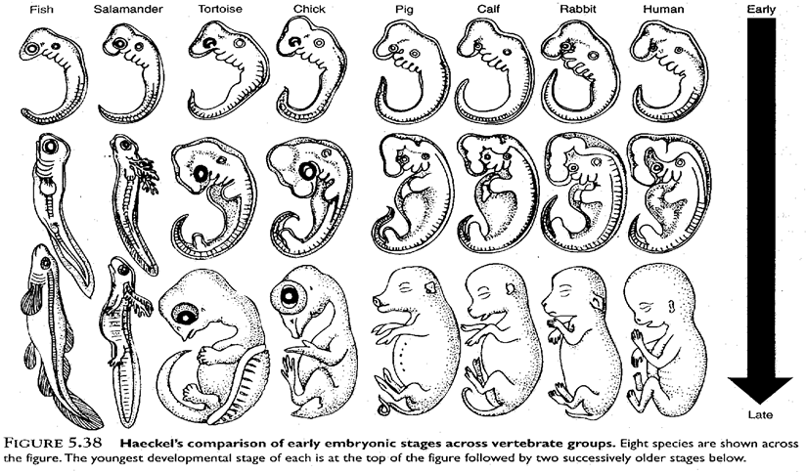
Embryology
Notes:
Now the person who began pushing this was Ernst Haeckel, otherwise known as “the bulldog of Darwinian Evolution”. Haeckel was a German Darwinist who in 1868 came up with a series of prints to try and show that in the 3rd stage of the embryo, the fish, hog, and human all look different. But if you go back to the first stage, he shows prints that makes it look like the embryos are the same.
So the theory was pushed that we all must have evolved from tadpoles because that’s what they looked like. There are school textbooks that still teach this today. Anyone ever studied this and know what the problem with Haeckel’s assertion was?

Slide 13
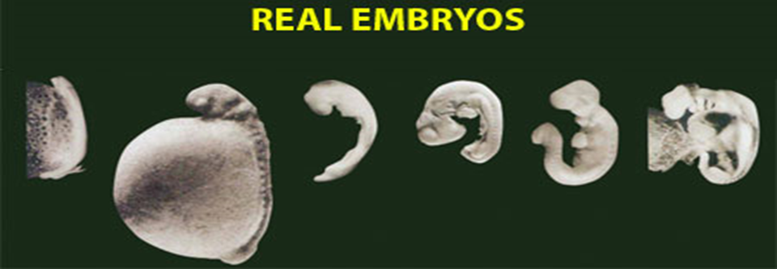
Embryology
Notes:
Haeckel faked the drawings.
The top drawings are what Haeckel showed the embryos looked like in the first stage. The bottom picture is what they really look like in the first stage. The Salamander is especially different…Haeckel left out 90% of what the embryo looks like to try and push his dogma for his friend Charles Darwin. Add this one to the list of frauds in Evolution. This is yet another example of an Evolutionist so bent on trying to push his worldview, that he is willing to fake the evidence to do so.

Slide 14
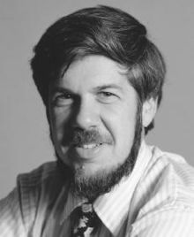
Embryology
Stephen J Gould – “…exaggerated the similarities by idealizations and omissions…it can only be called fraudulent…“
“simply copied the same figure over and over again”
“We…have the right to be…astonished and ashamed by the…mindless…persistence of these drawings in…a large number of…modern textbooks.” (Abscheulich! (Atrocious!), Natural History, Mar 2000, p. 42, 44–45.)
Michael Richardson – “one of the most famous fakes in biology” (“Haeckel's Embryos: Fraud Rediscovered“”, Science)
Notes:
In a March 2000 issue of Natural History, Stephen Jay Gould, a prolific Evolutionist of the 21st century, argued that Haeckel “exaggerated the similarities by idealizations and omissions…it can only be called fraudulent” “simply copied the same figure over and over again” “We…have the right to be…astonished and ashamed by the…mindless…persistence of these drawings in…a large number of…modern textbooks.’
In 2000, an international team of scientists reexamined Haeckel’s drawings, Michael Richardson (speaking for them), called them “one of the most famous fakes in biology” (“Haeckel's Embryos: Fraud Rediscovered“”, Science).
This was such a scandal that Haeckel’s own university held a trial and convicted him of fraud. But guess what? It is still taught in many school science textbooks meaning that Evolutionists are still trying to deceive people into believing it.

Slide 15
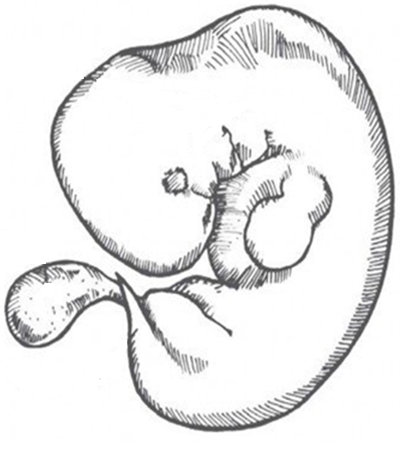
Vestigial Organs
Gill
Slits
Yolk
Sac
Tail
Notes:
This leads us directly to a 3rd misconception, and that is the so-called “vestigial organs”. Evolutionists will look at the human embryo and they’ll say something like, “If you want to believe in God, you’re going to have to admit that he didn’t do such a great job in Creation. Otherwise, why are there so many mistakes in human embryonic development? Why does a human embryo have gill slits like a fish that it never uses, a yolk sac like a chicken that it never uses, and a tail like a monkey that it doesn’t need? Obviously there is a common evolutionary ancestor!”
These are just 3 examples of so-called “vestigial organs”, what Darwinists push as useless leftovers from evolutionary ancestors, “vestiges”, if you will, that are reminders of bygone days when they claim our ancestors were apes, reptiles, and fish.
This is a subject that needs to be earnestly contended with. When I was growing up in the 80s, doctors were removing young children's tonsils left and right because they were deemed useless vestiges. However, with improvements in science, they’ve now come to the conclusion that they are helpful, needed functional parts of the body for fighting diseases. This has resulted in not just a few malpractice suits.
So what was once a seemingly impregnable argument for evolutionists has now been completely debunked. In fact, all 180 organs once listed as vestigial have now been shown to play significant roles in the human body.

Slide 16
Vestigial Organs
Throat Pouches
Thymus gland
Parathyroids
Middle ear canals
Gill
Slits
Yolk
Sac
Tail
Notes:
So start by looking at the 3 mentioned in the embryo:
Evolutionists observe the 4 slits in the neck area of a human embryo, and they say, “Why those look like gills from fish! They’re gill slits! This proves we’re descended from fish!”
What are these so-called “gill slits”? They are no gills at all. The gills in a fish have blood vessels all around them that aid fish in absorbing oxygen from the water. But no such structure exists in humans of any age. These so-called “gill slits” are not left over vestiges from fish, they are simply wrinkles in the skin from which the throat poaches grow out and are absolutely essential for human anatomy. The palatine tonsils, the middle ear canals, the parathyroid, and the thymus glands all come from the 3rd and 4th slit. So these slits are not vestiges – they are essential for human development.

Slide 17
Vestigial Organs
Throat Pouches
Thymus gland
Parathyroids
Middle ear canals
Gill
Slits
Blood-Forming Sac
First blood cells
Yolk
Sac
Tail
Notes:
The “yolk sac” was so named because in a chicken, the yolk contains much of the food it depends on for growth. But human embryos become attached to their mother and she nourishes us. So if evolutionists are right, we should be able to go right into an embryo and just cut this yolk sack off and nothing should happen, right? Wrong.
The yolk sac is the source of our first blood cells and without it, we’d die. We want to have blood cells inside our bone marrow because blood cells are sensitive to radiation and bones offer some protection from that. But you also need blood in order to form bone marrow. This is a circular dilemma right? Where do we get the blood from first? Well, apparently God decided to use a similar structure to the yolk sac in chickens to provide it and since it lies conveniently outside the embryo, it can easily be discarded after it has served its temporary purpose.
Modern examples: scaffolding in construction, tile spacers, etc.

Slide 18
Vestigial Organs
Throat Pouches
Thymus gland
Parathyroids
Middle ear canals
Gill
Slits
Blood-Forming Sac
First blood cells
Yolk
Sac
Coccyx
Muscle attachment
Tail
Notes:
What about the so-called “tail”? If it’s just a leftover from the monkey, lets just cut it out of the embryo, right? That would be a bad idea. This so-called tail is what forms our sacrum and our coccyx. Anyone here ever fallen and injured their tail bone? You can hardly move from the pain. The sacrum and coccyx are some of the most important bones in the body because they form the crucial point of muscle attachment required to maintain upright posture as well as defecate with ease. The reason this sticks out like it does in the embryo is because the muscles and limbs don’t develop until stimulated by the spine. As the legs develop, they then surround and enclose the tail bone and it ends up right inside the body.
The coccyx has long been a popular one for Evolutionists to mention, but they seldom mention it anymore.

Slide 19
Vestigial Organs
Appendix: Immunological functions
Wisdom Teeth: Diet, dental care, mutations
Sinuses: humidifier, insulator, resonator, etc.
Body Hair: insulation, sensory function, etc.
Notes:
Here are some other so-called vestigial organs whose uses have now been discovered:
Appendix – It has an immunological function; it’s a safe harbor for beneficial bacteria to hide when dangerous germs take over the gut.
Wisdom Teeth – Now Evolutionists claim that when our ancestors were apes, their jaws were bigger than ours and now that they’re smaller, we can’t fit the wisdom teeth anymore and have to have them removed. But studies have now shown that going from a course abrasive diet to a soft western diet, proper dental care, and genetic factors play a role in having them removed.
Sinuses – Many roles have been suggested: lightening the weight of the front of the skull, increasing resonance of the human voice, insulating the sensitive dental roots and eyes from the rapid temperature changes in the nasal cavity, and humidifying inhaled air.
Body Hair – Body hair was once assumed to be left over vestigial structures from the apes, but we know now that the eyelashes keep sweat and debris out of our eyes, our head hair insulates us and protects from sunburn, and even our body hair performs sensory functions for the nerves in our skin and keep the pores of the skin open and healthy.
There are several websites out there that list the other so-called vestigial structures and their uses.
Now, can we live without these? Of course, but does that mean we don’t need them? Can we live without our arms and legs? Yes, but don’t we also need them? You can remove them, you just might get a few more diseases or have a few more problems others don’t have.

Slide 20
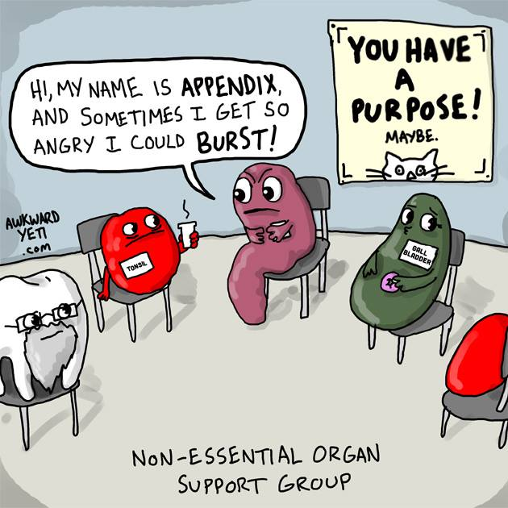
Vestigial Organs
Notes:
Why do we need to contend w/Evolutionists about this?
First, in principle it is impossible to prove that an organ is useless, because there is always the possibility that a use may be discovered in the future as science advances. This has happened with over a hundred alleged useless vestigial organs which are now known to be essential. So unless we’re prepared to admit that science has reached the zenith of discovery, Evolutionists should not be so rash to render something useless. However, seeing as how many worship scientism, sometimes scientists will dismiss such organs just to sound smarter.
Second, even if the alleged vestigial organ were no longer needed, this would simply prove devolution not evolution. Why might the Creation model allow for deterioration of a perfect creation? Because we live in a fallen world don’t we? Even the second law of thermodynamics in a sense allows for it. But the molecules to man evolution model needs to find examples of “emerging” organs, those which increase in complexity.
With God as our designer, the only thing vestigial is really this argument.

Slide 21
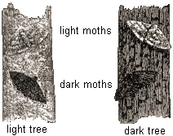
English Peppered Moth
Notes:
The English Peppered Moth example has been debunked for decades but it is still taught in school textbooks as evidence for Evolution. Here’s the story:
There are 2 varieties of the English Peppered Moth, the white moth and the dark moth. Before the industrial revolution of the 18th century, 95% of the moths were white and 5% of the moths were black because, as the story goes, the birds could see the black moths on the light colored trees and would eat them instead of the white moths. But then the industrial revolution hit and all the light colored trees became covered in dark soot, reversing the moth population. This resulted in the majority of the moths being dark and a small percentage being light because now the white moths showed up easier on the newly darkened trees while the dark moths could easily camouflage themselves.
Darwinists called this Evolution in action and it is taught in basically every single biology text book. I heard that its even in the British museum of Natural History. The man who supposedly discovered this and did the research on this and came up with the theory was Bernard Kettlewell.

Slide 22
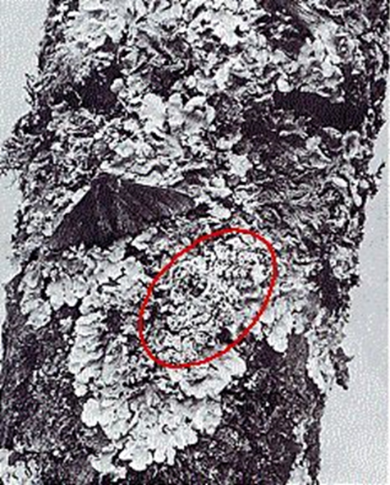
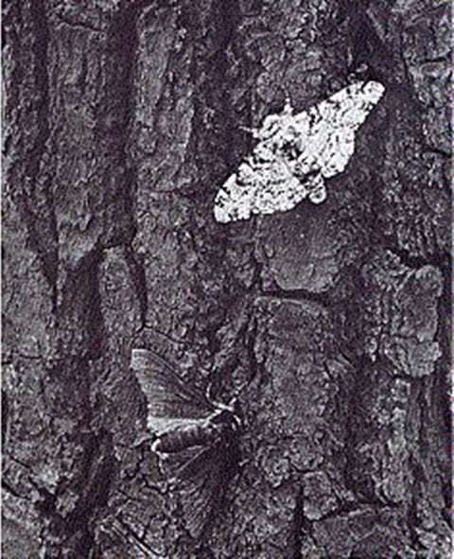
English Peppered Moth
Notes:
Well, the problem with this is that English Peppered Moths don’t rest on tree trunks. The moths in this picture, as well as the ones used in textbooks, are dead. They’ve either been pinned or glued. In 40 years of research, they’ve only found a handful actually resting on tree trunks. These moths fly at night and during the day take their rest high in the trees on the underside of branches out of sight from prey. Dr. Theodore Sergeant actually admitted to helping Bernard Kettlewell pin and glue the moths to the sides of these trees so that he could film the TV program where this was first introduced to the populace. They’ve never, though, been able to film one of these moths resting naturally on the side of a tree only to be eaten by birds.
Second, these moths don’t have the tendency to choose matching backgrounds. Dark moths don’t see a dark tree and decide to nest there.
Third, no one has been about to duplicate Bernard Kettlewell’s findings. And the reason is because Kettlewell manipulated his collection of data to obtain the desired result.
So does this prove Evolution? No, because even if Kettlewell was right and he had not manipulated the data, all it would prove was a moth changed into a moth. Natural selection in nature can be seen as producing variations within a kind, what we call microevolution. But this is a far cry from molecules to man evolution.
Ironically, Darwin, who evidence strongly suggests was racist, thought the Caucasian race was the superior race. But if a terrible UV storm were to hit, Caucasians would die and those with darker pigments and melanin in their skin would survive. And this too would not prove evolution, only variation within the human kind.

Slide 23
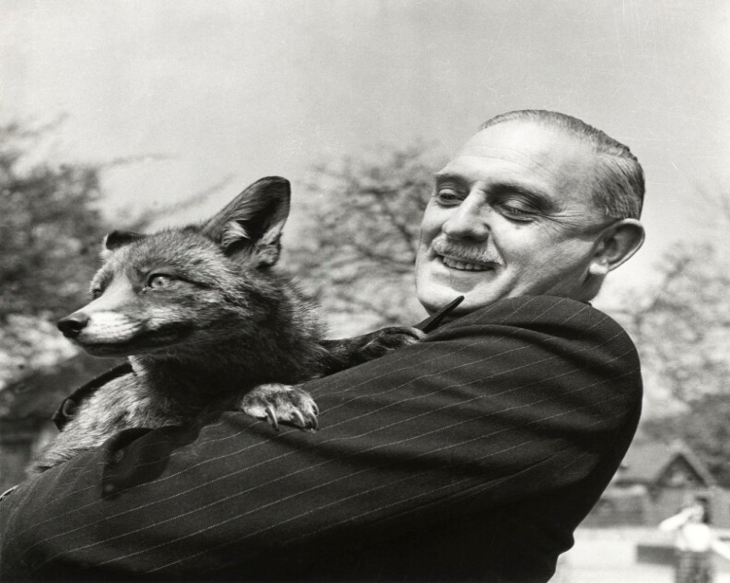
English Peppered Moth
L. Harrison Matthews – “The [peppered moth] experiments beautifully demonstrate natural selection — or survival of the fittest — in action, but they do not show evolution in progress”. (1971. Introduction to Darwin, Charles. Origin of Species. London: Dent & Sons.)
Eugenie Scott – “In my opinion, using creation and evolution as topics for critical-thinking exercises in primary and secondary schools is virtually guaranteed to confuse students about evolution and may lead them to reject one of the major themes in science.” (Larry Witham, Where Darwin Meets the Bible, p. 23, Oxford University Press, 2002.)
Notes:
Even Evolutionists have spoken out against the English Peppered Moth hoax.
L. Harrison Matthews, who wrote the introduction to Darwin’s Origin Of Species, said “The [peppered moth] experiments beautifully demonstrate natural selection — or survival of the fittest — in action, but they do not show evolution in progress”.
Why then is this example still used in text books? Well, let’s hear what the foremost proponent of Evolution to be taught in schools says about this, the atheist Eugenie Scott. She admits that if students heard criticism of evolution, they might end up not believing in it – “In my opinion, using creation and evolution as topics for critical-thinking exercises in primary and secondary schools is virtually guaranteed to confuse students about evolution and may lead them to reject one of the major themes in science.”
In another quote, which I neglected to include, she also noted that though she knows it doesn’t teach evolution, she said that there is no greater example to teach young people than the moth because its such a simple illustration for them to understand. Which group is doing pseudo-science? The Creationists or Evolutionists?
https://answersingenesis.org/natural-selection/much-ado-about-moths/

Slide 24
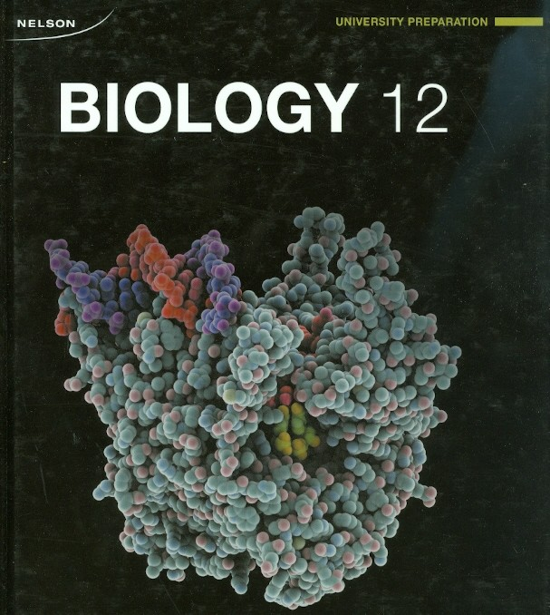
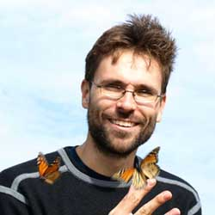
English Peppered Moth
Bob Ritter – “You have to look at the audience. How convoluted do you want to make it for a first time learner? [High school students] are still very concrete in the way they learn. The advantage of [the pepper moth] example of natural selection is that it is extremely visual.” (April 5, 1999, Alberta Report Newsmagazine)
Jaap De Roode – “The peppered moth should be reinstated as a textbook example of evolution in action.” (de Roode, J, “The Moths of War,” New Scientist 196 no. 2633 (2007): 49.)
Notes:
In 1999, Canadian textbook-writer Bob Ritter, who knew that the peppered moth pictures were staged yet used them in his textbooks any way, defended his practice on the same grounds. “You have to look at the audience. How convoluted do you want to make it for a first time learner?” “[High school students] are still very concrete in the way they learn. The advantage of this example of natural selection is that it is extremely visual.”
Jaap De Roode, a biologist at Emory, made this statement about the textbook authors who are removing it from textbooks because they realize it is not evidence of Darwinian Evolution. He said, “the peppered moth should be reinstated as a textbook example of evolution in action.”
So again, who are the ones practicing pseudo science? Creationists or Evolutionists?

Slide 25
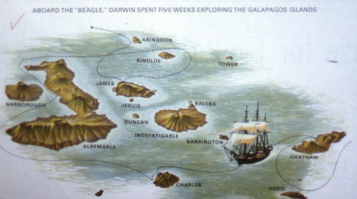
Darwin’s Finches
Gen 1:24-25 – “Then God said, ‘Let the earth bring forth living creatures after their kind: cattle and creeping things and beasts of the earth after their kind’; and it was so. God made the beasts of the earth after their kind, and the cattle after their kind, and everything that creeps on the ground after its kind; and God saw that it was good.”
Notes:
For the next 2 examples, we’re going to look at the subject of mutations. And we’re going to show that Neo-Darwinism is dead and this is according to the scientific community itself. Evolutionists have been looking for a new mechanism to explain macroevolution for the last 40 years and you know why a lot of people don’t know this? Because they don’t have a concrete idea yet. But the idea of gene level mutation, leading to gradual change and macroevolution, has been dead for 40 years.
In 1831, Darwin sailed from England all around the world as a naturalist, but especially to study and observe geology. But he also had the opportunity to evaluate different animal species, and one of those species he paid special attention to were finches. Now when he grew up in the Anglican church, he was told that anytime you observed a species, that species was fixed, meaning that however you observed it in the wild must be the way that God created it. Now we looked at animal kinds a few weeks back and made the point that animals like the dog, wolf, coyote, etc. are different yet can interbreed, but Darwin was taught by the Anglican church that that wasn’t the case and that God made them exactly as he saw them.
But we know today that animal species’ aren’t fixed, animal kinds are fixed. Gen 1:24-25 – “Then God said, ‘Let the earth bring forth living creatures after their kind: cattle and creeping things and beasts of the earth after their kind’; and it was so. God made the beasts of the earth after their kind, and the cattle after their kind, and everything that creeps on the ground after its kind; and God saw that it was good.” And the science that studies to determine what these kinds are is called Baraminology.
Well, 4 years later in 1835, Charles Darwin sailed aboard the H. M. S. Beagle with a few others to the Galapagos Islands right off the coast of Ecuador where they observed geographically isolated groups of plants and animals that were able to interbreed for hundreds if not thousands of years.

Slide 26
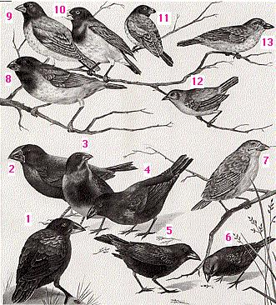
Darwin’s Finches
Notes:
Amongst the animals on this island, Darwin noticed 13 types of finches and saw that there was variation in these finches, variations in the beak, color, width, height, and size of the finches. Darwin’s conclusion was that since there were variations and some were becoming bigger while others were becoming smaller, that they must be evolving into different kinds of animals.

Slide 27
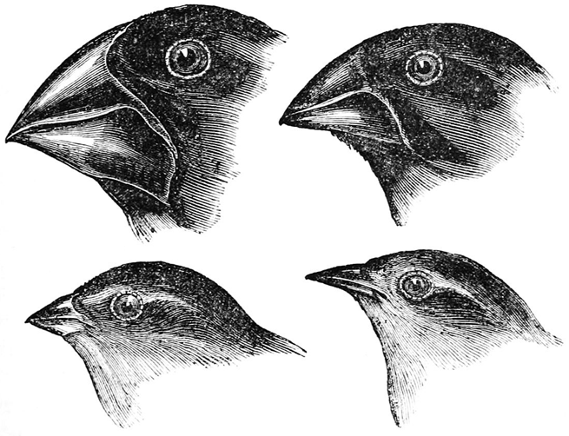
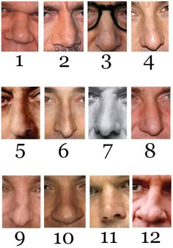
Darwin’s Finches
Notes:
Well, what does this prove? The fact that there are variations in kinds. But does this prove macroevolution? Does it prove molecules to man evolution? Of course not. There are different kinds. There are different types of bird beaks right? Variation within a kind does not prove evolution.
There are also different human beaks (noses). Notice the variation in width, length, color, etc. These are incredible differences in noses just as there are incredible differences in bird beaks. This does not prove evolution. It only proves that there is variation within kinds.
The reason for the 13 different finches Darwin observed is something in science called plasticity within animal kinds, which simply means that animals within a kind can change and bend within an environment based on their environmental needs.

Slide 28
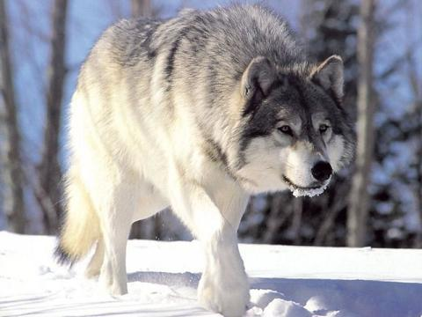
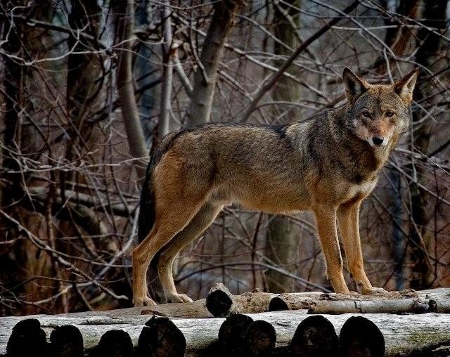
Darwin’s Finches
Long Haired Wolf
Short Haired Wolf
Notes:
The wolf has genes that codes its cells for long hair or for short hair. When its in a cold environment, the one that is able to survive better and spread its offspring is the long-haired wolf. But if those wolves migrated to, say, Central America, which animals would be able to survive better in the heat? The short-haired wolves, which will breed and pass its genes to its offspring and then we’d see those allylic variations come out.

Slide 29
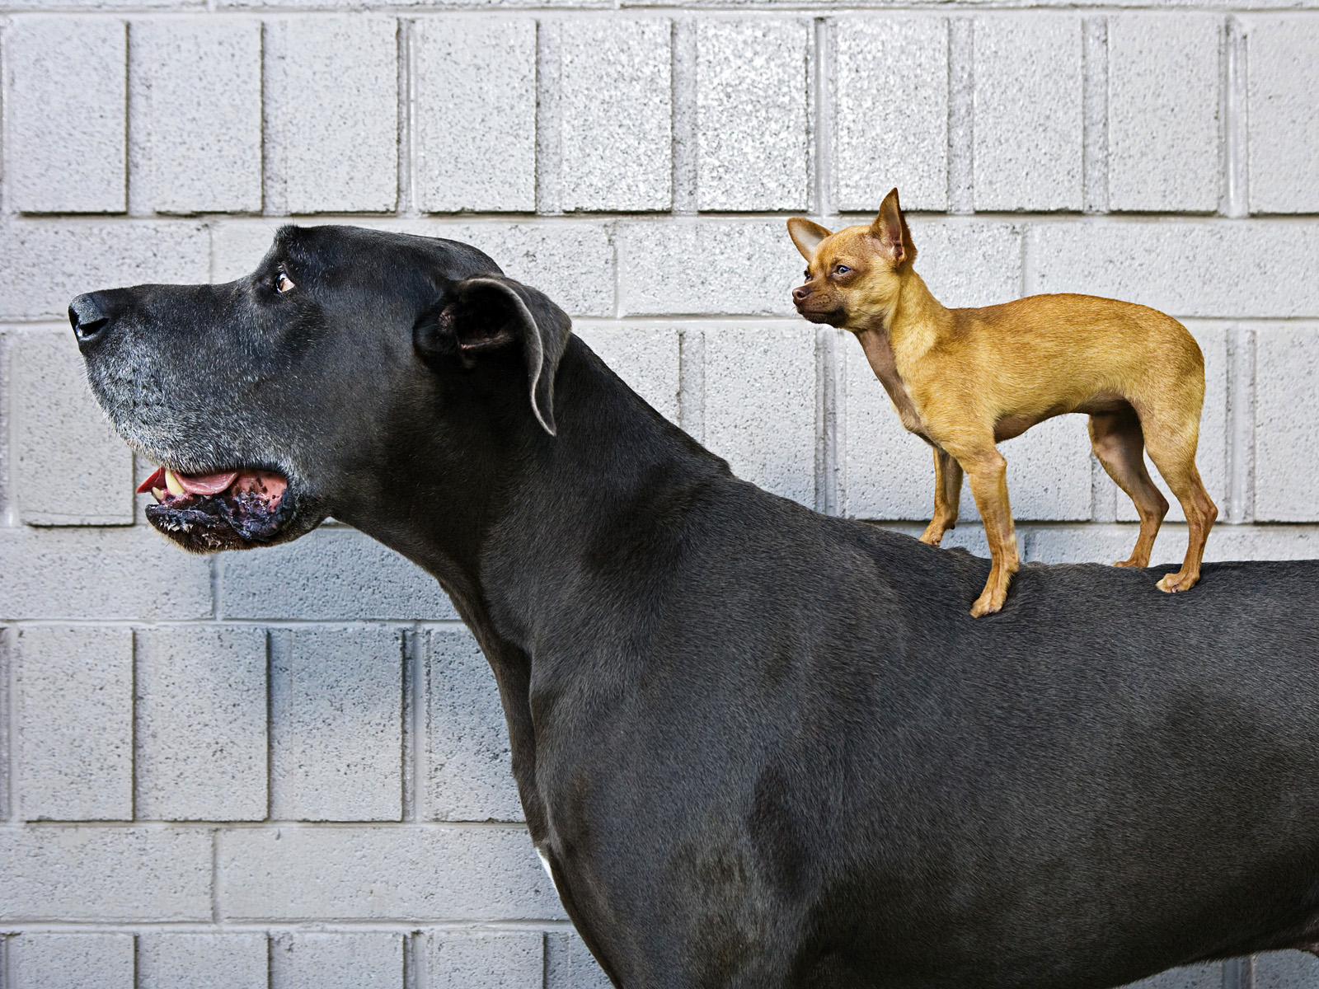
Darwin’s Finches
Notes:
There is even greater variation within the dog kind, especially when you compare a Chihuahua with a Great Dane. These specific dogs were bred. Since the 1600s, we bred for these animals. But they are all dogs. They aren’t changing into different animals.

Slide 30
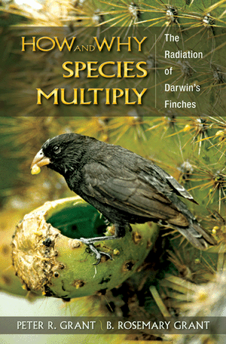
Darwin’s Finches
Notes:
Well, in 1973, two scientists by the names of Peter and Rosemary Grant took their first trip to the Galapagos Islands and did some in-depth study regarding the finches. They currently spend 6 months every year in the Galapagos observing the finches and measuring them. They’ve published some papers about their findings and also wrote a book where they were able to come up w/2 conclusions:
First, their findings proved that the finches’ beak size oscillates. In periods of drought where some finches can find food better than others, the beaks become shorter, wider, or longer based on environmental conditions. But they don’t move in a unidirectional path, they oscillate. They become longer than they become shorter than they become longer again and so on, and only in millimeters rather than lengths noticeable from the human eye. But the fact they oscillate means they are not moving in the same direction and they are certainly not changing into another kind of animal.
Second, they discovered that the finches are interbreeding. They are mating with each other which means they might actually be converging into one. And as they’re interbreeding, no new genetic material is being added to these birds. For Darwinian Evolution to take place, you’d have to have new genes. Rather, they simply find variation within a kind, meaning a finch is a finch is a finch is a finch.

Slide 31
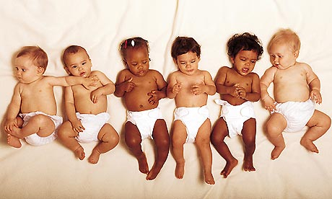
Darwin’s Finches
Notes:
Within human beings, not only are our “beaks” different, we also find different skin color, different heights, different weights, a lot of variety, correct? The picture on the right is a picture of the world’s tallest man with the world’s shortest man. See the variety? What if after these 2 men are buried, anthropologists uncover their graves 10,000 years from now. What conclusion might they try to derive? Well, if they have evolutionary biases, they’d likely suspect that the shorter man evolved into the taller man. But that’s not the case right?

Slide 32
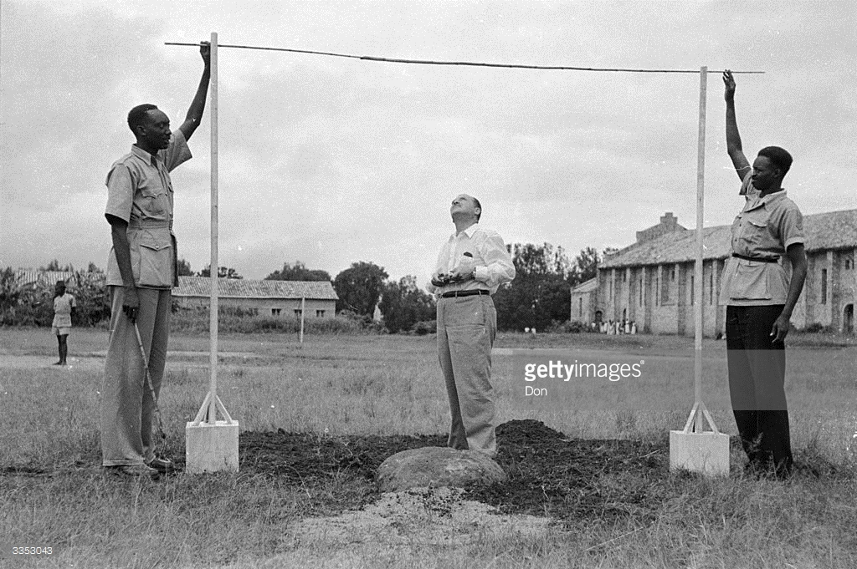
Darwin’s Finches
African Watusi – Avg Hgt of 7 ft
African Pygmies – Avg Hgt of 4 ft
Notes:
There are African tribes in the Sudan and Senegal whose average height is 6’ 6”. The African Watusi tribe averages 7’ feet in height. But then the African Pygmies only average 4 ft in height. That’s a 3 foot differential. Astounding variation within the human kind, right? Greater differences in the human kind than there are in the finches, and yet the finches are supposed to be proof of evolution?
Humans and animals can vary within a kind, but we do not see them gaining genetic material. They in fact lose genetic material. That’s why you can take a wolf and selectively breed him over a hundred years and turn him into a poodle. But you can’t turn the poodle back into a wolf again because you’ve lost those genes. That’s not evolution. If anything, its devolution.

Slide 33
Fruit Flies
Notes:
And finally, there is the fruit fly. It is common in middle school and high schools for biology teachers to make students breed fruit flies for various mutations. And when you do so, you’ll see differences in wing size, shape, abdomen, thorax, eyes, and feet. Various mutations come out of this, but the biggest one is the 4-winged fruit fly. And Darwinists will claim that the breeding of a 4-winged fruit fly proves evolution.
What is actually happening, though, is a mutation in his gene which causes the development of a 2nd thorax. But the 2nd set of wings that develop from this 2nd thorax are nonfunctioning – they are useless because there are no muscles attached to it. And the 4-winged fruit fly can neither fly nor breed. Did they mutate him? Yes. But in doing so they created a genetic freak of nature that doesn’t survive past one generation.

Slide 34
Fruit Flies
Mutations must be persistent
Mutations must be morphological
Mutations must be beneficial
Notes:
For Neo-Darwinian evolution to be true (mutations), you need three things. The mutation must be persistent, morphological, and beneficial. All that means is that there must exist favorable structural changes that can be passed down through succeeding generations. Let’s break down this point:
First, mutations must be persistent; it has to be a mutation passed down successively to the next generation. If the animal was mutated but the mutation was not passed down to the next generation, than it has nothing to do with MacroEvolution.
Second, they have to be morphological, coming out in the structure of the animal. It isn’t enough to say “antibiotic resistance!” or to show insects are resistant to pesticides. The structure of the animal has to change. “Well these animals are resistant to antibiotics!” Well, if the Darwinian theory was that a man evolved from sensitivity to poisons to resistance to poisons, then antibiotic resistance would prove that. But it doesn’t. Darwinian Evolution says that we evolved from a single-celled organism into mankind, or a blue whale, or a red wood tree. So the mutation has to change the structure, the shape, the organs, and the limbs of the animals.
Third, the mutation has to be beneficial. The mutation had to have given the animal a selective advantage so when it is released in the wild, it will outcompete the wild type thereby becoming the dominant species. Natural selection is survival of the fittest.

Slide 35
Fruit Flies
Notes:
So how many of these persistent, morphological, and beneficial mutations have been found? Zero.
Richard Dawkins was once asked for one good mutation that leads to evolution. There’s a long pause because he doesn’t have a response. This is the world’s leading proponent of atheism based on Evolution and he could not produce one example. Yet supposedly there have been millions upon millions upon millions? Who can believe it.
Google: “richard dawkins stumped”

Slide 36
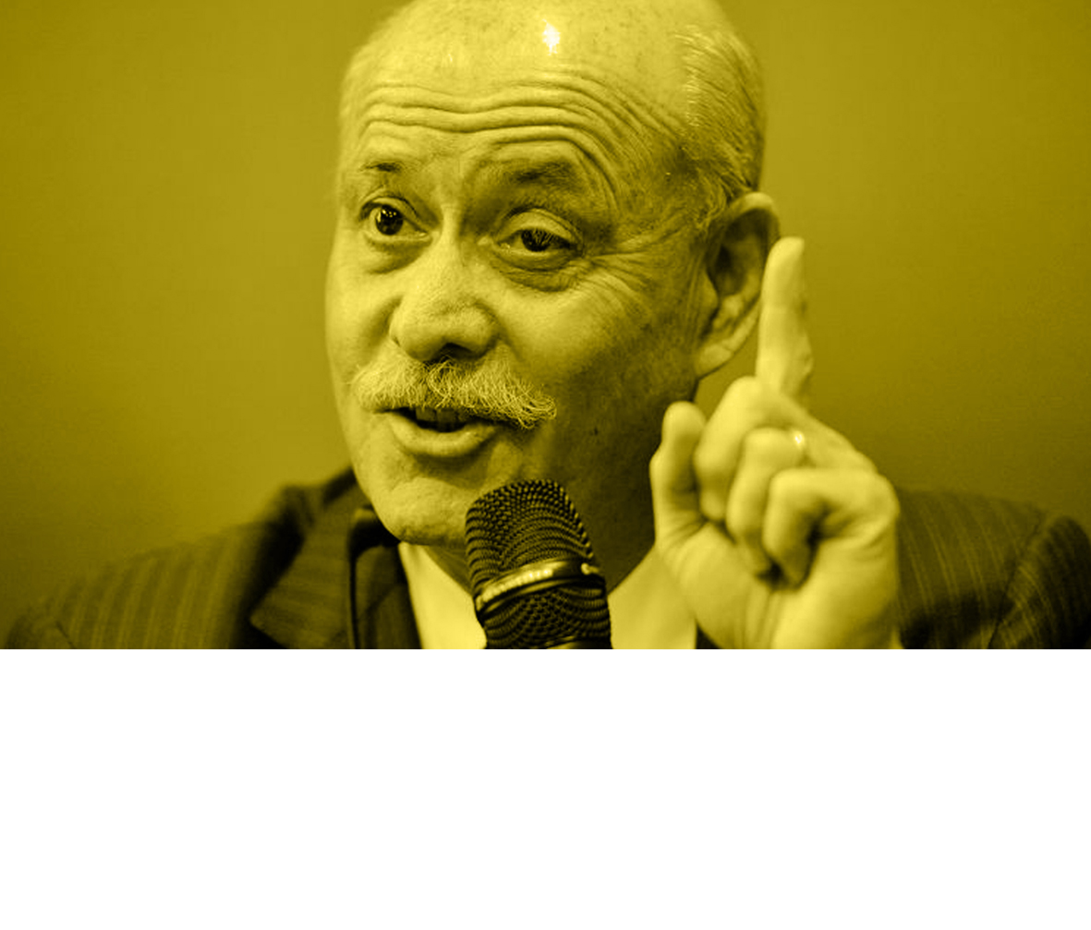
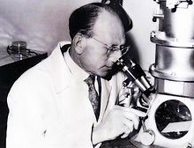
Fruit Flies
Jeremy Rifkin – “The fruit fly has long been the favorite object of mutational experiments because of its fast gestation period [twelve days]. X rays have been used to increase the mutation rate in the fruit fly by 15,000 percent. All in all, scientists have been able to catalyze the fruit fly evolutionary process…the equivalent of the many millions of years of normal mutations and evolution.”
“Even with this tremendous speedup of mutations, scientists have not been able to come up with anything other than another fruit fly.” (Algeny, 1983, p. 134.)
Pierre Paul Grasse – “The fruit fly (drosophila melanogaster), the favorite pet insect of the geneticists, whose geographical, biotropical, urban, and rural genotypes are now known inside out, seems not to have changed since the remotest times”.
Notes:
So why don’t mutations prove Darwinian Evolution?
First, over 99% of all mutations are harmful. And this comes from Evolutionist literature itself.
Second, of the 1% of mutations that are not harmful, no morphological mutations have been documented as persisting in a population. The fruit fly is the favorite choice for Evolutionists to talk about mutations, because its been mutated in labs more than any creature we know of.
Third, in 1995, the Nobel prize for medicine was given to 2 men for developing a technique to genetically control early embryotic development. They looked for every possible mutation in the genome of the fruit fly, every single one. But they could not find a single structurally beneficial mutation in the fruit fly. They mutated fruit flies until their were no more mutations to be found.
Jeremy Rifkin (Evolutionist) – “The fruit fly has long been the favorite object of mutational experiments because of its fast gestation period [twelve days]. X rays have been used to increase the mutation rate in the fruit fly by 15,000 percent. All in all, scientists have been able to catalyze the fruit fly evolutionary process…the equivalent of the many millions of years of normal mutations and evolution.”
This is significant because according to evolution, man has lived on the earth for a little over a million years. Yet experiments on fruit flies have already exceeded the equivalent of a million years of people living on earth!
He then said, “Even with this tremendous speedup of mutations, scientists have not been able to come up with anything other than another fruit fly.”
And Jeremy Rifkin is not a guy who would agree with us or like us. And even he admits that fruit flies do not prove Darwinian Evolution to be true.
Pierre Grassé‘, a professor at the Mayo University in Sweden – “The fruit fly (drosophila melanogaster), the favorite pet insect of the geneticists, whose geographical, biotropical, urban, and rural genotypes are now known inside out, seems not to have changed since the remotest times”.
Insect Evolution is extremely telling. When you go to the bottom layer of the Cambrian and look at the insects there, they look exactly like our insects of today. The dragonflies haven’t evolved. The fruit flies haven’t evolved. And Evolutionists admit it yet they can’t explain it.

Slide 37
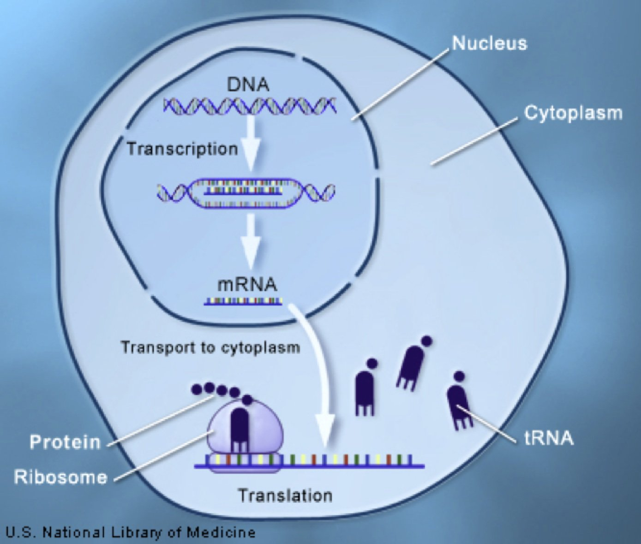
Fruit Flies
Notes:
Fourth, Neo-Darwinists cannot account for the fact that humans have 30,000 genes, yet if you go back to an E.coli bacteria, it only has about 5000 genes. They can take the E.coli and change its genetic makeup to make it resistant to antibiotics, but that doesn’t prove Darwinism. To prove Darwinism, you have to explain how to add 25,000 genes to make that evolve into man. Where did all these genes come from?
To try and explain this, they’ve developed an idea called “gene redundancy”. This is beyond the scope of the class but a good website is pasted below for further research. Gene redundancy in fact helps us understand the robustness of organisms and also their built-in flexibility to adapt to different environments. It cannot be understand through the natural selection worldview.
https://creation.com/genetic-redundancy

Slide 38
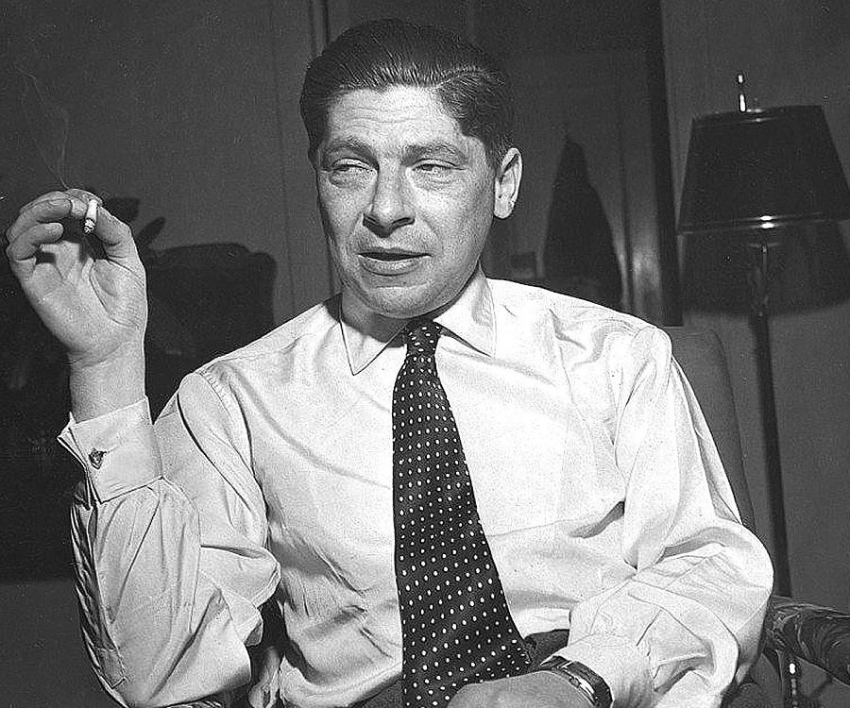
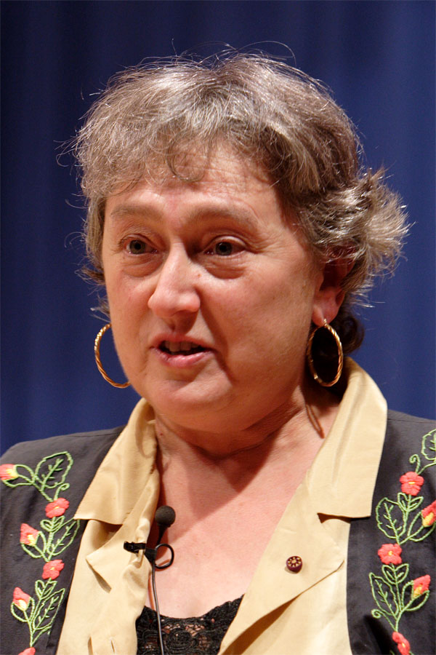
Fruit Flies
Arthur Koestler – “The educated public continues to believe that Darwin has provided all the relevant answers by the magic formula of random mutations plus natural selection – quite unaware of the fact that random mutations turned out to be irrelevant and natural selection a tautology” (Janus: A Summing Up, 1978, p. 170)
Lyn Margulis – “I have seen no evidence whatsoever that these [evolutionary] changes can occur through the accumulation of gradual mutations”; “Neo-Darwinism, which insists on [the slow accrual of mutations by gene-level natural selection], is in a complete funk.” (Science Vol. 252, 19 April 1991, p. 379.)
Notes:
But seeing that gene redundancy doesn’t work, they then move to point #5 – there are evolutionary scientists and philosophers that admit mutations cannot account for micro to man evolution. These are quotes from Evolutionists who say that NeoDarwinism is dead and that they have to come up with another idea.
Arthur Koestler – “The educated public continues to believe that Darwin has provided all the relevant answers by the magic formula of random mutations plus natural selection – quite unaware of the fact that random mutations turned out to be irrelevant and natural selection a tautology.”
Lyn Margulis (world expert on Evolution) – “I have seen no evidence whatsoever that these [evolutionary] changes can occur through the accumulation of gradual mutations”; “Neo-Darwinism, which insists on [the slow accrual of mutations by gene-level natural selection], is in a complete funk.”

Slide 39
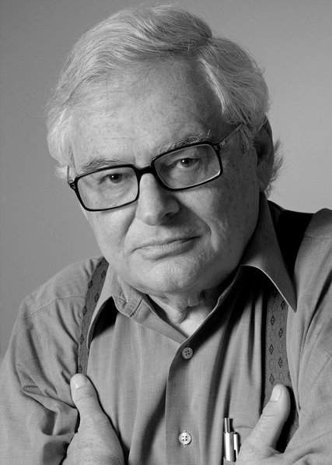
Fruit Flies
Jerry Fodor – “It works by selection of traits produced by random variations in the genes. That’s essentially Darwin’s hypothesis. I think not…There’s something wrong with the theory. It goes deep.” (London Review of Books article “Why Pigs Don't Have Wings”, Oct. 2007)
Pierre Paul Grasse – “The opportune appearance of mutations permitting animals and plants to meet their needs seems hard to believe. Yet the Darwinian theory is even more demanding: a single plant, a single animal would require thousands and thousands of lucky, appropriate events. Thus, miracles would become the rule: events with an infinitesimal probability could not fail to occur. There is no law against day dreaming, but science must not indulge in it.” (Evolution of Living Organisms, New York: Academic Press, 1977, p. 103)
Notes:
Rutger’s philosopher and Neo-Darwinist Jerry Fodor in 2007 in an article titles “Why Pigs Don’t Have Wings” – “It works by selection of traits produced by random variations in the genes. That’s essentially Darwin’s hypothesis. I think not…There’s something wrong with the theory. It goes deep.”
This article shook the Evolutionary community and he was severely castigated for simply saying the truth. And he is one of the most well-known atheistic philosophers in the world. He has no chips in the game, nothing to gain by disproving Darwinian Evolution. Which is why he is saying this in his 70s. If he had said this 30-40 years ago, he’d either be unemployed or working at a community college. It’s the older Evolutionists who are coming out starting to debunk Darwinism. He still believes Evolution is true, he just thinks they need to come up with a new idea.
In 1977, Pierre Paul Grasse, one of the world’s leading Zoologists – “The opportune appearance of mutations permitting animals and plants to meet their needs seems hard to believe. Yet the Darwinian theory is even more demanding: a single plant, a single animal would require thousands and thousands of lucky, appropriate events. Thus, miracles would become the rule: events with an infinitesimal probability could not fail to occur. There is no law against day dreaming, but science must not indulge in it”.
In other words, he rejects Darwinian Evolution.

Slide 40
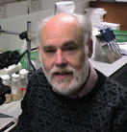
Fruit Flies
Brian Charlesworth – “There is nothing in evolutionary or developmental biology that justifies their assumptions that a successful mutation (which seems merely to mean a selectively neutral one in their model) is always associated with an increase in some global measure of phenotype.”
“If these assumptions are removed, the whole edifice collapses”. (Entropy: The Great Illusion, review of Evolution as Entropy by Daniel R. Brooks and E. O. Wiley, Chicago: University of Chicago Press, 1986, 335 pp., Evolution, vol. 40, no. 4, 1986, pp. 879-881.)
C.P. Martin – “The truth is that there is no clear evidence of the existence of such helpful mutations. In natural populations endless millions of small and great genic differences exist, but there is no evidence that any arose by mutation.” (American Scientist, vol 41, p.100)
Notes:
Brian Charlesworth, who has won numerous awards on Evolution, said – “There is nothing in evolutionary or developmental biology that justifies their assumptions that a successful mutation (which seems merely to mean a selectively neutral one in their model) is always associated with an increase in some global measure of phenotype”.
What he is saying is that there has never been any proof that you can create mutations that change the structure of the animal. He calls it “assumptions”. All Darwinian Evolution does is assume mutations have led to all the changes in animals. It is their foundation, but the mutations have never been proven.
He goes on to say, “If these assumptions are removed, the whole edifice collapses”. And this is why Neo-Darwinism is being rejected. Mutations with drastic fematific affects are overwhelmingly likely to cause disorganization of development.
C.P. Martin in 1953 – “The truth is that there is no clear evidence of the existence of such helpful mutations. In natural populations endless millions of small and great genic differences exist, but there is no evidence that any arose by mutation.”
So which model fits better, the Creationist or Evolutionist? They see the differences in nature, but they can’t account for them by mutations.

Slide 41
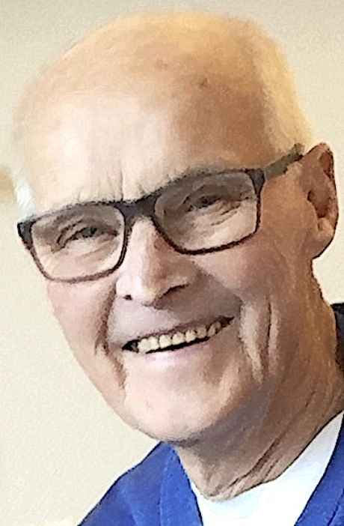
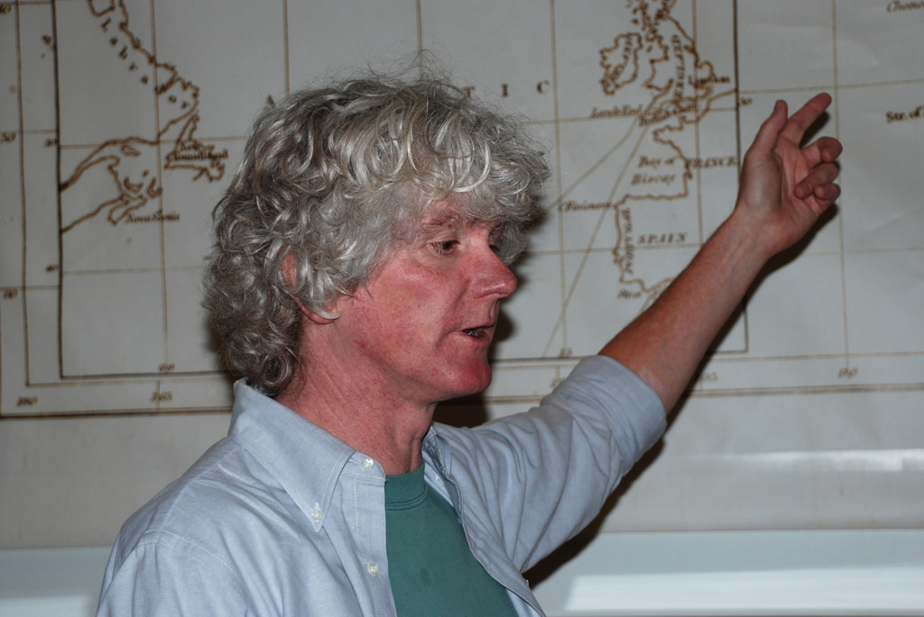
Fruit Flies
Herbert Nilsson – “The proof of the occurrence of mutations is by no means a proof of a current evolution…It is, therefore, absolutely impossible to build a current evolution on mutations or on recombinations.” (Lund, Sweden: Verlag CWK Gleerup, 1953, English summary, p. 1186)
Kevin Padian – “How do major evolutionary changes get started? Does anyone still believe that populations sit around for tens of thousands of years, waiting for favorable mutations to occur (and just how does that happen, by the way?), then anxiously guard them until enough accumulate for selection to push the population toward new and useful change? There you have the mathematical arguments of Neo-Darwinism that Waddington and others rightly characterized as ‘vacuous’.” (The Whole real Guts of Evolution”, Paleobiology, vol. 15, Winter, 1989, p. 77)
Notes:
Also in 1953, Herbert Nilsson said, “The proof of the occurrence of mutations is by no means a proof of a current evolution”; “It is, therefore, absolutely impossible to build a current evolution on mutations or on recombinations”
Professor Kevin Padian, of the University of California at Berkeley, asks whether random mutations in nature give rise to living species – “How do major evolutionary changes get started? Does anyone still believe that populations sit around for tens of thousands of years, waiting for favorable mutations to occur (and just how does that happen, by the way?), then anxiously guard them until enough accumulate for selection to push the population toward new and useful change? There you have the mathematical arguments of Neo-Darwinism that Waddington and others rightly characterized as “vacuous”.” He’s saying its useless, empty, and lacking intelligence.

Slide 42
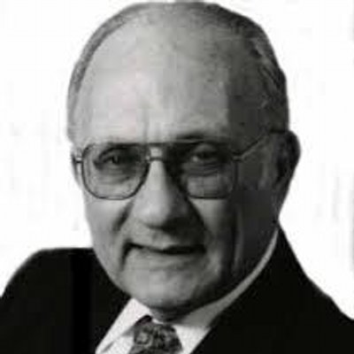
Fruit Flies
Lee Spetner – “…all these mutations reduce the information in the gene by making a protein less specific. They add no information and they add no new molecular capability. Indeed, all mutations studied destroy information. None of them can serve as an example of a mutation that can lead to the large changes of macroevolution…Whoever thinks macroevolution can be made by mutations that lose information is like the merchant who lost a little money on every sale but thought he could make it up on volume.” (Not by Chance: Shattering the Modern Theory of Evolution, pp. 159–60)
Notes:
Dr. Lee Spetner, a Jewish scientist and expert on mutations, states in his book Not by Chance: Shattering the Modern Theory of Evolution – “…all these mutations reduce the information in the gene by making a protein less specific. They add no information and they add no new molecular capability. Indeed, all mutations studied destroy information. None of them can serve as an example of a mutation that can lead to the large changes of macroevolution…Whoever thinks macroevolution can be made by mutations that lose information is like the merchant who lost a little money on every sale but thought he could make it up on volume.”
In other words, the people that know best and are winning top awards in Evolutionary Science are saying Darwinism is dead. Mutations do not lead to macroevolution. But they still teach that it does in public schools. They refuse to believe it is not true because to admit that would mean admitting Creationism, something the proud Darwinian heart just cannot do.

Slide 43
