Slide 1
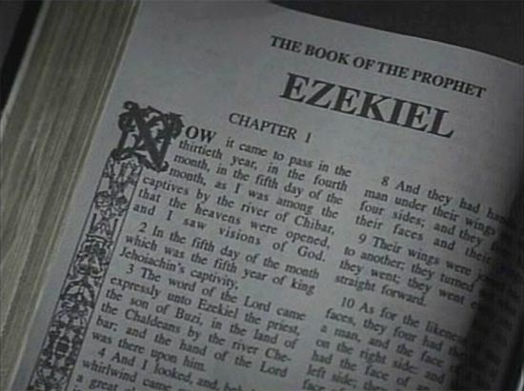
Notes:
The book of Ezekiel has the unfortunate reputation of being an Old Testament book that is difficult to understand. This could not be further from the truth. Ezekiel is a book that is full of wonderful teaching is practical for our day and time. The history of that time is clearly revealed and the majority of the signs given to Ezekiel are easily interpreted.
That being said, there are some sections of Ezekiel that are more difficult to interpret “which the untaught and unstable distort” (2 Pet 3:16), but that should not stop us from gleaning as much as we can from its message.
In this study, we will be doing a mostly topical study of Ezekiel in which we will attempt to gain knowledge of God’s overall objectives toward His exiled people in Babylon. But before we delve into the text itself, it would be beneficial to review the history of this time period so that we can better understand what prompted such a book.

Slide 2
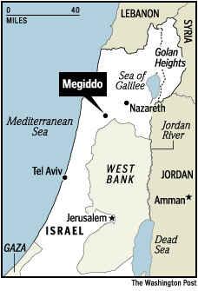
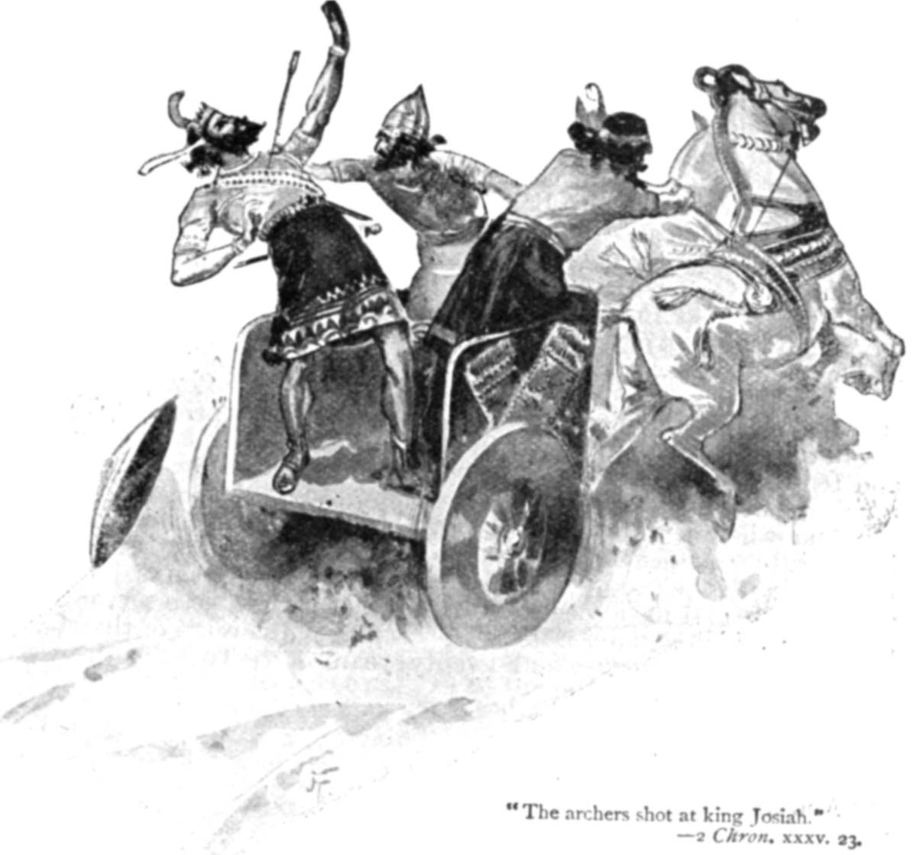
The Battle of Megiddo
2 Kings 23:28-30; 2 Chron 35:20-27
Notes:
In 612 BC, the Babylonian empire joined with the Medes and destroyed Nineveh, just as Nahum had prophesied years prior. Nineveh would never again be rebuilt. Babylon is now the dominant empire in the known world and would continue to be so for about 73 more years.
3 years later in 609BC, Pharaoh Neco of Egypt decided to join forces with the remnant of the Assyrian Empire at the Euphrates River in Carchemish in an attempt to hold off invasion by the Babylonians. Josiah seemed to prefer the Babylonians being in power vs. Assyria and Egypt and so he met Neco’s army in battle while they are traveling north – the Battle of Megiddo. This mistake in judgment led to Judah’s army being defeated and Josiah losing his life.
Josiah’s death is one of the darkest days in Judah’s history because, as a righteous king, he was Judah’s last hope to redeem itself. But as much as he tried to move the nation back to God, He could not turn the hearts of the people. Josiah’s death would therefore mark the end of Judean independence, the end of Josiah’s religious reforms, and the beginning of the collapse of the nation of Judah that would lead to Babylonian exile.
Just as our nation has events that mark turning points in our history (Kennedy’s assassination, 911, etc.), Josiah’s death marked the beginning of the end for Judah.

Slide 3
Pharaoh Necho Captures Judah
Notes:
When Josiah died in 609BC, Judah made his son Jehoahaz king in his place, but his reign lasted only 3 months. When Pharaoh Necho’s siege against Babylon failed, he left a sizable army at Harran and traveled back to Egypt. On his way back, he captured Judah and made it a vassal nation to Egypt. Jehoahaz was taken prisoner back to Egypt and his brother Jehoiakim was made king by Necho in his place as a “puppet” king. From this point on, Jehoahaz is never again a major character in bible history, which was exactly what was prophesied by Jeremiah.

Slide 4
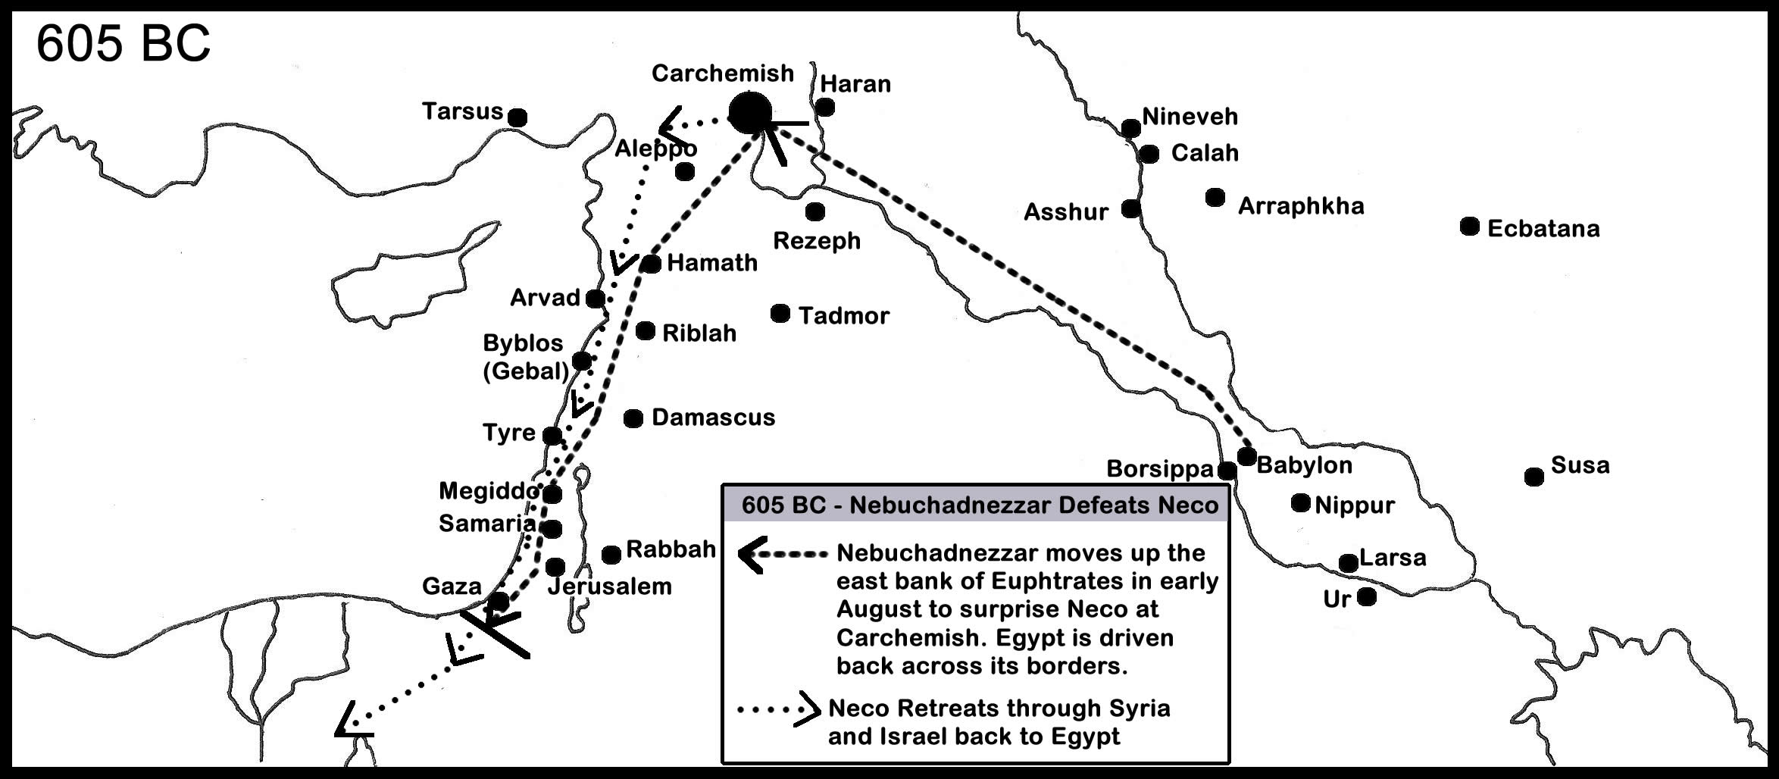
The 1st Deportation
2 Kings 24:1; 2 Chron 36:5-7; Dan 1:1-4
Notes:
4 years later in 605BC, the great battle of Carchemish takes place. It’s Egypt and Assyria vs. Babylon. Babylon wins and Assyria is annihilated and is never again an empire. The Egyptian forces flee back to Egypt pursed by their general, Nebuchadnezzar. Babylon is now the dominate world power.
Nebuchadnezzar gets word that is father, the king, Nabopolassar, has died. Therefore Nebuchadnezzar stops his march towards Egypt and heads back to Babylon to secure the throne for himself.
Before he goes back, though, he stops in Judah and places them under Babylonian control. Judah is now a vassal nation to Babylon. Nebuchadnezzar also took articles from the temple as well as young men from royalty and nobility that could be trained in the ways of the Chaldeans. Among those taken were Daniel, Shadrach, Meshach, and Abed-Nego.

Slide 5
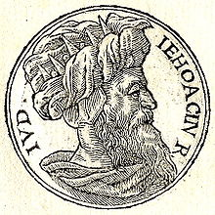
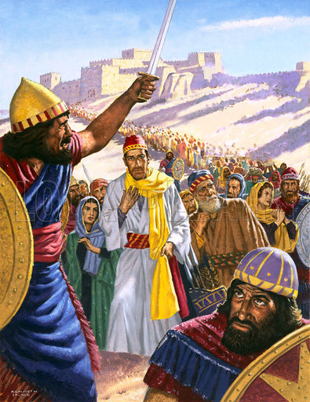
The 2nd Deportation
2 Kings 24:6-17; 2 Chron 36:9-10
Notes:
Jehoiakim decides to stop paying tribute to Nebuchadnezzar and seek help from Egypt. Jeremiah tries to give Jehoiakim inspired advice to submit to Babylon, but Jehoiakim did not listen. Therefore, Nebuchadnezzar comes back to Jerusalem and besieges and captures it on Mar 16, 597 BC. This date marks the 2nd deportation of Judah to Babylon.
This time, Nebuchadnezzar does not take a small number away like he did in the 1st deportation. He takes all the upper class citizens, skilled educators, skilled workmen, officers, soldiers, and even women of royalty. By doing so, Nebuchadnezzar is intentionally disrupting the infrastructure of the nation to prevent further rebellion as well as using them for Babylon’s purposes.
Fortunately for Jehoiakim, he had already died before Nebuchadnezzar takes Jerusalem. But his son, Jehoiachin, reigned in his place only 3 months before the city was captured and Jehoiachin is taken into captivity along with Ezekiel and Mordecai’s family (Esth 2:5-6). In Jehoiachin’s place, Zedekiah was made Babylon’s puppet king. He was the third son of Josiah.

Slide 6
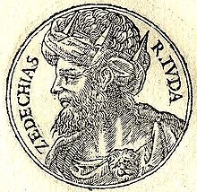
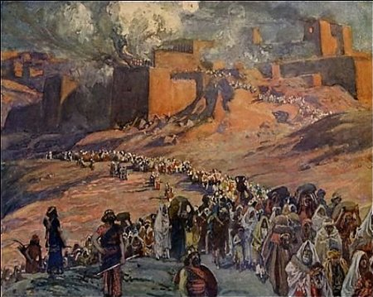
The 3rd Deportation
2 Kings 25:1-21; 2 Chron 36:11-21; Jer 39:1-7; 52:4-11
Notes:
At first, Zedekiah payed tribute to Babylon which is exactly what Jeremiah encourages him to do. But the Egyptians looked like they were gaining their strength back and so Zedekiah decides to rebel against Nebuchadnezzar by stopping payment. This would end up being a terrible mistake.
In 586BC, Nebuchadnezzar comes back to Judah for the 3rd and final time. This time he does not capture Jerusalem, he completely destroys it. Once captured, he takes Zedekiah and kills his sons in front of him right before he plucks out Zedekiah’s eyes so that the slaying of his sons would be the last thing that he sees.
The temple is burned to the ground, the walls are destroyed, and no one is left in Jerusalem except for the poorest of the poor.

Slide 7
Notes:
This is a timeline summary of the last 5 kings of Judah along with the major prophets who continued God’s work during and after the final deportation.
Daniel was taken in the first deportation and transferred to Babylon with other nobility and royalty. It was in Babylon that God would use Daniel and his 3 friends Shadrach, Meshach, and Abed-Nego to demonstrate His divine control over all nations including Babylon. Though the period of captivity had begun and Judah had fallen, God was still in control and had future plans involving the nation of Israel.
Jeremiah began his prophecy early in Josiah’s reign and it would continue even after the city had fallen. Jeremiah’s message was one of repentance but after Judah’s sin had reached a point where judgment by Babylon was certain, he encouraged the king to submit to Babylon so that he and his people would be saved. It was only after they continued rejecting Jeremiah’s counsel that God allowed Jerusalem to be destroyed. Jeremiah would continue after Jerusalem’s destruction to encourage the few remaining Jews to stay in the land and be faithful, but it was futile as they determined to go to Egypt.
Ezekiel was taken into exile in the 2nd deportation, but did not receive his call to prophesy until the 5th year of his exile in 593BC. This was also the 5th year of Zedekiah’s reign. The first 7 chapters of Ezekiel occur soon after this date. Ezekiel’s prophesies were directed toward the people already in exile that were taken in the 2nd deportation.

Slide 8
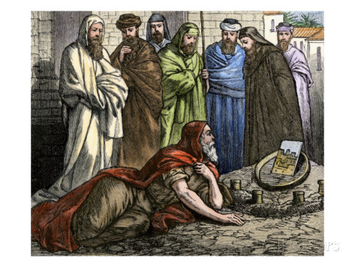
God’s Objectives Through Ezekiel
They’re staying a while
“Now you son of man, get yourself a brick, place it before you and inscribe a city on it, Jerusalem.”
(Ezek 4:1)
Notes:
There are four objectives God had for Ezekiel to accomplish with Israel while they are in captivity.
First, the political view in Judah as well as among the exiles in Babylon was that Babylon’s yoke would soon be broken and that the exiles would soon be able to go home. This belief was enforced by the false teachers in Jerusalem and among the exiles as they knew it was a popular teaching amongst the rebellious people.
God wants Ezekiel to destroy the people’s hope that they would be returning home anytime soon and to prepare them for the fact that Jerusalem would fall and that they would be in Babylon for quite a while. To make His point, God has Ezekiel to go through graphic demonstrations in order to pierce through their hard hearts. Jeremiah had already attempted to persuade them through words, but it was not enough to convince them to repent. The demonstrations by Ezekiel were intended to be radical and pointed to get through to the captives.

Slide 9
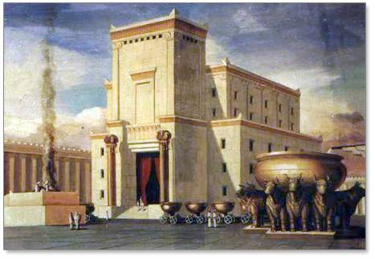
God’s Objectives Through Ezekiel
They’re staying a while
To expose their wickedness
“Son of man, do you see what they are doing, the great abominations which the house of Israel are committing here, so that I would be far from My sanctuary?”
(Ezek 8:6)
Notes:
Secondly, God wants to use Ezekiel to expose the wickedness of Israel. To present God’s case to the people. Ezekiel would be shown visions of just how engrained and deep-seated their sins were. By getting them to this point, they would see why they had to be taken captive and why they would stay there for some time.
The Israelites were prone to place the blame for their situation on other things besides themselves. Ezekiel’s biggest challenge is to show and convince them that they alone are responsible for their situation; not their fathers, not God, but themselves. They had allowed themselves to become corrupted to the point where God’s presence could not dwell with them further.

Slide 10
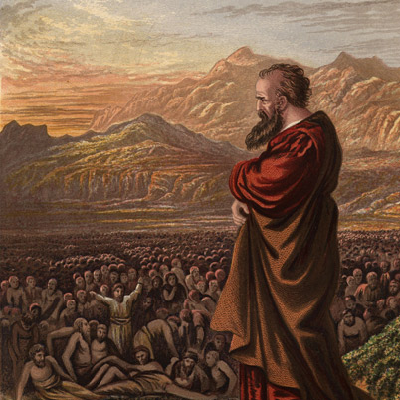
God’s Objectives Through Ezekiel
They’re staying a while
To expose their wickedness
To move them to repentance
“Son of man, I have appointed you a watchmen to the house of Israel…”
(Ezek 3:17a)
Notes:
Third, once the Israelites could see the reality of their sin and wickedness, God wants Ezekiel to move them to repentance. God uses Ezekiel to get them to see things from His viewpoint and Ezekiel’s life would become one of sacrifice to bring glory to God.
To bring about repentance was paramount. God’s intention was to use a remnant from these captives to return and rebuild Jerusalem once the 70 years of captivity were complete. But unless they could come to terms with their sin and repent of them, God would not be able to use them in the way which He intended.

Slide 11
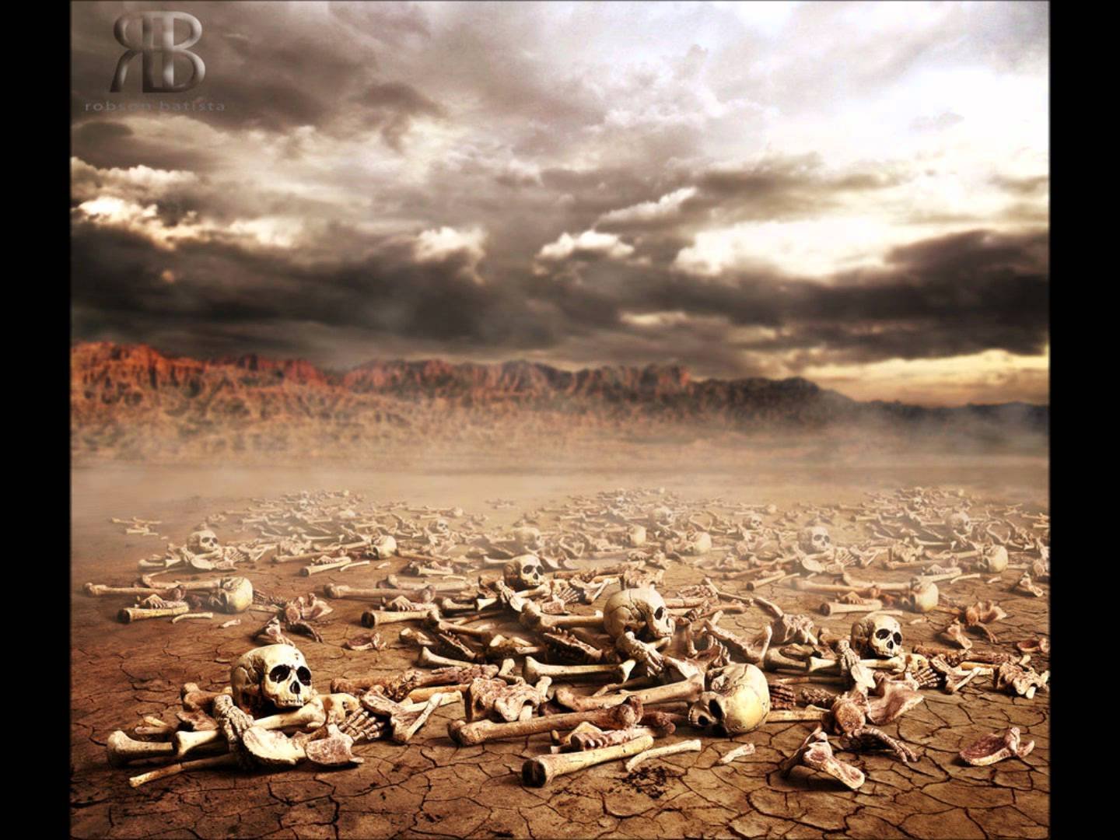
God’s Objectives Through Ezekiel
They’re staying a while
To expose their wickedness
To move them to repentance
To offer his people hope
“Behold, I will cause breath to enter you that you may come to life.”
(Ezek 37:5)
Notes:
Finally, based on the results of the previous 3 objectives, God wants to offer His people hope of greater times in store for the future. God had already fulfilled the land and nation promises made to Abraham, Isaac, and Jacob, but the seed promise was still forthcoming. To fulfill the seed promise, God must preserve a remnant of Abraham’s seed to fulfill this promise.
God has a Messianic Age in store for His people when the problem of sin would be taken care of once and for all. He would raise His people from Babylon and return them to their land against all foreseeable odds. Once there, Israel would remain until the fullness of time comes. God sends great visions to Ezekiel that he was to record that would assure the people that no matter how bleak the outlook was for Israel, they would once again “come to life”.

Slide 12
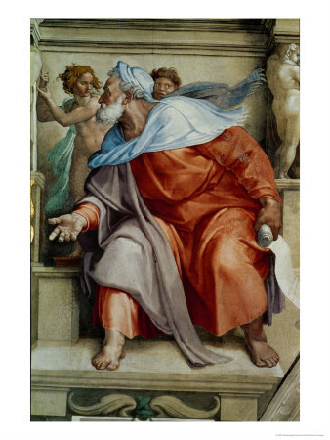
Who Was Ezekiel?
Born 622BC during Josiah’s reign
Ezekiel means “God will strengthen”
Son of Buzi and of priestly lineage
17 yrs old when Daniel taken captive
Taken into captivity himself at 25 yrs old
Called to prophesy at 30 yrs old
Jerusalem fell 6 years after his call
No evidence he was able to return home
Lived by the river Chebar (fertile area)
Contemporary of Daniel, Jeremiah, Zephaniah, Nahum, and Habakkuk
He was married, but his wife died when he was 34 yrs old
Notes:
Miscellaneous notes about Ezekiel.
Ezekiel was 30 years old when he began his ministry (Ezek 1:1). God commissioned him in the fifth year of his exile which made him 25 years old when he was taken into captivity in 597BC and 17 years old when Daniel was taken in the first deportation. Doing the math, Ezekiel was born in 622BC during Josiah’s reign. He was the son of Buzi, of whom we know nothing other than the fact that he was of priestly lineage. Jerusalem would fall 6 years after his call to prophesy which would make him 36 years old at that point.
Ezekiel was a contemporary of Daniel, who had already been in the capital city of Babylon for 8 years, and Jeremiah who was still in Jerusalem preaching God’s word. Zephaniah, Nahum, and Habakkuk were also doing their individual works around the same time.
Ezekiel lived by the river Chebar with the other exiles. This was a very fertile area of Babylon of which Israel would have had everything they needed to prosper in Babylon. Although Ezekiel was married, we know nothing about his wife other than than fact that she died when he was 34 years old to be a sign to the people.

Slide 13
Contains Keys To Unlocking Revelation
The Throne-Vision | Rev 4 | Ezek 1
The Book | Rev 5 | Ezek 2-3
The Four Plagues | Rev 6:1-8 | Ezek 5
The Slain Under the Altar | Rev 6:9-11 | Ezek 6
The Wrath of God | Rev 6:12-17 | Ezek 7
The Seal on Saint’s Foreheads | Rev 7 | Ezek 9
The Coals from the Altar | Rev 8 | Ezek 10
No More Delay | Rev 10:1-7 | Ezek 12
The Eating of the Book | Rev 10:8-11 | Ezek 2
The Measuring of the Temple | Rev 11:1-2 | Ezek 40-43
Jerusalem and Sodom | Rev 11:8 | Ezek 16
The Cup of Wrath | Rev 14 | Ezek 23
The Vine of the Land | Rev 14:18-20 | Ezek 15
The Great Harlot | Rev 17-18 | Ezek 16, 23
The Lament Over the City | Rev 18 | Ezek27
The Scavengers' Feast | Rev 19 | Ezek38
The First Resurrection | Rev 20:4-6 | Ezek 37
Gog and Magog | Rev 20:7-9 | Ezek 38-39
The New Jerusalem | Rev 21 | Ezek 40-48
The River of Life | Rev 22 | Ezek 47
Notes:
One of the side benefits of studying the book of Ezekiel is the fact that is often looked at as the Old Testament version of Revelation. Revelation is the most difficult book in the bible by far as it employs numerous signs and symbols in its teaching that are difficult for the unlearned to grasp. However, Ezekiel, as well as other apocalyptic literature in the Old Testament, employs some of the same signs and symbols as we find in the book of Revelation. In fact, Revelation borrows its language from other apocalyptic literature in the Old Testament.
Therefore, as we study Ezekiel, be on the lookout for signs and symbols found that reappear in Revelation as they can aid us in interpreting Revelation more accurately. Given that we know the timeline and history of Ezekiel better than we do Revelation, once we see how the signs and symbols should be interpreted there, applying the same interpretation skills in Revelation is the key to unlocking its mysteries.

Slide 14
Syllabus
Jan 10th – Ezekiel’s Commission (Ch. 1 – 3)
Jan 24th – Accepting the Yoke of Babylon (Ch. 4-7, 24)
Jan 31st – Facing Their Sin (Ch. 8 – 11)
Feb 7th – Facing Their Sin (Ch. 17 – 18, 20, 22)
Feb 14th – Repentance & Judgment Against Israel (I) (Ch. 16, 23, 19, 21)
Feb 21st – Judgment Against Israel (II) (12 – 15)
Feb 28th – Judgment Against The Nations (Ch. 25 – 32)
Mar 6th – Restoration: The Watchman and The Good Shepherd (Ch. 33 – 34)
Mar 13th – Restoration: Hope for Mountains; Valley of Dry Bones (Ch. 35 – 37)
Mar 20th – Restoration: Gog & Magog (Ch. 38 - 39)
Mar 27th – Vision of the Temple (Ch. 40 – 48)

