Slide 1
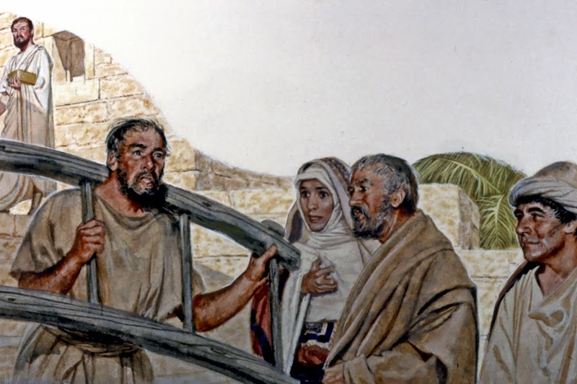
Accepting The Yoke
Of Babylon
Notes:
In Jer 27, God commands Jeremiah to place a yoke around his neck and to wear it in the presence of the people of Judah. God’s message to Judah, as well as the other nations, is that they need to subject themselves to Babylon for the sake of their lives. If they do not subject themselves, God will kill them with the sword, pestilence, and famine. One of the problems in Jerusalem, however, was that there were false prophets attempting to counter Jeremiah’s message and to appease the people. In Jer 28, one of these false prophets, Hananiah, decided to deceitfully prophesy in front of Jeremiah, the priests, and the people at the temple claiming that Babylon’s yoke would be broken in two years. Jeremiah argues with him and so Hananiah breaks the wooden yoke off of Jeremiah’s neck. God would punish Hananiah for this by taking his life about two months later.
This pretense that God would soon restore Judah by relieving them of Babylon’s yoke also existed amongst the exiles to which Ezekiel prophesied. Therefore, both prophets are essentially fighting the same battle in their respective territories. In this study, we will show how God used Ezekiel as a sign to the people by having him perform certain acts to show what would happen in Jerusalem. These acts were very graphic and radical for the sole purpose of causing the people to question Ezekiel as to what he was doing so that he might have opportunity to tell them. By going through these demonstrations, God’s objective is to show them the certainty of Jerusalem's destruction and the inevitability of a 70 years captivity.

Slide 2
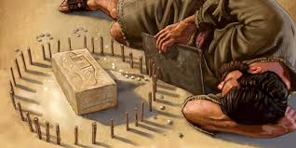
Ezekiel’s Siege
Build a model siege of Jerusalem
Lay siege against it
Lie on your side
Left side for 390 days
Right side for 40 days
Prophesy against it w/your arm bare
Eat defiled bread
Make bread from wheat, barley, beans, lentils, millet, and spelt
20 shekels/day, 1/6 hin water/day
Bake it over human cow dung
Notes:
In chapter 4, God gives Ezekiel 3 signs to perform. First, he is the build a model siege against Jerusalem. Second, he is to lay on his sides to bear the iniquity of Israel and Judah. And third, he is to eat defiled bread. It is important to remember that while he is enacting these signs, Ezekiel cannot speak unless a specific oracle from God comes. Therefore, he would have enacted these demonstrations silently causing great wonder within the people as to what these signs meant:
1) Ezek 4:1-3 – Ezekiel is to build a model on the ground of Jerusalem with a model siege against, almost like a little child would play with toys in the sand. Ancient armies would besiege a city by setting up a wall of soldiers around the city with battering rams. They would build up mounds of dirt up to the walls where their battering rams could break through strategic points of the walls and the soldiers could get through. Ezekiel is enacting all of this on the ground. He is also to take an iron plate and set it between himself and the city. The point of this sign is that no matter how they felt or what their false prophets were telling them, Jerusalem is going down. The iron plate most likely signifies the fact that God has blocked access to Himself from the people. This is confirmed by the many times God told Jeremiah to stop praying for the people (Jer 7:16; 14:11). So in the darkest moments of the siege the people would become penitent, but God would not listen to their pleas because this was a time of judgment.
2) Ezek 4:4-8 – Each day that Ezekiel laid on his side was to represent a year for each kingdom’s iniquity – 390 days for Israel and 40 days for Judah. To find which years in history were represented by these days has perplexed the ablest of bible students and a multitude of opinions exists. The most likely interpretation of Israel’s 390 years fits between the time Jeroboam would have first built his alters at Dan and Bethel until the last king of Judah was deposed - ~390 years. Judah’s years are slightly more difficult. If we count backwards from when Zedekiah was deposed, we would arrive to around the middle of Josiah’s reign. Or, it is entirely possible that these numbers should be interpreted as symbolic and that we need to look into numerology itself to interpret them. The precise meaning of these numbers is not as important as the understanding that Ezekiel is signifying the total judgment of Israel and Judah since their initial division. It is likely Ezekiel did not do this 24 hours a day, but during large chunks of the day where people would see it given that the next vision where he is transported to Jerusalem occurs during this timeframe of 430 days. He would also uncover his arm, which is signifying that God was ready to take action (similar to when we roll up our sleeves).
3) Ezek 4:9-17 – The point of this is not what our modern society pushes in the form of “Ezekiel Bread” that is healthy. The point is that Hebrews would normally make bread of just one of these items listed. But when you’re under siege, you only have sparse amounts of food because you are starving to death and making do with what you’ve got. God gives him only a limited amount of this makeshift bread and water during the days on his side - ~8oz of bread/day and ~1 pint of water. To make matters worse, God tells Ezekiel to use human dung as his fuel for cooking. Ezekiel protests as a result of its uncleanness so God lets him substitute cow dung. The point is that during a siege where there is no wood, etc. for cooking fuel, the people will resort to radical measures. All of this is to enact what would take place with the walls of Jerusalem while the city is under siege. And when the real thing finally occurs, “they will know that a prophet has been among them”.

Slide 3
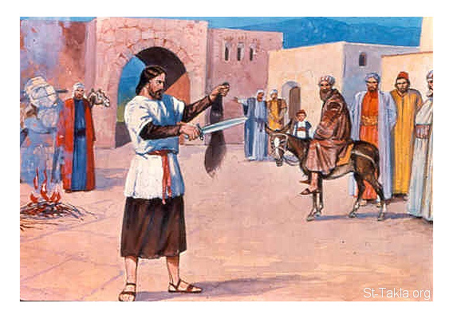
Destiny of the People
Ezek 5:1 – “As for you, son of man, take a sharp sword; take and use it as a barber’s razor on your head and beard.”
1/3 burned w/fire
1/3 struck w/sword
1/3 scatter w/sword
A few hairs bound in his robes
Some of these burned in fire
“I am against you…”
1/3 will die by plague/famine
1/3 will die by sword
1/3 will scatter followed by sword
A remnant will be spared, though through “fire”
Notes:
Ezek 5:1-4 – In Israelite culture, if your head was shaved or your beard was plucked out, it was a symbol of disgrace. Foreign invaders were known for doing so to humiliate their captives. God is having Ezekiel go through a demonstration of cutting his hair and his beard not to shame him so much as to show the shame that will be brought to the people of Israel. 1/3 of Ezekiel’s hair was to be burned with fire in the center of the city. 1/3 was to be struck with a sword. 1/3 was to be scattered to the wind. A few hairs, however, were to be bound in the edges of his robe and of a few of these some were to be burned in fire. All of this is to symbolize the judgment God would bring on Jerusalem.
Ezek 5:5-17 – The fulfillment of the sign is as follows: 1/3 of the people will die in the city of pestilence or famine. 1/3 of the people will be killed by the sword. 1/3 of the people will be scattered but the sword would follow them. Though it is not explicitly said so, the few hairs bound in Ezekiel’s robe most likely represent the remnant of people who would be spared by God and used later to rebuild the city, though some of these would go through great hardship to get to that point.
Things are about to get so bad in Jerusalem, that the people are going to start starving to death and looking for anyway to escape from the destruction Babylon is inflicting. But God will see to it that judgment occurs because the sin of Judah is so great that it must be punished. All of this was prophesied about back in Lev 26:27-33 when God was warning the people not to forsake His law. Yet the Israelites are disillusioned. This is why Ezekiel has to perform such radical signs before the people.

Slide 4
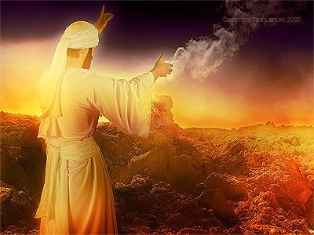
Prophesy Against Idolatry
Ezek 6:2 – “Son of man, set your face toward the mountains of Israel, and prophesy against them”
God will take the sword to the high places
God will spare a remnant who will learn contrition
“Clap your hand, stamp your foot…”
Notes:
Ezek 6:1-14 – The high places were where many of the Israelites tended to worship. Sometimes they would worship Jehovah on the high places even when God told them He would be the one to choose where they would worship (Deut 12:11), but many times they would worship idols. Moses had exhorted the people to destroy these high places once they took over Canaan’s land (Num 33:52, 55), but they were instead seduced by them and so the high places became a major stumbling block to the Jews. Several kings who led the nation in religious reforms such as Asa, Jehoshaphat, and Hezekiah were unable to remove the high places because they were such a fixture in the hearts of Jews. Josiah was the first king to rid the land of the high places, both in Israel and in Judah. But after he died, the people began worshipping on them again. Therefore, God has a special oracle for the high places since they were such a stumbling block – they too will have the sword taken to them as their alters will finally be destroyed and laid waste.
However, God will preserve a remnant of Judah. Some of those who are currently rebellious will learn the error of their ways. They will learn true contrition while they are in the nations to which they have been scattered; and while there, they will turn back to the Lord. As we will learn later on, God intends to use this repentant remnant to rebuild Jerusalem when the days of the exile are complete.
Ezekiel was to clap his hand and stamp his foot. This was a gesture of mixed emotion, amazement, indignation, sorrow, and pity, over what was to transpire. The people who were carried away by their idolatrous tendencies would be smote by sword, famine, and plague in order to appease God’s wrath. The city of God would turn to waste and desolation.

Slide 5
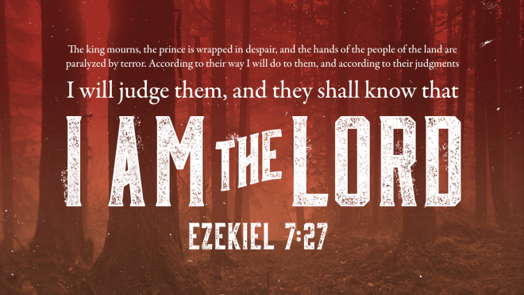
Oracle of Judgment
Ezek 7:2 – ““And you, son of man, thus says the Lord God to the land of Israel, ‘An end! The end is coming on the four corners of the land.”
Stresses inevitability of destruction
The people still did not know God, but the impending judgment will reveal how He feels about sin
“The Day of the Lord”
Notes:
The repetition of this chapter is important – “the end has come” (vs. 2), “the day has come” (vs. 10), “the time has come” (vs. 7), and “doom has come” (vs.7, 12). The repetition is to ensure the inevitability of Jerusalem’s destruction to counter the false thinking in the mind of the Israelite that things were going to turn around anytime soon.
Ezek 7:1-4 – The people loved to call upon God, but they still don’t really know who He is. But through the judgment He is about to inflict, the people would come to know more about His character. He is a God of justice that cannot allow sin to go unpunished.
Ezek 7:5-9 – The judgment against Israel is personified as was the case in 2 Pet 2:3. The popular idea of “the day of the Lord” was the idea that God would one day randomly appear and dispose of Israel’s enemies. Other prophets had tried to dispel such false ideas (Amos 5:18) but the idea persisted until the time of Ezekiel. And so Ezekiel is saying that the “day of the Lord” will be filled not with joyful shouting, but with screams of terror because of the triumph of Israel’s enemies.
Ezek 7:10-11 – Most OT prophets spoke of God’s judgments as culminating in “a day”. They saw in all calamities an ever-recurring omen of that day in which earth’s story would be judged as a whole. All those who suffer for their wickedness are foretokens of that last day when the fire will try every man’s work.
Ezek 7:12-13 – Commercial activities will cease. This stresses the uselessness and futility of buying and selling because the entire nation of Israel was doomed to the triple judgment of the sword, pestilence, and famine that will only leave a remnant. Neither the buyer or the seller will have a claim to the land because all of it will belong to the Chaldeans.
Ezek 7:14-18 – Judah’s military power will collapse. Though the trumpet will sound, it will not be for the year of jubilee, but for the onset of devastating war. But the people would be powerless to defend the city. Just as doves moan when driven through fear from their nests, so will the remnant of Israel who escapes death by living in exile. Their knees would become weak as water in that all of the strength of the people has been sinned away. They are now powerless before their enemies.
Ezek 7:19-22 – None of the wealth they have stored up will save them because they are worthless when one is confronted by the judgment of God (Zeph 1:8). Their ornaments were stumbling blocks in that they were used to make images and contributed to their pride.
Ezek 7:23-27 – All classes of people will experience dismay and despair. “Get your chains ready, you’re being deported to Babylon”. The Chaldeans were the worst of all nations in that they spared neither age or sex. They burned up crops, destroyed stores of grain, and left behind an impoverished and depressed population among whom pestilence and famine would continue to further. Babylon wasn’t interested in peace anymore, but total ruin and destruction. Every avenue of spiritual help, whether prophet, priest, or elder, was closed because no more religious advice or counsel would help them. All classes of society will suffer in this judgment.

Slide 6
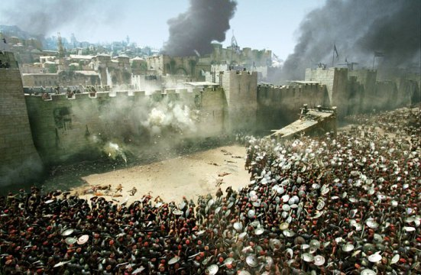
Jerusalem Is Laid Siege
Ezek 24:2 – “Son of man, write the name of the day, this very day. The king of Babylon has laid siege to Jerusalem this very day.”
Parable of the Boiling Pot
Jerusalem is like a boiling pot with rust/scum within it
God will “turn up the heat”
Their uncleanness (blood) will be exposed
Notes:
Ezek 24:1-2 – This is a watershed moment in the book of Ezekiel because it is the day that Ezekiel has been prophesying about for the last several years. The date is 589BC, 4 years after Ezekiel has begun his prophesying, and it marks the very day that Jerusalem is placed under siege by Nebuchadnezzar. This siege would last 3 years before the city would fall. That Ezekiel has this information is a miraculous sign itself since he could not have known this was the very day unless God Himself told him. And so this would be a sign that the people would later remember that would confirm Ezekiel as a prophet.
Ezek 24:3-14 – The image given to Ezekiel is that of an ordinary cooking pot with which you would boil meat. Yet the meat is boiling and boiling and boiling and the heat is so intense that even the bones starting seething. The pot represents the city of Jerusalem and “the heat is on”. The inhabitants of Jerusalem are being boiled in a pot because this is God’s judgment. Jerusalem is likened to a pot that has a rust/scum that can’t seem to be cleansed. So God is going to cleanse this pot by boiling it, removing the pieces, and then continue to turn up the heat until the rust/scum is melted off. Before meat is put in a pot to cook, you would drain the meat of its blood. But the contents of this pot are the residents of Jerusalem and they’re being boiled with the blood still in them. In other words, they are unclean and therefore God will put her blood on the bare rock for everyone to see

Slide 7
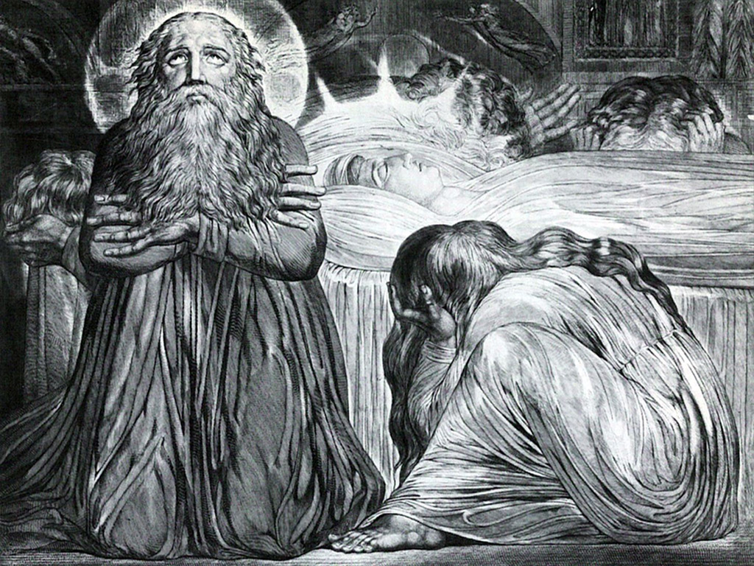
Ezekiel’ Wife
Ezek 24:16 – “Son of man, behold, I am about to take from you the desire of your eyes with a blow; but you shall not mourn and you shall not weep, and your tears shall not come.”
When Ezekiel’s wife dies, he is not allowed to go through the normal outward displays of mourning that would honor the fallen
When God takes Jerusalem, Israel must show they are in agreement with God’s judgment by likewise not going through outward displays of mourning
Notes:
Ezek 24:15-24 – Many cultures express their grief in different ways. In eastern cultures, it was common to honor the one who died by showing your grief in a grandiose and outward way. Israelites would often rend their garments, sit on the ground, remove their head garment and pour ashes on their head, take off their shoes, cover the lower part of their face with a cloth. In Jer 16:7, Jeremiah mentions a “bread of mourning” that was common to eat in times of grief. All of these were outward ways to honor your lost loved ones and if you didn’t do so, you were thought to not be honoring them. This appears to be what God is commanding Ezekiel to omit. It is probably not the case that God is forbidding Ezekiel from being sad or even weeping in private for the death of his wife that so often is involuntary on our part, merely to avoid the outward signs of mourning that Israelite society would expect of him. This would have caused shock and awe amongst the Israelites to the point where they would have questioned why he wasn’t mourning in the traditional way.
The point of this is that while Ezekiel’s wife was the delight of his eyes, Jerusalem was the delight of Israel’s eye. The people whom God is destroying for their sin are not to be honored for their judgment because they are not honorable people. God is not batting an eye at destroying the city and bringing judgment upon the people there and if the Israelites are not on the same page as God, they might show they are honoring the dishonorable by weeping outwardly and maybe even blame God for His decision. The exiles need to show by their response that this is a necessary judgment and not give the impression that God is unfair or done evil toward His people.
Ezek 24:25-27 – Once Ezekiel gets word that Jerusalem has indeed fallen (about 3 years later), God will allow him to talk again. Thus far since the beginning of His commission, God has required Him to be mute unless He gives Ezekiel a specific oracle to speak. But once word gets back to the exiles that Jerusalem has indeed fallen, the fact that he begins speaking again would be yet another sign to the people that a prophet indeed had been among them.

