Slide 1
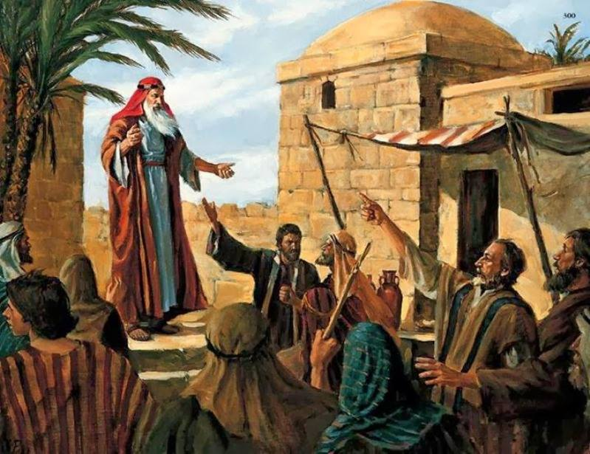
Judgment Against Israel
Notes:
There were so many things that God had His prophets do in order to try and get through their hard hearts when their sin was getting out of hand. In some ways, Ezekiel is the prophet of prophets when it comes to radical demonstrations because God has Ezekiel do some very strange things just to try and draw their attention to the message of God. The purpose of the signs God gives Ezekiel is to convince them that judgment is coming and it will be delayed no further.
In the next four chapters, God is going to not only present signs but also confront entities of people whom God who were responsible for Judah’s debaucheries: the prince, the false prophets, and the elders. Each of these people had a role in Judah’s judgment and God will lay out what that role was.

Slide 2
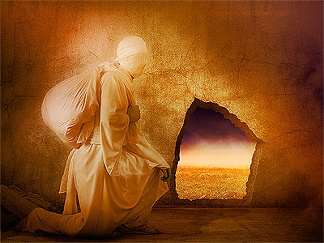
Ezekiel Prepares For Exile
Ezek 12:2 – “Son of man, you live in the midst of the rebellious house, who have eyes to see but do not see, ears to hear but do not hear; for they are a rebellious house.”
Ezekiel engages in an “escape” from Jerusalem
Ezekiel eats his meals with anxiety
God will cause their false proverbs to cease
Notes:
Ezek 12:1-7 – Like some previous chapters, what Ezekiel is doing here is similar to a monodrama, a little play that he performs to cause wonder amongst the people as to what the sign could mean. Ezekiel had been commanded by God to be silent unless God had a specific message for him to speak. But He was not to engage in normal conversation. The Israelites still falsely expect that they are going home soon, but God’s message is that, instead, they’re going to have company. In other words, there will be those who survive the siege of Jerusalem who will join Ezekiel’s people in Babylonian captivity. When God commands Ezekiel to go out with his luggage during the day where people can see, it is possible the people would have thought he was saying that they’re going home, though God told Ezekiel it is “for exile”. Yet, he was to do the same thing at night and dig a hole in the wall, which would happen only if you were trying to sneak out. This is what would happen toward the end of a siege when the Israelites realized that the walls were not going to hold; they would try to escape in secret in such a way that no one could see them. What would be the reason for covering your face? One reason would be because you’re sneaking out and don’t want anyone to see who you are.
Ezek 12:8-16 – The explanation found in these verses tells us who Ezekiel is specifically talking about. Besides the people going into exile, the prince, Zedekiah, would be the one to try and sneak out of the wall at night so that he could not be seen. The fact that he won’t see the land tells us what will happen to Zedekiah. Zedekiah’s sons would be slain in his sights right before his eyes would be plucked out. He would then be taken into exile to Babylon where he would eventually die. All of his helpers and troops would try to escape, but the sword would follow them. Some would die by that sword and others would be taken captive with Zedekiah to Babylon (Jer 39:1-7). However, consistent with God’s message of judgment, He promises to spare a remnant that would remember His judgment as well as the reason for such judgment. This remnant would be a people that He could use to fulfill His promise to Abraham, Isaac, and Jacob.
Ezek 12:17-20 – As another demonstration, Ezekiel is to eat his meals while trembling and anxiety. This was to symbolize the limited quantity of food that would exist during a time of siege. Because food was so scarce, many did not know if they would have anymore food to eat. Others were scared of the people because when there is no food, there is violence on account of starvation. Even today we can get angry when we are hungry. Imagine what it was like during a siege when it is starvation and not hunger?
Ezek 12:21-28 – These two proverbs were being spoken by the people to apparently encourage each other further in their rebellion against God. They were said in order to dismiss the reality of God’s judgment. The first proverb was likely in response to what men like Jeremiah and Ezekiel were saying was going to come to pass, but the fact they had not come to pass quickly caused people to doubt their relevancy (2 Pet 3:3). The 2nd proverb is a variation of the first, only that whatever men like Jeremiah and Ezekiel were saying would occur many years from then. God’s point is that coming up with a clever proverb, rhyme, or any other jingle that flows smoothly from the lips does not take away from truth. Those who were responsible for these proverbs were the false teachers of Israel whom God will address in the next chapter.

Slide 3
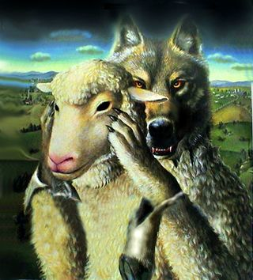
False Prophets Condemned
Ezek 13:2 – “Son of man, prophesy against the prophets of Israel who prophesy, and say to those who prophesy from their own inspiration, ‘Listen to the word of the Lord!’”
False prophets prophesied out of their own desires and imaginations
False prophets are whitewashed walls
False prophetesses prophesied purely for selfish gain
Notes:
Ezekiel has already prophesied against Jerusalem, against the mountains and cities of Judah, against the priests and against the king; and now he directs the prophecies against the false prophets. They were the reason why these proverbs from the previous chapter were so popular.
Ezek 13:1-9 – There are three reasons for these denunciations: First, they were prophesying out of their own subjective desires and imaginations. Second, they were doing nothing whatsoever to help Israel, whether building up the wall or helping to repair the breaches in it. Third, they prophesied lies and then expected God to confirm their lying words. This made them foolish. Just as foxes spoil vineyards and their fruit and take refuge in ruins, these false prophets were crafty. They laid waste the vineyard of the Lord and profited from the ruin of Israel and made that ruin worse. The wall is not literal, but figurative. It is the wall of integrity, truth, honor, and love for God which alone would afford the people all the protection that they needed against the coming disaster. Because of their grievous sin, God Himself will be against them as He will eradicate them from the land and the people.
Ezek 13:10-16 – Again, this is not a reference to a literal wall, but to the worthless “prophecies” that these sinful men were preaching in place of the true word of God brought by men such as Jeremiah and Ezekiel. The utter lack of integrity among these false prophets is illustrated by the word of a foolish, incompetent builder who uses whitewash in the construction of a wall. All whitewash does is temporarily cover up cracks and faults, but it cannot protect you from the storm. God is going to bring a storm that will destroy that wall and along with the false prophets who built it because they falsely prophesied “peace” when in fact there was no peace.
Ezek 13:17-23 – There are many prophetesses mentioned in the bible. Miriam (Ex 15:20), Deborah (Judg 4:4), Huldah (2 Kings 22:14), Elizabeth (Luke 1:41-45), Anna (Luke 2:36-38), and the four virgin daughters of Philip (Acts 21:9). But “prophetess” is too good a word for the women in Ezek 13; witches or sorceresses would better suit their description. They are the ancient forerunners of the palmists, fortune-tellers, card readers, and crystal ball watchers of our day and age. These same women used their own paraphernalia of witchcraft to exercise a certain level of control over individuals and to profit during a time when food was scarce. Their false prophecies came out of self-interest in order to victimize others and make a living for themselves. By their false counsel, they preserved the life of some God wanted dead and killed others whom He wanted to live. Thus they would reap their reward from God in due time.

Slide 4
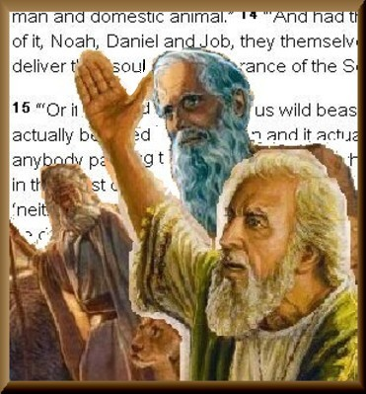
Idolatrous Elders Condemned
Ezek 14:3 – “Son of man, these men have set up their idols in their hearts and have put right before their faces the stumbling block of their iniquity. Should I be consulted by them at all?”
Hypocrisy of the elders
Prophets who cater to these elders
Inability of righteous men to contend for Jerusalem
The people will see that God was right for destroying the city
Notes:
This is not the first time the elders have come to Ezekiel and it won’t be the last. On the surface, this seems like a very good thing because they are obviously starting to accept that Ezekiel is a prophet and therefore want to know what message God has given them. However, there is an underlying hypocrisy that God wants Ezekiel to expose in these elders which disqualifies them from inquiring of God.
Ezek 14:1-8 – The problem with the elders inquiring of God is the fact that they are still worshipping idols even as they are in exile. And so they are not solely leaning on God, just doing this as another way to inquire of the spiritual realm. The idols are not just before their faces, they are also deep in their heart. To them, Ezekiel is just another avenue for discernment in what the “gods” say, in this case Jehovah. It is hypocrisy. Therefore, God tells them if they do so He will punish them. Ex 20:3 commands them not to have any other gods before Jehovah. This does not mean that Jehovah must be the top God in their pantheon of deities, it means He must be the only God because He is the only true God. So God will punish any Israelite and even any immigrant who stayed with Israel for devoting themselves to these idols. They will be cut off and all that will be left of them will be a proverb as a reminder to future generations. But instead of it being like “Remember the Alamo”, it would be more like “Let me tell you about Ryan…”. In other words, even after they are gone, people would still be talking about them.
Ezek 14:9-11 – What about the prophet who happens to cater to these idolatrous elders despite the fact that God had not given them a message? God will hold the prophet just as accountable as He will hold the idolatrous elder. What does it mean, though, that God will prevail upon that prophet to speak the word, as if He Himself is responsible for the prophet speaking this message? It’s not that God wants the prophet to commit sin. It’s likely the same thing that happened in 1 Kings 22:19-23 where God put a deceiving spirit in the mouth of the prophets who contended with Micaiah, and Micaiah tells them that is the case. This is also similar to what Paul says in 2 Thes 2:11 about sending a deluding influence. This happens to sinful people who are intent on committing sin in that God treats them as vessels of wrath for His glory. It’s not that He wants men to commit sin, but those who have gone too far and refuse to come back can be used for His purposes.
Ezek 14:12-21 – Because of how much Judah had sinned, no one, no matter how righteous they are, would be able to contend for the welfare of that city. God specifically brings up Noah, Job, and Daniel as men of righteousness who would not even be able to contend on behalf of Judah. These men would be able to save themselves, but not the city – the city had gone too far in their sin and the time for judgment had come. God will not be persuaded to not come in judgment.
Ezek 14:22-23 – Despite the certainty of judgment, the destruction would not be as total as Sodom and Gomorrah. There would be survivors and that would bring mutual comfort, in that they will all see the reason for why the destruction had to come about due to the character of those who were judged and come to join them in exile. They will know that this judgment was not in vain. It was carefully thought out and brought about in due season to bring about their repentance it needed to bring to prepare the people to one day return.

Slide 5
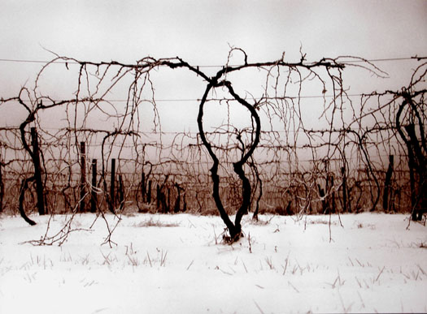
The Useless Vine
Ezek 15:2 – “Son of man, how is the wood of the vine better than any wood of a branch which is among the trees of the forest?”
The vine is different from other tress of a forest; it cannot be used for wood
If a vine does not bear fruit, its good for nothing but to be burned
God will make Jerusalem desolate because it is not bearing fruit
Notes:
Ezek 15:1-8 – The illustration of the useless vine is simple. Vines cannot be used for the value of their wood like other trees in the forest can. You can’t even make a peg from a vine. The purpose of the vine is to bear fruit and that is it. But because Jerusalem was not bearing fruit, he applied pressure by having it burnt it on both ends. Still it was useless and would not bear fruit. Therefore, all that is left is to throw it in the fire and let it be wholly consumed. The land will be made desolate as a result of their faithlessness and this too would cause them to know the Lord.

