Slide 1
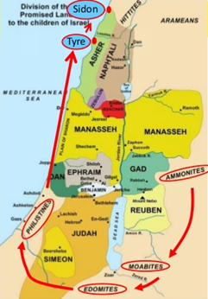
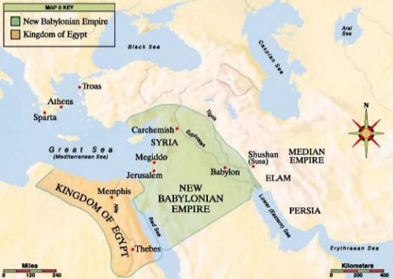
Oracles Against 7 Nations
Judgment Against Nations (25-28)
Judgment starts in the east and moves in clockwise fashion
Steeped in idolatry, happy for Israel’s downfall
Nations:
Ammon (25:1-7)
Moab (25:8-11)
Edom (25:12-14)
Philistia (25:15-17)
Tyre (26:1 – 28:19)
Sidon (28:20-26)
Judgment Against Egypt (29-32)
Notes:
1 Pet 4:17 – “For it is time for judgment to begin with the household of God; and if it begins with us first, what will be the outcome for those who do not obey the gospel of God?”
These are the kinds of chapters that people typically skip over when reading in the prophets because they refer other nations besides Israel. Yet these serve a purpose in Ezekiel as they do in every other prophet. These are 7 oracles to foreign powers that surround God’s people and are spoken, geographically, in a clockwise direction and then ultimately coming down to Egypt. Each of these oracles are oracles of doom for these 7 empires and each oracles is specifically spoken to these nations relative to what has occurred to Judah during the days of Ezekiel.
Ezek 24 was when God tells Ezekiel that the siege against Jerusalem had begun. This chapter is the climax. You’d expect chapter 25 to then maybe talk about the rest of the siege or the end of the siege. Instead, there is a break in that the focus is taken off Jerusalem and focused on these other nations. But rather than these oracles being intended to create repentance among the people, as was the case with Jerusalem and what Jonah did with Assyria, these oracles are instead intended to predict complete, utter judgment and destruction. Though the subject matter is to other nations, the oracles are giving to God’s people. And Ezekiel is in captivity preaching these oracles to the other captives.
Therefore, I suggest that the purpose of these oracles was:
To ensure the Jews that God’s judgment is not partial (He isn’t just picking on them).
To remind the Jews that the way of life of these pagan nations, which the Jews spent so much of their history envying, duplicating, and seeking after, is not going to lead to anything good for them.
To pave the way for the seed promise given to Abraham, Isaac, and Jacob; that Abrahams seed could truly become a blessing to all nations by purging these nations of their sin.
To show that though God used the Babylonians to judge Judah, that did not make the god of the Babylonians stronger. The judgment upon these foreign nations proves that God is the one true powerful God despite His punishment upon His people. The judgments against these nations would refute their false claims about Jehovah.

Slide 2
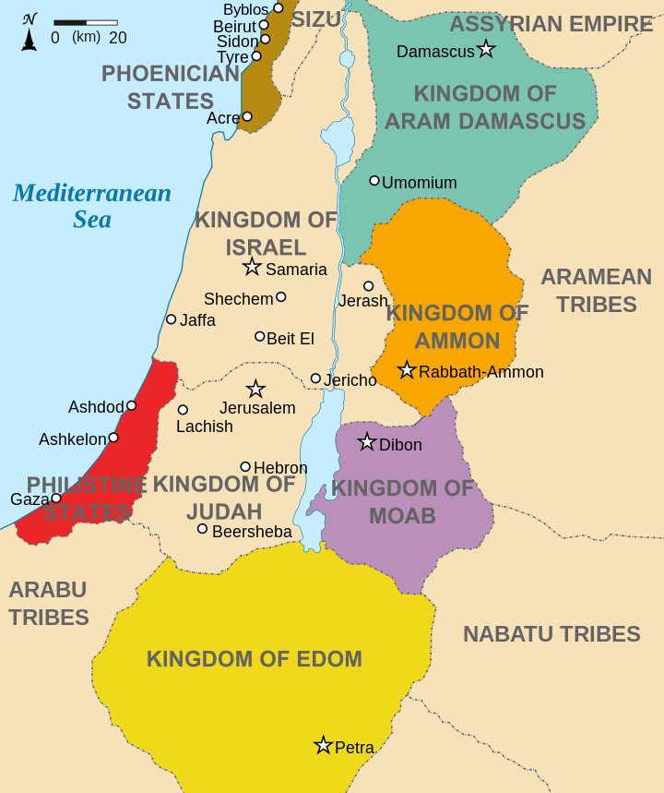
Ammon
Descended from Ben-Ammi, son of Lot and his second-born
Rocky history with Israel, though related
Ezekiel rebukes them for rejoicing over Jerusalem’s downfall
Their punishment would also come at the hands of Babylon
Notes:
Following the destruction of Sodom and Gomorrah, Lot’s youngest daughter got her father drunk and committed incest with him which resulted in the child “Ben-Ammi”. Hundreds of years later this man would become the father of the Ammonite nation. Deut 2:19-21 tells us that Ammon was living in the land formerly occupied by the Rephaim whom the Ammonites destroyed. Israel was not allowed to depose them because God had given them that land for the sake of Lot. The capital of Ammon was called Rabbah, but prior to the Exodus they were driven further west by the Amorites led by King Sihon (Num 21:21-31).
Despite being “cousins” and God forbidding Israel from taking Ammonite land, the Ammonites are antagonistic toward Israel throughout its history. While traveling to Canaan’s land, Ammon refused to allow Israel to pass through their land and would eventually align themselves with Eglon of Moab in attacking Israel. During the time of Jephthah, the Ammonites occupied land eats of the Jordan and even started to invade Israelite territory west of the river. Jephthah led Israel in victory against this threat in Judg 11. In 1 Sam 11, the Ammonite King Nahash invaded Jabesh-Gilead and enslaved some Israelites and threatened to gouge out the right eyes of its inhabitants. This was the impetus for King Saul’s first victory as King when he united the Israelites in victory against Ammon. David further conquered their king at their capital city and enacted a fierce judgment against its people (2 Sam 12:26-31). Despite this victory, the Ammonites displayed a better spirit toward David when he was a fugitive on the run from Absalom when they provided him and his men food (2 Sam 17:27-29).
When Israel and Judah divided, Ammon came under the control of Jeroboam of the northern kingdom until his wickedness led the kingdom to losing that territory to the Syrians with whom the Ammonites became allies. Later, the Ammonites would form a coalition with the Moabites and the inhabitants of Seir against Jehoshaphat of Judah, but it led to those 3 nations slaughtering one another (2 Chron 20). They would later be subdued and paid tribute to Jotham. There would be a back and forth between Ammon and Assyria until Assyria was destroyed. Ammon would then join forces with the Chaldeans, Moabites, and Arameans to invade Judah during the days of Jehoiakim (2 Kings 24:1-2).
Their cruelty toward Israel is chronicled in Amos 1:13 and their complete destruction is foretold by Jeremiah (Jer 49:1-6), Zechariah (Zech 2:8-9), and Ezek (Ezek 21:28-32). Despite the abundance of wealth produced by Ammonite land, they, gave themselves over to idolatry as Molech and Milcolm, who in turn became a stumbling block to the Jews.
Ezek 25:1-7 – It was during Ezekiel’s day that God rebukes Ammon for celebrating the downfall and destruction of Jerusalem. Rather than feeling sorrow for their relatives, they rejoiced and were glad for its ruin. God’s judgment against Ammon would be the same as it was toward Judah, that is the Chaldeans would conquer them, settle in their land, and eat of its spoil. He would cause the people of Ammon to perish, including its capital, because despite Israel deserving its punishment, it is also a sin to rejoice over the misfortune of another. We are commanded to love our enemies, not to hate them. Like Judah, Ammon would not be let off the hook.

Slide 3
Moab
Descended from Moab, son of Lot and his first-born
Mixed history with Israel, though it permanently soured in during the reign of David
Ezekiel rebukes them for not regarding Judah as special, but like all the other nations
Moab would lose its chief cities to the Babylonians
Notes:
Lot’s oldest daughter would give birth to a son by the name of “Moab”. This man would become the father of the Moabite nation. Deut 2:8-11 tells us that Moab eventually settled in the land formerly occupied by the Emim, whom the Moabites destroyed, in the rich highlands on the eastern side of the Dead Sea and would be known as the Plains of Moab. Prior to the Israelites conquering Canaan, God would not allow Israel to depose the Moabites because God had given them that land for the sake of Lot. The capital of Moab was called Dibon.
As Israel approached Canaan, the King of Moab, Balak, feared Israel would do to them what Israel had done to the Amorites and tried to convince Balaam to curse Israel, though he was forbidden to do so by God. However, the Moabite women were able to seduce some Israelite men which led to a plague by God against Israel (Num 25) as well as God disallowing them to enter the Israelites assemblies (Deut 23:3-6). Moses would die and be buried in Moab where they Israelites would spend 30 days mourning him prior to the conquest of Canaan.
After he conquest of Canaan, the Moabites relationship with Israel was mixed, in there would be times of peace as well as times of war. The idolatry of the Moabites was a frequent stumbling block to the Jews as they worshipped Chemosh and Baalpeor. Ruth was a Moabite and the husband of an Israelite Boaz which made her the grandfather of David. However, it was also during the days of the judges that God allowed Moab to defeat and enslave Israel under the leadership of their king Eglon. But when Israel repented, the Judge, Ehud, killed Eglon and took back Israelite land from Moab. When David was later on the run from King Saul, he committed his parents to the care of the King of Moab, most likely due to the fact that he was of Moabite blood, but this would be the last time we read of friendly relations between the two nations. David would later subdue the Moabites (2 Sam 8:2, 12), as would Jehoram of Israel and Jehoshaphat of Judah (2 Kings 3:4-27) and Jeroboam II (2 Kings 14:25). When Jehoiakim stopped paying tribute to Babylon, Moab was one of the nations Nebuchadnezzar sent to raid Israel (2 Kings 24:2).
Ezek 25:8-11 – God’s specific rebuke to Moab through Ezekiel is that despite God’s judgment against Judah, they did not regard Judah as holy, but like all the other nations. Therefore, God would deprive Moab of its best cities and give them into the hands of Babylon. Like Judah, Moab would eventually know who is Lord of heaven and earth.

Slide 4
Edom
Descended from Esau, son of Isaac and Rebekah, brother of Jacob
Struggle between Edom and Israel began in the womb
Edom was frequently jealous of Israel’s success
Ezekiel rebukes Edom for its vengeance against Israel
Notes:
The history of Edom began in the womb of Rebekah in a struggle between the twins Esau and Jacob and this struggle between the two nations would last up until the time when Edom would be destroyed. Despite Jacob’s own personal weaknesses, Esau despised his birthright as firstborn son to such a degree that he was willing to sell it to Jacob (Gen 25:29-34). Though other conflict would arise between Jacob and Esau in their youth, the brothers themselves held no enmity toward one another as individuals for their remaining days, even burying their father Isaac together in their old age (Gen 35:29). After Esau died, God would bless Esau as a nation for their sake of His father Isaac, though Esau would not inherit the blessing. This nation would later be known as Edom (red) or Idumea (land of Edom) or Seir (named after Mt. Seir).
Edom was a wild a rugged region with fruitful valleys which extended from the head of the Gulf of Akabah to the foot of the Dead Sea. It’s capital was Bozrah and the earliest inhabitants were the Horites who Edom destroyed and took their place, just as God did for the Israelites in Canaan. (Deut 2:12). However, when Israel asked permission from Edom to pass through their land, they were refused by the king and had to take a detour because of the king’s show of force. But God ordered Israel not to attack Edom and the king of Edom did not attack the Israelites even though they prepared for resistance (Num 20:14-21).
Even after Israel occupied Canaan, Edom would maintain an attitude of hostility toward Israel. But Edom would be conquered by David (2 Sam 8:14). Amaziah (2 Chron 25:11-12) but would later regain their independence, and in later years, make war with Israel during the decline of the Jewish kingdom. It was during the time of Nebuchadnezzar that Edom would join forces with the Chaldeans in the invasion, capture, and plundering of Jerusalem. The Edomites helped slaughter the Judeans and for this were vehemently denounced by the prophets.
Ezek 25:12-14 – God’s specific rebuke to Edom is in their invasion and plunder of Judah, they acted in vengeance. They did not show Israel the familial love that should have naturally resulted from two nations so closely related. They were instead glad to see Israel fall anytime God was judging them. This “avenging” on the part of Edom would not go unjudged by God. Like Israel, Edom would eventually be defeated by the very Chaldeans they were at one time in league with. The present desolate condition of Edom is a standing testimony to the inspiration of these prophecies. After an existence as a people for above seventeen hundred years, they have utterly disappeared and their language is forgotten.

Slide 5
Philistia
Descendants unknown, but existed as early as the days of Abraham
Fertile and well protected area incumbent to military, commercial, and economical success
In frequent battles with Israel during the Judges and kingships of Saul and David
Ezekiel rebukes Philistia for its great vengeance and scorn against Israel
Notes:
Philistia was a Pentapolis nation from the southwest Levant region, comprising Ashkelon, Ashdod, Ekron, Gath, and Gaza (modern day Palestine). It was a coastal plain that ran about 40 miles along the Mediterranean between Gerar and Joppa. They frequently ruled large parts of southern Canaan as they were a fierce military force in constant conflict with the neighboring nations of Egypt, Israel, and Canaan. It was a very secure territory with the sea on one end and rising elevations on the other that protected its towns and strongholds. Along with the extreme richness of its soil, it provided many commercial opportunities as a great thoroughfare between Phoenicia and Syria in the north and Egypt and Arabia in the south.
While the origin of the Philistine people is never expressed in scripture, they appear to have existed long before Israel as early as the days of Abraham (Gen 21:32, 34; 26:1, 8). While its portion of land would later be assigned to Judah during the days of Joshua, no part of it was conquered during Joshua’s lifetime (Josh 13:2). However, 3 of its 5 cities would be occupied during the times of the Judges (Judg 1:18) and the later recovered by the Philistines who then turned very aggressive toward Israel. Wars between the two nations existed with Shamgar (Judg 3:31), Samson (Judg 13 – 16), but neither of these men couldn’t permanently put Philistia under Israel’s yoke. Only during he days of Saul and David would the pendulum swing back toward Israel and Philistia would become subdued. Philistia was later included in Solomon’s empire but would join forces with the Syrians and Assyrians during Hezekiah’s reign to defeat Israel, which it would lose. This marked the turning point of the Philistine empire as it would never reach any degree of dominance as a nation, frequently finding its land used by other great kings in their conquests.
Ezek 25:15-17 – During Ezekiel’s day, it appears the old hatred Philistia had toward Israel reared its ugly head around the time of the Babylonian captivity though some of this hatred was abated after the return from exile when some of the Jews married Philistine women. Ezekiel, though, calls attention to the great, excessive wrath that they felt toward Israel. This attitude would be their undoing as God promises to eventually wipe out the remnant of the Philistines that lived on the coast.

Slide 6
Tyre
Israel & Tyre enjoyed friendly relations
Helped build David and Solomon’s palace as well as the temple
God rebukes Tyre as follows:
They exulted over Judah’s fall
Her wealth got to her head
Her security gave her false hope
Her wisdom puffed her up
Nebuchadnezzar would also besiege Tyre
Notes:
The bible mentions Tyra for the first time in Josh 19:29 as a boundary to the tribe of Asher and a fortified city of the nation of Phoenicia. However, no additional details are given about it until 2 Sam 5:11 when its king, Hiram, formed an alliance with David by sending him wood and workers for David’s palace. This alliance with Israel was strengthened in the days of Solomon when Hiram sent him materials for the building of the temple. Solomon and Hiram’s partnerships led to trade routes on both land and sea that contributed to the great wealth of both nations. However, Solomon’s payment to Hiram in the form of 20 cities in Galilee was displeasing to him as Hiram considered them worthless (1 Kings 9:10-14). However, Israel and Tyre remained on friendly terms even after the kingdom divided. However, Joel and Amos rebukes them for selling Israelites to the Greeks and Edomites as slaves (Joel 3:4-8; Amos 1:9-10). Tyre remained strong even after Shalmanesar took the city of Samaria including successfully resisting Assyria’s siege. Overall, it was a strong, wealthy nation with strong fortifications and kings.
Ezek 26:1–28:19 – Ezekiel’s rebuke of Tyra in these 3 chapters are some of the most detailed, prophetically fulfilled text of any nation of antiquity next to Rome and Athens. Ezekiel’s reasons for its rebuke is as follows:
First, when Nebuchadnezzar successfully invaded Judah, it would seem natural for Tyre to feel alarm and terror. Instead, they exulted over Judah’s destruction which is inconsistent with the friendly relations the two nations typically enjoyed. It is possible that when Josiah reformed Judah and by destroying all of the foreign idols and alters in the land that some of these idols were objects of Tyrian worship. And so when Jerusalem’s temple was destroyed, it is very conceivable that Tyre viewed this as payback.
Second, Tyre was so wealthy that it allowed its wealth to get to her head. The fall of Judah would no doubt open up more trade routes and strengthen its commercial trade. Tyre’s materialism blinded it to the more important matters of justice and righteousness and therefore God would bring Nebuchadnezzar against Tyre to besiege, plunder, and kill its citizens of the mainland with the sword.
Third, Tyre was so well fortified both on the mainland as well as on an island off the mainland, its head was swelled with pride that no nation could conquer it. God assures Tyre that He will make it a bare rock. That this could happen to a city as strong as Tyre would lead other nations to wail and lament and consider it own fragility before God’s hand.
Fourth, Tyre was puffed up in its wisdom. It believed its wisdom to be on the level of God Himself. It appears Ezekiel acknowledges in chapter 28 that it had been greatly blessed by God., but that this great blessing allowed Tyre’s heart to be too lifted up. God would bring them down because of its iniquity.
Nebuchadnezzar was not able to completely destroy Tyre, but Alexander the Great was able to build a land bridge from the mainland to the island and take it down – he would be the first to do so.

Slide 7
Sidon
20 miles north of Tyre
Home of Jezebel
God’s judgment:
He will be glorified in her midst
They will know He is the Lord
He will reveal His holiness there
He will send sword and pestilence
But, Israel will be regathered
Notes:
Sidon was a famous city of Phoenicia on the Mediterranean Sea about 20 miles north of Tyre. It is believed to be founded by Zidon, son of Canaan (Gen 10:15) and was mentioned very early on in Gen 49:13 as being a future border to the nation of Zebulun, though it would eventually fall to the Lot Asher. Like Tyre, Sidon was famous for trade and commerce and were a very wealthy nation. Ahab married Jezebel who was the daughter of the King of Sidon, Ethbaal, who was a fervent Baal worshipper. But despite this reputation, many inhabitants of Sidon would become followers of Jesus (Mark 3:8; Luke 6:17) and the gospel would be proclaimed to the citizens of Sidon soon after the death of Stephen in Acts 11:19. There would eventually be at least one church there that Paul would visit in Acts 27:3.
Ezek 28:20-24 – Ezekiel’s rebuke to Sidon is not very specific. It is merely mentioned that God would be glorified in her midst and that He would execute judgments in her midst that He would manifest His holiness in her. Therefore, it appears that like all the other nations Sidon glorified over the destruction of Judah and would have no doubt believed that their gods were stronger than Jehovah. God would prove otherwise by visiting destruction upon Sidon, pestilence and the sword. Sidon would be reduced to no more than a prickling briar.
Ezek 28:25-26 – In contrast to the complete judgment of these nations, God has every intention of returning His people, Israel, to their land and allowing them to dwell their securely. In there land, they will know the Lord better than they ever had before.

Slide 8
Egypt
Israel & Judah have a long, complicated history
A constant source of temptation
God will bring Egypt low because:
She is prideful
She interfered with His judgment against Judah
In her splendor, she did not seek God
She had an inadequate view of herself
Notes:
That 4 chapters of Ezekiel is dedicated to the judgment against Egypt should not surprise us when you consider the history that existed between the two nations from the time of Joseph until now. Though God used Egypt during the time between Joseph and Moses to shelter and grow the people to becoming a nation, Egypt was a constant thorn in their side. They enslaved Israel physically and were a constant temptation both for their idols and military.
Ezek 29 – God first rebukes Egypt because they prided themselves over what they had. Pharaoh believed himself to be a self-made man and forgot that God was the one who gave Egypt all of its luxury. Because of Egypt’s pride, God would force them out of Egypt for a period of 40 years (likely symbolic). He would then return them to their land but they would not be the mighty nation they once were, but rather the basest of the kingdoms. After Nebuchadnezzar finishes his siege against Tyre, Egypt will feel the wrath of Babylon when God would hand Egypt’s wealth to Nebuchadnezzar as a reward for acting on His behalf.
Ezek 30 – Not only will Egypt be judged by Nebuchadnezzar, but God would also punish any nation who cast their lot with Egypt to help her or join in her wickedness. No place in the land of Egypt would escape the wrath of the Babylonians, and a list of names is given. Vs. 20 – 26 appears to refer to Pharaoh Hophra’s failed attempt to aid Judah during Nebuchadnezzar’s siege. God did not appreciate Egypt’s futile attempt to keep God from judging Judah as He intended. History tells us that Egypt was also distracted at this time with Libya as well as civil war throughout its region. Nebuchadnezzar would later follow the siege of Judah by overwhelming the Egyptians.
Ezek 31 – Egypt is compared to a great cedar tree like Assyria had been as a world empire before its fall. Despite its splendor and magnificence, though, it would fall. There is no security or high-mindedness that can escape the judgment of God once He has His eyes set on punishment. Egypt, though a world empire of its own, would be different in that it would fall just as Assyria before it. And so Egypt too would be scattered amongst the nations because of its pride and it will be hard for the surrounding nations to even believe that it has happened.
Ezek 32 – While Egypt fancied itself as a lion, God viewed her as a crocodile. And so Egypt’s potential would never be realized as God would scatter her flesh. When the surrounding nations see what has resulted, they will be concerned that Babylon will come after them next.

