Slide 1
Notes:
Isa 8:9-10 – “Be broken, O peoples, and be shattered; and give ear, all remote places of the earth. Gird yourselves, yet be shattered; gird yourselves, yet be shattered. Devise a plan, but it will be thwarted; state a proposal, but it will not stand, for God is with us.” This was spoken as a part of Isaiah’s warning to Israel and Syria that their plans to take Judah down would not work – “God is with us”. Instead, they’d be the ones to be broken and shattered. But notice in vs. 9 who needs to heed this message: “all remote places of the earth”. Isaiah loves to drop hints of upcoming themes, and this statement is a tease to chapters 13 – 27, God’s world vision of the Messianic kingdom.
The idea is this: chapters 6 – 12 describe how God would ultimately save His people, despite their sin, by allowing a remnant to escape the coming Assyrian flood, ultimately fulfilled in the reign of the branch of David on Mount Zion. But this was not a “one and done” situation. As we were reminded in chapter 10, God is sovereign, and that means the fate of Israel, Syria, and Assyria will be the fate of any and all nations who attempt to pick a fight w/Zion outside of God’s sovereign will. This is the overall the theme of chapters 13 – 27, taking the main points of chapters 6 – 12, and expanding them to a broader worldview, to include other individual nations within Judah’s sphere of influence.
So, if these chapters are addressed to other nations, what might Judah get out of it? It is foolish to trust in these nations for assistance against looming threats, and for 2 reasons. 1) these nations are doom; it is already sealed. 2) after their judgment, they will be rallying to Zion to learn more about the one true God. This is a consistent theme of chapters 13 – 27.

Slide 2
Notes:
Chapters 13 – 27 that can be divided up into 3 cycles of oracles. The first 2 cycles are given to specific nations, though 4 of the 5 in the 2nd cycle are given enigmatic titles, but the 3rd cycle is more general in nature.
The first cycle, 13 – 19, declares the certainty that God holds the fate of the world in His hands and that His promises will be fulfilled, and we can bank on it.
Chapter 20 functions as an intermission designed to provide somewhat immediate grounds for trusting God’s promises, through Isaiah’s performing of a sign.
The second cycle, 21 – 23, is a complete contrast from the first in the sense that it reveals more uncertainty in the midst of a coming darkness in which the result cannot be determined. So, the idea would be that for those who passed the tests of faith from chapters 6 – 12 and chapters 13 – 20, this next cycle in chapters 21 - 23 will be a new challenge. When things seem really dark, will I still trust God?
The third cycle, 24 – 27, is not specific to any one nation. It is a continuous literary unit that contrasts the “world city” w/the city of God (Zion). It includes all the themes of the previous two cycles of oracles, but hones in on God’s grand strategy.
Now, in chapters 6 – 12, God proved His faithfulness to His people in many different ways, but by expanding these points to a broader worldview, it would challenge those in the present who lacked faith, because if they can’t come to see God’s sovereign power in the present, w/all the accompanying prophecies and signs, how would they ever trust Him regarding these more obscure promises?
A couple things to keep an eye on as we study these oracles. Isaiah will start by addressing a specific nation. But then he’ll often change course and say, “What I’m saying to/about this nation, this applies to the entire world”, and I’ll point those out as we arrive, but these are important to recognize.
Most of these oracles are pretty straight forward, but there are 2 or 3 that are very obscure and difficult to interpret. There will be a lot of speculating and reading between the lines and I’ll do my best to tell you what I think is being said in light of the times, but will help you to read the chapters several times beforehand to ensure you’re familiar w/them.
Also, the way I have this chart laid out is not random. Not only can these chapters be divided up into these 3 vertical themes, but also 5 horizontal themes, and I purposely left out the themes in order to challenge you to look for them yourself as you read these chapters. Meaning, there are repeated themes in chapter 13-14 with 21 and 24, the Philistia and Edom oracles have themes in common with the end of chapter 24, etc. Once we get to chapter 21, start looking for similarities between these chapters horizontally, and I’ll remove the veil officially once we complete chapter 27.

Slide 3
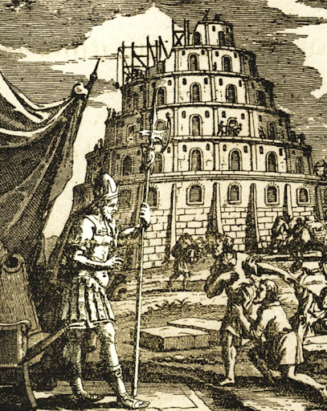
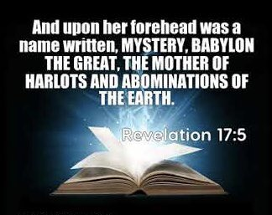
Babylon
Notes:
If history teaches us anything, it is when one superpower goes down, another rises to fill the void. Once Assyria goes down in 609BC, Babylon is that superpower, and they are the subject of chapters 13 – 14. Babylon would become an even bigger threat to God’s people than Assyria. What is so interesting about this is that while Babylon was a significant nation in Isaiah’s day, they were nowhere near as powerful as Assyria at that time, though they are being a pain in the neck to Assyria. But God, who knows the end of all things, He knew what they’d become. Yet Isaiah skips right over their rise to power to assuring is of their coming supremacy, and then focusing the entirety of the oracle on their inevitable judgment. These 2 chapters have caused some confusion for bible students because while it most definitely focuses on literal Babylon’s future fall, Isaiah will then go from speaking to literal Babylon to a more general worldview as if to suggest that while Babylon is the literal nation in mind, her ideologies are a figure of other nations and worldviews to come. And we do know that nations copied certain Babylonian ideologies, particularly its pagan practices, and the NT uses Babylon as a figure:
Rev 14:8 – “Fallen, fallen is Babylon the great, she who has made all the nations drink of the wine of the passion of her immorality.”
Rev 17:5 – “and on her forehead a name was written, a mystery, ‘BABYLON THE GREAT, THE MOTHER OF HARLOTS AND OF THE ABOMINATIONS OF THE EARTH.’” Even Peter said in 1 Pet 5:13 that he was writing this epistle from Babylon. But by the time of Peter and John’s writings, Babylon was nothing but a desert. It’s most likely Peter was in Rome, which I believe is what Revelation is probably referring to. So how do we navigate these chapters when sometimes it seems like Babylon is being referred to, and other times the entire world? Well, think of it like the 7 churches of Revelation. While those were specific issues for specific churches, they were intended to represent issues that all churches would struggle with. Though these oracles are to specific nations, these nations represented worldviews, that all the world needs to heed these messages, before all nations stream to Zion.

Slide 4
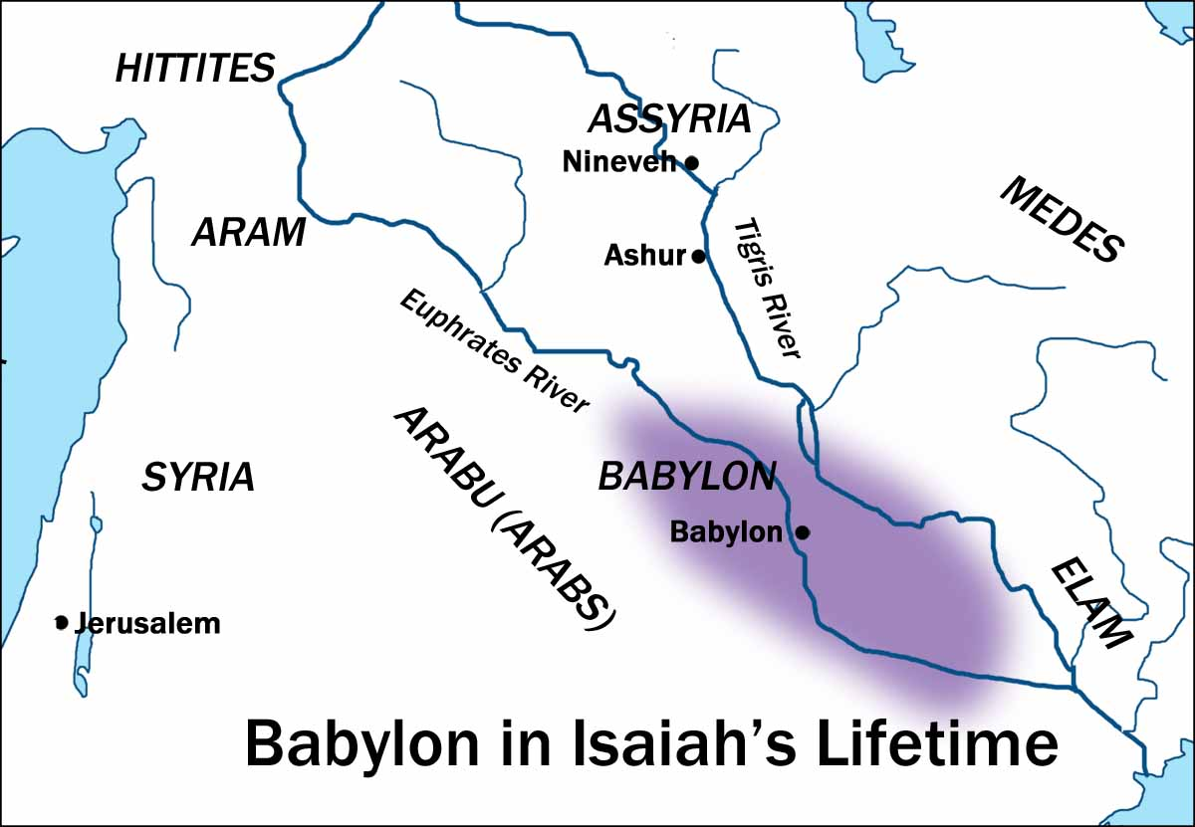
Babylon
God sends an army
Isa 13:1-5 – “¹The oracle concerning Babylon which Isaiah the son of Amoz saw. ²Lift up a standard on the bare hill, raise your voice to them, wave the hand that they may enter the doors of the nobles. ³I have commanded My consecrated ones, I have even called My mighty warriors, My proudly exulting ones, to execute My anger. ⁴A sound of tumult on the mountains, like that of many people! A sound of the uproar of kingdoms, of nations gathered together! The Lord of hosts is mustering the army for battle. ⁵They are coming from a far country, from the farthest horizons, the Lord and His instruments of indignation, to destroy the whole land.”
Oracle
Lift a standard
“Consecrated”
Instrument (10:5)
Notes:
Isa 13:1 – “Oracle/burden” is a heavy message of importance that weighty in sorrow and grief. What is the oracle to Babylon regarding?
Isa 13:2-5 – Isaiah loves using signal imagery. In 5:26, he used it as a way to call Assyria to judge Judah. In 11:10, he identified the root of Jesse as the One who’d summon the remnant of His people back to Zion. Ancient armies communicated by raising flags on hills that could easily be seen (bare hill) from far away places, distinct shouts that could be heard when closer, and hand gestures that signal certain actions to take place when available. And though we don’t find this out until vs. 17, the nation God is summoning to conquer Babylon are the Medes; they are summoned by God to enter the houses and gates of Babylonian nobles to overthrow them and take possession of the city.
Vs. 3 says they have been “consecrated” for this purpose, and we’re going to see this language used specifically of Cyrus when we get to chapter 45, but this is not in a religious sense. In fact, God affirms their arrogance. But despite their arrogance, He’s setting them apart to do His will, and that’s really the idea behind consecrated.
In fact, in vs. 5, He refers to them in the same way that He referred to Assyria in 10:5, as an instrument of indignation to destroy their whole land.

Slide 5
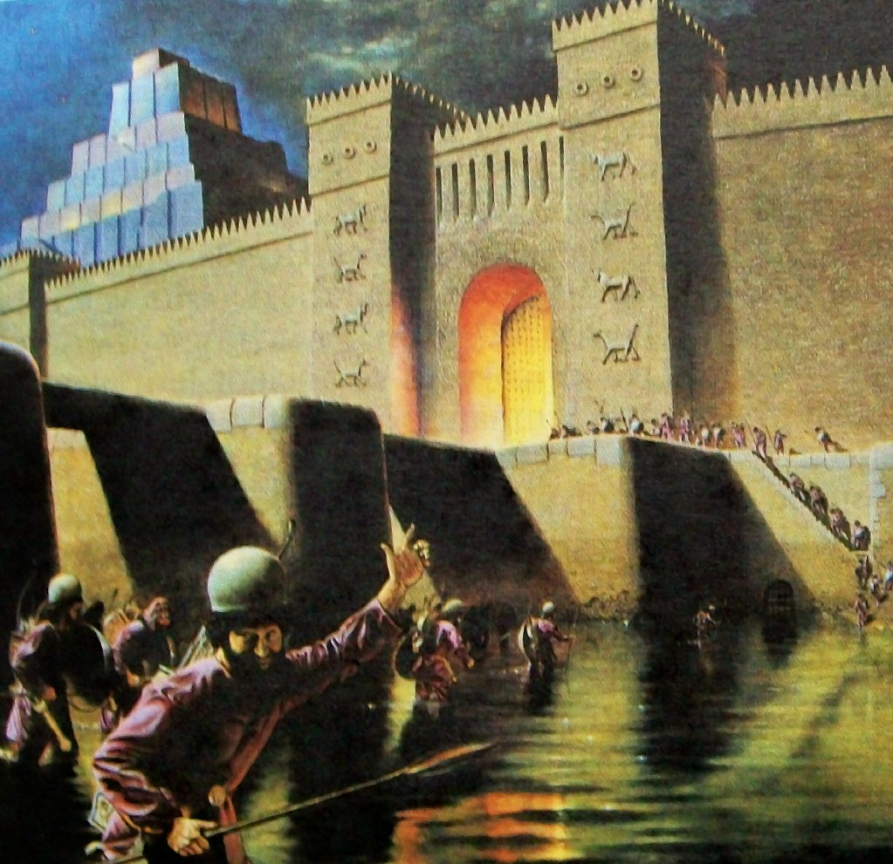
Babylon
Babylon’s response
Isa 13:6-8 – “⁶Wail, for the day of the Lord is near! It will come as destruction from the Almighty. ⁷Therefore all hands will fall limp, and every man’s heart will melt. ⁸They will be terrified, pains and anguish will take hold of them; they will writhe like a woman in labor, they will look at one another in astonishment, their faces aflame.”
Notes:
Isa 13:6-8 – “Wail” means “howling”. The oriental culture was much more expressive in their emotions than us westerners. “The day of the Lord” means fierce judgment, and it is near. We’ll talk more about what that means when we get to vs. 9.
Vs. 7 speaks of helplessness. Hands and heart are symbols of personal action and reflection, both the outer and inner. Meaning, Babylon won’t be able to act or plan. The hands will hang down, weapons falling, helpless to resist the enemy, and courage will vanish from the heart – they’ll have no nerve left.
In vs. 8, we learn that Babylon’s citizens were shocked to learn that their city had fallen. The phrase “faces aflame” literally means faces red w/embarrassment, shame, and indecision. Why embarrassment? Because no one within the walls of Babylon thought they could be taken. Yet history reveals that when Cyrus invaded Babylon, he did so by diverting the Euphrates River so that the moates it fed surrounding the city walls sunk to such a depth that the Medes could sneak in under the gates at night. They assassinated Babylon’s King and most of the government officials. It’s said that the commoners living in the city didn’t even find out the Medes had taken over for 3 weeks. So why are they so embarrassed? Because they finally come to realize that all the physical things they placed so much security in was all for not. That’s how the day of the Lord is – 1 Thes 5:2-3 – “For you yourselves know full well that the day of the Lord will come just like a thief in the night. While they are saying, ‘Peace and safety!’ then destruction will come upon them suddenly like labor pains upon a woman with child, and they will not escape.”

Slide 6
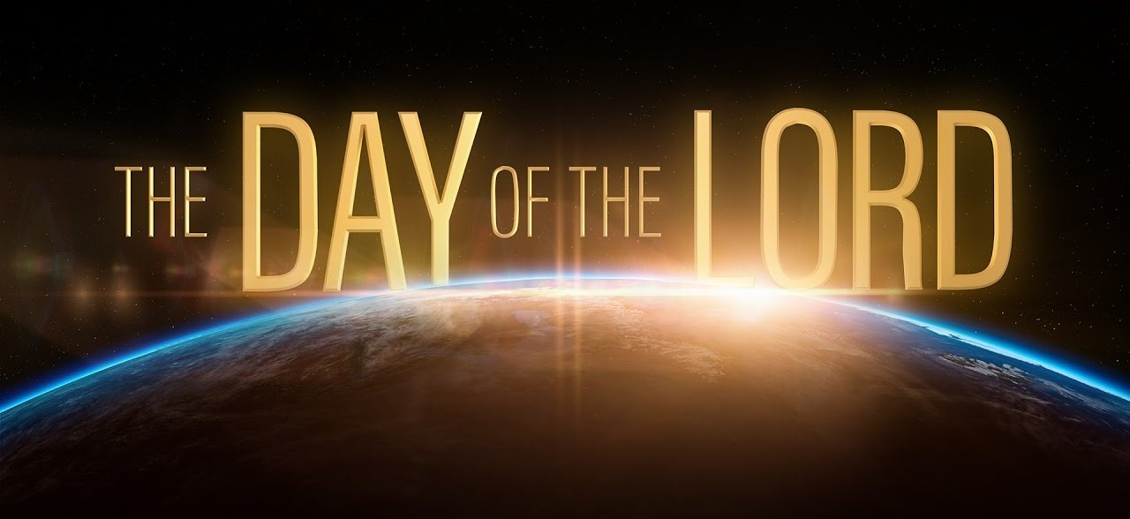
Babylon
Creation’s response
Isa 13:9-12 – “⁹Behold, the day of the Lord is coming, cruel, with fury and burning anger, to make the land a desolation; and He will exterminate its sinners from it. ¹⁰For the stars of heaven and their constellations will not flash forth their light; the sun will be dark when it rises and the moon will not shed its light. ¹¹Thus I will punish the world for its evil and the wicked for their iniquity; I will also put an end to the arrogance of the proud and abase the haughtiness of the ruthless. ¹²I will make mortal man scarcer than pure gold and mankind than the gold of Ophir.”
Possible Interpretations
“World coming apart”
Creation mourning
No creation benefits
“Decreation”
Notes:
Isa 13:9-10 – Vs. 10 is language that is often used to describe the day of the Lord. What does it mean? One thing that helps is to think of “the day of the Lord” not as a “when”, but as a “what”, because this verse is quoted by Jesus in Matt 24:29 and He is referring there to Jerusalem. This is not a specific event, it is not a “when”, it is a “what”. There are a few possible interpretations:
1) It could be as simple as the fact that judgments of this caliber make it seem like the whole world is falling apart.
2) It could be a poetic way of saying that even Creation itself responds mournfully to God’s judgments. We do see this language in Rom 8:20 where we’re told the whole creation was subjected to futility and that it groans and suffers, eagerly awaiting the day.
3) It could be a denial to sinners of the benefits creation brings for having corrupted it. Evil loves darkness so maybe God is saying, “You want darkness? You got it!”
4) But the likely interpretation is that Isaiah is describing the dismantling of creation itself – “decreation”. In Gen 1, God turned on the light, but now He’s flipping the switch. Creation = “let there be light” and the Lord populating the earth. Decreation = everything becoming dark and the Lord depopulating the earth, because a desolate, unpopulated land is the exact opposite of God’s will for creation. Evil always flourishes in the dark, but God is light and the celestial objects are merely reflections of His light. So, when God withdraws His blessing from the world, it’s appropriate for the lights to go out, metaphorically speaking.

Slide 7
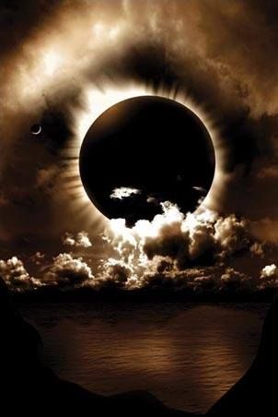
Babylon
Creation’s response
Isa 13:9-12 – “⁹Behold, the day of the Lord is coming, cruel, with fury and burning anger, to make the land a desolation; and He will exterminate its sinners from it. ¹⁰For the stars of heaven and their constellations will not flash forth their light; the sun will be dark when it rises and the moon will not shed its light. ¹¹Thus I will punish the world for its evil and the wicked for their iniquity; I will also put an end to the arrogance of the proud and abase the haughtiness of the ruthless. ¹²I will make mortal man scarcer than pure gold and mankind than the gold of Ophir.”
Notes:
Isa 13:11-12 – This is the first time that the reason for judgment is mentioned. Just like w/Judah and Israel, sinners have corrupted the land and need to be exterminated. But notice in vs. 11 that the prophecy goes beyond literal Babylon to include all the nations, global in scope. Babylon symbolizes nations motivated by pride and a desire to conquer and destroy. So, it is not just physical Babylon that is under judgment. This is against any nation that adopts her worldview, and many nations in the future would, as is evident from Revelation’s use of them as a figure and metaphor.
Vs. 12 indicates that where man was once abundant, He will now be scarce. This again points to a remnant, men being much rarer than a region known for its finest gold. Which means an awfully high price that is more costly than gold is going to have to be paid to redeem them (hint).

Slide 8
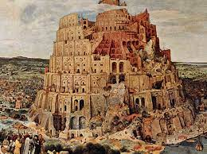
Babylon
Creation’s response
Isa 13:13-16 – “¹³Therefore I will make the heavens tremble, and the earth will be shaken from its place at the fury of the Lord of hosts in the day of His burning anger. ¹⁴And it will be that like a hunted gazelle, or like sheep with none to gather them, they will each turn to his own people, and each one flee to his own land. ¹⁵Anyone who is found will be thrust through, and anyone who is captured will fall by the sword. ¹⁶Their little ones also will be dashed to pieces before their eyes; their houses will be plundered and their wives ravished.”
Notes:
Isa 13:13 – So, similar to what God’s presence was doing in 6:4, the forces of nature are depicted to be in an upheaval due to the coming judgment. This is cosmic and worldwide. All the order brought forth from Creation will be undone in judgment. God is sovereign over all things, including heaven and earth, and humanity’s sin has cosmic implications.
Isa 13:14 – Gazelles are shy and fleet of foot when in danger. Sheep are timid, easily dispersed w/o the shepherd. And so, Babylon has found out, all at once, that they’ve made God their enemy and lost Him as their shepherd. Babylon was made up of many different people, and surely at its height, men would generally look out for its own. Now as they flee, it’s every man for himself.
Isa 13:15-16 – They gained an enemy, lost a Shepherd, and now find there is no escape. Anyone captured was killed by the sword. This is a sad result of war, men becoming heartless and void of compassion. Homes are supposed to be places of safety, but now those who seek it will find it plundered and their loved ones destroyed w/no mercy. There is only so much loot a soldier can carry. Pretty soon, only blood will satisfy him. Brutal language typical of ancient warfare. And while it sounds cruel, Babylon itself had done this to other nations. There was no Geneva Convention in the ancient world.

Slide 9
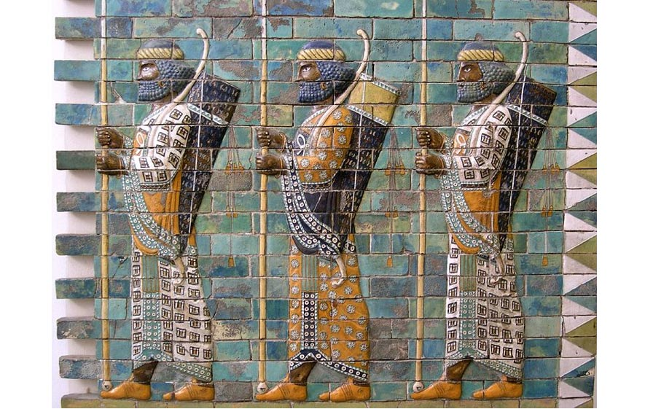
Babylon’s Conqueror
Isa 13:17-18 – “¹⁷Behold, I am going to stir up the Medes against them, who will not value silver or take pleasure in gold. ¹⁸And their bows will mow down the young men, they will not even have compassion on the fruit of the womb, nor will their eye pity children.”
Notes:
Isa 13:17-18 – The army God called in 13:2-5 is finally identified – the Medes, what is now central Iran. Cyrus defeated the Median army in 549BC and united them w/the Persians. And when they took Babylon in 539BC, the citizens received him as a liberator. The city and buildings were left intact, but the Babylonian political and military power were finished. The great cruelty in which they would defeat Babylon was personal – it was all about revenge; that is why they couldn’t be paid off. The Median army would have no compassion or mercy, equaling if not surpassing the ruthless cruelty and heartless Babylonians. Their young, who are the future, would be slaughtered by Median bows, their most reputable weapons.

Slide 10
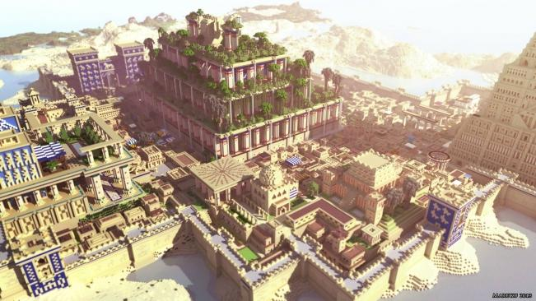
Babylon’s destruction
Isa 13:19-22 – “¹⁹And Babylon, the beauty of kingdoms, the glory of the Chaldeans’ pride, will be as when God overthrew Sodom and Gomorrah. ²⁰It will never be inhabited or lived in from generation to generation; nor will the Arab pitch his tent there, nor will shepherds make their flocks lie down there. ²¹But desert creatures will lie down there, and their houses will be full of owls; ostriches also will live there, and shaggy goats will frolic there. ²²Hyenas will howl in their fortified towers and jackals in their luxurious palaces. Her fateful time also will soon come and her days will not be prolonged.”
Dan 4:30 – “Is this not Babylon the great, which I myself have built as a royal residence by the might of my power and for the glory of my majesty?”
Notes:
Isa 13:19 – What “beauty” of Babylon? The same thing Nebuchadnezzar would have seen when Dan 4:29 says “he was walking on the roof of the royal palace of Babylon.”
He would have seen the golden palace and the huge walls which surround the city, 387ft high and 85 feet wide; they were so wide that 4 chariots could be driven side by side on top of them, all around the city walls The city itself was a perfect square, 15 miles on each side, the most powerful city of antiquity. It boasted wide streets and tons of buildings, populating 1.2 million inhabitants. It was protected by a deep, wide moat filled with water by the mighty Euphrates River which flowed into one side of the city and out the other side. And so, the city was well water, filled with gardens and farmland and palm groves and orchards, that, according to historians, provided enough food to feed the entire city for 20 years in case they were besieged. And in the city were gigantic shrines to the deities, beauty eclipsed only by the marvelous air-conditioned hanging gardens which the king had built to give his wife for a birthday present. And as Nebuchadnezzar looks out upon this magnificent city, he is so overwhelmed and puffed up with pride that his heart explodes into the following words:
Dan 4:30 – “Is this not Babylon the great, which I myself have built as a royal residence by the might of my power and for the glory of my majesty?” And God would have enough of that.
Though this destruction did not come in 539BC when Cyrus conquered it, Darius Hystopsis had to conquer it a 2nd time in 519BC, destroying all but 50 cubits of its wall, and it continued to get chipped away at until in 60BC, it is referred to by the historian Strabo as a desert. The reference to Sodom and Gomorrah suggests not only complete destruction, but also moral cause.

Slide 11
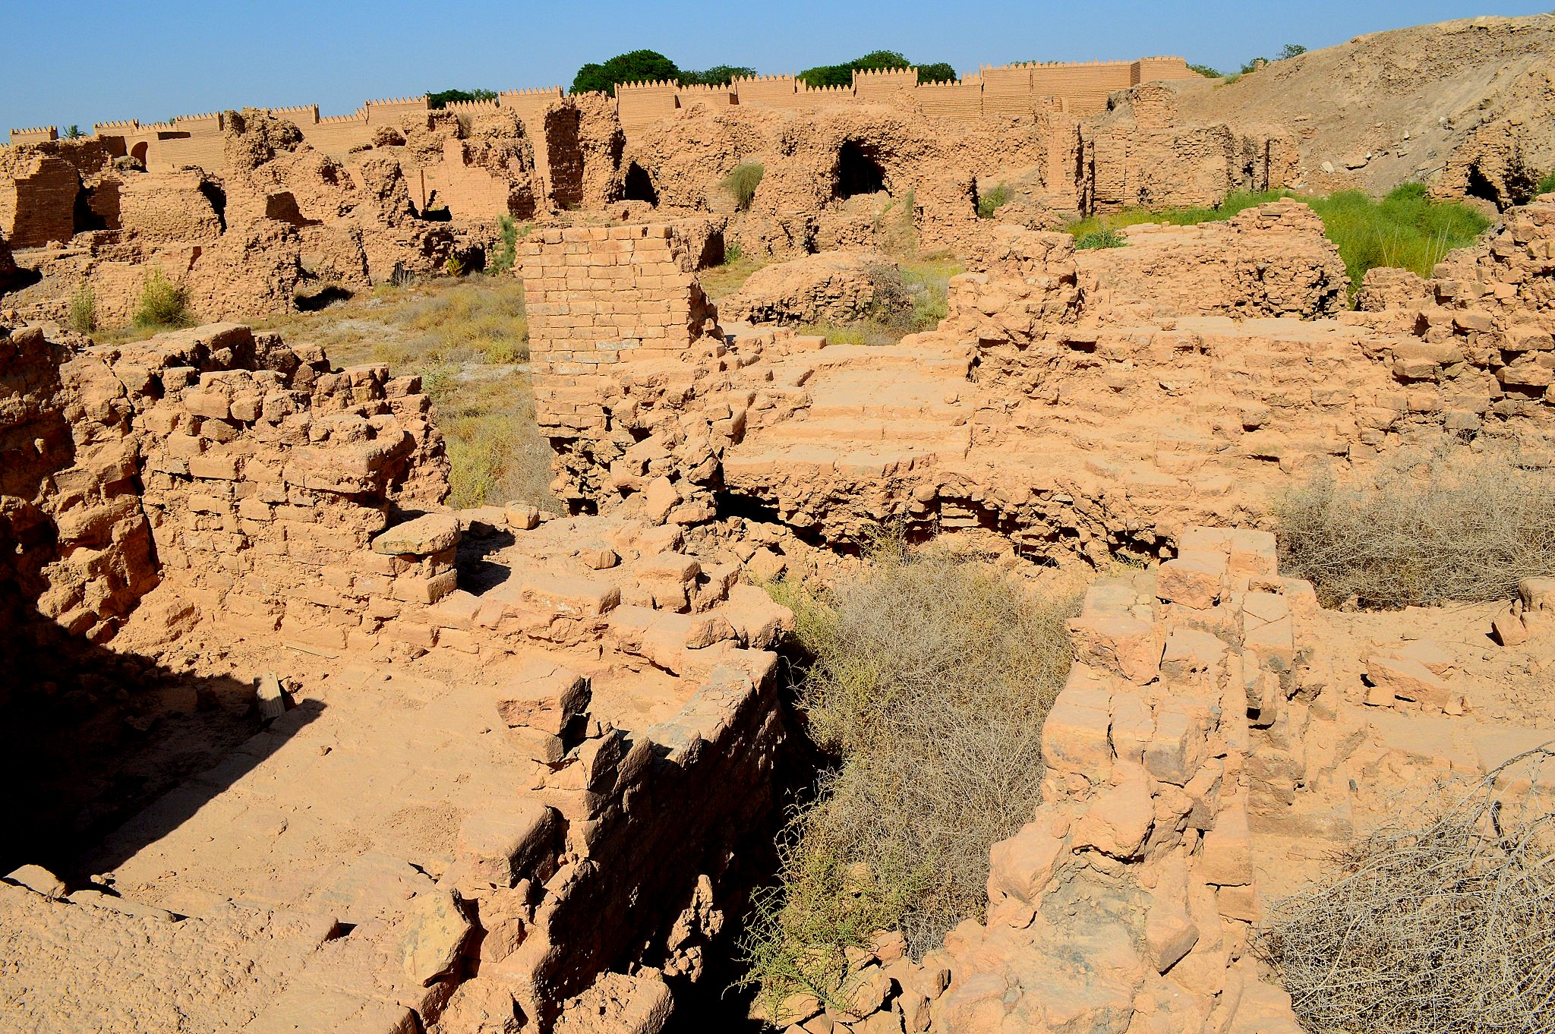
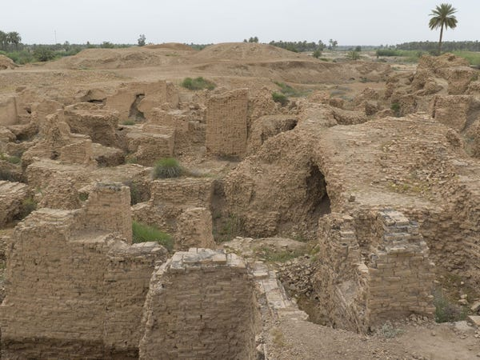
Babylon’s destruction
Isa 13:19-22 – “¹⁹And Babylon, the beauty of kingdoms, the glory of the Chaldeans’ pride, will be as when God overthrew Sodom and Gomorrah. ²⁰It will never be inhabited or lived in from generation to generation; nor will the Arab pitch his tent there, nor will shepherds make their flocks lie down there. ²¹But desert creatures will lie down there, and their houses will be full of owls; ostriches also will live there, and shaggy goats will frolic there. ²²Hyenas will howl in their fortified towers and jackals in their luxurious palaces. Her fateful time also will soon come and her days will not be prolonged.”
Notes:
Isa 13:20-22 – To this day, Babylon has never been rebuilt. Somehow, even the Arabs avoid pitching their tents on those grounds. Not even shepherds will use her for a pasturing place. Can there be a better picture of utter desolation? This is total abandonment, no human population. Every civilization, at some point in time, is brought face to face w/its insufficiency. God’s glory will fill the earth, not man’s. We can learn this the easy way or the hard way. Regarding the animals in vs. 21 and 22, translations struggle – we’re not sure what animals are being referred to. But they are those that inhabit dark and lonely places; scavenger, wild animals that go where nothing is alive. It’s a melancholy picture of wild creatures inhabiting a once spectacular, proud city where there is now nothing but darkness and confusion – this was Babylon’s “day of the Lord.”

Slide 12
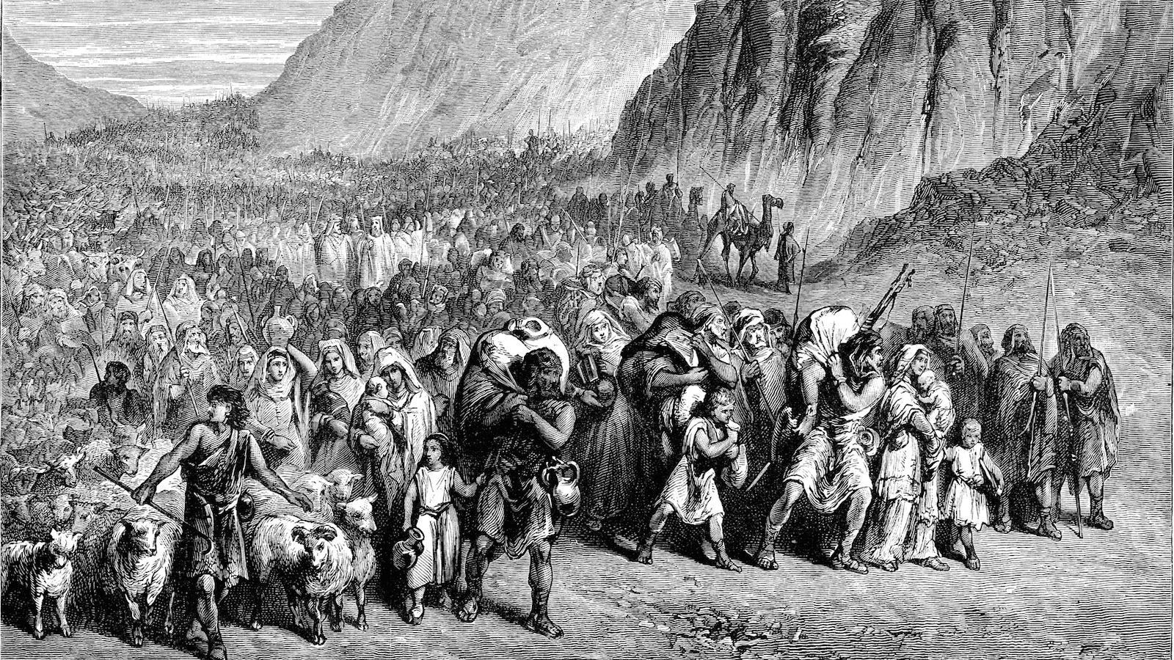
Return From Exile
Isa 14:1-2 – “¹When the Lord will have compassion on Jacob and again choose Israel, and settle them in their own land, then strangers will join them and attach themselves to the house of Jacob. ²The peoples will take them along and bring them to their place, and the house of Israel will possess them as an inheritance in the land of the Lord as male servants and female servants; and they will take their captors captive and will rule over their oppressors.”
Notes:
These 2 verses form the epilogue of chapter 13. Babylon’s destruction would be good news for God’s people – Isa 14:1a – In other words, since Babylon was Israel’s greatest enemy, any judgment on them was an expression of mercy toward His people. This will be the same judgment against anyone that will try to prevent God from bringing to redemption those through whom He intends to bless the world.
Isa 14:1b-2a – The promise of restoration from captivity was a precious promise, and Gentiles were inspired to join the winning team, both in an immediate and long-term future. In the immediate future we read in Esth 8:17 that when Mordecai was promoted to 2nd in the land of Persia and signed an edict allowing the Jews to defend themselves, “many among the peoples of the land became Jews, for the dread of the Jews had fallen on them.” And we also remember from Ex 12:38 that as Israel’s exodus began, a “mixed multitude also went up with them”. But in the long term, this has Messianic connotations, the 2nd exodus that we read about in chapter 11.
Isa 14:2b – This is troubling for some bible students because of the slavery connotations, but it need not be. The role of captor and captive will be reversed. Israel will no longer be dependent on the nations; the nations will be dependent on her. But this subjugation is not carnal, it is spiritual. It is the same teaching as 2:3 in which nations will come to Zion to be taught of her ways – the gospel will capture the Gentiles – Matt 5:5 – “Blessed are the meek, for they shall inherit the earth.” How do the nations become servants to Zion? In many ways, but when famine hit the NT church, it was the Gentile churches laying by in store and sending it by Paul and others to Judea. This is a theme that will be further developed later in chapters 60 – 62.

