Slide 1
Notes:
So far, we’ve seen a disheartened people wondering how God is going to rescue them from their spiritual captivity. God reminds them they are not forgotten, and He’s given us two more Servant Song’s in chapter 49 and 50 to foretell how He will help us. But it appears that the distress of both physical and spiritual captivity that prompted the complains of 40:27 and 49:14 have lulled into complacency and despair, and so Zion needs a wake-up call. God is about to provide them w/the ultimate solution to their despair, and they need a jolt to revive their senses so they can be prepared to receive the message. This is the them behind the section we are calling “Rousing Zion to New Life”. This section can be easily outlined by the words that are repeated for emphasis.

Slide 2
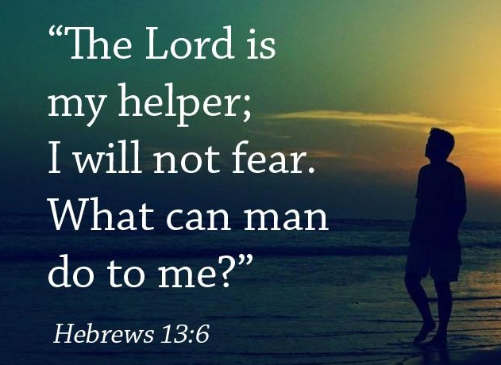
Rousing Zion to New Life
I, even I
Isa 51:12-13 – “¹²I, even I, am He who comforts you. Who are you that you are afraid of man who dies and of the son of man who is made like grass, ¹³that you have forgotten the Lord your Maker, Who stretched out the heavens and laid the foundations of the earth, that you fear continually all day long because of the fury of the oppressor, as he makes ready to destroy? But where is the fury of the oppressor?”
Notes:
Isa 51:12-13 – Yes, the Lord, the one who sent you into captivity and “seems” to be missing, He will comfort you. On what basis? Who He is (eternal) and who they are (transient) (40:7; Heb 13:6; 1 Pet 2:24-25). Repetition also matches their emotional intensity in vs. 9. Also raises question about their identity – who are they that they should fear transient man? “You’re Zion! You’re stronger than this!” Should their lives be ruled by fearing what is only as permanent as their next breath? He’s not some mere national God, but their Maker. Fear of man = forgetting God = foolishness of man. The core of the issue: God has not forgotten us, we’ve forgotten Him. We’re called to live out the reality of our confession. This doesn’t deny the reality of oppression, simply focuses us on the bigger picture. If fear fills my horizon, I’ll be ruled by it. If faith fills my horizon, who’s the oppressor? They no longer hold any power over me. We dare not attribute to man a power he does not possess. You think the Babylon’s are the “be all, end all” of everything? Don’t be afraid of them.

Slide 3
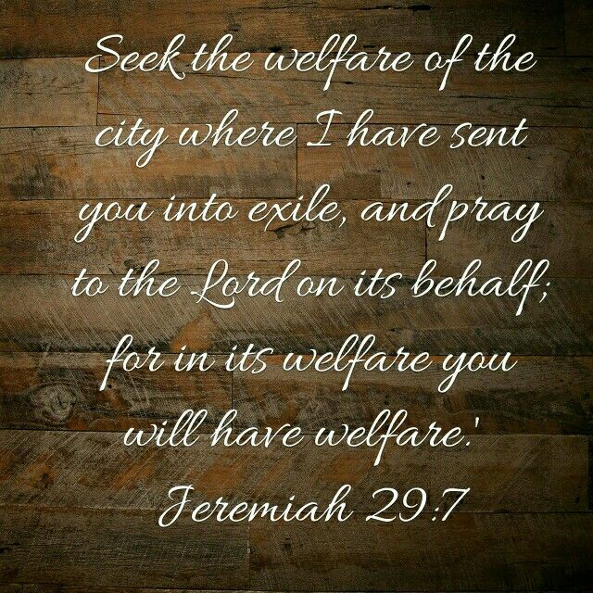
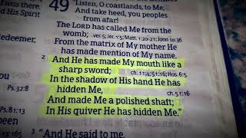
Rousing Zion to New Life
I, even I
Isa 51:14-16 – “¹⁴The exile will soon be set free, and will not die in the dungeon, nor will his bread be lacking. ¹⁵For I am the Lord your God, who stirs up the sea and its waves roar (the Lord of hosts is His name). ¹⁶I have put My words in your mouth and have covered you with the shadow of My hand, to establish the heavens, to found the earth, and to say to Zion, ‘You are My people.’”
Notes:
Isa 51:14-15 – Not physical exile; life was far from oppressive (Jer 29:4-7). Hence, why did so few actually return? Because it became so homelike. Spiritual exile, the greatest bondage of all: self, which alienates and condemns us. The oppressor’s rage will be ineffectual (Rom 8:39). God will provide for their needs (John 6:27, 35). “Why?” – Ex 5:2. Abrupt reminder that He is Lord. No matter how the “sea” rages, it’s a manifestation of His will and power. The earth is the Lord’s; its effects are the result of His causes.
Isa 51:16 – 49:2 – Abrupt change to Servant, as if God is speaking to the sinful people w/the Servant looking on. Deliverance will happen through one whose status goes from onlooker to participant – God with us (7:14). Concealed until fulness of time comes, bridging back to vs. 9 – even the Servant is willing to “wait”! God’s word is in His mouth (Deut 18:18). He will usher in a new order (65:16-17). “Covered you with the shadow of My hand” = Ex 33:17-23.

Slide 4
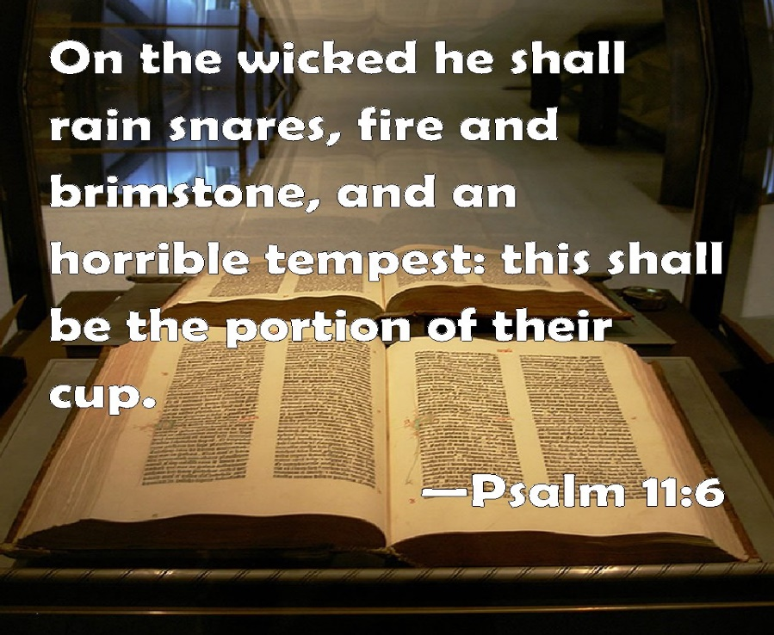
Rousing Zion to New Life
Rouse yourself, rouse yourself
Isa 51:17-20 – “¹⁷Rouse yourself! Rouse yourself! Arise, O Jerusalem, you who have drunk from the Lord’s hand the cup of His anger; the chalice of reeling you have drained to the dregs. ¹⁸There is none to guide her among all the sons she has borne, nor is there one to take her by the hand among all the sons she has reared. ¹⁹These two things have befallen you; who will mourn for you? The devastation and destruction, famine and sword; how shall I comfort you? ²⁰Your sons have fainted, they lie helpless at the head of every street, like an antelope in a net, full of the wrath of the Lord, the rebuke of your God.”
Notes:
How is Eden restored (51:1-3)? God removes the curse of His wrath. Urgent summons to “rouse yourself”.
Isa 51:17 – God wasn’t asleep. They had it backward. Their faith was asleep while big things were happening (40:2; Rom 13:11-12). “Cup” = all life’s experiences (Psa 11:6; 23:5; 75:8-9; Jer 25:15; Ezek 23:31; Matt 26:39; John 18:11; Rev 14:10; 16:19; 19:15). Hopelessly reeling under God’s wrath, not only did they drink the cup, they drained it. God used their enemies against them, but these enemies are powerless once God bids her to arise.
Isa 51:18-19a – Zion pictured as an old woman w/no children; no one to help her walk or stand (Lam 1:1). Cup of God’s wrath has denied her this. She is helpless in shame and weakness. Emphasis is on the fact no one can help Zion but God. Duplication is the idiom of totality. “two things” = the prior verse’s widowhood and childlessness or calamities on the land and calamities on the people of 19-20.
Isa 51:19b-20 – Who is there who can offer any sympathy or encouragement? “Mourn” = “who will nod the head for you?”, expressing grief (Job 2:11; 42:11). No one can comfort them but God (40:1; 51:3,12). More duplications and imagery of Zion’s helplessness, a hopelessly entangled animal w/no ability to escape. Children just as helpless as the mother of vs. 18. Not by chance, but because they are full of God’s wrath, “your” God. “lie at the head of every street” either defending, fleeing the city, or fainted in “drunkenness” (vs. 17). Assyria and Babylon did kill men at prominently, conspicuous locations.

Slide 5
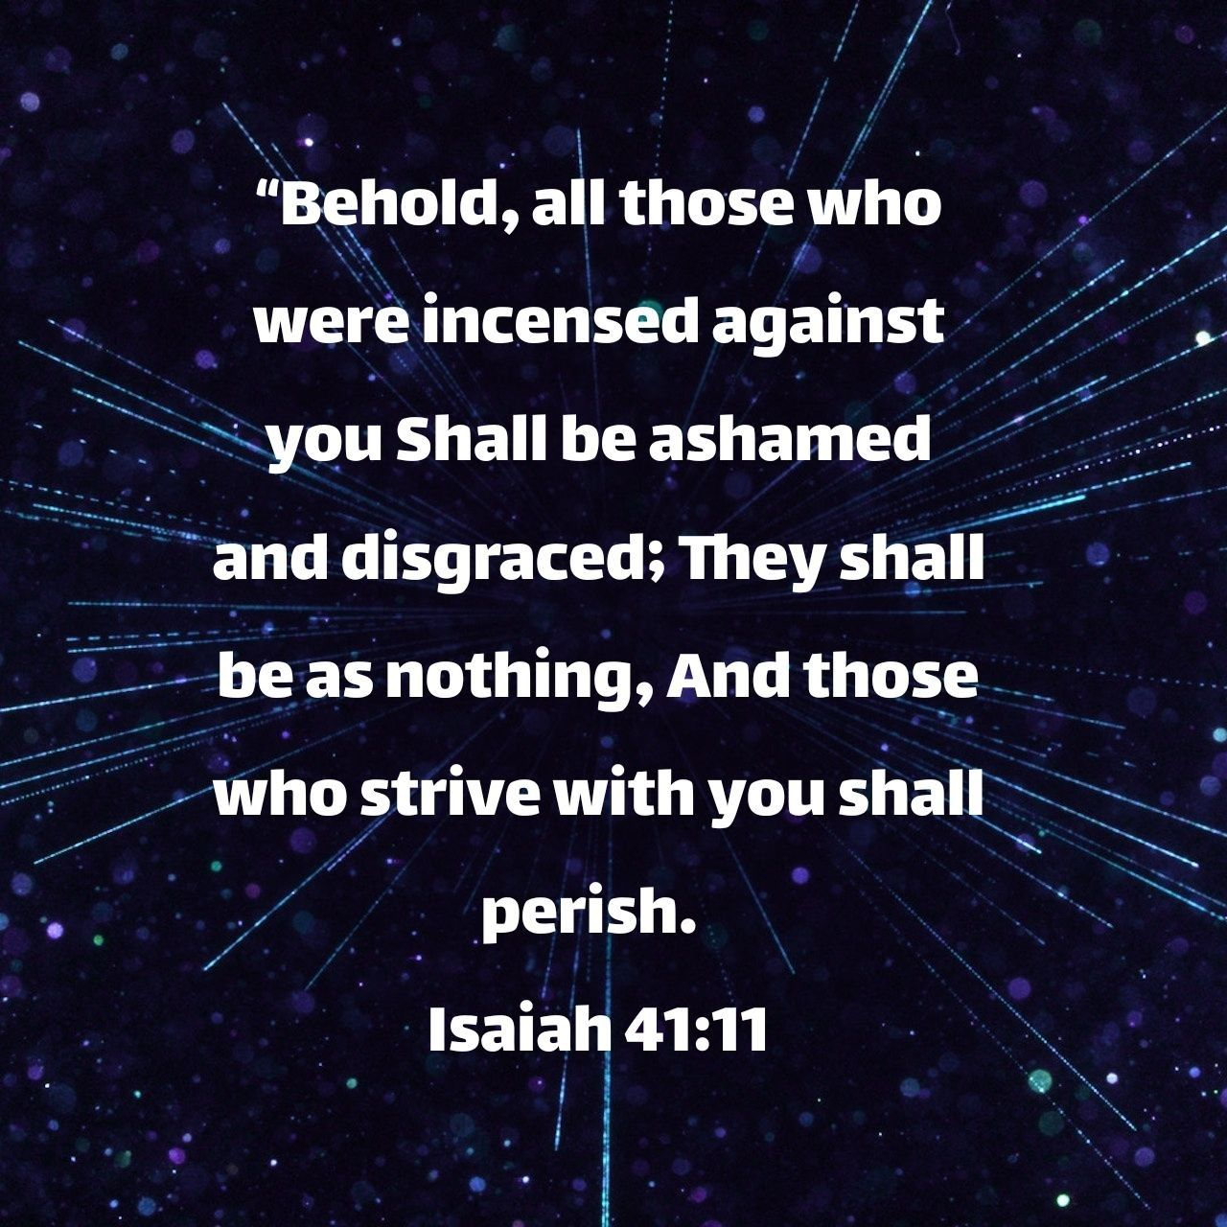
Rousing Zion to New Life
Rouse yourself, rouse yourself
Isa 51:21-23 – “²¹Therefore, please hear this, you afflicted, who are drunk, but not with wine: ²²thus says your Lord, the Lord, even your God Who contends for His people, ‘Behold, I have taken out of your hand the cup of reeling, the chalice of My anger; you will never drink it again. ²³I will put it into the hand of your tormentors, who have said to you, ‘Lie down that we may walk over you.’ You have even made your back like the ground and like the street for those who walk over it.”
Notes:
Isa 51:21-22 – Magnitude of the wrath made clear, now the magnitude of deliverance in the removal of God’s wrath. Returns to “cup”, a deliberate measuring out of wrath. Israel not a victim; they’ve experienced the cause and effect of sin, being drunk on His wrath, and they need to see their utter hopelessness before they’ll respond to God’s promises. “Lord” = plural, used of human masters, so likely used here as Israel’s husband. God goes from prosecutor (43:8-13,26) to defender (34:8; 41:11; 50:8). That He contends for His people means He has satisfied the legal conditions on which to lawfully contend for them. Repeating vs. 17, the drunkard now awakes to see the cup gone from his hand (Job 1:20b); rather, He desires they drink from the river of life (Rev 22:1). He has not put them away forever (50:1-2); He is still “your God”.
Isa 51:23 – In Exodus, God’s Passover afflicted their enemies. It was a removal of wrath toward one and an afflicting of it to another (10:5-34; 43:3). So, the cup is not taken away, but passed to her oppressors (Jer 25:26; 51:7,41,54-56; Hab 2:4-20). Not even service to God will relieve us of responsibility to the moral law. They will no longer stand on their victims’ backs to exalt themselves (Josh 10:24; Judg 1:7; Zech 10:5). They will reap what they sow (17:10; 32:19; Gal 6:7-10).

Slide 6
Rousing Zion to New Life
Awake, awake
Isa 52:1-2 – “¹Awake, awake, clothe yourself in your strength, O Zion; clothe yourself in your beautiful garments, O Jerusalem, the holy city; for the uncircumcised and the unclean will no longer come into you. ²Shake yourself from the dust, rise up, O captive Jerusalem; loose yourself from the chains around your neck, O captive daughter of Zion.”
Notes:
Isa 51:1 – In contrast to 51:9, God doesn’t need awakening like Baal (1 King 18:27); they need to arise from their drunken stupor and take their rightful place as “queen”. But some find it easier to question God’s character than to wait in faith (the suffering question). Jerusalem is to awaken to a new condition of holiness that demands a separation. She awakens to find new garments laid out that are to manifest her character (Ex 28:2). Now that He has satisfied the conditions of holiness, He wants to share His holiness. He refuses to let the disgusting picture of 3:16-4:1 become permanent. But they must exercise faith by awakening and putting on strength; not strength to deliver herself, but strength to lay hold of God’s promises.
Isa 51:2 – Not only demands a separation, but royal dignity. We are to be a royal, holy priesthood (Ex 19:4-6; 1 Pet 2:9). Babylon was called to the dust (47:1,10), Zion is called from it (3:26; 29:4). This is a call from spiritual bondage – 49:5-6. A putting off of the old, a putting on of the new (Col 3:9-10). This is a critical moment of faith in which we stop viewing ourselves as victims and begin to take responsibility.

Slide 7
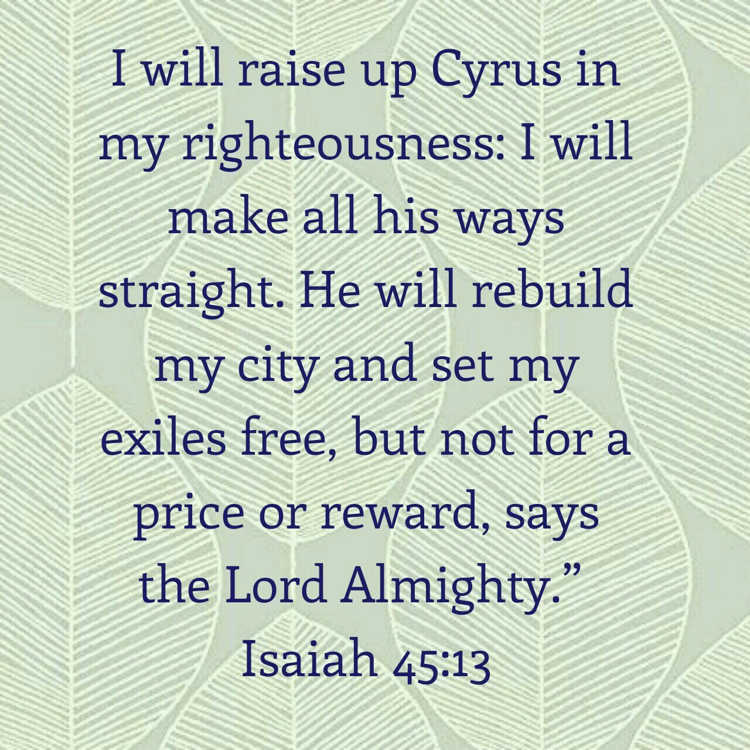
Rousing Zion to New Life
Awake, awake
Isa 52:3-6 – “³For thus says the Lord, ‘You were sold for nothing and you will be redeemed without money.’ ⁴For thus says the Lord God, ‘My people went down at the first into Egypt to reside there; then the Assyrian oppressed them without cause. ⁵Now therefore, what do I have here,’ declares the Lord, ‘seeing that My people have been taken away without cause?’ Again the Lord declares, ‘Those who rule over them howl, and My name is continually blasphemed all day long. ⁶Therefore My people shall know My name; therefore in that day I am the one who is speaking, “Here I am.”’”
Notes:
Isa 52:3 – Explanation of vs. 1-2. How can Zion find this strength? Though sold, they still remained the Lord’s property; He can recover at will (45:13). This is still redemption, so “w/o money” doesn’t mean “w/o cost”. The justice of God must be satisfied. So, what is the cost? We’re left in suspense until 52:13.
Isa 52:4-5 – “God” = “Yahweh”, the Exodus Redeemer (Ex 6:6-7). Examples of times He intervened as next-of-kin. Oppression from A to Z (Egypt to Assyria). Neither Egypt nor Assyria had cause to afflict Israel, yet the Lord demonstrated throughout history He will redeem. They went to Egypt by invitation choice (Gen 45:16-20; 47:5-6) and He redeemed them when it went sour (Deut 26:5-6). How much more when taken against her will by Assyria and Babylon? “What should I do about this?” God moved by His people’s misery and His name. What hurts them hurts Him. What hurts His name hurts His gospel. Must not be said He was forced by a superior god to give His people up or none would come to Him to be saved (Rom 2:24). On this basis, He must rescue them even though He delivered into captivity.
Isa 52:6 – A double “therefore” = emphasis and excitement. What He’s going to do will enhance His name among His people. Not new truth (Ex 3:15), but a revelation of existing truth. He’ll also be present in word and person. No more mediator like Moses/Isaiah. Rather, “Here I am” (6:8; 7:14). Almost as if He’s saying, “I can handle My name being blasphemed among the nations. Just let it be known and praised among My people.”

Slide 8
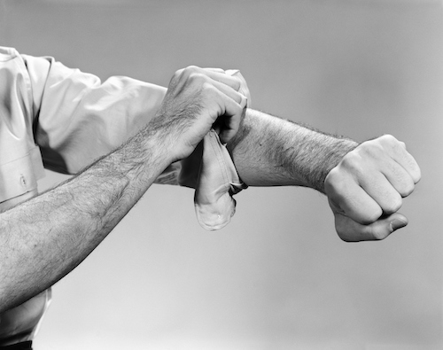
Rousing Zion to New Life
Awake, awake
Isa 52:7-10 – “⁷How lovely on the mountains are the feet of him who brings good news, who announces peace and brings good news of happiness, who announces salvation, and says to Zion, ‘Your God reigns!’ ⁸Listen! Your watchmen lift up their voices, they shout joyfully together; for they will see with their own eyes when the Lord restores Zion. ⁹Break forth, shout joyfully together, you waste places of Jerusalem; for the Lord has comforted His people, He has redeemed Jerusalem. ¹⁰The Lord has bared His holy arm in the sight of all the nations, that all the ends of the earth may see the salvation of our God.”
Notes:
Isa 52:7 – Depicts besieged city desperately awaiting the outcome of a conflict. Suddenly, a runner on a distant hill is seen. Feet are typically the dirtiest part of the body, but for the messenger bringing good news of salvation, even they are beautiful (Nah 1:15; Rom 10:15). Comes w/a spring in his step. 4 messages: “peace” = end of war/threats; “happiness/good tidings” = no bad news marring situation; “salvation” = oppressor’s power over, chains broken; “your God reigns” = the Lord’s kingship affirmed, basis of the tidings (Matt 10:1-7). 3rd voice of comfort in 40:9-11 confirmed.
Isa 52:8-9 – Recalls 40:3. The sound of the messenger leads to a unison cry of joy from the watchmen on the wall. That “God is with us” causes this outpouring of joy, and no one need be afraid any longer. “see w/their eyes” = Num 14:14 – 2 people being so close that they can see the whites of each other’s eyes. But what He has done and how still remains in suspense. Song spreads from messenger, to watchman, to the inhabitants joining in the chorus. They are united. This victory calls for all to celebrate, nothing to be held back. “waste places” = figurative, the restoration of the people to God. Lives of ruin and alienation from God will be comforted and redeemed (44:26; 51:3).
Isa 52:10 – The request of 51:9 has now been answered. Worldwide revelation of the Lord’s person and power, as a witness and testimony even to those not saved. “Arm” stands for persons actions and power to get things done (30:30; 40:10-11; 44:12; 48:14; 51:5,9). “bared” implies He has not done this in secret, but completely removed his train/robe (6:1), rolling up His sleeves for action in response to 51:9, and there are none who won’t see (18:3; 40:5). First, Isaiah said “here am I, send me.”. Then the Lord said, “Here I am” (52:6). Now the Lord takes action.

Slide 9
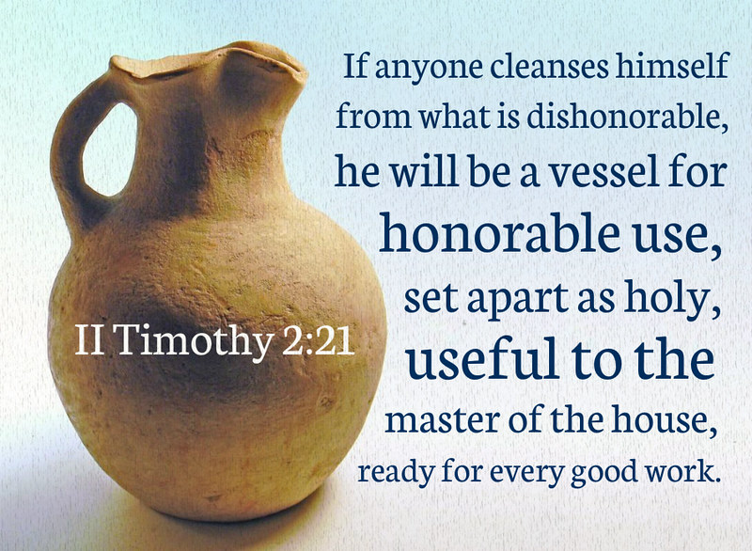
Rousing Zion to New Life
Depart, depart
Isa 52:11-12 – “¹¹Depart, depart, go out from there, touch nothing unclean; go out of the midst of her, purify yourselves, you who carry the vessels of the Lord. ¹²But you will not go out in haste, nor will you go as fugitives; for the Lord will go before you, and the God of Israel will be your rear guard.”
Notes:
Isa 52:11 – Not the temple vessels of Ezra 1:7-11. Implying such is only to form a framework of thought. This is spiritual. They are now performing priestly duties (52:1; 2 Tim 2:21). Though God has acted, we must get up and go forth. This will be both like and unlike the first Exodus. Though they plundered the Egyptians, they were to bring nothing unclean (idols) from “Babylon”.
Isa 52:12 – Though they left Egypt in haste (Ex 12:33,39), eating the Passover in haste, they will not experience the panicked flight of sinners under condemnation. They leave w/a sense of peace and dignity. He will both guide (front) and protect (rear) (40:10-11; Josh 6:9). His presence would be all around them (4:5-6). Vs. 3 – Vs. 12 ends w/such excitement. 51:17-23 = wrath of God removed. But how? 52:1-9 = redemption has been accomplished. But how? 52:10-11 = a new exodus. He bared His holy arm, but as to the act itself, we’re left in suspense. How did it happen, how is it possible?

