Slide 1
Notes:
In 1 Cor 13, the Apostle Paul offers God’s view of love. This is not just any love, but a divine love, the word “agape”, which is the only love under consideration in this chapter. What we learn is that love has power as well as priority over any other virtue. And the more we reflect the love described here and the more we give it to others, the more we will begin to experience love in our own lives.
We’re getting close to concluding our study of these virtues as we consider the last four things that Paul says love does – it bears, it believes, it hopes, and it endures. Not some things, but all things. Some have suggested that what Paul is really doing here is basically summarizing everything else he has already talked about. And there may be something to this as certainly there is some overlap to what he has already written. But we will consider each of them individually beginning in this lesson with the “bearing” and “believing” qualities of love.

Slide 2
Love Bears All Things
“bears” = “stegó”
literally: “a roof”
figuratively: “to cover closely, to bear up under, to shield;”
1 Cor 9:12 – “If others share the right over you, do we not more? Nevertheless, we did not use this right, but we endure all things so that we will cause no hindrance to the gospel of Christ.”
1 Thes 3:1 – “Therefore when we could endure it no longer, we thought it best to be left behind at Athens alone.”
1 Thes 3:5 – “For this reason, when I could endure it no longer, I also sent to find out about your faith, for fear that the tempter might have tempted you, and our labor would be in vain.”
Notes:
The Greek word for “bear” is “stegó”. This word literally means “a roof” and when you see the word “roof” in the NT this is the word used. So that’s descriptive. But figuratively, it means to cover closely, so as to keep water out, to bear up under, or to cover over, as you would with a roof, or to endure as if you’re shielded.
A roof protects, shields, and guards the inhabitants of a house from exposure to the outside influences of weather. Its designed to shield people from storms, hurricanes, tornadoes, rain, hail, snow, wind, blistering hot temperatures, etc. And this protection is vital for survival in most climates, preventing many people from either freezing to death or burning up as a result of continual exposure to sunlight. So the thought being conveyed is somewhat of a simile. Genuine love covers others just like the thatch of a roof covers the contents or inhabitants below it.
But a roof also conceals what is inside, does it not? No one flying in a plane should be able to see what’s going on inside of a house. Google earth should not be able to display what occurs inside of a house because that is private. So there are two ideas expressed incumbent to love “bearing” all things: it conceals and it protects.
Notice how this Greek word is used in other passages – 1 Cor 9:12 – “If others share the right over you, do we not more? Nevertheless, we did not use this right, but we endure all things so that we will cause no hindrance to the gospel of Christ.” What is Paul talking about here? The fact that he had a right to receive financial support from them was not what was most important for them. They should have been “bearing” that load for Paul, but in their weakness and in his desire to love them and protect them from unjustly accusing him of perhaps having the wrong motive, he “bears” them. He did not want his “right” to be an opportunity for Satan to bring the storm. So rather than Corinth bearing Paul, he chose instead to bear them for the sake of love.
1 Thes 3:1 – “Therefore when we could endure it no longer, we thought it best to be left behind at Athens alone”. What is Paul talking about? Well, as soon as he had planted the work in Thessalonica, a severe persecution came from the unbelieving Jews and Paul was forced out of there quickly. And what he’s saying is that all he could think about while he was away from them was how they were doing, if they were surviving spiritually, or if the persecution had affected them to the point where the church no longer even existed. And so he says, “I couldn’t endure not knowing, I couldn’t bear not knowing your state.” – 1 Thes 3:5 – “For this reason, when I could endure it no longer, I also sent to find out about your faith, for fear that the tempter might have tempted you, and our labor would be in vain.” And not being able to bear it, he sent Timothy and found out that not only had they survived, they were thriving spiritually.
Here is what W. E. Vine said in his commentary about this idea of love bearing all things: “this covering either supports what is placed upon it, or covers what is placed underneath it. Love acts in both ways in bearing all things.”

Slide 3
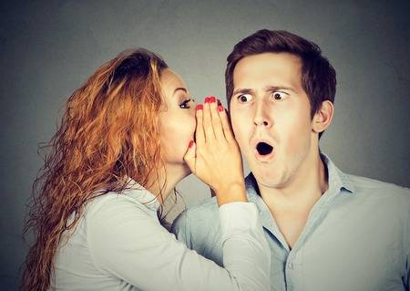
Love Bears All Things
Love Covers To Conceal
Prov 11:13 – “He who goes about as a talebearer reveals secrets, but he who is trustworthy conceals a matter.”
Prov 17:9 – “He who conceals a transgression seeks love, but he who repeats a matter separates intimate friends.”
Prov 10:12 – “Hatred stirs up strife, but love covers all transgressions.”
1 Pet 4:8 – “Above all, keep fervent in your love for one another, because love covers a multitude of sins.”
Notes:
So there appear to be two primary applications to this idea of bearing as it pertains to love.
First, in a relationship between two people, one might cover something in order to hide it from sight or, figuratively, from thought or memory. Love covers with silence in that it keeps certain things secret, private, and hidden Specifically, love will conceal the imperfections, faults, and errors of others. Love is not disposed to circulate or publicize such things.
Prov 11:13 – “He who goes about as a talebearer reveals secrets, but he who is trustworthy conceals a matter.”
Prov 17:9 – “He who conceals a transgression seeks love, but he who repeats a matter separates intimate friends.”
People who truly love one another in a biblical sense can trust one another to keep personal matters confidential. They should never fear that the things they share with each other will be disclosed to outsiders. They should never worry that the conflicts and problems that inevitably take place in all relationships will be revealed to others.
Prov 10:12 – “Hatred stirs up strife, but love covers all transgressions.”
Love does not dwell on the imperfections, faults, or errors of each other. These things are figuratively concealed from their view and thoughts. Love covers these weaknesses and mistakes and never demands justice, judgment, or revenge. In other words, we quickly dismiss and disregard the negative happenings that occur in relationships from time to time as well as the unfavorable characteristics of one another. Instead, love chooses to focus on the positive and good.
Love refuses to dwell on or promote that which is negative. This is probably what Peter was expressing in 1 Pet 4:8 – “Above all, keep fervent in your love for one another, because love covers a multitude of sins.”
Love doesn’t look for every fault or point out every shortcoming; it doesn’t complain, quibble, or criticize. How often we attack rather than protect. We expose rather than cover. We neglect rather than draw near! [Love] does not expose or exploit, gloat or condemn. It bears; it does not bare (John MacArthur).
We should also note that implicit in this phrase is the truth that love doesn’t criticize in a destructive way – in private or in public. We must stop dwelling on one another’s faults unless we’re active in helping them, throwing out “zingers” of sarcasm at home or otherwise, nitpicking, or vilifying.
It hides and excuses, the errors and faults of others. But does it hide sin? What’s the difference?

Slide 4
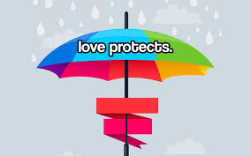
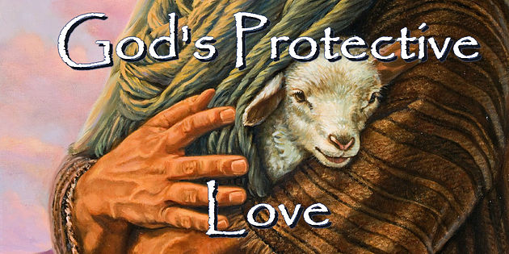
Love Bears All Things
Love Covers To Conceal
Love Covers To Protect
2 Thes 3:3 – “But the Lord is faithful, and He will strengthen and protect you from the evil one.”
Psa 121:7 – “The Lord will protect you from all evil; He will keep your soul.”
Notes:
Second, one might cover something to keep away outside forces that threaten. In other words, love protects, preserves, and sustains by covering. Love keeps out harmful influences like a roof keeps out water. One who loves does not allow affliction, detriment, insult, offense, or indignity to come upon the object of his affection.
Love will always do its best to protect one another and the relationship from external forces that have potential to cause harm. This may take many forms such as: outsiders with ill will, compromising situations, struggles and pressures of life, and so forth. Christians who truly love one another will be committed to preserving and sustaining their marriage come what may.
There are many different seasons to life, and not all seasons are pleasurable. In fact, some seasons of life are very stormy and difficult. There are moments when external circumstances assail us from without. If we have no shield to guard us during these stormy times, it becomes much more difficult for us to survive spiritually.
Paul lets you know that agape serves like a protection for you. Like the roof of a house, a friend who moves in the agape love of God will stay near in times of trouble. That friend will hover over you to protect you from the storms of life. Rather than expose you and your flaws to the view of others, a person who operates in this kind of love will conceal, cover, and protect you, for real agape love is always there in times of trouble to lend support.
This is what God does for us!
2 Thes 3:3 – “But the Lord is faithful, and He will strengthen and protect you from the evil one.”
Psa 121:7 – “The Lord will protect you from all evil; He will keep your soul.”
Is our love a load-bearing love?

Slide 5
Love Believes All Things
“believes” = “pisteuó” = “to be persuaded”
Phil 1:9 - “…love may abound still more and more in knowledge and all discernment…”
Notes:
The Greek word for “believes” is the word “pisteuó” and it is used in the place of believes some 244 times in the New Testament and so there is no mystery behind the definition. It simply means “to be persuaded”. But, since 1 Cor 13 is describing an attitude towards other people that is manifested by our actions, this expression “believes all things” is best understood as an attitude which assumes the best in others. It means that we give others the benefit of the doubt. We expect the best in others. We are able to overlook the offenses and failure of others. And it means that we believe that over time we can commit ourselves to one another and we’re willing to trust one another.
If we as Christians are loving other people, if loving other people is going to be a dominant feature in how we relate to other people, then we will not allow judgmental suspicions and critical attitudes to become the mainstay of our relationships. Or you could say it this way. When we don’t have all the facts in any given situation, then we will not choose to believe what would be the most damaging or judgmental thing based on the facts available to us. It is believing the best in others when we don’t know or cannot know all the facts. So, if we don’t have the cold hard facts that prove someone has done evil, then we are obligated to think the best, believe all we can with a good conscience to the other person’s credit.
This is the opposite of someone with a cynical attitude towards people and life in general. I don't think it means believing in someone in the face of clear evidence against that person. Phil 1:9 - “..love may abound still more and more in knowledge and all discernment…” So it isn’t that a Christian strips himself of wisdom and discernment or that he forgets how to distinguish black from white. It simply sees the potential in them. It believes that God can take the most unattractive and unworthy individual and turn that person into a masterpiece of beauty and grace. If love errs, it must err in the way of trustfulness and hopefulness.
This is also the opposite of being judgmental. When we are being judgmental, we tend to think the worst of other people. If we don’t have all the facts, we fill in with negative ones. We fill in with what may make the other person look the worst, not the best. We may say things like, “Well, so and so, I know how he is. No I didn’t see him speak rudely to her, but I’m sure he did; that is how he is! No I didn’t see her steal from her mother, but believe me, I know she did!” Or sometimes it is judging motives which we cannot see. “Do you know why she bought that dress? Well I do, and let me tell you what she was thinking when she bought that dress!” This is having a critical spirit, a judgmental spirit, an attitude of pride that says, “I know how people respond and even how they think, and it’s not pretty.” This is holding ourselves in very high regard, almost thinking that we are omnipotent, like we can know things about other people when we really can’t.
One commentator wrote, “Love will always opt for the most favorable possibility. If a loved one is accused of wrong, love will consider him innocent until proven guilty. If he turns out to be guilty, love will give him credit for the best motive.”

Slide 6
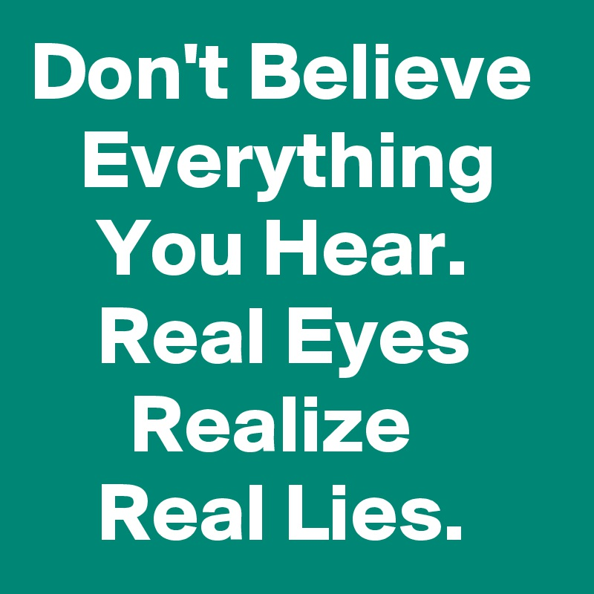
Why Don’t We Believe All Things?
Untrustworthy People
2 Tim 3:12-14 – “Indeed, all who desire to live godly in Christ Jesus will be persecuted. But evil men and impostors will proceed from bad to worse, deceiving and being deceived. You, however, continue in the things you have learned and become convinced of, knowing from whom you have learned them.”
Matt 10:16 – “Behold, I send you out as sheep in the midst of wolves; so be shrewd as serpents and innocent as doves.”
Prov 22:3 – “The prudent sees the evil and hides himself, but the naive go on, and are punished for it.”
Prov 14:15 – “The naive believes everything, but the sensible man considers his steps.”
Notes:
So why may this be hard to do? Well, one reason is that there are people who have shown they cannot be believed.
“Whoa! Love believes all things? Even that email I got from the deposed prince of Nigeria? Love believes all things on the internet, CNN, even what my lying neighbor tells me? How can it be loving for me to believe all things? Am I supposed to be gullible? That even sounds dangerous, doesn’t it? Am I to tell my children to believe everything they hear?”
2 Tim 3:12-14 – “Indeed, all who desire to live godly in Christ Jesus will be persecuted. But evil men and impostors will proceed from bad to worse, deceiving and being deceived. You, however, continue in the things you have learned and become convinced of, knowing from whom you have learned them.”
Here, God is warning us not to believe everything. There are evil people in the world who deceive because they have allowed themselves to be deceived. And so He says we should instead keep on believing what we have learned from scripture. Certainly, we must be aware of danger when we see it coming, and become “as wise as serpents” (Matt. 10:16). Tough love may be the best response to irresponsible and foolish people, but we can be too guarded, too wary and distrustful.
Prov 22:3 – “The prudent sees the evil and hides himself, but the naive go on, and are punished for it.”
To believe all things in the context of Paul’s writing must be loving, since the context is love toward other people. To knowingly believe a lie from another person would not be loving toward them, because we would position ourselves out of a loving role toward them rather than be used by God lovingly for their good. And so with that, hopefully we have some insight into what this verse cannot mean and how it is sometimes misused.
Prov 14:15 – “The naive believes everything, but the sensible man considers his steps.”

Slide 7
Why Don’t We Believe All Things?
Untrustworthy People
We’re Being Wise
Prov 14:15 – “The naive believes everything, but the sensible man considers his steps.”
1 Thes 5:21 – “But examine everything carefully; hold fast to that which is good; abstain from every form of evil.”
Jas 3:17 – “But the wisdom from above is first pure, then peaceable, gentle, reasonable, full of mercy and good fruits, unwavering, without hypocrisy.”
Notes:
We may not believe all things because we‘re trying to be wise. When Paul says that we are to believe all things, he cannot mean that we are to be blindly gullible.
Prov 14:15 – “The naive believes everything, but the sensible man considers his steps.”
To believe everything without discernment can be very harmful and even sinful. We are not called to be fools. We are not to be fools because of the harm it can bring to us, to others, and to the name of our Lord. We are cautioned against foolishness. So whatever Paul means by “love believes all things,” he does not mean to contradict the wisdom literature of the Proverbs which call us to be discerning, wise, and not foolish and gullible. Rather, we’re to do as he says in 1 Thes 5:21 – “But examine everything carefully; hold fast to that which is good; abstain from every form of evil.”
In James 3:17, we read that the wise person is a “reasonable” person. He is one who is willing to listen to facts, weigh the facts. He doesn’t jump to prideful conclusions thinking that his negative interpretation of partial facts is always correct. We must listen, gather information, and be careful not to make hasty judgments that put others unfairly in a bad light.

Slide 8
Why Don’t We Believe All Things?
Untrustworthy People
We’re Being Wise
We’re Cynical, Suspicious People
Rom 14:13a – “Therefore let us not judge one another anymore…”
Notes:
Perhaps we’re struggling to “believe all things” because we’re cynical people. We’re quick to expect others to fail. Perhaps we don’t believe that others will respond to things like they should. We doubt that they are capable of doing what they promise. We believe they will fail. We believe they will fail us. Maybe this is hard for us because we’re suspicious people; we suspect that others are being deceitful, hiding their true intentions and motives. We assume that despite someone’s own words, that they are up to no good. We’re stewing inwardly, dissecting the actions and remarks of others, interpreting their every act. We anticipate being offended and prepare our rebuttals. We anticipate being let down and prepare our scathing critique. We accuse the motives of others, assuming that their ultimate purposes are selfish. We do this because we’re cynical people.
This attitude has many consequences, but most notably it costs us friendships and fellowship. When we have this attitude, we ultimately close ourselves to relationships with others. To protect ourselves from being hurt, we doubt others, and this prevents us from opening our hearts to them and forming the Christian bond of fellowship where love can truly blossom.
Rom 14:13a – “Therefore let us not judge one another anymore…”. In the context, he’s reminding them concerning what we’ve come to call matters of indifference, having strong opinions negative opinions towards people that God does not.
It’s possible due to some past scars that we have trust issues. And we need to be understanding towards those who do because these are real issues. But we need to recognize it when it is in us and strive to find the balance God desires between believing all things and testing all things because until I find that balance, I’m not going to be able to love as God would have me to love. I’m just going to think the worst in every person simply because some other knucklehead in the past hurt me, and this person standing in front of me s not them, so why am I projecting my distrust on them? This is not to minimize those who are battling caring these kinds of wounds.
If you love another, you will have the type of love that by default trusts - you’re not cynical by nature.

Slide 9
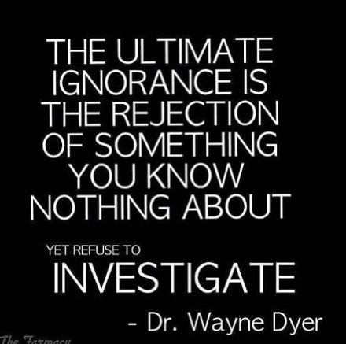
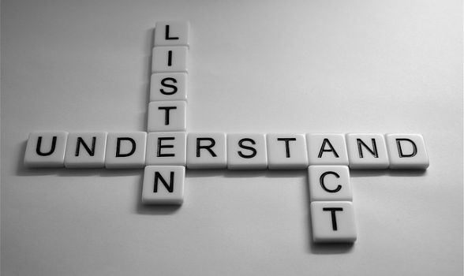
Why We Should Believe All Things?
We May Not Have All The Information
Prov 18:13 – “He who gives an answer before he hears, it is folly and shame to him.”
Prov 18:17 – “The first to plead his case seems right, until another comes and examines him.”
Notes:
Failure to love in this way is also a most hyper-critical thing. So many times I have been so quick to note someone else’s sin, usually privately, to myself, and considered them a lost cause. I have considered entire persons on the basis of only their most recent actions. I have used words “always” to my expectations for others sin, and “never” meeting my expectations. In this way I have reduced others to a mere caricature of their true selves.
Prov 18:13 – “He who gives an answer before he hears, it is folly and shame to him.”
Prov 18:17 – “The first to plead his case seems right, until another comes and examines him.”
There are lots of places in the Bible where we see hasty judgmental conclusions by individuals that do not have all the information. One place where we see others do this very thing, make judgements without cause, is in the book of Job. Job had some friends who upon hearing of Job’s life-altering trials came to him and at first simply sat with him saying nothing for seven days. They grieved for him. But then some things began to happen. Then these friends began to jump to some conclusions, and those conclusions were that God was punishing Job for flagrant sin in his life. They never gathered information, and they refused to listen to Job. Their take was, “Wow, this is all really bad. These things don’t just happen for no cause. Job must be hiding terrible, terrible sin. Why else would this happen?” In John 9, the disciples saw a man who was blind. The interpretation was that blindness is a bad thing, and bad things are caused by sinful behavior, in this case either sinful behavior by the man himself or the sinful acts of the parents. In their minds the cause was one of the two. Their conclusion was based on their small understanding of life, of God, of God’s purposes, of God’s glory, of God’s will. They were so limited in their understanding of the facts that they failed to even consider the correct conclusion until Jesus emphatically states it. He was born blind so that through his life God might be put on display. He was blind for the glory of God. That was the reason. And instead of considering that, these disciples only thought the worst of him and of his parents. Paul was a busy man, a servant, a minister of the Gospel, but from 1 Cor 4:4-5, we read that some found it necessary to judge him, judge his actions, his motives, and they did so wrongly. In 1 Thessalonians 2 he was accused of desiring to simply please men, which was far from the truth.
Loving others requires that we are slow to criticize, so slow that we take the time to gather solid information before we even consider thinking or sharing negative things. And even then, only share those things that are biblically necessary for the loving good of a brother or sister in Christ.

Slide 10
Why We Should Believe All Things?
We May Not Have All The Information
We’d Rather Fail In Loving
John 3:16 – “For God so loved the world, that He gave His only begotten Son, that whoever believes in Him shall not perish, but have eternal life. ”
Notes:
Second, we should believe all things because if we’re going to fail, if we’re going to be wrong, we should rather fail in loving than in not loving.
Years ago, I observed someone showing great affection toward someone I considered unworthy of love. I thought they were being duped and conned and I was afraid he would be disillusioned and saddened in the end. When I expressed my concern, he replied, “When I stand before my Lord, I hope He’ll say of me that I’ve loved too many, rather than too few.” Those words have resonated with me over the years.
John 3:16 – “For God so loved the world, that He gave His only begotten Son, that whoever believes in Him shall not perish, but have eternal life.” Does this verse tell us that Jesus loved too many or too few? It doesn’t do us any real harm to be hoodwinked and defrauded. Jesus reminds us over and over again in Matt 5 that such things leave us rewards in heaven and makes us more like our Father in heaven. So, yes, it’s better to believe in someone and have your heart broken than to have no heart at all, as Alfred Tennyson once wrote, “‘Tis better to have loved and lost than never to have loved at all.” In regards to divine love, agape love, I wholeheartedly agree.

Slide 11
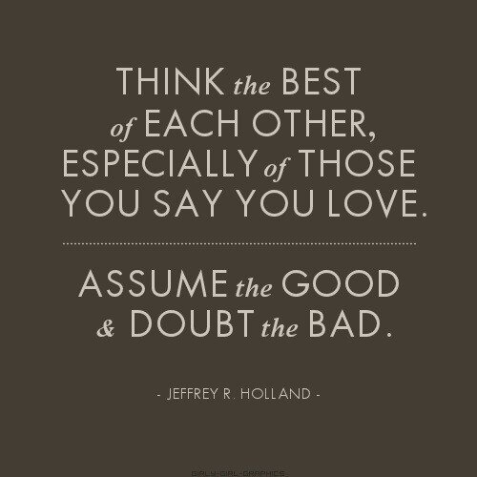
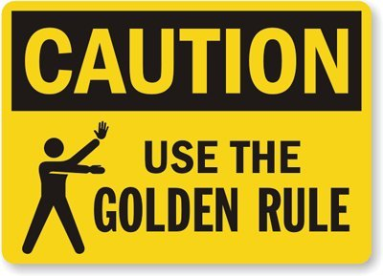
Why We Should Believe All Things?
We May Not Have All The Information
We’d Rather Fail In Loving
We Need People To Believe In Us
Matt 9:9 – “As Jesus went on from there, He saw a man called Matthew, sitting in the tax collector’s booth; and He said to him, ‘Follow Me!’ And he got up and followed Him.”
John 1:42 – “He brought him to Jesus. Jesus looked at him and said, ‘You are Simon the son of John; you shall be called Cephas’ (which is translated Peter).”
John 4:39 – “From that city many of the Samaritans believed in Him because of the word of the woman who testified, ‘He told me all the things that I have done.’”
Notes:
Finally, I’d suggest that love should believe all things because we need people to believe in us.
Jesus had a great inward and outward attitude toward everyone. He always saw the potential for good in the people around Him. In Matt 9:9, when Jesus saw Matthew, the tax collector, He saw potential for good. Tax collectors were not the most reputable of occupations, and that’s an understatement. The common man would not have seen what Jesus saw. But when Jesus saw Matthew, He invited him to become one of His followers. Jesus knew that there was more to Matthew that met the eyes, and aren’t we thankful that Jesus believed in Him? If he hadn’t, we wouldn’t have the gospel of Matthew. Perhaps what gave Matthew the courage and resolve to be everything he was capable of being is that someone loved Him enough to give him a chance.
In John 1:42, Jesus saw potential for good in Peter. Jesus knew that Peter was an impulsive and impetuous individual, but He also knew that given time, he would be as solid as a rock. He knew that Peter would deny Him three times, yet he also saw the potential for this man's ability to stand like a rock on the day of Pentecost and preach to the very mob who had called for Jesus’ crucifixion.
In John 4, Jesus saw the potential for good in the Samaritan woman. This woman was a moral failure. She was worthless in the eyes of many. It is impossible for us to even imagine the despair that must have filled her heart and life. She had no clue that her life was about to be transformed as she arrived at the well to draw water that day. Jesus saw her and He loved her. He wisely asked for water so He could open up a conversation with her. During the course of their conversation, he offered her the gift of living water. The end result of that offering was that this woman became a powerful witness for God. Vs. 39 tells us, "Many of the Samaritans from that town believed in Him because of the woman's testimony".
Most of us are tempted to see the potential for bad in others. We look first for their flaws; we observe other's deficiencies and short comings. Let us pray and ask God to give us the eyes of Jesus so that we too will see the potential for good in the people around us.
Think of it this way. You have made a mistake. You have really messed up. You have messed up and you know it. Maybe it was an oversight on your part, but it has really effected people around you in a negative way. You are feeling really rotten, and to make it worse, people who are close to you, they know it too. Your tendency is to wallow in this bad situation, to beat yourself up, to go over it again and again in your mind. You are having difficulty getting past this one, and it has now been days going on weeks and you just can’t let it go. It wasn’t really even a sin, just an oversight, but one that is big. What do you need? Where do you go? Who do you go to? Do you go to someone who is going to say, “Yeah, there you go again, I could see this one coming from miles away, look what you did to others, look how you have messed everyone’s lives up. You are so lazy, and careless, and inconsiderate!” Are you going to go to that person? Probably not. How about going to one who will think the best of you in this. They know you are not perfect, no one is, and they are not going to come down on you with quick judgments. Someone who will not criticize you, or rub your face in it. How about someone who, instead of pounding on you, who points you to Christ, to the Gospel, to the forgiving work of Christ, to the One who loves you, who cares for you, who has sacrificed for you on the cross, and who anxiously waits for you in heaven? Don’t we need that at times? Don’t we need that person? That person who rights our path, who sets our paths straight, who reminds us of our position before God?
Phil 4:8 – “Finally, brethren, whatever is true, whatever is honorable, whatever is right, whatever is pure, whatever is lovely, whatever is of good repute, if there is any excellence and if anything worthy of praise, dwell on these things. ”
Matt 7:12 – “In everything, therefore, treat people the same way you want them to treat you, for this is the Law and the Prophets.”

