Slide 1
Notes:
I heard a story once about a Christian woman who had an unbelieving husband. Every Sun service and every Wed service, she was faithful in her attendance and when she was at home she was a good wife to her husband. However, despite how much she loved her husband and was devoted to him, he began to resent the fact that when it was time for church, she would leave him to go to worship and so he began to forbid her from doing so. She very calmly and meekly told him that as much as she loved him and would continue to devote herself to him as his wife, she must put the Lord first. And so she continued to attend church and when she was home, she continued to be submissive to her husband. But that didn’t satisfy him. So in an act of spite, he began to calculate the times she would leave home to go to church and about 10 or 15 minutes before that time, he would take the car off somewhere hoping that by stranding her at home, he could not only keep her from going to church, but demoralize her in the process. Well, she started walking to church. And when she walked home, she continued to be respectful and submissive toward him, doing his laundry, cooking his meals, attending to his domestic needs. But he continued to take the car, and so she continued to walk, sometimes in the rain, sometimes in the snow, never complaining, never breaking down in front of him. And when she was at home, she continued to be submissive to him.
The story goes that one day that woman’s resilient spirit eventually broke down her husband and he began attending church with her. After a few weeks of hearing the gospel, he broke down further and became a Christian. And not long after that, he began preaching the gospel, and from what I understand, did so for a very long time.
I think about that story sometimes and I wonder how many other people were saved by this man’s preaching because he was saved by this woman’s behavior, because she determined to be like Jesus Christ? 1 Pet 3:1 – “…wives, be submissive to your own husbands so that even if any of them are disobedient to the word, they may be won without a word by the behavior of their wives”. And that is the usually the story I think about when I’m studying 1 Pet 3, but what exactly was that “behavior” that Peter mentions that we see exemplified in this faithful woman?
Without a doubt, we can say that she was patient, right? She was long suffering, suffering long her husband’s jealousy, his contempt, his malice, and his rejection of her spiritual values. She took some significant beatings, figuratively speaking, and never allowed it to break her resolve, and that’s why patient love is so powerful because being patient towards the unlovable yields fruit. But I would suggest that as powerful as patient love is by itself, the ability of love to reap amazing reward exponentially increases when patience teams up kindness. Hence, “Love is patient, love is kind.” This is the subject of our lesson today.

Slide 2
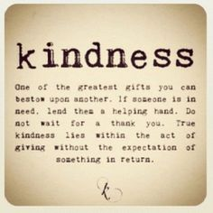
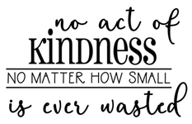
What Is Kindness?
“Kind” = chréstos = useful, serviceable, and benevolent toward another
Notes:
The word “kind” as used in 1 Cor 13:4 is the Greek word “chréstos”, and it means to be useful, serviceable, and benevolent toward another. And so kindness is not merely an attitude or a state of being. It’s primarily a deed. The biblical connotation is that kindness is to be obliging and accommodating. Rather than responding to provocation and conflict by being disagreeable bitter, sharp, or harsh, kindness desires to promote happiness by extending good toward others. It’s a good-naturedness that not only wishes well but also does well. Kindness is benevolent in action, courteous, gentle, mild, tender, compassionate, and pleasant.
Now, if you trace back the word origin even further, the word “kind” comes from the root word which means to “divest” in something. Divesting is the opposite of investing. When you invest in something, you expect a return for you investment and when no return comes, you’re surprised and disappointed because you went into this thing with certain expectations. But when you “divest”, that’s when you do something and you don’t expect anything in return. And that’s sort of the idea behind kindness. Being kind to someone is doing so independent of that person’s character, independent of their conduct toward you, and independent of any response they may give you for that act of kindness. You’re being kind for that person simply to love them a God has loved you.
Now just because kindness does not go into it looking for a return, it hopes for one does it not? Just like patience, kindness can yield very surprising fruit. Yet, if not one person’s life is ever changed as a result of the personal kindness that I show them, there has still been fruit born. Because who has changed? Me. When I love someone with kindness, I become just like my Father in heaven and just like my Lord Jesus Christ and that’s a pretty motivating reason alone for doing it. It means no act of kindness, no matter how small, is ever wasted.

Slide 3
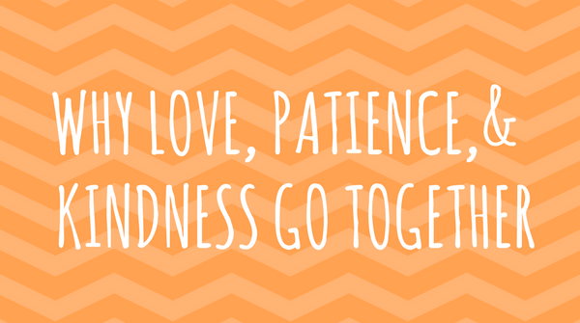
Patience
Kindness
Suffers
Forbears
Endures
Empathizes
Tolerates
Waits
Gives
Acts
Relieves
Accommodates
Serves
Forgives
Passive
Active
Notes:
Now, there is a relationship between patience and kindness that is important to understand. One thing to notice from 1 Cor 13 is that kindness comes after patience. This is also the case when the two are listed together in Gal 5:22 – “But the fruit of the Spirit is love, joy, peace, patience, kindness, goodness, faithfulness”. I don’t think this is a coincidence. As we discussed in our previous lesson, developing patience allows one to bear with suffering that prevents anger from arising. Patience means we do not retaliate in thought, word, or deed. This is a “passive” virtue. But kindness is the “active” virtue that blossoms from being patient. Kindness is the fruit of patience. It’s the ability to act for the welfare of those who would otherwise tax our patience so that even though our patience is being manifest by our reluctance to react toward others in anger and bitterness, we’re at the same time actively engaged in doing good for them – Eph 4:32 – “Be kind to one another, tender-hearted, forgiving each other, just as God in Christ also has forgiven you.”
That’s what the woman in the story did. It’s true she suffered long. She was patient in that she took some punches. But she went beyond the passive disposition that is patience and actively retaliated against her husbands malice by acting with kindness towards him. This makes patience and kindness a dynamic duo. Not Batman and Robin, but patience and kindness. Patient love will take anything others throw at them, but “kind” love will in return give anything to others. They truly are the dynamic duo – Eccl 4:9 – “Two are better than one because they have a good return for their labor.”
So patience is a driver; it drives how we relate to others through suffering, forbearance, endurance, empathy, toleration, and waiting. If we do not forbear the wrongs or even idiosyncrasies of others, we will probably react in frustration or anger or resentment. But these reactions cannot foster kindness. In fact, they bring about the opposite. On the other hand, if we react with patience even when other people do things which frustrate us, kindness and goodness will be our reaction. We’ll act, we’ll give, we’ll relieve their suffering, we’ll be accommodative toward them, serving them, and forgiving them. Patience is the passive attitude God expects of us and kindness is the active demonstration of our patient love.

Slide 4
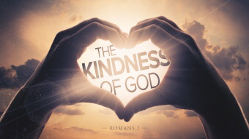
God & Kindness
Rom 2:4 – “Or do you think lightly of the riches of His kindness and tolerance and patience, not knowing that the kindness of God leads you to repentance?”
Notes:
Now kindness is underrated. We tend to think of it as being nice and pleasant, as though it were mainly about smiling, getting along, not ruffling any feathers, etc. But its more than this. True kindness is actually unnatural; its supernatural. As Gal 5:22 tells us, it is Spirit-produced, hence why it is one of the nine fruits of the Spirit. And so it’s truly a supernatural, generous orientation of our hearts toward other people because kindness is what God does. Hence, God is the author of true kindness.
Rom 2:4 – “Or do you think lightly of the riches of His kindness and tolerance and patience, not knowing that the kindness of God leads you to repentance?”
This is a instructive verse. Because while Satan is out there trying to entice us toward sin and corrupt our souls, this verse tells us that God isn’t just sitting idle. This verse tells us that God has done many wonderful things by way of his kindness. Satan is trying to persuade us to do wrong, but God is trying to persuade us to do right and the tool of that persuasion mentioned here is His kindness.
This is significant considering how often preachers tend to go the hell/fire/brimstone route, warning, admonishing, and picking apart Satan’s tactics so that we can see through the seemingly mundane and innocent things that ensnare us. And there is certainly cause and place for going that route, but Rom 2:4 tells us that this is not the only thing that works. God’s kindness is an enormously persuasive tool in leading to others’ repentance.

Slide 5
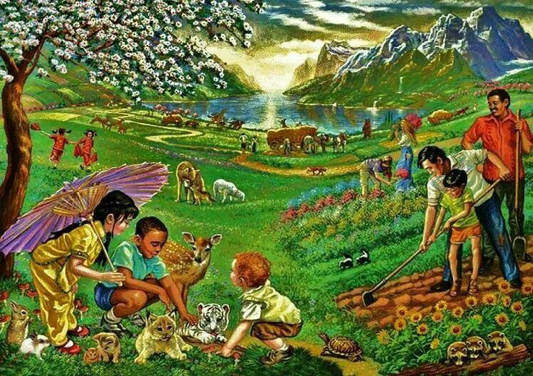
God & Kindness
Acts 14:17 – “and yet He did not leave Himself without witness, in that He did good and gave you rains from heaven and fruitful seasons, satisfying your hearts with food and gladness”
Notes:
In fact, Paul used God’s kindness as an evangelistic motivation toward the Greeks in Lystra in Acts 14:17 – “He did not leave Himself without witness, in that He did good and gave you rains from heaven and fruitful seasons, satisfying your hearts with food and gladness”. What is Paul doing here? He is attempting to create a positive impression in their minds about the one true God in order to get them to look beyond what has been supplied by this planet to the actual Supplier. He’s suggesting, “God did this for you. Though you’ve turned your back on him because of your ignorance, Creation is shouting from the rooftops God’s kindness, how much He loves you and desires a relationship with you.” So Paul’s uses kindness as a tool because Paul understands there is true gospel power in kindness, because it’s supernatural, God designed, God-given.

Slide 6
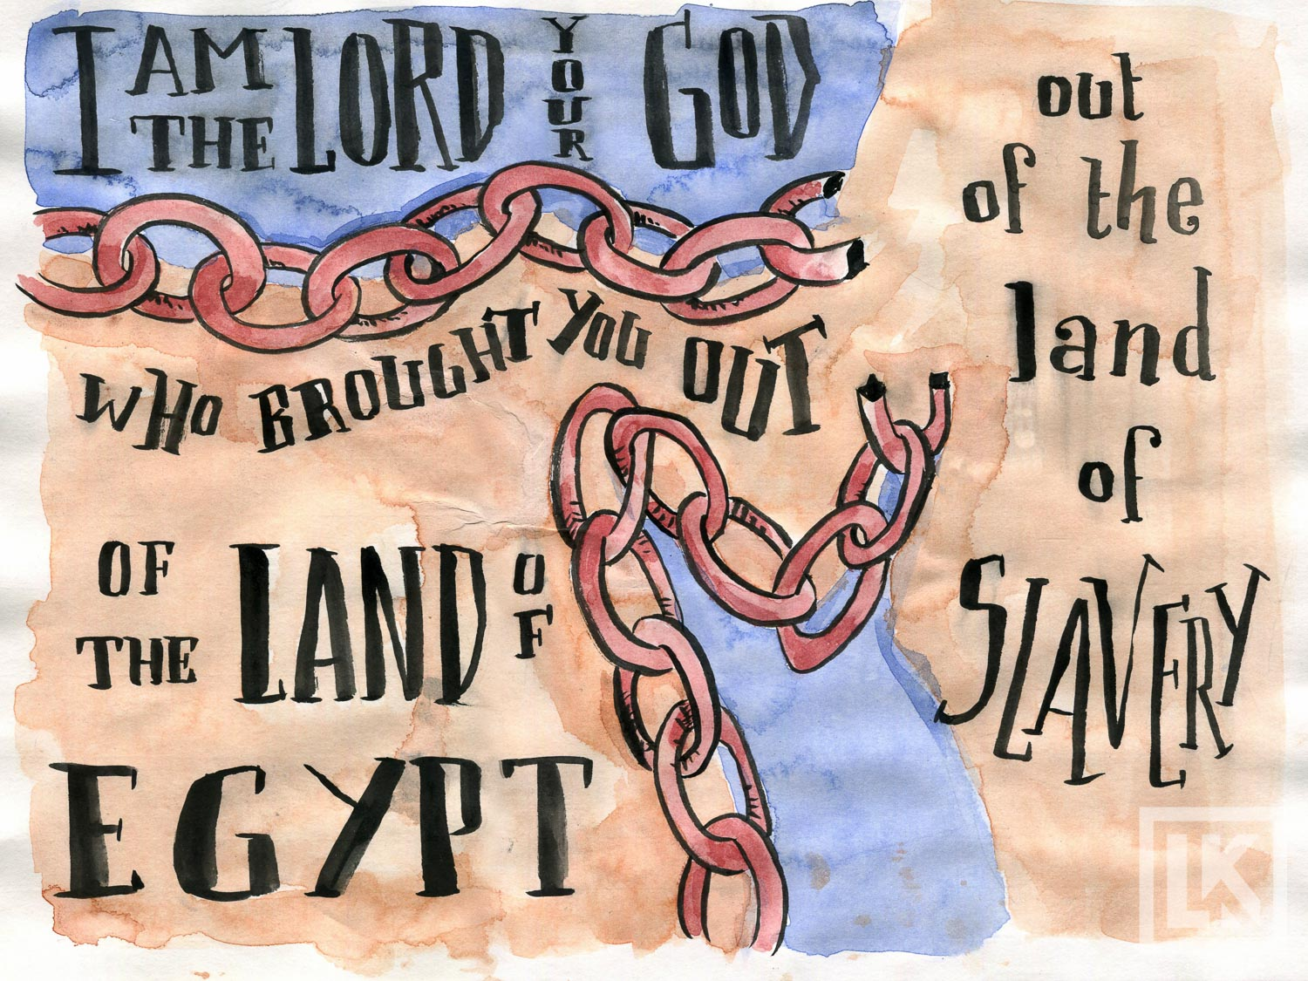
God & Kindness
Psa 105 – “Oh give thanks to the Lord, call upon His name; make known His deeds among the peoples…”
Notes:
And God showed this kindness not just to Gentiles, but to Jews. Psa 105 is a great example – Psa 105:1 – “Oh give thanks to the Lord, call upon His name; make known His deeds among the peoples.” And then he spends the entire chapter summarizing 1500 years of how He attempted to draw them to Him. And it wasn’t merely some authoritarian threat. He wanted to make them want to obey Him and submit to Him. So He gave them liberty from their captives, gave them a law, gave them a land, worked awesome miracles among them, rescued them from their oppressors time and time again, raised up prophets to lead them back when they strayed, etc. And though they rebelled over and over again, God continued to take them back. So many people look at the OT and say, “Wow, God was harsh. I don’t think I want to serve that God.” No one who has ever truly read the OT and studied God’s actions toward Israel could ever come away with that conclusion. God showed kindness toward Israel well beyond what they deserved, and because God understands more than that patience alone is limited. But patience combined with kindness yields amazing fruit, combining the passive attitude with active deeds of goodness towards others.

Slide 7
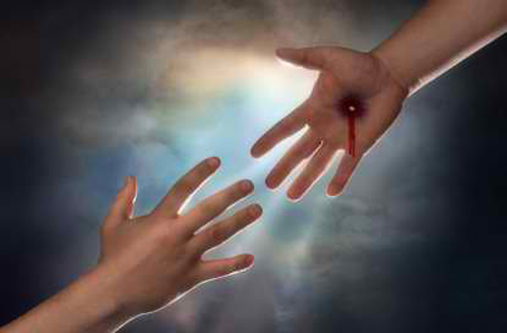
God & Kindness
Eph 2:6-7 – “[He] raised us up with Him, and seated us with Him in the heavenly places in Christ Jesus, so that in the ages to come He might show the surpassing riches of His grace in kindness toward us in Christ Jesus.”
Tit 3:4-5 – “But when the kindness of God our Savior and His love for mankind appeared, He saved us, not on the basis of deeds which we have done in righteousness, but according to His mercy, by the washing of regeneration and renewing by the Holy Spirit”
Notes:
Eph 2:6-7 – “[He] raised us up with Him, and seated us with Him in the heavenly places in Christ Jesus, so that in the ages to come He might show the surpassing riches of His grace in kindness toward us in Christ Jesus.”
Tit 3:4-5 – “But when the kindness of God our Savior and His love for mankind appeared, He saved us, not on the basis of deeds which we have done in righteousness, but according to His mercy, by the washing of regeneration and renewing by the Holy Spirit”
Brethren, it’s when we contemplate God’s kindness over the entirety of human experience, gaining a grasp of how truly kind God has been to us, I tell you, it takes a really hard-hearted person at that point to say to Him, “I just don’t care about you. It’s true you’ve been so kind, but I’m going do what I want to do.”
The kindness of God leads us to repentance, and that verse implies that as God continued to pour out His kindness, they hadn’t yet turned to Him. They were still His enemies. But in His patience, He continued to pour out kindness. And that particular characteristic of love has incredible power to draw men to Him, and we all here are evidence of that fact.

Slide 8
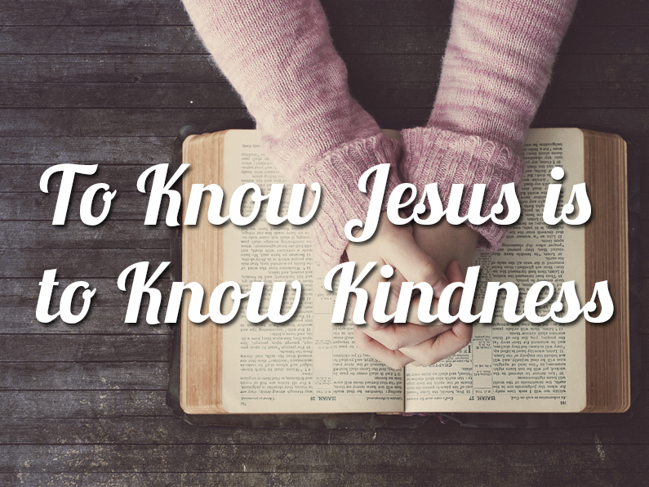
Jesus & Kindness
Luke 14:12-14 – “And He also went on to say to the one who had invited Him, ‘When you give a luncheon or a dinner, do not invite your friends or your brothers or your relatives or rich neighbors, otherwise they may also invite you in return and that will be your repayment. But when you give a reception, invite the poor, the crippled, the lame, the blind, and you will be blessed, since they do not have the means to repay you; for you will be repaid at the resurrection of the righteous.”
Notes:
And we see this love demonstrated by Jesus all throughout His ministry as He tirelessly catered to those who were less fortunate and could not return or reward His kindness. The gospels overflow with Jesus’ acts of kindness so that they read like a language in and of themselves. He so impacted the world with this gentle force that we can still see the fruit of it today. Jesus and those who follow Him continue to touch lives and make a difference. And so important to note about Jesus’ kindness specifically is that He never played favorites. He was to kind to those who you’d never expect: a Samaritan woman, an adulteress, harlots, tax collectors, lepers, Gentiles, etc. And He did it all expecting absolutely nothing in return. After all what can you give Jesus that isn’t already His? He didn’t go into these acts of kindness expecting anything. If I was the one who washed the Apostles’ feet, I might have said, “You see what I’ve done for you? Since I wash your feet, I want you to wash my feet.” No, Jesus said, “Since I washed your feet, I want you to wash other peoples’ feet.” He doesn’t want anything from us for Himself. He simply wants us to reciprocate his behavior toward others. He says it this way in the gospels:
Luke 14:12-14 – “When you give a luncheon or a dinner, do not invite your friends or your brothers or your relatives or rich neighbors, otherwise they may also invite you in return and that will be your repayment. But when you give a reception, invite the poor, the crippled, the lame, the blind, and you will be blessed, since they do not have the means to repay you; for you will be repaid at the resurrection of the righteous.”
It’s not that He says you can’t invite your friend or neighbors. That’s not the point. He’s not even saying that people shouldn’t be liberal with us because we’ve been liberal toward them. He’s simply saying, the motive in serving others should be loving kindness and not reward. And that is why it is better to show kindness toward the poor, crippled, blind, and lame because they cannot reward you. Kindness is its own reward, because its being like Jesus. It’s taking on His character, acting like Him. There is no greater reward than becoming closer to being like our Savior. Loving kindness is showing grace, compassion, and tenderness to someone not for what you expect in return, but simply for what you can give them and bless them with. And only those who are fully aware of what they’ve been freely given could even begin to give to others so freely.

Slide 9
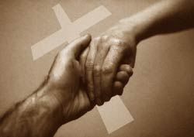
Thoughts On Kindness
Kindness is benevolence
2 Cor 9:13-14 – “Because of the proof given by this ministry, they will glorify God for your obedience to your confession of the gospel of Christ and for the liberality of your contribution to them and to all, while they also, by prayer on your behalf, yearn for you because of the surpassing grace of God in you.”
Notes:
Let’s look at some practical considerations relative to kindness:
Kindness is benevolence. And benevolence is kindness. So that means benevolence has the power to change people’s lives. I think this is easier to see when we’re individually helping nonChristians, but do we ever think about it like this as far as helping needy saints? When we supply help to needy saints, we are displaying the kindness of God. And what does the kindness of God do? Well, it leads others to repentance. That begs the question: if the church’s collective work in benevolence is limited to saints, which is what I believe the bible pattern teaches, what is it about benevolence that could lead Christians to repentance? Christians are already saved. Well, has anyone ever been in need, or had things taken away from you that you had come to depend on? Does that not test your faith? I mean, we say, “Christians should rise above that”, but many Christians have yet to reach that level of maturity. But then here comes Christians from some other church, who we may have never even met, who has heard we’re struggling, and they generously supply for our physical needs…can you see how something like that might strengthen faith?
My point is only this: don’t be so hasty, as I’ve been in the past, to think that the work of supporting gospel preachers from the treasury is more important than benevolent work for needy saints from the treasury. I do think we need to think about this a little more deeply. Is it true that come judgment day a person’s spiritual health will be more significant than their physical health. Yes, in the long run. But the problem with this logic, if we allow it to decrease our benevolent work above our evangelistic work, is that in doing so we’re underestimating the power that benevolent kindness can have on a Christian spiritually. I don’t think the work of supporting gospel is more important than benevolent work and I don’t think benevolent work is more important than supporting gospel preachers. Supporting gospel preachers is easier to do on a budget basis because benevolent support typically is on an “as needed basis”, but at the same time if a benevolent opportunity does fall in our lap and we’re able to help, we need to seize on those opportunities. And its not necessarily a bad thing to put feelers out there seeking opportunities, that’s my opinion.
2 Cor 9:13-14 – “Because of the proof given by this ministry, they will glorify God for your obedience to your confession of the gospel of Christ and for the liberality of your contribution to them and to all, while they also, by prayer on your behalf, yearn for you because of the surpassing grace of God in you.”
So what affect did the benevolent support from the Corinthian brethren to the Judean brethren have on them? It caused them to glorify God, it caused them to pray more fervently for those Christian, and to yearn after them more. These are all very positive, spiritual things.
Too, when we supply benevolence to needy Christians, how are others in that community, who are not part of the church, affected when they see the kindness of benevolence between Christians? Does that not have a positive affect on nonChristians in the community, evangelistically speaking?

Slide 10
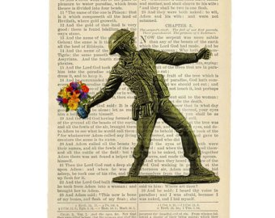
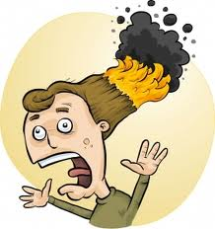
Thoughts On Kindness
Kindness is benevolence
Kindness is not always pleasant
Psa 141:5 – “Let the righteous smite me in kindness and reprove me; it is oil upon the head; do not let my head refuse it, for still my prayer is against their wicked deeds.”
Rom 12:20 – “But if your enemy is hungry, feed him, and if he is thirsty, give him a drink; for in so doing you will heap burning coals on his head.”
Notes:
Secondly, kindness is not always pleasant. We may think of kindness as compliments, flowers, candy, cooking someone a meal, and many other pleasant things that just warm our heart and make us feel mushy inside. But when we have cancer, physicians have to get rid of that cancer by cutting pretty deep. And that hurts. Is he showing kindness?
Psa 141:5 – “Let the righteous smite me in kindness and reprove me; it is oil upon the head; do not let my head refuse it, for still my prayer is against their wicked deeds.”
Spiritually speaking, kindness may be rebuking someone. It may be calling them out on their sin. It may be practicing church discipline. It may be telling someone something they don’t want to hear, stepping on their toes, piercing their hearts. In other words, how pleasant one feels at the end of it all is not an accurate definition of whether kindness has been demonstrated. David saw the rebuke of a righteous man, much like what Nathan had done for him, as an act of kindness and he is praying to God that he would not refuse it, which is what our temptation is to do. Because being the subject of rebuke is unpleasant. But…
Rom 12:20 – “But if your enemy is hungry, feed him, and if he is thirsty, give him a drink; for in so doing you will heap burning coals on his head.”
In other words, “kill them with kindness”. Who are we killing with kindness? The old man still in that person. And that old man needs to die. And kindness is a weapon of mass destruction for killing those old sinful inclinations just don’t won’t go away in us. Kindness has the power to soften hearts, though it may not feel pleasant initially.

Slide 11
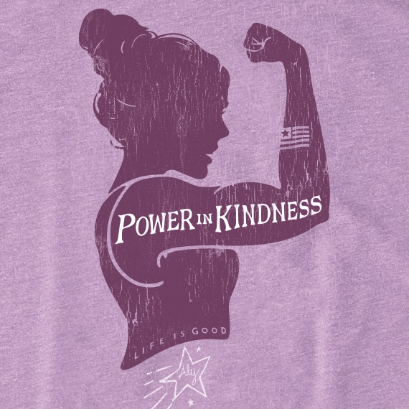
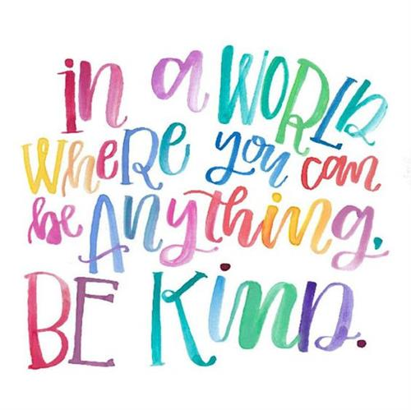
Thoughts On Kindness
Kindness is benevolence
Kindness is not always pleasant
Kindness changes us
Prov 11:16-17 – “A gracious woman attains honor, and ruthless men attain riches. The merciful man does himself good, but the cruel man does himself harm.”
Notes:
3. Finally, if we don’t change one person in this world with acts of kindness (which we will), at the very least it will change us.
Prov 11:16-17 – “A gracious woman attains honor, and ruthless men attain riches. The merciful man does himself good, but the cruel man does himself harm.”
A gracious and merciful person is kind. When we are kind, joy, happiness, and honor follow. That is an amazing payback. When we set out to be kind to others, to lift them up, to encourage/strengthen them, the result is that we are lifted up. We are encouraged/strengthened. Let’s be kind to others today and then pay attention to the payback we receive in our own lives. Perhaps if enough of us are kind to others the atmosphere at school, work, home, or maybe even the nation will change. But even if it doesn’t, at least the atmosphere in our own hearts will change.

