Slide 1
Notes:
Remember that famous line in the movie Snow White? “Mirror, mirror, in my hand, who’s the fairest in the land?” And year after year, that magic mirror assured Snow White’s stepmother that no one was fairer than she. But when Snow White grew up, she became more beautiful than her stepmother, and the mirror gave her an update she was not expecting. “Mirror, mirror, in my hand, who’s the fairest in the land?” “My queen, you are the fairest here so true. But Snow White, beyond the mountains at the Seven Dwarves, is a thousand times more beautiful than you.” And after an unsuccessful attempt to kill Snow White, the queen eventually died in a fit of fury.
In 1 Cor 13:4, Paul enumerates through the things that love does and then the things which love does not do. And the first enemy of love mentioned after saying love is patient and love is kind in verse 4, is that love “is not jealous”. Some of your translations say, “love does not envy”. Envy is not some petty whim, bad habit, or some faze we dare dismiss. Envy is a cancerous ulcer that will consume us until we waste away.
Shakespeare, in his famous tragedy about Antony & Cleopatra, referred to envy as the “Green Sickness”. And that’s very illustrative.
Philipp Bailey, another famous English poet of bygone years, vividly portrayed envy as a “coal that comes hissing hot from hell.”
Envy is an agitation of the spirit as our mind dwells continuously on something that we desire but which someone else has obtained. In the parable of the Laborers in the Vineyard of Matt 20, Jesus refers to it in verse 15 as an “envious eye”.

Slide 2
What Is Envy?
“Envy” = “zéloó” = “to boil over, to burn, to seethe”
Permissive
Prohibitive
1 Cor 14:1 – “Pursue love, yet desire earnestly gifts, but especially that you may prophesy.”
1 Cor 13:4c – “[Love] is not jealous.”
Rom 12:15a – “Rejoice with those who rejoice, and weep with those who weep”
Envy 6:66 – “Rejoice over those who weep, and weep over those who rejoice.”
Notes:
The Greek word for envy is interesting. It is the word “zéloó” and it literally means to “boil over” or “to seethe”. And what’s interesting about this word is that it is used in scripture in both a permissive and prohibitive manner. In fact, 1 Cor alone uses this same word in both these ways.
1 Cor 14:1 – “Pursue love, yet desire earnestly spiritual gifts, but especially that you may prophesy.” That phrase “desire earnestly” is the same Greek word that is used in a prohibitive setting in 1 Cor 13:4 but in a permissive setting in the very next chapter as it is encouraging “enthusiasm”. So translated in English, this word can mean “zealous” or “jealous”. But there is a world of difference between these two ideas. Because whenever it is used in a negative matter, it always refers to that seething, boiling, envy that grows and infects our heart. And Paul, who was informed by Chloe’s people that the Corinthians were torn apart by factions and divisions, is pleading with them that an envious heart destroys our ability to love
Usually when we speak of envy, we use this interchangeably with the word jealous. The NT even uses them interchangeably. But there is a subtle difference. And if I had to pick which one is worse, I’d have to go with envy because we learn in scripture that God is jealous but never does it say that He envies. Here’s the difference: envy stands at the back of the line spewing ill will toward everyone who is in front. But jealousy stands at the front of the line irritated that someone might try to replace him. Envy is angry at what everyone else has that it does not possess. But jealousy is afraid that what it owns will be taken away. Envy begins with empty hands, lamenting its own lack yet joyful when others lose their superiority. Jealousy begins with full hands, fearful of losing what it has already achieved. Envy, in a lot of ways is a backhanded compliment. Someone once said that envy is the tribute that mediocrity plays to genius. Because in order to belittle, you have to be little.
Rom 12:15a – “Rejoice with those who rejoice, and weep with those who weep”, but envy flips that right on its head because envy weeps at those who rejoice and it rejoices over those that weep. And this is why envy has destroyed marriages, wrecked families, divided churches, and devastated relationships more than perhaps any other vice with the possible exception of its twin sin “pride”.

Slide 3
Where Does Envy Develop?
Prosperity Circles
Gen 26:14 – “[Isaac] had possessions of flocks and herds and a great household, so that the Philistines envied him.”
Notes:
Most biological organisms, those inside and outside of our body, are harmless by themselves. But when you introduce certain settings and conditions into the equation, these harmless organisms cause diseases that are harmful. Envy, as a spiritual disease, works the same way. There are certain settings and circles which by themselves are harmless, but if envy begins to ferment, it corrupts those circles and settings
First, envy develops in circles of prosperity – Gen 26:14 – “[Isaac] had possessions of flocks and herds and a great household, so that the Philistines envied him.” See, there was nothing inherently wrong with Isaac having been successful and having accrued wealth through the grace God gave him and there was nothing inherently wrong with him dwelling with other people who had less than he. But in those settings, if the disease of envy begins to develop, that’s when that evil eye starts to look suspiciously at the person who has a little bit more. Envy is often cultivated in the hearts of those who to most people have more than enough, but cannot be content when their eye spots another within the circle who has just a little bit more.

Slide 4
Where Does Envy Develop?
Prosperity Circles
Power Circles
Psa 106:16 – “…they became envious of Moses in the camp, and of Aaron, the holy one of the Lord”
Acts 5:17-18 – “But the high priest rose up, along with all his associates (that is the sect of the Sadducees), and they were filled with jealousy. They laid hands on the apostles and put them in a public jail.”
Notes:
Secondly, envy develops in circles of power (Psa 106). In the book of Numbers, we read about Miriam and Aaron and Korah, Dathan, and Abiram who envied Moses because of the leadership role he had before God. And the Psalmist gives us a behind the scenes look at what was actually going on in their hearts – Psa 106:16 – “…they became envious of Moses in the camp, and of Aaron, the holy one of the Lord”
And all throughout the books of the Kings and Chronicles, we see story after sorted story of usurpation taking place. A man would want power so badly he was willing to be devious and betray and even kill in order to become the one in charge. And anytime you have a person in some capacity of leadership or power, even today, you can be sure that envy is corrupting the heart of someone who would rather it be them.
In Acts 5, as the Sanhedrin are persecuting the Apostles, on the surface it looks like nothing more than religious persecution. And that is almost always the case with envy, in that the one who is infected by it will rarely admit it and will instead attack the other person under false pretenses – Acts 5:17-18 – “But the high priest rose up, along with all his associates (that is the sect of the Sadducees), and they were filled with jealousy (same Greek word). They laid hands on the apostles and put them in a public jail.” There will always develop within some a tendency to become jealous of any position of influence or power that does not emanate within myself

Slide 5
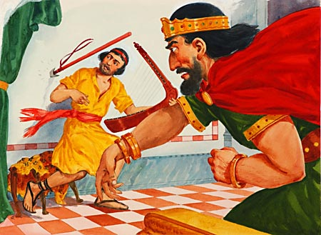
Where Does Envy Develop?
Prosperity Circles
Power Circles
Performance Circles
Gen 30:1 – “Now when Rachel saw that she bore Jacob no children, she became jealous of her sister”
1 Sam 18:7,9 – “Saul has slain his thousands, and David his ten thousands…Saul looked at David with suspicion from that day on.”
Notes:
Third, envy develops in circles of performance. When Rachel saw that Leah was bearing sons and Rachel herself was barren and therefore unable to give children to Jacob who loved her so, we read the following – Gen 30:1 – “Now when Rachel saw that she bore Jacob no children, she became jealous of her sister”
And then there is of course David and Saul. After David struck down Goliath on behalf of God and the people of Israel, the women in the cities of Israel began singing a song – 1 Sam 18:7 – “Saul has slain his thousands, and David his ten thousands.” And when those words came to Saul’s ear, that’s when the green sickness started to develop in his heart – 1 Sam 18:9 – “Saul looked at David with suspicion from that day on.” There’s that “evil eye” Jesus mentioned. And Saul would spend the rest of his life trying to bring down David, because he could not duplicate the performance of his servant whom God was blessing.
Illustration: A few years ago, Reader’s Digest had a story about a mother of 4 who was talking about her neighbor who also had 4 children, saying, “She’s amazing. Her house is always as neat as a pin, she’s a wonderful cook, she does her own sewing, her children are always polite and well behaved, she’s active in the PTA and the Brownies and she’s a den mother for the Cub Scouts, and she’s pretty and has loads of personality. She makes me sick.” And all of us have said that in jest, but brethren, that’s what we’re talking about. Envy is not a bad habit – it makes us sick
And it’s unfortunate that it develops in circles of performance because all of the public acts of worship we do in local churches, from preaching, to leading singing, and to public prayer, can’t you see how easily envy could develop in an environment like this? And you know when this becomes apparent to me? It’s when a person says, “I have a hard time worshipping at your church because it’s just too big and I don’t have enough opportunities to serve.” Now think about that statement for a moment. Doesn’t the fact that we are so big mean we have more opportunities to serve? We have widows, members who are shut in, members who have surgery, some who are falling away, some who have fallen way, some who just need a letter of encouragement, some who need financial assistance, some who just need a friend, some who need someone to take them under their wing and study with them, and a thousand other areas of service. You cannot look at the University church of Christ and use a lack of opportunity to serve as an excuse unless what you’re really talking about are those areas of service where eyes are on me. And I would say to those of us who are serving in those capacities, which are necessary, take care that this green sickness doesn’t develop in our hearts.

Slide 6
Where Does Envy Develop?
Prosperity Circles
Power Circles
Performance Circles
Professional Circles
Phil 1:15 – “Some, to be sure, are preaching Christ even from envy and strife, but some also from good will”
Phil 1:18 – “What then? Only that in every way, whether in pretense or in truth, Christ is proclaimed; and in this I rejoice.”
Notes:
Fourth, envy develops in professional circles (Phil 1). When Paul was in a Roman prison, he tells us in Phil 1:15 that some of his contemporary preachers were only preaching out of envy and strife. So what was he going to do about this? Would he return envy for envy? Would he lambast them and deride their ego-motivated ill-will? – Phil 1:18 – “What then? Only that in every way, whether in pretense or in truth, Christ is proclaimed; and in this I rejoice.” In other words, Paul didn’t get caught up in professional envy. And this is often a circle in which envy is cultivated.
Everyone here knows what I’m talking about. We see it in business when someone wants your job and they’ll do anything to cut you down. And in the corporate world, if you don’t play the game, you’ll get walked all over and decimated and left behind in the dust.
Brethren, most churches that go through an eldership/deacon process face this. It’s almost inevitable that when one man gets selected and another man doesn’t who thinks he should have been selected, that envy begins to sneak its way into their heart and it hurts the relationship between those two men. Brethren, please, please, please be on guard against this. Satan wants to infect us with this envy so that it will destroy our ability to love one another as Christians, which will only stagnate and cripple our walk with the Lord Jesus Christ and hurt others as well.

Slide 7
Where Does Envy Develop?
Prosperity Circles
Power Circles
Performance Circles
Professional Circles
Family Circles
Notes:
And fifth, envy develops in family circles as well. And I don’t know whether this will shock you or not, but there are more examples in the bible of envy being demonstrated within families than in any other context. Cain’s jealousy towards Abel. Ishmael’s mocking of Isaac. Jacob’s aspirations towards Esau’s superior birthright. Jesus was rejected by his own brothers of the flesh because of His claims of preeminence. When the prodigal son returned, remember the statement that his brother made, a statement just dripping with envy? “you have never given me a young goat, so that I might celebrate with my friends”. And one of the more profound examples is in Gen 37 between Joseph and his brothers; oh how they envied Joseph for how much their father loved him.
My mother told me that when I was born, my sister, who is 6 years older than me, couldn’t stand me. I asked my sister once if that was true and she said, “Yes, because you stole my playroom.” We’re cool now. The bible shows us time and time again that when envy comes into a family’s front door, love goes out the back door.

Slide 8
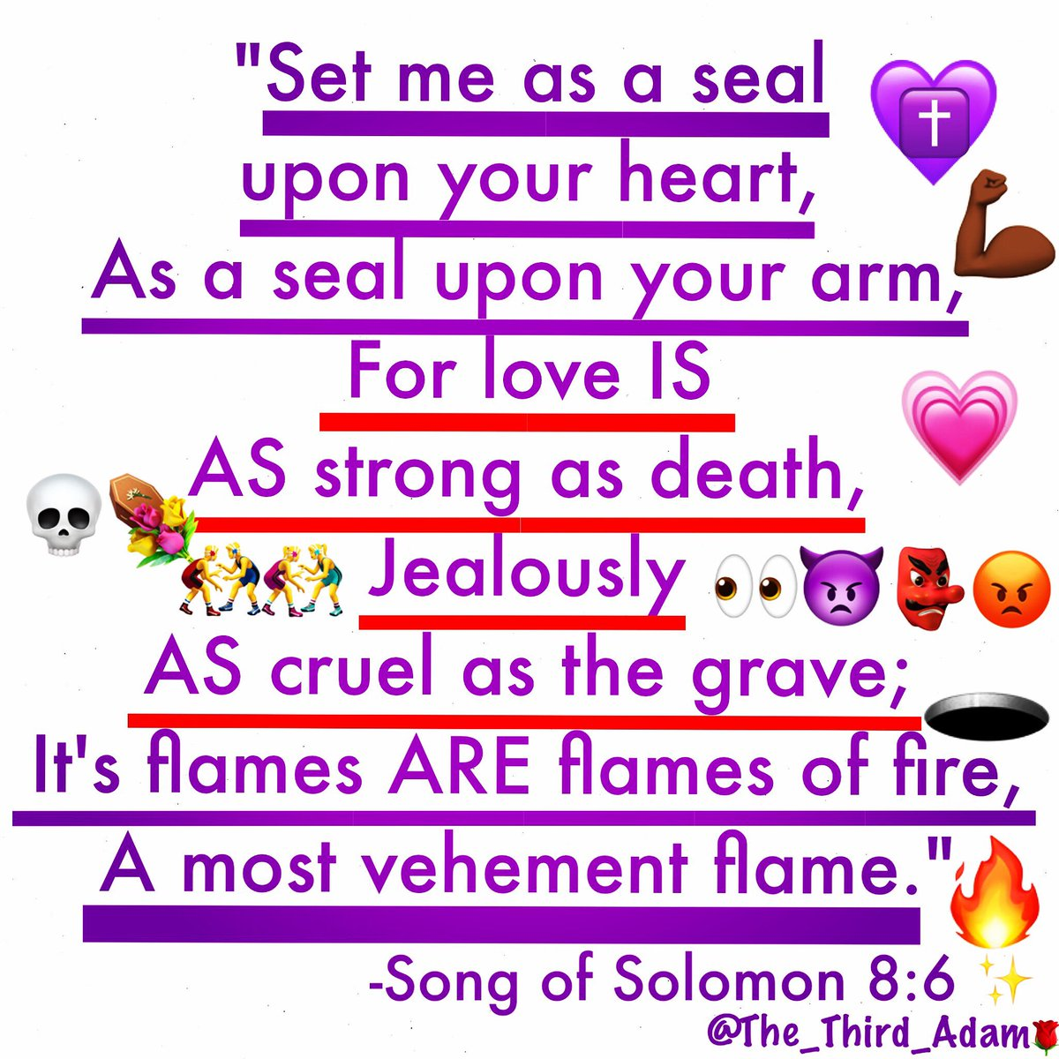
What’s At The Heart Of Envy?
It Is Cruelty
Cain -> Abel
Saul -> David
Herod -> Children
Joseph’s Bros -> Joseph
Peninnah -> Hannah
Korah -> Moses
Sanballat -> Jews
Pharisees - > Jesus
Notes:
What’s at the heart of envy?
First, envy is a form of cruelty that replaces and destroys the heart’s ability to love. And this is what we see all throughout scripture, a bloody trail of destruction and cruelty exhibited time and time again when envy takes over the heart. Cain kills Abel, Saul tries to kill David, Herod kills all the children who he fears might replace him on the throne, and on and on the list goes. The history of envy is that it always ends in destruction. Envy led Joseph’s brothers to say about him, “Here comes this dreamer”. Elkanah’s other wife repeatedly provoked Hannah over Elkanah’s love toward her. Moses was slandered and belittled by Korah and his princes. Envy had the Samaritan Sanballat jealous over the prosperity of the rebuilt walls of Jerusalem. And it was the envy toward Jesus that caused the scribes to discount His miracles, not believing the blind man of John 9 was healed and questioning his credentials.
All throughout scripture we see just how cruel envy really is. And when it is allowed to fester and grow, unabated by an influx of love, it leads to physical murder, character assassination, rivalries, factions, and some of the nastiest divisions you can imagine.

Slide 9
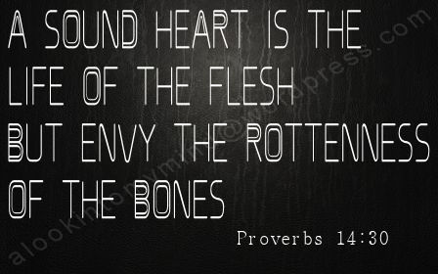
What’s At The Heart Of Envy?
It Is Cruelty
It Is Self-Mutilation
Notes:
Second, it’s self-mutilation at its core.
Prov 14:30 – “A tranquil heart is life to the body, but [envy] is rottenness to the bones.”
Illustration: You may heard the story of the two men who were jealous of one another until one night an angel visited one of the men offering him whatever he wished. But there was a stipulation. The angel told him that whatever he wished for, the other guy he envied would receive doublé. He said, “You mean if I ask for a $1 million he’ll receive $2 million?” “That’s right.” “And if I wish for 20k sqft house, he’ll get a 40k sqft house?” “That’s right”. He then said, “Hmph. Ok then….I wish to be blind in one eye.”
That is exactly how envy works, brethren. It’s so cruel, we’re willing to hurt and maim and practically destroy ourselves just so we can destroy the object of our envy.

Slide 10
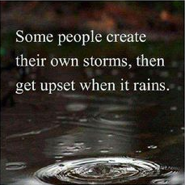
What’s At The Heart Of Envy?
It Is Cruelty
It Is Self-Mutilation
One Of The Most Reap-able Sins
Notes:
Third, it is one of the most reap-able sins to ever be sown. Like a boomerang, envy will always come right back around and bite the offender.
It was Haman who was hanged on the very gallows he prepared for Mordecai, the object of his envy.
Daniel’s envious coworkers were crushed by the very same den of lions they had convinced the king to throw Daniel into the prior day.
Joseph was far better off sold into slavery than his brothers were who were left to deal with guilt and uneasy consciences.
David, in the wilderness with his psalms of confidence, was far better off than King Saul being eaten alive by the green sickness.
Envy is a miserable and cruel sickness, and if you are here this morning and afflicted by it, I hope you’ll muster the faith and courage to let it go, as quickly as possible.

Slide 11
What Can We Do?
Renounce As Sin
1 Pet 2:1 – “Therefore, putting aside all malice and all deceit and hypocrisy and envy and all slander…”
Notes:
First, we need to renounce it fully as nothing less than sin. Envy is not a personality disorder, or something you inherited with your temperament, and it is not a bad habit. Envy is sin. And the wages of this sin, like all others, is death.
1 Pet 2:1 – “Therefore, putting aside all malice and all deceit and hypocrisy and envy and all slander…” We need to put it away.
In the many catalogs of sins in the bible, those frequent lists we come across, you’ll always see envy and jealousy near the top. Because as Jas 3:15-16 says, it’s a byproduct of bitterness and it is according to the wisdom of the world which is demonic. We dare not undermine the seriousness of this sin, because Matt 27:18 tells us that it was this very sin that nailed our Lord to the cross. Have you ever thought about it in those terms, that every day we live with envy in our hearts, we’re living with the same spirit of those who crucified the Lord?. Envy is a dreaded sin, and we don’t do ourselves good by discounting it, or ignoring it, or passing it off as something that’s a faze

Slide 12
What Can We Do?
Renounce As Sin
Pray For The Object Of Your Envy
Notes:
Second, nothing frees one from jealousy quite like remembering the object of your envy in prayer every day. “Gross”. Only if you want to stay chained to this cruel vice. Only if you want it to continue eating away your soul like a cancer. But if you want to be free from it, I dare you to remember that person in your prayers every day, and you just see what begins to happen as a result of the display of that selfless kind of love. Because by praying for your rival continuously, you’re either going to have to get things settled with them, or that envy will just dissipate away. “Well, Ryan, who is my rival? Who do I envy?” I don’t know. Who is at the forefront of your mind as we discuss this subject? And do you have the courage to pray for that person daily?
A Scottish minister from the 19th century named Andrew Bonar acknowledged a life long struggle with envy, something very few people are willing to admit publically. It’s a rather embarrassing sin to admit is it not? It’s hard to admit that we’ve allowed another human being to have that kind of control over us. He wrote the following in his diary – “It is amazing that the Lord has spared me and used me at all. I have no reason to wonder that He used others far more than He does me. Yet envy is my hurt, and today I have been seeking grace to rejoice exceedingly over the usefulness of others, even where it cast me into the shade. Lord, take away this envy from me!” He went on later to explain that the only way he found he could deal with the envy he felt towards others in his professional circle was to remember them in his prayers.
Brethren, prayer for those whom you view as your rival, pray, pray, pray, and watch the envy dissipate away.

Slide 13
What Can We Do?
Renounce As Sin
Pray For The Object Of Your Envy
Learn Contentment
Notes:
Third, learn to be content with the goodness God has bestowed on you personally. Because when we are content, we do not become envious.
There’s a neat little story about a little snail who lived by the ocean and in envy he noticed the large beautiful shell in which the lobster lived. “What a grand palace. Oh I wish I lived in his place. Oh wouldn’t my friends admire me in this shell?” Well, in time, this envious snail watched as the lobster eventually walked right out of the shell to grow up in a larger one. “Now I shall have my wish!” The snail then boasted to all his friends how he was about to take up residence in this grand new palace, and so he pulled himself loose from his little shell, and finally crawled in the giant lobster shell. But it was so big he couldn’t fit and so he huffed and he puffed and he blew and he gasped in order to make himself fit. But in all his effort, he felt so small inside that great big lobster shell. He died the very first night in that shell, because being so large and him being so exhausted trying to fit inside of it, the shell was too cold. A wise old crow, looking on, said to the younger crows, “You see what become of envy? What you have is enough. Save yourself from a lot of trouble; because it is better to be a little snail in a comfortable shell than to be a little snail in a comfortable shell and freeze to death.
What if, instead of letting envy eat us alive, we stopped, observed our blessings, and approached God in prayer saying, “Lord, you have blessed me far greater than I deserve.”? Because envy cannot dwell in a thankful, content heart can it? They cannot coexist together. Those righteous fruits pushed envy right out

