Slide 1
Notes:
A young boy was sitting in his classroom drawing a picture. The teacher walked up behind him, saw the picture, and asked him, “What are you drawing?” He answered, “I’m drawing a picture of God.” The teacher replied that no one had ever really seen God and that we don’t really know what He looks like. The young boy didn’t miss a beat. He replied, “They will when I’m finished.”

Slide 2
“Mi” – “cha”
“Who [is] like…”
Notes:
Mic 1:1 – “The word of the Lord which came to Micah of Moresheth…” – typically when we encounter a Hebrew name that ends with “ah”, we assume the name “God” is in the name because “ah” is actually “Yah” in Hebrew, the abbreviation for ”Yahweh”. “Jeremiah” means “God loosens”. “Nehemiah” means “God comforts”.
(CLICK) But that is not the case w/the name “Micah”. Micah’s name is composed of two parts. The first word pronounced “mi” is the interrogative question “who?”. The second part “cha” means “as” or “like”, and so the name literally means, (CLICK) “Who is like…?” Now, this is interesting because Micah’s name is an incomplete sentence. The name of God is not in this name – it’s assumed to be the object of the phrase, but it’s not actually there. This is part of the poetic beauty of this book, that it’s not until we get to the end of the book, in 7:18, that the sentence is completed when we see the full phrase. “Who is like God?”
And so, the book entirety of this book is “Micah”, an incomplete sentence, completing the sentence. It’s taking us on a tour of the mighty workings of God, the things that make Him so wonderful, so incredible, that if someone were to ask us to tell them about God, all we could say is, “Who is like God?” And so, like that boy in the classroom, we will know God when we allow this book to finish the picture.
PRAYER

Slide 3
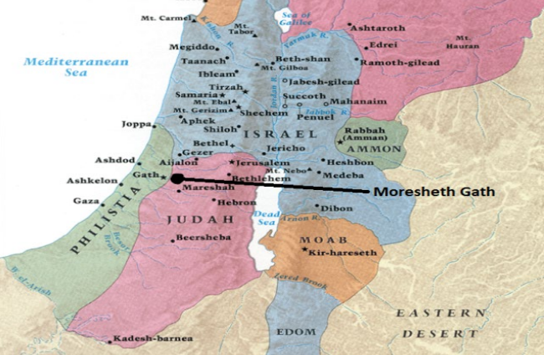
Who Was Micah?
Notes:
Before we look at “who is like God”, who is “Micah” the man? We don’t know. Mic 1:1 says he was from Moresheth, which was located ~22 miles southwest of Jerusalem in the fertile lowlands of Judah right across from the Philistine city of Gath. In fact, sometimes it was referred to as “Moresheth-Gath”. But Moresheth was also situated right on that famous highway called the “Via Maris”, the main highway between Egypt and Mesopotamia, and so like everyone in that town, we’d infer from this that Micah would have been acutely aware of international movements.
But we still know almost nothing biographically about Micah – the emphasis is purely on the message, not the man. While his contemporary Isaiah frequented royal circles in Jerusalem, Micah seems to have delivered much of his message in this little area on the outskirts of Jerusalem. But it’s not important where one serves, but how he serves. His life is completely concealed behind the word he was commissioned to proclaim. Though considered a “minor” prophet, the brevity of and the terseness of his message is anything but minor. is zero political correctness found in his speech. Micah was unafraid to name the elephant in the room and to speak plain truth. All this is to say that who he was is not as important as what he had to say.

Slide 4
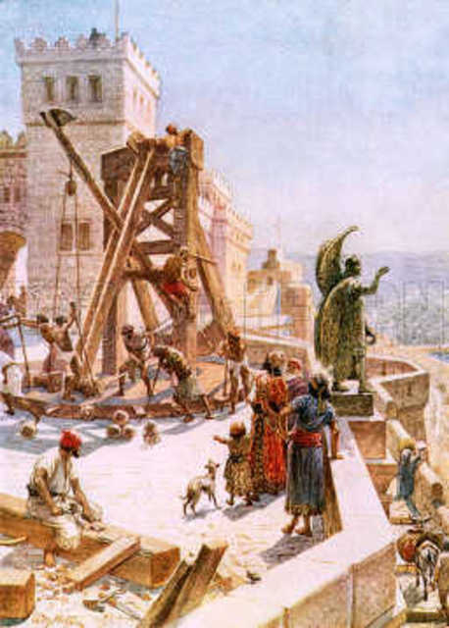
Background
Uzziah & Jotham
Good Kings
Nation Prospered
People Corrupt
Notes:
Mic 1:1 – “The word of the Lord which came to Micah of Moresheth in the days of Jotham, Ahaz and Hezekiah, kings of Judah…” – To understand what prompted Micah’s message, it is helpful to understand what was happening in Judah during his time as we find it recorded in 2 Chron 26; 2 Kings 15:
Around 791BC, 16-year-old Uzziah became king, and he’d reign for 52 years. Uzziah was one of the best kings to reign since David. God allowed the nation of Judah to become immensely strong under Uzziah. All the surrounding nations were subjugated to Uzziah, and he fortified Judah more than any other king before him. 2 Chron 26:5 – “as long as he sought the Lord, God prospered him.” And when his son Jotham became king in his place, he was also a good man, reigning 16 years – 2 Chron 27:6 – “So Jotham became mighty because he ordered his ways before the Lord his God.” And Jotham would continue fortifying Judah and subduing the surrounding nations. It’s in Jotham’s reign that Micah begins his ministry. (CLICK) So, both of these kings were 2 of the best kings Judah had seen. (CLICK) And under Uzziah and Jotham’s leadership, Judah prospered economically.
But what about the people they ruled? Under Uzziah, where were the people at, spiritually speaking? (CLICK) – 2 Kings 15:4 – “Only the high places were not taken away; the people still sacrificed and burned incense on the high places.” What about under Jotham? – 2 Chron 27:2c – “But the people continued acting corruptly.”

Slide 5
Background
Uzziah & Jotham
Good Kings
Nation Prospered
People Corrupt
Uzziah’s Pride
God Losing Patience
Notes:
And even Uzziah made a terrible mistake in the latter years of his reign – 2 Chron 26:16 – “But when he became strong, his heart was so proud that he acted corruptly, and he was unfaithful to the Lord his God, for he entered the temple of the Lord to burn incense on the altar of incense.” And if you keep reading, God struck Uzziah with leprosy, and he had to live out the remainder of his days in a separate house, and that’s when Jotham took over as coregent to his father.
How could this happen? Because while Israel and Judah both enjoyed peace their enemies as well as economic prosperity, it lulled the people into spiritual complacency and ultimately sin, and that sin even infected one of Judah’s best kings. (CLICK) And so, God’s patience w/His people is starting to wear thin. They’re not doing right, they’re not listening to the prophets He sends, and the sin of the people is so contagious that it’s infected one of Judah’s most righteous kings. Something has got to be done to fix the problem of sin.

Slide 6
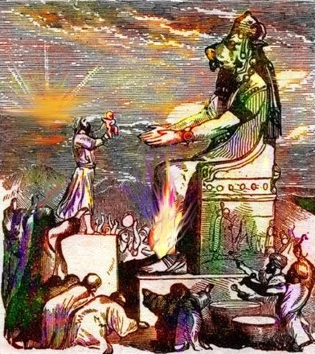
Background
Ahaz
Exceptionally wicked
Judah brought low
Decimated by nations
Notes:
Now, when Jotham died, his son Ahaz became king. And Ahaz was not like his father and grandfather – he was an exceptionally wicked man. 2 Chron 28:1-4 – “¹Ahaz was twenty years old when he became king, and he reigned sixteen years in Jerusalem; and he did not do right in the sight of the Lord as David his father had done. ²But he walked in the ways of the kings of Israel; he also made molten images for the Baals. ³Moreover, he burned incense in the valley of Ben-Hinnom and burned his sons in fire, according to the abominations of the nations whom the Lord had driven out before the sons of Israel. ⁴He sacrificed and burned incense on the high places, on the hills and under every green tree”
(CLICK) And so, God brought Judah very low because of Ahaz. Under Uzziah and Jotham, Judah experienced incredible prosperity. Isaiah described the land in Isa 2 as “full of silver and gold” and “full of horses”. But by the time Ahaz’s 16-year reign ended, everything had changed. Why? Because despite Uzziah and Jotham’s military reforms, God inserted Himself, bringing Judah very low because of Ahaz and the people’s sins. Under Uzziah and Jotham, the surrounding nations were subjugated. (CLICK) If you go on reading in 2 Chron 28, we’re told that during Ahaz’s reign, Syria took many Judeans captive to Damascus. Israel, led by its king Pekah, slew 120,000 Judeans in one day and carried into captivity 200,000 more until a prophet of the Lord made Israel return them to Judah. Edom and Philistia started attacking Judah and were just decimating the land, even settling in some of its cities on the border. This is a really bad time for Judah in which its sin and rebellion is coming back to bite it.

Slide 7
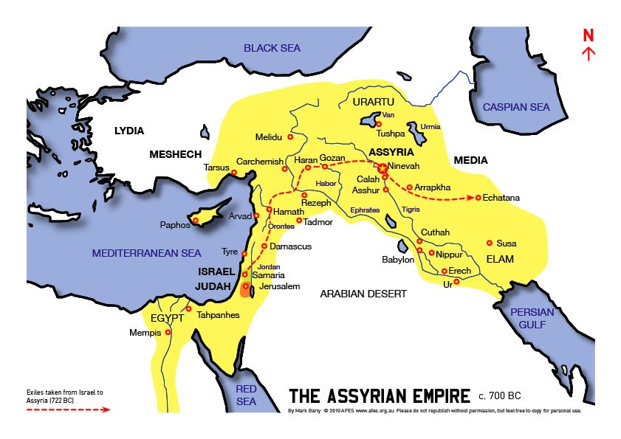
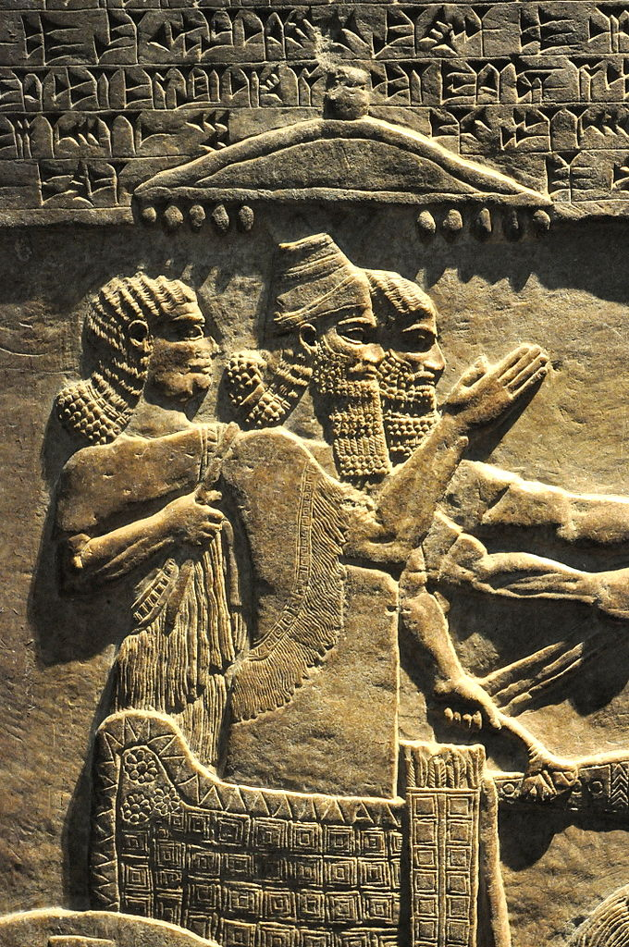
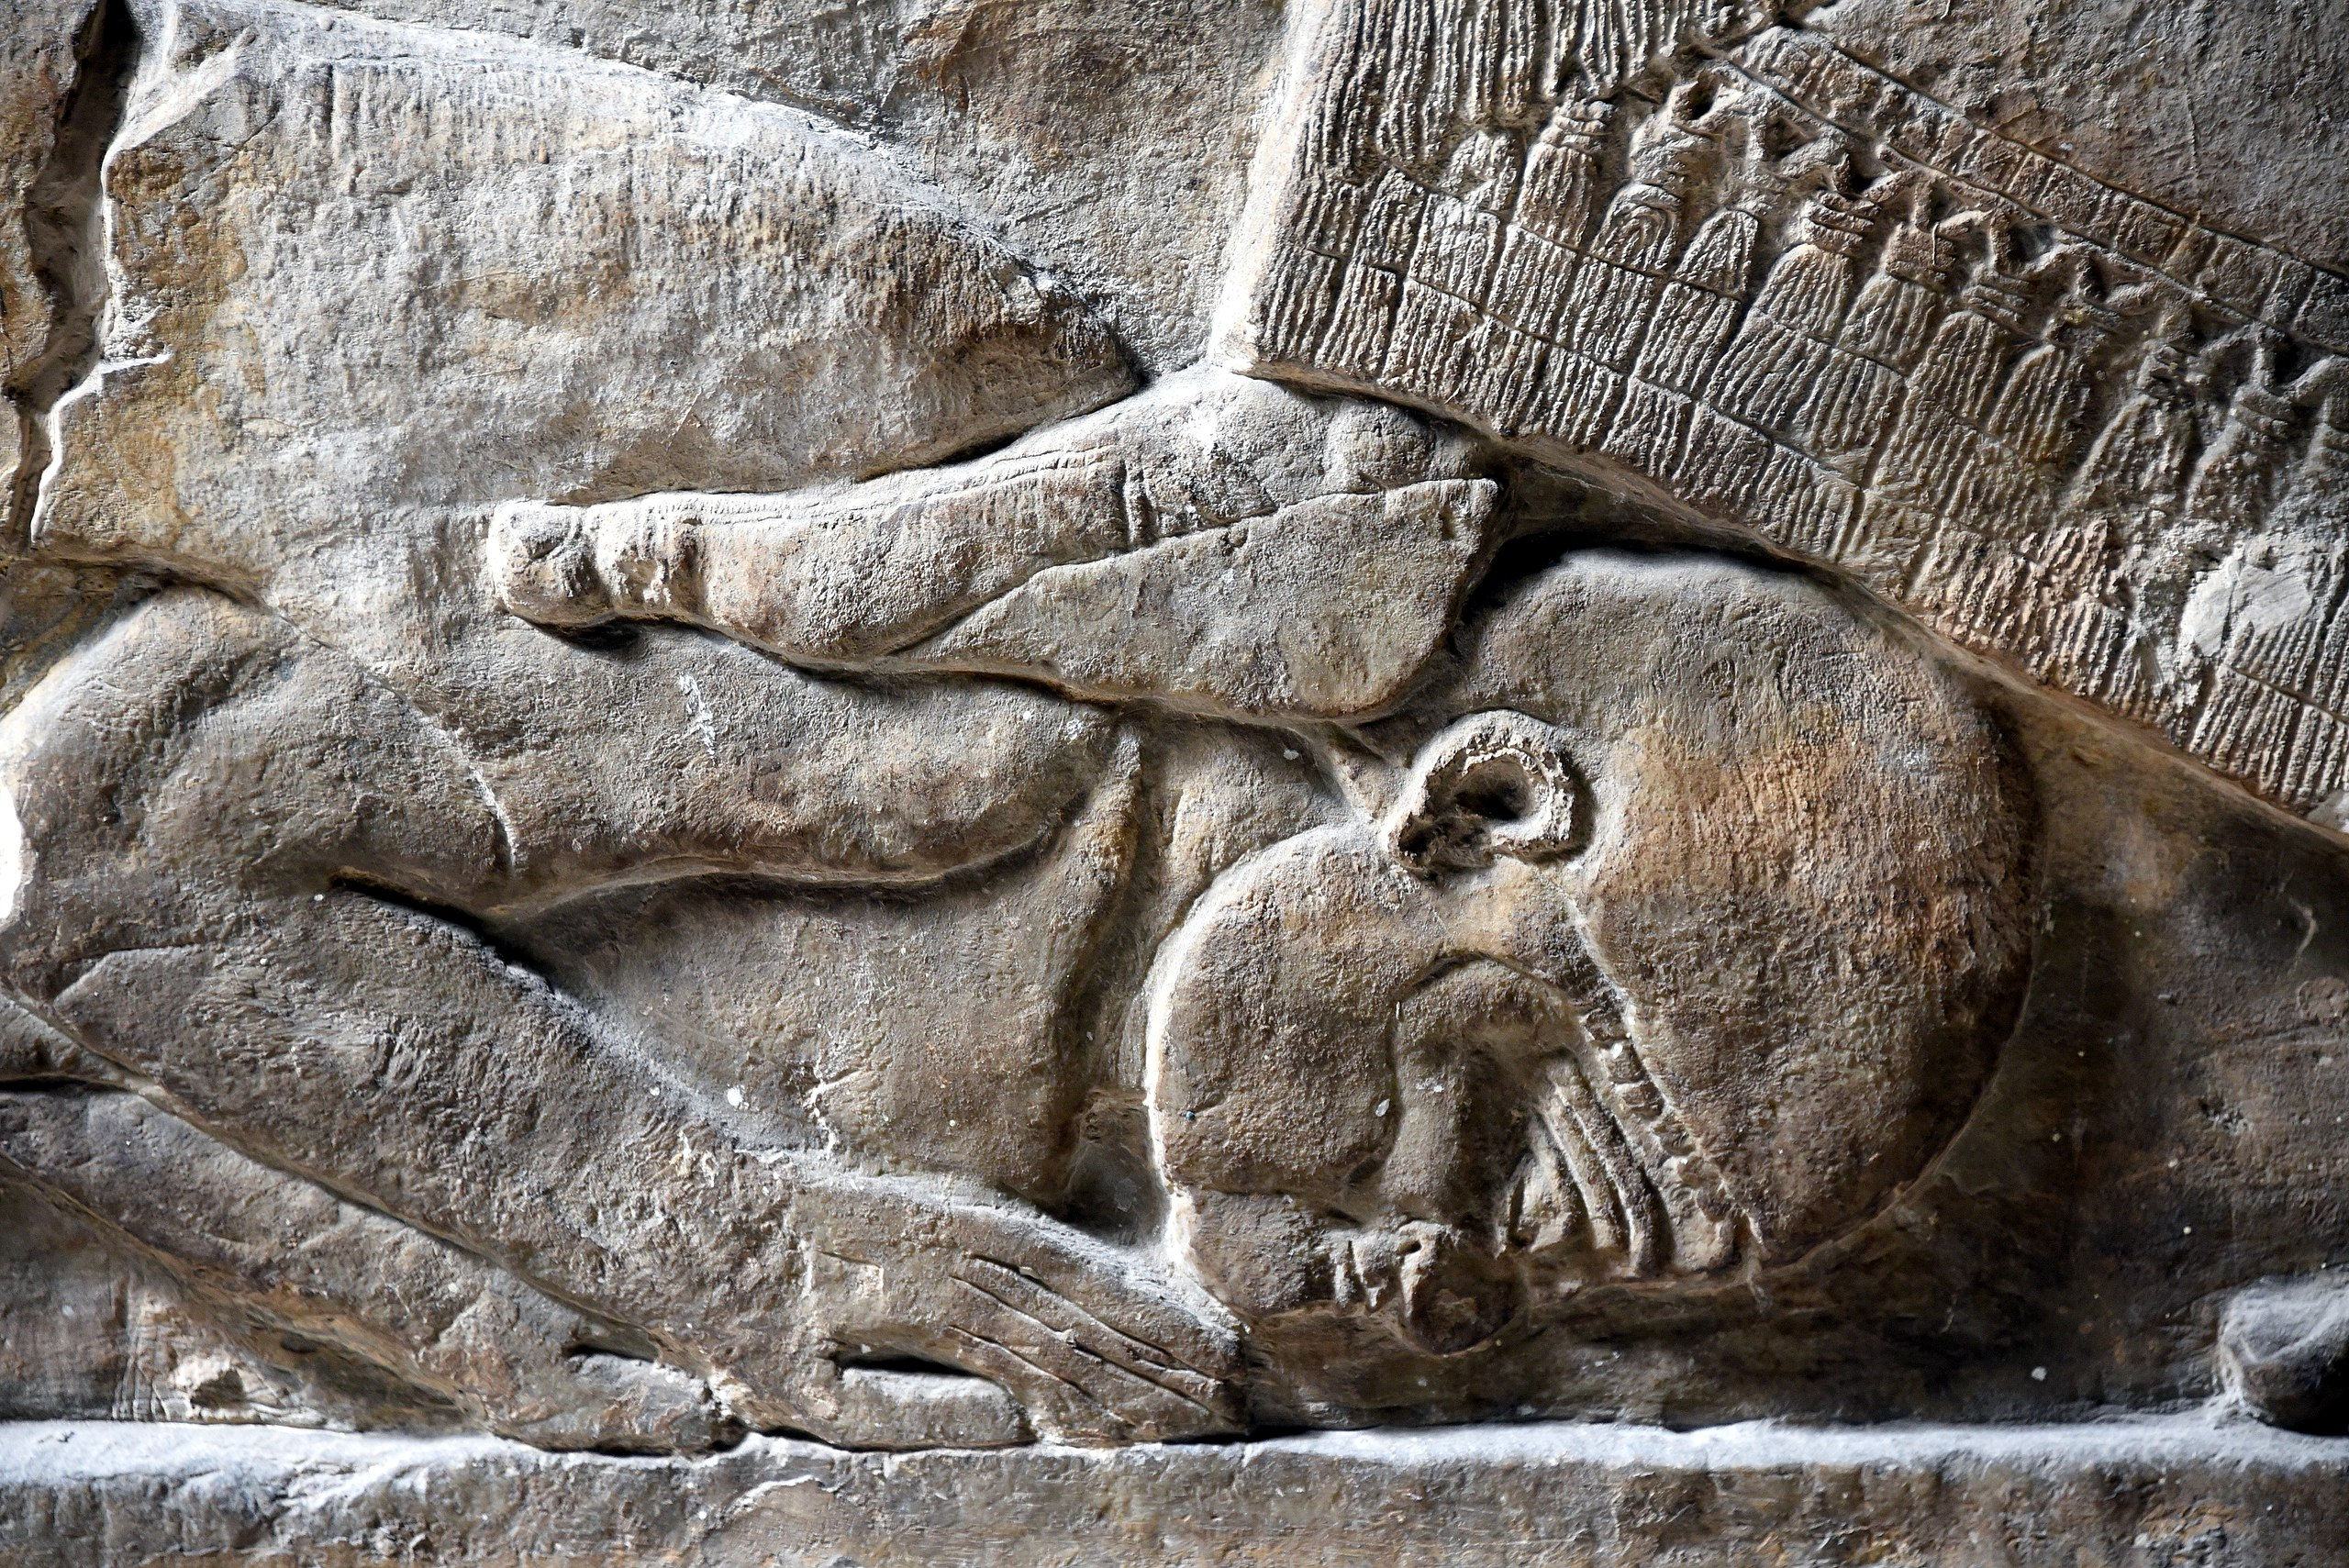
Background
Notes:
And so, along w/his contemporaries Isaiah, Amos, and Hosea, Micah announces a purging that God would be bringing upon both Israel and Judah, and He’s going to do so by raising up a very powerful, intimidating nation called the Assyrian empire. It’s king, Tiglath-Pileser III (depicted on the right), was the very epitome of an Assyrian king – ruthless, powerful, intelligent, energetic, and decisive. And he was unmerciful, decorating their palaces w/the flayed skin of its victims. And under his reign, Assyria was beginning to conquer a large portion of the fertile crescent and was posing a threat to every nation in its path.

Slide 8
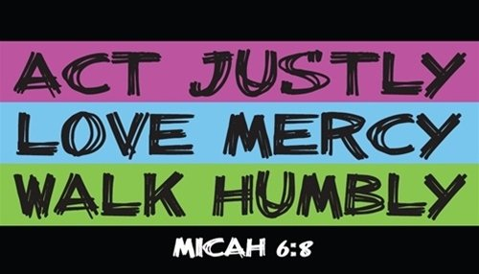
The Message
Notes:
And so, much of Micah’s message can be easily reconstructed in light of this historical context. The economic revolution, the prosperity enjoyed by the country, it was a mixed blessing. It actually spawned materialism, greed, and self-interest in which the wealthy would take advantage of the poor. There were land-grabbers who were driving people off their land (2:1-3,8-9), there was injustice (3:1-3,9-10), dishonest practices (6:10-11) and the poor had no redress (6:10-11; 7:1-4a). We might ask, “Well, where were the judges? Where were the Levites?” Oh, they were available – to the highest bidder (2:6,11; 3:5-7,11), ingratiating themselves toward the rich at the expense of justice and righteousness. And Micah, being from Moresheth, a small farming community, he would have seen this firsthand, which explains why his message is geared toward this – exposing their wickedness and calling for their repentance. And Micah’s message can really be summed up in Mic 6:8b – “do justice…love kindness…walk humbly with your God.”
But it’s not all negative. There’s a reputation about the OT prophets that they are all negative, doom and gloom – this is not true. In the vast majority of the prophetic literature, the messages of judgment are always balanced w/messages of hope. And there was a remnant of faithful people in Micah’s day who, like him, were concerned about their spiritual lot in life. They were asking questions like, “If Assyria does to us what it was doing to other nations, what will become of the promises of God? How will the theocracy survive? And must the righteous remnant of the nation also suffer w/the wicked?” These were the challenges facing both the unfaithful and faithful of Judah. And while Micah pronounces swift judgment to the former, he pronounces hope to the latter.

Slide 9
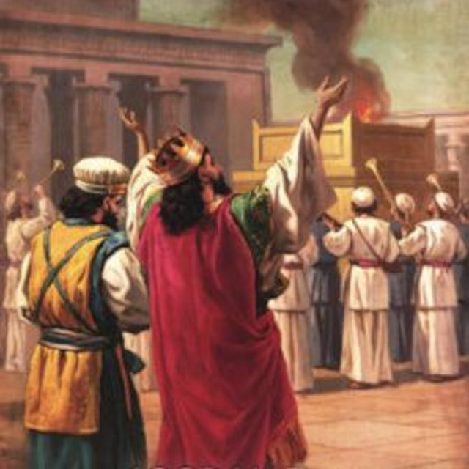
Background
Hezekiah
Reversed Ahaz’s apostasy
Abundant restorations
Notes:
One of these faithful men was wicked Ahaz’s son. (CLICK) When Hezekiah began his reign at 25 years old, 2 Kings 18 and 2 Chron 29 tell us that he immediately began reversing the heinous practices of his father. Hezekiah could clearly see that the reason Judah was struggling was because of their unfaithfulness. (CLICK) So, he took it upon himself to reopen the temple and to reconsecrate the priests to the service. He also reinstituted the Passover, even inviting Israelites from the northern kingdom; and some of them actually came! And so inspired were they by their participation in this Passover that when the feast was over, they went all throughout the cities of Judah and Israel tearing down idols and removing the high places. Hezekiah was such a faithful man who exercised tremendous influence over the people.

Slide 10
Background
Hezekiah
Reversed Ahaz’s apostasy
Abundant restorations
Knew Micah
Jer 26:16-19 – “¹⁶Then the officials and all the people said to the priests and to the prophets, “No death sentence for this man! For he has spoken to us in the name of the Lord our God.” ¹⁷Then some of the elders of the land rose up and spoke to all the assembly of the people, saying, ¹⁸'Micah of Moresheth prophesied in the days of Hezekiah king of Judah; and he spoke to all the people of Judah, saying, ‘Thus the Lord of hosts has said, “Zion will be plowed as a field, and Jerusalem will become ruins, and the mountain of the house as the high places of a forest.”’ ¹⁹Did Hezekiah king of Judah and all Judah put him to death? Did he not fear the Lord and entreat the favor of the Lord, and the Lord changed His mind about the misfortune which He had pronounced against them? But we are committing a great evil against ourselves.””
Notes:
In fact, while we believe Micah did most of his prophesying from the outskirts of Jerusalem, we know for a fact Hezekiah had access to his message. (CLICK) ~100 years after the Assyrian threat ended, when Judah sank back into wickedness and Babylon is the nation threatening them, and the prophet Jeremiah is trying to help them, there were priests and false prophets who were trying to kill Jeremiah for what he was prophesying. Jer 26:16-19 – “¹⁶Then the officials and all the people said to the priests and to the prophets, ‘No death sentence for this man! For he has spoken to us in the name of the Lord our God.’ ¹⁷Then some of the elders of the land rose up and spoke to all the assembly of the people, saying, ^{18’}Micah of Moresheth prophesied in the days of Hezekiah king of Judah; and he spoke to all the people of Judah, saying, “Thus the Lord of hosts has said, ‘Zion will be plowed as a field, and Jerusalem will become ruins, and the mountain of the house as the high places of a forest.’” ¹⁹Did Hezekiah king of Judah and all Judah put him to death? Did he not fear the Lord and entreat the favor of the Lord, and the Lord changed His mind about the misfortune which He had pronounced against them? But we are committing a great evil against ourselves.’”
This is neat because while we usually think of Isaiah as the one who had the most influence on Hezekiah, even though Micah wasn’t headquartered in the capital, Hezekiah had access to his message and was personally and positively affected by it. And according to these verses, who else was affected by Micah’s message? Jeremiah himself! Micah’s message would inevitably save Jeremiah’s life ~100 years later – Jer 26:24b – “…he was not given into the hands of the people to put him to death.”
My hope for this study is that someone else’s life may be saved by Micah’s message.
(COMMENTS)

Slide 11
Mic 3:9 – 4:5 – “⁹Now hear this, heads of the house of Jacob and rulers of the house of Israel, who abhor justice and twist everything that is straight, ¹⁰who build Zion with bloodshed and Jerusalem with violent injustice. Her leaders pronounce judgment for a bribe, her priests instruct for a price and her prophets divine for money. Yet they lean on the Lord saying, ‘Is not the Lord in our midst? Calamity will not come upon us.’ ¹²Therefore, on account of you Zion will be plowed as a field, Jerusalem will become a heap of ruins, and the mountain of the temple will become high places of a forest. ¹And it will come about in the last days that the mountain of the house of the Lord will be established as the chief of the mountains. It will be raised above the hills, and the peoples will stream to it. ²Many nations will come and say, ‘Come and let us go up to the mountain of the Lord and to the house of the God of Jacob, that He may teach us about His ways and that we may walk in His paths.’ For from Zion will go forth the law, even the word of the Lord from Jerusalem. ³And He will judge between many peoples and render decisions for mighty, distant nations. Then they will hammer their swords into plowshares and their spears into pruning hooks; nation will not lift up sword against nation, and never again will they train for war. ⁴Each of them will sit under his vine and under his fig tree, with no one to make them afraid, for the mouth of the Lord of hosts has spoken. ⁵Though all the peoples walk each in the name of his god, as for us, we will walk in the name of the Lord our God forever and ever.”
Hosea
Joel
Amos
Obadiah
Jonah
Micah
Nahum
Habakkuk
Zephaniah
Haggai
Zechariah
Malachi
Notes:
Now, in the original Hebrew text, the minor prophets were not separate books – all 12 were part of one volume called “The Twelve”. And there is symmetry to their layout, particularly as it pertains to Micah. The most notable feature is that (CLICK) the oracle in Micah about the death and resurrection of the temple (Mic 3:9 - 4:5) is in the exact center of the 12 minor prophets, (CLICK) w/Mic 3:12 being the exact midpoint. And this is the verse the elders of Jeremiah’s day quoted to save Jeremiah’s life.
(CLICK) The 3 books in the middle, Jonah, Micah, and Nahum, all deal w/Assyria, and so they are sometimes referred to as the “Assyrian triad”. And each of these 3 books feature, in some way, the divine name of God as prescribed in Ex 34:6-7 – “…The Lord, the Lord God, compassionate and gracious, slow to anger, and abounding in lovingkindness and truth; who keeps lovingkindness for thousands, who forgives iniquity, transgression and sin; yet He will by no means leave the guilty unpunished, visiting the iniquity of fathers on the children and on the grandchildren to the third and fourth generations.” In Jon 4:2, the prophet uses it there as the basis for Assyria’s salvation. In Mic 7:18-19, it is paraphrased to show that after judgment, God will show mercy to the remnant of His people. And it is used again in Nah 1:2-4 as a basis for why God would ultimately judge Assyria. And so, though all 3 books deal w/Assyria, all 3 books deal w/this credo and, when studied together, show how these characteristics of God are worked out in history.
There are many other connections in the Assyrian triad and other cool literary connections w/the other books in the 12. But pertinent to our study, Micah’s unique position in the center shows the importance of the remnant for its ultimate, future ministry to the nations – that in Israel’s salvation rests the salvation of the entire world. When the remnant is brought back to Jerusalem and its one true King comes and reforms it and it is exalted, it will become a beacon to the nations. Those who come will be changed (4:1-5). Those who don’t will be judged (5:15).

Slide 12
A. Micah – Who is like…? (1:1)
B. God’s demolition project (1:2-7)
C. Lamentation (judgment) (1:8-16)
D. Iniquity (coveting) (2:1-6)
E. Misunderstanding God (2:7-11)
F. God will lead them (2:12-13)
G. God strips away (3:1-12)
H. Nations among remnant (4:1-8)
I. Agony in labor (4:9-13)
X. Humiliation & Victory (5:1-2)
I’. Rejoicing in birth (5:3-6)
H’. Remnant among nations (5:7-9)
G’. God strips away (5:10-15)
F’. God led them (6:1-5)
E’. Misunderstanding God (6:6-8)
D’. Iniquity (Omri’s statutes) (6:9-16)
C’. Lamentation (immorality) (7:1-8)
B’. God’s rehabilitation project (7:9-17)
A’. Who is like God? (7:18-20)
Notes:
That the coming of Christ is central to God’s working is clearly seen in Micah. Let’s illustrate it this way:
But more pertinent to our study is the layout of Micah itself. Any time I study something, and I see a book or a major section of a book, end in a similar way to how it began, I immediately begin searching for a chiasm. (CLICK) While the book begins w/the author’s identity, “Micah”, whose name is an incomplete sentence, the book ends w/asking the question in full – Mic 7:18a – “Who is a God like You, who pardons iniquity…”. But as you begin to walk it toward a center theme, (CLICK) we find God doing a demolition project vs. a rehabilitation project, (CLICK) and then there are two lamentations by Micah that match. (CLICK) He then mentions specific iniquities followed by (CLICK) two sections that show a misunderstanding by God’s people of how He work. (CLICK) Then there are two matching sections in which God strips things away (CLICK) followed by allusions to a remnant. (CLICK) And then there are two labor allusions that match, one being the agony of it, the other being rejoicing at its culmination. (CLICK) And then the meat of the sandwich appear to be the first 2 verses of chapter 5 which, uncoincidentally, is the famous prophecy of the birth of Jesus Christ.
So, this is a chiasm, more specifically a “palistrophe”, which is what we call a large chiasm.

Slide 13
A. Micah – Who is like…? (1:1)
B. God’s demolition project (1:2-7)
C. Lamentation (judgment) (1:8-16)
D. Iniquity (coveting) (2:1-6)
E. Misunderstanding God (2:7-11)
F. God will lead them (2:12-13)
G. God strips away (3:1-12)
H. Nations among remnant (4:1-8)
I. Agony in labor (4:9-13)
X. Humiliation & Victory (5:1-2)
I’. Rejoicing in birth (5:3-6)
H’. Remnant among nations (5:7-9)
G’. God strips away (5:10-15)
F’. God led them (6:1-5)
E’. Misunderstanding God (6:6-8)
D’. Iniquity (Omri’s statutes) (6:9-16)
C’. Lamentation (immorality) (7:1-8)
B’. God’s rehabilitation project (7:9-17)
A’. Who is like God? (7:18-20)
Notes:
Think of it in terms of a sandwich. You start with a piece of bread on top, some lettuce, some cheese, and then right in the center is where you put the juicy piece of meat, then another piece of cheese, another piece of lettuce, and finally another piece of bread on the bottom. Now, the most delicious part of a sandwich is that flavorful meat in the center. The cheese and lettuce are necessary to complete the sandwich, but the meat is the center – same for chiastic parallelism; the strongest, most emphatic message is always in the center. But the bread, the beginning and end, like a sandwich, is what holds it all together – the bread is the second level of emphasis.
In this chiasm/palistrophe, we are drawing a picture of God, showing His incomparable, holy character, that though He must judge the sinfulness of His people, He still desires to forgive them, and He must be true to His promises. And so, this book draws us a picture of God in how He can be both just as well as loving, showing how His judgment and His salvation beautifully connect together, the centerpiece of this picture being Jesus Christ – this is how we will approach it in our study.

Slide 14
Outline
Mic 1:2 – “Hear, O peoples, all of you…”
Mic 3:1 – “Hear now, heads of Jacob…”
Mic 6:1 – “Hear now what the Lord is saying…”
God
Gathers
God
Restores
God
Forgives
Penalty & Promise
Affliction &
Hope
Sin &
Grace
Judgment Announced
Kingdoms Contrasted
Sin Cast
Away
Chapters 1 - 2
Chapters 3 - 5
Chapters 6 - 7
Notes:
Now, if chiasms are not your thing and you prefer a more linear outline, most commentators divide the 20 oracles of this book into 3 sections that are divided by an inclusio of the word “hear”, as we find it in Mic 1:2, 3:1, and 6:1. And so this would put chapters 1 & 2 together, then chapters 3 – 5, then chapters 6 & 7. How they are summarized from there could be many things.
But as w/most prophets, oracles of judgment are balanced by oracles of salvation, which shows that however severe God’s judgment, that judgment will not be the last word – salvation will follow, but that salvation will not be cheap.

Slide 15
Curriculum
May 3 – Intro; Mic 1:1
May 10 – Mic 1:2-16
May 17 – Mic 2:1-13
May 24 – Mic 3:1-12
May 31 – Mic 4:1-13
June 7 – Mic 5:1-15
June 14 – Mic 6:1-16
June 21 – Mic 7:1-20

