Slide 1
Notes:
In Mic 1, we learned that God would be paying Israel and Judah a visit, but not to exchange pleasantries – it’s for judgment, one of such magnitude, it prompts a very memorable lamentation by the prophet, whose name invokes a question – “Who is like God?” And so far, we’ve learned that He is a God who will not tolerate sin, One who keeps His promises, One who if we will not humble ourselves, He will humble us. But He’s also a God of 2nd, 3rd, and 4th chances, evidenced by the fact that He’s willing to delay judgment in order to send faithful men like Micah to hopefully rouse the people to repentance.
But chapter 1 left us in suspense as to exactly what God has witnessed them doing that was so wrong – chapter 2 answers that question. And Micah, being a small-town boy from Moresheth, would’ve likely witnessed these things, too.
PRAYER

Slide 2
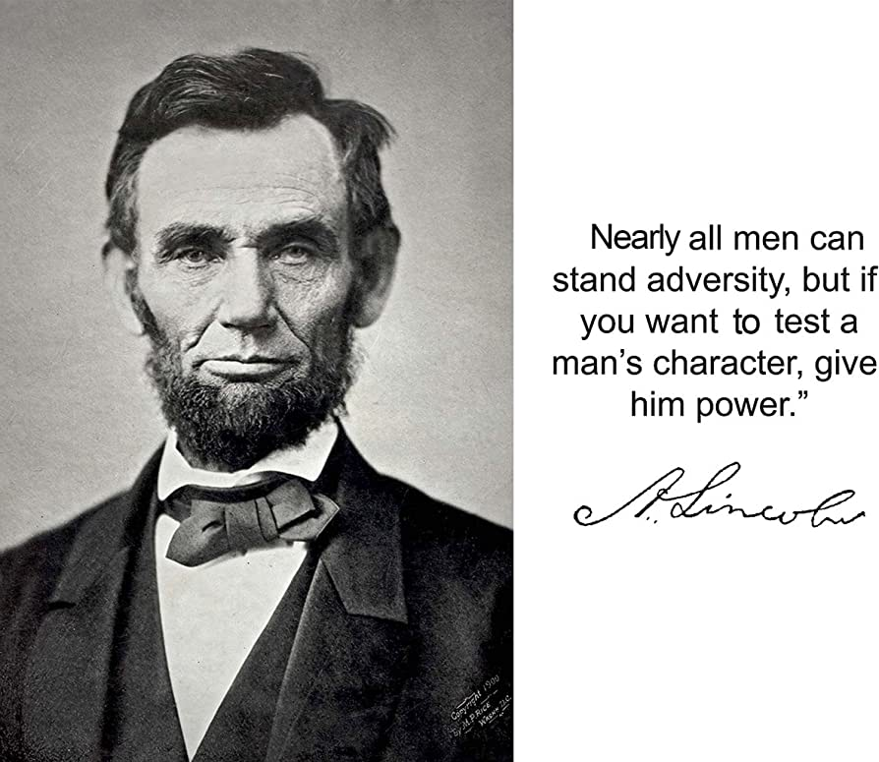
Crime & Punishment
Mic 2:1-2 – “¹Woe to those who scheme iniquity, who work out evil on their beds! When morning comes, they do it, for it is in the power of their hands. ²They covet fields and then seize them, and houses, and take them away. They rob a man and his house, a man and his inheritance.”
Notes:
Now, before calling out their sin, notice the extent they go to accomplish wickedness – Mic 2:1 –All of us have had negative thoughts late at night, but they can usually be curbed by a good night’s sleep. Not for them – they lay in bed carefully planning how to achieve their wickedness, and then they wake up intent on achieving it, in broad daylight. And while many of us may have wicked desires w/o the resource to achieve it, these are people who’ve learned how to exploit the law to give them power over the lower class. That phrase “in the power of their hand” literally means “for their hand is for a god”. (CLICK) Abraham Lincoln – “Nearly all men can stand adversity, but if you want to test a man’s character, give him power.” So obviously, those w/power didn’t deserve to be.
Because here’s what they were doing (CLICK) – Mic 2:2 – And who hasn’t coveted what was not rightfully theirs? I just thank God that I didn’t have the power or resources to achieve it. But the people in question did, and it resulted in oppression and thievery. They planned it at night, and no sooner planned was it executed, and likely through a variety of ways – extortion, manipulating the legal system, foreclosing on loans, or even through force.
And its not just any land/houses they’re seizing, but a man’s “inheritance”. In an agrarian society, that was to lose everything, rendering you a day-laborer at best, a slave at worst. God’s wanted Israel to be a nation of free landholders, not debt-slaves, sharecroppers, or hired workers. But these covetousness land barons were taking from man the sacred trust that God had given, enslaving them like the very Pharaoh God rescued them from.

Slide 3
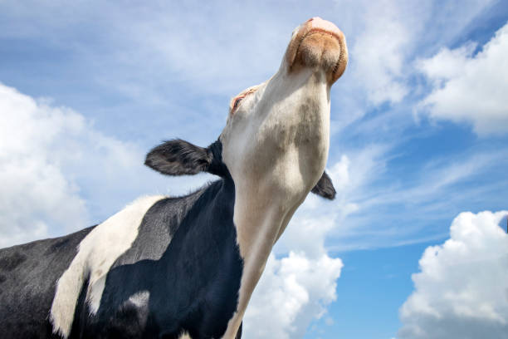
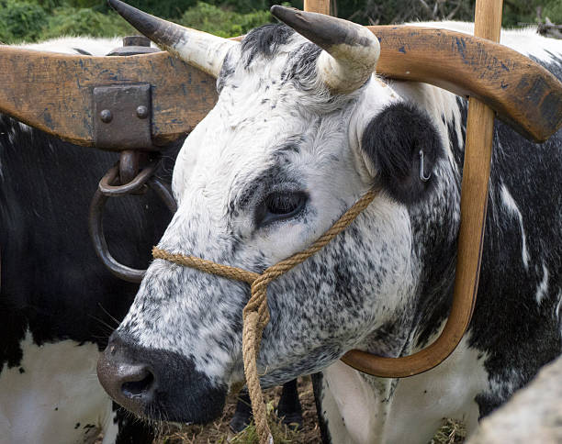
Crime & Punishment
Mic 2:3 – “³Therefore thus says the Lord, ‘Behold, I am planning against this family a calamity from which you cannot remove your necks; and you will not walk haughtily, for it will be an evil time.”
Notes:
And so, just as He judged Egypt, He’s going to judge those like them (CLICK) – Mic 2:3 – The idea being that just as they have been up late at night planning, God is planning their destruction. It’s an interesting play on words, as if God is saying, “Oh you guys like to plan? I’ve got a plan, too. Two can play at that game, and I’m better at it than you!” (CLICK) Those outstretched, arrogant necks are going to be fitted w/a yoke they cannot remove – it’ll be bad times for them.

Slide 4
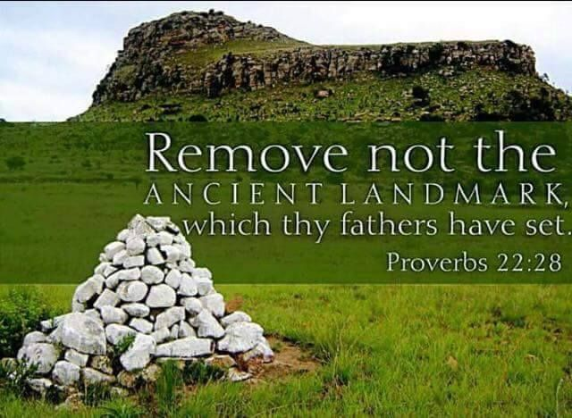
Crime & Punishment
Mic 2:4-5 – “⁴On that day they will take up against you a taunt and utter a bitter lamentation and say, ‘We are completely destroyed! He exchanges the portion of my people; how He removes it from me! To the apostate He apportions our fields.’ ^{5‘}Therefore you will have no one stretching a measuring line for you by lot in the assembly of the Lord.’”
Notes:
And so, Micah’s lamentation from chapter 1 is just a prelude (CLICK) – Mic 2:4 – This is tricky, but based on the pronouns, what this sounds like is that when God punishes these land barons, they will lament, but those nations who come in to punish them will mockingly quote their lamentation back to them. And as God so often works, the fact God “exchanges the portion of my people”, removing it from them, (CLICK) shows that the sentence fits the crime. God gave it to them, they abused His gift, and so He takes it away. (CLICK) Prov 22:28 – “Do not move the ancient boundary which your fathers have set.” But they did it anyway, and so God is going to remove theirs, casting them out as they had cast out others, rendering them as an object of shame to their oppressors.
But there is a worse punish God has in store for them than physical removal (CLICK) – Mic 2:5 – This looks beyond mere physical exile, doesn’t it? They may have had an entrepreneurial spirit that made them success stories from an earthly standpoint, but their injustice toward others will inevitably rob them of heaven.
COMMENTS

Slide 5
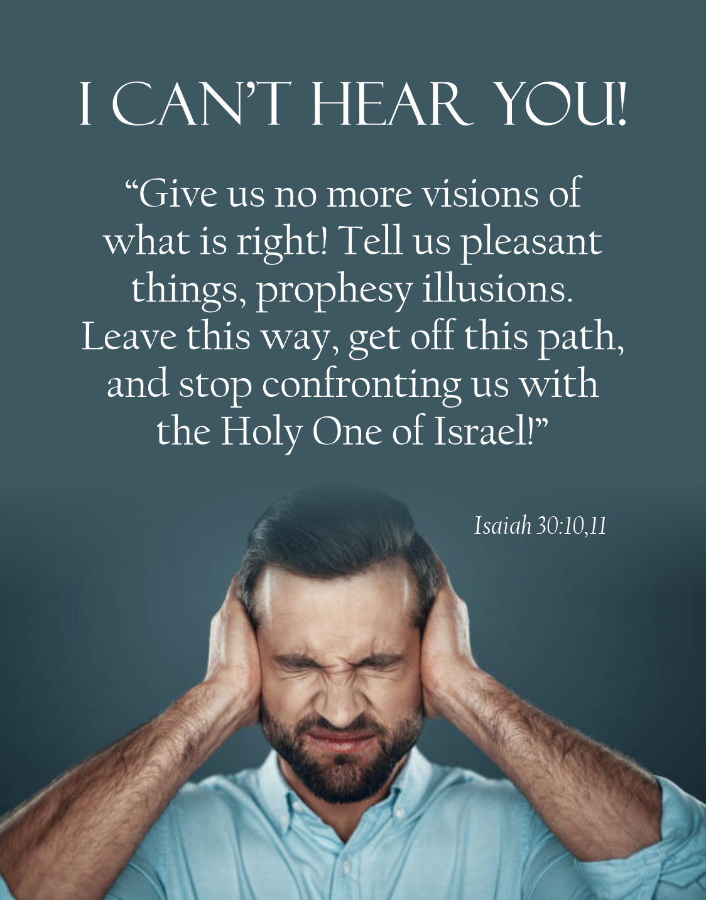
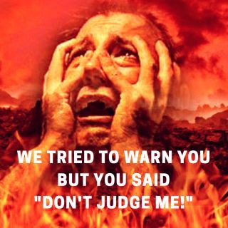
Pushback
Mic 2:6 – “⁶‘Do not speak out,’ so they speak out. But if they do not speak out concerning these things, reproaches will not be turned back.”
Notes:
Now, “captain obvious” question: do you suppose this message made Micah popular to those who needed to hear it? No, like all of God’s messengers who are obligated to speak unpopular truths, Micah’s going to get some pushback, and on 2 fronts:
(CLICK) First – Mic 2:6a – (CLICK) Isaiah is getting the same pushback in the capital, and it’s the same thing we experience today, because a culture that insists on doing whatever it feels like doing will always try to force Christians into one of two categories – “you either affirm me, or you hate me”. But this isn’t an either or. Christians cannot hate a sinner because of God’s word. Christians also cannot affirm sin because of God’s word.
(CLICK) And we have to grow to the point where unashamedly tell people that we are unwilling to rewrite the bible for a society that needs the bible – Mic 2:6b – If we don’t speak out, nothing is going to change. In the Hebrew, that literally reads as “the shame will not withdraw”. There were people being oppressed who were w/o a voice, and so someone w/some gumption needed to stand up and say something, and this was going to have to be a person who cared more about what God thinks than He does what the sinner thinks who has no better retort than to say, “Stop telling me things I don’t want to hear!”. So that’s the first pushback…

Slide 6
Pushback
Mic 2:7 – “⁷Is it being said, O house of Jacob: ‘Is the Spirit of the Lord impatient? Are these His doings?’ Do not My words do good to the one walking uprightly?”
Notes:
2nd pushback is denial – the enemies appear to be claiming that it’s Micah’s preaching that contradicts God, because he asks in (CLICK) Mic 2:7a – to paraphrase: “That’s absurd! He’s a God of love. He’s only going to do good for His people”. They’re trying to limit God’s character to simply His love at the expense of His justice. Sound familiar? (CLICK) Ex 34:6-7a – “Then the Lord passed by in front of him and proclaimed, ‘The Lord, the Lord God, compassionate and gracious, slow to anger, and abounding in lovingkindness and truth; who keeps lovingkindness for thousands, who forgives iniquity, transgression and sin…”.
But here’s Micah’s response from God (CLICK) – Mic 2:7b – (CLICK) In fact, that’s what the rest of Ex 34:7 says – “…yet He will by no means leave the guilty unpunished, visiting the iniquity of fathers on the children and on the grandchildren to the third and fourth generations.” And I as I was googling a picture of these 2 verses to put on my PowerPoint slides, I was shocked at how many quoted Ex 34:6-7 and left out the last part of vs. 7! This is a common tactic of false teachers, honing in on only one aspect of God’s covenant promise – His love, etc. – but this one-sided approach glosses over other aspects of His character more relevant to their current state. And it is this misconception about God that in their minds gave them license to sin.
God is a loving, gracious, benevolent God. But He is not unconditionally benevolent. “I will be your God” must be coupled with “you will be My people” or the conditions of the covenant aren’t satisfied. Who is like God? He is a God of love and a God of justice.

Slide 7
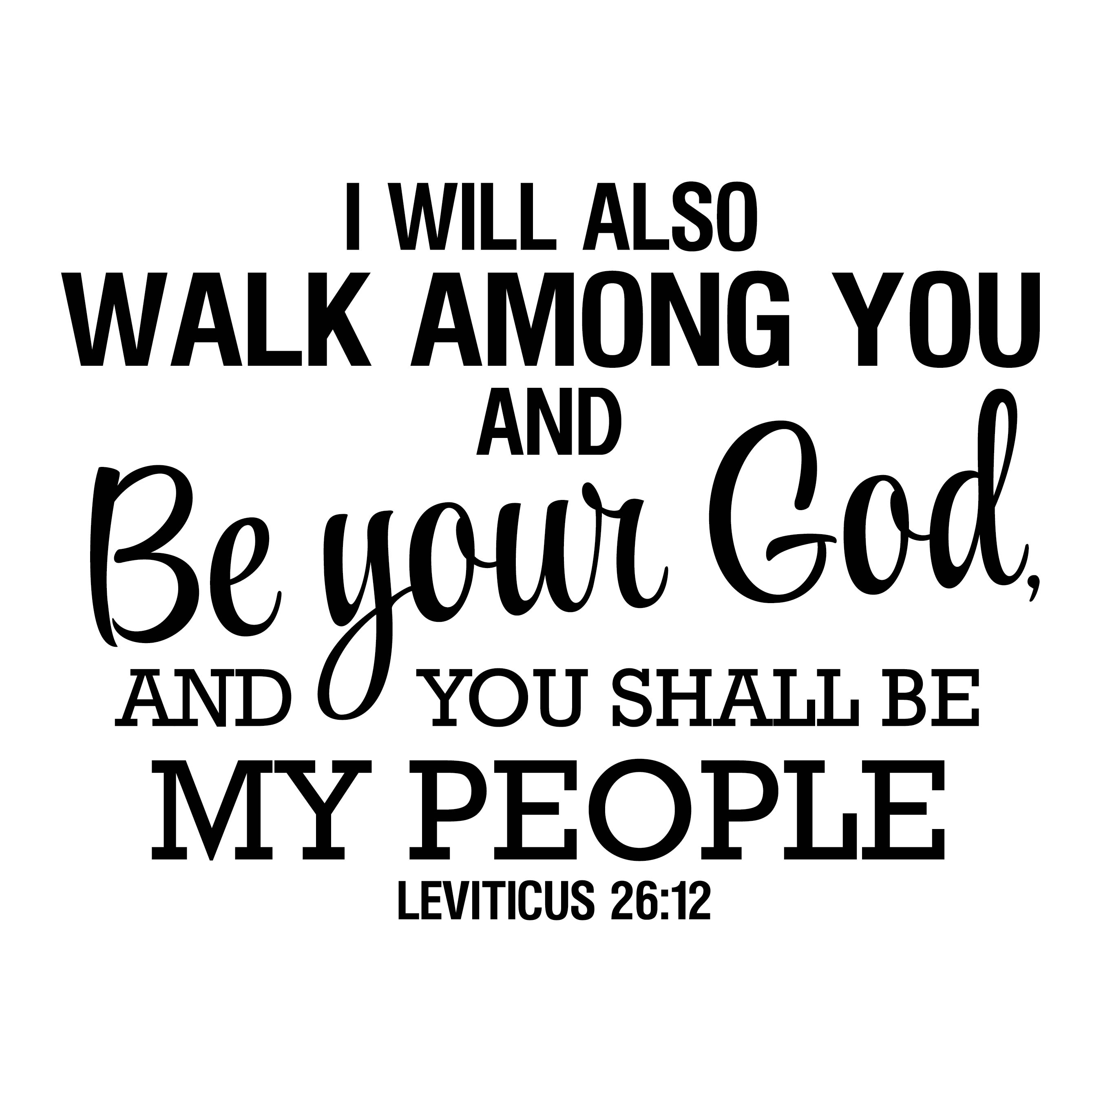
Further Accusation
Mic 2:8-9 – “⁸Recently My people have arisen as an enemy— you strip the robe off the garment from unsuspecting passers-by, from those returned from war. ⁹The women of My people you evict, each one from her pleasant house. From her children you take My splendor forever.”
Ex 22:26-27 – “²⁶If you ever take your neighbor’s cloak as a pledge, you are to return it to him before the sun sets, ²⁷for that is his only covering; it is his cloak for his body. What else shall he sleep in? And it shall come about that when he cries out to Me, I will hear him, for I am gracious.”
Ex 22:22 – “You shall not afflict any widow or orphan.”
Notes:
So, to show they are not a people walking uprightly and undeserving of judgment, Micah is going to prove that they hadn’t been living up to the terms of the covenant by declaring the extent to which they were seizing people’s property. (CLICK) Remember, the covenant states, “I will be your God, you will be my people” (CLICK) But notice Mic 2:8a – In other words, “You sure don’t act like My people; you look more like my enemies”.
(CLICK) How so? – Mic 2:8b-9 – These are thugs. The robe represented a man’s dignity, and what they did was a clear violation of God’s law (CLICK) – Ex 22:26-27 – And that they were doing so from men who’d just returned from war likely means that the man had taken out a loan, but then had to go to war and couldn’t pay it off, but then as soon as he returns , w/o any warning, his creditor takes it from him when he least expects it.
And that’s bad enough, but notice how Micah crescendos from men, to women, to children. Not only were they abusing the men by “taking the shirt off their back”, they were evicting women from their homes, perhaps widows of the men who died at war defending their country, (CLICK) a clear violation of Ex 22:22. And when the house wasn’t enough to pay their debt, it sounds like they’d take their children as slave labor – children who are pure and innocent, made in God’s image. So, by abusing them, they’re abusing His splendor.
This is insatiable greed and callousness of the highest degree from a people who have deceived themselves into thinking that the covenant terms only worked one way. “My people”? No, vs. 9 tells us they were oppressing and enslaving His people, and this made them His enemies. How can there not be judgment for this?
COMMENTS

Slide 8
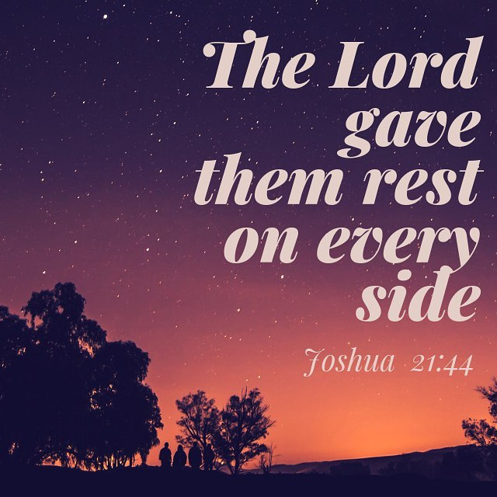
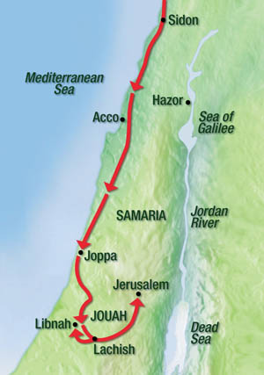
Verdict
Mic 2:10 – “¹⁰Arise and go, for this is no place of rest because of the uncleanness that brings on destruction, a painful destruction.”
Notes:
Now, before we read vs. 10, it’s common in Micah for the imperatives to be a bit ambiguous or for the pronouns to abruptly change, making it a bit difficult to know who he’s talking to or talking about. This next verse is one of those places (CLICK) – Mic 2:10 – My best guess, when you take the last 4 verses of the chapter together as a whole, is that Micah is addressing those who’ve been taken advantage of, evicted and enslaved by the greedy, covetous land barons. (CLICK) You may recall from Josh 21:44, that God’s purpose in driving out the Canaanites and gifting them w/the land was to give them rest – this is something repeated all throughout the Pentateuch, that this would be a land of rest. But w/these land barons doing what they’re doing? This is no place of rest. And so, I’d suggest that in vs. 10, he’s encouraging His true people to get out of there because, remember, (CLICK) this is the area that Assyria's king Sennacherib would eventually decimate.
It’s almost as if Micah is saying, “What these land barons are doing is heinous, but you are not going to want to be anywhere near here when God sends Assyria”, because God is going to bring a destruction on this area that is so bad, it can only be qualified w/pain. It was purged once before in Joshua, it must be purged again.

Slide 9
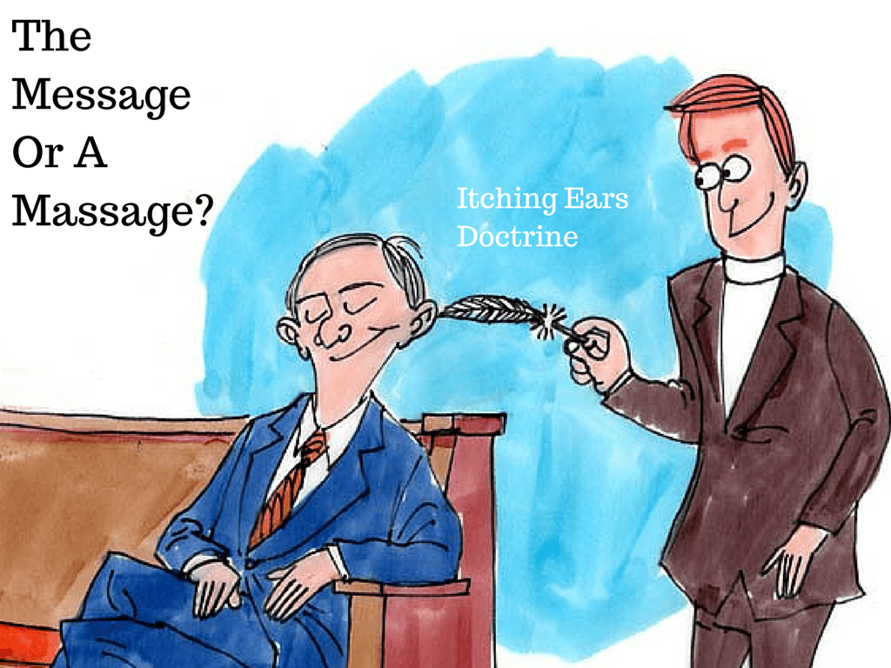
Verdict
Mic 2:11 – “¹¹If a man walking after wind and falsehood had told lies and said, ‘I will speak out to you concerning wine and liquor,’ He would be spokesman to this people.”
Isa 6:10 – “Render the hearts of this people insensitive, their ears dull, and their eyes dim, otherwise they might see with their eyes, hear with their ears, understand with their hearts, and return and be healed.”
Notes:
Because nobody was listening to reproof. And where are the leaders who should be standing up to this nonsense? Given the cold shoulder, as Micah was. And rising in their place? (CLICK) – Mic 2:11 – So this oracle comes back full circle from its starting point in vs. 6. Those who were pushing back on Micah, even accusing him of error, are choosing to surround themselves w/those who will tell them what they want to hear.
But Micah basically calls them lying windbags – they talk, but don’t really say anything. There is no substance to their teaching. Their goal is to simply pander themselves to the base desires of their hearers, much like politicians do today. And the hearers were more than willing to swallow it hook, line, and sinker. It didn’t matter if he was lying, because in their minds, what made a message true was whether it tailored to their greed. (CLICK) Paul warned Timothy about in 2 Tim 4:2-3 – “preach the word; be ready in season and out of season; reprove, rebuke, exhort, with great at patience and instruction. For the time will come when they will not endure sound doctrine; but wanting to have their ears tickled, they will accumulate for themselves teachers in accordance to their own desires”. All that false prophets need in order to succeed is people that consent to the status quo.
Point – (CLICK) These are no longer God’s people…they are truly enemies, and when God finally sends His rod of anger in Assyria to purge the enemies from the land, His faithful remnant are not going to want to be anywhere near that area.
COMMENTS

Slide 10
Protection
Mic 2:12-13 – “¹²I will surely assemble all of you, Jacob, I will surely gather the remnant of Israel. I will put them together like sheep in the fold; like a flock in the midst of its pasture they will be noisy with men. ¹³The breaker goes up before them; they break out, pass through the gate and go out by it. So their king goes on before them, and the Lord at their head.”
Notes:
Now, for the first time in the book, the tone is going to change from judgment to optimism. He’s now going to give the faithful remnant of Judah cause to have hope – Mic 2:12 – So, the faithful remnant found no protection where they were at, due to being ripped off by the covetous land barons, and the covetous will get what’s coming to them when Assyria comes to town. And so, in our first shepherd imagery of the book, God, the Great Shepherd, is going to gather them into a protected area in order to deliver them.

Slide 11
Protection
Mic 2:12-13 – “¹²I will surely assemble all of you, Jacob, I will surely gather the remnant of Israel. I will put them together like sheep in the fold; like a flock in the midst of its pasture they will be noisy with men. ¹³The breaker goes up before them; they break out, pass through the gate and go out by it. So their king goes on before them, and the Lord at their head.”
Isa 8:7-8 – “⁷now therefore, behold, the Lord is about to bring on them the strong and abundant waters of the Euphrates, even the king of Assyria and all his glory; and it will rise up over all its channels and go over all its banks. ⁸Then it will sweep on into Judah, it will overflow and pass through, it will reach even to the neck; and the spread of its wings will fill the breadth of your land, O Immanuel.’
Notes:
Now, from what we know of Assyria’s invasion, if you were listening to the prophets of this time and wanted to go to the one place where you were guaranteed to be safe, where would that be? Jerusalem. (CLICK) Isaiah said it this way – Isa 8:7-8 – The idea is this – Assyria would completely conqueror Israel, which they did. Then they’d sweep into Judah and come up to its neck. What I take that to mean is they’d mostly conquer Judah, but not completely.

Slide 12
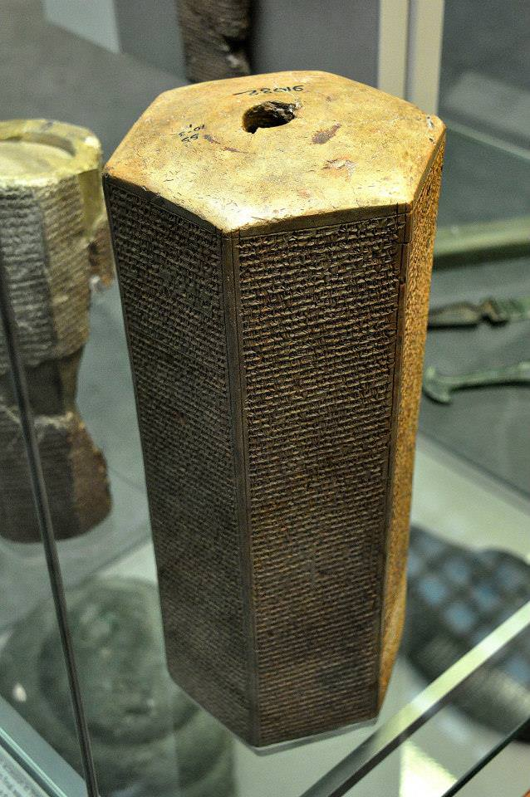
Protection
Mic 2:12-13 – “¹²I will surely assemble all of you, Jacob, I will surely gather the remnant of Israel. I will put them together like sheep in the fold; like a flock in the midst of its pasture they will be noisy with men. ¹³The breaker goes up before them; they break out, pass through the gate and go out by it. So their king goes on before them, and the Lord at their head.”
Taylor Prism – "As for the king of Judah, Hezekiah, who had not submitted to my authority, I besieged and captured forty-six of his fortified cities, along with many smaller towns, taken in battle with my battering rams. ... I took as plunder 200,150 people, both small and great, male and female, along with a great number of animals including horses, mules, donkeys, camels, oxen, and sheep. As for Hezekiah, I shut him up like a caged bird in his royal city of Jerusalem. I then constructed a series of fortresses around him, and I did not allow anyone to come out of the city gates. His towns which I captured I gave to Mitinti, king of Ashdod; Padi, ruler of Ekron; and Silli-bel, king of Gaza."
Notes:
Because that’s exactly what happened historically. According to the Taylor Prism, Assyria was able to conqueror 46 Judean cities, leading over 200k Judeans into captivity, and then as they’re finishing up the siege at Lachish, they advance on Jerusalem, (CLICK) the place that Assyria’s king Sennacherib brags that he shut up Hezekiah like a bird in a cage.
And the people were scared – no doubt Jerusalem was “noisy w/men”. That word “noisy” means “throng” – it means “to be distraught” or “to moan noisily”. The image we’re being presented w/is God, the Great Shepherd, gathering His sheep, the outcasts, into Jerusalem in the midst of an Assyrian invasion, and though He’s gathering them for their protection, they’re initially going to be anxious and restless.
(CLICK) Now interestingly, the Taylor Prism also records that Sennacherib “did not allow anyone to come out of the city gates”. Now, you’d think we’d find additional annals describing the conquest and capture of Jerusalem. But Assyria’s annals are curiously silent about what happened after this. And you know why?

Slide 13
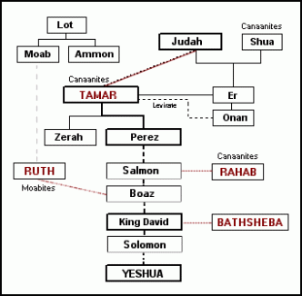
Breakthrough
Mic 2:12-13 – “¹²I will surely assemble all of you, Jacob, I will surely gather the remnant of Israel. I will put them together like sheep in the fold; like a flock in the midst of its pasture they will be noisy with men. ¹³The breaker goes up before them; they break out, pass through the gate and go out by it. So their king goes on before them, and the Lord at their head.”
Gen 38:27-30 – “²⁷It came about at the time she was giving birth, that behold, there were twins in her womb. ²⁸Moreover, it took place while she was giving birth, one put out a hand, and the midwife took and tied a scarlet thread on his hand, saying, ‘This one came out first.’ ²⁹But it came about as he drew back his hand, that behold, his brother came out. Then she said, ‘What a breach you have made for yourself!’ So he was named Perez. ³⁰Afterward his brother came out who had the scarlet thread on his hand; and he was named Zerah.
Notes:
Because Micah tells us what God would do – Mic 2:13 – Here’s the idea – the Shepherd King, God, gathers His remnant to Jerusalem, and there is restlessness. But when all seemed lost, in a moment, He breaks open the blockaded gate, passing through the opening, and then takes His rightful place as their King. Now, what biblical event would this represent? In Isa 38:36 – “Then the angel of the Lord went out and struck 185,000 in the camp of the Assyrians; and when men arose early in the morning, behold, all of these were dead.” And the next verse then tells us Sennacherib tucked tail and went home.
Now, the fulfillment of this prophecy is cool enough, but one thing the prophets love to do is draw on themes from their history. That word “breaker”, which alludes to God, is a derivative of the Hebrew word “perez”. What famous biblical story do we remember in which we see this name? (CLICK) In Gen 38, when Judah’s daughter-in-law, gives birth to twins – Gen 38:27-30 – And what famous person in history is found in the line of Perez? (CLICK) None other than Jesus Christ (Matt 1:3).
You know, we still use the term “breakthrough” to describe a positive yet unexpected event. Was there any more positive, unexpected event in history than Jesus Christ?

Slide 14
Breakthrough
Mic 2:12-13 – “¹²I will surely assemble all of you, Jacob, I will surely gather the remnant of Israel. I will put them together like sheep in the fold; like a flock in the midst of its pasture they will be noisy with men. ¹³The breaker goes up before them; they break out, pass through the gate and go out by it. So their king goes on before them, and the Lord at their head.”
Ex 12:12 – “¹²For I will go through the land of Egypt on that night, and will strike down all the firstborn in the land of Egypt, both man and beast; and against all the gods of Egypt I will execute judgments—I am the Lord.”
Ex 12:23 – “²³For the Lord will pass through to smite the Egyptians; and when He sees the blood on the lintel and on the two doorposts, the Lord will pass over the door and will not allow the destroyer to come in to your houses to smite you.”
Ex 13:21a – “The Lord was going before them in a pillar of cloud by day to lead them on the way…”
2 Sam 5:20,24 – “So David came to Baal-perazim and defeated them there; and he said, ‘The Lord has broken through my enemies before me like the breakthrough of waters.’ Therefore he named that place Baal-perazim…It shall be, when you hear the sound of marching in the tops of the balsam trees, then you shall act promptly, for then the Lord will have gone out before you to strike the army of the Philistines.’”
Notes:
Allusion #2 – any guesses on where that phrase “pass through” is used, another famous story in which God “passed through” a seemingly impenetrable barrier? Not the Red Sea, but the great event that was a prelude to it (CLICK) – Ex 12:12,23 – And when they leave, who led them? (CLICK) Ex 13:21.
Point – The wealthy, land barons of Judah had become oppressors like Egypt. So, God does the same thing He did in exodus. He sends a “plague” in the form of Assyria to punish the wicked. He gathers His true people into a confined place in which this “plague” won’t touch them – Jerusalem. And you’ll remember from Exodus that many of those plagues had no affect on the Israelites while they were in Goshen. Then after repeatedly refusing to let Israel go, a “breakthrough” occurs in which God intervenes in a radical way and then He personally leads them out. It’s almost as if Micah is using terminology that the Jews would have known in order to get them thinking back to this event in order to have faith in their future. And it’s also ironic than one of the main reforms Hezekiah instituted when he became king in the midst of all this mess was the “Passover”, which should have been a weeklong reminder of an old story perhaps long forgotten.
So, who is like God? When all seems lost, He is a God who specializes in “breakthroughs”, (CLICK) and we this theme pop up time and again in scripture.

