Slide 1
Notes:
In Mic 2, we learn the primary sin that would prompt God visiting His people for judgment was greedy land barons who were using their power to take away the poorer people's possessions that they coveted, making no distinction between men, women, and children. They were rejecting Micah’s correction, justifying themselves behind some false illusion of covenant immunity, and also installing spokesmen who’d only tell them what they wanted to hear. And so, God’s plan is to raise up the Assyrian empire to rid the land of His enemies. But in the last two verses of the chapter, God gives the faithful people hope by promising to shepherd His faithful remnant, to curb how far He’s willing to let the rod of His anger, Assyria, go through w/their scourge.

Slide 2
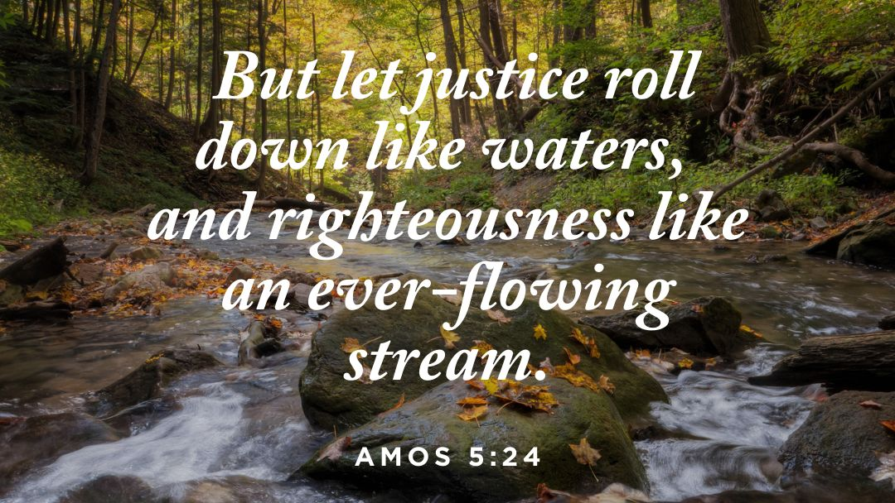
Rulers/Heads
Mic 2:13 – “¹³The breaker goes up before them; they break out, pass through the gate and go out by it. So their king goes on before them, and the Lord at their head.”
Mic 3:1 – “¹And I said, ‘Hear now, heads of Jacob and rulers of the house of Israel. Is it not for you to know justice?”
Gen 4:1 – “Now the man had relations with his wife Eve, and she conceived and gave birth to Cain, and she said, ‘I have gotten a manchild with the help of the Lord.’”
Amos 3:2 – “You only have I chosen among all the families of the earth; therefore I will punish you for all your iniquities.”
Jer 22:16 – “‘He pled the cause of the afflicted and needy; then it was well. Is it not that what it means to know Me?’ declares the Lord.”
Notes:
Recall how chapter 2 ended w/a “breakthrough” – Mic 2:13 – Then now notice how chapter 3 begins (CLICK) – Mic 3:1a – Here’s the question prompted by these two verses, (CLICK) if God has to come down and take the lead as their “head”, where were the earthly “heads”, and what were they doing about that wickedness from chapter 2? Back on Mt. Sinai, God established social law for the Jews, and leaders were installed to see to it that the law was kept. Where were they? Where were the rulers, the judges, the priests, people who were supposed to be the guardians of justice, whose job it was to curb lawlessness and see to it that law and order was kept?
Well, as we progress through chapter 3, we’re going to see that they were part of the problem. While chapter 2 addressed the land barons, chapter 3 addresses the magistrates, and by the time we’re through this chapter, it should be clear that both parties were in collusion w/one another. And so, chapter 3 begins w/Judah’s corrupt rulers being called to give an account before a higher court.
PRAYER
So, what’s the issue? Look at what He asks them (CLICK) – Mic 3:1b – That word “know” is an “affectionate knowing”, (CLICK) often translated in scripture as “love”. The idea isn’t just that Judah’s rulers were to know the letter of the law, the difference between right and wrong – by the end of the chapter, that much is true. They were to affectionately know it, to love it. This was their job. They were in those roles to serve the position, not so the position could serve them.

Slide 3
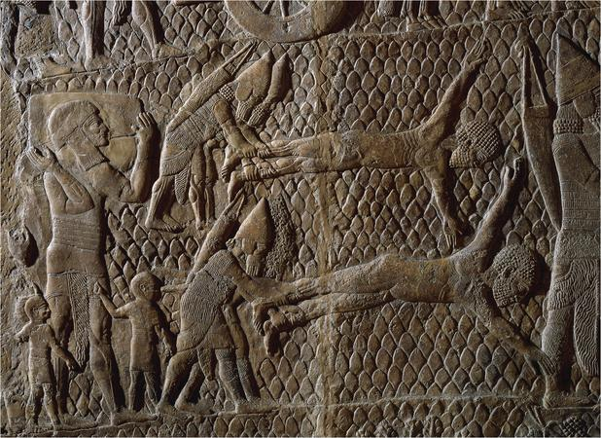
Rulers/Heads
Mic 3:2-3 – “²You who hate good and love evil, who tear off their skin from them and their flesh from their bones, ³who eat the flesh of my people, strip off their skin from them, break their bones and chop them up as for the pot and as meat in a kettle.”
Total Consumption
houses (2:2)
robe off the garment (2:8)
skin from their flesh (3:2b)
flesh from their bones (3:2c)
break their bones (3:3c)
throw them in the kettle (3:3d)
Notes:
Why didn’t they love justice? Because they loved something else (CLICK) – Mic 3:2a – That’s why – they were turning the moral code on its head. The courts were taken over by the criminals. Vice had become virtue. They were completely consumed by self-interest.
Here’s the extent (CLICK) – Mic 3:b-3 – Notice the digression we’ve seen: (CLICK) first they robbed houses (2:2), then the shirts off their backs (2:8), skin from their flesh (3:2b), then flesh from their bones (2:3c), then they’d break their bones (3:3c), then throw them in the kettle to eat. These descriptions sound redundant on the surface, but its as if Micah wants us to see just how bad thing had gotten. Those whose job it was to stand up for people’s rights, are taking everything, everything, from them – totally consuming them. He’s piling clause upon clause to represent his frustration, having no doubt witnessed much of it himself.
(CLICK) Here’s some poetic justice for you – the tool God will use to judge them, Assyria, was known for flaying their enemies, as is being depicted in this relief (British Museum). But God is showing us who the real flayers were before Assyria ever showed up. This is just another example of God causing people to reap what they sow. This is why I’ve repeatedly stated that if we will not humble ourselves God will humble us.
And in the bible, God makes it very clear that people do not exist for the sake of leaders. Leaders are supposed to exist for the sake of people. But instead of using their sacred office to defend the defenseless, they abused and circumvented the law to live luxuriously at the expense of their victims, rendering them cannibals. See if the description “wolf in sheep's clothing” was simply a person pretending to be someone he is not, Jesus could have just used the word “hypocrite”. A wolf in sheep’s clothing is not just a pretender, but a pretender whose goal it is to feed off of the people even if it means destroying them in the process. Instead of serving the poor, they “served them up” for consumption. Like the farmer does to the cattle, they did to people.

Slide 4
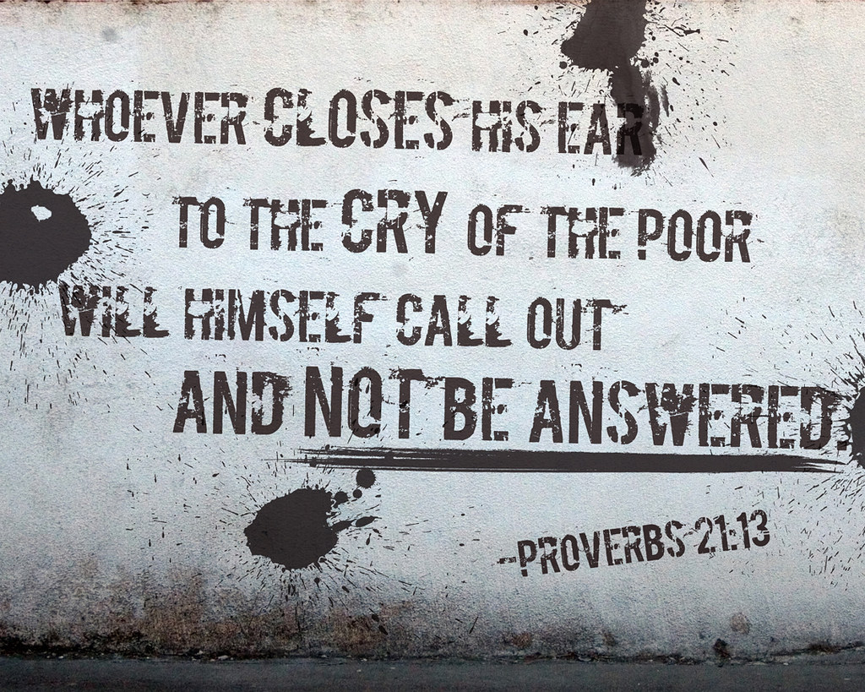
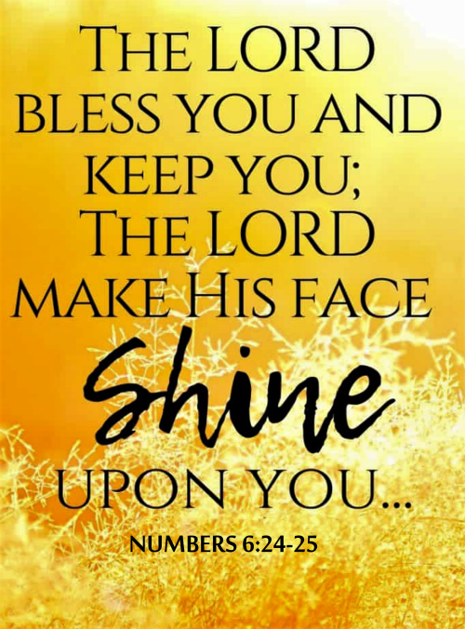
Rulers/Heads
Mic 3:4 – “⁴Then they will cry out to the Lord, but He will not answer them. Instead, He will hide His face from them at that time because they have practiced evil deeds.”
Notes:
And so, again, what goes around will come around (CLICK) – Mic 3:4a – this is another one of these truths that has been grounded in God’s word for ages – Prov 21:13. In fact, what nation once cried to God do to deliver them from their oppressors? Israel – and God heard them, judged the Egyptians oppressors, and rescued them. If His people then start to become the oppressors, why would He not do the same thing here? And when it’s the rulers/judges, those turning a deaf ear to the poor/oppressed, and they cry out, in order to reap what they have sown, they will find God equally unresponsive.
Specifically (CLICK) Mic 3:4b – (CLICK) Ever been so disappointed w/your child that you said, “I cannot even look at you right now”? That’s how God feels. (CLICK) The prior blessing of Num 6:25, Aaron’s benediction, is removed. He rescued them from Egyptian bondage and set them up in the land to be better than this. But as it stands here, they no longer have any claim on God whatsoever.
COMMENTS

Slide 5
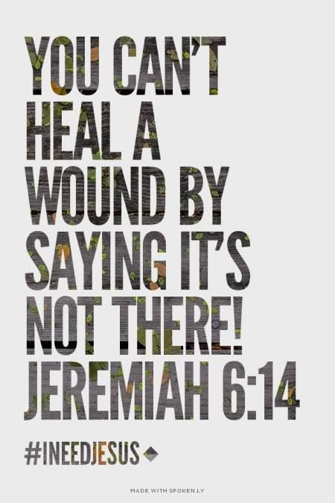
Prophets
Mic 3:5 – “⁵Thus says the Lord concerning the prophets who lead my people astray; when they have something to bite with their teeth, they cry, ‘Peace,’ but against him who puts nothing in their mouths they declare holy war.”
Notes:
Now, what about the prophets? We’ve already seen from 2:6 that the enemies were rejecting men like Micah who spoke uncomfortable truths, and we learned from 2:11 that they were installing spokesmen who’d tell them what they wanted to hear. God is going to speak further about these guys.
(CLICK) Mic 3:5 – So, here we have those who were supposed to be the moral watchdogs of that society. But rather than barking at those who were threatening the people, (CLICK) they were wagging their tails at whatever the cannibalistic ”heads” wanted – because they were just like them. These prophets were available to the highest bidder, in that what came out of their mouths depended on what went into it. Once again, we find men in positions of leadership who were consumed by their own interests rather than the interests of the people – seeing a pattern here?
These were colleagues of Micah who had abused their calling. (CLICK) There were real, spiritual issues that needed addressing and action that needed taking. But for them, money talked louder than God. And for anyone who wouldn’t pay the proper price, they would make sure the people were worse off than had they not spoken at all.

Slide 6
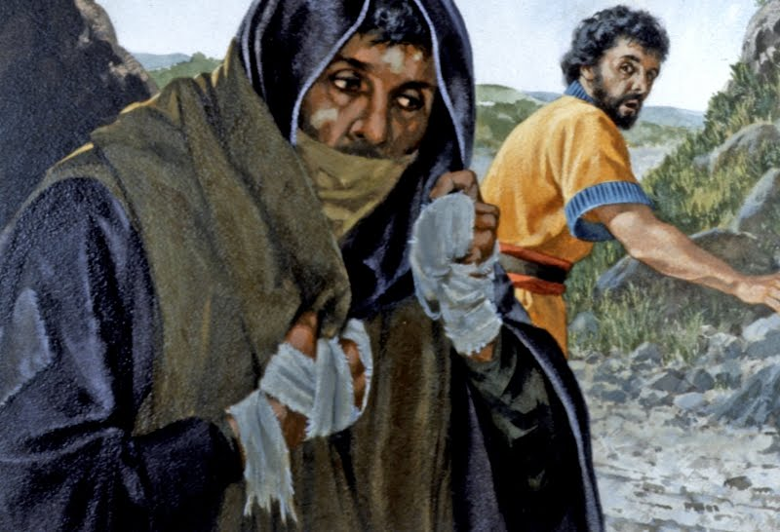
Prophets
Mic 3:6-7 – “⁶Therefore it will be night for you—without vision, and darkness for you—without divination. The sun will go down on the prophets, and the day will become dark over them. ⁷The seers will be ashamed and the diviners will be embarrassed. Indeed, they will all cover their mouths because there is no answer from God.”
Lam 4:13-15 – “¹³Because of the sins of her prophets and the iniquities of her priests, who have shed in her midst the blood of the righteous; ¹⁴they wandered, blind, in the streets; they were defiled with blood so that no one could touch their garments. ¹⁵‘Depart! Unclean!’ they cried of themselves. ‘Depart, depart, do not touch!’ So they fled and wandered; men among the nations said, ‘They shall not continue to dwell with us.’”
Lev 13:45 – “As for the leper who has the infection, his clothes shall be torn, and the hair of his head shall be uncovered, and he shall cover his mustache and cry, ‘Unclean! Unclean!’”
Notes:
And so, once again, God will pronounce a sentence that fits the crime (CLICK) – Mic 3:6 – Often, a prophet/seer would receive his visions at night (Daniel, Zechariah). And so, the idea is that these false prophets will receive a total eclipse of inspiration, the sun setting on their clairvoyance. Because for those who abuse the prophetic gift, God will deprive them of it. Just like Samson – when he abused his calling, he lost it.
Micah goes on to say that this will lead to their public disgrace (CLICK) – Mic 3:7 – (CLICK) One interesting thing about this is that in Lev 13:45, it was lepers who were required to cover their mouths and cry, “Unclean, unclean!” If this is what Micah is alluding to, then he’s saying that when these prophets are finally exposed for the frauds they are, they’d be considered social lepers in which people not only would not approach them, but completely keep their distance from them. (CLICK) And by the time Babylon would come and finish the job, Jeremiah would say this about the false prophets in Lam 4:13-15. Sounds a lot like the lot of a leper, doesn’t it? Very similar to what Micah says here.
These are people who were used to having a preeminent position before the people, who made living of them, and now like lepers they are w/o resource and w/anyone to look on them w/compassion for how they misled the people.

Slide 7
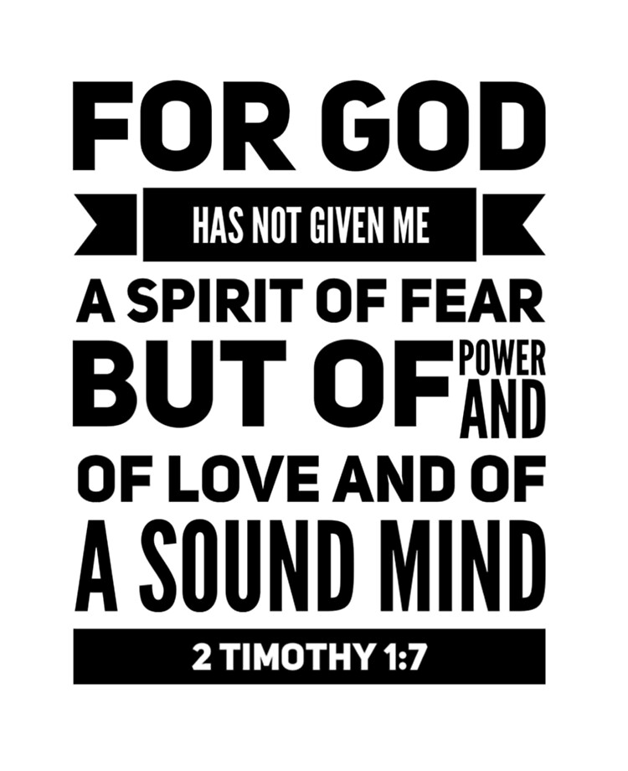
Prophets
Mic 3:8 – “⁸On the other hand I am filled with power—with the Spirit of the Lord—and with justice and courage to make known to Jacob his rebellious act, even to Israel his sin.”
Micah The Prophet
Power
Energy, vigor, dynamism
Spirit
Direct line from God
Justice
Valor, right/wrong
Courage
Fortitude, not influenced by fear or favor
“Justice without power is powerless. Power without justice is tyrannical…justice and power must therefore be connected so that what is just is also powerful is also just.” (H. Wolff)
Notes:
But then there’s Micah, who unlike these false prophets, his message was determined by what God wanted, not the audience (CLICK) – Mic 3:8 – This is an interesting statement, because not only is it one of the few autobiographical texts from Micah, it’s also a rather bold, confident, and some might say “immodest” statement from what was probably a very humble man. But in controversy, he’s likely seemingly casting aside his veil of modesty to boldly deal w/the adversary, which in rare occasions we do see other prophets doing (Jesus, Paul, etc.). Certain situations do require a more outward display of zeal than might otherwise define our demeaner, and contending w/false prophets who are hurting people is one of those situations.
To summarize this verse, Micah is a man of principle.
(CLICK) He’s been given power, which would be Spirit-directed energy and vigor, and this would stand in direct conflict w/the “holy war” waged by the false prophets of 3:5 – the so-called “power” of the false prophets was an illusion – like Pilate, they were on borrowed time.
(CLICK) He was given the Spirit, a direct line from God to speak truthful things.
(CLICK) He was given justice (valor) – His true motive was to encourage right and discourage wrong, not to enrich himself. His message was based on a true sense of right.
(CLICK) He was given courage. Meaning, he was not influenced by fear or favor, but to speak unflinchingly in God’s name, regardless of how popular the message was. Because it’s not enough to have knowledge. God’s messengers must have the fortitude to say it and pass it on.
This is what really distinguished him from the false prophets. If I understand 3:6-7 correctly, the false prophets were never lacking knowledge. They simply lacked the moral conviction and strength that Micah had, and this is what caused justice to flee the land. (CLICK) One commentator said – “Justice without power is powerless. Power without justice is tyrannical…justice and power must therefore be connected so that what is just is also powerful is also just.”
COMMENTS

Slide 8
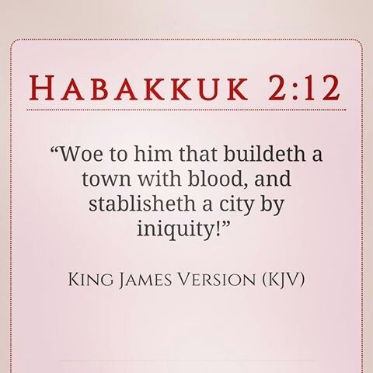
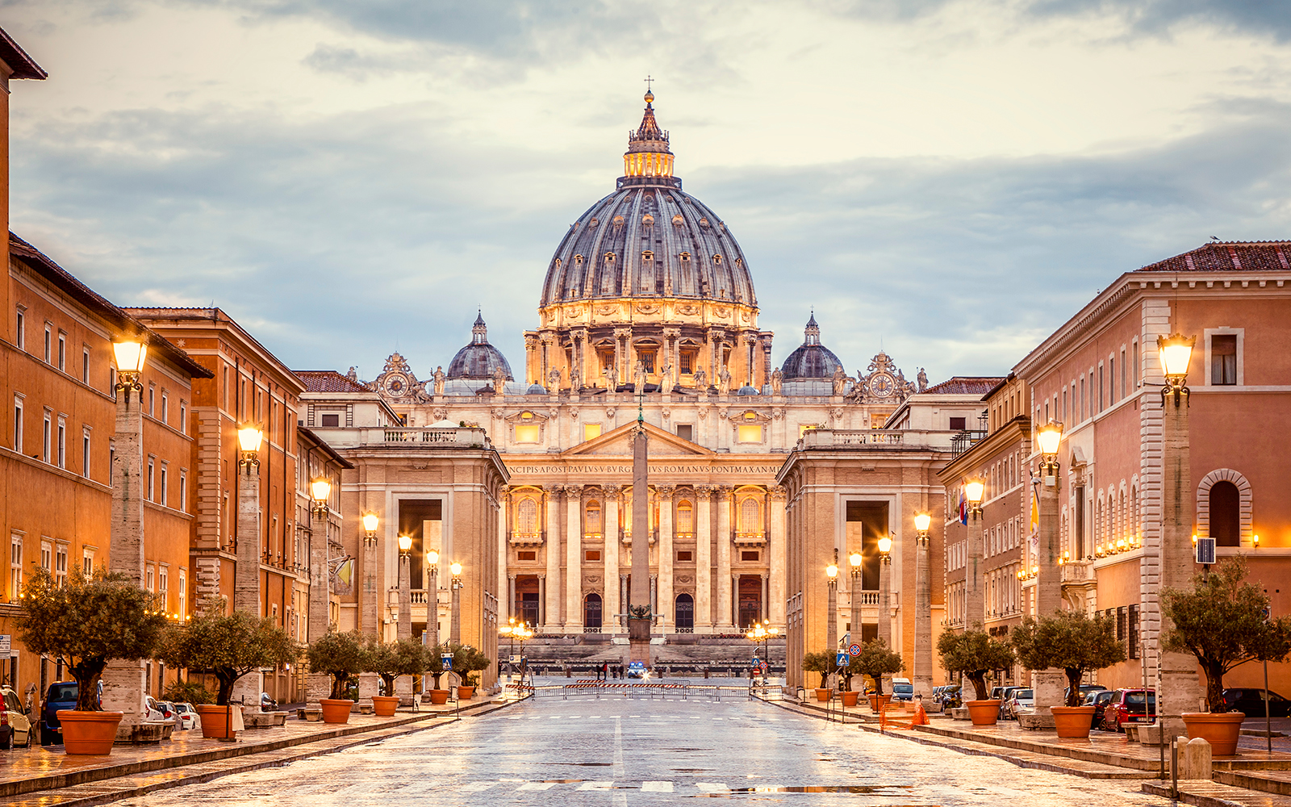
Prophetic Climax
Mic 3:9-10 – “⁹Now hear this, heads of the house of Jacob and rulers of the house of Israel, who abhor justice and twist everything that is straight, ¹⁰who build Zion with bloodshed and Jerusalem with violent injustice.”
Notes:
We now arrive at the climactic oracle of not just this book, but the entire collection of prophets. As mentioned in our introductory class, these next four verses represent the middle point of all the minor prophets. So, if structure means anything, which I’d suggest it does, these verses are very important to consider in the overall context of the times.
(CLICK) Mic 3:9a – So he’s reissuing the challenge from vs. 1, but this time he doesn’t bother w/an appeal of, “Is it not for you to know justice?” He calls it exactly how it is (CLICK) – Mic 3:9b – That word “abhor” means to “loathe, regard as detestable, to hold the right in horror”. So, it’s not just that they don’t share Micah’s propensity for justice from the previous verse, they abhor/hate it, because it doesn’t give them what they want. They also “twist everything that is straight”, meaning they knew what was right, but openly defied it to serve their own interests.
Micah continues (CLICK) – Mic 3:10 – What does “Jerusalem” mean? “City of peace” – yet look at how it was built. If I understand this correctly, the city walls, palaces, opulent buildings, and costly stones would’ve been beautiful architecture, brilliant engineering, but there was something more sinister behind it. These things were being erected at great human cost – exploitation of the poor, social oppression, robbery, and murder.
(CLICK) Example – St. Peter’s Basilica – largest church in the world, one of the most beautiful cathedrals in the entire world. Millions of people tour the Vatican every year just to see it for its splendid architecture. But this great feat of human ingenuity was financed through the sale of indulgences. False teachers of the Catholic church sold slips of paper claiming that repentance of sin wasn’t necessary on the part of the buyer because those indulgences gave complete forgiveness of sins, time out purgatory, and not just for the buyer, but depending on the price you were willing to pay, even for loved ones who had already passed on. So understand that every time we go to places like this and marvel over the beauty, underneath the beauty is bloodshed and injustice. And this is what Micah is seeing in Jerusalem.

Slide 9
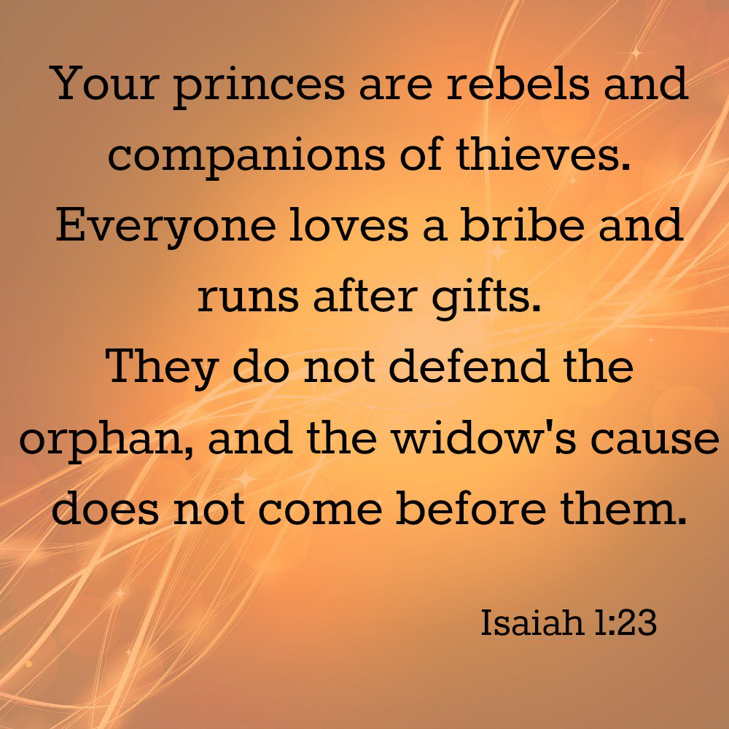
Prophetic Climax
Mic 3:11 – “¹¹Her leaders pronounce judgment for a bribe, her priests instruct for a price and her prophets divine for money. Yet they lean on the Lord saying, ‘Is not the Lord in our midst? Calamity will not come upon us.’”
“We take the position that a Christian's sins do not damn his soul. The way a Christian lives, what he says, his character, his conduct, or his attitude toward other people have nothing whatever to do with the salvation of its soul....All the prayers a man may pray, all the Bibles he may read, all the churches he may belong-to, all the services he may attend, all the sermons he may practice, all the debts he may pay, all the ordinances he may observe, all the laws he may keep, all the benevolent acts he may perform will not make his soul one whit safer; and all the sins he may commit from idolatry to murder will not make his soul in any more danger....Salvation is settled once and for all when we believe....The way I live has nothing whatsoever to do with the salvation of my soul” (Sam Morris, “Do A Christian's Sins Damn His Soul”?).
Notes:
And he’s not done yet. Mic 3:11a – Interesting how judgment all of the sudden became a good thing when a price tag was attached to it. And this is all really just a summary of everything he’s talked about so far, that God has to come down and be their head because the nation was currently being headed by an unholy trinity of hacks (leaders, priests, and prophets) who were completely corrupted by money.
But, as we already saw from chapter 2, they had this sort of “once saved, always saved”, “but I bought an indulgence!” mentality – Mic 3:11b – In other words, they’re deluded. It’s difficult to imagine a more perverted concept of God. God has always made His presence contingent on behavior, OT and NT.
(CLICK) Example – Unless we think this mindset doesn’t exist anymore, here is a statement from a denominational pastor named Sam Morris giving a defense of the doctrine of “once saved always saved”.
COMMENTS

Slide 10
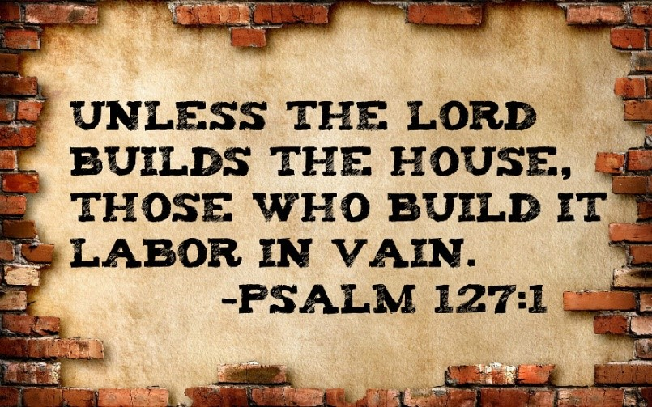
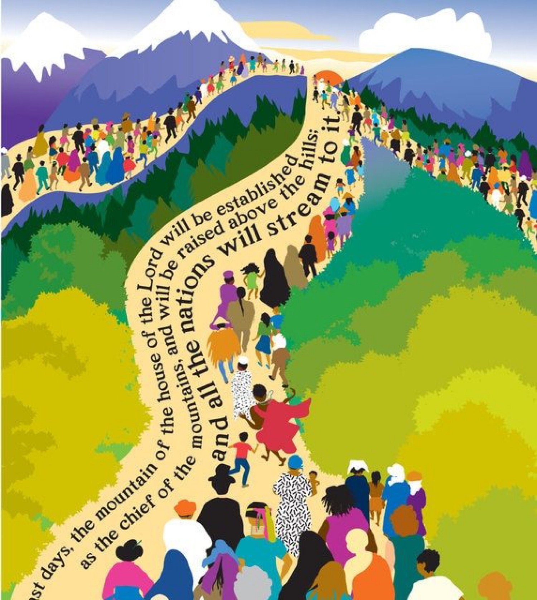
Prophetic Climax
Mic 3:12 – “¹²Therefore, on account of you Zion will be plowed as a field, Jerusalem will become a heap of ruins, and the mountain of the temple will become high places of a forest.”
Judgment/Sentences
3:1 – 3:4: silence
3:5 – 3:8: darkness
3:9 – 3:12: absence
Notes:
So why the repetition? Why the reemphasis? Because these are the reasons why God would allow the city of Jerusalem along w/the beloved temple to be destroyed – Mic 3:12a – not because of the strength of the enemy, not because of the strength of the enemies’ idols, not because of any weakness on God’s power, and not because God acted rashly in a moment of anger. Whose fault was it? The leaders who practiced injustice and oppression and would not defend the weaker, and the priests and prophets who were in it for the money and were willing to pervert God’s message to achieve it. These were the actions that led to God’s wrath – nothing else.
Mic 3:12b – more poetic justice – the wicked efforts they took in vs. 10 to build it up will be the very thing that causes it to come down. I keep bringing up “poetic justice” because this is God teaching an unjust people what justice looks like. And make no mistake, this is God’s justice. (CLICK) Because as Psalm 127:1 says, “Unless the Lord builds the house, those who build it labor in vain”. It’s the same sentence given to Samaria in 1:6, showing that He is truly a God of justice in that He shows no partiality whatsoever.
(CLICK) But what we learn from the 3 oracles in this chapter is that the worst judgment God could ever bring on mankind is not being w/them, and that’s what we’ve seen consistently in this chapter. In the first four verses, He would not answer their prayers. In the next four verses, He’d bring them darkness, and in these last four, He leaves completely. And it is this last oracle in which He promises the temple will be destroyed in which God will pull out from the leaders any pretext to justify themselves and make themselves feel secure – “Oh you think having the temple here allows you to do what you want? Let’s just get it out of the way then…”.
(CLICK) Now, we know from history, that this judgment would be delayed because of Hezekiah’s repentance as we discussed from the prophesy at the end of chapter 2. But though delayed, it was assured, and would occur about 100 years later when Babylon came knocking. What then? Because if all that God’s people had to go off of was His justice, they’d be hopeless. Point – this is the middle verse of all the minor prophets, ending in complete destruction. But chapter 4 is going to begin by looking into the future in which His people will find hope. Chapter 3 ends w/judgment on the mountain of His house, and chapter 4 begins w/hope found in the future mountain of His house.

