Slide 1
“The fear of the Lord is the beginning of knowledge”
(Prov 1:7a)
“The knowledge of the Holy One is understanding”
(Prov 9:10b)
“For if you cry for discernment, lift your voice for understanding”
(Prov 2:3)
“The fear of the Lord is the beginning of wisdom” (Prov 9:10a)
“The fear of the Lord is the instruction for wisdom” (Prov 15:33a)
Understanding
Fear
Instruction
Knowledge
Discernment
Righteousness
Trust
“The mouth of the righteous flows with wisdom”
(Prov 10:31a)
“Trust in the Lord with all your heart and do not lean on your own understanding.”
(Prov 3:5)
Wisdom
…has built her house, she has hewn out her seven pillars. (Prov 9:1)

Slide 2
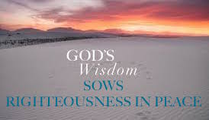
FACTUAL KNOWLEDGE
SITUATIONAL INSIGHT
NECESSARY RESOLVE
Righteous goal
Psa 37:30 – “The mouth of the righteous utters wisdom, and his tongue speaks justice.”
Prov 10:31a – “The mouth of the righteous flows with wisdom”
Notes:
The definition of wisdom that we’ve been evaluating is this – “Wisdom is the combination of factual knowledge, situational insight, and necessary resolve, which, when practiced, has the greatest likelihood of achieving an intended righteous goal”. Everything we’ve discussed so far have been to get us to this “righteous goal”. That is the whole point of wisdom. It is not to rob us of fun, rob us of joy, or something we can have in order to pat ourselves on the back. And wisdom is not simply reserved for the “elite Christians” because there is no such thing. Gaining wisdom is about getting all Christians to the point where they can be righteous.
Psa 37:30; Prov 10:31a

Slide 3
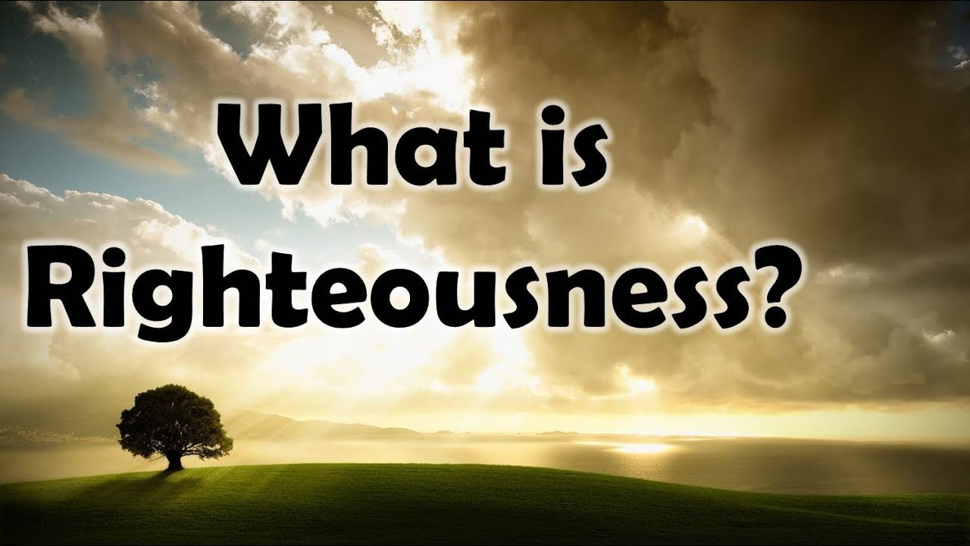
dikaiosune
Rom 1:17 – “For in it the righteousness of God is revealed from faith to faith; as it is written, ‘But the righteous man shall live by faith.’”
Rom 4:3 – “For what does the Scripture say? ‘Abraham believed God, and it was credited to Him as righteousness.’”
Rom 4:6b – “…God credits righteousness apart from works”
Rom 4:13b – “…through the righteousness of faith”
Notes:
What is righteousness? If you look it up in a standard dictionary, it means the state of being morally right. We might think of justness, virtuous, morality, etc. But if you want to get really technical, righteousness is God. God is the only one who is righteous as righteous can even be defined because He is always right. But when the bible uses the term righteous, it is often describing conduct in relation to someone else. And while the bible does use it in regards to the rights of others in business or legal matters, the overwhelming majority of verses uses righteousness as conduct in relation to God – Rom 1:17 – so this means that any measurement of righteousness, in its purist sense, has to be defined by what we actually see in God’s character.
Another way to think about righteousness is as being “approved”. So, for example, when you’re attempting to get a loan, you’ll sit down with a bank, and they’ll go through your finances, your credit score, your job history, your current bills, and based on requirements set by underwriting, they’ll either approve or disapprove. Every bank is different. There may be some that approve you and others that disapprove, and it may seem unfair, but they’re the bank so they call the shots.
So if we take these two ways of looking at righteousness, both as who God is as well what a state of being approved, we can conclude logically that God is the one who approves whether we are meeting the requirements and standards of righteousness. We don’t get to set the standards by man made expectations. He does. And God has deemed that those who have faith, true faith, are righteous. And this is not something earned, it is rather something that has been credited to man by virtue of God’s requirements – Rom 4:3, 6b, 13b.
I have dealt with banks who have standards that I didn’t agree with. I’m thinking, “I’m fully qualified to be credited x amount of money” but the fact says, “But we need to see _____” and I think its ridicules. But they’re the bank; its there money. I don’t get to tell them I’m worthy of their credit simply by the opinion I hold of myself and financial situation. In the same way, God has defined wherein we are credited righteousness in his sight, and despite however “good” I may think I am, my sense of “good” is not necessarily God’s sense of good.

Slide 4
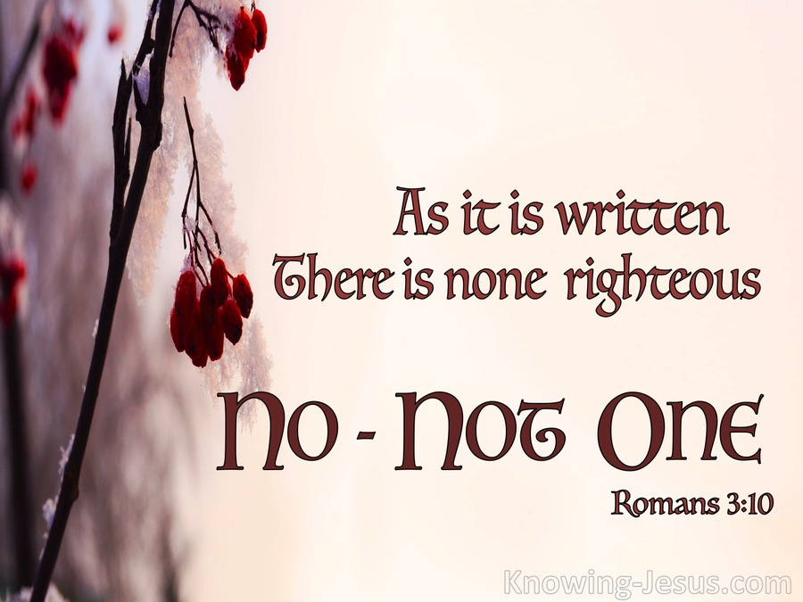
Phil 3:8-9 – “⁸More than that, I count all things to be loss in view of the surpassing value of knowing Christ Jesus my Lord, for whom I have suffered the loss of all things, and count them but rubbish so that I may gain Christ, ⁹and may be found in Him, not having a righteousness of my own derived from the Law, but that which is through faith in Christ, the righteousness which comes from God on the basis of faith.”
Notes:
Now, the reason righteousness has to be something which God credits to us, so that we may be “approved” in His sight, is because it is not possible for us, a sinful human beings, to be righteous in and of ourselves. No one has ever been able to achieve this other than Jesus Christ, and no one will ever achieve it – Rom 3:10 – And because of this conundrum, if God was going to save us, He was going to have to come up with a means by which He could declare us righteous without us being able to achieve it of our own means.
And it’s through faith in Jesus Christ that we can be declared and approved as righteous. He then becomes our righteousness – 2 Cor 5:10 – This means that while we are not righteous, by God crediting righteousness to us, we are made righteous, meaning we’re accepted and treated as righteous by God, on account of what Jesus Christ did for us, even though the actions of our past and maybe even our present seem to be the furthest thing from God’s holy character. And God can do this because we are in Christ. He was made sin, we are made righteous. On the cross, Jesus was treated as if He were a sinner, even though He was perfectly holy and pure. And once we’re in Christ, He covers us, we are treated as if we are righteous, even though we are sinners.
Paul says it so well in Phil 3:8-9 – Paul saw the wisdom in God’s plan, that we would be made righteous in Christ, knowing our inability to be righteous of our ourselves, that attaining Christ was worth giving up everything for.

Slide 5
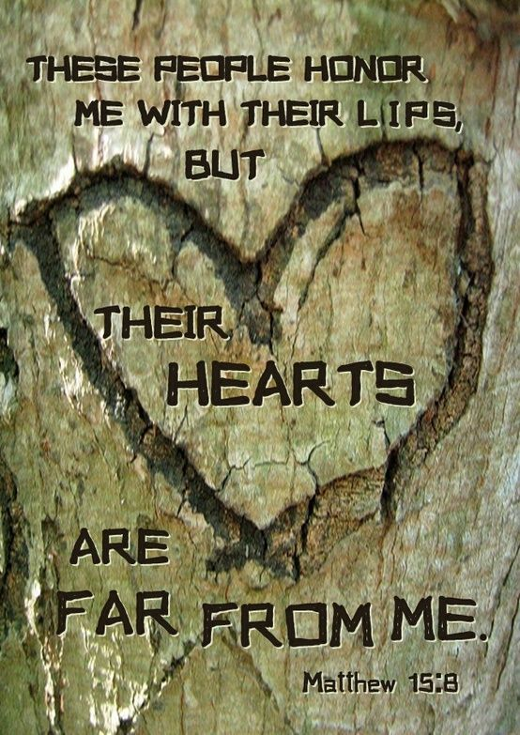
Matt 5:20 – “For I say to you that unless your righteousness surpasses that of the scribes and Pharisees, you will not enter the kingdom of heaven.”
Matt 6:1 – “Beware of practicing your righteousness before men to be noticed by them; otherwise you have no reward with your Father who is in heaven.”
Superficial Giving (vs. 2 – 4)
Superficial Praying (vs. 5 – 6)
Superficial Fasting (vs. 16 – 18)
Matt 6:33 – “But seek first His kingdom and His righteousness, and all these things will be added to you.
Notes:
Now, let’s contrast this true righteousness found in Christ w/a false standard of righteousness that we see exhibited by the scribes and Pharisees. Here is a seemingly startling statement made by Jesus about them – Matt 5:20 – This would have seemed like a shocking statement to the ordinary Jew of that day because they considered the Pharisees the religious elite. But the Pharisees righteousness was superficial; it was merely external conformity, eye candy, but there was no internal devotion toward God – Matt 15:8-9 – How so? Consider what Jesus said in Matt 6:1 – In what ways? He goes on to say that in their giving, in their praying, and in their fasting, they were simply putting on a show. It was all done so people would notice them. But there was no heart behind it. There was no bankruptcy of spirit that recognized their own sinfulness before God. There was no mercy, no hungering and thirsting for righteousness, none of those qualities Jesus spoke of in the beatitudes that is incumbent of truly spiritual people who actually are seeking to attain righteousness.
Because true righteousness stems first from our acknowledgement that we are sinners wholly unworthy of God, and secondly by applying God’s credit terms to our life, which is faith in Jesus Christ. This produces a thankfulness, a love, that causes us to strive for righteousness with all our heart, not so men can see us, but so that they can see God. It has nothing to do with us. It’s about bringing glory to God and His Son – Matt 6:33

Slide 6
Seeking Righteousness
Starve for it
Matt 5:6 – “Blessed are those who hunger and thirst for righteousness, for they shall be satisfied.”
Value it above persecution
Matt 5:10 – “Blessed are those who have been persecuted for the sake of righteousness, for theirs is the kingdom of heaven.”
Heart driven
Matt 5:20 – “For I say to you that unless your righteousness surpasses that of the scribes and Pharisees, you will not enter the kingdom of heaven.”
Right motives
Matt 6:1 – “Beware of practicing your righteousness before men to be noticed by them; otherwise you have no reward with your Father who is in heaven.”
Seek above everything else
Matt 6:33 – “But seek first His kingdom and His righteousness, and all these things will be added to you.”
Notes:
And that’s key. Though we cannot be righteous in and of ourselves, the implications of this fact as well as what God did for us in Jesus Christ should cause us to seek after God’s righteousness with everything we’ve got, even while at the same time we acknowledge we can’t attain it perfectly.
Starve for it – Matt 5:6 – In other words, righteousness is something we’ve got to really, really want…bad! We have to see just how empty we are without so that this dehydration of the spirit will cause us to go however far we must to get it.
Value it above persecution – Matt 5:10 – Make no mistake, even the attempt to attain to God’s righteousness will lead to resentment, mocking, and insults by those who choose to pitch their tents in darkness. You will be the subject of scorn, lies, and all manner of trouble in life. But we must value God’s righteousness above these earthly troubles, as Jesus did, in order to receive the kingdom of heaven.
It must be heart driven – Matt 5:20 – It can’t begin with the outward things that separate us from worldly people (being baptized, assembling, the LS., no instruments, etc.). That is putting the cart before the horse. It starts with a born again spirit, a heart that is starving for the righteousness of God and who is pained when he cannot attain it.
Which means its all about motive – Matt 6:1 – Its not that the external things are wrong or that we shouldn’t strive to worship God and work with the church in the manner He has specified. A truly transformed heart will make these a priority in his/her life. But it must begin with the motive to attain God’s righteous and not do things so we can boast in them, or exalt ourselves above other religiously minded people who may not know better.
Most importantly, though, we must seek righteousness above everything else – Matt 6:33 – Righteousness is the sum total of God’s requirements for us and seeking it must come first before we have expectations for anything else.

Slide 7
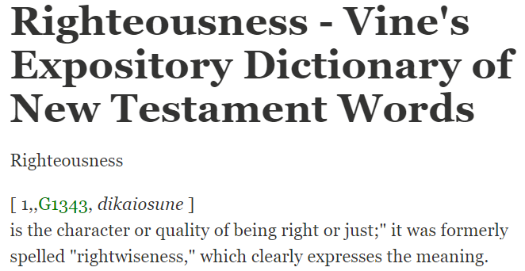
Probabilities
Not Promises
Notes:
Now, all of this begs the following question. What does righteousness have to do with wisdom? If you study the book of proverbs, you will find the word righteousness is used 90 times throughout this book. This means the relationship between applying wisdom and gaining righteousness is incontrovertible. If we apply wisdom, we will be righteous; and we cannot attain to righteousness without applying wisdom.
In fact, if you look up that Greek word for “righteousness” in Vine’s Greek dictionary, you will find that “righteousness” used to be spelled “rightwiseness”. Consider the implications of this. To be righteous means that we make choices not on the basis of whether they can be explicitly proven to be right vs. wrong or sinful vs. not sinful. To be righteous is to be wise. And to be wise is to be righteous. Does that not tell you how important the subject of wisdom is? Being a Christian is about choosing those paths that has the greatest likelihood of achieving a righteous goal. This means we can’t just make decisions on the basis of that which can be explicitly proven (though many things can), but those things which speak of probability. Remember, proverbs is about probabilities and God is telling us that those who are righteous walk according to those probabilities. Its not just promises, but probabilities. The only thing that is promised is if we abide by these probabilities, we will have the greatest likelihood of success, spiritually speaking. It will lead to righteousness.

Slide 8
Eccl 9:11 – “I again saw under the sun that the race is not to the swift and the battle is not to the warriors, and neither is bread to the wise nor wealth to the discerning nor favor to men of ability; for time and chance overtake them all.”
Eccl 1:18 – “Because in much wisdom there is much grief, and increasing knowledge results in increasing pain.”
Eccl 7:16 – “Do not be excessively righteous and do not be overly wise. Why should you ruin yourself?”
Eccl 9:1 – “For I have taken all this to my heart and explain it that righteous men, wise men, and their deeds are in the hand of God. Man does not know whether it will be love or hatred; anything awaits him.”
Notes:
But that begs another question. Why is it that some people, who practice wisdom, do not see the kind of success that Proverbs says comes to those who make the sacrifices for that righteous goal? That’s where the book of Ecclesiastes comes in.
Proverbs personifies wisdom into a woman who is shouting the virtue of pursuing wisdom, and she’s optimistic that if you acquire it, you’ll have a successful life. So lady wisdom is the optimist. But Ecclesiastic is the realist, the critic, who says in addition to all these things under the sun being vanity, that wisdom doesn’t always lead to success. Obviously there is a cause and effect relationship between applying wisdom and being rewarded in this life, but life sometimes throws a curve ball – Eccl 9:11; 1:18; 7:16; 9:1
The point the critic makes in Ecclesiastes is that wisdom is the better route to go over foolishness, without a doubt, but just because you have wisdom doesn’t guarantee success in this life. In fact, it may increase your grief because, in your wisdom, you watch others that you love pursue paths of foolishness, as you sacrifice so much for the sake of wisdom only for chance to overtake success, as you watch people resent you for wisdom, etc.
However, he concludes the book with, “Fear God and keep His commandments for this is the whole duty of man”. And the point is, wisdom is not about what we can accumulate here on this Earth. We’ll have a greater chance of earthly success with wisdom rather than without, but its not so much about that. Its about righteousness. Its about fearing God. Its about preparing ourselves for eternity because death, as the great equalizer, comes to every man, and we’re going to stand before God on judgment day and give an account for our walk here on this Earth. And that is not vanity in the least.
And so while Proverbs is crying for us to be optimistic in the rewards wisdom bring, Ecclesiastes, as the pessimist, helps us fine tune the motive for doing so. The righteous don’t always see reward here on this planet. They may have to hold out for eternity.

Slide 9
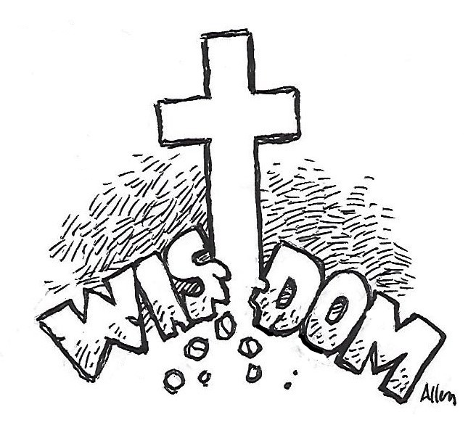
Heb 12:2 – “fixing our eyes on Jesus, the author and perfecter of faith, who for the joy set before Him endured the cross, despising the shame, and has sat down at the right hand of the throne of God.”
1 Cor 1:23-24 – “²³but we preach Christ crucified, to Jews a stumbling block and to Gentiles foolishness, ²⁴but to those who are the called, both Jews and Greeks, Christ the power of God and the wisdom of God.”
1 Cor 1:30 – “But by His doing you are in Christ Jesus, who became to us wisdom from God, and righteousness and sanctification, and redemption”
Notes:
Jesus Christ is out ultimate example of this very principle. No one lived a wiser, more righteous life on this Earth than that of the Son of God Himself. And yet, He suffered tremendously for it. How did He get by? Heb 12:2 – His righteousness depended not on what this corruptible, dying Earth could offer. It lay in what was coming to Him after the cross.
This is true wisdom, living a life of righteousness, modeled after Jesus Christ Himself who is called by the Holy Spirit God’s wisdom – 1 Cor 1:23-24 – It’s God’s way of saying, “If you want to live the wisest, fullest, most meaningful life on this Earth, look no further than Jesus Himself.” Jesus became, for us, God’s wisdom – 1 Cor 1:30 – That is why we can only achieve true righteousness through Jesus, because Jesus is the path of true wisdom. See how the two or indispensable of the other?

