Slide 1
Alcohol
And
Wisdom
Notes:
Why does the subject of alcohol need to be considered through the lens of wisdom?
The bible speaks of “wine” in both a positive and negative sense.
Those in biblical times drank wine for different reasons than most do today
Distillation was not even invented until the 13th century
“Moderate” consumption of alcohol is not as definitive of a line as some wish it were
Influence becomes keys. Even areas I may deem as “liberty” could be the undoing of someone else
So truth be told, comparing wine of antiquity vs. wine of modern day times is like comparing apples to oranges so it is not enough to simply say, “They drank it then, why can’t we drink it now?” We must approach the subject cautiously, looking carefully at principles, examples, and precedence. This is the key to unraveling the “social drinking” debate.

Slide 2
Alcohol & The Fear Of The Lord
Statistics
CDC: 2006 and 2010, 88,000 deaths per year from alcohol
~17 million alcoholics in America
>$1B tax dollars spent on health care, law enforcement, imprisonment, and rehabilitation
>$25 billion spent by consumers this year alone
Advertisers spend >$600 million encouraging alcohol
Billions of dollars wasted in time/efficiency at the workplace
Hundreds of Auburn students flunk out, some losing full rides
55% of sexual assault victims were drinking before assault
97% of sexual assault victims were drinking at time of assault
Mental & health problems, and ultimately death of many
Broken homes due to neglect, spousal abuse, child abuse, etc.
>55% of highway deaths are alcohol related
Notes:
Prov 9:10a – “The fear of the Lord is the beginning of wisdom”
What do the statistics say?
The CDC says that between 2006 and 2010, excessive alcohol abuse led to 88,000 deaths per year
~17 million alcoholics in America
Billions of our tax dollars spent on health care, law enforcement, imprisonment, and rehabilitation
25 billion dollars will be spent by consumers this year alone
Advertisers will spend $600 million encouraging you to engage in alcohol
Billions of dollars wasted in time and efficiency of employers in the workplace
Hundreds of Auburn students flunk out; some of those will lose full rides
55% of sexual assault victims have been drinking at the time of the assault
97% of the victims had been drinking at the time they did the assaulting
Alcohol leads to mental problems, health problems, and ultimately will lead to the death of many
It has been the cause of many broken homes due to neglect, spousal abuse, child abuse, etc.
Over 55% of highway deaths are alcohol related
We could stop the lesson now and make a solid case that based on these statistics alone, alcohol should be something that followers of Jesus should avoid at all cost. But at the very least, given these stats, can we really afford to be cavalier about it?

Slide 3
Alcohol & The Fear Of The Lord
Noah was seen naked in front of family
Gen 9:21 – “He drank of the wine and became drunk, and uncovered himself inside his tent.”
Lot impregnated daughters
Gen 19:33 – “So they made their father drink wine that night, and the firstborn went in and lay with her father; and he did not know when she lay down or when she arose.”
Son who was disrespectful toward parents
Deut 21:20 – “They shall say to the elders of his city, ‘This son of ours is stubborn and rebellious, he will not obey us, he is a glutton and a drunkard.’”
Marriage conflict between Ahasuerus and Vashti
Esth 1:10-12 – “On the seventh day, when the heart of the king was merry with wine, he commanded…to bring Queen Vashti before the king with her royal crown in order to display her beauty to the people and the princes, for she was beautiful. But Queen Vashti refused to come at the king’s command delivered by the eunuchs. Then the king became very angry and his wrath burned within him.”
Nadab & Abihu killed
Lev 10:9 – “Do not drink wine or strong drink, neither you nor your sons with you, when you come into the tent of meeting, so that you will not die—it is a perpetual statute throughout your generations”
Notes:
It is irrefutable that alcohol existed in much lesser potency than the majority of alcohol available today. Modern day wines and beers have all kinds of sugars, yeast, and distillation whereas wine of biblical days fermented naturally. Yet consider what it did to people in the bible in much weaker potency:
Noah disrobed and was seen naked by those who should not have seen him – Gen 9:21; Lam 4:21
Lot’s daughters – Gen 19:33-35
Son who was disrespectful and disobedient toward parents – Deut 21:19-20
Marriage conflict between Ahasuerus and Vashti – Esth 1:10-12
Nadab & Abihu – Lev 10:8-11

Slide 4
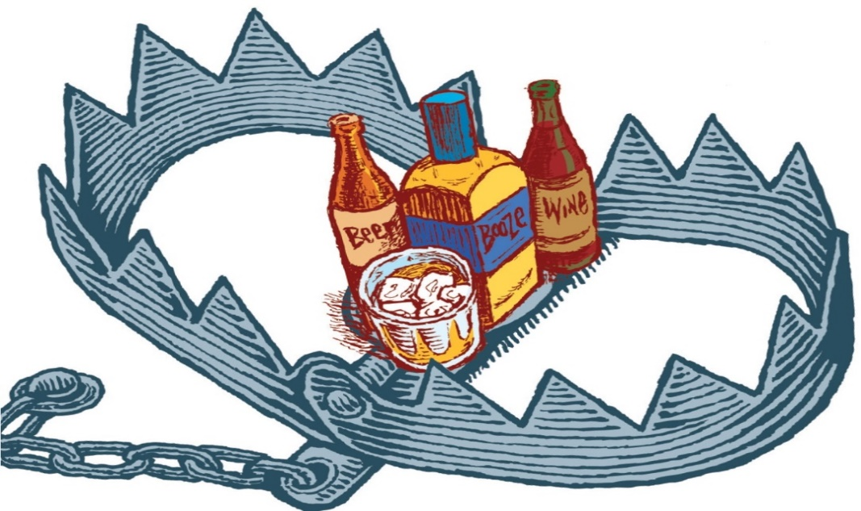
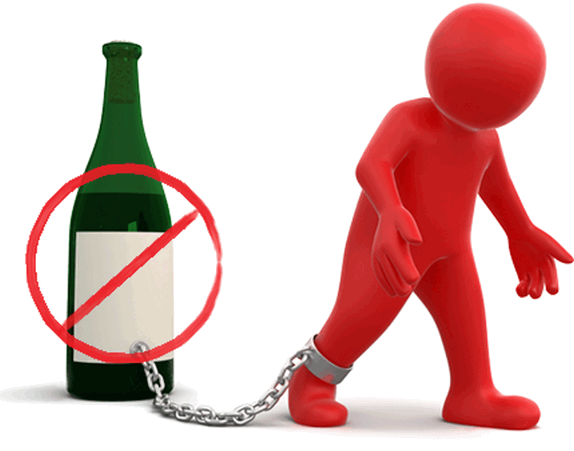
Alcohol & The Fear Of The Lord
Mocks – Prov 20:1
Destroys – Nah 1:10
Poverty – Prov 23:21
Woes – Hab 2:15; Isa 5:11,22
Sorrow – Prov 23:29
Contention – Prov 23:29
Harms judgment – Prov 31:4-5; Isa 28:7
Complaining – Prov 23:29
Perversion – Prov 23:33b
Worries without cause – Prov 23:29
Notes:
Other consequences
Mockery and brawling – Prov 20:1
Destroys – Nah 1:10
Leads To Poverty – Prov 23:21
Woes – Hab 2:15
Sorrow, Contention, Complaining – Prov 23:29
Perversion – Prov 23:33b
Worries w/o cause – Prov 23:29

Slide 5
Alcohol & The Fear Of The Lord
Impairs judgment – Prov 31:4-5; Isa 28:7
Inflames passions – Isa 5:11
Enslaves – Tit 2:3
Boisterous – Zech 9:15
Inappropriate business – Joel 3:3
Bad company – Hos 7:5
Takes away understanding – Hos 4:11
Bad influence – Isa 56:12
Vomiting – Isa 19:14; Jer 25:27
Staggering – Job 12:25; Psa 60:3
Notes:
Other consequences
Impairs judgment – Prov 31:4-5; Isa 28:7
Inflames passions – Isa 5:11
Enslaves –Tit 2:3
Boisterous – Zech 9:15
Inappropriate business transactions – Joel 3:3
Associate with the wrong people – Hos 7:5
Takes away your understanding – Hos 4:11
Incites others to get drunk with you – Isa 56:12
Vomiting – Isa 19:14; Jer 25:27
Staggering – Job 12:25; Psa 60:3; Psa 107:27

Slide 6
Alcohol & The Fear Of The Lord
Eternal Consequences Of Drunkeness
Gal 5:19-21 – “Now the deeds of the flesh are evident, which are: immorality, impurity, sensuality, idolatry, sorcery, enmities, strife, jealousy, outbursts of anger, disputes, dissensions, factions, envying, drunkenness, carousing, and things like these, of which I forewarn you, just as I have forewarned you, that those who practice such things will not inherit the kingdom of God.”
1 Cor 6:9-10 – “Or do you not know that the unrighteous will not inherit the kingdom of God? Do not be deceived; neither fornicators, nor idolaters, nor adulterers, nor effeminate, nor homosexuals, nor thieves, nor the covetous, nor drunkards, nor revilers, nor swindlers, will inherit the kingdom of God.”
Notes:
But the worst of all consequence are eternal consequences. Drunkenness will keep us out of heaven – Gal 5:21; 1 Cor 6:9-10
Can any social drinker claim they have never crossed the line their drinking? I have never met one – 1 Cor 10:12
Therefore, w/all the issues that alcohol causes, can we really afford to be cavalier towards it, boasting in supposed liberty or straining over the legal technicalities over my supposed right to be able to imbibe it? No, when it comes to this subject, we need to search out the answer in the fear of the Lord.

Slide 7
Instruction & Alcohol
2 Tim 3:16-17 – “All Scripture is inspired by God and profitable for teaching, for reproof, for correction, for training in righteousness; so that the man of God may be adequate, equipped for every good work.
2 Tim 2:15 – “Be diligent to present yourself approved to God as a workman who does not need to be ashamed, accurately handling the word of truth.”
Heb 5:14 – “But solid food is for the mature, who because of practice have their senses trained to discern good and evil.”
Gal 5:21a – “envying, drunkenness, carousing, and things like these…”
Notes:
What we need to figure this issue out, first and foremost, is to give an honest inspection of God’s word – 2 Tim 3:16-17 – This means God’s word has the answer. It’s adequate, complete, and will equip us for every good work. This includes whether or not it is wise to engage socially and recreationally in the consumption of modern day alcoholic beverages.
2 Tim 2:15 – This means uttering a caveat doesn’t solve the issue. As many verses as there are that, on the surface, appear to grant liberty over this subject, there are other verses that pronounce woe. There is context to consider, motive, and many other considerations. So any study from God’s book on this subject must take all verses in mind, and weigh them against one another. That is how we will find the answer to this difficult subject.
Heb 5:14 – Many will attempt to justify this topic by asking, “Show where the bible specifically condemns it”. This does nothing more than show an immaturity in our approach to biblical interpretation which God expects us to overcome. The Hebrew writer points out that the mature have their senses trained to “discern good and evil”. Discerning is the key, and this means rightfully dividing passages, making inferences, and weighing the evidence of scripture against itself.
Another passage to consider is in Gal 5 where Paul enumerates through the deeds of the flesh, which he says in vs. 21 will keep one out of the kingdom of heaven. But when he gets to the end of this very specific list in vs. 21, he adds “and things like these”. And so there are “things like these” that are wrong, which were not necessarily specified by Paul in his teaching, but instead require discernment on our part. And so, by saying “Show me where the bible specifically condemns it” what we’re really saying is that we either don’t know about passages or it could mean that we simply haven’t learned how to discern much from the principles and information provided in the bible. Or it could mean, and I would hope this isn’t the case with us, that we don’t really care to try and discern between good and evil, from right from wrong.
But the goal should be to lay out all of the principals involved in helping us make the right decisions about matters that aren’t specifically prohibited in the bible, and developing the necessary discernment to distinguish between right and wrong. And alcohol, like many subjects, requires an honest and mature approach to bible interpretation. Pigeon holing God’s word by demanding a “thou shall not” for every single circumstance shows an improper understanding of biblical hermeneutics.

Slide 8
Instruction & Alcohol
Prov 22:24-25 – “Do not associate with a man given to anger; or go with a hot-tempered man, or you will learn his ways and find a snare for yourself.
Prov 13:20 – “He who walks with wise men will be wise, but the companion of fools will suffer harm.”
Rom 12:2 – “And do not be conformed to this world, but be transformed by the renewing of your mind, so that you may prove what the will of God is, that which is good and acceptable and perfect.”
Notes:
Secondly, who we spend time with will absolutely determine whether we become drinkers or not – Prov 22:24-25 – Would anyone suggest that angry man is the only person we learn to imitate when we’re around him? This applies to a multitude of sins and bad habits and social drinking is no exception, hence the word “social” – Prov 13:20 – Seldom will you meet someone who got into alcohol by themselves without the influence of someone else.
In contrast, if we will develop friendships with people who put God first in their lives, whose desire is to remain undefiled from the world, we will be more likely to receive the correct “instruction” by way of their example than if we find ourselves involved too much with people of the world.
It is likely that you will have to sever relationships with those involved with things like this. If you don’t, it will potentially lead you to compromising – Rom 12:2

Slide 9
Instruction & Alcohol
Prov 30:17 – “The eye that mocks a father and scorns a mother, the ravens of the valley will pick it out, and the young eagles will eat it.
Prov 15:20 – “A wise son makes a father glad, but a foolish man despises his mother.
Prov 23:22 – “Listen to your father who begot you, and do not despise your mother when she is old.”
Notes:
Third, you need to heed the instruction of your parents. Many parents have experimented w/alcohol in the past, and likely under the same illusion of straining over legal technicalities as young people do today. Yet, hindsight has given them 20/20 vision on just how destructive that path has been. It would serve you well to listen to them – Prov 30:17 – The child who mocks his parents advice because they are older is a stupid thing. Parents aren’t trying to keep their children from having fun and enjoying life, they are trying to save their soul. Prov 15:20; 23:22
My grandfather died of alcoholism so I never knew him. One of the greatest things parents bring to this discussion is having lived long enough to see the ill effects of this substance and to share those stories with us.

Slide 10
Instruction & Alcohol
1 Cor 10:6 – “Now these things happened as examples for us, so that we would not crave evil things as they also craved.”
1 Cor 10:11 – “Now these things happened to them as an example, and they were written for our instruction, upon whom the ends of the ages have come.”
Rom 8:28 – “And we know that God causes all things to work together for good to those who love God, to those who are called according to His purpose.
Notes:
And then fourth, your observations and experiences with alcohol can be painful reminders of every reason why it is wise to abstain from it socially and recreationally altogether. Because alcohol does leave such a wrecking ball of destruction, it’s damage can be easily seen. And bad examples such as this serve as warnings to us – 1 Cor 10:1-6, 7-11 – The entire book of Deuteronomy is one big reminder to the second generation of Israelites not to make the same mistakes as their forefathers, and many of them were alive to have seen these mistakes. They knew what the source of the issue was. Moses hones in on the power of observation to help them avoid the same mistakes.
Will we make these same mistakes? Many of us will, sure. And hopefully it will not kill you, or kill another person, physically or spiritually. But the important thing is to rise from the ashes and use your failures as stepping stones for the future – Rom 8:28

Slide 11
Knowledge & Alcohol
Unfermented
Isa 65:8 – “Thus says the LORD, ‘As the new wine is found in the cluster, and one says, “Do not destroy it, for there is benefit in it,” so I will act on behalf of My servants in order not to destroy all of them.”
Isa 16:10 – “Gladness and joy are taken away from the fruitful field; in the vineyards also there will be no cries of joy or jubilant shouting, no treader treads out wine in the presses, for I have made the shouting to cease.”
Lam 2:11-12 – “My eyes fail from weeping, I am in torment within; my heart is poured out on the ground because people are destroyed, because children and infants faint in the streets of the city. They say to their mothers, ‘Where is bread and wine?’ as they faint like the wounded in the streets of the city, as their lives ebb away in their mothers’ arms.”
Eccl 9:7 – “Go then, eat your bread in happiness and drink your wine with a cheerful heart; for God has already approved your works.”
Notes:
One of the most common misconceptions we can have about this subject is thinking that whenever the word “wine” is used in the bible that it always refers to an alcoholic beverage. This is understandable because today when the word wine is used, it always refers to an alcoholic beverage – and so it is easy to assume that that is how it was always used in the bible. But the truth is, wine is spoken of in the bible as both grape juice, meaning the unfermented juice of the grape; and the bible also speaks of wine as a fermented beverage that can cause intoxication.
Isa 65:8 – This is clearly speaking of the fresh juice of the grape – in the cluster and unfermented. This is “wine” described as pure, unfermented grape juice.
Isa 16:10 –In this passage, wine is being spoken of as something treaded out in the presses, directly from the grape. This kind of wine is not an intoxicant or a drug. You know, when we go to a restaurant to enjoy a nice meal and we want an alternative beverage to water, don’t we order things like sweet tea or a coke? These kinds of drinks bring us joy, don’t they? In the same way, unfermented wine of the Mediterranean world is mentioned in the bible as something that brings joy because it was a pleasant alternative to water and a blessing from God.
Lam 2:11-12 – That’s instructive isn’t it? The wine that is food can be drunk by children. This is just more biblical evidence that there was a wine that was nourishing because it was food.
Eccl 9:7 – This is a reference to food, not of an alcoholic beverage that stirs up the mind and the emotions. Context always determines it and that is true of all language.
What we see from these verses is that there was wine in biblical days that had nothing to do with being a drug or something that adversely affected judgment. The fresh, unfermented juice of the grape was a sweet, refreshing alternative to water that was incumbent of that culture, much like our sweet tea here in the south. It was a blessing and it was enjoyed as a beverage by many and not as an intoxicant.

Slide 12
Knowledge & Alcohol
Fermented
Prov 20:1 – “Wine is a mocker, strong drink a brawler, and whoever is intoxicated by it is not wise.”
Prov 23:29-35 – “Who has woe? Who has sorrow? Who has contentions? Who has complaining? Who has wounds without cause? Who has redness of eyes? Those who linger long over wine, those who go to taste mixed wine. Do not look on the wine when it is red, when sparkles in the cup, when it goes down smoothly; at the last it bites like a serpent and stings like a viper. Your eyes will see strange things and your mind will utter perverse things. And you will be like one who lies down in the middle of the sea, or like one who lies down on the top of a mast. They struck me, but I did not become ill; they beat me, but I did not know it. When shall I awake? I will seek another drink.””
Isa 5:11, 22 – “Woe to those who rise early in the morning that they may pursue strong drink, who stay up late in the evening that wine may inflame them...Woe to those who are heroes in drinking wine and valiant men in mixing strong drink”.
Notes:
But then in contrast to wine as fresh, unfermented grape juice, the bible also uses the term “wine” to refer to a strong drink and intoxicant – and with it are many warnings against its consumption.
Prov 20:1 – In the previous slide, we read Eccl 9 where Solomon encourages us to drink our wine with a cheerful heart. But here in Prov 20, Solomon goes a different route. Why? Because he is dealing with wine in its fermented state. When we’re dealing with wine in this state, it is obvious we are talking about a drug that has untoward effects on us and on our minds and our judgments and our health.
Prov 23:29-35 – This wine has consequences on the consumer, and the proverb writer is inferring that it is something a child of God should have nothing to do with.
Isa 5:11, 22 – Now clearly these are references to a “wine” that we ought not to have anything to do with.
Remember, there are a lot of words in the bible that have different meanings today than what they did then: baptism, pastor, Christian, disciple, saint, church, bishop, elder, fellowship, priest, love, works, grace, believe, etc. This needs to considered when we’re dealing with this topic, that the word “wine” by itself does not determine where it was alcoholic.
So we see that in the bible, wine is seen as something that is moral, amoral, and immoral. By amoral, I mean that it is neither good nor bad at times, you could either drink or not drink and at times nothing would be wrong with it. Other times it was moral because it was used for good purposes, such as for medicinal purposes, which we will talk about later. And there would be times when wine is seen as something that is very immoral and evil. One is the cause of intoxication, violence, misery, woe, and is poison. The other the occasion of comfort and peace. One is the cause of apostasy, self-destruction, and is the symbol of divine wrath. The other is the symbol of spiritual blessings. There are blessings in the one that we should receive; there are curses in the other that we must avoid at all costs.

Slide 13
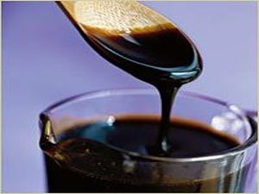
Knowledge & Alcohol
How Was Fermentation Prevented?
Boiling
Prov 9:1-5 – “Wisdom has built her house, she has hewn out her seven pillars; she has prepared her food, she has mixed her wine; she has also set her table; she has sent out her maidens, she calls from the tops of the heights of the city: ‘Whoever is naive, let him turn in here!’ To him who lacks understanding she says, ‘Come, eat of my food and drink of the wine I have mixed.’”
Aristotle – “The wine of Arcadia was so thick that it was necessary to scrape it from the skin bottles in which it was contained and to dissolve the scrapings in water.” (Meteorologica 388b, 6)
Horace – “There is no wine sweeter to drink than that of Lesbos; it was like nectar . . . and would not produce intoxication.”
Virgil described housewives boiling down “sweet must” (Georgics, 1.295)
Notes:
If wine that is the pure grape juice is a blessing and yet a curse as an intoxicant, how did they prevent it from fermenting? After all, they had no refrigerators as we do today to keep it from becoming alcoholic. So the question we ask is how did they do it? Well, there is a surplus of evidence that we have historically that proves they were very capable in those days of preserving their unfermented wine. And though there are no passages that specifically mention these methods, there are passages in scripture that allude to the fact that some of these preservations were used.
First of all, we know that the most common method of keeping the wine from fermenting was to boil it down to a thick syrup. Boiling the grape juice causes the water to evaporate leaving a concentration high in sugar, which makes it impossible for fermentation to take place. Wine could then be preserved for years in this state. And often when we read about the combination of bread and wine in the bible, we’re reading about two things used together for food. People often would use wine in its syrup form like we use jelly to dip their bread in. But whenever they wanted to drink this beverage, they would mix a small amount of the syrup with water like we do with our Kool-Aid. Different ratios of this were used. It varied from 1 part syrup to 3 parts water all the way up to 1 part syrup 20 parts water. This depended on the type of grape, the age of the syrup, the temperature of the water used and even the season – Prov 9:1-5 – This mixing that is mentioned is mixing the boiled down, unfermented syrup with water. I love how it says that this is wisdom. Prov 20:1 talks about a person being intoxicated by wine as not being wise. But here boiling it down to prevent it from fermenting and then mixing it with water is incumbent of wisdom. Prov 20 is an intoxicant but the wine mentioned here in Prov 9 is a sweet beverage, food, the pure unfermented juice of the grape that is a blessing from God.
Several Greek writers of antiquity refer to the drinking of wine in this state, the method of preserving it in a syrup form:
Aristotle – “The wine of Arcadia was so thick that it was necessary to scrape it from the skin bottles in which it was contained and to dissolve the scrapings in water.” (Meteorologica 388b, 6)
Horace – “There is no wine sweeter to drink than that of Lesbos; it was like nectar . . . and would not produce intoxication.”
Virgil described housewives boiling down “sweet must” (Georgics, 1.295)

Slide 14
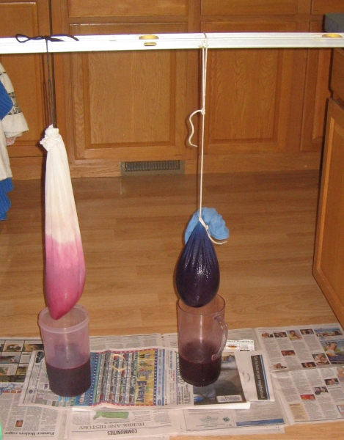
Knowledge & Alcohol
How Was Fermentation Prevented?
Filtering
Isa 25:6 (KJV) – “And in this mountain shall the Lord of hosts make unto all people a feast of fat things, a feast of wines on the lees, of fat things full of marrow, of wines on the lees well refined.”
Pliny The Younger – “The most useful wine has all its force or strength broken by the filter.” (Natural History, 23.24).
Plutarch – “Wine is rendered feeble in strength when it is frequently filtered. The strength or spirit thus being excluded, the wine neither inflames the brain nor infests the mind and passions, and is much more pleasant to drink.” (Symposiacs, 693b 3-5).
The Mishnah mentions the “wine filter” (Terumot 8.6)
The Babylonian Talmud records debates regarding whether wine should be filtered on the Sabbath or not (Shabbat, 139b)
Notes:
Second, those living in biblical times developed methods of filtration. While pressing out the grape in a wine press, they would use a bag called a “sacco” to capture the fermentable substances, but allow the juice from the pulp to flow through it to a vase below the bag – Isa 25:6 – The word “refined” literally means “to purify, distil, strain” and so this is referring to putting the wine through a filtration process. And several ancient records mention this method as in use during biblical times, as well as the fact that one of the primary reasons they did it is because unfermented wine tastes better:
Pliny The Younger – “The most useful wine has all its force or strength broken by the filter.” (Natural History, 23.24).
Plutarch – “Wine is rendered feeble in strength when it is frequently filtered. The strength or spirit thus being excluded, the wine neither inflames the brain nor infests the mind and passions, and is much more pleasant to drink.” (Symposiacs, 693b 3-5).
The Mishnah mentions the “wine filter” (Terumot 8.6)
The Babylonian Talmud records debates regarding whether wine should be filtered on the Sabbath or not (Shabbat, 139b)
Now this is the testimony of two pagan Gentiles not only confirming that filtration existed in the ancient world, but that doing so caused the wine to taste better because its strength is removed. But they are merely confirming what we already know, right? Beverages like grape juice begin fermenting when they are going bad, not when they are getting better. Alcoholic beverages are called an “acquired taste” purely for the narcotic effects produced in the body by the alcohol and not because it is pleasing to the taste buds.

Slide 15
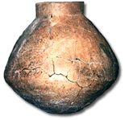
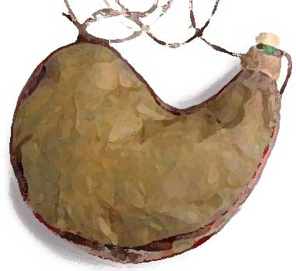
Knowledge & Alcohol
How Was Fermentation Prevented?
Storage
Earthenware vessels (Jer. 13:12; 40:10; Hab. 2:15)
Skins/Jugs (Gen 21:12; 1 Sam 1:24; 10:3; 16:20; 25:18; 2 Sam. 16:1)
Cato the Elder claimed that must stored in an amphora coated with pitch and stored for days in a water tank could be removed and kept as “must” all year (Cato, De Re Rustica 120, 3 )
Columella, the Roman tribune of Syria in 35 AD, claimed it was 40 days (Colimella, De Re Rustica 12.29)
Notes:
Third, wine that was boiled or filtered were often stored in two devices: earthenware vessels (Jer. 13:12; 40:10; Hab. 2:15) or animal skins or jugs when traveling (Gen. 21:14; 1 Sam. 1:24; 10:3; 16:20; 25:18; 2 Sam. 16:1). Several OT scripture reference skins as devices for carrying both water and wine.
The University of Pennsylvania has on display a two-and-one-half gallon jar that is believed to be the oldest wine jar ever found (bottom right pic). It was discovered in the excavation of an ancient kitchen in Hajji Firuz Tepe, Iran. Traces of terebinth resin and red wine have been found on the inner walls (Object No. 69-12-15). This likely indicates that the walls of the jar were coated with this resin to seal it.
Cato the Elder (234 BC – 149 BC) claimed that must stored in an amphora coated with pitch and stored thirty days in a water tank could be removed and kept as “must” for the whole year (Cato, De Re Rustica 120). 3 Columella, who was the Roman tribune of Syria in 35 AD claimed the same thing but extended the period during which the amphora was submerged in water to forty days (Colimella, De Re Rustica 12.29).
Some earthenware vessels were also glazed. A multi-gallon Canaanite wine vessel found at Tel Kabri, near the Mediterranean coast in northern Israel, dated to around 1800 B.C. used to store gallons of red wine was covered with a white glaze (Shapira, Ran. “Ancient wine vessel found in north Israel draws picture of Canaanite banquets” Haaretz {Dec. 9, 2012} [online] http://www.haaretz.com/news/national/ancient-wine-vessel-found-in-north-israel-drawspicture-of-canaanite-banquets.premium-1.483537).

Slide 16
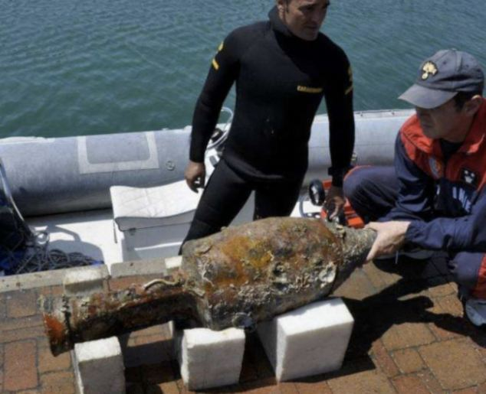
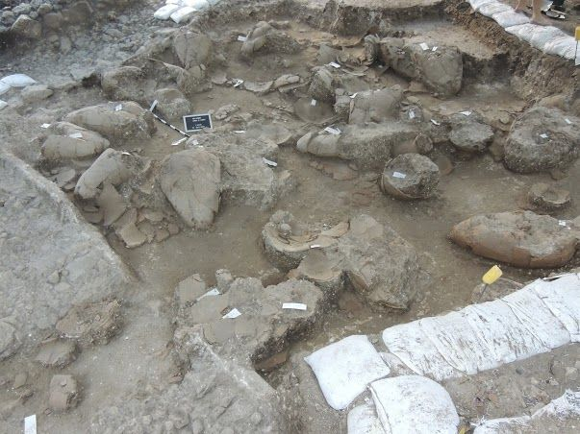
Knowledge & Alcohol
How Was Fermentation Prevented?
Refrigerating, Sealing
Horace mentions earthenware vessels sealed with a pitch coated cork (Carminum Liber 3, 8, 9-12)
Columella describes covering an amphora, plastering over the lid, and then covering it with leather (De Re Rustica 12.39)
The ancients recognized that “must” stored in the cold does not ferment (Plutarch, Natural Questions 27)
When attempting to keep “must” it was generally stored in a cool place and could be kept as sweet “must” for as much as a year (Columella, On Agriculture 12.20.1; 12.37.1; 12.29.1).
Notes:
Fourth, even without refrigerators, they were still able to store wine in conditions that prevented fermentation. Grape juice kept cold cannot ferment. And if you keep it cold long enough (<= 45° F), the fermentable substances will actually settle at the bottom where the juice can be skimmed off of the top where it will never ferment even if warmed. We know from archeology that they stored this kind of wine in caves, under water, and in the ground where it was cooler. So even without refrigerators, they still had the means to keep wine cool.
But they also kept their containers air tight by corking the bottle and then sealing it with things like pitch or glaze or certain oils. Earthenware vessels could be sealed with a pitch coated cork (Horace, Carminum Liber 3, 8, 9-12), but other methods of sealing were used as well. Columella describes covering an amphora, plastering over the lid, and then covering it with leather (De Re Rustica 12.39).
In the 1960s, a sunken ship was discovered at the bottom of the Mediterranean that had containers of wine dating back to the Roman Empire. The containers were sealed so well that water from the sea had not penetrated them. In August of 2012 a 1st century Roman shipwreck was discovered off the coast of Italy with nearly 200 amphora containing wine, oil, grain, and pickled fish with pine caps coated with pitch still sealed and in place. (ABC News, Aug. 9, 2012).
The ancients recognized that “must” stored in the cold does not ferment (Plutarch, Natural Questions 27). When attempting to keep “must” it was generally stored in a cool place and could be kept as sweet “must” for as much as a year (Columella, On Agriculture 12.20.1; 12.37.1; 12.29.1).

Slide 17
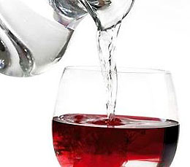
Knowledge & Alcohol
How Was Fermentation Prevented?
Dilution
Homer: 20 to 1 (Odyssey 9.208)
Pliny: 8 to 1 (Natural History 14.6)
Among the Jews 2 or 3 to 1 (Shabbat 77a)
Athenaeus cites ratios of 3 to 1, 4 to 1, 2 to 1, and 5 to 2. He mentions 3 to 2 as being “strong” (“The Learned Banquet”)
2 Macc 15:39 – “It is hurtful to drink wine or water alone…wine mingled with water is pleasant”
Mnesthus of Athens – “Mix it half and half, and you get madness; unmixed, bodily collapse.”
Plutarch – “We call a mixture ‘wine,’ although the larger of the components is water.”
Greeks and Romans refer to drinking unmixed wine as intemperate, something only fit for Barbarians (Will Durant, Caesar and Christ, p. 71)
Clement of Alexandria – “It is best for the wine to be mixed with as much water as possible…” (Instructor II, ii, 23.3-24.1)
Notes:
Fifth, other ancient records describe the fact that wine could be diluted with water. This was as much as 20 to 1 (Homer, Odyssey 9.208), 8 to 1 (Pliny Natural History 14.6), or among the Jews 2 or 3 to 1 (Shabbat 77a). Athenaeus cites ratios of 3 to 1, 4 to 1, 2 to 1, and 5 to 2. He mentions 3 to 2 as being “strong” (“The Learned Banquet”). The apocryphal book of 2 Maccabbes goes so far as to claim, “It is hurtful to drink wine or water alone… wine mingled with water is pleasant” (15:39).
Mnesthus of Athens – “Mix it half and half, and you get madness; unmixed, bodily collapse.”
Plutarch – “We call a mixture ‘wine,’ although the larger of the components is water.”
Greeks and Romans refer to drinking unmixed wine as intemperate, something only fit for Barbarians (Will Durant, Caesar and Christ, p. 71)
Clement of Alexandria – “It is best for the wine to be mixed with as much water as possible…” (Instructor II, ii, 23.3-24.1)
Something to consider: ancient Roman morals, generally speaking, were exceptionally wicked. Yet when using alcoholic wine as a beverage, their standards of diluting it compared to our modern day distilled alcoholic beverages reveal that everything from our modern day beer to liquor would be considered strong drink. And with so many warnings against strong drink in scripture, Christians would be wise to avoid them altogether. And if we are not willing to do so, we must be ready to concede that the standards of sobriety of ancient pagans were much more stringent than that which the bible demands.
And so, with multiple ways to prevent fermentation, not having electricity doesn’t mean these guys didn’t have brains. Wine of biblical days was not necessarily alcoholic. Not only could it easily be preserved and enjoyed as a refreshing alternative to water and a blessing from God that provided joy and not intoxication, but it was regularly preserved in this way.

Slide 18
Knowledge & Alcohol
Uses For Strong Drink
Sickness, severe pain
Prov 31:6 – “Give strong drink to him who is perishing, and wine to him whose life is bitter.”
Mark 15:23 – “And they gave him to drink wine mingled with myrrh: but he received it not.”
Notes:
Now, in order to treat this topic fairly, we should note that fermented wine of biblical days was used/drunk in certain situations.
First, they were drunk in medicinal situations, situations where the person was sick or in severe pain – Prov 31:6 – “Give strong drink to him who is perishing, and wine to him whose life is bitter.” The soldiers at the cross attempted to give Jesus wine mixed w/myrrh, which would have dulled His pain. Why? Just as fermentable substances could be filtered out of grape juice, fermentable substances could also be added to increase its alcoholic content: dates, figs, beans, pears, pomegranates, wormwood, or myrrh. It’s interesting to note, though, that Jesus would not take it.

Slide 19
Knowledge & Alcohol
Uses For Strong Drink
Sickness, severe pain
Antiseptic
Luke 10:34 – “…came to him and bandaged up his wounds, pouring oil and wine on them”
Notes:
Secondly, it was used medicinally, such as in the story of the Good Samaritan – Luke 10:34 – In context, we know this was alcoholic wine because it is the alcohol that would have killed the bacteria from the wound.

Slide 20
Knowledge & Alcohol
Uses For Strong Drink
Sickness, severe pain
Antiseptic
Kill Dangerous Pathogens in Water
1 Tim 5:23 – “No longer drink water exclusively, but use a little wine for the sake of your stomach and your frequent ailments.”
Notes:
Third – to kill dangerous pathogens in water, which is why that verse in 2 Macc alludes to drinking both wine and water alone causes issues – 1 Tim 5:23 –It is obvious from the text that Timothy was suffering from a stomach ailment, though the nature of the ailment is not known. However, Paul appears to suggest that the water is the culprit for his illness. Since the days of Hippocrates, it has been known that the water of the ancient world contained harmful bacteria that could produce illness. When Paul writes this letter, Timothy is in Ephesus. Ephesus was an ancient, decaying city whose harbor was silting up and creating sewage problems that poisoned underground water supplies (Williams, Paul’s Metaphors, p. 101). It is very likely that this was the cause of Timothy’s stomach ailment. Fermented wine of ancient, biblical times was often used as a remedy for such illnesses as the alcohol would prevent dysentery by destroying the bacteria and harmful pathogens of the water. This remedy was widely recognized by the Talmudists, Plutarch, Pliny, and as far back as the writings of Hippocrates himself (Fee, New International Biblical Commentary, p. 135).
Therefore, Paul’s instruction to Timothy was in no way an endorsement of the recreational and social conception of alcoholic beverages, but advised purely for medicinal purposes. This passage also reveals a lot about Timothy’s character. Regardless of the legitimacy of his need to consume fermented wine for medicinal purposes, it is reasonable to conclude that he had abstained from it for the sake of his own sobriety and personal influence. Such was not expedient as his personal service to Christ was far more important than the potential damage inflicted by misguided critics, hence the need for Paul’s exhortation. This passage cannot provide support or comfort for those desiring to engage in the pleasurable consumption of modern day alcoholic beverages. First, imbibers rarely drink just a “little” as was Paul’s instruction to Timothy. Second, imbibers do not dilute their wine with water as was practiced in ancient times. Third, fermented wines, as drunk in ancient times, were nowhere near as potent as today’s distilled fortified wines.

Slide 21
Knowledge & Alcohol
How “Strong” Was Strong Drink?
Kyle Pope’s Experiment
http://eciconference.com/resources/2015---Social-Drinking/06PopeExperiment1.pdf
Result: somewhere between 6% - 12% alcoholic content
Dr. Gary Calton – “An amateur wine maker will not usually get above 6% alcohol content even with all of the information and yeast cultures available to him today. This is probably (no one knows for sure) equivalent to strong drink in the Bible. The maximum alcohol content of a wine is 15.5%, however, this is with a very specially selected strain of yeast for alcohol for fuel production with optimized sugar content. Most yeasts are killed when the level of alcohol reaches 12%. In contrast with that, the distilled beverages that are sold today contain up to 95% alcohol.”
Notes:
How exactly how strong was “strong drink” of biblical days? Opinions vary on this, though pretty much every scholar agrees that strong drink of biblical days was nowhere near the level of the average alcoholic beverages of today.
A gospel preacher named Kyle Pope experimented on what the maximum fermentation you could get from allowing grape juice to ferment naturally without boiling or filtering. His experiments yielded 6% - 12% alcoholic content, but the sample that fermented to 12% was moldy with a strong, pungent smell.
Dr. Gary Calton, who is Scientific Director for Calwood Nutrinonals, PhD. Organic Chemistry, Biochemistry and Microbiology, Texas A&M University, 1971, in his unpublished “A PRIMER FOR WINE AND ALCOHOL PRODUCTION IN ANCIENT TIMES” offers some claims which may call a reading of 12% into question. Calton writes: “…”
Other research I’ve shown shows 5% max, but the truth is no one knows what it would have been at that time unless you were there to measure it. But if we assume strong drink was in the 6% range, do the math based on how much ancient writers say it was diluted and you’ll find that most of our weakest alcoholic beverages of today would have been considered strong drink of biblical days, something ancient Roman and Greek writers say was only fit for barbarians.

Slide 22
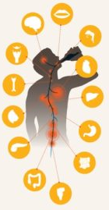
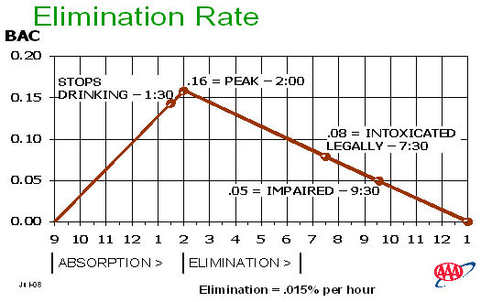
Understanding & Alcohol
What About Moderate Consumption?
Gender
Weight
Height
Body Fat %
Body Temperature
Muscle Tissue
Mood
Medications
Health
Rate of Consumption
Oxidation
Temperature of drink
Hydration
Hormones
How much food in stomach
Ratio of protein, fat, carbs
General body size
Liver function
Fatigue
Carbonation
Notes:
Prov 9:10b – “The knowledge of the Holy One is understanding”.
What about moderate consumption?
Remember that third Batman movie by Christopher Nolan where the bad guys were sentencing the good guys to having to walk across that big frozen river? They couldn’t tell whether the ice they were about to walk on was solid or whether it would collapse under their weight. Somehow those guys weren’t comforted by the fact there was no distinct line between frozen and not so frozen. So why does this comfort us about alcohol? Well, there is a reason why there is no clear line between being drunk and not drunk. Here’s why:
The rate of alcohol absorption in the blood stream varies according to a number of things: gender, weight, height, body fat %, body temperature, muscle tissue, mood, medications, health, rate of consumption, oxidation, temperature of the drink, hydration, hormones, having food in your stomach, the ratio of protein, fat, and carbohydrates of the food of your stomach, your body size, the function of your liver, fatigue, carbonation, and a bunch of other stuff we probably haven’t even discovered yet. Now since most of those things in that laundry list I just mentioned vary day to day, there is no way you can know whether you’ve consumed too much unless you put it to the test. So does arguing from moderation sound wise?
Also, alcohol absorption in the blood stream isn’t instantaneous. Studies show it takes anywhere between 1 and 3 hours after consumption for it to fully absorb. You know what that means? It means that even if I have determined, for myself, an amount of alcohol that I can drink before I’m drunk, a line I’ve determined in my mind I shouldn’t cross, I may incorrectly assume that I have stopped before crossing that line only to realize later that I have passed it. So, again, does arguing from moderation sound wise?

Slide 23
Understanding & Alcohol
What About Moderate Consumption?
Secular Opinion?
College Life
“The higher nerve functions of the forebrain, such as reasoning, judgment, and social restraint are impaired by very low concentrations of alcohol in the blood.” Encyclopedia Britannica, 1959 ed., “Drunkenness”, by Clarence Weinert Muelberger, p. 683
Dating
Safety
Good Grades
Secularism
Isolation
Bad Influences
Owning Your Faith
Freedom
Time Management
Home Sickness
Finances
Socialization
Notes:
Second, consider the irony of this claim – “I know I’m drinking a beverage that hinders judgment the moment I begin drinking it, but I’ll know when I’ve had enough”. You’re placing your hope on discretion while you’re drinking a beverage that breaks down your discretion the moment you begin drinking it. Does that make sense? Alcohol is a depressant that dulls the senses and weakens a person’s power of self-criticism. The fact that there is no definitive amount of ethyl alcohol that we can be sure will keep our judgments sound is evidence of the danger in experimenting with it in the first place.
“The higher nerve functions of the forebrain, such as reasoning, judgment, and social restraint are impaired by very low concentrations of alcohol in the blood.” (Encyclopedia Britannica, 1959 ed., “Drunkenness”, by Clarence Weinert Muelberger, p. 683)
This is true for everyone, but I especially want you college folk to think about this. You are surrounded every single day by challenges and temptations that hinder your ability to make sound choices even when you’re sober. A lot of you kids are dating, and resisting sexual temptation is one of the most difficult things you have probably had to wrestle with. That’s a hard fight when you’re sober isn’t it? How much tougher does that fight get when you start throwing a judgment impairing beverage in the situation? You’re going to willingly make it tougher by introducing alcohol in any amount? And then there are safety concerns, people that will try to take advantage of some of you young ladies even when you’re sober. In 2017, an AU tiger transit driver was caught raping an 18-year old girl. When the girl was located, and they attempted to question her, "she did not remember anything due to her level of intoxication."
No Christian has any business patronizing or drinking at a place like “Sky Bar” and then coming to church the next morning singing “It Is Well With My Soul”. But then throw on top of that drinking there when probably 9/10 dudes at that place only have one thing on their mind and they’re going to pull out every hat trick to sway you. You’re going to purposefully lower your wits and place yourself in a position where people go to take advantage of another person? If you’ve been accepted to Auburn University, you are in an elite class of intelligent people. You are blessed. You’re going to ruin that by engaging in a performance debilitating substances that could hinder your educational pursuits? The statistics of people who lose their full rides because of alcohol is astonishing. Then there is secularism and propaganda that gets thrown at you, potential isolation as a result, bad influences through roommate and classmates, learning to develop your own faith, managing your new found freedom, time management, home sickness, financial strains, a healthy social life, etc. You’re going to throw in an incapacitating substance like alcohol that will keep you from working out these many challenges when they rear their ugly faces? Is that wise?

Slide 24
Understanding & Alcohol
What About Moderate Consumption?
“Experts”
God
Alabama: DUI >= 0.08%
Germany: DUI >= 0.05%
Sweden: DUI >= 0.02%
Saudi Arabia: DUI > 0%
Hungary: DUI > 0%
Israel: DUI > 0%
Czech Republic: DUI > 0%
Mocks – Prov 20:1
Destroys – Nah 1:10
Poverty – Prov 23:21
Woes – Hab 2:15; Isa 5:11,22
Sorrow – Prov 23:29
Contention – Prov 23:29
Complaining – Prov 23:29
Perversion – Prov 23:33b
Worries w/o cause – Prov 23:29
Harms judgment – Prov 31:4-5
Inflames passions – Isa 5:11
Enslaves – Tit 2:3
Notes:
Third, experts throughout our world are divided over how much alcohol is too much. In Alabama, the blood/alcohol standard used to determine DUI is 0.08% for drivers over 21 years of age. But in countries such as Australia, Saudi Arabia, Hungary, Israel, the Czech Republic, and others, the standard is 0%. In Sweden, it is 0.02%. In Germany, it is 0.05%. So people with greater expertise than us and whose job it is to try and define a line between sobriety and drunkenness to prevent as many highway deaths as possible, cannot agree on a line. But I wonder, who gets to define what it means to be intoxicated? Does the government decide that for God? Is a blood alcohol level of .08 God’s definition of drunkenness? Are you acceptable to God when your blood alcohol level is .07, but sinning when it passes .08? I do contracting work for Nucor Steel Tuscaloosa. If you come to work at all with alcohol in your system, you will be immediately terminated. Many other companies do the same because safety is at risk. I’m not an expert on what definitively quantifies this and no one else here is either. But those who are the so-called experts can’t even agree.
And so I ask again, “Is it wise to engage in the private or recreational consumption of modern day alcoholic beverages?” Why not let the Expert of all experts tell us? Why not listen to God’s word? What does His manual for humanity say about alcohol? It says it mocks, destroys, leads to poverty, woes, sorrows, contentions, complaining, perversion, worries without cause, impairs judgment, inflames passions, and enslaves.

Slide 25
Understanding & Alcohol
What About Influence?
Matt 18:6-7 – “Whoever causes one of these little ones who believe in Me to stumble, it would be better for him to have a heavy millstone hung around his neck, and to be drowned in the depth of the sea. Woe to the world because of its stumbling blocks! For it is inevitable that stumbling blocks come; but woe to that man through whom the stumbling block comes!”
Rom 14:21 – “It is good not to eat meat or to drink wine, or to do anything by which your brother stumbles.”
1 Cor 4:2 – “In this case, moreover, it is required of stewards that one be found trustworthy.”
Notes:
Influence is a two-edged sword. On one hand, a good influence can be one of the most powerful weapons at our disposal to lead another to Christ (Matt 5:16). But a bad influence can cause another to stumble and even lose their soul. It is for this reason that Jesus uses some of the strongest language in the gospels to talk about stumbling blocks. Matt 18:6-7 – What does our influence have to do with our decision of whether or not to consume modern day alcoholic beverages?
1) Its inevitable that we will influence others by our actions whether we intend to or not. Sometimes professional athletes or celebrities will get in trouble and then when they’re chastised by others for the fact that people look up to them, they will say, “I never asked to be anyone’s hero or role model.” But that’s irrelevant. They chose to step into the lime light and have their face plastered all over the media and therefore cannot ignore the fact that people are watching them and looking up to them. In many ways, Christians are in the same boat. When we choose to put on Christ, people start watching us and, in many cases, look up to us. Therefore every decision we make must be guided by our potential to influence another individual, even if that decision falls into the realm of a perceived liberty. The painful truth about influence is that it is hard to correct a bad one and the consequences can be severe.
2) When we consider the torrential damage that alcohol has created throughout society, I am deeply disturbed by those who develop a cavalier attitude surrounding their so-called right to drink. How am I possibly influencing anyone for good when I parade around my alleged liberty to consume a depressant and narcotic that has led so many of God’s creation to violence, misery, and self-destruction? Rom 14:21 – Even if I privately believed that consuming modern day alcoholic beverages was a liberty, I would never tell someone that I thought so not knowing whether I could be causing that person’s future downfall. Christians cannot afford to be so haughty regarding alcohol with the millions of lives that have been destroyed in its wake.
3) Even if a Christian only consumes a “moderate” amount of strong drink, what about the example you set for potential alcoholics? Dr. A.C. Ivy – “When a person starts to drink occasionally, he or she takes a 1 in 9 chance of becoming a heavy or addicted drinker and chronic alcoholic. There is no way of telling in advance which drinker will become an alcoholic.” Dangerous odds. Social drinkers never make it their purpose to become alcoholics, and yet it happens every day. If you become the facilitator for another person’s drunkenness, could you then in good conscience reprove that same individual while continuing to defend your right to drink socially? If your neighbor learns that you consume alcohol socially, will that enhance or diminish your godliness in their sight? What about nonChristians who see the dangers in even moderate alcohol consumption? Will your insistence on the legitimacy of moderate alcohol consumption increase or decrease your chances of converting them? Endless scenarios. 1 Cor 4:2. Let us strive to be godly influences, not “under the influence”.
Illustration: College student I visited in emergency room who drank for pain relief.

Slide 26
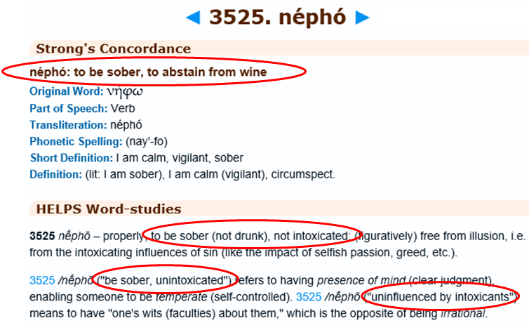
Understanding & Alcohol
What About Sobriety?
1 Cor 15:34 – “Become sober-minded as you ought, and stop sinning.”
1 Thes 5:6 – “So then let us not sleep as others do, but let us be alert and sober.”
2 Tim 4:5a – “But you, be sober in all things…”
1 Pet 1:13a – “Therefore, prepare your minds for action, keep sober in spirit…”
1 Pet 4:7b – “…therefore, be of sound judgment and sober spirit…”
1 Pet 5:8 – “Be of sober spirit, be on the alert. Your adversary, the devil, prowls around like a roaring lion, seeking someone to devour.”
Notes:
In considering whether it is wise for Christians to engage in the temperate consumption of modern day alcoholic beverages, we also must consider the bible’s teaching in regards to sobriety. Sober-mindedness, sobriety, and alertness carries with it the basic idea of being under the control of, regulated by, or ruled by the mind, intellect, and reason. It also means not being under the influence of an intoxicant that can rob a person of good sense, balance, judgment, and reason. This is a concept that is stressed throughout the entirety of the New Testament: 1 Cor 15:34; 1 Thes 5:6; 2 Tim 4:5a; 1 Pet 1:13a; 4:7; 1 Pet 5:8
One of the primary reasons that Christians should eliminate any and all substances from our lives that rob us of our judgment and reason is because of who we are at war with. Our war is against an enemy of incredible intelligence and immense fury and hatred towards us. He is incredibly opportunistic (Luke 4:13), carefully evaluating the weaknesses of Christians to which he can exploit. What better time to tempt Christians then when we are imbibing a beverage that begins hindering our judgment and decision making the very moment we ingest it? If I am serious about standing “firm against the schemes of the devil” (Eph 6:11), why would I engage in the consumption of a beverage that robs me of that ability? Is that wise?
Some believe they ought to be able to engage in the consumption of alcohol in the privacy of their home while they are away from the influence of the world. I will argue that there is no better time to be on guard against the devil than in this very moment. It is in the privacy of our home where no one is watching that we can be most tempted - by the television shows we watch, the web sites that we browse, how we treat our spouse and our children, etc. It is when we are behind closed doors that we must have our wits about us the most, not engaging in a beverage that robs us of our judgment. The privacy of our home is a vulnerable atmosphere in which Satan loves to exploit.
Alcohol is such a deceptive drug. This is why many people arrested for DUI did not realize they were over the limit. It is why the person sitting at the bar is talking so loudly without realizing they are doing so. No person who is under the influence of a judgment impairing substance like alcohol is the best judge of his own sober-mindedness. The path between “moderation” and “drunkenness” is just too slippery. We have a hard enough time fighting off the schemes of the devil when we are not drinking. Let us resolve not to make it any easier on the devil to deceive us by abstaining from the recreational and social pursuits of alcohol.

Slide 27
Trust & Alcohol
The World Will Think You Strange
Notes:
Prov 3:5-6 – “Trust in the Lord with all your heart and do not lean on your own understanding.”
1 Pet 4:4 – It’s really an incredible change of course, to live in a culture where it is more frowned upon to deny that you drink than it is to affirm it. Jennifer and I were vacationing in Mexico a few years ago and while we were relaxing by the water a family sat next to us and we got to talking. The man was an engineer from Ohio so he and I were chatting a bit and he was drinking a beer and about 5 minutes into the conversation he asked me if I wanted one and I very politely declined. And he seemed bothered by that. And a couple minutes later he said, “You sure you don’t want a beer?” and I politely declined again and then he asked me a third time and I finally told him that I don’t drink and, well, he just couldn’t believe it. I was enjoying talking about engineering but now all the sudden he was intently curious as to why I didn’t drink. He wouldn’t drop it. It was as if he had never met someone who didn’t drink alcohol. And so I finally told him, in the most nonjudgmental sounding way I could, that I was a Christian, and that around the time I became one I decided to give that up and I didn’t even go into too much detail, just left it out there as a personal choice I had made. But when I told him that, he just looked at me as if I was crazy. All of the sudden, he wasn’t as interested in talking to me anymore.
People always want an explanation. “Why don’t you drink? Do you have a health issue that prevents you? Did you accidentally kill somebody?” No, it’s a lot simpler than that. I just decided I wasn’t going to drink poison anymore. Isn’t that incredible? Alcohol is the only poison that you actually have to explain to other people why you don’t consume it, and they’re shocked. People don’t act that way about other beverages. “You know, I never drink water.” “You don’t? That’s cool.” “I also don’t drink alcohol.” “What! Are you crazy?”
If we let it, this scorning and ridicule will give us uncertainty, which is the opposite of trust. Remember verse 5 – they will have to face God like we will.

Slide 28
Trust & Alcohol
Believers Will Think You Strange
Common Labels
John 17:20-21 – “²⁰I do not ask on behalf of these alone, but for those also who believe in Me through their word; ²¹that they may all be one; even as You, Father, are in Me and I in You, that they also may be in Us, so that the world may believe that You sent Me.
Judgmental
Legalist
Pharisee
Neo Pharisee
Hypocrite
Intolerant
Notes:
And if it was only the world, we could handle it. But even more incredible is that other Christians will look down on you for abstaining from alcohol and teaching others to do the same. Yet none of the Christians who drink or approve of others doing it can make a valid argument for why it is wise to socially and recreationally drink alcohol.
I’ve had these discussions with Christians and I do pay close to attention because that’s how we build understanding. But I notice is how many strain over legal technicalities of a culture very different from ours about a wine of antiquity that is very different from modern day wine. And if you point these things out and the dangers, the labels start flying – you’re judgmental, you’re a legalist, a Pharisee, a hypocrite. Because the purpose of a label is to marginalize you in the eyes of others, to brand you as unworthy of study on a matter. Labeling is easy to do, but its lazy.
But you know what courage is? You know what takes guts? It’s approaching someone and saying, “I hear what you’re saying, I’m not sure that I agree with your conclusions, but we’re both Christians and unity is important to the Lord and I’d like to sit down with you over an open bible and study the issue together further”. It seems like that’s what we’d be doing if our desire was to come to the truth rather than to simply justify something we’ve already made up our mind we’re going to do. This is more discouraging than the mocking that comes from the world, Christians who ought to know the beauty of peaceful fellowship, and how that unity demands we work hard to study through our differences. Because that’s makes us closer, builds our love for one another as well as our patience and our forbearance and all those other Christian virtues that unless we practice we’ll never achieve.

Slide 29
Discerning Alcohol
Common Caveats
“But Jesus turned water into wine!”
“Gluttony is a sin too!”
“Paul told Timothy to drink wine!”
“Doctors say it is good for health!”
Tit 2:15 – “These things speak and exhort and reprove with all authority. Let no one disregard you.”
Notes:
Prov 2:3 – “For if you cry for discernment, lift your voice for understanding.”
Often when someone desires desperately to justify a course of behavior, they will make superficial, caveat arguments in order to justify their position. The subject of alcohol is no exception. The following are very common caveats:
“But Jesus turned water into wine!”
“Gluttony is a sin too!”
“Paul told Timothy to drink a little wine!”
“Doctors say it is good for your health!”
However, Christians who like myself uphold the position that the social and recreational consumption of alcohol should be avoided by Christians have thought deeply about these very issues. If you try hard enough, you can go to the bible and incorrectly use it to justify pretty much whatever you want. Worldly people have been doing that for years. But if you want to do God’s will, you’re going to have to go beyond a surface reading of scripture. You’re going to have to study those passages, rightly divide them with other scriptures, meditate on them, ask yourself some hard questions, and then come to some reasonable conclusions.
But in providing instruction on this topic, many will attempt you of attempting to bind where the bible isn’t binding, scoff, or mock, but won’t be willing to actually sit down and look at the caveats further – Tit 2:15 – Don’t let the do this. You have a right to demand a valid argument on why it is wise to socially and recreationally drink alcohol. But most won’t, because as Abraham Lincoln once said, “Alcohol has many defenders, but no defense.”
So let’s look at some of the arguments used to justify social drinking and see if we can discern between what is valid and not so valid.

Slide 30
Discerning Alcohol
Jesus Turned Water Into Wine
Are we prepared to take this to its logical conclusion?
Can we produce it, sell it, serve it, and make a living from it?
He produced 120 to 180 gallons of it – John 2:6
This would not be social drinking – it’s a binge
They were already “well drunk”, “drunk freely” – John 2:10
Jesus used His 1st miracle to contribute further to intoxication?
Wine could be fermented or unfermented – Isa 16:10; 65:8
Where is the evidence in the text it was fermented?
Unfermented wine would be the better miracle – John 2:13
Only old wine was left before Passover
If Jesus served alcoholic wine, He sinned – Luke 17:1-2
We serve a risen Lord in whom no apologies need be made
Notes:
Did Jesus really turn water into wine? The answer is unequivocally “yes”. But that is not what we generally want to know about this text. We want to know whether Jesus turned water into fermented, alcoholic wine. There are several problems with taking this interpretation:
First, many Christians who justify from John 2 the consumption of alcoholic beverages of today are unprepared to take this argument to its logical conclusion. If Jesus did indeed produce alcoholic wine, not only would it be morally right to drink it, it would also be morally right to produce it, sell it, serve it, and even bank a living from it. But this is further than many are prepared to go because that would absolutely and undeniably cause others to stumble.
Secondly, John 2:6 tells us that Jesus filled 6 stone water pots 20 to 30 gallons each to the brim. That is 120 to 180 gallons of wine. If He truly made alcoholic wine, we’re no longer in the realm of “temperate” consumption and social drinking – it’s a binge.
Third, John 2:10 tells us that Jesus made this wine after they were “well drunk” or had “drunk freely” where they would not have been able to detect poorer wine had it been served afterwards. If we’re to assume, as many do, that this means they were well on their way to being inebriated, than the fact that Jesus prepared 120 – 180 gallons means that He used His first miracle to contribute further to their intoxication (Hab 2:15). Is this consistent with the sinless nature of our Lord?
Fortunately, there is a more reasonable view to consider as it pertains to our Lord’s first miracle that does not propose as many problems. The evidence is considerable that Jesus actually produced nonalcoholic, unfermented wine of the highest quality.
First, the term “wine” in biblical times could refer to fermented or unfermented drink. Part of the problem with interpreting John 2 correctly is that we assume it was alcoholic wine merely because wine in our day exclusively refers to an alcoholic beverage. But when we use the term “church” today, we typically refer to the building in which Christians assemble. Yet in the bible, the term “church” always refers to people. The Greek word for “church” is “ekklesia” and literally means a people “called out”. Words can change meaning over time. Despite how the term "wine" is used today, bible wine could refer to an unfermented beverage (Isa 16:10; 65:8; Jer 48:33; Lam 2:11-12). Therefore, we must approach John 2 with this possibility in mind and let the inferences we derive from the context and not our current culture teach us its proper interpretation.
Second, it is more plausible to assume that the phrase “well drunk” or “drunk freely” is similar to what Economics calls, “The Law of Diminished Marginal Utility”. If you eat a piece of cake, it tastes good. If you eat a second piece, it is diminished in its ability to satisfy you. If you eat a third piece, you probably could have done without it. By the fourth piece, you might start feeling sick. In other words, the more you have of something, the less you appreciate it. It is more plausible that this is what the head waiter is referring to, that the more you drink of something the less you care what it tastes like simply because your taste buds have become saturated.
Third, the wine Jesus made was of the highest quality. It was “good wine” (John 2:10). Historical writings provide evidence that the best wine of biblical days was nonalcoholic. Pliny the Younger said, “The most useful wine has all its force or strength broken by the filter.” Plutarch said, “Wine is rendered feeble in strength when it is frequently filtered. The strength or spirit thus being excluded, the wine neither inflames the brain nor infests the mind and passions, and is much more pleasant to drink.”
Fourth, turning water into unfermented juice of the grape would have been the better miracle. This wedding was right before Passover (John 2:13) which was right before the time when the first grapes of the season were about to be harvested; only old wine remained. The reference to Jesus’ wine as “good wine” indicates fresh grape juice before the first harvest and would have been an evident wonder of God when it was tasted this late in the year just before Passover.
Finally, it is inconceivable to suggest that Jesus provided these Jews with 120 – 180 gallons of substance that the bible says mocks, destroys, leads to poverty, woes, sorrows, contentions, babblings, worries without cause, impairs judgment, inflames passions, and enslaves. If Jesus did that, He sinned. If He sinned, that disqualifies Him from being the unblemished Lamb of God. Are we prepared to take that stance concerning the Lord? Did the one who spoke so strongly against stumbling blocks (Luke 17:1-2) become one Himself? Fortunately, Christians have a Savior in whom we need offer no apologies.

Slide 31
Discerning Alcohol
Gluttony Is A Sin Too
Is this about gluttony or is it a red herring?
If we’re going to be fair, let’s truly be fair
There are similarities, but also profound differences
Ethyl alcohol hinders rationality the moment we imbibe
Ethyl alcohol is not a food, it’s a poison – Col 2:16
What is worse in the pot brownie, the pot or the brownie?
The only health benefits are in the grape, not the alcohol
“Resveratrol”, antioxidants
Would we heal an ingrown toenail by shooting out foot off?
Notes:
Secondly, yes, gluttony is a sin too. But it’s unfortunate that the only time anyone wants to talk about gluttony is when someone else wants to warn about the dangers of alcohol. I don’t have a problem talking about the dangers of gluttony. I do have a problem with someone using the subject of gluttony as a red herring for avoiding the topic of alcohol.
There are similarities between gluttony and alcohol, but there are also some pretty significant differences. Show me where people are killing other people in automobile accidents because they over-ate at Pizza Hut and then we can start rightly comparing the two. Show me a person in prison who wishes he could have gone back and not eaten that box of Krispy Kreme doughnuts before he beat his wife and kids, and we can have this discussion. Look, food is an essential part of our development and growth as human beings; ethyl alcohol is not. It is not a food, it is a poison that diminishes our ability to make rational and sound judgments. I get that there are long term health issues associated with gluttony and unhealthy eating. But with ethyl alcohol, we’re talking about a substance that hinders our ability to think sensibly the moment we engage in it – and that’s a significant difference between the two issues.
Sometimes folks will quote Col 2:16 – “Therefore no one is to act as your judge in regard to food or drink or in respect to a festival or a new moon or a Sabbath day”. Well, would you judge me for going to Colorado and eating one of those pot brownies from the pot brownie stores? It’s food! How dare you judge me! You know, with all the concern certain Christians have with gluttony when you’re trying to talk about alcohol, I think they’d be madder at me for eating a brownie than eating a brownie that had pot in it. Ok, fine, we’ll remove the brownie from our diet. How about we instead fix ourselves up a nice, healthy salad, lightly dabbed w/olive oil, balsamic vinegar, and methamphetamines? Its food right? Don’t you judge me. We know better. Ethyl alcohol is not a food, it is a poison.
And no, there aren’t any health benefits to it. “I drink red wine because there are health benefits”. That’s not because of the alcohol; it’s what’s in the grapes. It’s a substance called “resveratrol”, and you can get the same health benefits from it as well as the antioxidants by drinking unfermented grape juice w/o having to subject your body to a poison. Good for your health...trying to improve your health by drinking alcohol is like suffering from an ingrown toenail and deciding to fix it by taking a gun and shooting your foot off. People don’t drink recreationally or socially out of concern for their heart or other medical conditions. This is an argument from ignorance, a smokescreen, or maybe both.

Slide 32
Discerning Alcohol
Jesus was called a drunkard
Jesus’ enemies never painted an accurate picture of Him
Called a Samaritan (John 8:48), demon-possessed (John 7:20), and a sinner (John 9:24)
His silence was not affirmation
He didn’t give Herod the time of day (Luke 23:9)
Proper contrast: John led austere lifestyle. Jesus mingled
Engaging people in social atmospheres is what led to charge
Puts more faith in claims of Jesus’ enemies than God Himself
God has spoken on this matter: Prov 20:1; 21:17; 23:29-35
Are Jesus’ enemies influencing my decisions more than God?
Notes:
In Luke 7:34, we read that Jesus’ critics called Him a drunkard. Some have suggested that they would not have called Jesus a drunkard if He did not at the very least imbibe alcoholic wine on occasion. Others say the fact that Jesus never explicitly denied the charges means He at least consumed moderate amounts of alcohol. And so this text is used as justification by some that we can consume modern day distilled alcohol.
First, Jesus’ enemies were not interested in painting an accurate picture of Jesus. They merely wanted to discredit Him and rob Him of His influence. As a result, He was called many things – a Samaritan (John 8:48), demon-possessed (John 7:20), and a sinner (John 9:24). If we follow the same logic, does that mean Jesus had just a little bit of sin? Did He have a little bit of demon in Him? Was He at least part Samaritan? If we can see the utter falsehood in these accusations, why do we assume that the fact they called Him a drunkard means He engaged in the social drinking of alcohol?
Second, when you fight on the front lines long enough, you get used to taking some beatings. You will be slandered, insulted, and falsely accused. In the process, you learn that some false charges hurled at you are not worth defending. When Jesus was a called a Samaritan in John 8:48, he neither confirmed or denied it. Is His silence affirmation that He was of Samaritan descent? No, Jesus was keenly aware of the fact that those who knew Him needed no denial; and those who hated Him would accept no denial. When Herod questioned Jesus as the chief priests and scribes accused Him, Jesus was silent (Luke 23:9). Why? Because there are some accusations not worth defending. So when Jesus said instead, “Wisdom is vindicated by her children,” it implies that His followers were well acquainted with his manner of life and would continue to be so through eternity.
Third, when Jesus’ enemies claim that John refused wine (Luke 7:33), some assume John only refused intoxicating wine. However, the Nazarite vow prevented those under it from consuming any product from the grape, fermented or unfermented (Num 6:3-4). The contrast between John and Jesus is not that one did not consume alcoholic beverages whereas the other did. The contrast is that John was given to austerity and ascetic customs leading some to believe he had a demon (John), while Jesus went the opposite route by engaging people in social atmospheres leading some to accuse Him of being a drunkard (Jesus).
Finally, it is concerning that those who use this passage to claim Jesus engaged in social consumption of alcohol place more faith in the claims of Jesus’ enemies than the bible’s numerous warnings against strong drink (Prov 20:1; 21:17; 23:29-35; 31:4; Isa 5:11, 22). It begs the question of who we are allowing to influence our decision-making more, Jesus’ enemies or the Holy Spirit Himself?

Slide 33
Discerning Alcohol
Deacons Aren’t To Be Given To Much Wine
Condemning excessiveness doesn’t permit lesser amounts
Eccl 7:17a; 1 Pet 4:4a; Prov 23:22
Should this wording cancel out clearer passages?
Careless to use this passage to override clear prohibitions against strong drink
Notes:
In 1 Tim 3, Paul gives Timothy the qualifications of both elders and deacons. In vs. 3, part of the qualifications for elders is that they not be “addicted to wine”. However, when the qualifications for deacons are considered, vs. 8 tells us that they are not to be “addicted to much wine”. Since the language appears to indicate that deacons can engage in modern day alcoholic beverages, this leads some to believe that all Christians can engage in modern day alcoholic beverages.
First, there are several passages in scripture that condemn an excessive action without implying that the same action is permissible in lesser amounts. By considering these passages, we can see that the logic does not work across the board. For example:
Eccl 7:17a – “Do not be excessively wicked….” Does forbidding one from being excessively wicked imply that it is acceptable to be a little wicked?
1 Pet 4:4 – “Wherein they think it strange that ye run not with them to the same excess of riot, speaking evil of you” – Did Peter mean moderate rioting was appropriate? What about just a little bit of rioting?
Prov 23:22 – “Despise not thy mother when she is old.” Does this imply that it's alright to despise her when she is young or middle aged? God forbid.
This argument is not proof alone for why Christians should not consume modern day alcoholic beverages, but it does show the fallacy of trying to use this passage to prove its acceptance.
Second, while we don’t know why the Holy Spirit chose to use the wording that He did in 1 Tim 3:8, it would be careless to use this passage to cancel out every other passage in scripture that gives very specific and easily understood warnings against strong drink. Heb 5:14 – “But solid food is for the mature, who because of practice have their senses trained to discern good and evil.” This passage teaches us that mature Christians have their senses trained to discern between good and evil. Discerning involves learning how to practically apply bible passages (1 Cor 10:11; Rom 15:4), rightfully divide them (2 Tim 2:15), and make inferences when applicable (Matt 22:31-32; Act 10:9-16, 28; 16:9-10). This is an approach incumbent of spiritual maturity and must be sought after with all diligence because every bad argument provides fodder for another to potentially commit sin and subsequently die in that ignorance.

