Slide 1
Psalms
Book 2 – Psalms 42 - 72

Slide 2
Arrangement of the Psalms
The Psalms were originally collected into 5 “books” according to the material found in them
Book I (Psalm 1 & 2, 3 – 41)
Book II (Psalm 42 – 72) 57-72 tonight
Book III (Psalm 73 – 89)
Book IV (Psalm 90 – 106)
Book V (Psalm 107 – 150)

Slide 3
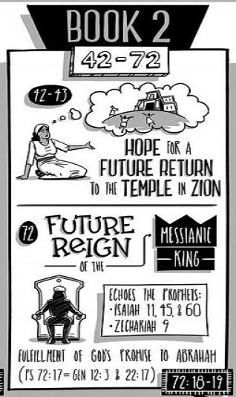
Book II is Psalms 42-72 and includes poems written by the Sons of Korah, David, Asaph and Solomon. These psalms continue the cry for help and many of the poems are written when David was in exile running from King Saul paralleling the book of Exodus.

Slide 4
Psalms Book 1 Summary
Psalm 57:5 “Be exalted, O God, above the heavens! Let Your glory be over all the earth!
Psalm 58:6 “O God, break the teeth in their mouths; tear out the fangs of the young lions, O Lord!
Psalm 59:1 “Deliver me from my enemies, O my God; protect me from those who rise up against me”
Psalm 60:1 “O God, you have rejected us, broken our defenses; you have been angry; oh, restore us.”
Psalm 61:5a “For you, O God, have heard my vows”
Psalm 62:7 “On God rests my salvation and my glory; my mighty rock, my refuge is God”
Psalm 63:1bc “my soul thirsts for You; my flesh faints for You, as in a dry and weary land where there is no water.”
Psalm 64:1 “Hear my voice, O God, in my complaint; preserve my life from dread of the enemy.”

Slide 5
Psalms Book 1 Summary
Psalm 65:2 “Oh You who hear prayer, to you shall all flesh come.”
Psalm 66:1a “Shout for joy to God, all the earth”
Psalm 67:4a “Let the nations be glad and sing for joy,”
Psalm 68:18a “You ascend on high, leading a host of captives in your train”
Psalm 69:1 “Save me, O God! For the waters have come up to my neck.”
Psalm 70:5a “But I am poor and needy; hasten to me, O God!”
Psalm 71:2 “In your righteousness deliver me and rescue me; incline your ear to me, and save me!”
Psalm 72:7 “In his days may the righteous flourish, and peace abound, til the moon be no more!”

Slide 6
Psalm 72
Prayer for the King. 2 layers to this Psalm.
David’s prayer for his son, Solomon
Prophecy for the future Messiah and His Kingdom
His son’s Righteousness (3 times)
Long Life (health) for his son
To be a man others would pray for continually
Many other Kingly \ Godly characteristics
Reflected in Solomon’s request
II Chronicles 1:9-12

Slide 7
Psalm 72
Prayer for a Righteous King (1-7)
Jesus is the Righteous King fortold
Jeremiah 23:5-6 (sound familiar?)
Prayer for a Sovereign King (8-14)
Already had a plan for all peoples
All the earth, all nations, all kings
Prayer for an Everlasting King (15-20)
Luke 1:31-33 His kingdom will have no end
Echoes of the great commission
The perfect reign of the one true kingdom is right now and will stand forever.
II Peter 1:11 – eternal kingdom of Jesus

Slide 8
Psalm 69
Three requests – distress of David & the Messiah (1-6)
Reproach of David & the Messiah (7-12)
Reproach of the Messiah (13-21)
Judgement upon the crucifiers, Judas (22-28)
Acts 1:20 quotes vs 25
Prayer and praise to God for salvation (29-33)
Israel’s restoration under the Messiah (34-36)

Slide 9
Psalm 61
Rock (vs 2) – immovable
Refuge (vs 3) - shelter
Tower (vs 3) – safety\defense
Tent (vs 4) – God’s presence
Wings (vs 4) – Protection
Ends the Psalm in praise

Slide 10
Psalm 67
Bless us (vs1)
So the Earth will know (vs 2)
Praise God (vs 3)
Nations Rejoice (vs 4)
Praise God (vs 5)
The Earth is blessed (vs 6)
God will bless us (vs 7)

