Slide 1
Notes:
The Sermon on the Mount is the one place in the gospels where Jesus has the most to say about the kingdom of God. It is not the only place where He speaks about the kingdom and its not necessarily more important than other teachings about the kingdom. But it does give us a very good overview of the nature of the kingdom as well as the responsibilities of being in that kingdom. It challenges us to see things the way God sees things, to see ourselves as God sees us, and to properly visualize how God defines what being in a relationship w/Him and w/one another should really be about. And as we’ve seen so far, this is not a sermon where Jesus is sitting on a hillside having a casual chat with His audience. He’s not offering suggestions for easier earthly living. He’s explaining to us the level of commitment that is required of anyone who would become His disciple. He is challenging us to choose.
Everything we’ve studied so far comes down to these last few verses in Matt 7. He begins this conclusion by discussing two ways/directions we can take in life – and there are only two. And then He talks about two kinds of teachers – there are only two.

Slide 2
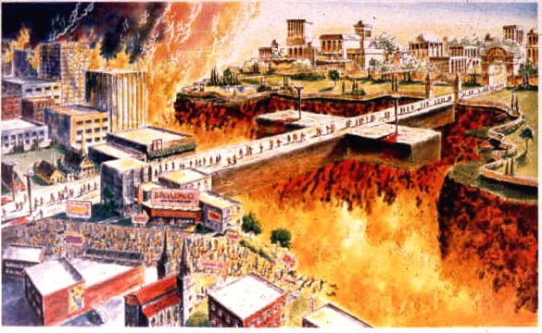
Two Ways
Matt 7:13 – “Enter through the narrow gate; for the gate is wide and the way is broad that leads to destruction, and there are many who enter through it.”
Not a suggestion; eternal consequences
Notes:
Matt 7:13 – The most important thing we need to see from this text is that this is not a suggestion. He is not advising us to consider something that will make life easier and happier here on Earth, but that if we decide to go the broad way, life will be a little bit more difficult for us. Now, obviously when we don’t heed Jesus’ instruction, that will make things more difficult for us than they need to be. But in this statement, He has attached dire spiritual consequences to the choice He’s laying out. In other words, this is a heaven or hell issue.

Slide 3
Two Ways
Matt 7:13 – “Enter through the narrow gate; for the gate is wide and the way is broad that leads to destruction, and there are many who enter through it.”
Not a suggestion; eternal consequences
Entire sermon lays out 2 options – Matt 5:3, 5-9, 12, 22, 29-30; 6:14-15, 20
Notes:
All throughout this sermon, Jesus has shown us two choices we can make. We can choose to be poor in spirit or choose not to be. We can be peacemakers, or we can be divisive. We can be angry towards our brother, or we can be reconcilers. We can lust, or we can take the necessary measures to guard our hearts and minds. We can forgive our brother, or we can harbor resentment. Each of these choices will bring eternal salvation, or eternal destruction and we have to choose which road we will travel.

Slide 4
Two Ways
Matt 7:13 – “Enter through the narrow gate; for the gate is wide and the way is broad that leads to destruction, and there are many who enter through it.”
Not a suggestion; eternal consequences
Entire sermon lays out 2 options – Matt 5:3, 5-9, 12, 22, 29-30; 6:14-15, 20
Broad Way = Satan’s way
Most will go this way
Easy way – Satan’s temptations to pursue a selfish and carnal life
Notes:
Now what is the broad way? Quite simply, it’s Satan’s way. It is a way of selfishness and carnal pursuits. 2 Cor 4:4 says that he is the “god of this earth”, and as such, he has set up his throne here on Earth, placing all kinds of tantalizing temptations in front of us to lure us away from God’s standards.
Now interestingly, the world doesn’t know this verse. The world thinks that as long as you’re not Hitler or Osama Bin Laden himself, you’re going to go to heaven. And at pretty much every funeral, the preacher will “preach him to heaven” even if he didn’t really know the person whose funeral he’s officiating over. But you can’t preach someone into heaven because by the time the funeral is happening, it is too late. And so in these verses, Jesus does not want us to be fooled.
There is reality and there is wishful thinking. And the reality is that most people in this world are going to take the easy path in life, and the American way of life that strives for comfort and security and convenience does not make this any easier. It’s turning us into a selfish people w/no grit and no discipline and no drive to do the hard things. Make no mistake, if we take the easy path that the majority is traveling, we’re going to be condemned. This is unsettling and hard truth, but the man who is love personified is the one saying it, not me.

Slide 5
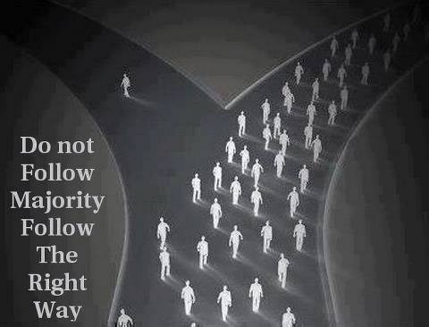
Two Ways
Matt 7:14 – “For the gate is small and the way is narrow that leads to life, and there are few who find it.”
The narrow way is God’s will
The “few” who find it are not hand picked by God. They are people who make the hard choices – Mark 8:34
Notes:
But there’s another choice – Matt 7:14 – The narrow way is God’s will. He is calling us to be different from other people. We’re not called to fit in. We’re not call to swim down stream w/everyone else. We’re not called to run w/the grain. We’re called to be different. If we are not standing out in our appearance and character from the rest of the world, something is wrong and we need to check ourselves.
Few will find it not because God has only selected a few people. Few will find it because it is a path that requires absolute self-denial, self-sacrifice, and an abandoning of self-will – Mark 8:34. Denial of self is the thing that puts us in the minority, isn’t it? That’s what makes one stand out and leads to difficulty and suffering. Jesus has asked us to love our enemies, to not lust, to not be greedy, to not be anxious, to not be judgmental. Practically everyone in the world are doing those things. So for us to go against that will not only make us stand out, it will require great sacrifice on our part because we’re living a life of principle over passion.

Slide 6
Two Ways
Matt 7:14 – “For the gate is small and the way is narrow that leads to life, and there are few who find it.”
The narrow way is God’s will
The “few” who find it are not hand picked by God. They are people who make the hard choices – Mark 8:34
Christ would not have invited us on the narrow way if it could not be achieved
Notes:
But what we need to remember is that Jesus would have never invited us on this narrow way if He knew it could not be achieved. This way is available inasmuch as we give our lives wholly and completely to Christ and His cause. So, when Jesus is talking about the narrow way, all He’s really saying is to go the route that He went while He lived here. And the route He went confused people didn’t it? It really does. When He tells us things like, “If your enemy strikes you, turn the other cheek” or “Love your enemies” or “Do unto others as you would have them do unto you”, these are not the kind of answers we’d expect. I’ve studied the gospel accounts for years and just when I feel like I’ve reached a point where I think I understand why He says what He says or does what He does, I find myself having to go back and reevaluate. Because the more I study Him, the more I’m astounded by His actions and by His words. He really confuses us. He does things we wouldn’t have expected and He says things we wouldn’t have predicted. Is it this way because He wants to confuse us? No, it’s because His ways are so much higher than our ways and His thoughts are so much higher than our thoughts that we just can’t comprehend it. See, the narrow way is actually the higher way, what Isaiah calls in Isa 35 “The Highway of Holiness”. And part of Jesus coming here is to show us that if He can do it, we can do it too. Don’t go the broad way; don’t become just another cliché.

Slide 7
False Teachers
Matt 7:15 – “Beware of the false prophets, who come to you in sheep’s clothing, but inwardly are ravenous wolves.”
There are false teachers
People exist who preach the “gospel” merely for carnal advantages
Notes:
Matt 7:15 – The first thing we need to understand from this passage is that Jesus confirms there are indeed false teachers. This can be one of the most difficult truths to get through to some because many are fooled into thinking that if a person talks religious or dresses religious that he must be the real deal and that if he’s teaching something different than what I understand, well we just need to figure out where he fits into God’s grand scheme. But Jesus didn’t come into this world to die because everything was alright with religious teaching. He is teaching us in this passage that everything is not alright with religious teaching, that we need to beware it.

Slide 8
False Teachers
Matt 7:15 – “Beware of the false prophets, who come to you in sheep’s clothing, but inwardly are ravenous wolves.”
There are false teachers
People exist who preach the “gospel” merely for carnal advantages
Gal 6:12-13 – “¹²Those who desire to make a good showing in the flesh try to compel you to be circumcised, simply so that they will not be persecuted for the cross of Christ. ¹³For those who are circumcised do not even keep the Law themselves, but they desire to have you circumcised so that they may boast in your flesh.”
Some are more interested in fitting people into their agenda than the pure, unadulterated truth
Notes:
There are teachers in this world who are only interested in using portions of God’s word to advance their own agenda. One such sect were the Judaizing teachers of Paul’s day, those who tried to convince Gentiles that they couldn’t truly be Christians unless they were circumcised ad kept other aspects of Mosaic law. Why did they do this? – Gal 6:12-13 – he gives 2 reasons. One is so they won’t be persecuted by their Jewish brethren. This sounds an awful lot like what Jesus just warned against in Matt 7:13-14 – the broad way. Some teach false doctrine because they don’t want to tell people they’re wrong and they don’t want to suffer through fractured relationships as a result of standing for what is right. That’s a broad way. The 2nd reason he gives is so they could boast in their flesh. They didn’t care about these Gentiles, the just wanted a convert to their party. They were interested in adding number to their cause, in gaining a following.
Many only teach religion for what it can bring them – self-glory, popularity, money, fame, to feed their narcissism, etc. They’re not sheep, they are wolves and you are simply prey to feed their carnal appetites. Beware of this. They are not apparent at first. They’re very sneaky.

Slide 9
False Teachers
Matt 7:15 – “Beware of the false prophets, who come to you in sheep’s clothing, but inwardly are ravenous wolves.”
Personal responsibility to judge who they are
“Beware” – Be cautious, alert, and keep your eyes open
We cannot avoid difficult questions – we must verify everything taught with God’s word
Notes:
Now interestingly, this falls on the heels of Matt 7:1-5 where Jesus tells us not to judge lest we be judged. And so, there are some judgements that must be made.
The statement to “beware” implies we can and that we must make a judgment on who is and isn’t a false teacher. We cannot just go through life coasting through religion and avoiding controversy and difficult questions. And we cannot sit on the sidelines and let other people do the studying and teaching because the devil can use others take advantage of us. We must be on guard, always having our eyes opening, verifying everything that we’re taught to ensure it is according to God’s will.

Slide 10
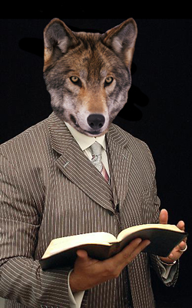
False Teachers
Matt 7:15 – “Beware of the false prophets, who come to you in sheep’s clothing, but inwardly are ravenous wolves.”
Don’t look/act like false teachers
Charming, polished speakers, hospitable, listens to your problems, “humble”, etc.
Example: counterfeit money
Rom 16:18 – “For such men are slaves, not of our Lord Christ but of their own appetites; and by their smooth and flattering speech they deceive the hearts of the unsuspecting.”
Notes:
What is so frightening about a false teacher is you can’t tell he is one by looking at him. It’s not that easy. They are charming, hospital, and will listen to your problems. They are polished speakers with a knowledge of the bible who will inspire you. This is by design though. If you are the devil and you wanted to deceive people into believing something that is false, would you dress your preacher up in ragged clothing and put horns on his head? Or would you be like the guy who makes counterfeit money? The goal with counterfeit money is to make look as close to the real thing as you can without it actually being the real thing.
Rom 16:18 – In other words, they’re good. It’s hard to pin them down. And when you finally confront them, they’ll play the martyr card – “Oh, how you’ve oppressed me!” They’re so good many are deceived. Men like this will appear to be the purest and noblest of men there are. Sheep’s clothing looks like sheep, feels like a sheep, but its when you start to look closer that you find there is something inconsistent.

Slide 11
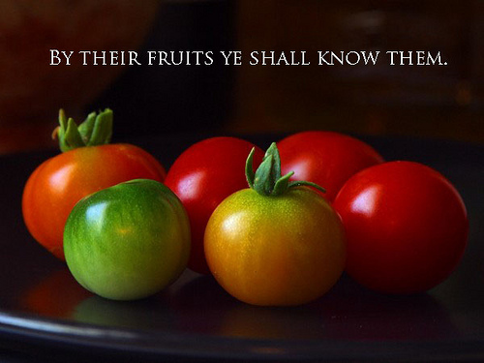
False Teachers
Matt 7:16a – “You will know them by their fruits.”
They must be tested
We must train ourselves to look past the externals – 1 Sam 16:7
1 John 4:1 – Are his words and lifestyle consistent w/God’s word?
Don’t tear the wool off every sheep because you’re looking for a wolf
Notes:
So how do you know? Matt 7:16
We will recognize the difference when we learn to look past the external niceties, their abilities, and look at who and what they actually are - 1 Sam 16:7
1 John 4:1 – All men must be tested to see if his words and his lifestyle match up to the kind of man that should be teaching and leading others with God’s word.
One thing we must be careful of is to make sure we’re not ripping the wool off of every sheep looking to see if there is a wolf underneath. Some people can be so paranoid, suspicious, and cynical that they spend practically their whole lives trying to pick out false teachers to the point of doing nothing else. This is one reason we are biting and devouring one another and there is so much hatred between brethren – we’re not stopping to listen and lovingly try to help one another. We can be guilty by running to both extremes concerning false teachers.

Slide 12
False Teachers
Matt 7:16-20 – “¹⁶You will know them by their fruits. Grapes are not gathered from thorn bushes nor figs from thistles, are they? ¹⁷So every good tree bears good fruit, but the bad tree bears bad fruit. ¹⁸A good tree cannot produce bad fruit, nor can a bad tree produce good fruit. ¹⁹Every tree that does not bear good fruit is cut down and thrown into the fire. ²⁰So then, you will know them by their fruits.”
Time eventually reveals all
Will they study the bible with you?
Are they honest in the bible study?
Are they consistent?
Do they repent?
Notes:
Eventually, time reveals a person’s fruit, their true character. There are ways to get the ball rolling, however. For example:
Ask them for a bible study. Are they willing or do they make excuses? If they’re not willing to even sit down with you over an open bible and work out a disagreement, it speaks a lot to their character.
If they have a bible study with you, are they honest? Do they answer your questions? Do they commit to a particular stance or are they ambiguous to the point where you don’t know exactly where they stand?
Are they consistent? Many false teachers will say one thing to the “unstable” who are not versed enough to know any better but will do a 180 when another well-versed bible student questions them. If they’re being two-faced, this is a clear sign of a sinister intent.
Finally, when they are shown their error, do they admit they are wrong and change their view? The reason Apollos cannot be considered a false teacher from Acts 18 is because when he was shown the way more accurately, he changed his teaching.

