Slide 1
4/7/2021 – Beatitudes
4/14/2021 – Salt & Light
4/21/2021 – Law & Prophets
4/28/2021 – Righteousness of Scribes & Pharisees
5/5/2021 – You Have Heard (1)
5/12/2021 – You Have Heard (2)
5/19/2021 – Motives of the Heart
5/26/2021 – Materialism
6/2/2021 – Anxiety
6/9/2021 – Judging
6/16/2021 – Ask, Seek, Knock
6/23/2021 – Narrow Way; False Teachers
6/30/2021 – Two Foundations
Notes:
DON’T FORGET TO RECORD

Slide 2
Notes:
The Sermon on the Mount is a sermon about brass tacks. Jesus is honing in on exactly the kind of people we are to be if we’re going to be fit for His kingdom. To get to the Mountain of the House of the Lord, it will be an uphill climb – we’ll have to trade our passions for godly principle and do what is right simply because it is right. We’ll have to sacrifice our rights for the good of other people. And who will be the one to gauge how far we’ve come? Who will measure how far we’ve traveled on the road to being what we are called to be in Christ? Only God.
So, while this lesson is going to conclude the study, I hope this will be a sermon that we’ll all meditate on for the rest of our lives, using it every so often to take a inventory of our spiritual life to see where we are. But this last study is typically the most challenging because of what Jesus will say in Matt 7:21-23.

Slide 3
Not Everyone Who Says ‘Lord, Lord’
Matt 7:21-23 – “²¹Not everyone who says to Me, ‘Lord, Lord,’ will enter the kingdom of heaven, but he who does the will of My Father who is in heaven will enter. ²²Many will say to Me on that day, ‘Lord, Lord, did we not prophesy in Your name, and in Your name cast out demons, and in Your name perform many miracles?’ ²³And then I will declare to them, ‘I never knew you; depart from Me, you who practice lawlessness.’”
Some of the scariest verses in the bible
Not for everyone else – they are for me
While painful, they are meant to enlighten
Notes:
These verses are some of the scariest verses in God’s word; not just the NT, but the entirety of God’s word – Matt 7:21-23 – There is really no way to take away the sharp edges from what Jesus says here. It cannot be sugar coated, soft-peddled, and the import of it cannot be denied or ignored. We need to accept the fact that Jesus says what He means and means what He says and that I am being challenged to take His warning seriously and not attempt to discount what He is saying as some kind of fear-mongering tactic used by preachers to subject other people.
These cannot be verses that we simply quote to everyone else in the religious world. They were not written to provide the “religious right” w/a tool to look down on others while boosting our ego. These verses are here so that everyone who reads them, myself included, will test our own lives in regard to them. When I’m reading these verses, I need to be asking question, “Could this be me on Judgment Day? Are there issues in my spiritual life that would put me in the category to which He is speaking?”
So, of all the wonderful things we can say about the SOTM and its style and vision and the way Jesus words things and how much love He showed us in delivering us, Jesus ends this greatest of all sermons with the hardest of hard sayings. Why? Because He’s being mean or because He enjoys the audience wallowing with fear and He wants them to leave them feeling utterly hopeless and lost without a prayer? No, He is simply saying that there is an uncomfortable reality associated w/Judgment Day that goes beyond how we may feel about things, and Jesus doesn’t want us to be deceived. He wants us to be enlightened and prepared for this day. And so, the painfulness of this truth is designed to stimulate us to action, and for that we should be thankful for texts like this, and not resentful of them.

Slide 4
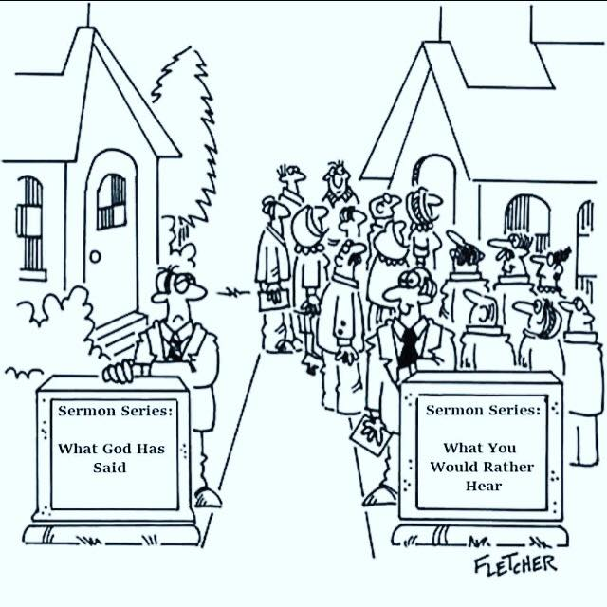
Not Everyone Who Says ‘Lord, Lord’
Matt 7:21-23 – “²¹Not everyone who says to Me, ‘Lord, Lord,’ will enter the kingdom of heaven, but he who does the will of My Father who is in heaven will enter. ²²Many will say to Me on that day, ‘Lord, Lord, did we not prophesy in Your name, and in Your name cast out demons, and in Your name perform many miracles?’ ²³And then I will declare to them, ‘I never knew you; depart from Me, you who practice lawlessness.’”
Who is Jesus talking to?
“Many” (consistent theme in SOTM)
Notes:
Not only are these verses some of the scariest in all of scripture, but they are some of the politically incorrect verses in all of scripture. Exactly who is Jesus talking to in these verses?
Well, notice the first word of vs. 22 – “Many”. Where have we seen that concept taught in this chapter? In Matt 7:13 – “Enter through the narrow gate; for the gate is wide and the way is broad that leads to destruction, and there are many who enter through it.” The consistent theme in this sermon is that come judgment day, few will be saved and many will be condemned. This is not only the theme of the SOTM, but of the entire bible. What are some stories from the bible in which many were lost but only a few saved? The 8 souls that were saved in the flood; the 2 spies who believed they could take Canaan’s land while the other 10 and the entirety of that adult generation disbelieved. The key word stated and repeatedly resonated even throughout the OT was that God would save a remnant. And come judgment day, Jesus is warning us that it will be no different. The biggest difference between this verse and Matt 7:13 is He’s alluding to how surprised the “many” will be.

Slide 5
Not Everyone Who Says ‘Lord, Lord’
Matt 7:21-23 – “²¹Not everyone who says to Me, ‘Lord, Lord,’ will enter the kingdom of heaven, but he who does the will of My Father who is in heaven will enter. ²²Many will say to Me on that day, ‘Lord, Lord, did we not prophesy in Your name, and in Your name cast out demons, and in Your name perform many miracles?’ ²³And then I will declare to them, ‘I never knew you; depart from Me, you who practice lawlessness.’”
Who is Jesus talking to?
“Many” (consistent theme in SOTM)
The sincere(ly wrong)
Notes:
Also, He is speaking to those who are sincerely – they say “Lord, Lord.” I would suggest this is the sincere believer, the person who believes that Jesus came from heaven, died on the cross for our sins, and was raised to be seated at the right hand. This person not only verbally acknowledges Him as Lord, but accepts it as such. This person knows Jesus on Judgment Day and appears to be sincere. There is a degree of faith and belief from a person who says, “Lord, Lord” to Jesus. And yet, Jesus says not everyone who says to me ‘Lord, Lord’ will enter the kingdom of heaven. Something more is required than words and sincerity, because what we see from this Judgment Day scene is that the “many” will be sincerely in the wrong.

Slide 6
Not Everyone Who Says ‘Lord, Lord’
Matt 7:21-23 – “²¹Not everyone who says to Me, ‘Lord, Lord,’ will enter the kingdom of heaven, but he who does the will of My Father who is in heaven will enter. ²²Many will say to Me on that day, ‘Lord, Lord, did we not prophesy in Your name, and in Your name cast out demons, and in Your name perform many miracles?’ ²³And then I will declare to them, ‘I never knew you; depart from Me, you who practice lawlessness.’”
Who is Jesus talking to?
“Many” (consistent theme in SOTM)
The sincere(ly wrong)
Talent and ability
Notes:
Also, He is speaking to those who justify themselves by their works of service, as a result of their talents and ability. These are people blessed w/ability, doing things they thought were good and right, things in the name of the Lord. And the interesting thing is that Jesus doesn’t deny it. He never says, “Don’t you lie to me, you never did anything for me!” These are people who prophesied and taught in His name. These are people who had been given power to cast out demons, power to perform miracles. On the surface, this person appears to be faithful. They have all the externals that we as human beings would admire in a devout. Religious person. But Jesus is telling us that it is possible to do impressive things in the name of the Lord and still wind up on the broad road that leads to destruction.
“Have you met my dad ‘so-and-so”’? He’s a preacher. Have you met my granddad ‘so-and-so’? He’s an elder.” Who you are related will be irrelevant on Judgment Day.
“I can preach…I have ability.” This won’t matter on Judgment Day.
“I really know the bible…I can false teachers in their place.” This won’t matter on Judgment Day.

Slide 7
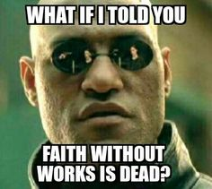
Not Everyone Who Says ‘Lord, Lord’
Matt 7:21-23 – “²¹Not everyone who says to Me, ‘Lord, Lord,’ will enter the kingdom of heaven, but he who does the will of My Father who is in heaven will enter. ²²Many will say to Me on that day, ‘Lord, Lord, did we not prophesy in Your name, and in Your name cast out demons, and in Your name perform many miracles?’ ²³And then I will declare to them, ‘I never knew you; depart from Me, you who practice lawlessness.’”
We must do the will of the Father
Guard against false teachers who espouse the doctrine of “faith only”
Jas 2:24 – “You see that a man is justified by works and not by faith alone.”
Notes:
One reason why this verse catches so many religious people off guard is that they do not know it exists. The reason they do not know it exists is because of the false doctrine of “faith only” that is propagated by so many denominational teachers. Anyone that teaches doctrine that is contrary to the bible, particularly words spoken by Jesus Himself, does not have our best interest at heart no matter how satisfying that doctrine is to me from a fleshly or preferential nature.
Jas 2:24 – James is perfectly clear that a man is not justified by faith alone. We will not stand before denominational pastors on judgment day, we will stand before the author of this sermon. And yet we just talked about the fact that our works by themselves won’t save us either. An interesting paradox we need to work out.

Slide 8
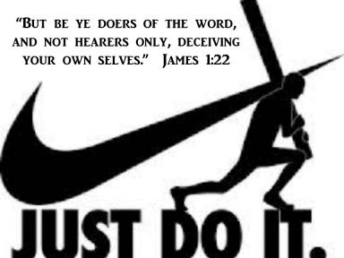
Not Everyone Who Says ‘Lord, Lord’
Matt 7:21-23 – “²¹Not everyone who says to Me, ‘Lord, Lord,’ will enter the kingdom of heaven, but he who does the will of My Father who is in heaven will enter. ²²Many will say to Me on that day, ‘Lord, Lord, did we not prophesy in Your name, and in Your name cast out demons, and in Your name perform many miracles?’ ²³And then I will declare to them, ‘I never knew you; depart from Me, you who practice lawlessness.’”
How do I avoid this terrifying shock?
God’s word must be source of all religious acts – Rom 10:17; Acts 17:11
Notes:
Since judgment day is going to be a day with a lot of shocked and surprised people, how do I make sure I am not of that number?
First, I must make God’s word the source of all religious practice. It’s “He who does the will of my Father who is in heaven”. Everything that I believe and practice must find its root in God’s word. In other words, if my faith is true and it is not vain faith, it must have at its origin the word of God. That’s it; that is the only place. If my faith comes from what my parents taught me, what a preacher tells me, what my church tells me, from myself, from what a dead relative believes, or what I simply want to believe and practice because its convenient for me, then its not real faith – Rom 10:17. True faith is produced when it comes from God’s word, nowhere else. And while it may be true that what my parents taught me is accurate and what my preacher told me was accurate and what the church I grew up in taught me is accurate, you will never know until you start verifying it with what the bible says. That’s what they did in the 1st century – Acts 17:11. If we want to be sure that we’re not those sincere people on judgment day who the Lord rejects because we didn’t truly perform His will, we will search the scriptures to see if the things we have been taught and we have believed are really God’s will because that’s the only thing that’s going to matter come judgment day. It’s not my pride or my pleasures, or my family, or my friends, its whatever is the will of our High and most Holy God of heaven.

Slide 9
Not Everyone Who Says ‘Lord, Lord’
Matt 7:21-23 – “²¹Not everyone who says to Me, ‘Lord, Lord,’ will enter the kingdom of heaven, but he who does the will of My Father who is in heaven will enter. ²²Many will say to Me on that day, ‘Lord, Lord, did we not prophesy in Your name, and in Your name cast out demons, and in Your name perform many miracles?’ ²³And then I will declare to them, ‘I never knew you; depart from Me, you who practice lawlessness.’”
How do I avoid this terrifying shock?
God’s word must be source of all religious acts – Rom 10:17; Acts 17:11
Be open to examination and correction – Acts 18:25-26
Notes:
This completely rubs against the grain of conventional religious teaching. Because the popular notion in the religious world is that it does not matter what you believe. All that matters to so many is that you verbally acknowledge Jesus as the crucified Son of God, that you say a sinner’s prayer, feel some emotional love for Him in your heart, season your speech with religious talk, and you’re going to be ok. And I have absolutely no doubt that many people who are like this have a great degree of sincerity in their heart. But Jesus is demanding of all of us more than verbal acknowledgement and a lifestyle that appears to conform to godliness. The sole problem that Jesus has with these people is that they do religious things, but they are not the religious things Jesus told them to do. So, when someone comes along and challenges us regarding something we believe and teach, be open to the challenge. And if you’re wrong, correct it – Acts 18:25-26 – Apollos was one of the most gifted speakers and orators of that day. I have no doubt he would been that popular gospel meeting preacher you had to schedule 3 – 5 years in advance. But despite his knowledge, his skill, his ability, when 2 tentmakers corrected a misunderstanding he had about scripture, he was man enough to rectify it. We need this same humility, lest when someone approach us to try to help us, we let our pride get in the way and become victims of Matt 7:21.

Slide 10
Not Everyone Who Says ‘Lord, Lord’
Matt 7:21-23 – “²¹Not everyone who says to Me, ‘Lord, Lord,’ will enter the kingdom of heaven, but he who does the will of My Father who is in heaven will enter. ²²Many will say to Me on that day, ‘Lord, Lord, did we not prophesy in Your name, and in Your name cast out demons, and in Your name perform many miracles?’ ²³And then I will declare to them, ‘I never knew you; depart from Me, you who practice lawlessness.’”
How do I avoid this terrifying shock?
God’s word must be source of all religious acts – Rom 10:17; Acts 17:11
Be open to examination and correction – Acts 18:25-26
Be a Christian – 1 Cor 13:1-3
Notes:
So, what is this text talking about? It’s talking about being a Christian. Of course, there are things we must “do” to be saved”. And of course, we must “believe”. The question is why are we doing it, and how far does my belief take me? As we’ve said repeatedly, this is a sermon primarily about being rather than doing. It’s challenging us to take on a particular character. The things God commands us to do are designed to help produce that character, but they were never meant to be an end to themselves. This is what I believe Jesus means when He says, “I never knew who”. They never allowed Jesus to become a model for their lives. They never allowed love to be the primary driver behind their obedience. So where does that leave our obedience? – 1 Cor 13:1-3. Never forget that everything Jesus talks about in this sermon revolve around application of the first and second greatest commandments. That’s the driver. And Jesus said in John 14:15 – “If you love Me, you will keep my commandments.” That’s how we assure we do right and be right. That’s the narrow way, letting the sacrificial love of Jesus guide everyone of our habits and decisions in which we become like Him so that when we stand before Him come Judgment Day. He recognizes us as one of His own.

Slide 11
Two Builders
Matt 7:24-27 – “²⁴Therefore everyone who hears these words of Mine and acts on them, may be compared to a wise man who built his house on the rock. ²⁵And the rain fell, and the floods came, and the winds blew and slammed against that house; and yet it did not fall, for it had been founded on the rock. ²⁶Everyone who hears these words of Mine and does not act on them, will be like a foolish man who built his house on the sand. ²⁷The rain fell, and the floods came, and the winds blew and slammed against that house; and it fell—and great was its fall.”
Similarities:
Desire/Interest
House
Fill a void
Point:
The way we are building our house
Notes:
Matt 7:24-27 – There are similarities between the two builders here.
First, there is an interest and desire on the part of both men to build a house. Neither man in this scenario is idle or lazy, but intent on building what it is he wants in the way that he is wants. So the issue is not a lack of enthusiasm, interest, or desire.
Second, after they build their houses, there’s no indication that there is a difference in the house they built itself. For all we know, the two houses could be the same blueprint, same plan, same square footage. If you walked in each house and gave them a cursory look, you might not be able to tell a difference.
But the point Jesus is making is that everybody, no matter who they are, is building a house. Everybody wants a house, everybody desires something out of life. Whether it be happiness, peace of mind, comfort, success, achievements, rewards, money, we’re all building our personal strongholds in life. And the reason we do this is because there is a void within us that we’re trying to fill.
But Jesus’ lesson here is that the way we build our house has eternal significance. The foundation upon which we choose to rest our desires, hopes, and dreams will determine how long our projects last.

Slide 12
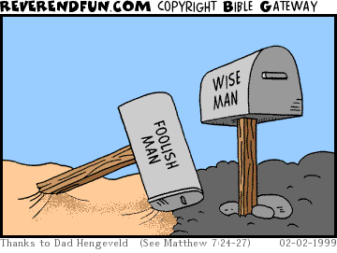
Two Builders
Matt 7:24-27 – “²⁴Therefore everyone who hears these words of Mine and acts on them, may be compared to a wise man who built his house on the rock. ²⁵And the rain fell, and the floods came, and the winds blew and slammed against that house; and yet it did not fall, for it had been founded on the rock. ²⁶Everyone who hears these words of Mine and does not act on them, will be like a foolish man who built his house on the sand. ²⁷The rain fell, and the floods came, and the winds blew and slammed against that house; and it fell—and great was its fall.”
Wise man sees the storm ahead and prepares
Example: Noah – Heb 11:7
Notes:
The wise man is a person who looks ahead. He sees that there is a storm coming and He prepares for it by seeing to it that He builds his stronghold on a solid foundation, a rock. Perhaps no greater example of this is found in the bible than the example of Noah in building the ark – Heb 11:7. Noah was able to see that there was a day of judgment coming, a flood, that was going to wipe out all the ungodliness that walked the Earth and so by faith He prepared an ark for the saving of His household. And in his off time, Peter tells us in his second epistle that Noah was a preacher of righteousness. In other words, he attempted to save others by pleading with them regarding their sin. And you can only imagine what the response must have been. “Noah, why are you doing this to yourself? Why are you wasting so much time on this big boat project you’ve got going on? Why don’t you just stop it and come hang out with us?” But Noah kept building and then the day came when what He built his life around was able to endure the coming judgment of God. So it will be w/us.

Slide 13
Two Builders
Matt 7:24-27 – “²⁴Therefore everyone who hears these words of Mine and acts on them, may be compared to a wise man who built his house on the rock. ²⁵And the rain fell, and the floods came, and the winds blew and slammed against that house; and yet it did not fall, for it had been founded on the rock. ²⁶Everyone who hears these words of Mine and does not act on them, will be like a foolish man who built his house on the sand. ²⁷The rain fell, and the floods came, and the winds blew and slammed against that house; and it fell—and great was its fall.”
Wise man sees the storm ahead and prepares
Example: Noah – Heb 11:7
Foolish man builds purely for the moment
Example: Rich Man – Luke 12:16-21
Notes:
The foolish man only builds for the moment. All the foolish man can think about as he is building is what he wanted right then and there – that is it. No concern for the future or the coming storm, only for what can satisfy his flesh in the short term. Like the rich man filled with greed, he will store up more and more and more until he is saturated with his own selfish desire. Having expended nothing or very little toward God, this man will not be able to stand during the coming storm.

Slide 14
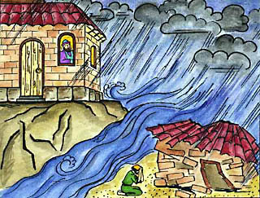
Two Builders
Matt 7:24-27 – “²⁴Therefore everyone who hears these words of Mine and acts on them, may be compared to a wise man who built his house on the rock. ²⁵And the rain fell, and the floods came, and the winds blew and slammed against that house; and yet it did not fall, for it had been founded on the rock. ²⁶Everyone who hears these words of Mine and does not act on them, will be like a foolish man who built his house on the sand. ²⁷The rain fell, and the floods came, and the winds blew and slammed against that house; and it fell—and great was its fall.”
Everything we do in life will be tested by the coming storm
The foundation: Teaching, doctrine, philosophy, worldview, lifestyle, etc.
Notes:
Jesus is telling us that the time is coming when what we have done in this life is going to be tested by a storm that God is one day again going to unleash. But before it comes, it’s hard to tell the difference between the houses because all of them are standing.
The difference is the foundation they rest upon. This is not literal rock and literal sand. The foundation He is talking about is whatever teaching, doctrine, or philosophy, worldview, or lifestyle to which we subscribe. And if it is any other teaching, doctrine, or philosophy other than what the word of God has revealed, it is sandy ground and its not going to stand through God’s judgment. It is doomed for destruction because nothing but God’s word and God’s way will withstand the storms of life and the trials and tests that come our way. We’ll be destined to fall, and he’s talking about an eternal falling.

Slide 15
Two Builders
Matt 7:24-27 – “²⁴Therefore everyone who hears these words of Mine and acts on them, may be compared to a wise man who built his house on the rock. ²⁵And the rain fell, and the floods came, and the winds blew and slammed against that house; and yet it did not fall, for it had been founded on the rock. ²⁶Everyone who hears these words of Mine and does not act on them, will be like a foolish man who built his house on the sand. ²⁷The rain fell, and the floods came, and the winds blew and slammed against that house; and it fell—and great was its fall.”
Everything we do in life will be tested by the coming storm
The foundation: Teaching, doctrine, philosophy, worldview, lifestyle, etc.
How can we tell the difference?
Notes:
Well how do we know the difference? We know the difference by being honest about where our faith comes from and what we do with that faith. It is true faith that comes by hearing and hearing by the word of God. But its not hearing only that saves us, is it? It’s not even a mental acknowledgement of Christ and what He did that’s going to get us where we want to be. More often than not we don’t mind hearing, but we don’t want to live it out. We like to come to church and hear what the bible teaches us, but when it comes to taking what we’ve learned and living it, turning it into practical application by which our lives are centered, that’s the challenge. Its like looking in a mirror, seeing what is wrong, acknowledging a change needs to be made, but then turning away and forgetting about it. And this can be a hard lesson in our day when so many people only go to church to find something that pleases them instead of coming for an opportunity to please God. In this culture, everything revolves around me, what I want, what pleases me. And so, I’ll go to great lengths to get what I want, to find whatever doctrines or philosophies that will allow me to not have to give up too much. But that’s deception, not reality. Life doesn’t revolve around us; it revolves around God and His holy demand. We’re not the center of the universe, He is. And its fortunate that despite the fact that everything in existence finds Him at the center, He has loved us immensely, and desires for us to go to heaven and be with Him. But in order to do that we must come to understand His will and do His will, not our own. Because the day will come when every single person on this Earth will stand before the great, awesome and powerful God of heaven, and the record of our life will be revealed. And the Lamb of God will be standing there, the crucified Savior who died so that we might choose to live for Him. And how we responded to that awesome event on the cross will be revealed. And we’ll either stand before that storm or we’ll fall, depending on what foundation we built our stronghold.

