Slide 1
Notes:
In the sermon on the mount, Jesus is calling on us to examine our character. On what side does our religion stand? The righteousness of the Pharisees or the righteousness of the Beatitudes? Is our righteousness of self or is it a righteousness that yearns for God? Are we people-pleasers, twisting the scriptures toward our own desires or are we poor in spirit, mournful, meek, hungry, merciful, pure in heart, and peaceable?
This is a sermon that challenges us to go against the grain of human nature which requires us to be born again. Instead of being concerned about murder, we should eliminate anger. Instead of being concerned about adultery, we should seek to purify our hearts. It is the inner being that God is ultimately after, not mere external conformity. And so what is my motive with Christianity?

Slide 2
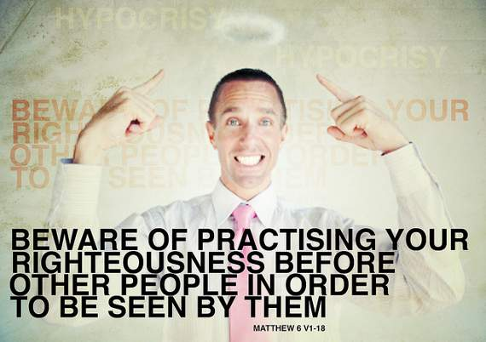
Righteousness Before Men
Serve God or Serve Self
From what spirit do our acts of worship come?
What is my motive in worshipping God?
Pharisees
Why were they interested in religion? Answer: Ego
Many are interested in religion purely for reasons other than glorifying God (Phil 1:15-17)
Notes:
Matt 6:1 – We explored the word “righteousness” before in this sermon, as it is actually defined in the beatitudes. And then we also contrasted it with that of the Pharisees. As we worship and perform the acts necessary for true worship, we must self-examine ourselves to know from what spirit it derives. In other words, what is my motive for worshipping God?
One might ask how the Pharisees, in their wickedness and shallowness, could be so interested in religion. It is simply because worship stoked their egos. They practiced their righteousness to be noticed and admired by men, not God. This shows us that it is possible for men to attach themselves to religion for reasons other than glorifying God and reflecting His image. You will even find people in the church who are Christians for reason other than to glorify God. Paul spoke about this in Phil 1:15-17. In other words, not everyone who stands in a pulpit or other leadership positions in religion, are doing so from pure, selfless motives. And to Paul’s credit, Phil 1:18 – “What then? Only that in every way, whether in pretense or in truth, Christ is proclaimed; and in this I rejoice.” Meaning, he never got caught up in the rat race. His joy was that Christ was preached, no matter the motive. What an attitude.

Slide 3
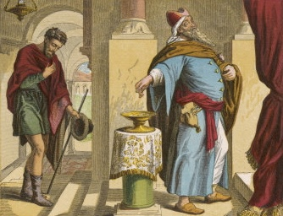
Giving
Matt 6:2 – “So when you give to the poor, do not sound a trumpet before you, as the hypocrites do in the synagogues and in the streets, so that they may be honored by men. Truly I say to you, they have their reward in full.”
The poor often gathered in the temple, synagogues, and streets – broad arena to publicize deeds
Issue not secrecy, but motive: why am I doing what I am doing?
Notes:
Matt 6:2 – So what was the Pharisees’ motive for giving? To do it in plain sight of everyone else so that the populace would see just how benevolent they were
Since the poor typically gathered at the temple, synagogues, and in the streets, this arena was broad for sounding a trumpet to the masses. Their motive was not generosity or to glorify God, but for self-publication and admiration from the masses. Jesus very bluntly says that this was the only reward they would receive for their acts.
This is not to say that whenever we give it must be in secret. It is inevitable others will see our deeds; we are in fact commanded to shine our light. The issue is motive. Why do we do what we do in the name of religion? Remember Jesus’ reason for us needing to be the light of the world. Is it truly so that others will glorify God or so they will glorify us?
Illustration: man who gave in Jamaica.

Slide 4
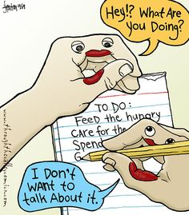
Giving
Matt 6:3-4 – “³But when you give to the poor, do not let your left hand know what your right hand is doing, ⁴so that your giving will be in secret; and your Father who sees what is done in secret will reward you.”
Not only should we care less that other people see us giving, we should barely notice ourselves
We should be so busy giving, we can’t remember what we’ve done – Matt 25:37-40
Yesterday’s deeds are done. We’re privileged to give today
Notes:
Matt 6:3-4 – Jesus says the key is to not let your left hand know what your right hand is doing. The point is that not only should we care less whether people see us, but we should barely notice it ourselves.
We should be so busy in serving and giving that we can’t even remember what we’ve done. (Matt 25) This characterizes the attitude of saved on judgment day – Matt 25:37-40. They were so busy serving, they couldn’t remember all they had done. When you serve, it is inevitable people will approach you years later reminding you of how much you influenced them in a particular way. One indication that we’re going to make it is when we have to be reminded.
We need to remember that yesterdays deeds are done with. We are privileged to live another day to give and to serve. So we must focus on the present and what we can do today to glorify God and display His tender mercies toward mankind.

Slide 5
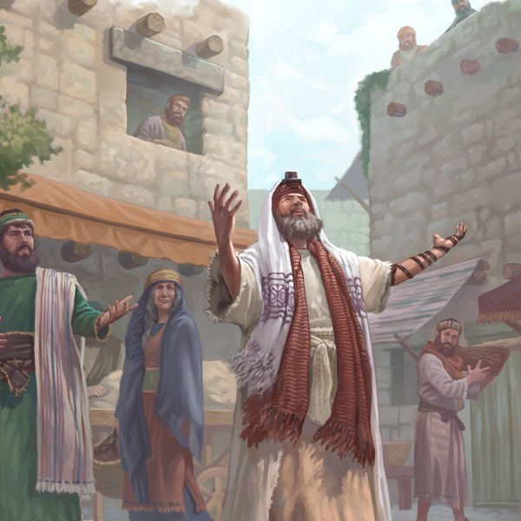
Praying
Matt 6:5-6 – “⁵When you pray, you are not to be like the hypocrites; for they love to stand and pray in the synagogues and on the street corners so that they may be seen by men. Truly I say to you, they have their reward in full. ⁶But you, when you pray, go into your inner room, close your door and pray to your Father who is in secret, and your Father who sees what is done in secret will reward you.”
Not commanding proper place or proper posture (Luke 18:11,13)
Are the words from my heart or for personal glory?
God only answers genuine prayers uttered in faith (Jas 4:3)
Notes:
Matt 6:5-6 – Why were the shallow Pharisees so interested in something like prayer? Because it was yet another outlet to boost their egos and be seen by men. Jesus is not commanding a specific posture or a specific place where prayer must be uttered. The Pharisee and tax collector were both standing when they prayed and both did it in the temple. And yet one was justified and the other was not. The place and stance is not what is important.
What is important, again, is motive. Am I praying to God with my heart or am I am doing so for personal glory and ego/pride?
Jas 4:3 – God will only answer prayers that are genuine and uttered in faith with a heart that seeks His mercy and deliverance.

Slide 6
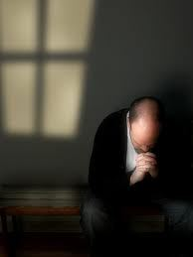
Praying
Matt 6:7-8 – “⁷And when you are praying, do not use meaningless repetition as the Gentiles do, for they suppose that they will be heard for their many words. ⁸So do not be like them; for your Father knows what you need before you ask Him.”
Success in prayer is not found in:
Number of prayers
Length
Oratory
A formula
Key: speak to God like He is a person, not a machine
Notes:
Matt 6:7-8 – Likewise, the vain repetitions of the Gentiles are not what please God.
It is not how many times we prayer that is important. It’s not how long we make the prayer, how eloquent it sounds, or making sure we use the proper formula (guide, guard, and direct us…ready recollection…next appointed time).
The key is pouring out our most heart-felt desires upon the One who knows what we need before we even ask, yet desires for us to put our perils in His hands and lean on Him for deliverance. We must speak to God like He is a person, not a machine who can be stimulated if just push the right buttons.

Slide 7
Praying
What kind of prayer comes from the one who is hungering & thirsting for righteousness?
Recognizes God as a Father
Holds God in reverence
That His purpose be accomplished
Sees the importance of life’s necessities
Needs forgiveness from his sins
Desires to show mercy towards others
Desires an escape from temptation
Recognizes God’s sovereignty
Notes:
So what kind of prayer is uttered by a person who hungers and thirsts for righteousness? Matt 6:9-15
1. He is a child who recognizes God as His father who cares for Him and wants what is best. In other words, prayer begins by knowing our position on the totem pole.
2. He is a person who reveres and hallows God. He approaches the king of the cosmos with fear and respect for His person and position.
3. He approaches God with the desire that only His will be accomplished and that His prayers be aligned with God’s will.
4. He sees the importance of life’s simple necessities, that even things like food and shelter are glorious gifts from God that He could take away at any moment. And so, he urges God to continue with the distributing these simple blesses with no assumption they or any other blessings are deserving.
5. He is someone who knows he needs forgiveness. He is poor in spirit and mournful and therefore hungers for God’s redemptive blessings.
6. Because of the ample forgiveness received, he recognizes his own need to forgive others who have crossed him and therefore makes his former request contingent on the later. In other words, he is a peace maker.
7. Because he is pure in heart, he desires to be free of temptation so that he may pursue things that are just, right, and holy in God’s sight.
8. He recognizes God’s sovereignty. He is in full control. His is the kingdom and power and glory forever and we are merely the clay in the potter’s hands privileged to be allowed access to God in prayer.

Slide 8
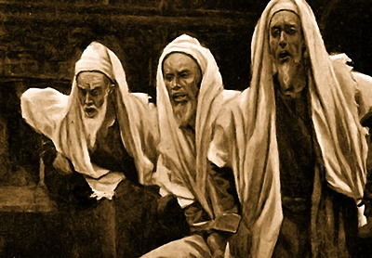
Fasting
Matt 6:16 – “Whenever you fast, do not put on a gloomy face as the hypocrites do, for they neglect their appearance so that they will be noticed by men when they are fasting. Truly I say to you, they have their reward in full.”
Purpose of fasting is to humble the spirit in times of distress (Psa 69:10)
When fasting is done for our glory, that is all the reward we get
Notes:
Matt 6:16
The purpose of fasting was to humble the spirit in times of distress. However, the Pharisees, like in their giving and prayer, used it for the purpose of vain glory. They would neglect their appearance and wear sorrowful faces so that others would see their piety and think highly of their hypocritical devotion.
Because this was their motive, this was also their only reward.

Slide 9
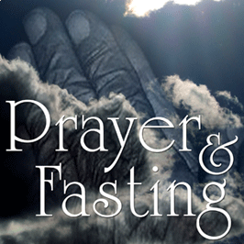
Fasting
Matt 6:17-18 – “¹⁷But you, when you fast, anoint your head and wash your face ¹⁸so that your fasting will not be noticed by men, but by your Father who is in secret; and your Father who sees what is done in secret will reward you.”
Keep fasting between you and God
Without neglecting our hygiene, let it be our joy that others see even in our sorrow
Notes:
Matt 6:17-18
If we fast, we must make efforts to keep it between ourselves and God. This does not mean that if it’s a moment of sorrow, no one must ever know you’re going through a trying time. It’s all about motive.
A brighter light will be shone when in our moments of trial and fasting, we are joyful – this leaves a godly impression and yields a faithful reward.

