Slide 1
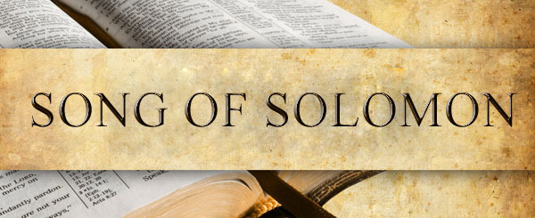
Notes:
We have 5 poetry books in the bible, and each serve to answer important riddles for everyday life.
The book of Job deals w/the struggle of trial/suffering, where it can come from and why it can happen.
The Psalms address our communication w/God through prayer and worship as we go through different phases of life.
Proverbs deals with the mystery of wisdom and its use in everyday life.
Ecclesiastes deals w/the philosophical challenges of existence, how to find true meaning and satisfaction in life.
5) And then there is the Song of Solomon, and this addresses the great challenge called love.

Slide 2
1 Kings 4:32 – “He spoke three thousand proverbs, and his songs were one thousand and five.”
Notes:
It begins this way – SOS 1:1 – “The Song of Songs, which is Solomon’s.” The phrase “the song of songs” is the Hebrew phrase “Shir-HaShirim”. The Hebrew word “Shir” is typically used of happy songs, musical celebrations. And the Hebrew word “HaShirim” is the plural of that, hence the “song of songs.” We also call it “The Song of Solomon”, and in the Latin Vulgate it is called “Canticles”. But “Song of Songs” is the literal description.
We see phrases like in scripture often, don’t we? “King of Kings”, “Lord of Lords”, “Hebrew of Hebrews”, “Holy of Holies”, “Vanity of Vanities”. These phrases are alluding to the ultimate of these things, and for this reason there are some who even refer to this as “The Ultimate Song”. (CLICK) It’s hard to argue w/this because in 1 Kings 4:32, we’re told that Solomon actually wrote 1005 in all. And so, the fact that this is the only one which the Holy Spirit deemed worthy of retaining means God wants us to get the message within. It must truly be the best of His songs, at the top of Casey Kasem’s Top 40.

Slide 3
Peculiarities
Ancient Musical Recital
Monologue & Dialog
Pure Poetry
Not Quoted in the NT
No Internal Evidence of Inspiration
The Word “God” Only Appears Once
Difficult to Outline
Sexual Connotations
Multiple Suggested Interpretations
Notes:
Yet, for being His best song, it’s one of the least studied books in the bible, and the reason is because there are some peculiarities associated w/it:
(CLICK) It’s peculiar in its literary style. It appears to be an ancient musical recital, perhaps not too different from an opera, divided into acts and scenes.
(CLICK) It’s mostly monologue and dialogue, conversation, from beginning to end. Either the individual is speaking within herself, or himself, or individuals are talking one to another.
(CLICK) It is pure poetry from beginning to end w/no prose in between. And as w/all poetry, there’s always an element of imagination involved, which is what contributes to its many possible interpretations.
(CLICK) It’s a book that is never quoted in the NT. As far as I know, it’s not even referred to in the NT.
(CLICK) There’s no miracle, no vision, and no direct word from God. There’s no indication of its inspiration like we find in the prophets, and there is no direct message or teaching to anybody in particular.
(CLICK) The word “God” in any form appears only one time, in the 8th chapter, and its an abbreviation of the word Jehovah, the word “Ja”.
(CLICK) Outlining this book can be difficult. Eastern literature is just not as structured like western literature is. We see people singing back and forth, but determining who the speakers are is a challenge. Most of your translations will attempt to tell you how to outline the book, but they all differ dramatically translation to translation. And forewarning, I will probably teach a different structure than how your bible lays it out, so for the purposes of our study, ignore the translator’s heading (not the text itself, just the translator’s inserted headings).
(CLICK) There are sexual connotations throughout the book, and this can make Christians uncomfortable. I once tried preaching a 3-lesson series on it, and after the first lesson, I was approached by an elderly Christian man who asked me not to continue preaching it. Some unfortunately believe this book to be “x-rated” – I can assure you that this is far from the truth, and the lessons are too important not to be taught.
(CLICK) There are more suggested interpretations of this book than Revelation, some say up to 16 possible interpretations.
Bottom line: due to these peculiarities, it’s one of the more neglected books of the bible.
PRAYER

Slide 4
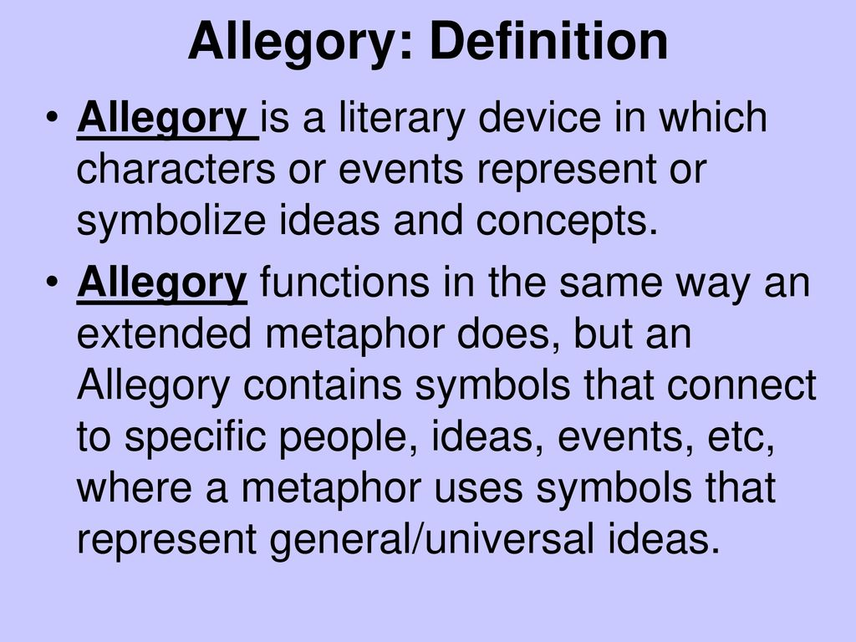
Interpretations
Allegorical
Notes:
But let’s go ahead and look at some of these interpretations, the most common ones – this will help us to see why some of the peculiarities are really not all that peculiar. (CLICK)
1) Allegorical – 2 forms. The Jewish allegory, which suggests it is talking about the love between God and Israel, similar to how God presents Himself in Hosea. This view was taught by most of the Jewish Rabbis and Josephus himself. Then there is the Christian allegory, which would be similar, only the love between Christ and the church. And until the mid-19th century, this was just about the most exclusive interpretation, w/rare exceptions.
Strengths
a) Early scholars who were uncomfortable w/some of sexual connotations demanded by a more literal interpretation will state point blank that this is why they take this view. They’ll argue this interpretation is necessary for giving SoS religious value.
b) “Marriage” and “church” are analogous in many places in scripture (Eph 5). Some will evoke passages like John 5:39 – “You search the Scriptures, for in them you think you have eternal life; and these are they which testify of Me” and point out that if the Song of Solomon is not doing that, how does it belong in the OT?
Weaknesses
a) The nature of an allegory is that it can only be made known by understanding it in the literal sense first. It’s only when we understand what is happening literally that we can then ask, “Ok, now what could this mean allegorically?” I don’t see any internal signals requiring an allegorical interpretation as I do in other scriptures (i.e., Judg 9).
b) It makes the song’s interpretation largely arbitrary and subjective. Throughout the years, people have made it mean virtually whatever they’ve want it to mean! For example, the woman’s dark complexion from 1:5 is said by some to represent sin and conversion. The Jewish allegory states that her naval, which is described in 7:2, represents the Sanhedrin in Jerusalem because it’s in the center of the world. The Christian allegory states it represents a church’s baptistry. There’s no explanation as to why, its just pure conjecture.
Personally, I do not agree that this is an outright allegory, and here’s how I’d challenge people who are offended by a literal interpretation. God designed sexuality and attraction, intending for that to be expressed in marriage. So why would there not be a text in which proper and improper principles can be learned to navigate this part of life that consumes such a large part of life?
But while I don’t personally believe is is an allegory outright, that is not to say there are not allegorical principles in the book. More on that as we walk through it.

Slide 5
Interpretations
Allegorical
Anthology of love poems
Notes:
2) Anthology of love songs – Another common interpretation is to suggest that it is simply a disconnected anthology of love songs, ambiguous, celebrating the dynamics involved in love and infatuation between a woman and a man. This view states that the book was never intended to be outlined or to connect together as a fluid story, but would be similar to, say, how the book of Proverbs is just a collection of seemingly random “sayings”. Yet this interpretation would argue that the things to be picked up on are clear.
Strengths
Given all the suggested weaknesses to the literal interpretations, this interpretation allows you not to be bound by any particular outline or structure. That’s settling for some.
Not being bound by any particular structure, this would allow someone to unpack the same metaphors as if taking the dramatic/literal approach
Weaknesses
a) I’ve noticed that among the commentators and scholars who take this view, many take concepts from heathen poetry and try to interrupt the Song around those. I believe this to be very dangerous. I think we need to let the song itself be the interpretation and not rely on pagan literature to point us toward how we should adopt its interpretation.
b) While there are weaknesses to each literal approach, I don’t think those weaknesses are so weighty as to suggest we should eliminate all attempts to see structure. I think there is enough evidence in the text to suggest there is a fluid story happening in this song.

Slide 6
Interpretations
Allegorical
Anthology of love poems
Literal (2-character love story)
Notes:
3) Literal love story – and there are a couple ways to take this. Some suggest it is a 2-character drama between a bride and a groom, the groom being Solomon. In general, it’s outlined as chapters 1-2 being their courtship, chapters 3-4 being the wedding, and chapters 5-8 being married life along w/some things that happen when they’re apart.
Strengths
Since the mid 19th century, this is the most common way the song has been understood by commentators. This makes it uncomfortable when taking an opposing view.
b) Scripture does identify Solomon as a type (Psa 72; Matt 12:42; Luke 11:31) and a type need not correspond to its antitype in every detail. This would potentially avoid the issue of polygamy being encouraged.
Weaknesses
If this is the example of what marital love is supposed to be, wouldn’t God be condoning polygamy? – Deut 17:17a – “Neither shall he multiply wives for himself, lest his heart turn away”. In 6:8, we read that by the time Solomon meets this girl, he already has 60 queens and 80 concubines. That’s 140 wives on his way to a 1000. Some have done the math and have calculated based on his likely age and how long he reigned, that’s an average of one wife every 2 weeks. Hebrew weddings lasted a week, and so he had one week to honeymoon a woman before securing the next wife. Even if you consider he married some of them before becoming king, say 10 years before, he’d still be getting married about every 3 weeks. Polygamy is what brought Solomon down and led to the Divided Kingdom. Would God preserve a song that exalted his relationship w/1 out of 1000 of these wives? If SOS is the story of Solomon marrying just this one girl, I struggle w/what real value it has since he’d go on to marry 860 more women after telling this girl in 6:8-9 that she was the one who met all his needs.
Despite the popularity of this view, the more I read the song, the more comfortable I am not taking this view. I understand that places me in a minority amongst those who have studied it in depth, and I’m open to being challenged, but I’d rather follow what I think God is saying rather than following another man who is telling me what he thinks God is saying.

Slide 7
Interpretations
Allegorical
Anthology of love poems
Literal (2-character love story)
Literal (3-character love story)
Notes:
3) Literal love story – The other way to take this as a literal love story would be in the form of a 3-character drama in which there is a Shulamite girl and a shepherd boy who are sweet on each other. But then one day, Solomon sees her and makes a play for her. Solomon tries to woo her, and he takes her back to the palace to woo her some more. And though she seems to be tempted in the beginning by the prospect of marrying the most powerful man in the known world, the entire time her mind and heart are on the shepherd. And in the end, true love triumphs as she rebuffs Solomon’s attempts and chooses the Shepherd, who is her one true love. Most of the book is from the Shulamite’s perspective as she contrasts the shepherd she loves w/this king who is trying to woo her away through his wealth, power, pomp and ceremony, and his really carnal pick-up lines – all secular approaches.
Strengths
a) Cat out of the bag – this is the interpretation that presently makes the most sense to me. It is hard for me to read this and not see 2 male characters. For example, in 5:9-16, she had been gushing about some guy while in the presence of the palace women, and they want to know who this guy is that she keeps gushing about that could actually compete w/the king. Then 8:12 is the biggest one to me, a personal rebuffing of Solomon, which doesn’t make sense to me if they are in love and going to live happily ever after.
b) There is obviously a literal shepherd in the book. How can that be Solomon? Shepherds and kings are 2 different categories. When David became king, he gave up his shepherd duties. I can’t picture a situation in which Solomon, w/all the kingly duties before him, is hanging out w/smelly sheep all day and night.
c) Polygamy being so condemned by God, it makes more sense this would be a godly woman rejecting the overtures of a fleshly oriented man in order to pursue true love. And Solomon had indeed been very fleshly oriented, as he attested to in Eccl 2.
Weaknesses
a) The biggest objection I see when I read commentaries is “Why would Solomon write a book in which he’d incriminate himself?”
b) Also, there are difficulties in some places trying to figure out who is speaking in the text, especially in the first two chapters. This can lead to “overinterpreting” the text, if not careful, just to make the plot work.
c) Also, shepherds were sometimes referred to in the ancient world as “king” (pic of king tut’s womb – Isa 44:28), and there is an interpretation which combines the 3-character love story w/a semi-allegorical interpretation.
All that is to say, it’s important to remain open-minded and not be dogmatic about any particular view. Because the truth is, many of the principles and lessons taught in the book are actually consistent across the interpretations, whether literal or anthological.

Slide 8
Notes:
But what I would stress is that we dare not neglect this book, because what we have in the Song of Songs is God's marriage preparation manual.
Sexuality, romance, and puppy dog love is a major aspect of the human experience, and this “greatest of all songs” focuses on those things. But while it encourages readers toward a proper expression of it, it also warns us about its power in our lives. We’re all adults here – we know that the thrill and power of love is profound, don’t we? Most of us are also acutely aware of the attendant pains. Sweetheart love is a grand paradox because few things bring more earthly joy than an intimate, physical relationship, but few things can break and destroy an individual emotionally and spiritually than love lost. God cares for our spirituality, and so how we handle sweetheart love and sexuality will determine our spiritual destiny.
And so, it would make sense that there’d be a book designed to teach the proper and improper mechanics of this lest we find our happiness w/the opposite sex through trial and error and make mistakes that could cost us.
COMMENTS

Slide 9
3-Character Drama
Shulamite Girl
Notes:
The approach I take is the 3-character drama:
The main character in the story is a Shulamite girl, as she is referred to in 6:13. She would be from a town called “Shunem” which is in northern Issachar. She is seen by others in the song as a very beautiful girl, but she views herself very modestly. And throughout this song, she vents her deepest feelings, which we know is a very feminine quality. She voices her yearnings, anxieties, fears, and delights in a very expressive way.
Interestingly, some have suggested that she could actually be Abishag, the maiden they brought in to keep David warm in his old age, and the arguments are a bit compelling, but it can’t really be proved. We’ll simply refer to her as the song does, the Shulamite.

Slide 10
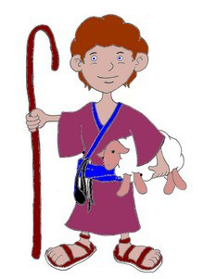
3-Character Drama
Shulamite Girl
Shepherd Boy
Notes:
2) Then there is a Shepherd boy – he’s actually a young man, and he’s very much in love w/the Shulamite. He is simple, rustic, handsome, and he is the love of her life. Interestingly, it’s not until chapter 8 that he makes a literal appearance. We mostly learn who he is by how she recalls things about him in her mind, how she described him to the maidens, and things he had said to her before Solomon whisked her away.

Slide 11
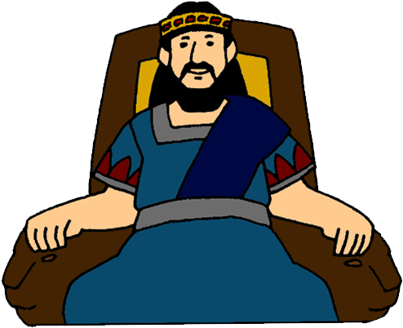
3-Character Drama
Shulamite Girl
Shepherd Boy
King Solomon
Notes:
3) King Solomon – according to the view I hold, he’d be the villain of the story. At the beginning of the story, the Shulamite and the Shepherd already have a relationship, but Solomon sees her, lusts after her, and invites her back w/him to the palace in order to try to convince her to become one of his wives, even though 6:8 tells us he already had 140 on his way to 1000.
And as we study the book, one of the things to notice is the contrast between how Solomon tries to win her affections through carnal, sensual means, describing her body parts and whatnot. Parents, Solomon represents the guy you don’t want your daughter dating.
Now, the Shepherd finds her attractive, too, but he wants to spend time w/her, take her on romantic walks in the countryside, and do all the silly things w/her like pick flowers together. Solomon focuses on her body, but the Shepherd is impressed w/her character and her mind.
Now, one thing I want to mention is that one of the supposed weaknesses about this position is why King Solomon, in his greatest song, would make himself out to be the bad guy. My response to that is, isn’t Ecclesiastes a refutation of his former follies? Can we not find Proverbs written by Solomon that would address the particular weaknesses of character he had in his later life? Did not even the Apostles record some of their less flattering moments in the NT? So, I have no trouble in thinking that as Solomon got older, and hopefully learned the errors of his ways, that he took time to write this “greatest of songs” as a refutation of his womanizing as a future lesson to all of us for what sweetheart love should and shouldn’t be.

Slide 12
3-Character Drama
Shulamite Girl
Shepherd Boy
King Solomon
Daughters of Jerusalem
Notes:
4) And then there are a few minor characters that speak, the most prominent of which are these “daughters of Jerusalem”. These could be “women in waiting” or they could be Solomon’s harem. Whoever they are, they’ve been given the pretty transparent task of being Solomon’s cheerleaders. They’ve likely been assigned to butter the Shulamite up and encourage her to marry Solomon. They’re the matchmakers of the story, seemingly always in the powder room w/the Shulamite. And while they speak on several occasions, much of what the Shulamite says is actually directed to them as she tends to use them as a sounding board throughout the song.
COMMENTS

Slide 13
Lessons
1 Thes 4:3-5 – “For this is the will of God, your sanctification; that is, that you abstain from sexual immorality; that each of you know how to possess his own vessel in sanctification and honor, not in lustful passion, like the Gentiles who do not know God”
Lust Vs. Love
Their Reputation
Gift Giving
Overcoming self-doubt
Broken homes = rushed marriages
Don’t settle
Love cannot be rushed
Living w/your wife w/understanding
Absence makes heart grow fonder
Peacocking
A Woman’s Speech
The Sanctity of Virginity
The Dating “Game”
Marriage requires sacrifice
Am I controlling?
Love cannot be bought
Pressure & Dating
Our Body: Reality vs. Actual
Destructiveness of pornography
Why sex only works in marriage
The curse of physical beauty
Importance of family in dating
Avoid being in love w/being in love
Jealousy
Notes:
Now, if I had to pick one theme verse for the song from the NT, I’d pick 1 Thes 4:3-5 – “For this is the will of God, your sanctification; that is, that you abstain from sexual immorality; that each of you know how to possess his own vessel in sanctification and honor, not in lustful passion, like the Gentiles who do not know God”.
(CLCK) Of all the themes, the most prominent one is lust vs. love. True love has great strength. It brings mutual satisfaction and mutually satisfying experiences, and as we’ll see throughout this book, true love triumphs over things like wealth, flattery, power, and privilege. And as we’ll learn in chapter 8, it is as strong as death. Lust, however, is fleeting. Just because a man is attracted to a woman doesn’t mean he’s attracted to her. And what we’ll see in Solomon, in his use of eastern methods of complimenting women, is that he loved to highlight her physical features, but he wasn’t as interested in her person as the shepherd was.
And so, (CLICK) out of this idea arises a great many other topics that can be unpeeled from this book, and the above list is not exhaustive. But overall, the Song of Solomon covers all the dynamics involved in sweetheart love, both the blessings and the dangers, the joys and the tensions, and gives us wisdom in how to navigate the perplexities incumbent w/sweetheart love. The Song of Solomon is God’s preparation manual for dating and marriage, something to teach our young people on how they should go about choosing a mate, and something that can also help us married folk remember what marriage ought to be.
COMMENTS

Slide 14
Who Was The Shulamite?
SOS 8:8-9 – “⁸We have a little sister, and she has no breasts; what shall we do for our sister on the day when she is spoken for? ⁹If she is a wall, we will build on her a battlement of silver; but if she is a door, we will barricade her with planks of cedar.”
Notes:
I want to begin the book by looking at how it ends. The poetic narrative runs through 8:7, then once we get to 8:8, there appears to just be some concluding remarks. We learn in the song that the Shulamite had some older brothers, who the song seems to indicate may have been her caretakers, and vs. 8 reveals something that these brothers were debating about her when she was just a little girl
(CLICK) SOS 8:8 – So, her brothers are strategizing their future responsibility toward her, and I think what they’re asking in simple terms is, “We have a sister who right now is very young, but she’s not always going to be that way. What will we do when men start to become interested in her?” The idea is that while she is young, she is still innocent and there has yet to be any sort of sexual awakening within her. They want her to remain sexually pure before she is spoken for so she can be a blessing for the one she marries.
And here’s what they decided – (CLICK) SOS 8:9a – Now, which offers more of a defense to intruders, a wall or a door? (CLICK) A wall. “If she’s a wall” = if she’s strong and has self-control, able to say “no” to those who might exploit her beauty for their own carnal gain, if in moments of temptation she proves able to make good decisions, we’ll build on those good decisions “battlements of silver”. This probably alludes to reward, more leeway, more privileges, extra freedoms.
(CLICK) SOS 8:9b – If she’s not strong, easily moved to and fro like a door, so impressionable and unstable that she acquiesces to anyone who shows enough interest and desire, we’re going to bar the door and restrict her freedoms for her own self-interest and protection. We’re going to safeguard her sanctity until she emotionally matures.
There is a lesson here that could take up an entire bible class – the important role that family has in the purity and dating relationships of children. Parents have to stop worrying about making their kids upset over denying privileges until they’ve proved they are trustworthy and worry more about standing before God in judgment and being called “Eli”. Parents must judge how well their kids handle saying “no” to temptation before giving them certain freedoms.

Slide 15
Who Was The Shulamite?
SOS 8:10 – “¹⁰I was a wall, and my breasts were like towers; then I became in his eyes as one who finds peace.”
Notes:
But now the Shulamite says which child she was, and this is where we’re going to learn about the main character of this book.
(CLICK) SOS 8:10a – This is what we’re going to learn about the Shulamite throughout this poem. She is going to prove herself to be strong against Solomon’s temptations. That her “breasts were like towers” is not to imply anything about her proportions. Rather, it’s consistent w/the same figures from vs. 9 that we see in “walls” and “door”. This young lady she did not allow a man to touch her inappropriately, which we all know is the “gateway drug” to fornication. She’s saying that if a man was going to enjoy the blessing of her body, he was going to have to “climb the tower” for it – they were going to have to prove themselves. She’s not saying she was playing hard to get; (CLICK) she’s saying what 1 Thes 4:3 teaches, that her honor and dignity and virginity would be strongly defended until marriage.
And because of that (CLICK) – SOS 8:10b – She’s talking about the Shepherd that she loves. The shepherd respected her all the more for this because what it meant was that when they did tie the knot, he could trust her not to fool around after they got married. There was peace of mind. Chastity brings the man you love peace and trust. (CLICK) Not only will there be an absence of strife, but there will be fulfillment, contentment, satisfaction, and wholeness. If you don’t want a jealous spouse, prove your trustworthiness not just to your parents, but also to who is courting you.
The reason I wanted to show you this first is to impress on us that this book is full of practical lessons along these same lines. It is not a book to be avoided – it is worthy of a serious study.

