Slide 1
Notes:
The Song of Solomon introduces us to a Shulamite girl who is beautiful in both her appearance and her character. But she’s in a Cinderella situation in which her brothers have forced her to take care of vineyards. Solomon’s nobles have taken notice of her and whisked her away to meet him. But there’s conflict – while Solomon is trying to charm her, she can’t stop thinking about the mutual love she shares w/a shepherd. And yet, we learned in our last study that there were some relationship snags between the Shulamite and the shepherd that needed untangling, and that between that and her seemingly bad home environment, the prospect of becoming Solomon’s next bride is slightly enticing.
So, what we’re seeing in this book is not only what real romantic love is supposed to be, but what it’s not supposed to be, and we’re also seeing some of the dynamics involved in it that can make it such a challenge. But these are principles that need to be studied and thought through because this kind of love has been the undoing of countless God-fearing people. There are timeless truths presented in this book that are deserving of our sincerest study.
PRAYER

Slide 2
“¹On my bed night after night I sought him whom my soul loves; I sought him but did not find him. ²‘I must arise now and go about the city; in the streets and in the squares I must seek him whom my soul loves.’ I sought him but did not find him. ³The watchmen who make the rounds in the city found me, and I said, ‘Have you seen him whom my soul loves?’ ⁴Scarcely had I left them when I found him whom my soul loves; I held on to him and would not let him go until I had brought him to my mother’s house, and into the room of her who conceived me.” (Song 3:1-4)
Shulamite’s First Dream
Concerns/insecurities
Takes a risk
Notes:
Chapter 3 begins w/the Shulamite recounting a dream she had to the Daughters of Jerusalem, the first of 2 dreams from this book. While being courted by Solomon during the day, her heart was courting the shepherd at night. A characteristic of love is someone being on your mind day and night, and that often spills into one’s dreams.
SOS 3:1 – This is interesting, because chapter 2 ended w/her sending the Shepherd away, basically saying, “I’m not ready yet”. But now, it appears that the separation is bothering her, and she’s concerned about the possibility of losing him. (CLICK) So, this dream is reflective of her concerns and insecurities.
Song 3:2 – She’s so bent on finding the shepherd, she gets up in the middle of the night to go looking for him in the streets, putting herself in danger, because nothing can satisfy her but his actual presence. This not only emphasizes the urgency and the depth of her seeking, (CLICK) but also the fact that for someone who is a little reluctant to take risks, she has it in her to do it.
Song 3:3 – This is funny because she assumes everyone knows him as well as she does. “He is so important to me, surely the whole world knows him!” Love disorients our senses and our rationality. It takes possession of our hearts and minds and can’t be quenched even by a flood (8:6-7). But they don’t answer her, and I’d suggest that their lack of an answer is the answer – they have not seen him. So, the reasonable thing to do would be to go home, but she is undeterred from the object of her desire.

Slide 3
“¹On my bed night after night I sought him whom my soul loves; I sought him but did not find him. ²‘I must arise now and go about the city; in the streets and in the squares I must seek him whom my soul loves.’ I sought him but did not find him. ³The watchmen who make the rounds in the city found me, and I said, ‘Have you seen him whom my soul loves?’ ⁴Scarcely had I left them when I found him whom my soul loves; I held on to him and would not let him go until I had brought him to my mother’s house, and into the room of her who conceived me.” (Song 3:1-4)
Shulamite’s First Dream
Concerns/insecurities
Takes a risk
Realizes what she could lose
Ready for marriage
Notes:
And in vs. 4, she finds him – Song 3:4a – So she goes from yearning for his presence, to panicky searching, to a rushing torrent of relief when she finds him, and now secure in his embrace, she’s calm. Chapter 2 ended w/her saying, “I’m not ready yet, but keeping on fighting for us”. But now the tables have turned. The shepherd isn’t the one seeking her; she is seeking him. (CLICK) She’s realizing what she might be losing if she were to choose Solomon over the shepherd.
And now notice how hard she’s holding on to him – Song 3:4b – (CLICK) She doesn’t let go until she has consummated her marriage w/him in the room where she herself was conceived, stage 2 of the Jewish wedding. Stage 1 is where the groom and the father of the bride sign a legal contract. In stage two the bride would have 10 maidens as witnesses and the groom would have ten male witnesses. This is seen in the parable of the ten virgins in Matthew 25:1-13. They would be having a party in the house while the bride and groom consummated the marriage, and that’s what she’s saying she wants to happen.

Slide 4
“⁵I adjure you, O daughters of Jerusalem, by the gazelles or by the hinds of the field, that you will not arouse or awaken my love until she pleases.” (Song 3:5)
Shulamite’s First Dream
Concerns/insecurities
Takes a risk
Realizes what she could lose
Ready for marriage
Notes:
But she’s not able to make her dream a reality because as we’re going to see in the next few verses, it appears she’s agreed to go back to Jerusalem w/Solomon to at the very least consider the king’s proposal. So now, she’s going to repeat the chorus we saw in 2:7 – Song 3:5.
(CLICK) This is further evidence of what we discussed last week, that love must be allowed to “work itself out”, and her separation from the shepherd has been part of this “maturing process” that love sometimes needs and has led her to understanding her true feelings for the shepherd and that despite her fears/insecurities, he is in fact worth the risk.

Slide 5
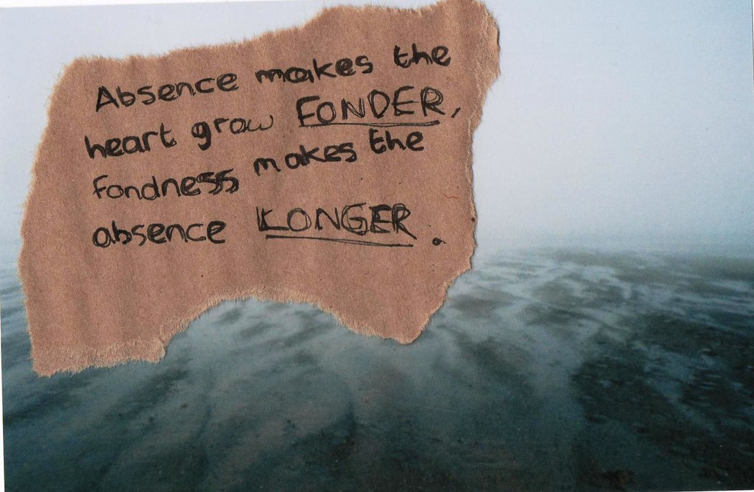
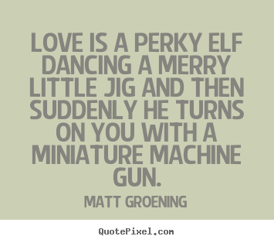
Love Hurts
Notes:
PRACTICAL APPLICATION – Now, we saw from chapters 1 and 2 that the shepherd’s presence brought her joy (1:17; 2:3-6). Now we’re seeing that his absence in her life brings sorrow. Love has the dual ability of bringing greater experiences of joy above anything we could’ve ever imagined, but along w/it, a greater capacity for pain. That’s the funny thing about love – we can’t live w/it, we can’t live w/o it. (CLICK) And when we’re not able to be the w/the one we love, it can lead to endless speculations and hypotheticals – “What’s he doing, who is he with, who is trying to entice him?” And w/o this fulfillment, it leads to a desperate fear of isolation and loss that spills its way even into our dreams. One person said, “Love is a perky elf dancing a merry jig and then suddenly turns on you with a machine gun” – that’s pretty accurate!
And even if we’re yet to experience that kind of emotion romantically, it’s the kind of emotion we should have w/Jesus. In Phil 1:23-24 – “But I am hard-pressed from both directions, having the desire to depart and be with Christ, for that is very much better; yet to remain on in the flesh is more necessary for your sake.”
COMMENTS

Slide 6
Notes:
But she’s got herself in a pickle now because in 3:6, Solomon is bringing her back to Jerusalem! As chapter 3 begins, they’re leaving Issachar and traveling to Jerusalem, and there’s this great welcoming party, a lot of pomp and ceremony, and there is some monologuing by as many as 2 or 3 of Jerusalem’s citizens – Song 3:6-10 – a couple things worth noting:
The emphasis from these verses is on what can be “seen”. The horses are kicking up dust, the very air is perfumed by the smoke of incense, the mighty entourage surrounding it, the fancy sedan that was apparently decorated by his harem and made from the best quality wood. Everything mentioned would be appealing to the eyes, a constant theme whenever Solomon is in the picture
And in contrast to some of the insecurities she felt from the first 5 verses, it is very apparent from vs. 8 that Solomon can provide her w/all the security she would ever need, powerful men who’d protect her.
Yet we’ve also learned that the Shulamite is a free-spirited, country girl and she loves her free-spirited Shepherd who she encouraged in 2:17 to be as the gazelle or hind on the mountain, to be free! But Solomon has to be guarded by 60 of his very best men, his secret service, men who are experts at handling the sword. So, Solomon has to be under constant guard or protection, but the Shepherd is free. Which would you rather be?
And yet, any man who has this at his disposal could certainly provide for her. She’d never have to be forced to work in her vineyards ever again! I mean, Solomon’s ride would be the modern-day equivalent of a Ferrari, and the Shepherd would never be able to give her that!
Song 3:11 – Meaning, “What woman wouldn’t want what Solomon could give them? Who wouldn’t want to be his next bride?” And Solomon is likely thinking the same thing. But what he’s going to discover about this Shulamite is that she’s not as vain as his harem.
So, this section helps us see what would be on the horizon for the Shulamite should she accept Solomon’s proposal, and it also implies what she’d be leaving behind. Both have their advantages and disadvantages.

Slide 7
Don’t Marry For Money
Notes:
PRACTICAL APPLICATION – So, do you marry for love or for money? Why is it wrong to marry for money? All of us have heard of those exotic stories of the young girl who is romanced by and then gets married to the proverbial older multi-millionaire to live in jet-set luxury. Such cases are rare, of course, but the happiness found in these arrangements are even rarer. What’s closer to home are the situations where, for example, a young lady is reared by a shiftless, unproviding father, and determined to have the better life, she marries the first young man who is able to offer her economic stability. Such a barter is a sorry basis for marriage, and she may learn well the heartbreaking lesson that a happy home is more than dollars and cents.
Because money doesn’t buy happiness. It actually gives you more responsibility, more burden, and demands wisdom and character to manage. It’s work.
Because money won’t solve your problems. Just look at Hollywood – they have more money than they know what to do with and more problems than we do. Ask lottery winners…
Because it is true love that provides you w/your emotional needs, not money. “Things” can’t satisfy one emotionally.
COMMENTS

Slide 8
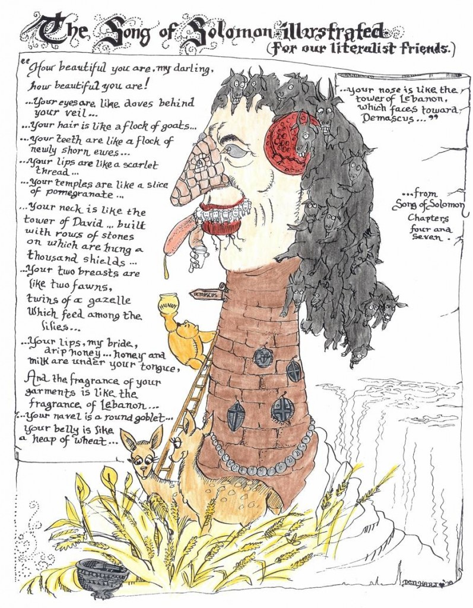
Physical Descriptions
Eyes
Hair
Teeth
Lips/Mouth
Temple/Cheeks
Neck
Breast
Notes:
Now, as we begin chapter 4, I think Solomon has brought the Shulamite back to his palace to continue trying to charm her. This is the 2nd of 3 times in which he tries to do so, the 1st of which was back in chapter 1 when they were in his tent. The 3rd time he attempts to charm her is in chapters 6 and 7 where, like a broken record, he’ll say the exact same things to her that he says in the first 5 verses of this chapter, which means they’re just lines he’d likely used before. This reveals how Solomon looked at women, as anatomical objects, a prize to be conquered rather than a person to be cherished.
As we study 4:1-7, keep in mind that all throughout the song, Solomon employs eastern methods of complimenting women that are a bit lost in translation to us. In fact, (CLICK) funny pictures have been created such as this one to show what the Shulamite might have actually looked like if these pick-up lines were to be take literal, which looks ridicules. But just keep in mind that there are poetic meanings behind each of the things Solomon says to her, and they are almost entirely designed to flatter her physical form rather than her character.
He describes 7 of her physical features, starting from the top down – eyes, hair, teeth, lips/mouth, temple/cheeks, neck, breasts – 7 being the perfect number, is he telling her how perfect she is?

Slide 9
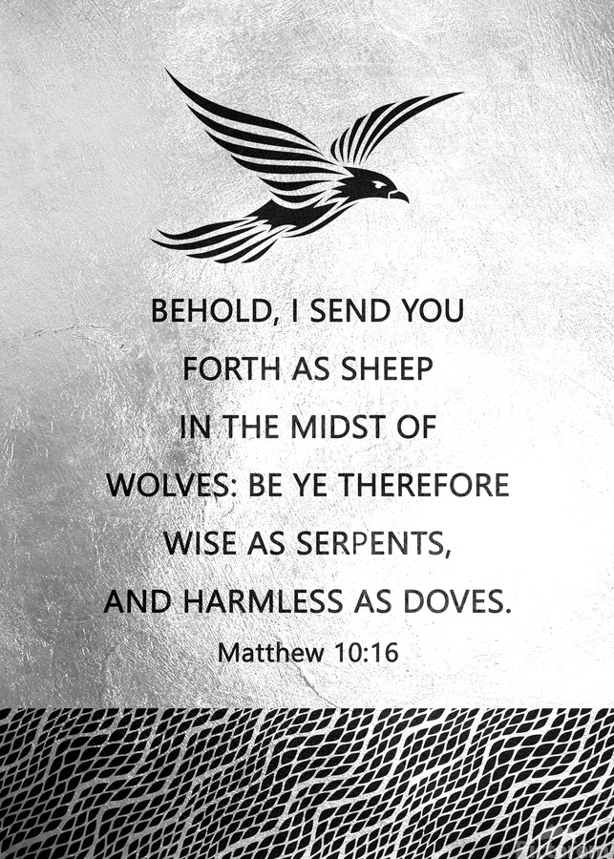
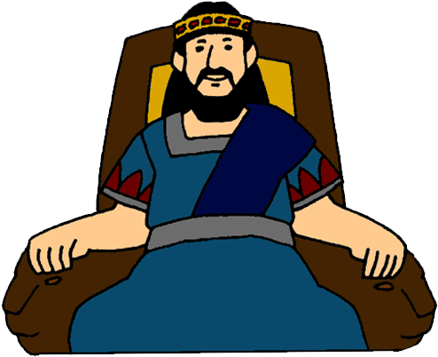
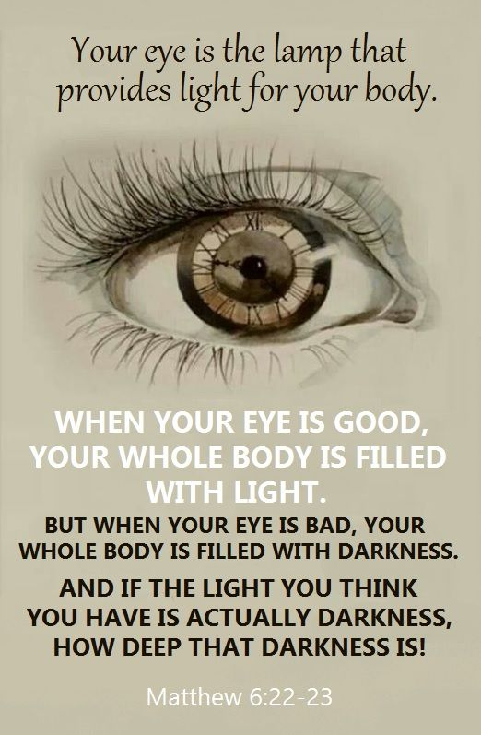
“¹How beautiful you are, my darling, how beautiful you are! Your eyes are like doves behind your veil;” (Song 4:1a)
1) Shulamite’s Eyes
Inner disposition
Gentle/Innocent
Loyal
Trustworthy
Notes:
1) Eyes – Song 4:1a – This is a repeat from 1:15, in which we made the point that it likely is referring to her character, the eyes representing a person’s inner disposition, her harmlessness and innocence, her loyalty and trustworthiness. It is the one of the few compliments he seems to give about her character as most of what remains will focus on her body.
But one additional thing this verse reveals that 1:15 doesn’t is that this time she’s veiled, which maybe having learn her lesson from his pickup lines in chapter 1, could be her idea of protecting her from the very kind of attention Solomon was giving her, her way of saying, “I don’t want you to want me for my body” – that projects dignity.

Slide 10
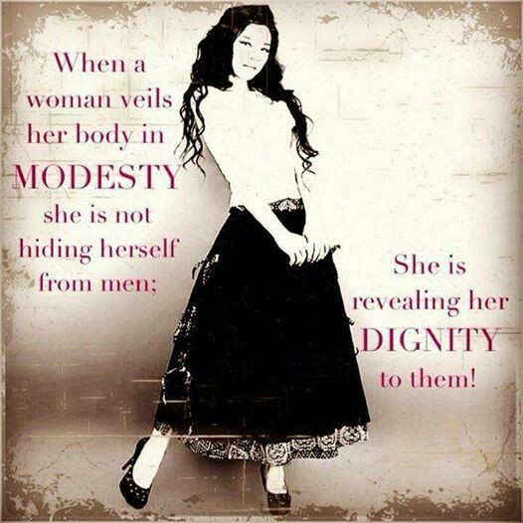
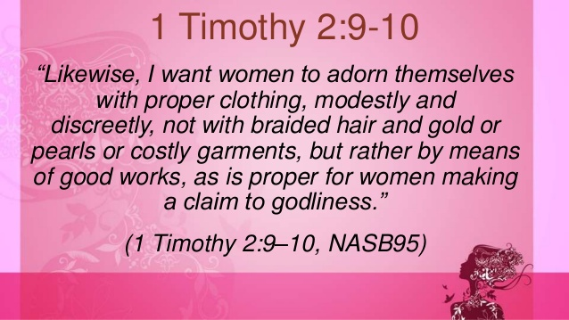
Modest Apparel
Notes:
PRACTICAL APPLICATION – 1 Tim 2:9-10 – “Likewise, I want women to adorn themselves with proper clothing, modestly and discreetly, not with braided hair and gold or pearls or costly garments, but rather by means of good works, as is proper for women making a claim to godliness.”
Here’s a question: modest apparel – what does it reveal and what does it conceal? It reveals your godliness, your humility, your shamefacedness, all wonderful qualities. And what does it conceal? Those parts of your video that are not to be revealed to anyone save your husband.
Opposite question: immodest apparel – what does it reveal and what does it conceal? Well, it absolutely conceals your godliness. You dress like those girls on campus, in tight pants, short shorts that expose the upper legs, low cut shirts that expose the tops of the breast, you are making no distinction between who you claim to serve and the worldliness around you. It doesn’t just dim your light, it completely extinguishes it.
Modest apparel is intended to reveal your dignity and your strong sense of self-worth. It shows you are confident in your person and that if a man is going to love you, they are going to love you for who you are, and not for the tantalizing previews that revealing clothing exposes.
COMMENTS

Slide 11
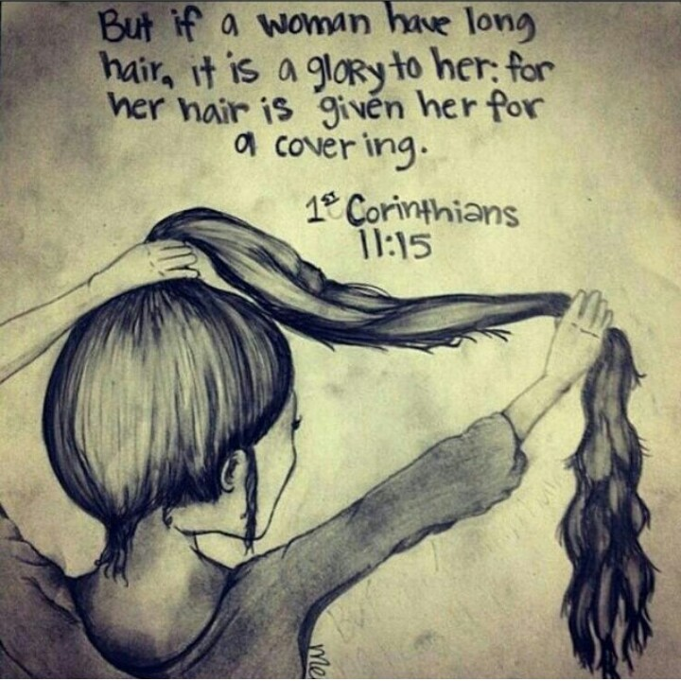
“Your hair is like a flock of goats that have descended from Mount Gilead.” (Song 4:1b)
H. W. Longfellow – “Not ten yoke of oxen have the power to draw us like a woman's hair!”
2) Shulamite’s Hair
Flowing
Lush
Bouncing w/life
Her glory
Notes:
2) Hair – her veil was perhaps not completely covering her hair, though – Song 4:1b – Mount Gilead is none for its high, rigged cliffs east of Galilee and Samaria and if you were to stand at a distance and watch a flock of goats descending from it, it would cause those hills to come alive w/flowing, rippling waves. (CLICK) The idea is that her hair majestically flowed down – it was long, lush, and bouncing w/life, perhaps when she walks or turns (Vidal Sassoon). The hair is a very attractive feature of a woman. (CLICK) Paul would agree, when he says in 1 Cor 11:15 that a woman’s hair is her glory, which is why I read somewhere that over her lifetime, a woman will spend ~$55,000 on her hair. (CLICK) “Not ten toke of oxen have the power to draw us like a woman’s hair” – H. W. Longfellow.

Slide 12
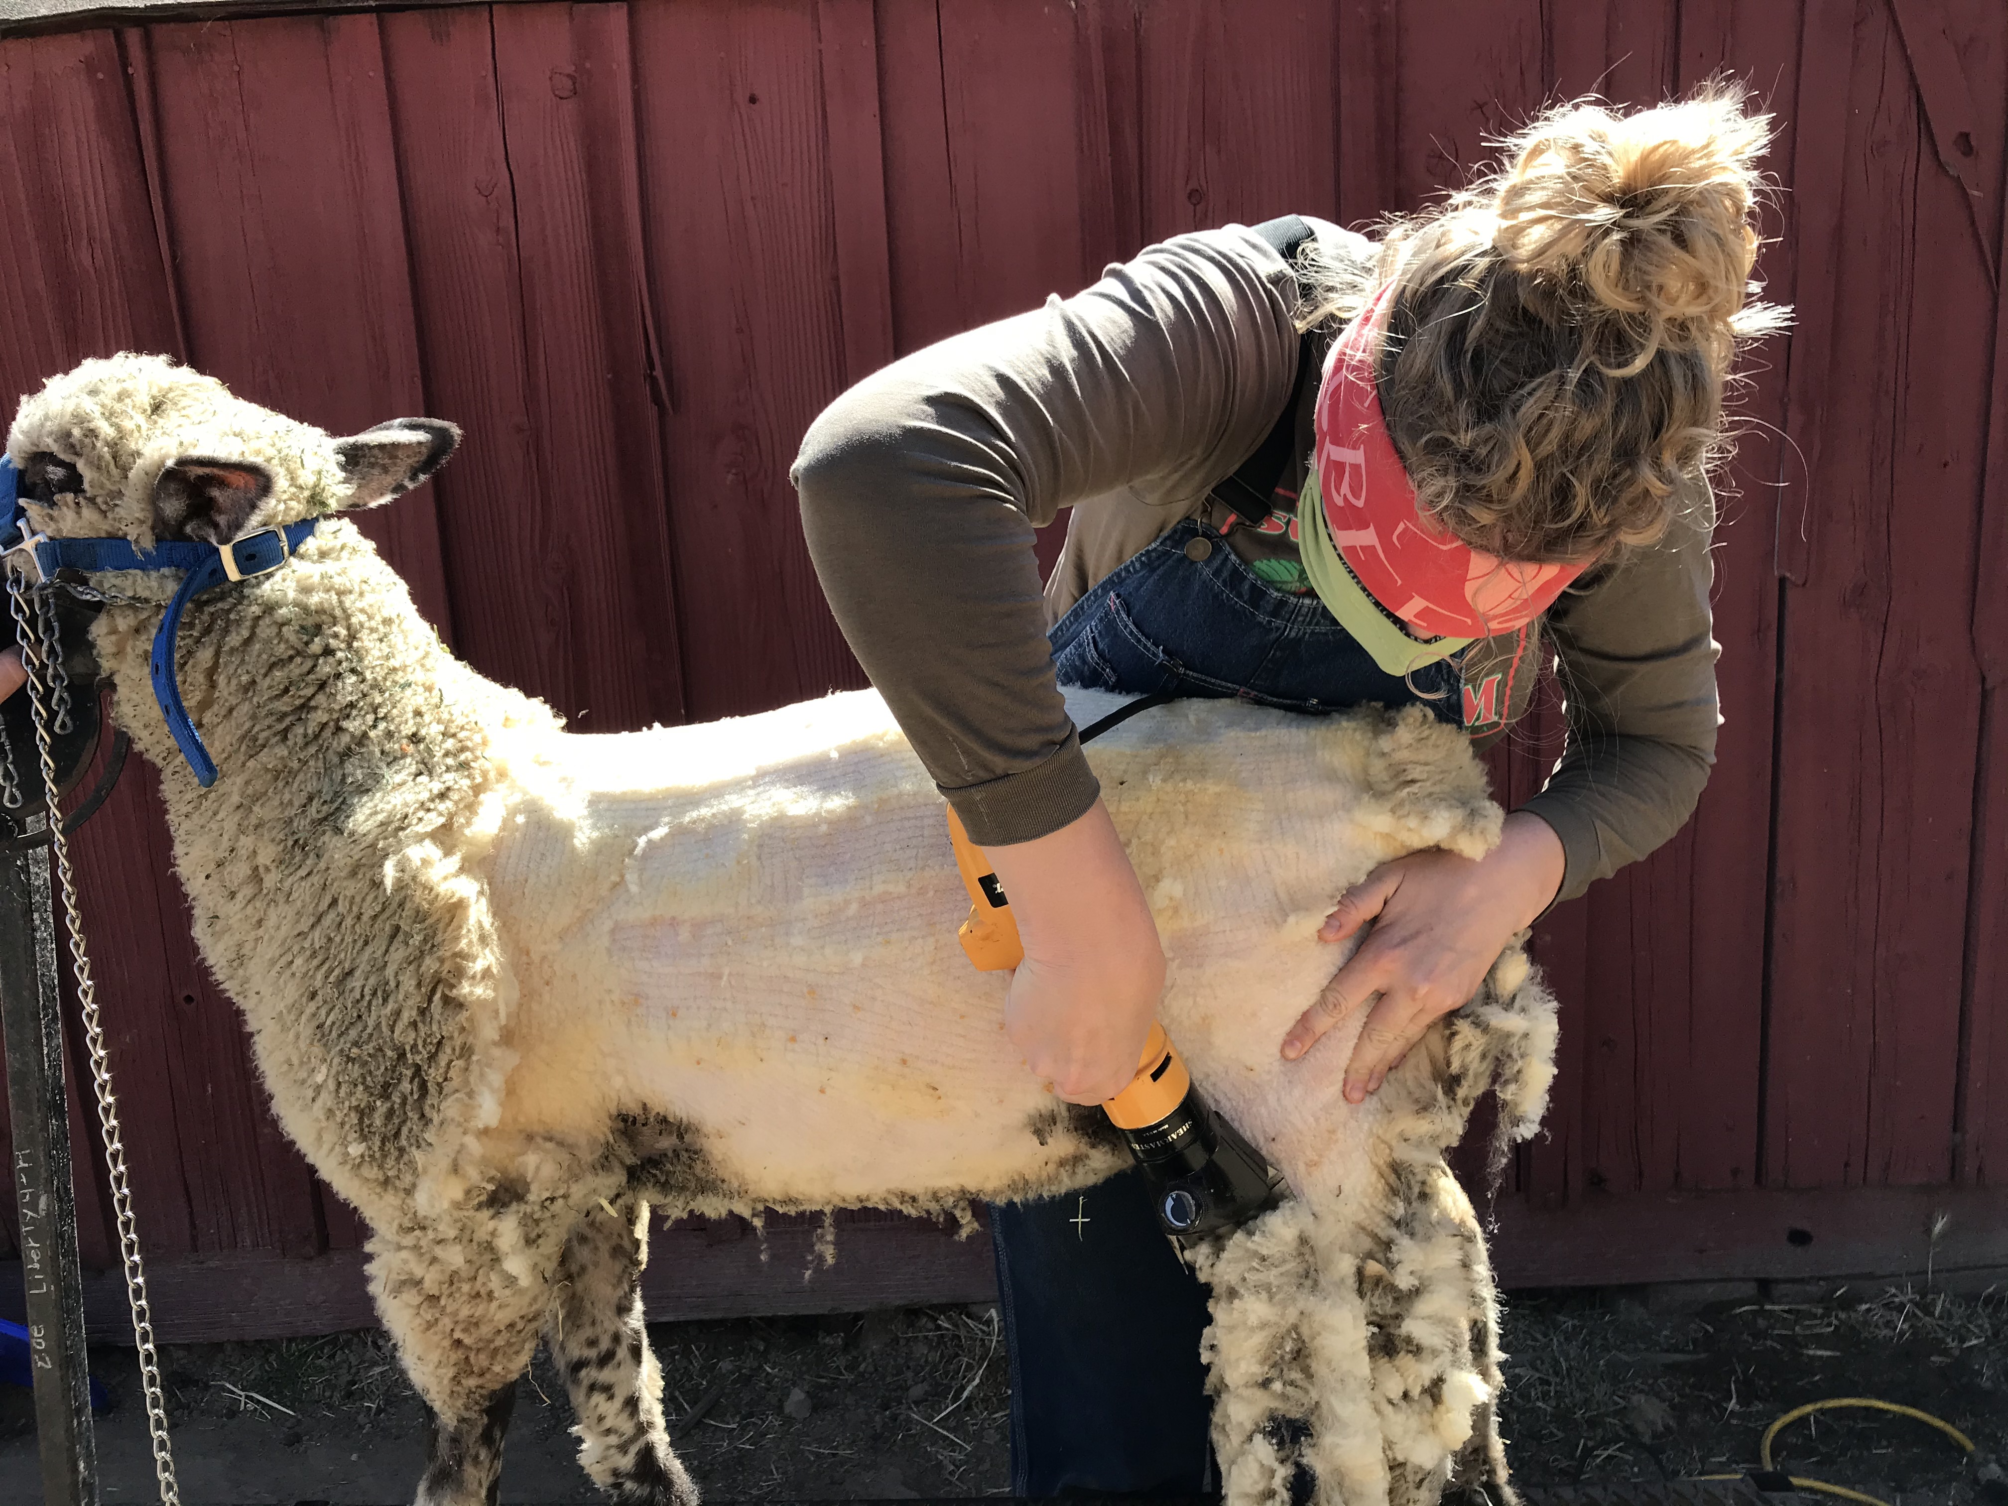
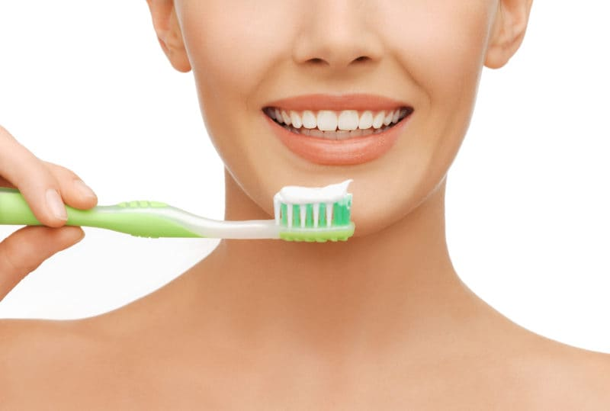
“²Your teeth are like a flock of newly shorn ewes which have come up from their washing, all of which bear twins, and not one among them has lost her young.” (Song 4:2)
3) Shulamite’s Teeth
Flawless
Clean/White
Symmetric
Perfect smile
Notes:
3) Teeth – Song 4:2 – Without dentists, more people in that day had teeth that were broken, chipped, or removed by the time they were 20, (CLICK) but her teeth were flawless. When ewe lambs were shorn to the skin and then washed, they all look the same, so he’s saying they’re clean, they’re white, and the fact they “bear twins” means there is symmetry, the upper teeth mirroring the lower teeth. Twins among sheep were rare and desirable. (CLICK) “not one among them has lost her young” = they are complete; none are missing. Her face/smile would be perfect for a toothpaste commercial.

Slide 13
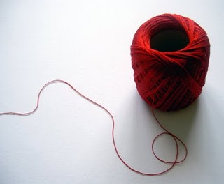
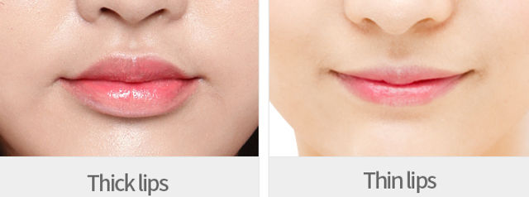
“³Your lips are like a scarlet thread, and your mouth is lovely.” (Song 4:3a)
4) Shulamite’s Lips/Mouth
Thin lips
Deep red
Notes:
4) Lips/Mouth – Song 4:3 – (CLICK) this would seem to imply that her lips were thinner rather than fuller, which from what I’ve read was actually considered more attractive in that day, whereas fuller lips are considered more attractive now. Her lips are well-outlined, a beautiful deep red color.

Slide 14
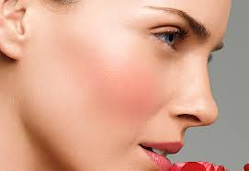
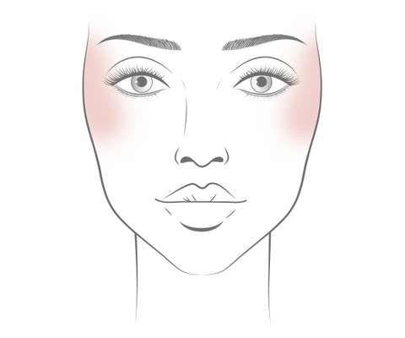
“Your temples are like a slice of a pomegranate behind your veil.” (Song 4:3b)
5) Shulamite’s Temple/Cheeks
Her blush
Full of color
Rosy skin
Notes:
5) Temple/Cheeks – Song 4:3b – Most translations have the word “temple”, but there are a few like he ESV that uses “cheeks” as it can mean the side of one’s face. The Hebrew word can mean both so it’s difficult to know what’s intended. (CLICK) Regardless, it’s likely that Solomon is alluding to the blush of her face, the fact that it is full of color, that she has rosy cheeks.

Slide 15
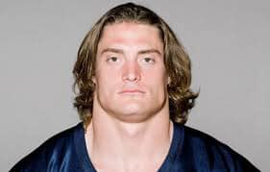
“⁴Your neck is like the tower of David, built with rows of stones on which are hung a thousand shields, all the round shields of the mighty men..” (Song 4:4)
6) Shulamite’s Neck
Symmetry
Dignified/Elegant
Perfect for jewelry
Character
Inaccessibility
Notes:
6) Neck – Song 4:4 – I don’t think he’s saying, “Baby, you could play linebacker for the Cowboys.” (CLICK) (look at this throatagraph). He’s not saying she has a broad, wide neck, rather there is a beautiful symmetry to her neck; (CLICK) it was well proportioned, dignified, and elegant. “built w/rows of stone” = probably saying the same thing as in 1:10, that her neck is perfect for hanging jewelry, layers of necklaces, and that it would enhance her already stunning beauty. Necks were often associated w/character – bent-over neck being humiliation, a stiff neck being stubbornness. Could be that the way she carries herself reflects integrity that all who see her respect. Being “built” up, it could represent inaccessibility. Her neck is made strong and secure by what “protects” it. Could it be he recognizes how strong and secure she is?

Slide 16
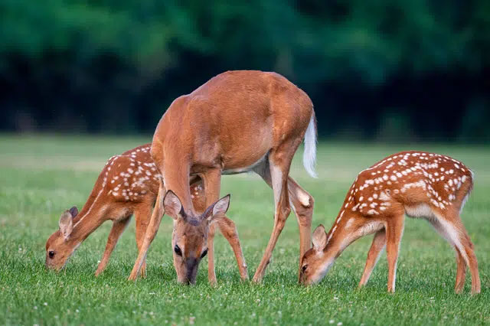
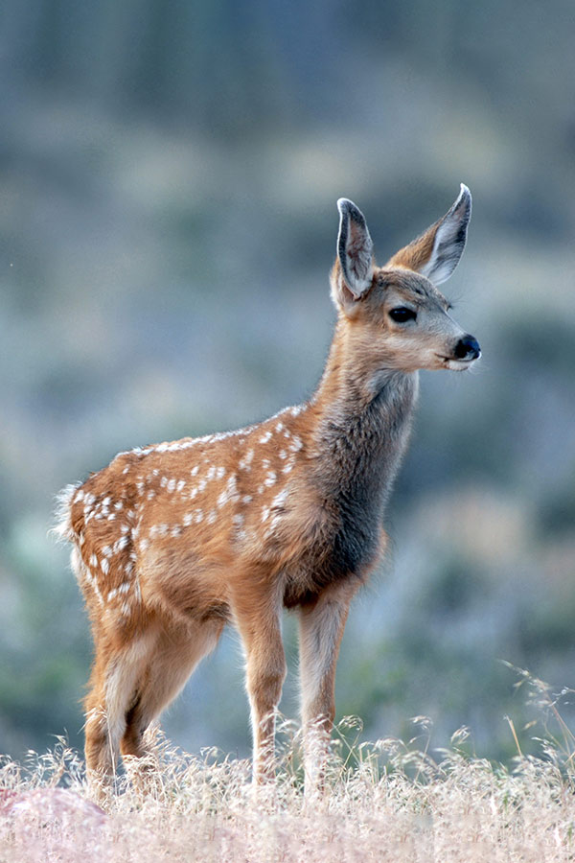
“⁵Your two breasts are like two fawns, twins of a gazelle which feed among the lilies.” (Song 4:5)
7) Shulamite’s Breast
Symmetric
Sprightly
Graceful
Untouchable
Notes:
But if he was about to talk about her character again, it wouldn’t last – Song 4:5 – So, the symmetry of her teeth now repeated about her breast. That they’re like twins is him saying that they match, they’re perfect, they’re sprightly. Fawns are innocent, soft and gentle, graceful and beautiful, we get the gist. And I don’t want to belabor this point because this is one of just a few verses in this book that can be a little uncomfortable to talk about, but it’s important to get this context so that the next verse makes sense (so bear w/me through this). Fawn are baby deer who are untouchable, though many would want to touch them if they were to let them near them. My suspicion is that this might be what Solomon’s play is here.

Slide 17
“⁶Until the cool of the day when the shadows flee away, I will go my way to the mountain of myrrh and to the hill of frankincense.” (Song 4:6)
“¹⁵How beautiful you are, my darling, how beautiful you are! Your eyes are like doves.” (Song 4:2)
Shulamite’s Response
“Settle down!”
“This isn’t happening!”
Leaves for a bit
Needs time to think
Notes:
Why? Because I suspect it’s in this next verse that the Shulamite then speaks up, almost as if to put a stop to where she thinks this might be headed – Song 4:6 – It’s almost as if she can tell he’s starting to get suggestive, (CLICK) and so she stops him in his tracks before he can go any further. (CLICK) “Ok, stop right there – I need to go away and be alone”; “I need to sleep on it”; “I need to think about it”.
What she’s referring to by “mountain of myrrh” and “hill of frankincense” are those gardens of that day, calm places where one could retire to in order to meditate and think, just as Jesus did in garden of Gethsemane. Interestingly, this exact same phrase is uttered by her as an encouragement to the shepherd in 2:17 to work hard to overcome those lingering issues that separated them. But there is no such disclaimer to Solomon. And this shows that what obviously had worked for other carnal women wasn’t working for her.

Slide 18
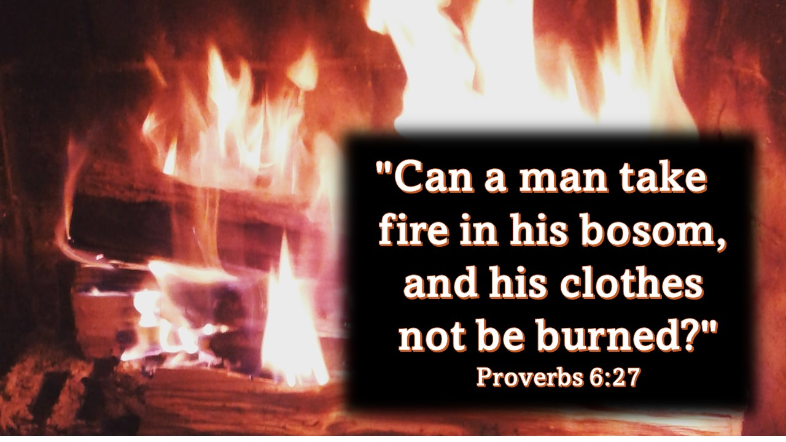
Flee Youthful Lusts
Notes:
PRACTICAL APPLICATION – This is a good time to remind us all that if we ever find ourself in a situation in which something is about to get out of hand w/someone of the opposite sex who is not our spouse, flee (CLICK) – 2 Tim 2:22 – “Now flee from youthful lusts and pursue righteousness, faith, love and peace, with those who call on the Lord from a pure heart.” In Gen 39, what did Joseph do when Potiphar’s wife grabbed him to lay w/him? Well, here’s what he didn’t do – he didn’t sit her down and try to teach her about God’s word. This wasn’t the time for personal work. He didn’t try to reason with her. There was no, “Listen Mrs. Potiphar, before you jump the gun let’s think about the consequences of your actions here.” He didn’t say, “Mrs. Potiphar, before you do anything rash, can we sit here and pray together about this?” And you know what else he didn’t do? He didn’t yell “No!” “No means no, we’re not doing this.” Because there were no words that was going to get him out of this situation. Joseph knew that when sexual temptation rises to this kind of level, it is not something that you just stay and battle out. The text tells us when she grabbed his garment, he slipped out of it, leaving the garment in her hand, and fled outside. (CLICK) Prov 6:27 – Don’t play w/fire. The Shulamite is a great example that when Solomon’s eyes started drifting further and further south, it was time to end the conversation. Let this be an example to us all.
COMMENTS

Slide 19
“⁷You are altogether beautiful, my darling, and there is no blemish in you..” (Song 4:7)
Notes:
But before she leaves – Song 4:7 – In other words, “Baby, you’re perfect”. And if I’m here (CLICK), I’m thinking, “Yeah, I heard you the first time.” But what’s interesting is that the phrase “no spot in you” is typically used in the OT (CLICK) for animals that were acceptable sacrifices. So, while we can certainly read into that the fact that he is saying she is truly flawless, that he would use the language typically reserved for an animal sacrifice makes you wonder, again, how much he really is interested in her as a person rather than an object of lust.

Slide 20
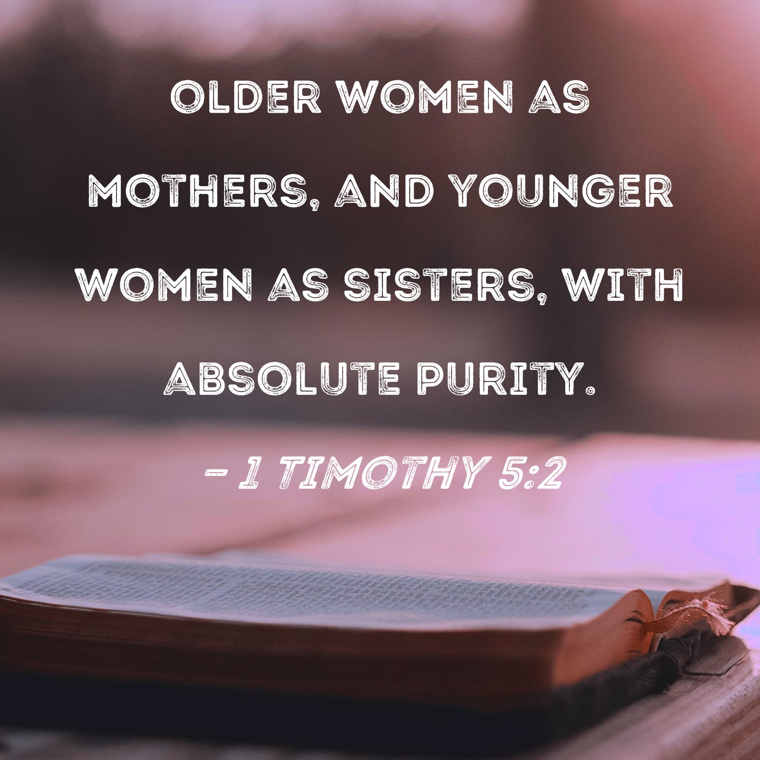
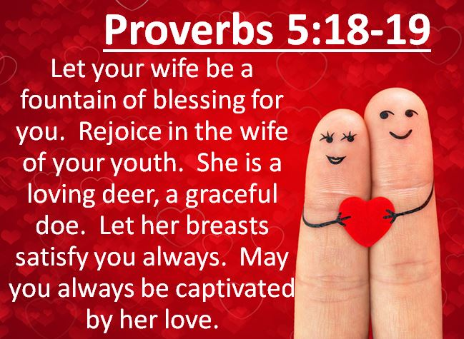
Men Need Self-Control
Notes:
PRACTICAL APPLICATION – And men, this is something we need to be constantly reminded of, and that is that women are not be treated as sexual objects. They are human beings made in the image of God, they are someone’s daughter, someone’s wife, a ransomed life Jesus paid for on the cross, and they do not deserve to be objectified by us, but to be personified and dignified (CLICK) – 1 Tim 2:2.
And ladies, on behalf of the men on this planet, I am sincerely sorry that our lack of self-control has led us to objectifying you. You deserve better from us. Men do have urges, God gave us these urges, which means He obviously intended for us to fulfill these urges. But in what realm? (CLICK) Prov 5:18-19 – “Let your fountain be blessed, and rejoice with the wife of your youth. As a loving deer and a graceful doe, let her breasts satisfy you at all times; and always be enraptured with her love.”
COMMENTS

