Slide 1
Notes:
So far, we’ve encountered a Shulamite girl caught in a love triangle. One man, Solomon, is the most powerful man in the world, and could provide her w/whatever she needed to survive – money, possessions, and security. The downside is her life would be reduced to sitting around in her rich clothes and jewelry w/the rest of his wives, dividing Solomon's attention between them all, while likely raising her kids as a single mom in a state daycare.
On the other hand, w/the Shepherd, there’d be true love, mutual respect, and shared values. It wouldn’t be the lavish lifestyle Solomon offered, but there’d no doubt be romance, there’d be integrity in the relationship, and she’d share the shepherd w/no one.
Now, by this point in the text, she’s weighed both options and it is apparent she wants the Shepherd. But at the moment, she’s stuck in Jerusalem w/Solomon. She’s just had a second dream that has her worried she may have overplayed her hand and lost the Shepherd. And keep in mind that the daughters of Jerusalem, Solomon’s harem, have been w/her virtually the entire time seeing this conflict within her, and that’s where we pick up in 5:9.

Slide 2
“⁹What kind of beloved is your beloved, O most beautiful among women? What kind of beloved is your beloved, that thus you adjure us?” (Song 5:9)
Who is the Shepherd?
Head
Hair
Eyes
Cheeks
Lips
Hands/Arms
Abdomen/Body
Legs
Appearance
Mouth
Notes:
The anguish at potentially losing the Shepherd and her lovesickness has the Daughters of Jerusalem curious – they’re realizing this Shepherd is no ordinary man.
(CLICK) Song 5:9 – This is another one of those verses that makes it difficult for me to take the 2-person approach. Because if the only male is Solomon, why would they say this? They’ve been spending all their time encouraging her to marry Solomon, having already witnessed 140 previous weddings, and they’re going to ask (CLICK), “Who is this mystery man? What does he have that Solomon doesn’t have that you pine over him like this?”
Well, in the following verses, she will basically say, “Let me educate you on just tell you how awesome he is”. And the description she gives in 5:10-16 is going to have a profound impact on them that in 6:1. Single ladies, pay attention, because this is what you should be looking for in a man. And young men, these are qualities you need to aspire for.
5:10 – 5:16 is going to consist of 10 descriptions of the Shepherd (CLICK) – his head, hair, eyes, cheeks, lips, hands/arms, abdomen, legs, appearance, and his mouth, but they are symbolic, most of them referring to his character. These descriptions are not as much what he looks like, but who he is, as well as a reflection of how she feels about him.
PRAYER

Slide 3
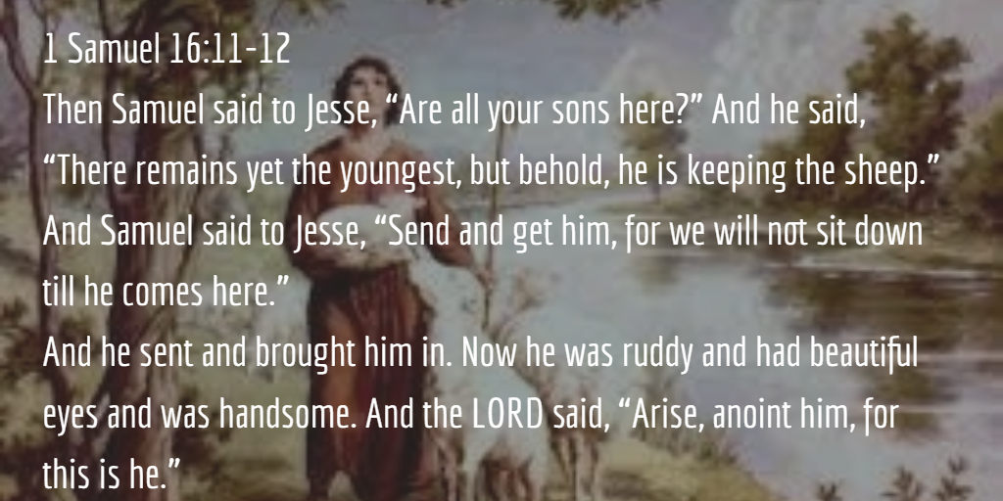
“¹⁰My beloved is dazzling and ruddy, outstanding among ten thousand.” (Song 5:10)
Who is the Shepherd?
A sleeper prospect
Notes:
General description first – Song 5:10 – “dazzling” means “radiant, white”. It’s a picture of his countenance. He’s a healthy, handsome young man. “ruddy” means he was sun tanned, just like we learned about her in 1:6, fully flush, a healthy hue, vibrant, and full of life. “outstanding among ten thousand” means he’s no average man, but a superlative man among a multitude of men – a leader. Ironic that in that society, a shepherd would not have been considered great because of his job. Still today we can judge people based on what they do. She didn’t care what he did; she cared who he was.
And so, handsome, ruddy, outstanding among 10,000. Who does this remind us of? Who was it that it was once sung about, “Saul has slain his thousands but ____ his ten thousands?” (1 Sam 18:7). (CLICK) He sounds an awful lot like David, who no one initially saw coming, not even Samuel – because he was considered the least amongst his brothers. (CLICK) But like David, the Shepherd is a sleeper prospect, someone who flew under most people’s radar, but to the people who actually knew him, he was outstanding.
See, these women are saying, “Who is this man you’re all infatuated by that he could possibly compete w/the king?” Yet he shared many of the qualities Solomon’s dad did before he became famous. And despite not being well-known, she knew he was one of the best men you’d ever meet – he was quite the catch.

Slide 4
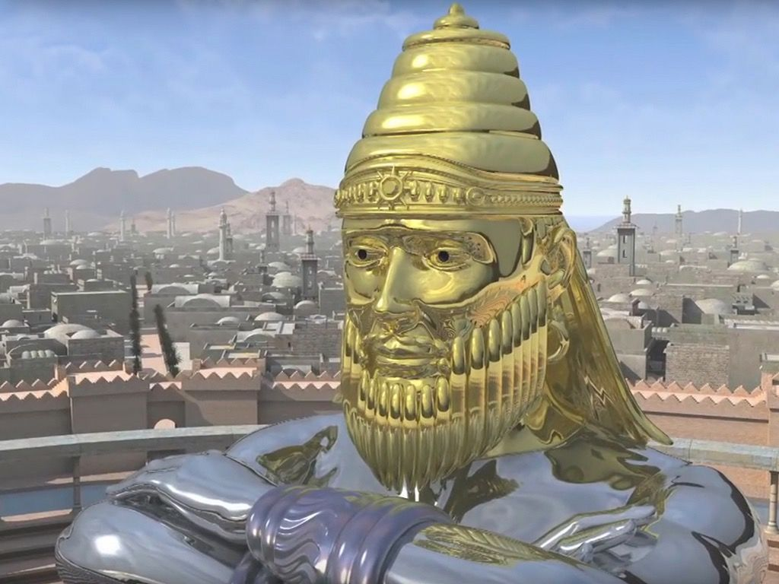
“¹¹His head is like gold, pure gold; his locks are like clusters of dates and black as a raven.” (Song 5:11)
Who is the Shepherd?
A sleeper prospect
Preeminent among men
Diamond in the rough
Notes:
1) Head – And this is further evidenced by his next description – Song 5:11a – Who else in the bible had a head of gold? (CLICK) Nebuchadnezzar – and it signified that his kingdom was preeminent to every other kingdom, including those that’d come after him. I think she’s saying that, sure, he flies under the radar, but he is of the highest quality in men imaginable, as rare/valuable as gold.
2) Hair – Song 5:11b – (CLICK) In hot, arid regions close to where they grew up, dates were regarded as highly auspicious, because despite these trees growing in barren, desert sands, this fruit thrived. I suspect the black hair is mentioned as a dramatic contrast w/the golden face, much like how much brighter the sun would look in the blackness of space.
Point: I believe all these description so far are pointing to the same thing – this is a guy who no one in the capital would have ever heard of, but to her, he was regarded as an outstanding specimen of a man, (CLICK) a true diamond in the rough.

Slide 5
Popularity Isn’t Everything
Notes:
PRACTICAL APPLICATION – Sometimes we’re turned off by someone like this simply because the world is be turned off by them (shepherd); and so, I wouldn’t want to be caught out with someone who looks like that. And guys, there are a lot of women out there that have absolutely nothing under the skin, absolutely nothing.
Example: I bagged groceries all through high school and the first couple of years of college, and I remember we hired this new cashier who so pretty. And so, I asked her out on a date, and she actually said yes. Then we went out….man, one of the dullest times I’ve ever had. She was one of those “dur” kind of girls, you know the ones I’m talking about. “What do you want to do with your life?” “Well, durr.” There was just nothing of substance under the surface, and it just detracted from her physical beauty. That one date was enough for me.
(CLICK) Prov 31:30a – “Charm is deceitful and beauty is vain”. Charm and beauty are those things which makes one popular, (CLICK) and many times there are things you have to give up by way of virtue to attain it. But they’re vain/empty, and will fade over the years. It doesn’t matter what others think of them or their popularity, but who they are.
COMMENTS

Slide 6
“¹²His eyes are like doves beside streams of water, bathed in milk, and reposed in their setting.” (Song 5:12)
Who is the Shepherd?
A sleeper prospect
Preeminent among men
Diamond in the rough
Sensitive and tender
Notes:
3) Eyes – Song 5:12 – Same thing Solomon has said multiple times about her. (CLICK) As we’ve noted before, doves are known for only having one mate for their entire life, and so the idea is that despite how unreal this guy is, he has his eyes solely on her.
Also remember that the eyes are the seat of expression. And how does he look at her? By streams of water, I believe it’s saying he looks at her w/calm repose. Not fierce and furious, not red and wrathful eyes, but clearly, as if washed w/milk, full of sympathy and concern.
The phrase “reposed in their setting” is better translated “sitting upon full streams”. (CLICK) So, I’d suggest that the eyes are a fountain of tears of sympathy, that he’s sensitive and tender toward her. When she experiences trial/difficulty and is upset, he looks at her w/kindness and compassion. This is a young man who when they marry will have a leg up on living w/her in an understanding way.

Slide 7
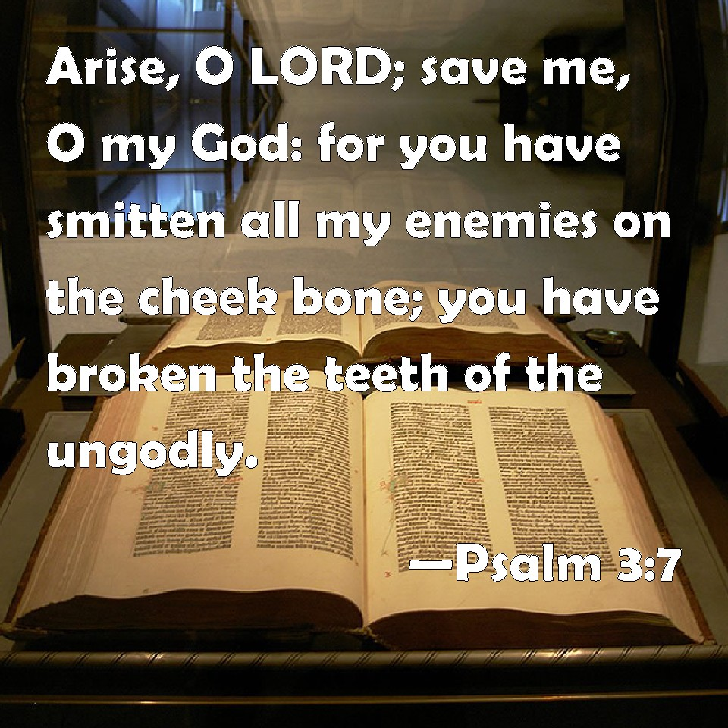
“¹³His cheeks are like a bed of balsam, banks of sweet-scented herbs; his lips are lilies dripping with liquid myrrh.” (Song 5:13)
Who is the Shepherd?
A sleeper prospect
Preeminent among men
Diamond in the rough
Sensitive and tender
Well-respected
Notes:
4) Cheeks – Song 5:13a – In oriental culture, the cheek/jaw was jealousy guarded against touch or defilement, such that a stroke to the cheek, as Jesus talked about in Matt 5:39, would be regarded as extreme rudeness of behavior. (CLICK) And most Israelites decorated their cheeks/jaws w/beards, as that was considered a symbol of dignity and pride.
There’s also a verse that helps in (CLICK) Psa 133:1-2 – “Behold, how good and how pleasant it is for brothers to dwell together in unity! It is like the precious oil upon the head, coming own upon the beard, even Aaron’s beard, coming down upon the edge of his robes.” How is unity like oil on Aaron’s beard? I would suggest because of all the spices that the anointing oil was made up of (Ex 30:23-25,30). Also keep in mind that we learned that oil/perfume is used as an emblem for reputation, and she already said he had a good one, and balsam is where they’d get their oil.
Point: (CLICK) I think what she’s saying is that even though a shepherd, he is well respected by people and he carries himself w/self-respect and poise.

Slide 8
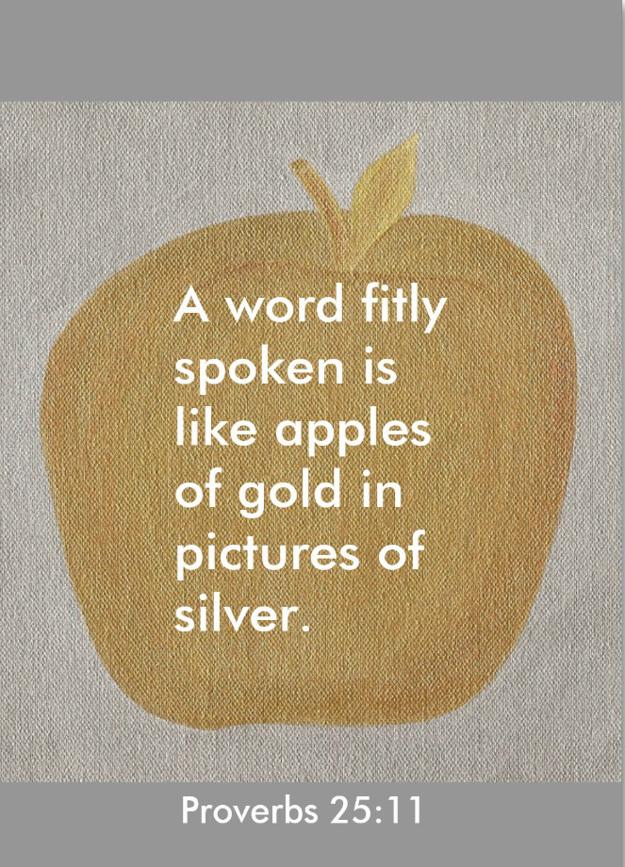
“¹³His cheeks are like a bed of balsam, banks of sweet-scented herbs; his lips are lilies dripping with liquid myrrh.” (Song 5:13)
Who is the Shepherd?
A sleeper prospect
Preeminent among men
Diamond in the rough
Sensitive and tender
Well-respected
Edifying speech
Notes:
5) Lips – Song 5:13b – In the bible, myrrh was used in a variety of ways – embalming a dead body to cover the smell, in perfumes, to treat wounds, and it was used in Esther to beautify the girls that were to be presented to Xerxes. But what all these situation shave in common is that myrrh was used when you were wanting to improve something. This would imply about the shepherd what we read in passages like Prov 25:11 – “Like apples of gold in settings of silver is a word spoken in right circumstances.” This is a guy who always knew the right thing to say in the moment, showing discretion in what he said.

Slide 9
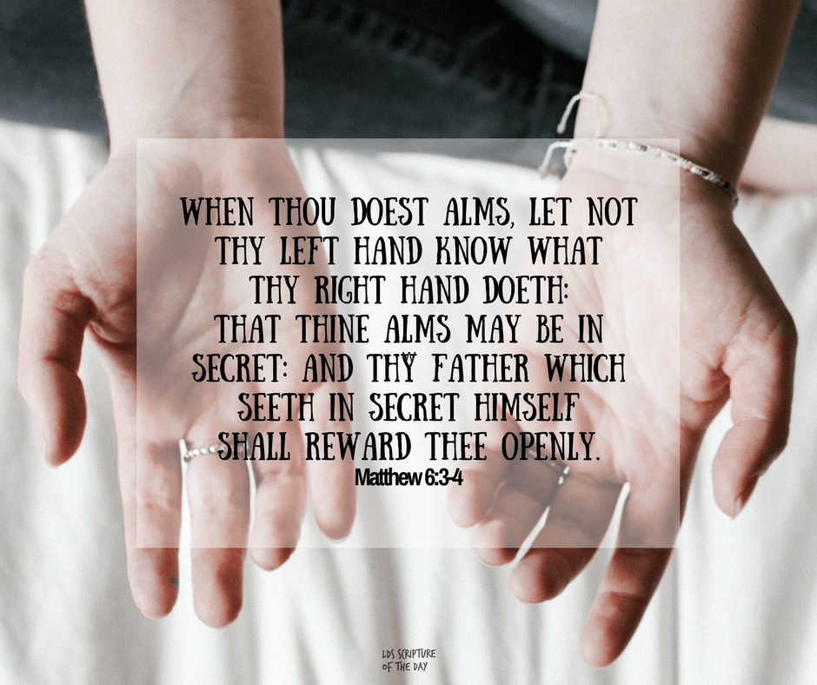
“¹⁴His hands are rods of gold set with beryl; his abdomen is carved ivory inlaid with sapphires.” (Song 5:14)
Who is the Shepherd?
A sleeper prospect
Preeminent among men
Diamond in the rough
Sensitive and tender
Well-respected
Edifying speech
Servant/giver
Notes:
6) – Hands/arms – Song 5:14a – This verse is sometimes translated arms, but IMHO, “hands” is the better translation as it seems to indicate fingers that are outstretched w/nails stained w/the color of beryl which theologians suggest some often wore as polish on their fingers. The hands are depicted in scripture as instruments of action and also in (CLICK) distribution of gifts/charity as Jesus uses it in Matt 6:3. (CLICK) I’d suggest she’s saying he’s giving. He is someone who gives to people freely and generously, actively reaching out to help those in need.

Slide 10
“¹⁴His hands are rods of gold set with beryl; his abdomen is carved ivory inlaid with sapphires.” (Song 5:14)
Who is the Shepherd?
A sleeper prospect
Preeminent among men
Diamond in the rough
Sensitive and tender
Well-respected
Edifying speech
Servant/giver
Hard worker
Notes:
7) Abdomen – Song 5:14b – Sometimes this is translated “body”. The regions of Canaan were known to be a very hilly, mountainous region. Since he’s a shepherd, this means he’d be hitting the gym everyday simply in his vocation, as he moved the sheep throughout the steep hills for pasture. (CLICK) This is a very fit, young man who knows all about hard work, w/the physique to back it up.

Slide 11
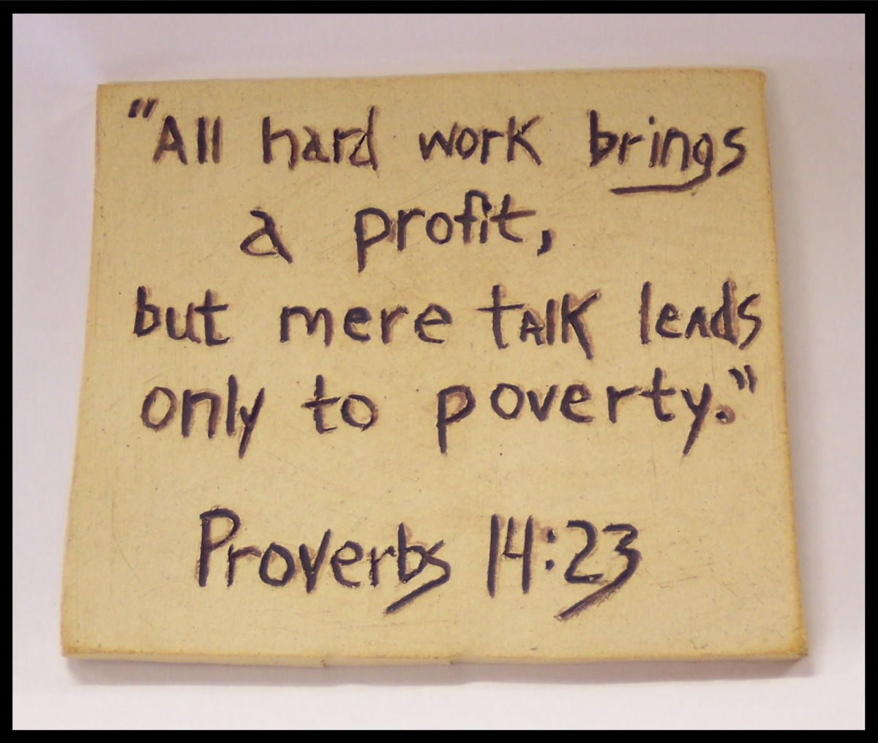
Look For Strong
Work Ethic
Notes:
PRACTICAL APPLICATION – Look for a hard worker. I’m not talking about a workaholic, but someone w/a strong work ethic. If you marry someone w/o a strong work ethic, you’re sentencing yourself to a lifetime of picking up the slack. If he is the kind of person who just gives up and feels sorry for himself, he won’t put forth the work of finding employment but will just wait for someone to help him out.
If your child gets into real trouble, he may just give up and say, “Kids will be kids.” If the responsibilities of keeping up a house become too overwhelming or caring for an ill spouse (that would be you, of course) becomes too wearisome, he may seek refuge in an escape. Rather than confront life and work to improve their current situation, they collapse, feel sorry for themselves, and make things worse with “self-medication.”
This applies to staying in shape, to progressing spiritually, to saving responsibly for retirement, to even be willing to do things he doesn’t want to do, but needs to do for the sake of his family. If you marry someone who resents work, you’re in for a world of hurt.
(CLICK) Prov 14:23 – “In all labor there is profit, but mere talk leads only to poverty.”
COMMENTS

Slide 12
“¹⁵His legs are pillars of alabaster set on pedestals of pure gold; his appearance is like Lebanon choice as the cedars.” (Song 5:15)
Who is the Shepherd?
A sleeper prospect
Preeminent among men
Diamond in the rough
Sensitive and tender
Well-respected
Edifying speech
Servant/giver
Hard worker
Upright life
Choice specimen
Notes:
8) Legs – Song 5:15a – A few ways to look at this. A man’s legs can be representative of his stability and his strength/might (Eccl 12:3), being that they are what support the body. But they are also the instruments of walking, implying that the course of his life is righteous and upright. Being on pedestals of gold, (CLICK) his entire life is of a pure, quality foundation. And being that his head was made of gold, and now his body is set on pedestals of pure gold, (CLICK) this Shepherd is truly golden, from head to toe.
9) Appearance – Song 5:15b – This is the wood Solomon chose for the temple because it was the best wood, most quality material. The Shepherd is a choice specimen – solid, firm, and confident.

Slide 13
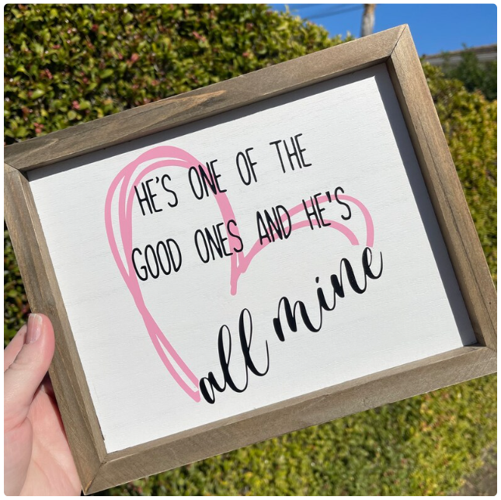
“¹⁶His mouth is full of sweetness. And he is wholly desirable. This is my beloved and this is my friend, O daughters of Jerusalem.” (Song 5:16)
Who is the Shepherd?
A sleeper prospect
Preeminent among men
Diamond in the rough
Sensitive and tender
Well-respected
Edifying speech
Servant/giver
Hard worker
Upright life
Choice specimen
Loves listening to him
A true friend
Notes:
Song 5:16a – We’ve already seen from vs. 13 that he knew how to say the right thing. (CLICK) But this seems to be the idea that he is pleasant to listen to. Wisdom comes from his mouth (Prov 16:21). Keep in mind that this is the same compliment he had given her in 4:11, so this is another sentiment they had in common. They both loved talking to each other.
And to sum him up? She comes back to his overall form – Song 5:16b – To her, everything about him is delightful, pleasant, he’s great to be with. She loves being around him. And most importantly, she says, (CLICK) “He’s all mine!” She looks at him as more than just a romantic interest. (CLICK) He is her friend – she can share anything w/him, He accepts her for who she is, and she can imagine spending the rest of her life w/him and being happy. She loved him for who he was and wouldn’t change a thing.
Quite a man, isn’t he?

Slide 14
“²My beloved has gone down to his garden, to the beds of balsam, to pasture his flock in the gardens and gather lilies. ³I am my beloved’s and my beloved is mine, he who pastures his flock among the lilies.” (Song 6:2-3)
“¹Where has your beloved gone, O most beautiful among women? Where has your beloved turned, that we may seek him with you?” (Song 6:1)
Notes:
Apparently, the Daughters of Jerusalem are convinced, because notice their response (CLICK) – Song 6:1 – What a change! At first, they were like, “Who could possibly compete w/Solomon?” But now that she’s told them, it’s as if they see exactly what true love is supposed to look like and it’s turned their whole world upside down. Now they’re thinking, “Tell us where he is, and we’ll go fetch him w/you! We can all have him!”
(CLICK) But her response? – Song 6:2 – In other words, she already knows exactly where he is, what he is doing, and she knows she has his heart. This is a dependable man and a woman who is confident and self-assured in him, making clear that the anxiety in her dream was not based in reality. She also knows he’s thoughtful, because he’s likely gathering lilies for her.
Being the harem, maybe they thought if she could have him, they could have him too. “He could have 10 wives!” – Song 6:3 – But she basically says to them, “hands off”. (CLICK) The Shulamite makes it clear that is not how her relationship w/him will work. “Don’t go hunting, girls, you can’t have him, stay away, I don’t need your intervention.”

Slide 15
Monogamy Has Always Been God’s Plan
Notes:
PRACTICAL APPLICATION – This exalts the idea of monogamy. We know, form the very beginning, that polygamy was never God’s intention, though we do see it legislated in the OT (Deut 21:15-17), like many other things God allowed because of the hardness of Israel’s heart. All the way back in Gen 2, (CLICK) which Jesus quotes in Mark 10:8, God’s design was that “two shall become one flesh”. And what do we see when it’s more than 2? We see it associated w/the rise of sin in Gen 4 w/Lamech being the first polygamist. We see it creating problems for Abraham, for Jacob, for Solomon, all narratives in which polygamous relationships led to spiritual and familial devastation. These stories were not given to encourage us toward polygamy, but as a warning against it, and I believe Song of Solomon, particularly 6:1-2, is a further reminder of where God’s plan for marriage find it’s ultimate purpose – one man and one woman committed solely to one another.
COMMENTS

Slide 16
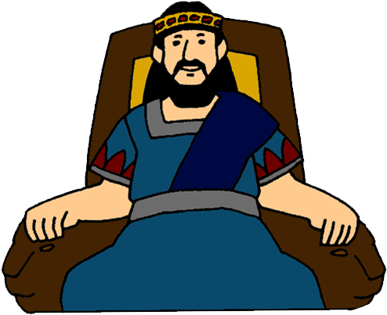
“⁴How You are as beautiful as Tirzah, my darling, as lovely as Jerusalem, as awesome as an army with banners. ⁵Turn your eyes away from me, for they have confused me;” (Song 6:4-5a)
Solomon’s 3rd Try
Impregnable
Sight to behold
Confusing
Notes:
Now we come to Solomon’s 3rd and final attempt to woo her – Song 6:4a – Tirzah was the first capital of the northern kingdom of Israel for ~50 years until Omri purchased Samaria and made it the capital. And while both it and Jerusalem were beautiful, they are especially noted for being lifted up on a mountain, and unconquerable, impregnable, part of why they were chosen to be capitals. I suspect Solomon begins his 3rd attempt w/this comparison because he’s been trying to conquer her, but she isn’t melting before him like other women do. “I’ve gone through this shpeal 140 other times, and it’s worked, but it’s not working on you, and I don’t know why.” She’s a challenge for him.
Song 6:4b – we’ve seen this before. (CLICK) It’s the idea that she’s a sight to behold, a spectacle, which explains the next verse – Song 6:5a – now there are a couple ways to take this. It could he’s claiming that he can’t make eye contact w/her because her beauty is just too much for him, that she has an attraction that is enchanting and can’t be resisted, that her eyes exude a powerful strength that holds him captive. (CLICK) Another possibility is that he’s “confused” because her eyes are not inviting him in as the previous 140 women had. Maybe he’s seeing that her disposition toward him is even less inviting than the last time they were last together, and he doesn’t get it.
Guys, women are beautiful, and there will be some you’ll have a hard time not looking at – they’re going to captivate you. But you have to treat them like you would the sun. You can glance, but you can’t stare, or you’re going to hurt yourself.

Slide 17
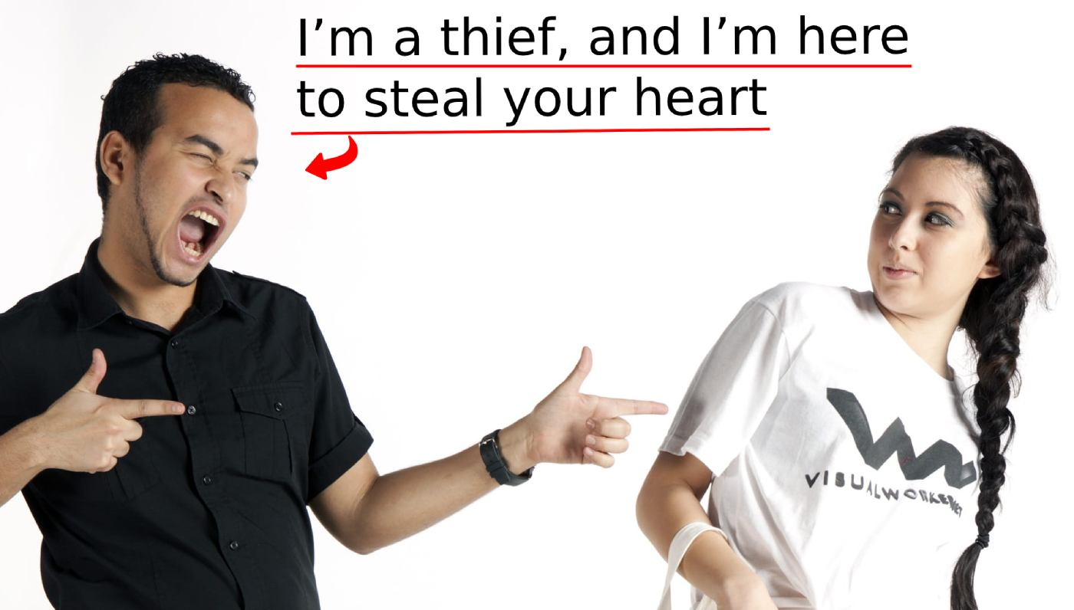
“Your hair is like a flock of goats that have descended from Gilead. ⁶Your teeth are like a flock of ewes which have which have come up from their washing, all of which bear twins, and not one among them has lost her young. ⁷Your temples are like a slice of a pomegranate behind your veil.” (Song 6:5b-7)
Solomon’s 3rd Try
Impregnable
Sight to behold
Confusing
Repetitive
Notes:
Because I suspect based on these next verses that he’s starting to lose his composure – Song 6:5b-7 – having lost his composure, he reverts back to the same well-rehearsed lines from 4:1-3, (CLICK) being as unoriginal as he can be. So, this was obviously a game to Solomon, but to her, this was her life, and Solomon hasn’t yet figured out that marriage cannot survive on sensual love alone.

Slide 18
“⁸There are sixty queens and eighty concubines, and maidens without number; ⁹but my dove, my perfect one, is unique: she is her mother’s only daughter; she is the pure child of the one who bore her.” (Song 6:8-9a)
Solomon’s 3rd Try
Impregnable
Sight to behold
Confusing
Repetitive
The BEST!
Notes:
And if he’s already used these lines w/her, he certainly used it w/the maidens before her. And she has to know that. And I wonder if Solomon knows she knows it, because notice what he says next – Song 6:8-9a – (CLICK) “Baby, I’ve been w/a lot of women, but none of them have been like you.” Talk about unoriginal – this line is 3000 years old, isn’t it? Think about what he’s saying – “I know, I have 140 other wives, but baby, baby, baby, they’re nothing like you.” (gag) But how do we know he’s a bag of wind? Because he’d go on to have 860 more wives and concubines.
That she is her “mother’s only” is the idea that she is preferred, the favorite, afforded special parental affection, much like Isaac was to Abraham, which I suspect would be him suggesting to her that should she marry him, it’d be the same. It’s as if he is promising she will be preferred above all the other wives and concubines. But the Shulamite knows better.

Slide 19
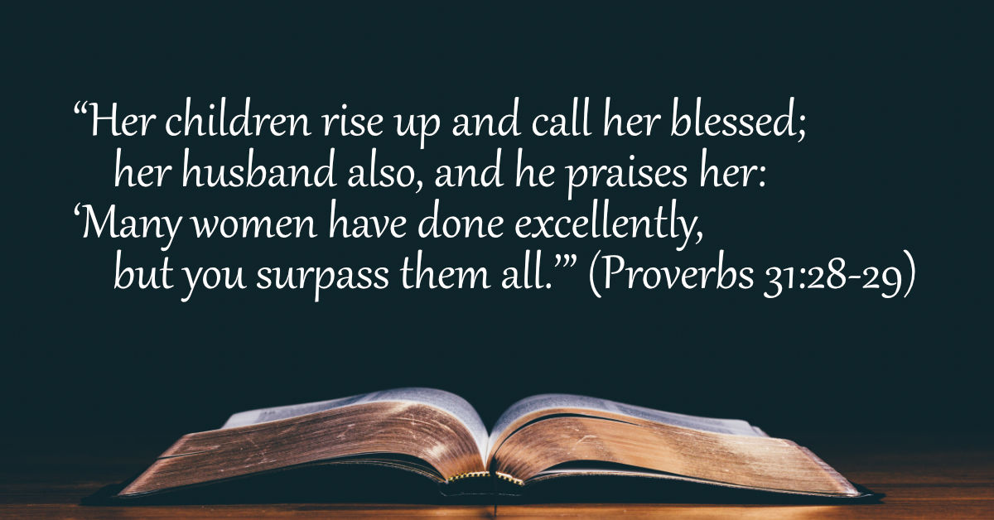
Women Want To Be Preferred
Notes:
PRACTICAL APPLICATION – And let this be another reason why monogamy is God’s plan, because what wife in here wants to share their husband w/another man? What husband wants to share their wife w/another man? No, the beauty of marriage is it is the one place where the other is always the preferred party. And women most certainly want to be preferred above and beyond other women, don’t you ladies? (CLICK) That’s why Prov 31:28-29 is such a special verse – “Her children rise up and bless her; her husband also, and he praises her, saying: many daughters have done nobly, but you excel them all.” This would lose its power in a polygamous situation. Women want to be preferred, and wives deserve to be preferred by their husbands above every other woman, and this is going to be one of the themes we are going to hit on hard when we get to chapter 8’s summary lessons and consider the idea of jealousy.
(CLICK) Remember, part of the curse upon woman in Gen 3:16 is her desire would be toward her husband, and men, we have to make it easy on them to desire us by putting her up on a pedestal where she belongs.
COMMENTS

