Slide 1
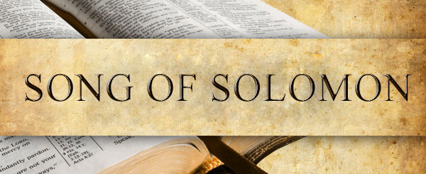
Notes:
This will conclude our study of Song of Solomon. By the end of the chapter 7, the Shulamite has chosen true love w/the Shepherd over what Solomon offered her by way of carnal compliments and a palace lifestyle. And as we begin chapter 8, most of the narrative is complete. Chapter 8 mostly consists of some summary remarks and lessons that the book wants to push home for us as we sit back and contemplate the story that was unfolded before us.
PRAYER

Slide 2
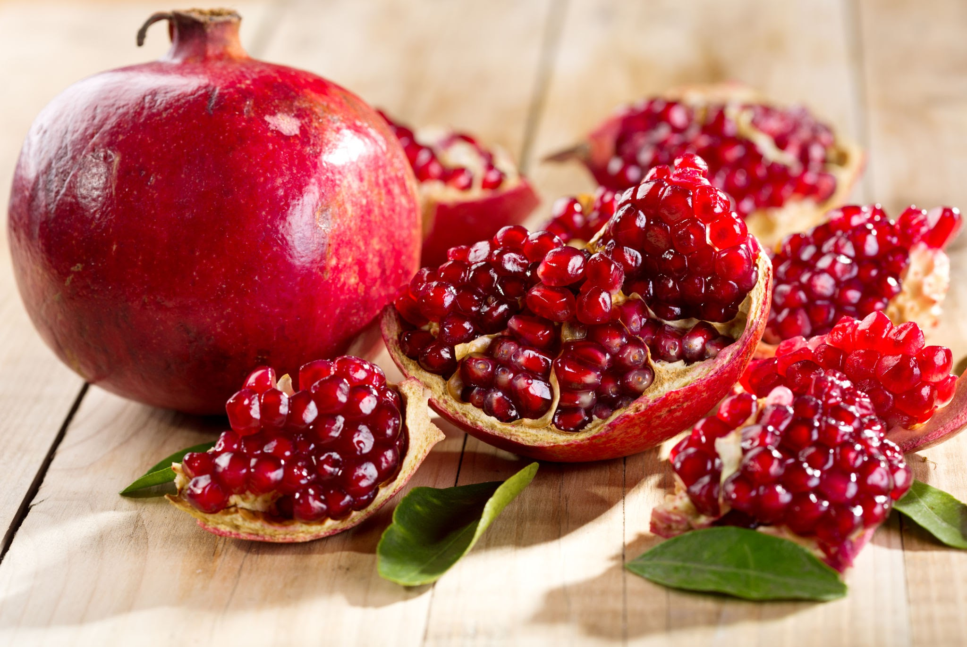
“¹Oh that you were like a brother to me who nursed at my mother’s breasts. If I found you outdoors, I would kiss you; no one would despise me, either. ²I would lead you and bring you into the house of my mother, who used to instruct me; I would give you spiced wine to drink from the juice of my pomegranates. ³Let his left hand be under my head and his right hand embrace me.” (Song 8:1-3)
Notes:
So, the Shulamite has chosen the shepherd, and she says this to him – Song 8:1 – not “a” brother, but “like” a brother. (CLICK) The idea is that since they’re not yet married, it’d be improper for her to display open affection toward him. She’s ready to marry him because she wants the freedom of being able to publicly express her love toward w/o others putting them to shame.
Song 8:2a – Meaning, a safe place; together, but under the watchful care of her mother so that in view of their upcoming marriage, they wouldn’t be enticed to cross any lines. Her mother, who was her instructor, instilled in her a good foundation on the “facts of life”, giving her the knowledge by which she’d be equipped to make right decisions. As we’ve seen, she did go through a challenge w/Solomon’s advances. Everyone comes to moments in their life where what they know to be right will be tested. Thankfully, she had the wisdom and determination to apply the knowledgeable she had learned from her mother to make the right decisions in the end.
Song 8:2b – (CLICK) We’ve seen pomegranates used several times in this song. Pomegranates have a lot of seeds – it’s an emblem of fruitfulness. Meaning, she’d be someone who’d express her love for him by serving him and making him happy in every way imaginable. She wants to care for him, and she looks forward to that. She will serve him in his best interests just as her mother taught her.
Song 8:3 – We saw this same verse in 2:6. She’s imagining what affection and kissing him would be like, how true sweethearts embrace one another. She can’t wait to enjoy the simple intimacies w/him that are incumbent w/a romantic relationship. She is longing for intimate contact.

Slide 3
Matt 5:28 – “but I say to you that everyone who looks at a woman with lust for her has already committed adultery with her in his heart.”
Prov 5:18-19 – “Let your fountain be blessed, and rejoice in the wife of your youth. As a loving hind and a graceful doe, let her breasts satisfy you at all times; be exhilarated always with her love.”
Desire For Marital Intimacy Is Not Wrong
Notes:
PRACTICAL APPLICATION – Is that wrong? Before your wedding day, is it wrong to desire and look forward to getting to be intimate?
Two competing scriptures I want to consider.
(CLICK) Matt 5:28 – “but I say to you that everyone who looks at a woman with lust for her has already committed adultery with her in his heart.”
(CLICK) Prov 5:18-19 – “Let your fountain be blessed, and rejoice in the wife of your youth. As a loving hind and a graceful doe, let her breasts satisfy you at all times; be exhilarated always with her love.”
Same desires, but in one verse it is condemned, in the other verse it is encouraged. What’s the difference? One is expressed in marriage toward one’s spouse, the other is not.
Longing for marital intimacy is not wrong. In fact, looking forward to being intimate w/our future spouse, as the Shulamite expresses, is not wrong either, in and of itself. Now, what would make it wrong? If it turns into lust or if it is consummated. And so, there are boundaries to be considered.
The truth is, you know what a successful marriage is? One in which the honeymoon was the low point.
COMMENTS

Slide 4
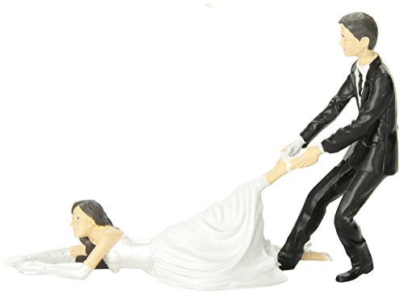
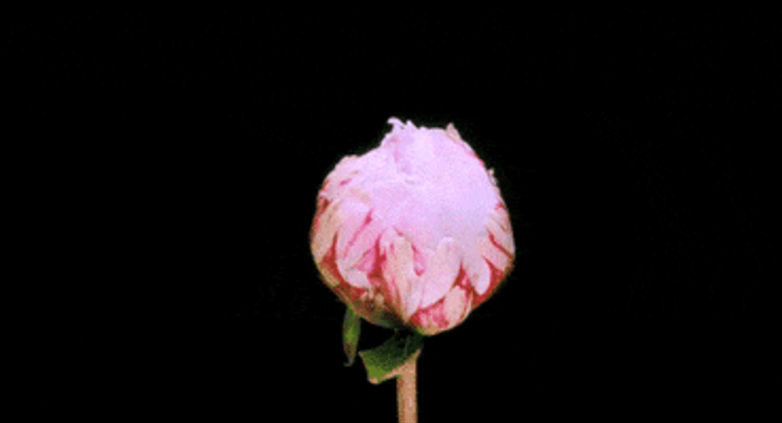
“⁴I want you to swear, O daughters of Jerusalem, do not arouse or awaken my love until she pleases.” (Song 8:4)
Notes:
Now, though 8:3 looks like a repeat of 2:6, there is a key difference – a change of pronouns, which seems to suggest she is saying these things to the Daughters of Jerusalem. So, I’d suggest that 8:1-4 is her parting words to them as she makes her way out of Solomon’s palace and back home.
Song 8:4 – 3rd time she’s warned them of this (2:7; 3:5). (CLICK) The idea is, “The kind of love I have w/the shepherd was a love worth waiting for. Stop pushing this “false love” of Solomon, (CLICK) trying to force me to marry someone I don’t love.
But there are a couple key differences to this verse and when she said it in 2:7 and 3:5. One difference is the prior two times, she said, “by the gazelles or by the hinds of the field”. And I suggested that the interpretation of this is that the gazelles and hinds don’t find a partner through the kind of elaborate ceremony Solomon was putting on. It’s natural – even they become acquainted before they mate. But she doesn’t say that here. Also, there is a different Hebrew word used here than the prior two times that suggests she’s actually phrasing it as a question rather than a statement – “Why do you arouse or awaken love…”.
Point – (CLICK) her love for the shepherd was natural, it has already awakened, she has made up her mind, and she needs nothing further from them.

Slide 5
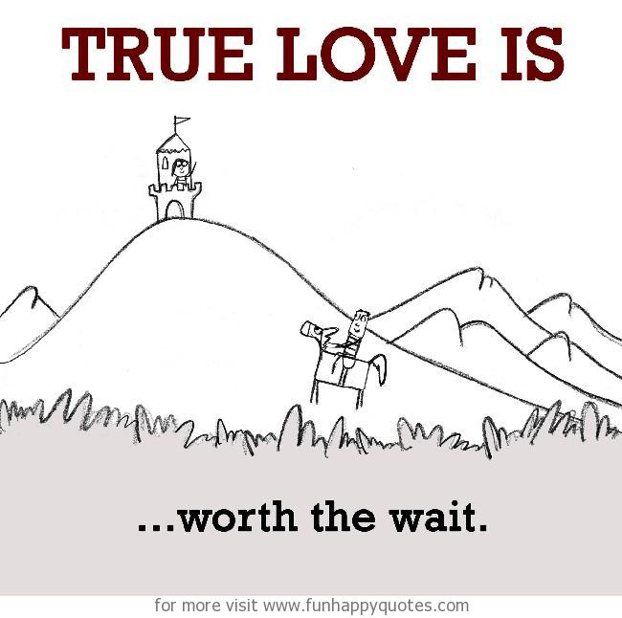
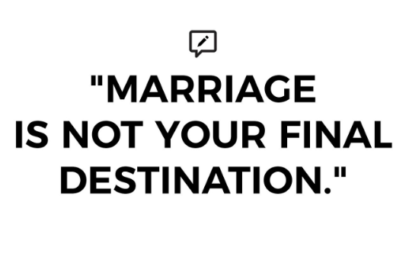
Don’t Be In Love With Being In Love
Notes:
PRACTICAL APPLICATION – Now, we’ve alluded to this several times, but it is worth repeating. Don’t try to force love. Don’t be so in love w/wanting to be in love that you’re not able to go into a romantic relationship w/some objectivity, else you’ll be more prone to overlook the negative. Many Christians have fallen away because they made marriage such an idol they could not live w/o, they ended up settling for someone unworthy of their affections. Such desperation often leads to sex outside of marriage, discouraging men from making wise choices w/their sex drive and long-term commitments, and this has happened at this church.
Strive for “the real deal.” Love is a sacred thing, and it must not be trifled with. It stirs and awakens of itself. And should it not happen for you, that’s ok, (CLICK) because marriage is not your final destination – heaven is. And the joys of heaven will infinitely outweigh the joys experienced in the happiest marriage. What you don’t want to do is idolize romantic love to the point that you make mistakes that will keep you from eternal bliss.
COMMENTS

Slide 6
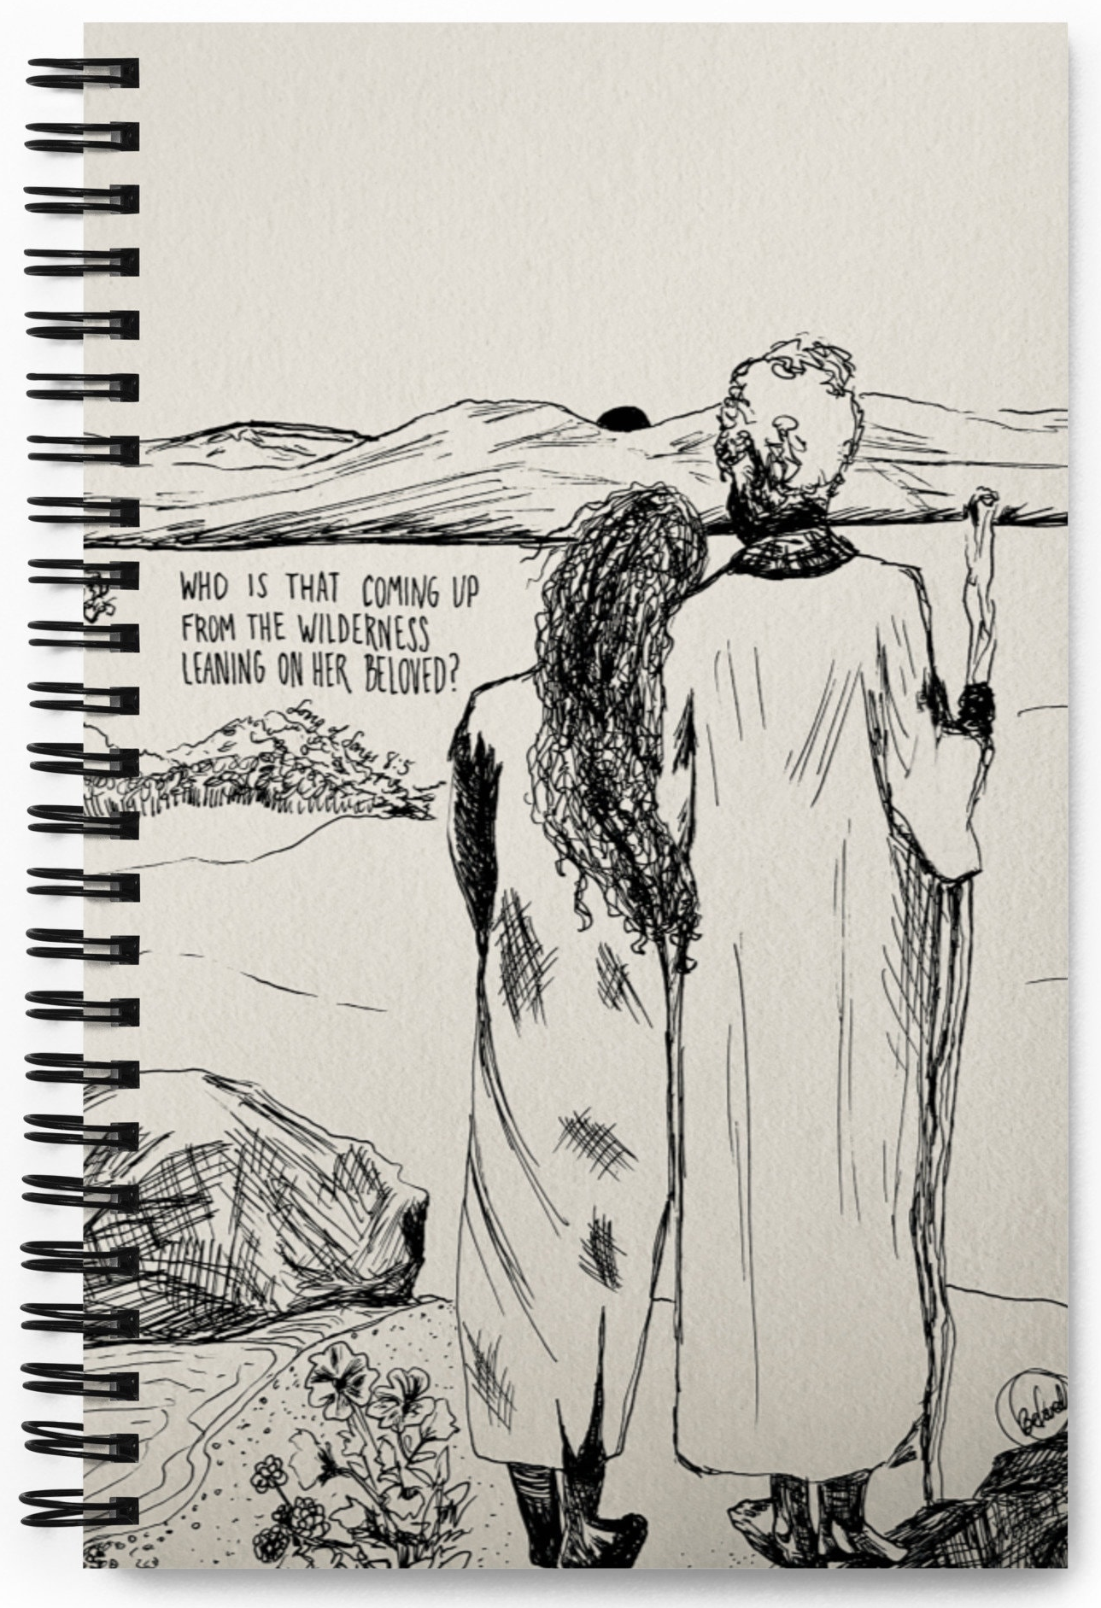
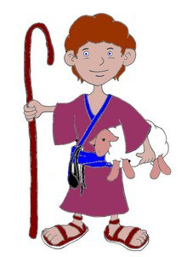
SOS 8:5a – “⁵Who is this coming up from the wilderness leaning on her beloved?”
“Beneath the apple tree I awakened you; there your mother was in labor with you, there she was in labor and gave you birth.” (Song 8:5b)
Notes:
The narrative ends in vs. 4 – Song 8:5a – “Who is this coming up from the wilderness leaning on her beloved?” – Now, we don’t know who is speaking here. Is it a chorus? Villagers? Townsfolk? We’re not sure. But the purpose seems to be to show us the Shulamite and Shepherd together for the first time, and that they’re finally taking their relationship from the private sector to public. This resolves the tension throughout the entire book of whether or not the Shulamite and Shepherd would ever get together or if this would be a tragic love story.
One interesting thing about this is that it echoes Solomon’s entrance to Jerusalem in 3:6 in which the mystery speakers marveled at his pomp and wealth. But here, the mystery speakers marvel at the couple’s love, perhaps shocked that she chose the Shepherd’s love over Solomon’s money and power.
(CLICK) “leaning on her beloved” = “to take the elbow”, probably implying possession. This is not neediness, but design. 1 Cor 11:8-9 teaches that both man and woman are dependent on each other. Though equal in Christ, men and women are not equal in everything. God didn’t design us to compete w/one another, but to compliment one another.
Now, the 2nd half of the verse reveals that the person being spoken to is masculine in gender, so this is likely the Shulamite speaking to the shepherd – (CLICK) Song 8:5b – The chorus that has been repeated throughout the book has been about not arousing or awakening love until it pleases. Now she’s saying, “Here’s how I awakened your love for me. I did it underneath the apple tree in the front yard of your mother’s house.” There was purity and uprightness to their courtship. Their love was stirred up in a pure setting, in a righteous way in which both could be protected. But now she seems to be telling him, “I sought you then, and though I’ve been dumb, I want you again, and this time forever.”

Slide 7
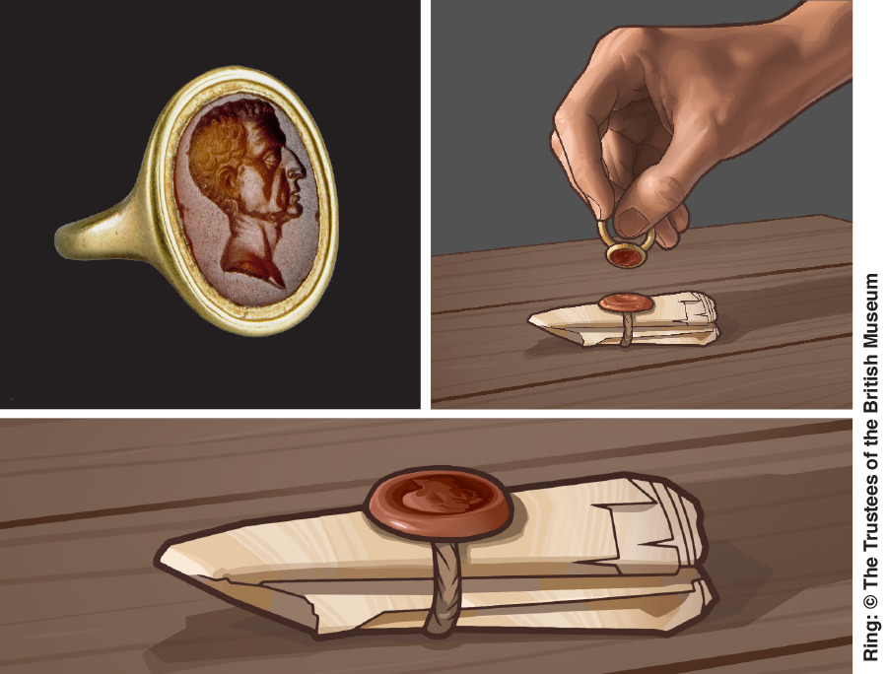
“⁶Put me like a seal over your heart, like a seal on your arm. For love is as strong as death, jealousy is as severe as Sheol; its flashes are flashes of fire, the very flame of the Lord.” (Song 8:6)
Notes:
But she’s put this shepherd through a lot, hasn’t she? And so, she heals his wounded heart w/these soothing words, easily the most famous verse in the Song – Song 8:6a.
(CLICK) The “seal” is a sign of ownership, possession, often stamped into soft clay and then left to dry and attached to letters as certification of identity of the sender (like a signature) while at the same time keeping the contents private. She wants to be a seal on him in two places, on both his heart and his arm. This would represent the permanence of her commitment to him. And the arm would be the outward stamp, one everyone could see, perhaps similar to our modern-day engagement ring, but from what I read could have been a bracelet of some type. As we’ve already seen in this chapter, she no longer wants their love to be hidden – she wants to imprint her claim to him openly, her way of saying, “I belong solely to you, and nothing will part us from this day forth.”
But the thing about the wedding band is that it can be taken off, and your commitment to your loved one is still there. And so, she wants to be a seal on his heart because the heart would be the inward stamp. Because w/o that seal being on the heart, the band means very little.
“For love is as strong as death” – love is a potent force. It can lead to ecstatic joy, as we’ve seen in 2:5; 5:8, or it can make one sick, or it can lead to crushing heartbreak. It’s so strong, it broke both the strongest man in the bible in Samson and the wisest man in the bible in Solomon.
And what about something that threatens it? – Song 8:6b – So strong is love, it makes jealousy equally stronger, cruel in fact. (CLICK) As Prov 27:4 teaches, jealously in human love can trigger rage. That it is as severe as Sheol means it is inflexible, and that it is like the very flame of the Lord means it is intense, and hints at the potential danger of it coming about. Few things are more painful in life then having to watch someone you love choose another or be unfaithful to you. If there is a threat to that relationship, jealousy is a proper emotion because so much hangs on the integrity of that relationship.
They’ve got a little bit of experience w/that now, don’t they? And now, the Shulamite would never be jealous/envious of the palace women and the shepherd no longer has to wonder whether she will choose him. She never wants to allow what happened w/Solomon ever happen again.

Slide 8
“⁷Many waters cannot quench love, nor will rivers overflow it; if a man were to give all the riches of his house for love, it would be utterly despised.” (Song 8:7)
Notes:
Song 8:7a – (CLICK) water can quench fire, but it cannot quench what love sparks. In fact, if a fire is hot enough, it can actually evaporate any water. The spark that love ignites laughs in water’s face – it is just that potent a force.
And how strong is her love for the Shepherd? – Song 8:7b – Even Solomon w/everything he offered her could not drown or quench the love she had for the shepherd. Neither could separation nor a beating by the watchmen in her dream. Love’s indestructibility means it can endure every trial of life, every mistreatment, and it absolutely cannot be bought. Love is not for sale – it has its own economy. . It doesn’t matter how many diamond rings you buy her, how many cars, how big a house, how much money, you cannot buy her love. It’s either there or it’s not. (CLICK) Like the song, “Money can’t buy me love”. To try and buy love would be to bring nothing but shame, and that’s profound because we all know that money is another very powerful force. But when pitted together, money doesn’t hold a candle to it. Sex can be bought, but love must be given

Slide 9
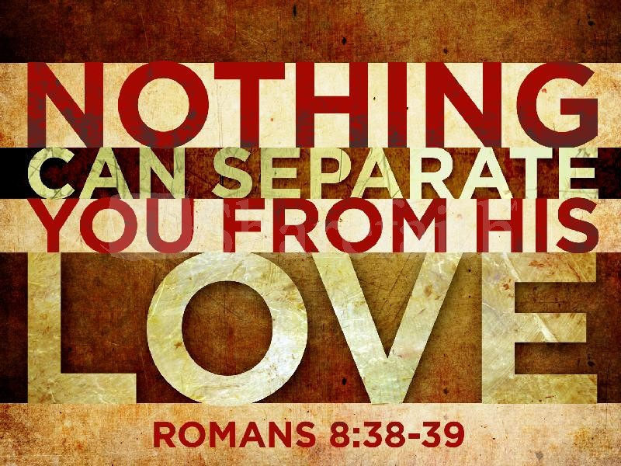
The Power Of God’s Love For Us
Notes:
PRACTICAL APPLICATION – Now, I mentioned in the very first class that though I do not hold to the allegorical interpretation of this Song, that is not to say there are not things to learn from it from of allegorical nature. And I believe Song 8:6-7 is one of the cases, particularly as we consider what the scriptures have to say about God’s love for His people:
(CLICK) For example, God’s love for us is so strong, it sustains our relationship w/Him – Rom 8:38-39 – “For I am convinced that neither death, nor life, nor angels, nor principalities, nor things present, nor things to come, nor powers nor height, nor depth, nor any other created thing, will be able to separate us from the love of God, which is in Christ Jesus our Lord.”
(CLICK) Isa 43:2 – “When you pass through the waters, I will be with you; and through the rivers, they will not overflow you. When you walk through the fire, you will not be scorched, nor will the flame burn you.”
So, for all of us that no the power of love for our spouse, and the means we would go to in order to guard them and protect them, this is how God feels toward us, His children.
And this is a love freely given by Him. But it’s not cheap, is it? It came w/a heavy, heavy price, the cross of Jesus Christ. For Jesus, His love for us was truly as strong as death and the horrendous suffering He endured prior to entering death.
COMMENTS

Slide 10
Who Was The Shulamite?
SOS 8:8-9 – “⁸We have a little sister, and she has no breasts; what shall we do for our sister on the day when she is spoken for? ⁹If she is a wall, we will build on her a battlement of silver; but if she is a door, we will barricade her with planks of cedar.”
Notes:
The poetic narrative runs through 8:7, then once we get to 8:8, we’re seeing concluding remarks. We learned in chapter 1 that the Shulamite had some older brothers, who seem to have played some kind of caretaker role toward her, and 8:8 reveals something that these brothers were debating about her when she was just a little girl
(CLICK) Song 8:8 – So, her brothers are strategizing their future responsibility toward her, and I think what they’re asking in simple terms is, “We have a sister who right now is very young, but she’s not always going to be that way. What will we do when men start to become interested in her?” The idea is that while she is young, she is still innocent and there has yet to be any sort of sexual awakening within her. They want her to remain sexually pure before she is spoken for so she can be a blessing for the one she marries.
And here’s what they decided – (CLICK) Song 8:9a – Now, which offers more of a defense to intruders, a wall or a door? (CLICK) A wall. “If she’s a wall” = if she’s strong and has self-control, able to say “no” to those who might exploit her beauty for their own carnal gain, if in moments of temptation she proves able to make good decisions, we’ll build on those good decisions “battlements of silver”. This probably alludes to reward, more leeway, more privileges, extra freedoms.
(CLICK) Song 8:9b – If she’s not strong, easily moved to and fro like a door, so impressionable and unstable that she acquiesces to anyone who shows enough interest and desire, we’re going to bar the door and restrict her freedoms for her own self-interest and protection. We’re going to safeguard her sanctity until she emotionally matures.

Slide 11
Who Was The Shulamite?
SOS 8:10 – “¹⁰I was a wall, and my breasts were like towers; then I became in his eyes as one who finds peace.”
Notes:
But now the Shulamite says which child she was – (CLICK) Song 8:10a – That her “breasts were like towers” is not to imply anything about her proportions. Rather, it’s consistent w/the same figures from vs. 9 that we see in “walls” and “door”. This young lady she did not allow a man to touch her inappropriately, which we all know is the “gateway drug” to fornication. She’s saying that if a man was going to enjoy the blessing of her body, he was going to have to “climb the tower” for it – they were going to have to prove themselves. She’s not saying she was playing hard to get; (CLICK) she’s saying what 1 Thes 4:3 teaches, that her honor and dignity and virginity would be strongly defended until marriage. And she proved herself to be strong against Solomon’s temptations.
And because of that (CLICK) – Song 8:10b – She’s talking about the Shepherd that she loves. The shepherd respected her all the more for this because what it meant was that when they did tie the knot, he could trust her not to fool around after they got married. There was peace of mind. Chastity brings the man you love peace and trust. (CLICK) Not only will there be an absence of strife, but there will be fulfillment, contentment, satisfaction, and wholeness. If you don’t want a jealous spouse, prove your trustworthiness not just to your parents, but also to who is courting you.

Slide 12
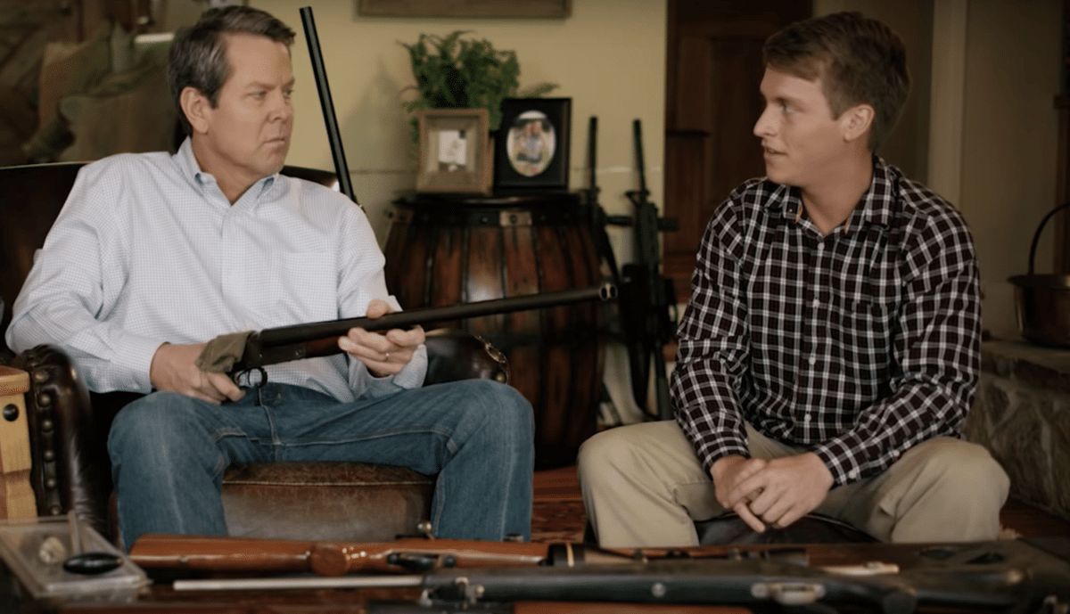
Role Of The Family In Dating Relationships
Notes:
PRACTICAL APPLICATION – There is a lesson here that could take up an entire bible class – the important role that family has in the purity and dating relationships of children. (CLICK) Parents have to stop worrying about making their kids upset over denying privileges until they’ve proved they are trustworthy and worry more about standing before God in judgment and being called “Eli”. Parents must judge how well their kids handle saying “no” to temptation before giving them certain freedoms.
And be kind to your daughter’s bf. (CLICK) No need to torture him for the sake of torturing him. You should lay the law down if/when you need to. But remember this could one day be the father of you grandchildren. Love them.
COMMENTS

Slide 13
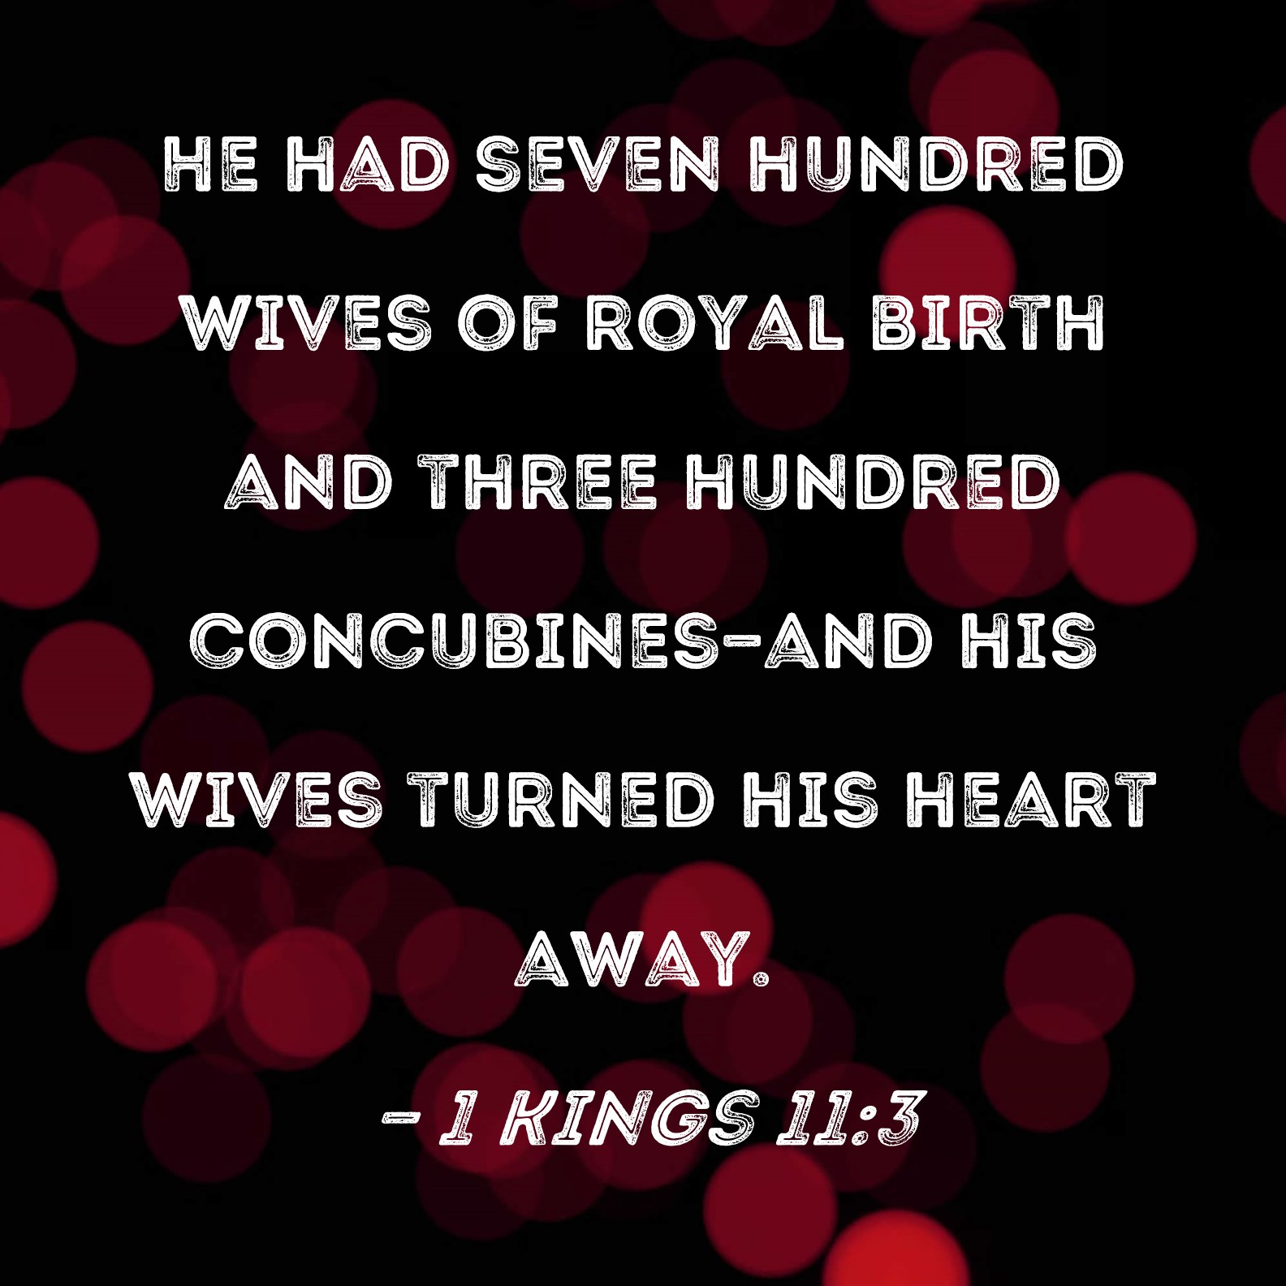
“¹¹Solomon had a vineyard at Baal-hamon; he entrusted the vineyard to caretakers. Each one was to bring a thousand shekels of silver for its fruit. ¹²My very own vineyard is at my disposal; the thousand shekels are for you, Solomon, and two hundred are for those who take care of its fruit.” (Song 8:11-12)
Notes:
Closing remarks – Song 8:11 – The context here seems to be that Solomon had vineyards he paid men to take care of, and probably a lot of them. “Baal-hamon” means “Lord of a crowd/multitude”. Now, what else would Solomon have a thousand of before he died? (CLICK) Wives and concubines. And so, it is possible that this is a prophetic way of saying, “You have enough wives…but me? My vineyard?”
Song 8:12 – In other words, in an expanded response to the end of vs. 7 where she talked about how despising it is to think you can actually buy love, the Shulamite reminds Solomon, perhaps as she is leaving him, that her metaphorical vineyard, her body (1:6; 2:15), was not for sale. In other words, “Take a hike”. Just as Solomon owns a vineyard and rents it out to the highest bidder, she owns her body and can do likewise. Solomon gets the money/produce, but the shepherd who truly loves her gets her love. In other words, back home w/her shepherd, living in a little one room cabin with dirty floors, that’s where she’ll be content. (CLICK) Solomon can have the rest. This is so different from modern, western culture in that she estimated her worth highly and correctly, a reflection of what we saw in 8:8-10, and only a girl of true self-worth and dignity would speak this way.
Being written by Solomon himself, what a dramatic self-rebuke – “Was I really that shallow so long ago?”.

Slide 14
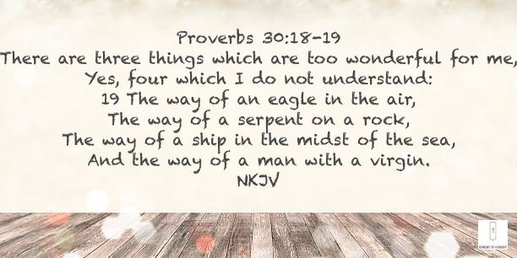
“¹⁴Hurry, my beloved, and be like a gazelle or a young stag on the mountains of spices.” (Song 8:14)
“¹³O you who sit in the gardens, my companions are listening for your voice—let me hear it!” (Song 8:13)
Notes:
Here’s how the Song ends. This is the shepherd to the Shulamite – Song 8:13 – I suspect the idea is this – he’s been waiting. He had left her alone to make her own decisions w/o coercion, manipulation, or any pressure. He didn’t badger her or push her. When she vacillated, he left her alone. And this was good – badgering is what a desperate person does and that is a huge mistake in relationships. Let the other person make the decision for themselves. But now, I believe he’s wondering, “Has she made her decision?” He adds, “My companions are listening for your voice”. Meaning, he wasn’t the only one. Many, including us, were hoping she’d choose him. They want to hear her voice, and more than that, he does – “Let me hear it. Let it be me that you choose.”
The Shulamite’s response? – Song 8:14 – “Yes, I choose you.” Remember back in 2:17, she had told him – “Until the cool of the day when the shadows flee away, turn, my beloved, and be like a gazelle or a young stag on the mountains of Behar”, and we made the point that what she was saying is, “Now is not the right time, and until it is, just keep being who you are.” But now, it’s as if she’s saying, “I’m ready now. I choose you, and now come to me, and be quick about it.”
What a great ending! But why did it take all this drama to get here?!?!? (CLICK) – Prov 30:18-19.
Point: In vs. 13, the man expresses a desire to be with her, and in vs. 14 she expresses the same desire to be w/him. Before, one seemed to want the other, but wasn’t completely reciprocated. Now it is for the first time. How odd! Or is it? This only happens one time in our life, and it is w/the one we end up marrying. So, it is a rare thing indeed.

Slide 15
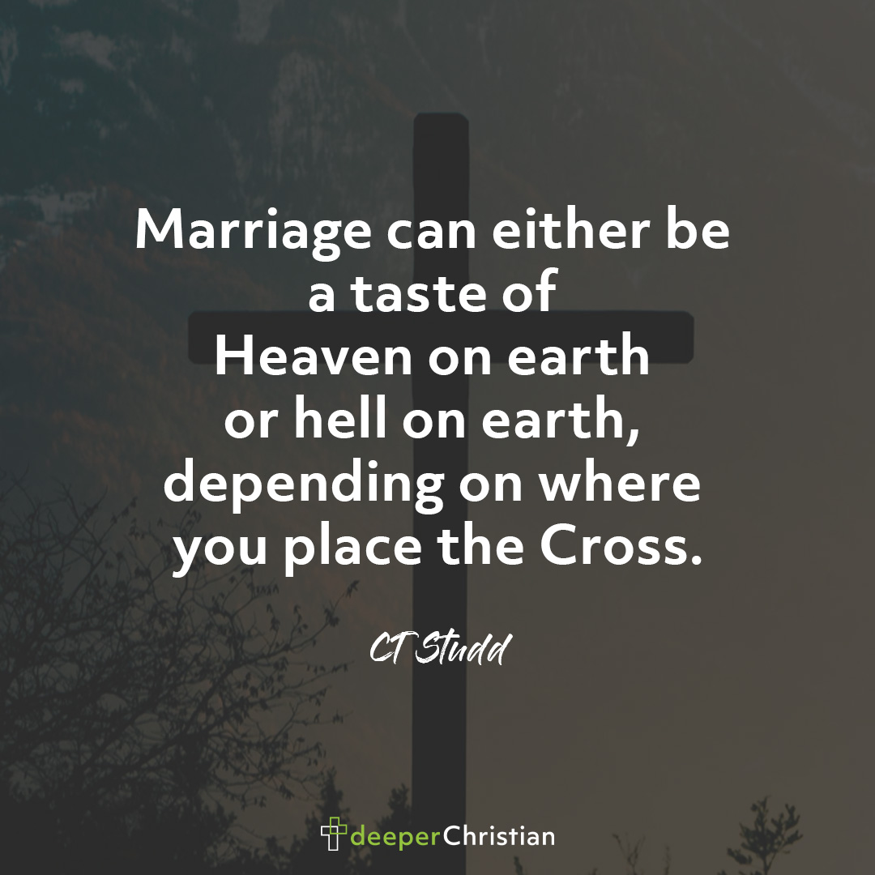
Return To The Garden
Notes:
PRACTICAL APPLICATION – Once again, just because I don’t take the allegorical position doesn’t mean there are not allegorical points to be made. There is one key theme that seems to stick out in the greater context of the OT if you really pay attention, and that is the constant use of garden imagery. I believe this is a powerful echo of that ideal scene in Gen 2 (CLICK) in which the man and woman were together in the Garden of Eden, in bliss, and Gen 2:25 – “And the man and his wife were both naked and were not ashamed.” They’re naked and vulnerable, but unified w/one another, they’re safe w/one another, and I believe this is something that is going on in the Song of Solomon that resonates in the backward.
By the end of the book, we are now getting a glimpse of a relationship untainted by selfishness and sin, and this where the Song provides us spiritual hope. Even though our own relationships are often marred by selfishness, love is a gift that is designed to point us to something greater – God’s love, which would one day bring us all back to paradise conditions. (CLICK) Marriage is designed to be a taste of that, as we learn from passages like Eph 5, and I believe the Song of Solomon is wanting to reflect this idea.
COMMENTS

