Slide 2
CURRICULUM
Sep 06: Introduction
Sep 13: Its Nature
Sep 20: Its Standard of Authority
Sep 27: False Standards (1)
Oct 04: False Standards (2)
Oct 11: Applying the Standard (1)
Oct 18: Applying the Standard (2)
Oct 25: Local Organization (1)
Nov 01: Local Organization (2)
Nov 08: Local Organization (3)
Nov 15: Nature of Worship
Nov 22: ***No Class***
Nov 29: Elements of Worship
Dec 06: Its Work of Edification
Dec 13: Its Work of Evangelism
Dec 20: Its Work of Benevolence
Dec 27: ***No Class***
Jan 03: ***No Class***
Notes:
(Deut 32) A study on local church organization is a foundational study. Organization reveals purpose, and since God designed local churches to be organized around certain roles, He has a purpose for what a local church is to do. It is by understanding how a local church is to be organized, we begin to learn the boundaries by which the Lord’s work can be accomplished.

Slide 3
Notes:
This study is to show what happens when we decide to go outside those divine boundaries. Deut 32:7a – “Remember the days of old, consider the years of all generations”. We’re going to just that. We/re going to take a trip ~1800 years back in history to a time in the early church in which a crisis occurred, and we’re going to look at how the Christians of that time decided to deal w/that crisis. Because what began as a desire by Christians to protect the churches ended up doing the opposite, and it became the beginning stage for one of the greatest apostasies that the church has ever seen. And our goal in walking through this event is that hopefully by considering the church’s own history, that will be a guide for us today.
PRAYER

Slide 4
Local Organization Apostasy
Holy Spirit Predicted
Acts 20:28-31a – “²⁸Be on guard for yourselves and for all the flock, among which the Holy Spirit has made you overseers, to shepherd the church of God which He purchased with His own blood. ²⁹I know that after my departure savage wolves will come in among you, not sparing the flock; ³⁰and from among your own selves men will arise, speaking perverse things, to draw away the disciples after them. ³¹Therefore be on the alert…”
Notes:
The Apostles prophesied that apostasy would inevitably come. In Acts 20, Paul alludes to it in his farewell address to the Ephesian elders – Acts 20:28-31a – Notice how this particular threat of apostasy would not come from the world, rather from “among you…among your own selves”. Not just from men who were simply untaught or well-meaning in their intentions. Paul describes them as savage wolves not sparing the flock, speaking perverse things. And he tells them to keep alert against such men.

Slide 5
Local Organization Apostasy
Holy Spirit Predicted
1 Tim 4:1-3 – “¹But the Spirit explicitly says that in later times some will fall away from the faith, paying attention to deceitful spirits and doctrines of demons, ²by means of the hypocrisy of liars seared in their own conscience as with a branding iron, ³men who forbid marriage and advocate abstaining from foods which God has created to be gratefully shared in by those who believe and know the truth.”
Notes:
1 Tim 4:1-3 – Now, hypothetically, if these “doctrines of demons” were to circulate here, do you know how we’d avoid getting sucked in? By having a deep understanding of the truth and being alert against those who’d use Christianity as a cover for selfish goals and who’d seek to exploit unknowing or unstable brethren by taking advantage of their naivety or bitterness.

Slide 6
Local Organization Apostasy
Holy Spirit Predicted
2 Tim 4:2-4 – “²Preach the word; be ready in season and out of season; reprove, rebuke, exhort, with great patience and instruction. ³For the time will come when they will not endure sound doctrine; but wanting to have their ears tickled, they will accumulate for themselves teachers in accordance to their own desires, ⁴and will turn away their ears from the truth and will turn aside to myths.”
Notes:
2 Tim 4:2-4 – These aren’t people who necessarily want to introduce destructive heresies, they’re just believers who no longer want to hear sound, stable doctrine. It’s not that they necessarily want soft teaching; they simply want teaching that is agreeable to them. Even hard teaching is fine as long as it doesn’t step on their toes. What they don’t want is teaching that challenges self-reflection and encourages repentance. They wanted teaching that made them feel good about where they were at, regardless of reality.

Slide 7
Local Organization Apostasy
Holy Spirit Predicted
NT Apostasies
Judaizing Teachers (Acts 15; Gal; Col 2)
Corinthian Church
Sectarianism (1 Cor 1-2)
Corruption w/the LS (1 Cor 11)
Denying resurrection (1 Cor 15)
False letters circulating (2 Thes 2:1-2)
Selfish ambition (3 John 9-10)
5 of 7 Asian Churches departing
Ephesus: left her first love (Rev 2:4)
Pergamum: doctrine of Balaam & Nicolaitans (Rev 2:14-15)
Thyatira: Tolerated “Jezebel” (Rev 2:20)
Sardis: Spiritually Dead (Rev 3:1)
Laodicea: Spiritually Lukewarm (Rev 3:15-16)
Notes:
Now, as the Apostles were warning the 1st century churches about this, various apostasies were already at work.
One of the earliest apostasies came from the Judaizing teachers. These were Jewish Christians who couldn’t break away from their Jewish culture, and so when a Gentile would obey the gospel, they’d attempt to “Judaize” them by trying to convince them they had to be circumcised in order to really be saved. And Paul spent much of his ministry contending w/them.
The Corinthian church had a variety of problems.
In 2 Thes 2, Paul alluded to false letters supposedly written by him, and to counter this, he basically started signing his letters, as we see at the very end of that epistle.
In 3 John, we are introduced to a man named Diotrephes who was selfishly ambitious and had problems w/authority.
And then in Rev 2 and 3, we know that 5 of the 7 churches in Asia Minor were departing from the faith and were in desperate need of repentance.

Slide 8
Local Organization Apostasy
Holy Spirit Predicted
NT Apostasies
Post-Apostolic Apostasy
Gnosticism
Greek “gnosis” = “knowledge”
Bragged of secret knowledge
Pandered to spiritual pride
Hellenistically influenced
Leaders: Marcion, Basilides, Valentinus
Dualism (OT God evil, NT God good)
Body, physical world are evil
Rejected Christ’s Humanity
Rejected Christ’s physical death
Rejected Christ’s resurrection
Notes:
And this apostasy didn’t end in the 1st century as Gnosticism eventually took off. The Gnostics were in some ways the Greek counterparts to the Judaizers, only they were influenced by Hellenistic philosophies of that day. Its seeds had already been planted in the 1st century, but it really took off in the 2nd century. The term “Gnostic” comes from the Greek word “knowledge”. They considered the God of the OT to be an inferior, ignorant god who made an evil creation, and so they believed that all physical matter, including the body, was evil, though they disagreed among themselves whether the body’s desires should be met. But this led to them rejecting some of the most fundamental Christian doctrines. See, the Gnostics believed in Christ, but because they believed all matter was evil, they could not accept that Jesus came to earth in the flesh, insisting He was merely an apparition. And since they denied His humanity, they also denied His physical death, claiming that Simon died on the cross instead. And since they did not believe that Christ died, they did not believe in His resurrection from the dead. And several of these guys even wrote false gospels in attempt to legitimize their theories, though they were universally rejected from the canon.
When this false teaching started taking off in the 2nd century, the Apostles were no longer around, and churches were really struggling on how best to defeat this.

Slide 9
Local Organization Apostasy
Holy Spirit Predicted
NT Apostasies
Post-Apostolic Apostasy
Montanism
Emerged ~155AD claiming divine inspiration from Holy Spirit
Leaders: Montanus, Prisca, & Maximilla
Believed 2nd coming of Christ at hand
Strict asceticism, forbade marriage, required acts of penance
Believe its leaders forgave sins
Notes:
Another 2nd century apostasy that caused a lot of problems in the early church was called Montanism, begun by a man named Montanus. After his conversion to Christianity, Montanus came to Phrygia and claimed to be the voice of the HS. He was joined by 2 women named Prisca and Maximilla who left their husbands and also claimed to prophesy. They taught that the 2nd coming of Christ was imminent and based on this, they insisted on strict morality of its followers, forbidding marriage and practicing asceticism. They also claimed that only its leaders could forgive sins. This began from just one man in Phyrgia, but like a disease it spread all over the West and had a strong presence in North Africa.

Slide 10
Local Organization Apostasy
Holy Spirit Predicted
NT Apostasies
Post-Apostolic Apostasy
Biblical Response
2 Thes 2:15 – “So then, brethren, stand firm and hold to the traditions which you were taught, whether by word of mouth or by letter from us.”
1 Cor 11:2 – “Now I praise you because you remember me in everything and hold firmly to the traditions, just as I delivered them to you.”
Jude 3 – “Beloved, while I was making every effort to write you about our common salvation, I felt the necessity to write to you appealing that you contend earnestly for the faith which was once for all handed down to the saints.”
Notes:
So, imagine not having the Apostles around anymore and having to deal w/the fact that Christians you love are falling way from the faith because of these teachings. How were the early churches supposed to deal w/this? Well, in Matt 4, when Jesus was confronted by Satan’s temptations, how did He respond? “It is written”, and then He quoted scripture. Jesus’ solution is to be our solution, meaning, the word of God is to have the final say so in matters of doctrine and practice.
This is exactly what the Apostles taught (CLICK) – 2 Thes 2:15 – “Stand firm and hold” means, “Don’t move”. Don’t venture from what the Apostles taught by the HS in any direction. Stand firm in what they’ve laid down for us. (CLICK) 1 Cor 11:2 – The words of the Apostles were to be the deciding matter in all things pertaining to religious practice. Hold firmly to them. (CLICK) Jude 3 – So don’t just stand firm and hold firmly, but contend for it as well. Every aspect of the word of God is to be fought for against all who’d deviate from the pattern of its teachings. It is to be the standard by which we judge every single religious practice.

Slide 11
Local Organization Apostasy
Holy Spirit Predicted
NT Apostasies
Post-Apostolic Apostasy
Biblical Response
Heretics Response
“And if those also who follow heresies venture to avail themselves of the prophetic Scriptures; in the first place they will not make use of all the Scriptures, and then they will not quote them entire, nor as the body and texture of prophecy prescribe. But, selecting ambiguous expressions, they wrest them to their own opinions, gathering a few expressions here and there; not looking to the sense, but making use of the mere words” (Clement of Alexandria, book 7, ch 16)
Notes:
However, when you study the uninspired writings of certain Christians in the 2nd and 3rd centuries, what you learn about the false teachers of that time is that they quoted scripture too. Clement of Alexandria, a devout believer who lived at the end of the 2nd century and into the 3rd, said the following in one of his uninspired writings:
(CLICK) “And if those also who follow heresies venture to avail themselves of the prophetic Scriptures; in the first place they will not make use of all the Scriptures, and then they will not quote them entire, nor as the body and texture of prophecy prescribe. But, selecting ambiguous expressions, they wrest them to their own opinions, gathering a few expressions here and there; not looking to the sense, but making use of the mere words”.
And another writer who lived about the same time named Tertullian, mentioned in his writings that you could argue with w/these heretics all day long but all you’d get is an upset stomach because they’d twist scripture to defend their position.
So, what should we do? What do you do when you face a crisis that is threatening the church? Well, we’ve already examined what we are supposed to do, but let me tell you what the early Christians actually did. Rather than holding to the apostles teaching, they let go. Rather than standing firm, they got tired and sat down. Rather than contending for the faith, they came up w/a compromise that according to their judgment was a better method for dealing w/the crisis at hand than what Jesus and the Apostles taught. And this simply began as what many would have considered just a tiny little tweak in God’s pattern for the organization of the local church. And it was done under seemingly good intentions. What was this tweak?

Slide 12
Local Organization Apostasy
Holy Spirit Predicted
NT Apostasies
Post-Apostolic Apostasy
Biblical Response
Heretics Response
Local Organization
Notes:
Well, recall from last week’s study that local churches are to be overseen by men who are deemed to meet certain qualifications, and there are 3 different Greek words used to describe this office: “presbuteros” which is translated as “elder”, “episkopos” which is translated as “overseer”, and “poimen” which is translated “shepherd”. As we saw last week, all 3 terms describe the same office of the eldership.

Slide 13
Local Organization Apostasy
Holy Spirit Predicted
NT Apostasies
Post-Apostolic Apostasy
Biblical Response
Heretics Response
Local Organization
Each local church is to have a plurality
Elders in a local church are equal in authority
Elders only have authority in their local church
Implication: church autonomy
Notes:
Also keep in mind what we learned about the eldership from last week’s study:
(CLICK) Each local church is to have a plurality of elders, because in each and every case where elders are referred to in a church, there was always more than one.
(CLICK) Each elder is equal in authority. Even though there may be a difference in talent and ability amongst elders, no elder has the right to usurp the authority of another elder in the same position.
(CLICK) Elders are limited in authority to the local church they oversee. They are to simply shepherd the flock of God among them.
(CLICK) And because they are limited in authority to their local church, this means every local church is independent, what we’ve come to call “church autonomy”. And so, while every church must be guided by the word of God, no local church can dictate what another local church can do.
This is the pattern for local church oversight that we looked at last week.
But in the midst of the present distress of 1800 years ago, Christians began tweaking this pattern. As early as the 2nd century, distinctions began to be made in those 3 terms we looked at for the eldership, which began establishing a precedent that caused local churches to move away from having a plurality of elders in favor of a pyramid, ecclesiastical organization. It cannot be stressed enough that this whole thing began as a result of what they believed to be a necessity for their present distress, little changes they deemed necessary due to the challenges of their time. And it began slowly, subtle, seemingly minor changes over the course of just a few hundred years, and what they didn’t realize until it was too late, was that their proposed solution for protecting the brethren actually led to the very thing they were trying to prevent. In fact, the steps they took to “protect” the churches led them down a slippery slope toward the culmination of the first ever denomination that dominated the religious world for almost 1500 years. And I want to show you briefly how this happened.

Slide 14
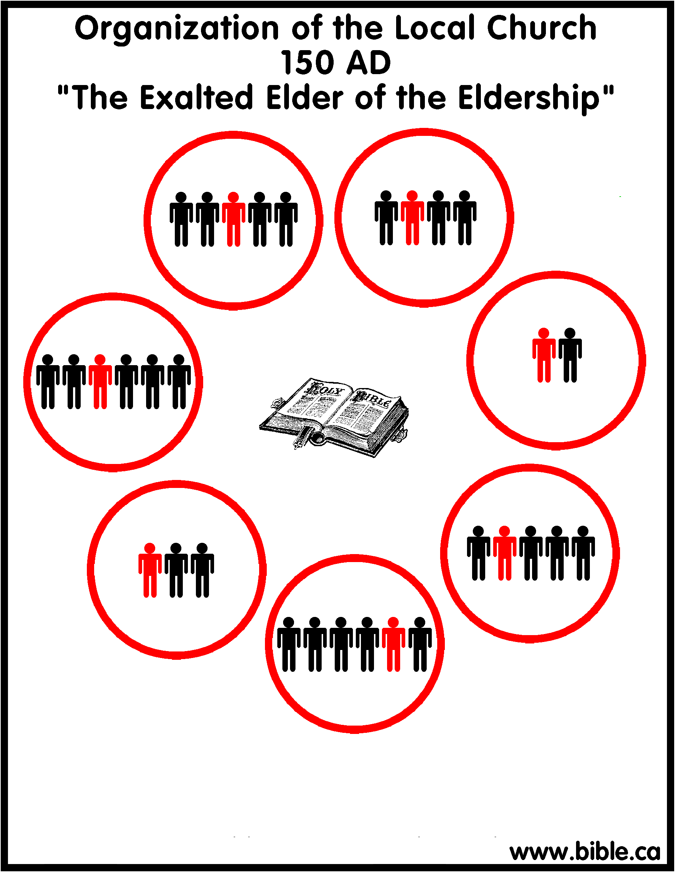
Local Organization Apostasy
Holy Spirit Predicted
NT Apostasies
Post-Apostolic Apostasy
Biblical Response
Heretics Response
Local Organization
Local Church Apostasy
Notes:
In the 2nd century, ~150AD, Christians decided to make a small change in its local organizational structure. Some of the early Christian writings reveal distinctions being made between the elders in a local church and one particular elder. Now, again, it’s not uncommon for an elder to surpass other elders in talent and ability, and given that there were men like Diotrephes in the early church, personal ambition could have contributed to this. But as time went on, we know that one elder within the eldership began to be exclusively referred to as the “president” or the “presiding bishop”, and then exclusively as the “bishop”, while the others were merely the “elders”. Now as we’ve already seen, that is not scriptural, because they’re supposed to be the same office, each sharing equal authority. But the rationale behind this tweak was that you could stop the spread of apostasy more easily when the final say on doctrinal matters is given to just one elder. This one change in local church organization seems so small when compared to other things, but it set a precedent for other unscriptural steps.

Slide 15
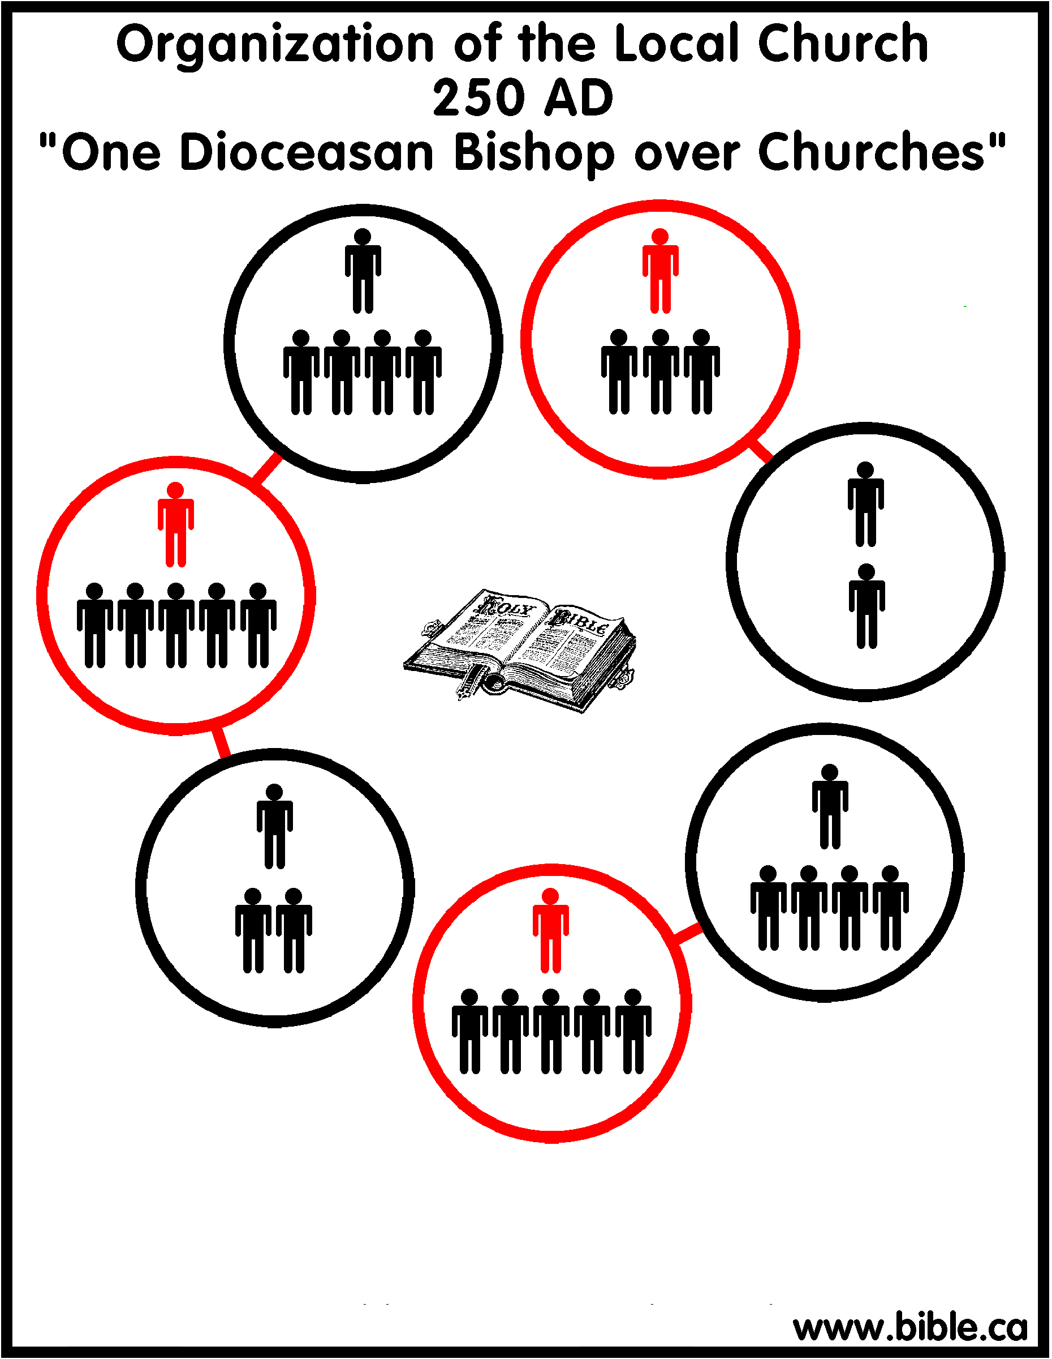
Local Organization Apostasy
Holy Spirit Predicted
NT Apostasies
Post-Apostolic Apostasy
Biblical Response
Heretics Response
Local Organization
Local Church Apostasy
Notes:
Because in the 3rd century, that local bishop’s authority began to expand beyond the local church w/which they were identified. You’ll recall from Acts that when the Apostle Paul established churches, he often began in the highly populated cities, particularly port cities where there was a lot of traffic. A church would be planted than brethren would branch out and start churches in smaller surrounding area. But instead of recognizing these new churches as independent, autonomous groups, the bishop of the city church started exerting authority over them. Because, after all, if a singular bishop within an eldership can curb false teaching, why not a singular bishop over several churches? Because if we’re just going to use human wisdom rather than scripture, why not? This bishop of the city church became known as the “diocesan bishop”, and he ruled over all the bishops of the smaller churches in his region who in turn ruled over the elders of the same church. And so, a pyramid hierarchy started forming.

Slide 16
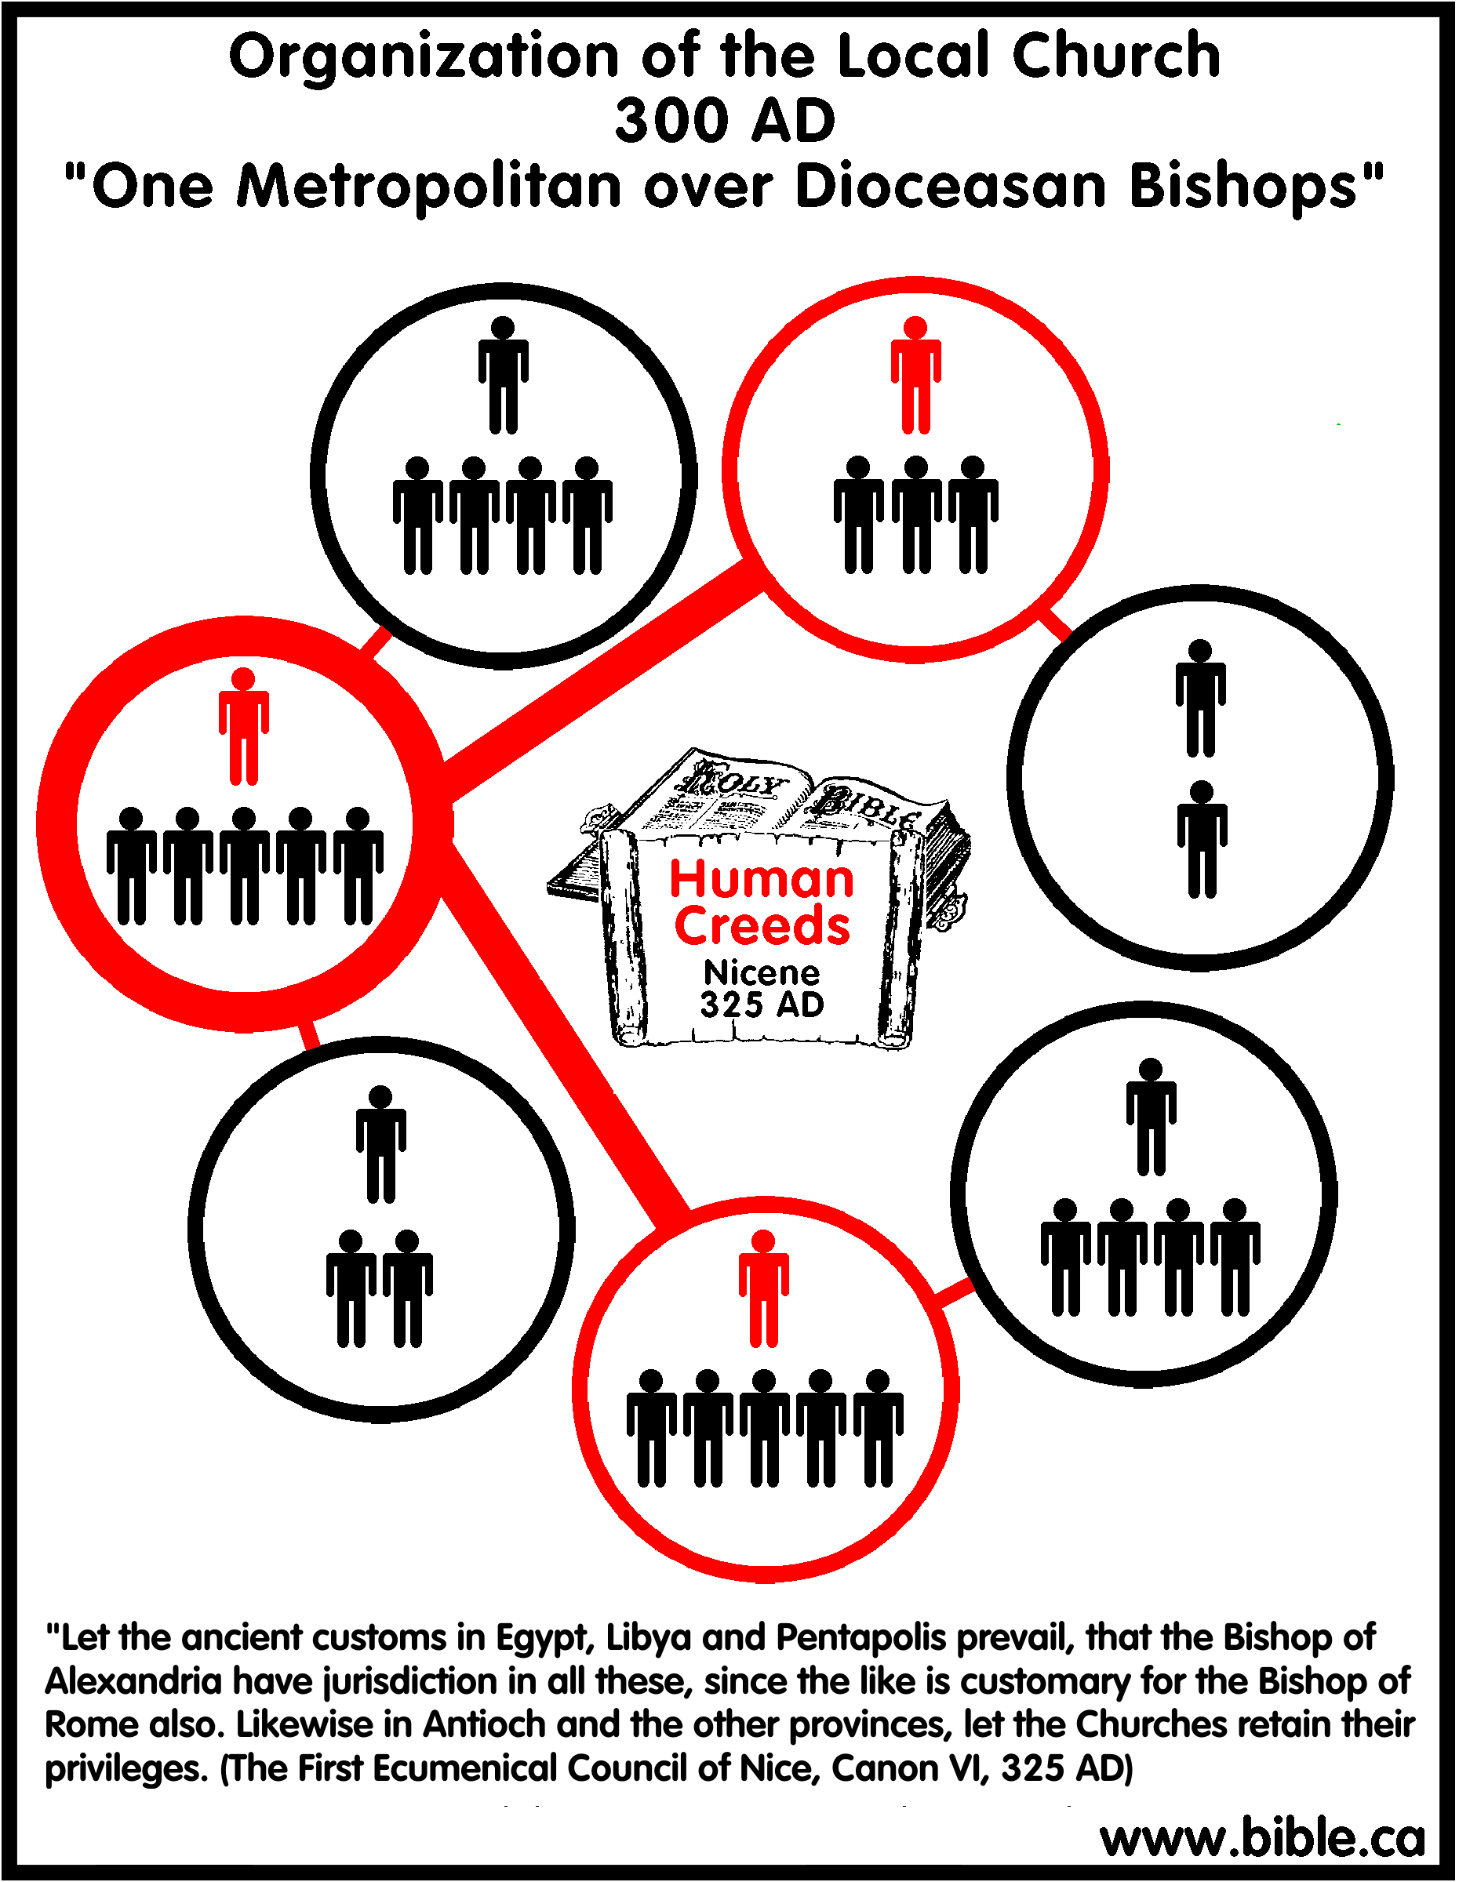
Local Organization Apostasy
Holy Spirit Predicted
NT Apostasies
Post-Apostolic Apostasy
Biblical Response
Heretics Response
Local Organization
Local Church Apostasy
Notes:
Then by the 4th century, certain diocesan bishops decided that more authority was needed. And so, the diocesan bishops of the city churches that were founded by the apostles claimed that their teaching was more authentic and their authority reciprocal to the apostles. So, these “diocesan bishops” became known as “metropolitan bishops”. Several diocesan bishops would be under the authority of the metropolitan bishop from this church. The pyramid was getting larger. Church autonomy was now a thing of the past.

Slide 17
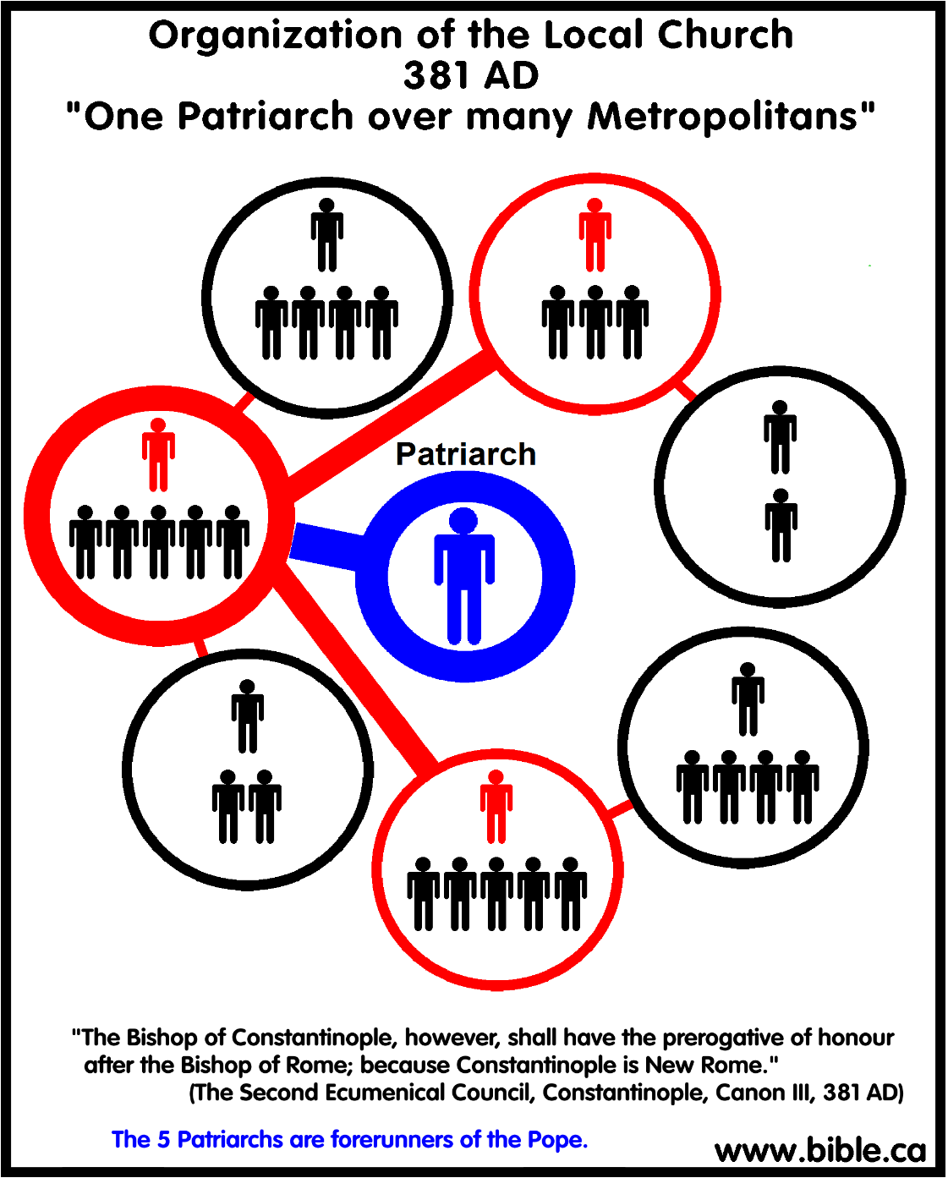
Local Organization Apostasy
Holy Spirit Predicted
NT Apostasies
Post-Apostolic Apostasy
Biblical Response
Heretics Response
Local Organization
Local Church Apostasy
Notes:
Then by the last half of the 4th century, consolidation of power rose to a new level. It was deemed that the metropolitan bishops of the 5 great cities of the Roman Empire should have preeminence. These 5 cities were Rome, Constantinople, Jerusalem, Antioch, and Alexandria. These cities were seen as prominent mainly for their association w/the apostles who established them, and so the bishops over them became known as “patriarchs”. And though these patriarchal bishops were to be equal in power, they were to oversee metropolitan bishops in their respective regions, who oversaw the diocesan bishops, who oversaw the bishops, who oversaw the elders.

Slide 18
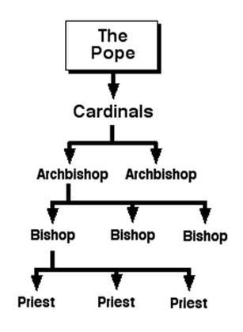
Local Organization Apostasy
Holy Spirit Predicted
NT Apostasies
Post-Apostolic Apostasy
Biblical Response
Heretics Response
Local Organization
Local Church Apostasy
Notes:
But over time, a patriarchal bishop arose who wanted even more. At the end of the 6th century, the patriarch of Constantinople, a man named John the Faster, decided to declare himself Universal Bishop over all churches. This self-promotion was not well received by the patriarch of Rome, Gregory the Great, who ironically declared it apostasy (really patriarch?), and he urged John the Faster to renounce the title. But when Gregory the Great died, the new patriarch of Rome who took his place, Boniface III, declared himself Universal Bishop. And this feud between the patriarchs of Rome and Constantinople would continue for hundreds of years until Constantinople separated from Rome and become the Eastern Orthodox church.
What began as a tiny, seemingly simple, unscriptural distinction between elders and bishops, just a little bit of leaven that got in the lump of dough, created precedence for other small changes in local church organization, which then created momentum for one of the greatest departures from NT Christianity since its inception (CLICK) – the Roman Catholic church. And by the time of the first declaration of Universal Bishop, known today as the Pope, the identity of the NT church became so skewed, it was barely recognizable. The same pyramid hierarchy remains. They use different names, but it is the same.

Slide 19
Local Organization Apostasy
False Standards
Prov 25:28 – “Like a city that is broken into and without walls is a man who has no control over his spirit.”
Old Testament
Majority Rule
Family
Elders
Preachers
Creed/Tradition
Government
Conscience
Human Wisdom
Feelings
Fear
Comfort
Desire
Dream/Vision
Notes:
So, (DISCUSSION) let’s look back at the chart we studied from class #4 on false standards of authority. Which of these false standards do you think were involved in solving this particular crisis?
Fear – In this particular case, they got so wound up over the false teachings that were killing churches, they forgot to stand on biblical principles and instead overreacted (CLICK) – Prov 25:28. This is a human struggle. We are emotional beings. It’s why when the weatherman forecasts snow in the south, the bread and milk disappear from the grocery stores. It’s a human struggle, but these kind of kneejerk reactions have absolutely become the impetus for so many apostasies throughout the ages.
Example: when the emperor Constantine signed the Edict of Milan in 313AD, ending Christian persecution, Christians were ecstatic. Oppression had worn them down, they were tired of fighting for the faith and they just wanted peace, and Constantine commanded peace in his empire. But because Constantine was a nominal Christian himself, pagans flooded the church w/o actually converting, and they brought their pagan superstitions w/them. And the faithful, in a classic case of overreaction to the new peace of their times, gave into these superstitions over fear of what Constantine would do if they contended against him. And that leavening effect completely changed the doctrinal structure of the church within just a couple hundred years. Doctrines finding their foundation in pagan idolatry became centerpieces of the church, and many of those false doctrines still exist in Catholicism today.
Example: another example is when the church stopped standing firm and holding fast to biblical teaching, it became worldly, and then another overreaction occurred. Certain godly men began to withdraw themselves from society and live in isolation in order to more ably devote themselves to holiness. This became known as monasticism, and it’s where our word “monk” comes from. It was a kneejerk reaction of panic over the church’s worldliness. They didn’t want to live in or among the world, but this unfortunately robbed churches of those who could’ve been its strongest defenders.
Example: and then the Protestant Reformation, though well-intentioned, was an overreaction by certain believers who became so put out w/the works-oriented teaching of Catholicism, that to avoid that extreme, they swung the pendulum to the other extreme, bemoaning any and all works of faith, leading to the false doctrine of faith-only that we still wrestle w/today.

Slide 20
Local Organization Apostasy
False Standards
False Standards
Prov 25:28 – “Like a city that is broken into and without walls is a man who has no control over his spirit.”
Isa 55:9 – “as the heavens are higher than the earth, so are My ways higher than your ways and My thoughts than your thoughts.”
Dan 3:16-18 – “¹⁶Shadrach, Meshach and Abed- nego replied to the king, ‘O Nebuchadnezzar, we do not need to give you an answer concerning this matter. ¹⁷If it be so, our God whom we serve is able to deliver us from the furnace of blazing fire; and He will deliver us out of your hand, O king. ¹⁸But even if He does not, let it be known to you, O king, that we are not going to serve your gods or worship the golden image that you have set up.’”
Old Testament
Majority Rule
Family
Elders
Preachers
Creed/Tradition
Government
Conscience
Human Wisdom
Feelings
Fear
Comfort
Desire
Dream/Vision
Old Testament
Majority Rule
Family
Elders
Preachers
Creed/Tradition
Government
Conscience
Human Wisdom
Feelings
Fear
Comfort
Desire
Dream/Vision
Notes:
2) Human wisdom? – someone had to come up w/this idea – it didn’t come from scripture. And we can put a lot of stock in our own ideas and even try (CLICK) – Isa 55:9 – Question, given God’s infinitely amazing foresight, when God gave us His word, is it reasonable to conclude He expected us to obey his word even when it’s hard, or when it doesn’t make sense? Yes.
3) Elders? – We don’t know, though if there is one thing history teaches us is that positions of leadership will test a man, and the desire for power is a tempting thing. One thing is for sure, though. When a crisis occurs, leaders need to be the ones standing firm. They don’t need to be listening to the ideas of those who are driven by fear, they need to be listening to God’s word and letting it be the final arbiter in decisions.
4) Preachers? – Surely someone was preaching against this, trying to stand firm. Were they let go by the church for not going along w/the leadership or did they compromise in order to keep their paycheck? We don’t have those answers, but we’ve seen this occur before. (CLICK) And someone 1800 years ago needed to stand up like Shadrach, Meshach, and Abed-nego and say, “God will save me from this. But no matter what you do to me, I’m not bowing down to this idol of fear.”
5) Majority? – Maybe other churches started to do it, and what some back country church reasoned was, “Well, they’re all doing it. Brother “Big-Name Preacher preaches at that church and he really know his bible. So surely they are right.” BTW, “brotherhood authority” is also a false standard of authority, and its one we can fall prey to if we’re not careful.
COMMENTS

Slide 21
Notes:
It took over a 1000 years for most believers to start seeing the error of what occurred in the early church. The reformation movement was well-intentioned, but it met huge opposition and didn’t go as far as it needed to do in restoring biblical Christianity. That is why when churches/Christians make mistakes, the worst thing you can do is cover it up. It needs to be corrected and corrected quickly so that wrong actions do not become precedence for further wrong actions, the leavening affect Paul talks about – Prov 28:13.
And here’s what we need to remember. Christians make mistakes. Churches make mistakes. But how we correct the mistake will define us. And we serve a God who allows us to make mistakes and pours out on us grace, grace, and more grace. But as James tells us, “God opposes the proud and gives grace to the humble”. What the early churches needed to do was humble themselves, acknowledge error, repent of it, fix the problem in a transparent way, so they could move on to bigger and better things. And this takes courage and good and honest hearts.
As the Lord’s church here in Auburn, AL, we, like those early churches have been entrusted w/a sacred commission by the Lord Jesus Christ, and His word must be exalted above all else.

Slide 22
CURRICULUM
Sep 06: Introduction
Sep 13: Its Nature
Sep 20: Its Standard of Authority
Sep 27: False Standards (1)
Oct 04: False Standards (2)
Oct 11: Applying the Standard (1)
Oct 18: Applying the Standard (2)
Oct 25: Local Organization (1)
Nov 01: Local Organization (2)
Nov 08: Local Organization (3)
Nov 15: Nature of Worship
Nov 22: ***No Class***
Nov 29: Elements of Worship
Dec 06: Its Work of Edification
Dec 13: Its Work of Evangelism
Dec 20: Its Work of Benevolence
Dec 27: ***No Class***
Jan 03: ***No Class***

