Slide 1
Psalms
Book 1 – Psalms 1 - 41

Slide 2
Arrangement of the Psalms
The Psalms were originally collected into 5 “books” according to the material found in them
Book I (Psalm 1 & 2, 3 – 41) – 20-41 today
Book II (Psalm 42 – 72)
Book III (Psalm 73 – 89)
Book IV (Psalm 90 – 106)
Book V (Psalm 107 – 150)

Slide 3
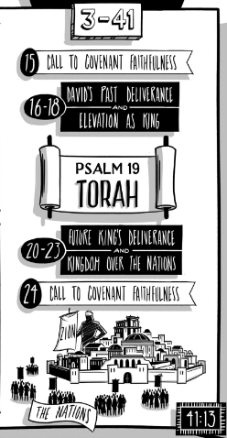

Slide 4
Psalms Book 1 Summary
Psalm 20:5c “May the Lord fulfill all your petitions!”
Pslam 21:7 “For the king trusts in the Lord, and through
the steadfast love of the Most High he shall not be moved.”
Psalm 22:16bc “a company of evildoers encircles me;
they have pierced my hands and feet”
Psalm 23:4c “for you are with me”
Psalm 24:3 “Who shall ascend the hill of the Lord?
And who shall stand in his holy place?
Psalm 25:11 “For your name’s sake, O Lord, pardon my guilt, for it is great.”
Psalm 26:6 “I wash my hands in innocence and go around your alter, O Lord”
Psalm 27:4 “One thing I have asked of the Lord, that I will seek after:
that I may dwell in the house of the Lord all the days of my life,
to gaze upon the beauty of the Lord and to inquire in His temple.”

Slide 5
Psalms Book 1 Summary
Psalm 28:4d “render them their due reward”
Psalm 29:1,9c “Ascribe to the Lord, O heavenly beings, ascribe to the Lord glory and strength…and in His temple all cry, “Glory!” “
Psalm 30:7a “By your favor, O Lord, you made my mountain stand strong”
Psalm 31:5a “Into your hand I commit my spirit”
Psalm 32:3 “For when I kept silent, my bones wasted away”
Psalm 33:12 “Blessed” – Hebrew 80 words before and after
Psalms 34:11b “I will teach you the fear of the Lord”
Psalm 35:1b “fight against those who fight against me!”
Psalm 36:5 “Your steadfast love, O Lord, extends to the heavens,
your faithfulness extends to the clouds”

Slide 6
Psalms Book 1 Summary
Psalm 37:1 “Fret not yourself because of evildoers;
be not envious of wrongdoers!”
Psalm 38:15 “But for You, O Lord, do I wait; it is You,
O Lord my God, who will answer.”
Psalm 39:7 “And now, O Lord, for what do I wait? My hope is in You.
Psalm 40:1 “I waited patiently for the Lord; He inclined to me and heard my cry.”
Psalm 41:12 “But you have upheld me because of my integrity,
and set me in your presence forever.”

Slide 7
Psalm 22
Prophetic Elements
Matt 27:46 – Jesus quotes vs 1a
Matt 27:43 – Jesus us mocked w\almost same words as vs 8
John 19:28 – Jesus thirsts (vs 15b)
Matt 27:35 – pierced (vs 16c)
Matt 27:35 – Jesus garments divided\cast (vs 18)
Bones out of joint (vs 14)
Heart like wax, melted (vs 14)
Count all bones (vs 17)
Future generations (vs 30-31)

Slide 8
Psalm 22
I feel forsaken, but I know You are to be trusted (1-5)
I am scorned, but you are my God (6-11)
I am defeated \ surrounded by enemies(12-18)
You will rescue me (19-22)
I am heard \ surrounded by the godly (23-25)
All should worship God \ He rescues to afflicted (26-28)
Everyone will worship God \ He is to be trusted (29-31)
This psalm never gives in to complete despair. The word "trust" or some form of it occurs 5 times in the first 11 verses. Over and over David reminds God that, even though he doesn't understand why God hasn't acted yet, he still trusts Him.

Slide 9
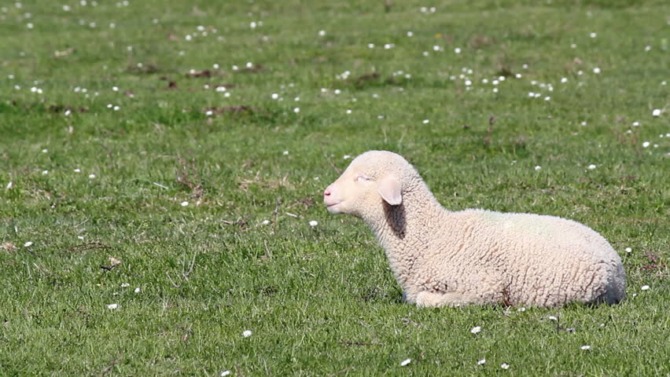
Psalm 23
Psalm 22 – Why have you forsaken me?
Psalm 23 – You are with me
Physical and spiritual provision (vs 1-3)
Protection of the Lord (vs 4-5)
Faith and hope in Lord’s Preservation (v 6)
In this life
In the life to come

Slide 10
Psalm 32
Blessed is the forgiven (1-2)
Sad is the one who doesn’t confess (3-4)
God forgives (5)
God protects (6)
God delivers (7)
Wise is he who does the will of God(8-9)
Blessed are those who trust the Lord (10-11)
It seems that David took his lessons learned and wanted to share. David’s humility at never hiding his sins but using them to teach others is a rare character trait.
Seeking that which set David apart from other men, from other Kings is worth reflecting on.

