Slide 1
Satan laughs at authority
Genesis 3:5 (NKJV) - For God knows that in the day you eat of it your eyes will be opened, and you will be like God, knowing good and evil.”

Slide 2
What does a member of Christ’s body do?
Colossians 3:17 (NKJV) - And whatever you do in word or deed, do all in the name of the Lord Jesus, giving thanks to God the Father through Him.

Slide 3
What does a member of Christ’s body do?
2 Timothy 3:16-17 (NKJV) - All Scripture is given by inspiration of God, and is profitable for doctrine, for reproof, for correction, for instruction in righteousness, 17 that the man of God may be complete, thoroughly equipped for every good work.

Slide 4
What is the local church?
All Christians are under Christ as their head. (Eph 5:23)

Slide 5
What is the local church?
All Christians are under Christ as their head. (Eph 5:23)
Every Christian is in this universal body. In this sense there is but one church. (Eph 4:4-6; 1:22-23)

Slide 6
What is the local church?
All Christians are under Christ as their head. (Eph 5:23)
Every Christian is in this universal body. In this sense there is but one church. (Eph 4:4-6; 1:22-23)
This one body is not speaking of a local church.

Slide 7
What is the local church?
All Christians are under Christ as their head. (Eph 5:23)
Every Christian is in this universal body. In this sense there is but one church. (Eph 4:4-6; 1:22-23)
This one body is not speaking of a local church.
You cannot be in this one church without Jesus being your head. (Lk 6:46)

Slide 8
What is the local church?
There are three things necessary to have a local church.

Slide 9
What is the local church?
There are three things necessary to have a local church.
There is an agreement to work and worship together as a church. (Heb 13:17)

Slide 10
What is the local church?
There are three things necessary to have a local church.
There is an agreement to work and worship together as a church. (Heb 13:17)
There is a common oversight. (1 Pt 5:1-2)

Slide 11
What is the local church?
There are three things necessary to have a local church.
There is an agreement to work and worship together as a church. (Heb 13:17)
There is a common oversight. (1 Pt 5:1-2)
There is a pooling of resources. (1 Cor 16:1-2)

Slide 12
What is the local church?
There are three things necessary to have a local church.
There is an agreement to work and worship together as a church. (Heb 13:17)
There is a common oversight. (1 Pt 5:1-2)
There is a pooling of resources. (1 Cor 16:1-2)
Some say any coming together of Christians constitutes a local church. For example some Christians may get together and pool their money to buy pizza.

Slide 13
What is the local church?
There are three things necessary to have a local church.
There is an agreement to work and worship together as a church. (Heb 13:17)
There is a common oversight. (1 Pt 5:1-2)
There is a pooling of resources. (1 Cor 16:1-2)
Some say any coming together of Christians constitutes a local church. For example some Christians may get together and pool their money to buy pizza.
This is not a local church at work!

Slide 14
What is the local church?
God has given local churches unique responsibilities.

Slide 15
What is the local church?
God has given local churches unique responsibilities.
In discipline there is a time and place for the church to act. (Mt 18:15-17)

Slide 16
What is the local church?
God has given local churches unique responsibilities.
In discipline there is a time and place for the church to act. (Mt 18:15-17)
In benevolence there are differing responsibilities concerning the local church and the individual Christian. (1 Tim 5:16)

Slide 17
What is the local church?
God has given local churches unique responsibilities.
In discipline there is a time and place for the church to act. (Mt 18:15-17)
In benevolence there are differing responsibilities concerning the local church and the individual Christian. (1 Tim 5:16)
Because of this we need to find the local church addressed in the context of a passage before assuming church responsibility.

Slide 18
What is the local church?
God has given local churches unique responsibilities.
If a scripture addresses only the individual Christian this would not be enough to authorize church action. If not, then whatever the individual Christian may do, the church may do!

Slide 19
What is the local church?
What does the individual have authority to do.

Slide 20
What is the local church?
What does the individual have authority to do.
This would involve secular business. (Eph 4:28)

Slide 21
What is the local church?
What does the individual have authority to do.
This would involve secular business. (Eph 4:28)
This would involve politics. (Rom 13:1-4)

Slide 22
What is the local church?
What does the individual have authority to do.
This would involve secular business. (Eph 4:28)
This would involve politics. (Rom 13:1-4)
This would involve recreation and many other things. Are you ready?

Slide 23
What is the work of a local church?
When should take all the passages dealing with church action.

Slide 24
What is the work of a local church?
When should take all the passages dealing with church action.
God may specify a certain thing. In this we must not substitute! (1 Cor 16:1-2)

Slide 25
What is the work of a local church?
We should take all the passages dealing with church action.
God may specify a certain thing. In this we must not substitute! (1 Cor 16:1-2)
In the authority to act there may be things authorized that are necessary to fulfilling the things to be done. This is sometimes called "general authority."

Slide 26
What is the work of a local church?
The church may use its resources for that which it is authorized to do.

Slide 27
What is the work of a local church?
The church may use its resources for that which it is authorized to do.
God has authorized a collection for the work of the local church.

Slide 28
What is the work of a local church?
The church may use its resources for that which it is authorized to do.
God has authorized a collection for the work of the local church.
The resources of the local church constitute the treasury and those things purchased from the treasury that are overseen by the church.

Slide 29
What is the work of a local church?
The church may use its resources for that which it is authorized to do.
God has authorized a collection for the work of the local church.
The resources of the local church constitute the treasury and those things purchased from the treasury that are overseen by the church.
This would include the building or other things purchased from the treasury.

Slide 30
What is the work of a local church?
The church may do only that which is wholly its work.

Slide 31
What is the work of a local church?
The church may do only that which is wholly its work.
Only that which is authorized may be done with God's approval. To mix that which is authorized in with things that are not authorized is in effect is a substitution for what God has said.

Slide 32
What is the work of a local church?
The church may do only that which is wholly its work.
Only that which is authorized may be done with God's approval. To mix that which is authorized in with things that are not authorized is in effect is a substitution for what God has said.
Playing baseball is not authorized wider passages that instruct us to preach the gospel.

Slide 33
What is the work of a local church?
The church may do only that which is wholly its work.
Only that which is authorized may be done with God's approval. To mix that which is authorized in with things that are not authorized is in effect is a substitution for what God has said.
Playing baseball is not authorized wider passages that instruct us to preach the gospel.
Someone may preach while the game is being played, but playing baseball and preaching the gospel are two separate activities!

Slide 34
What is the work of a local church?
The work of the local church can be described in three areas.

Slide 35
What is the work of a local church?
The work of the local church can be described in three areas.
God has authorized local churches to be involved in the preaching of God's word. (Phil 4:15-16; 2 Cor 11:8)

Slide 36
What is the work of a local church?
The work of the local church can be described in three areas.
God has authorized local churches to be involved in the preaching of God's word. (Phil 4:15-16; 2 Cor 11:8)
God has authorized local churches to be involved in the edifying of its members. (Acts 9:31; 1 Cor 14:26)

Slide 37
What is the work of a local church?
The work of the local church can be described in three areas.
God has authorized local churches to be involved in the preaching of God's word. (Phil 4:15-16; 2 Cor 11:8)
God has authorized local churches to be involved in the edifying of its members. (Acts 9:31; 1 Cor 14:26)
God has authorized local churches to be involved in the relief of its members. (Acts 2:44-45; 4:32-35; 6:1-6;11:27-30; Rom 15:26; 1 Cor 6:1-4;2 Cor 9:12-14)

Slide 38
What is the work of a local church?
Where does a social meal fit? (Eph 4:11, 12; Jn 6:44, 26-27)

Slide 39
What is the work of a local church?
Where does a social meal fit? (Eph 4:11, 12; Jn 6:44, 26-27)
Consider some common examples of liberal churches in this area.

Slide 40
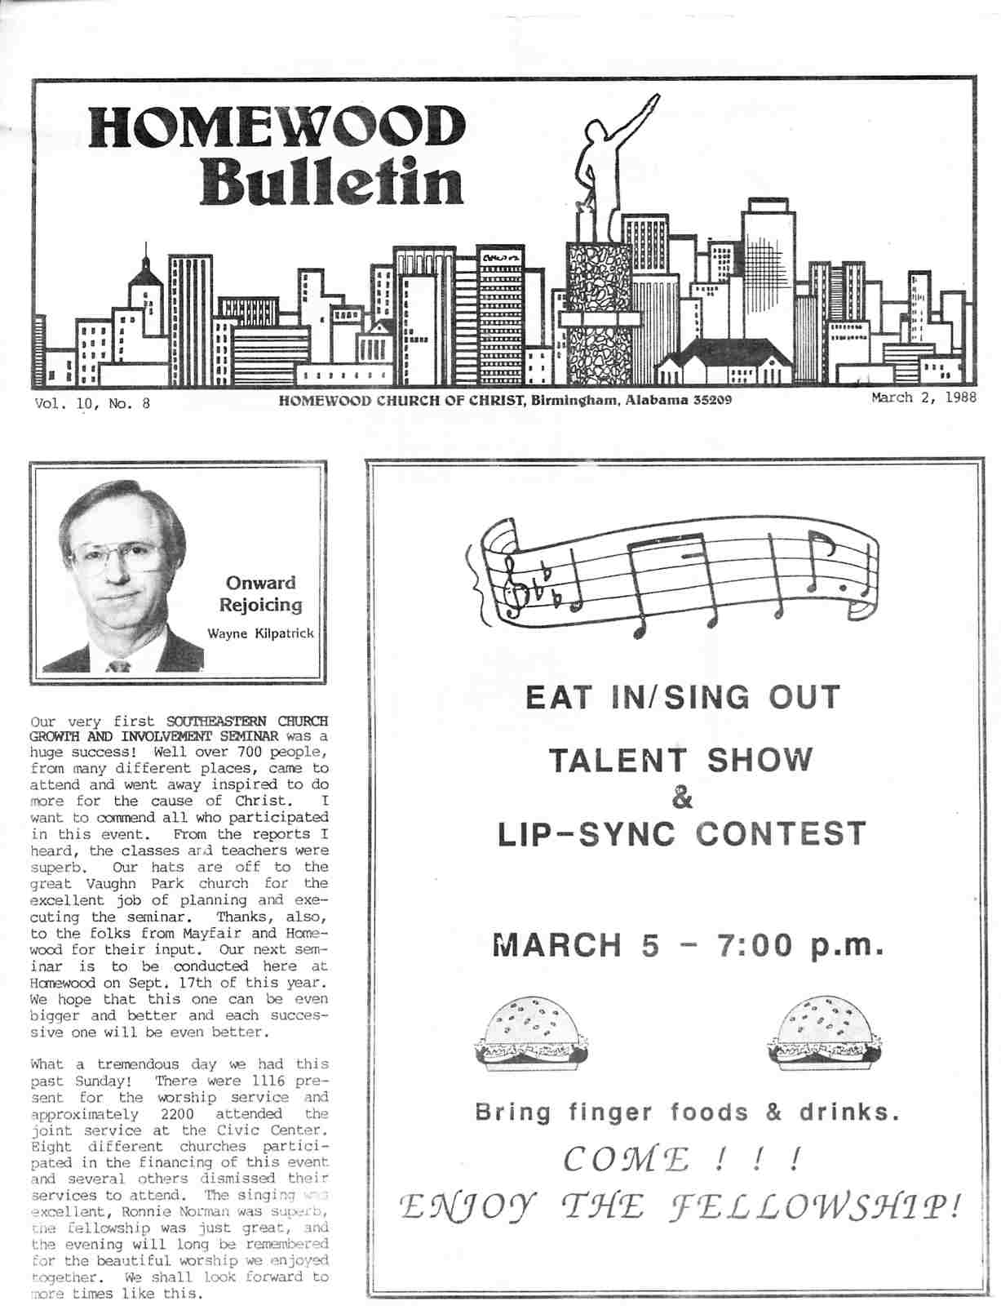
What is the work of a local church?

Slide 41
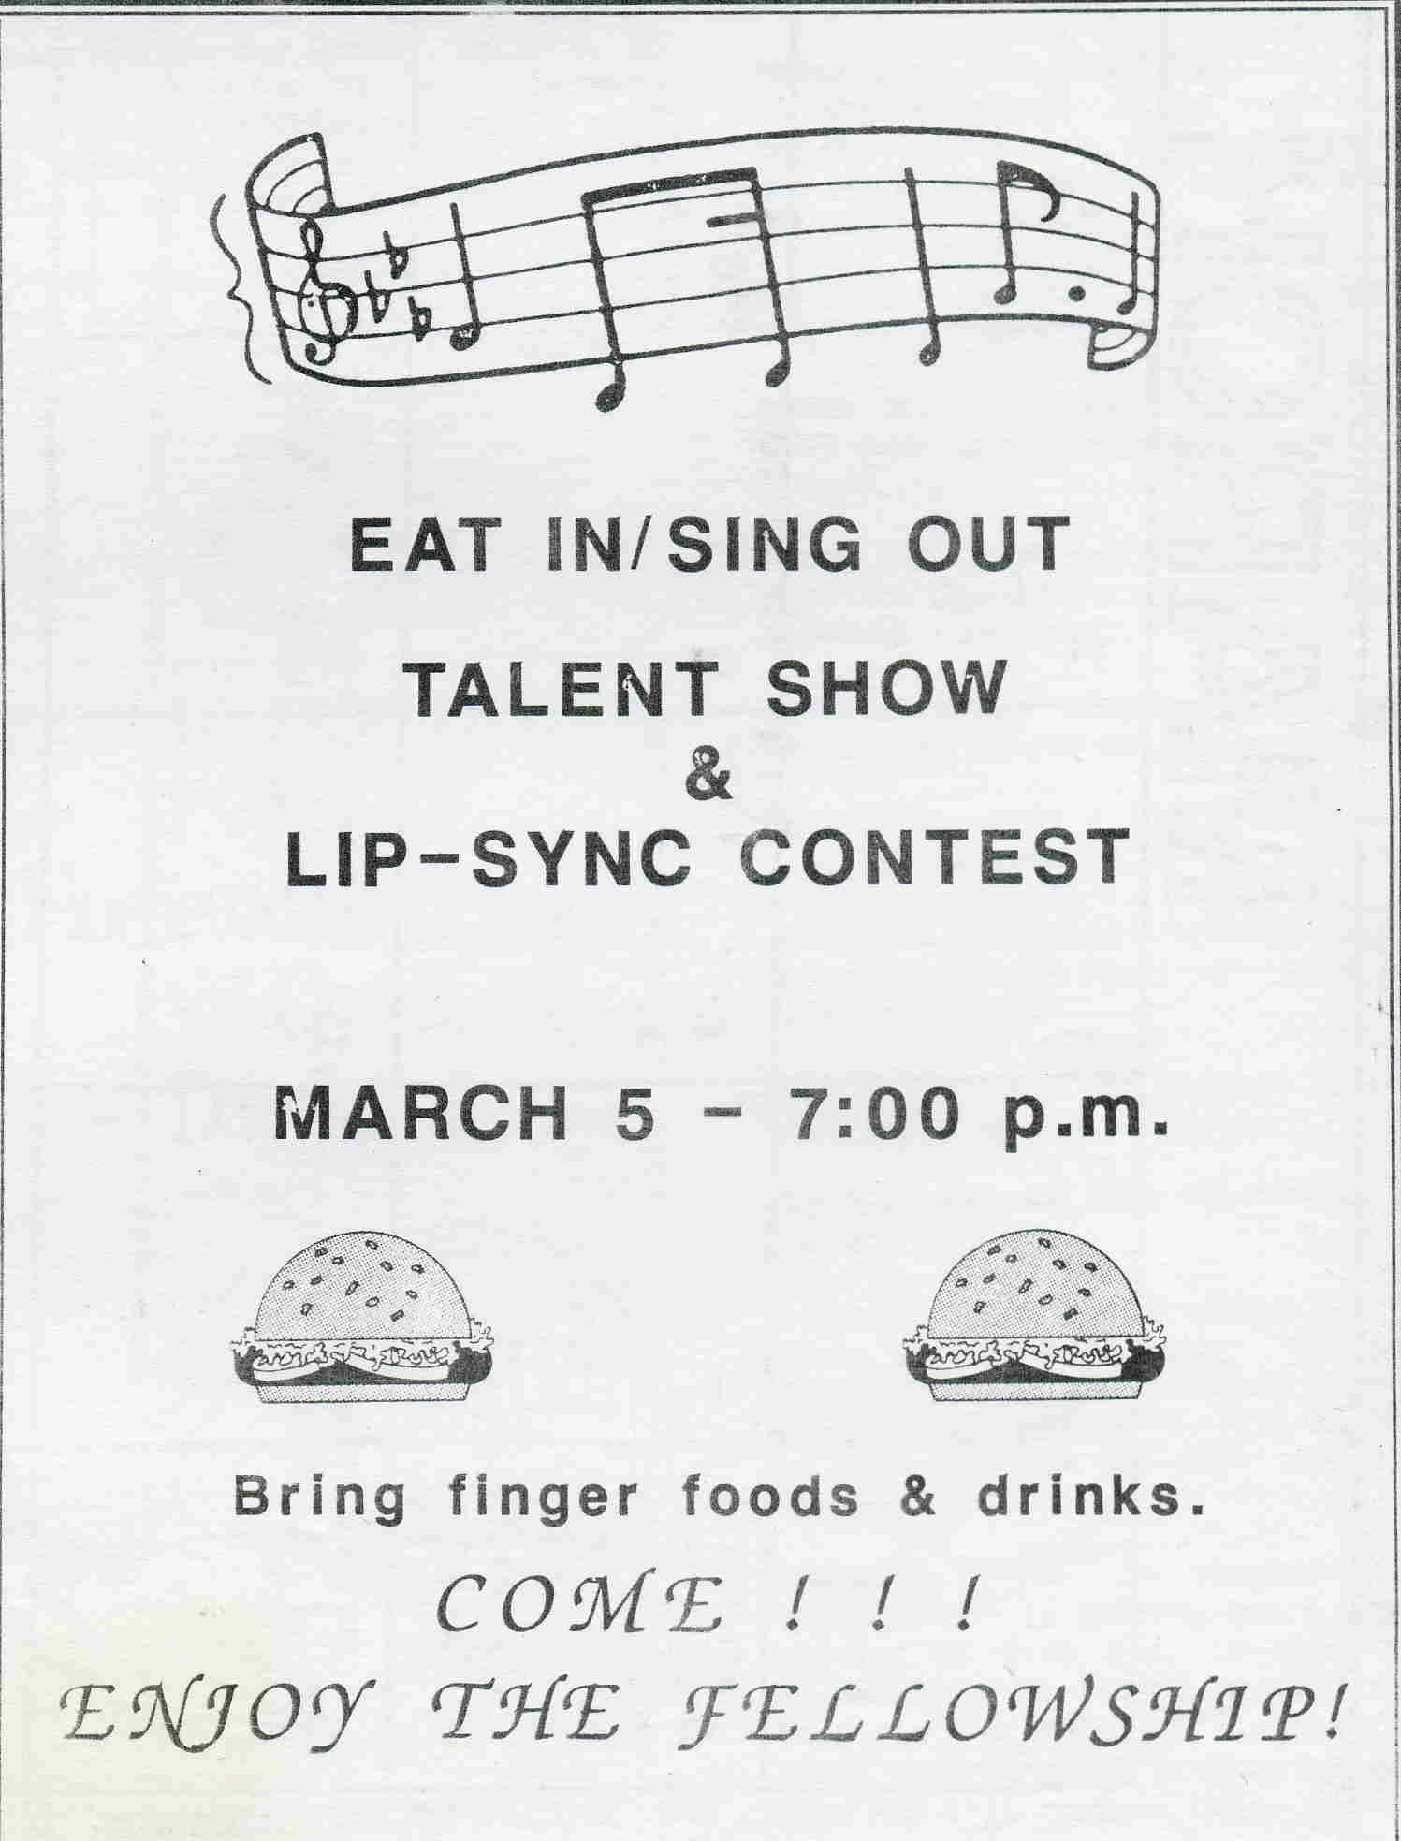
What is the work of a local church?

Slide 42
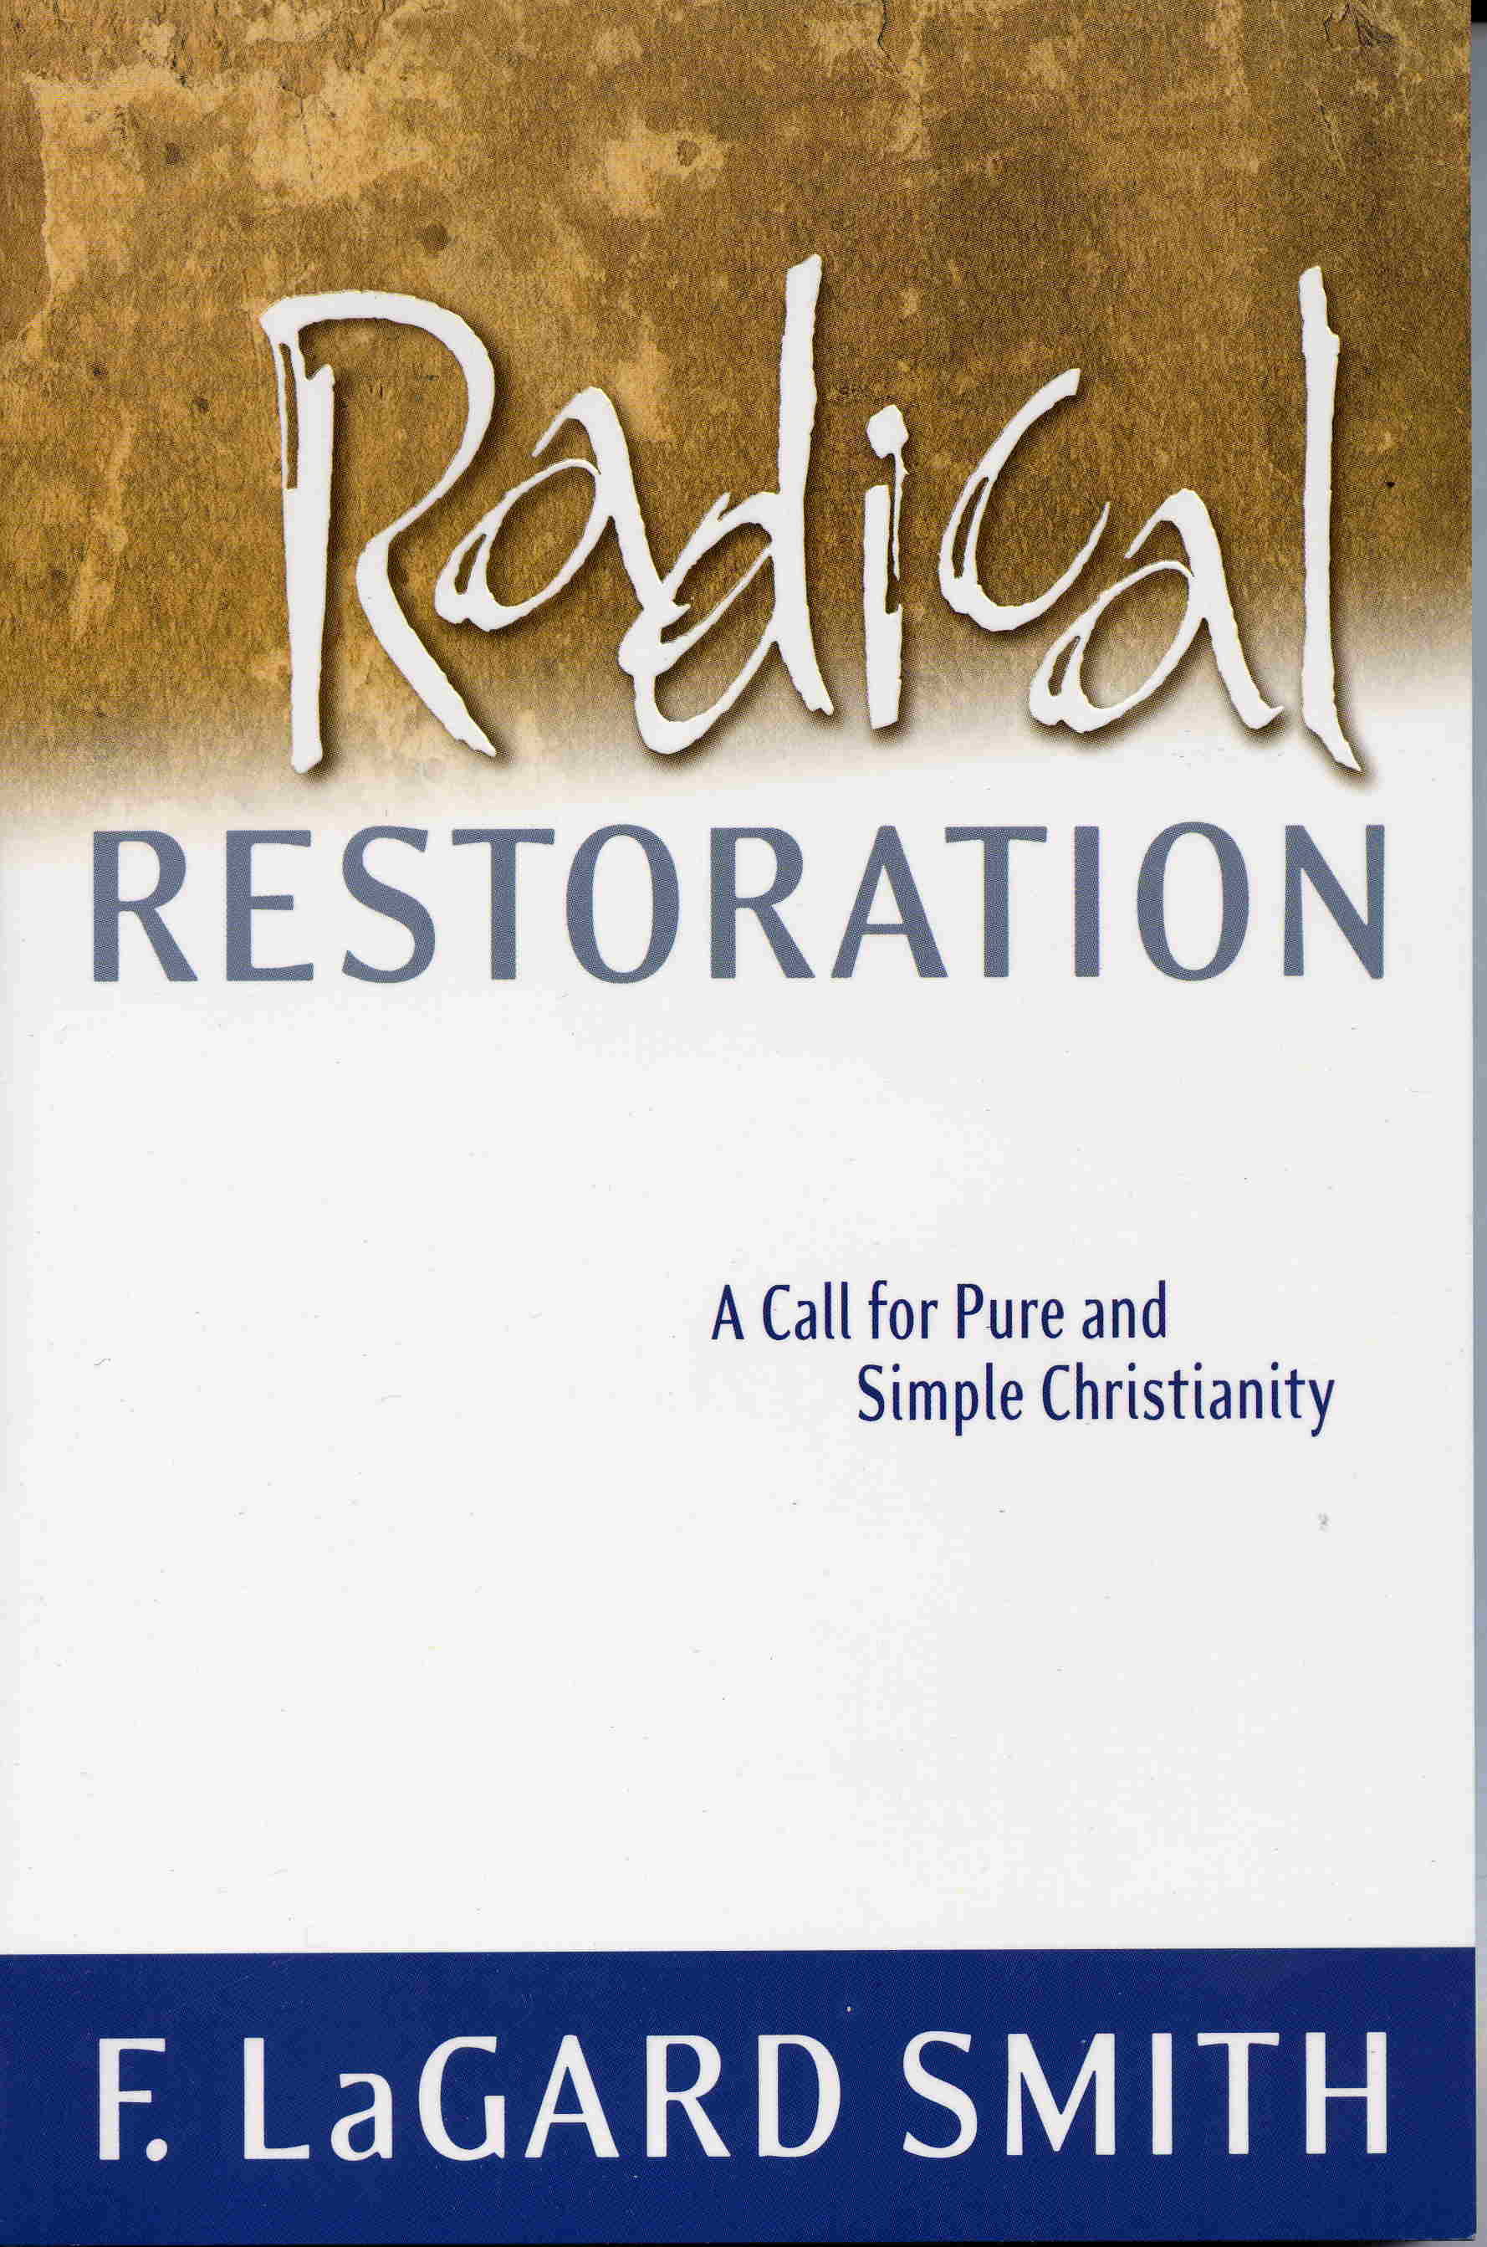
New efforts to justify a social meals
LaGard Smith book “radical restoration” has found a receptive audience.

Slide 43
New efforts to justify a social meals
He claims the Bible demand that we change many practices.

Slide 44
New efforts to justify a social meals
He claims the Bible demand that we change many practices.
That there be no fully supported local preacher.

Slide 45
New efforts to justify a social meals
He claims the Bible demand that we change many practices.
That there be no fully supported local preacher.
That churches be small groups that meet in homes.

Slide 46
New efforts to justify a social meals
He claims the Bible demand that we change many practices.
That there be no fully supported local preacher.
That churches be small groups that meet in homes.
That elders be over many churches in an area.

Slide 47
New efforts to justify a social meals
He claims the Bible demand that we change many practices.
That there be no fully supported local preacher.
That churches be small groups that meet in homes.
That elders be over many churches in an area.
That there be no collections except for specific temporary needs.

Slide 48
New efforts to justify a social meals
He claims the Bible demand that we change many practices.
That there be no fully supported local preacher.
That churches be small groups that meet in homes.
That elders be over many churches in an area.
That there be no collections except for specific temporary needs.
We must abandon the uniform use of the name “church of Christ.”

Slide 49
New efforts to justify a social meals
He claims the Bible demand that we change many practices.
That there be no fully supported local preacher.
That churches be small groups that meet in homes.
That elders be over many churches in an area.
That there be no collections except for specific temporary needs.
We must abandon the uniform use of the name “church of Christ.”
That the Lord’s Supper be part of a common meal.

Slide 50
New efforts to justify a social meals
LaGard Smith has spoken at Robuck Parkway, the Central church in Tuscaloosa and in many other places in Alabama.

Slide 51
New efforts to justify a social meals
LaGard Smith has spoken at Robuck Parkway, the Central church in Tuscaloosa and in many other places in Alabama.
There are at least 10 churches that have divided over these doctrines.

Slide 52
New efforts to justify a social meals
LaGard Smith has spoken at Robuck Parkway, the Central church in Tuscaloosa and in many other places in Alabama.
There are at least 10 churches that have divided over these doctrines.
Brother Smith has a following among many in this area.

Slide 53
New efforts to justify a social meals
LaGard Smith has spoken at Robuck Parkway, the Central church in Tuscaloosa and in many other places in Alabama.
There are at least 10 churches that have divided over these doctrines.
Brother Smith has a following among many in this area.
I want to examine the claim that the Lord’s Supper be a part of a common meal.

Slide 54
New efforts to justify a social meals
There is only one example of Christians bringing a social meal into the work of the church. In this case it is not an approved example! (1 Cor 11:17-34)

Slide 55
New efforts to justify a social meals
There is only one example of Christians bringing a social meal into the work of the church. In this case it is not an approved example! (1 Cor 11:17-34)
They should have come together for the Lord's Supper. (1 Cor 11:17, 20)

Slide 56
New efforts to justify a social meals
There is only one example of Christians bringing a social meal into the work of the church. In this case it is not an approved example! (1 Cor 11:17-34)
They should have come together for the Lord's Supper. (1 Cor 11:17, 20)
By bringing in an unauthorized action into the assemblies they in fact defeated the purposes of God! (1 Cor 11:20-22)

Slide 57
New efforts to justify a social meals
“The major argument that LaGard sets forth in this chapter is that we must observe the memorial Supper IN CONJUNCTION WITH "a normal, ordinary meal with the usual variety of food"(p.128). Somewhere in this normal meal of chicken, butterbeans, deviled-eggs, and camp stew, we are to pause with some unleavened bread and wine, and remember the offered body and blood of Jesus.”

Slide 58
New efforts to justify a social meals
“He says that this is what the early Christians did, and he says that we "may" be abusing the Lord’s Supper if we do not, and he says that we have definitely NOT restored anything akin to the Lord’s Supper if we do not combine the memorial with a common meal.” – Terry Benton

Slide 59
New efforts to justify a social meals
Did Paul give instructions for the Lord's supper or a common meal? (1 Cor 11:33)

Slide 60
New efforts to justify a social meals
"The ritual we now euphemistically call "communion“ (not wholly unlike the Catholic’s sacramental Eucharist) doesn’t hold a candle to the dynamic koinonia communion of the first-century disciples in their sharing together of the Lord’s Supper within the context of the fellowship meal." LaGard Smith, Radical Restoration (p.135).

Slide 61
New efforts to justify a social meals
"The ritual we now euphemistically call "communion“ (not wholly unlike the Catholic’s sacramental Eucharist) doesn’t hold a candle to the dynamic koinonia communion of the first-century disciples in their sharing together of the Lord’s Supper within the context of the fellowship meal." LaGard Smith, Radical Restoration (p.135).
I heard brother Smith in Tuscaloosa say that “crackers and grape juice” in a “snack and not a ‘supper.”

Slide 62
New efforts to justify a social meals
Paul plainly told us that hunger was not be fulfilled at the Lord’s Supper!

Slide 63
New efforts to justify a social meals
Paul plainly told us that hunger was not be fulfilled at the Lord’s Supper!
Where was the common meal to be eaten? (1 Cor 11:34)

Slide 64
New efforts to justify a social meals
Does authority for a “love feast” this authorize church fellowship halls? (Jude 12)

Slide 65
New efforts to justify a social meals
LOVE FEASTS: Feasting on Food? Or Feasting On Love?
“LaGard assumes that "love feasts" were common meals together. I would argue that the memorial associated with unleavened bread and fruit of the vine (per Jesus’ instructions) is a feast of love, and it is a feast of the heart and not the stomach. It is feasting on Jesus, His kingdom and righteousness, that fills us with commonality and brotherhood, and a common meal is not itself a "love feast".

Slide 66
New efforts to justify a social meals
It is the purpose of the Supper to provide us with united focus and concentration as we devote our attention together on what Jesus said for us to "remember". When we are casually eating chicken and butterbeans, we are not called to focus our thoughts on his body and blood. That is no more a love feast than a baseball game together is a "love game". We feast on Jesus’ love, our love and admiration of Him, and share common salvation and faith, when we take that bread and cup of blessing in a worthy manner in memory of Him together.

Slide 67
New efforts to justify a social meals
THAT is a feast of love. In the Lord’s Supper we are advocating our faith and love, and we are communing with Him.” – Terry Benton

Slide 68
New efforts to justify a social meals
Is this passage dealing with church action? (Gal 2:11-13)

Slide 69
New efforts to justify a social meals
Is this passage dealing with church action? (Gal 2:11-13)
What kind of food feeds the soul?

Slide 70
New efforts to justify a social meals
Is this passage dealing with church action? (Gal 2:11-13)
What kind of food feeds the soul?
It is not the food that perishes. (Jn 6:27, 32-33)

Slide 71
New efforts to justify a social meals
“Moses did not give the bread from heaven. The Father has given the "true bread" from heaven. That true bread is Jesus who gave His life to the world. The physical elements of the Lord’s Supper do not, themselves, give life. It is the remembrance made of those elements that allows or guides our minds to feast on the "true bread". We feast on the "true bread" and remember that He gave His life for us. Truly, then, the supper is a special occasion when we unitedly focus our attention on the true bread and feed our souls together.”

Slide 72
New efforts to justify a social meals
That is a feast of love. That is the "love feast", not a common meal together, not a game together, not an earthly pleasure together, but a moment of singularity in our sharing the love of God together in memory of what He did for us on the cross.” – Terry Benton

Slide 73
Let us not fail the "test case."
Often major changes are brought in by a small test case.

Slide 74
Let us not fail the "test case."
Often major changes are brought in by a small test case.
Churches in Alabama and Colorado bought existing denominational buildings.

Slide 75
Let us not fail the "test case."
Often major changes are brought in by a small test case.
Churches in Alabama and Colorado bought existing denominational buildings.
The preacher and others wanted to use it for common meals!

Slide 76
Let us not fail the "test case."
Often major changes are brought in by a small test case.
Churches in Alabama and Colorado bought existing denominational buildings.
The preacher and others wanted to use it for common meals!
We must always stand on principle and never yield. (Gal 2:5)

Slide 77
Let us not fail the "test case."
Often major changes are brought in by a small test case.
Churches in Alabama and Colorado bought existing denominational buildings.
The preacher and others wanted to use it for common meals!
We must always stand on principle and never yield. (Gal 2:5)
Will you give book, chapter and verse for your practices?

