Slide 3
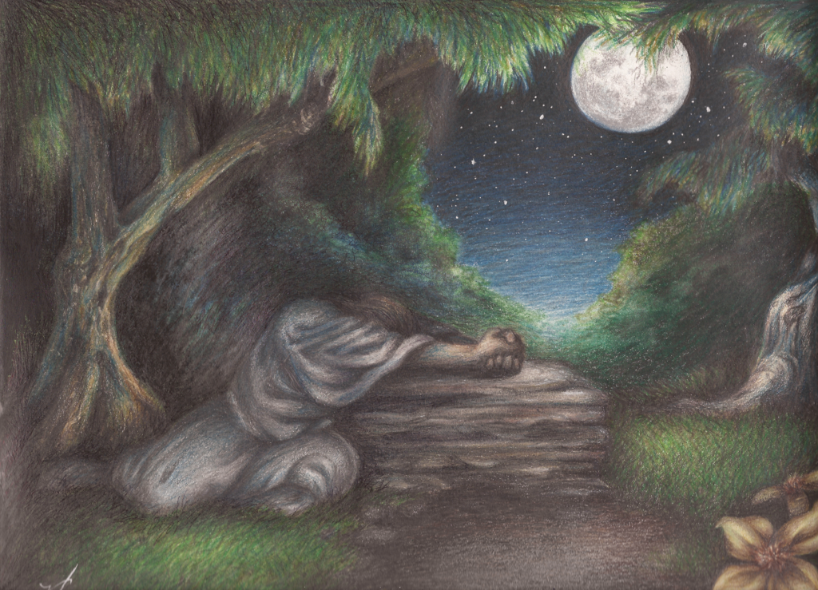
Garden of Gethsemane
Matt 26:37-38 – “He took with Him Peter and the two sons of Zebedee, and began to be grieved and distressed. Then He said to them, ‘My soul is deeply grieved, to the point of death…”
Matt 5:37 – “But let your statement be, ‘Yes, yes’ or ‘No, no’; anything beyond these is of evil.

Slide 4
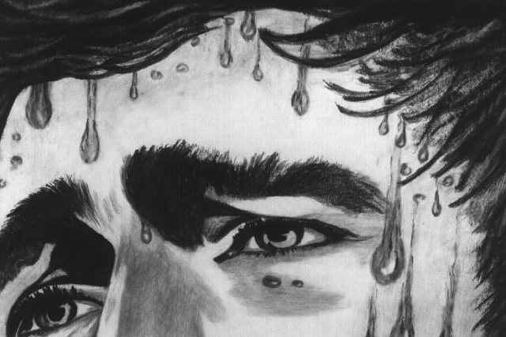
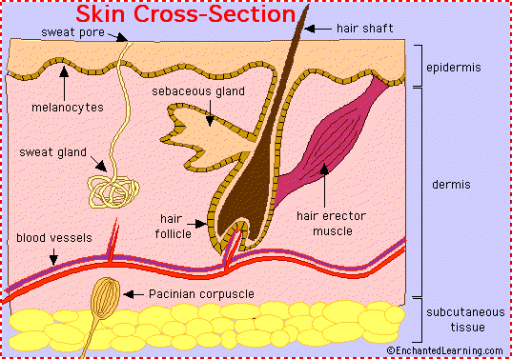
Garden of Gethsemane
Luke 22:44 – “And being in agony He was praying very fervently; and His sweat became like drops of blood, falling down upon the ground.”
Hematidrosis:
“An extremely rare condition characterized by the sweating of blood, which is said to occur when a person is facing death or other highly stressful events. It has been seen in prisoners before execution and occurred during the London Blitz.” (Segen's Medical Dictionary)

Slide 6
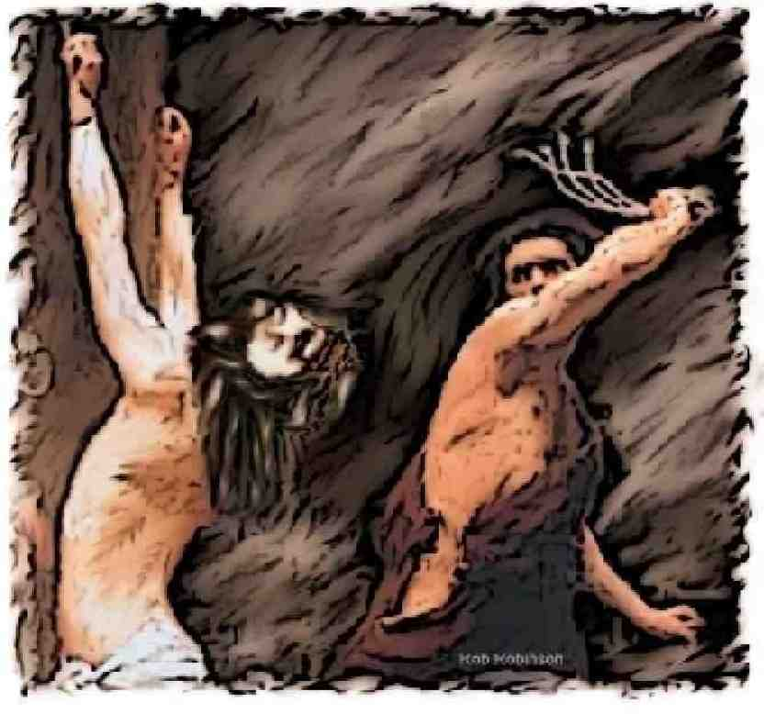
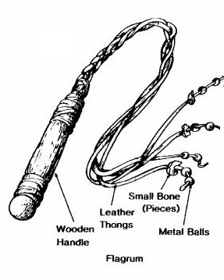
Scourging
John 19:1 – “Then Pilate therefore took Jesus, and scourged him.”

Slide 7
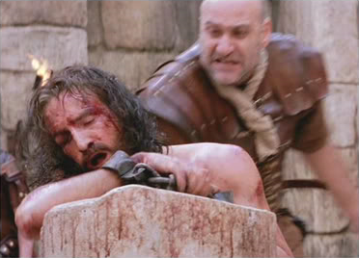
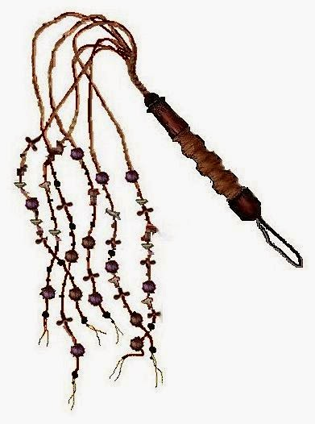
Scourging
Isa 52:14 – “Just as many were astonished at you, My people, so His appearance was marred more than any man and His form more than the sons of men.”
Isa 53:5 – “But he was wounded for our transgressions, he was bruised for our iniquities; the chastisement of our peace was upon him; and with his stripes we are healed.”

Slide 9
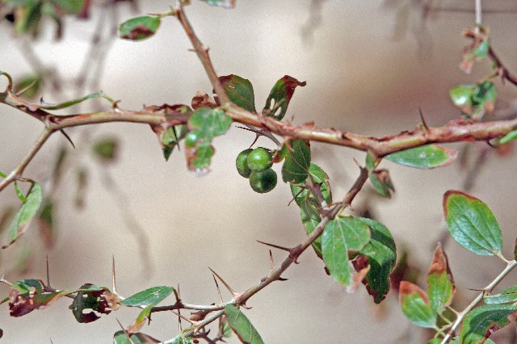
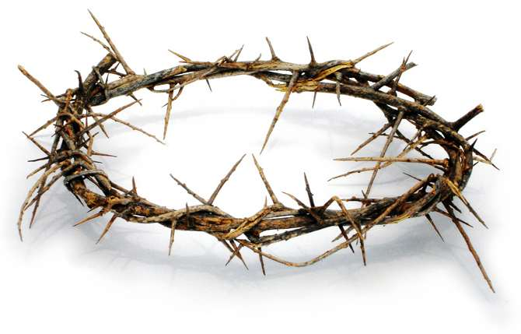
The Crown of Thorns
Matt 27:27-29 – “Then the soldiers of the governor took Jesus into the Praetorium and gathered the whole Roman cohort around Him. They stripped Him and put a scarlet robe on Him. And after twisting together a crown of thorns, they put it on His head, and a reed in His right hand; and they knelt down before Him and mocked Him, saying, ‘Hail, King of the Jews!’”

Slide 10
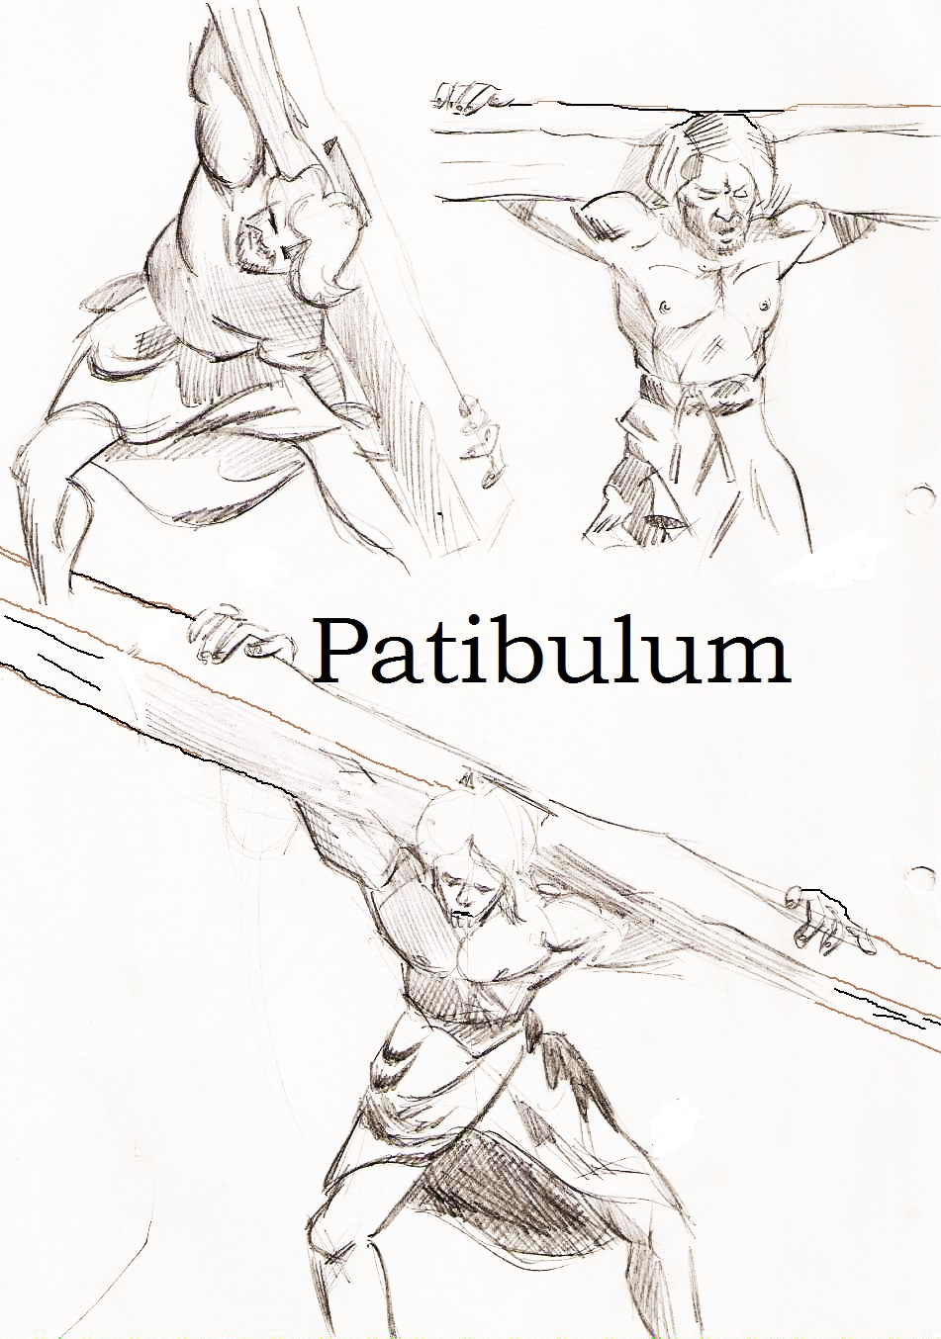
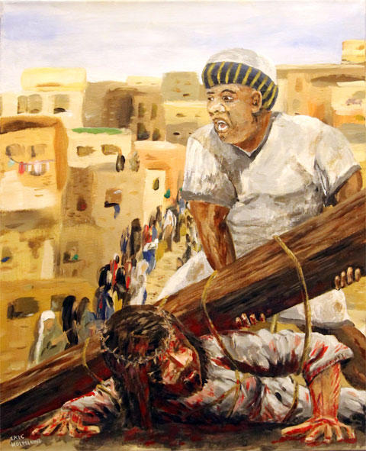
Carrying His Cross
John 19:17 – “They took Jesus, therefore, and He went out, bearing His own cross, to the place called the Place of a Skull, which is called in Hebrew, Golgotha.”

Slide 11
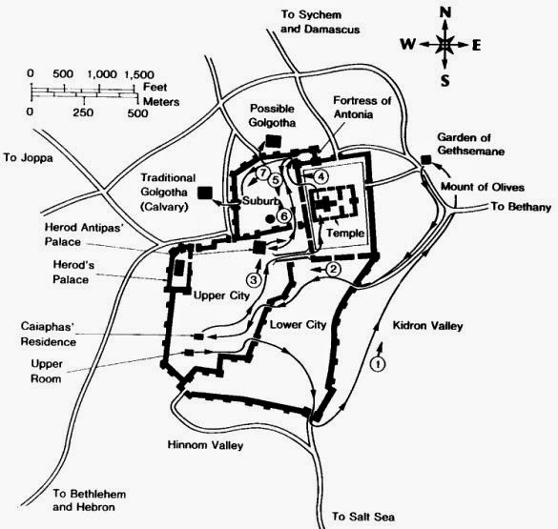
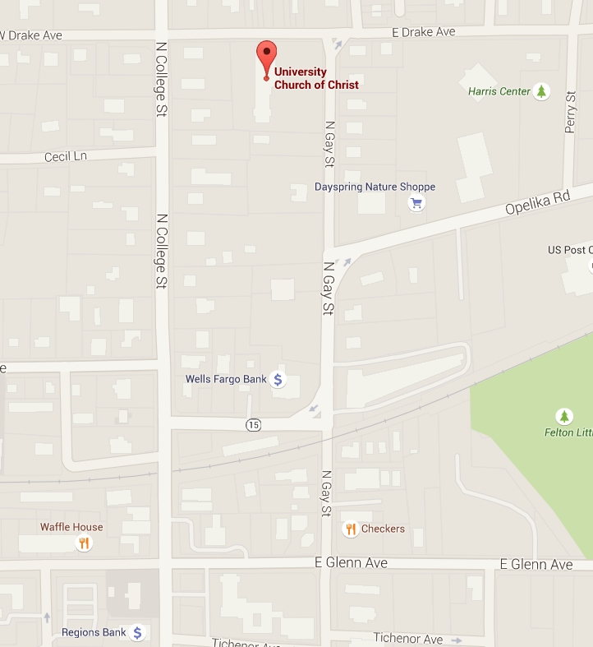
Carrying His Cross
Mark 15:21 – “And they compel one passing by, Simon of Cyrene, coming from the country, the father of Alexander and Rufus, to go with them, that he might bear his cross.”

Slide 12
