Slide 4
Latin Cross
Tau Cross

Slide 5
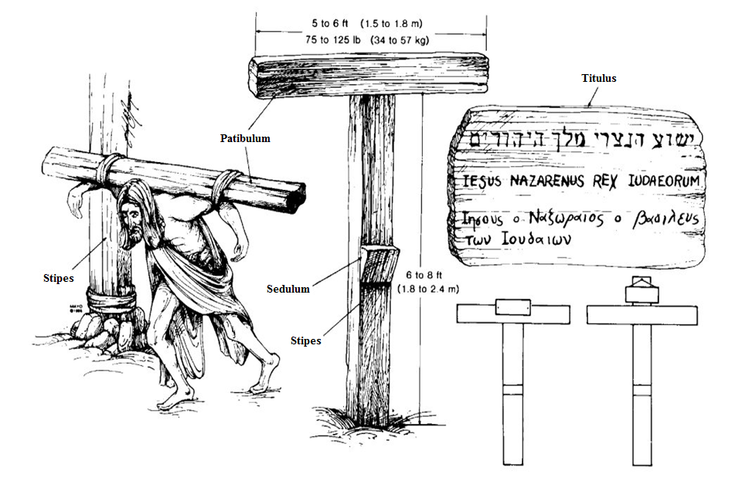
Parts of the Cross

Slide 7
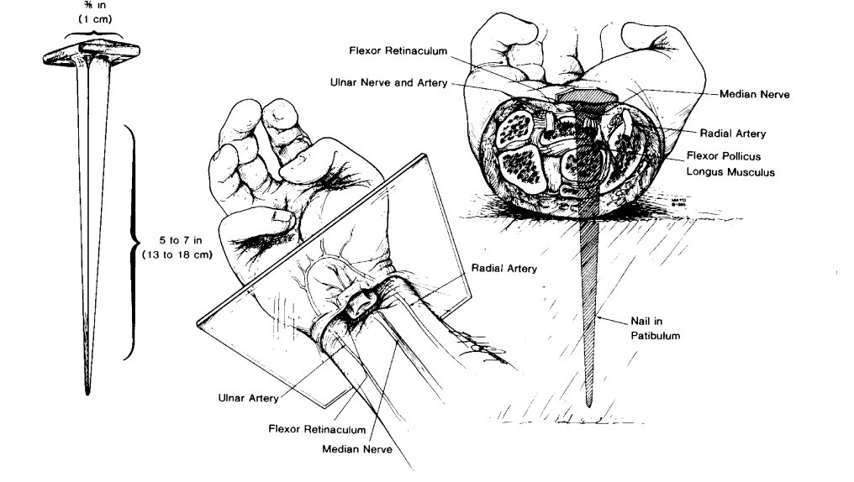
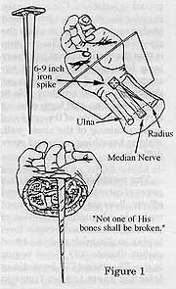
Piercing of the Hands
Argument for the palm: http://www.bibleserralta.com/JesusNailedByHisHands.html

Slide 8
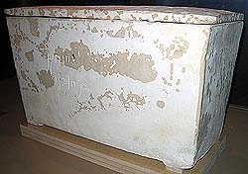
Archeological Remnant of Crucifixion
“Yehohanam the son of Hagakol”

Slide 9
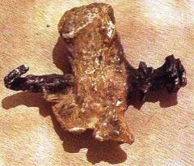
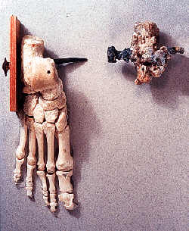
Archeological Remnant of Crucifixion

Slide 10
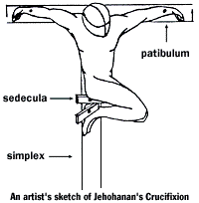
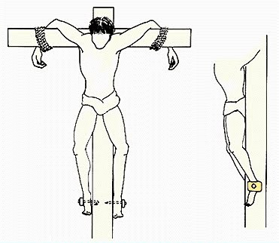
Archeological Remnant of Crucifixion

Slide 11
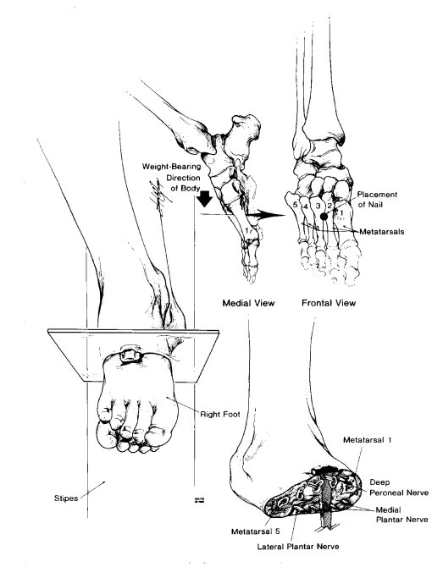
Piercing of the Feet

Slide 13
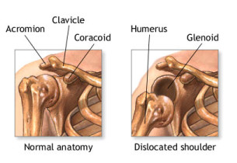
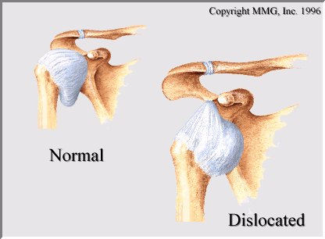
Dislocation

Slide 14
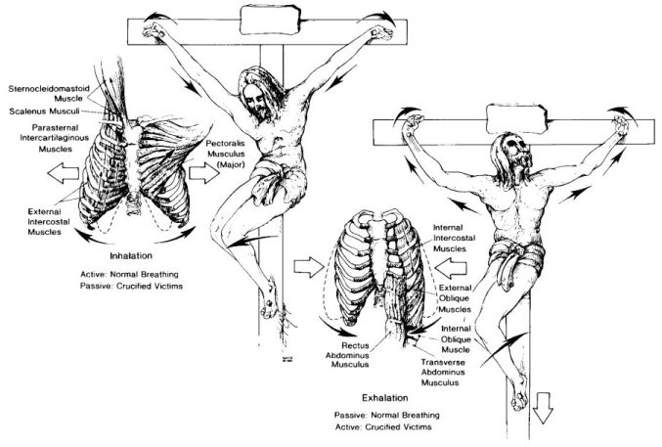
Suffocation

Slide 15
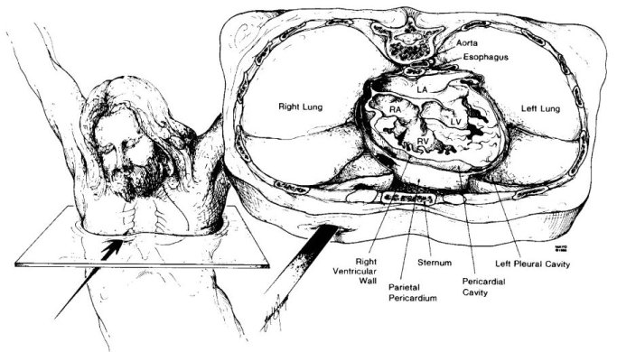
Piercing Jesus’ Side

