Slide 3
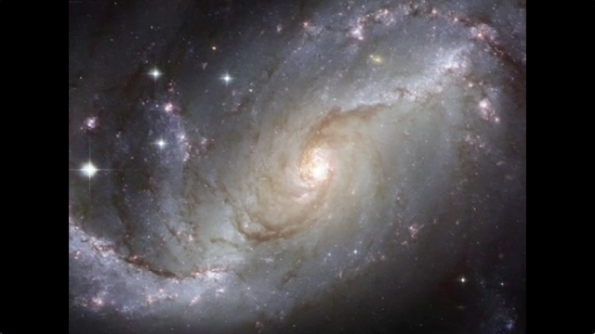
The Case For Existence
What We Will Not Do:
Attack Atheism
Account For God’s Existence
Confront “Evolution”
Talk About Every “Possibility”
What We Will Do:
Account For “Existence” Itself
Propose Most Reasonable Explanation For Our Universe

Slide 4
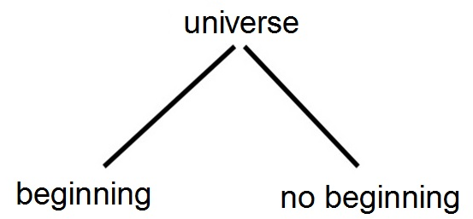
Accounting for Existence

Slide 5
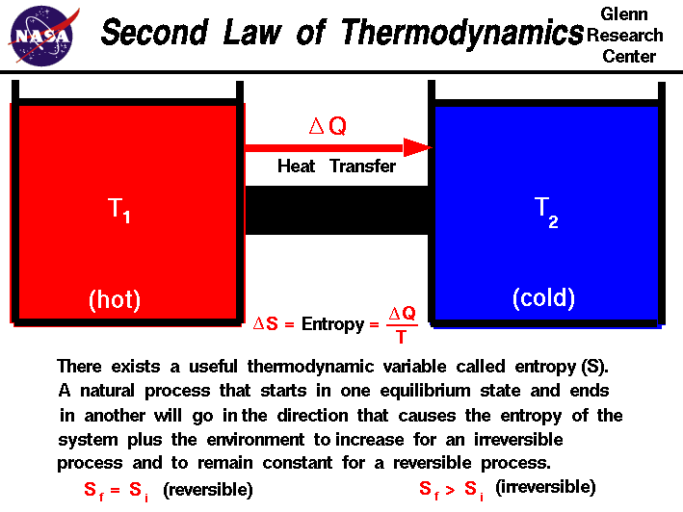
Accounting for Existence

Slide 6
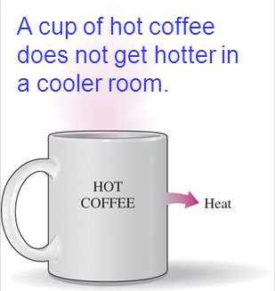

Slide 7
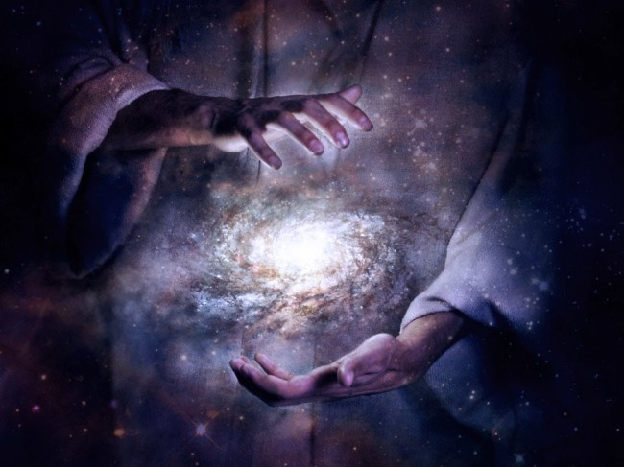
Psa 102:25-26 – “²⁵Of old You founded the earth, and the heavens are the work of Your hands. ²⁶Even they will perish, but You endure; and all of them will wear out like a garment; like clothing You will change them and they will be changed.”

Slide 8
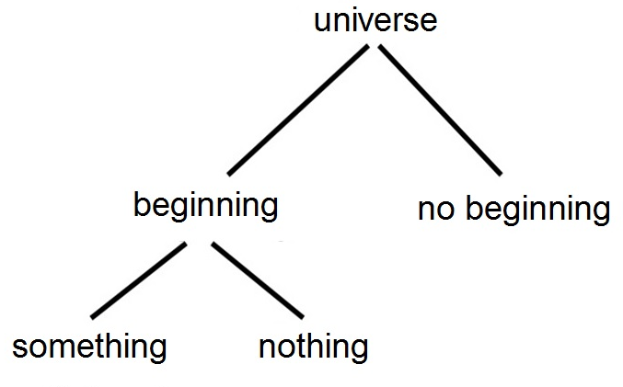
Accounting for Existence

Slide 9
Accounting for Existence
Stephen Hawking – “Because there is a law like gravity, the universe can and will create itself from nothing.” (Page 180)

Slide 10
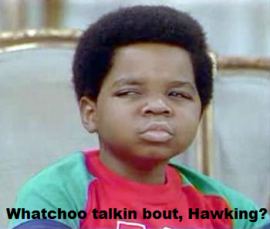
Accounting for Existence
Hijacking words
i.e. something = nothing
Scientific laws don’t make things happen. They describe what happens
Nothing creates nothing

Slide 11
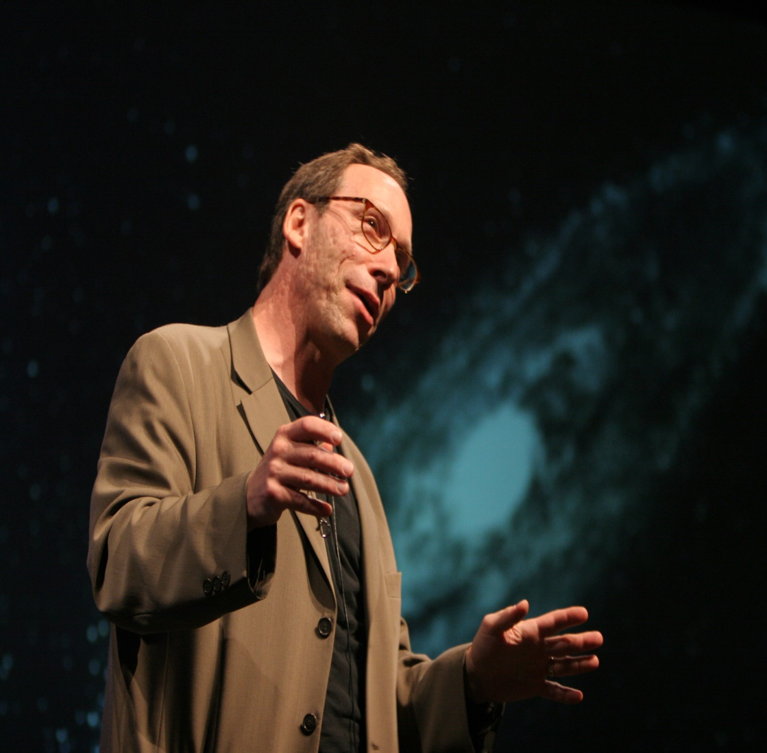
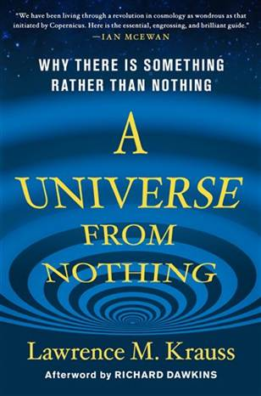
Accounting for Existence
Lawrence Krauss – “One of the things about quantum mechanics is not only can nothing become something, nothing always becomes something. Nothing is unstable. Nothing will always produce something in quantum mechanics.” (Chapter 10)

Slide 12
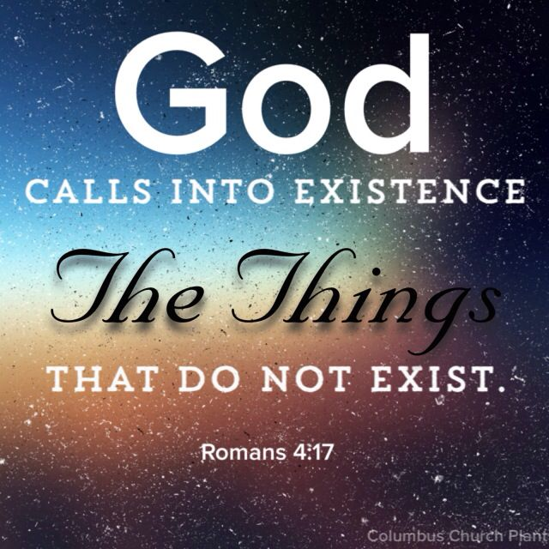

Slide 13
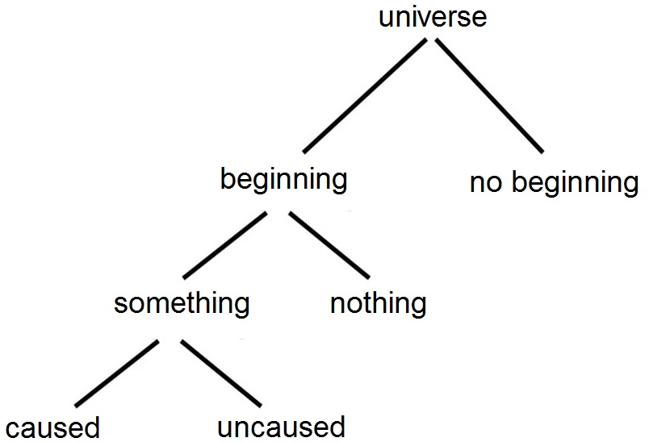
Accounting for Existence

Slide 14
Accounting for Existence
Law of Causality (Cause & Effect) – “The relation between an event (the cause) and a second event (the effect), where the second event is understood as a consequence of the first.”

Slide 15
Accounting for Existence

Slide 16
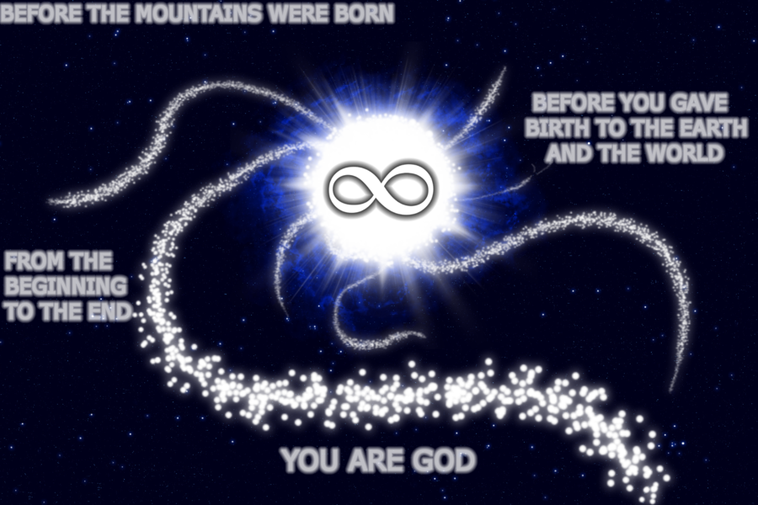
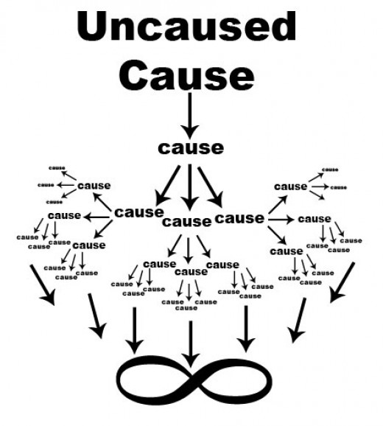
Accounting for Existence
Acts 17:28-29 – “For in Him we live and move and exist, as even some of your own poets have said, ‘For we also are His children.’ Being then the children of God, we ought not to think that the Divine Nature is like gold or silver or stone, an image formed by the art and thought of man.”

Slide 17
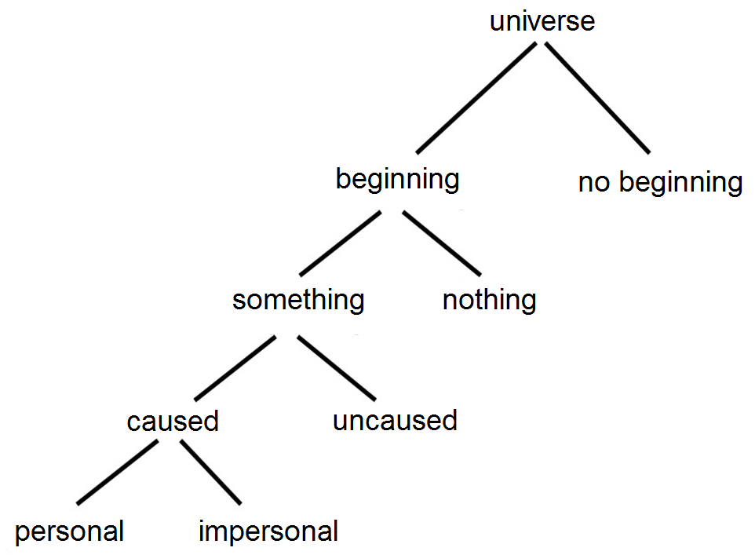
Accounting for Existence

Slide 18
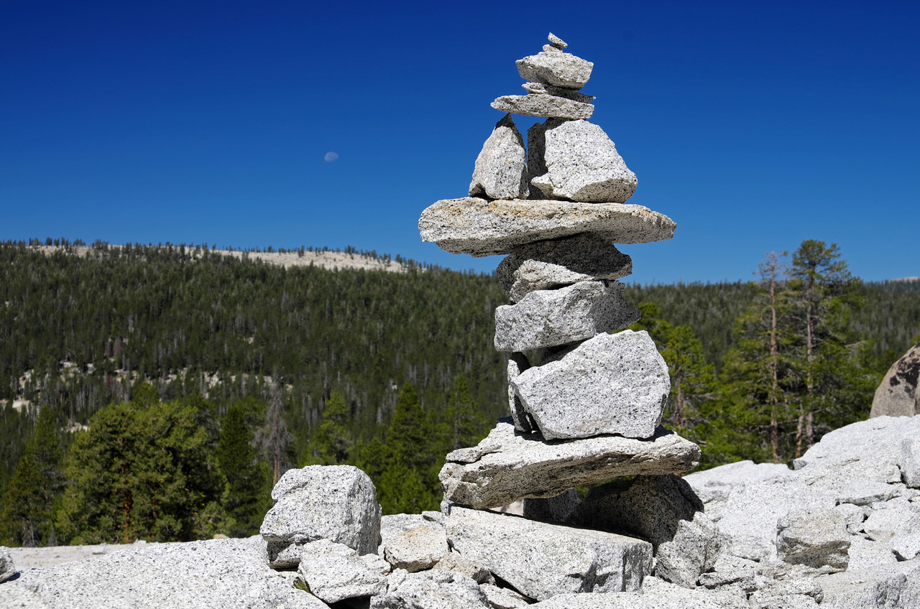
Accounting for Existence

Slide 19
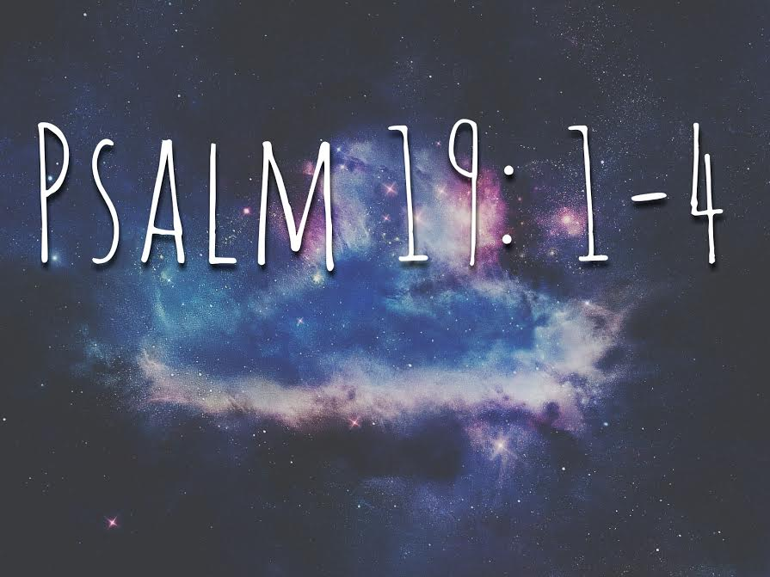
Accounting for Existence

