Slide 3
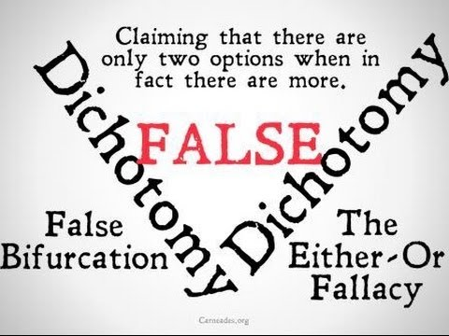
False Dichotomy
Two opposing views, options, or outcomes are presented in such a way that they seem to be the only possibilities
If one is true, the other must be false, or, more typically, if you do not accept one then the other must be accepted.
The reality in most cases is that there are many in-between or other alternative options, not just two mutually exclusive ones.

Slide 4
False Dichotomy
Biblical Example
Matt 22:15-22 – “Then the Pharisees went and plotted together how they might trap Him in what He said. And they sent their disciples to Him, along with the Herodians, saying, ‘Teacher, we know that You are truthful and teach the way of God in truth, and defer to no one; for You are not partial to any. Tell us then, what do You think? Is it lawful to give a poll-tax to Caesar, or not?’ But Jesus perceived their malice, and said, ‘Why are you testing Me, you hypocrites? Show Me the coin used for the poll-tax.’ And they brought Him a denarius. And He said to them, ‘Whose likeness and inscription is this?’ They said to Him, ‘Caesar’s.’ Then He said to them, Then render to Caesar the things that are Caesar’s; and to God the things that are God’s.’ And hearing this, they were amazed, and leaving Him, they went away.”

Slide 5
False Dichotomy
Biblical Example
John 9:1-3 – “As He passed by, He saw a man blind from birth. And His disciples asked Him, ‘Rabbi, who sinned, this man or his parents, that he would be born blind?’ Jesus answered, ‘It was neither that this man sinned, nor his parents; but it was so that the works of God might be displayed in him.’

Slide 6
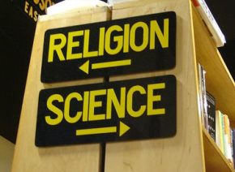
False Dichotomy
Real World Examples
Religion or Relationship?
God’s Sovereignty or Man’s Free Will?
Faith or Works?
Science or Religion?
Love or Discipline?

Slide 7
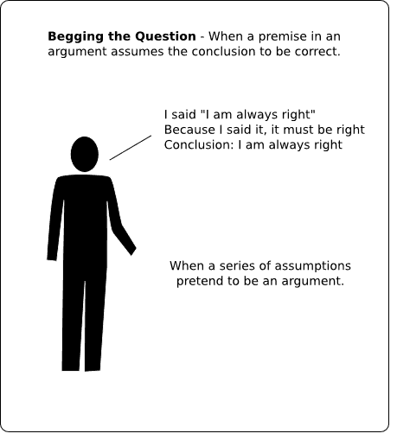
Begging The Question
Occurs when the conclusion of an argument is used as a premise of that same argument
The premise would not work if the conclusion wasn't already assumed true
Often the conclusion is the same as the premise, only reworded

Slide 8
Begging The Question
Biblical Example
Matt 12:22-29 – “Then a demon-possessed man who was blind and mute was brought to Jesus, and He healed him, so that the mute man spoke and saw. All the crowds were amazed, and were saying, ‘This man cannot be the Son of David, can he?’ But when the Pharisees heard this, they said, ‘This man casts out demons only by Beelzebul the ruler of the demons.’ And knowing their thoughts Jesus said to them, ‘Any kingdom divided against itself is laid waste; and any city or house divided against itself will not stand. If Satan casts out Satan, he is divided against himself; how then will his kingdom stand? If I by Beelzebul cast out demons, by whom do your sons cast them out? For this reason they will be your judges. But if I cast out demons by the Spirit of God, then the kingdom of God has come upon you. Or how can anyone enter the strong man’s house and carry off his property, unless he first binds the strong man? And then he will plunder his house.”

Slide 9
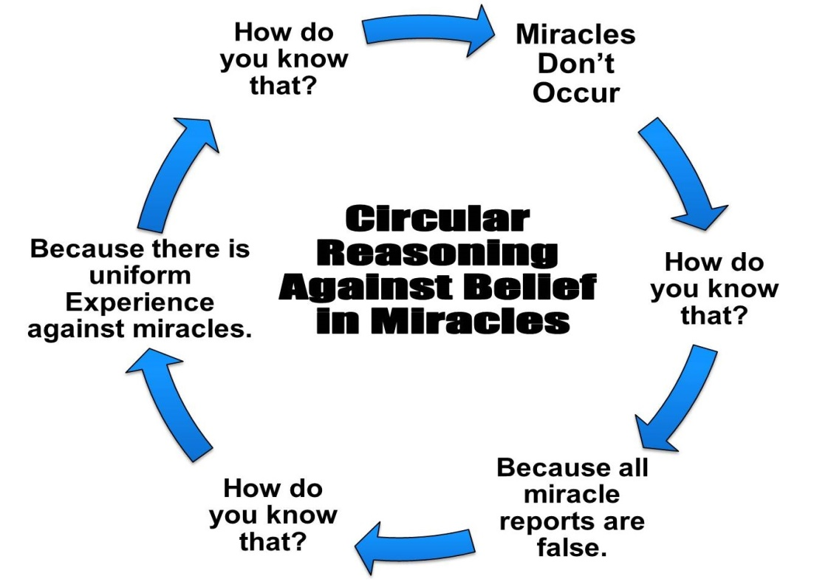
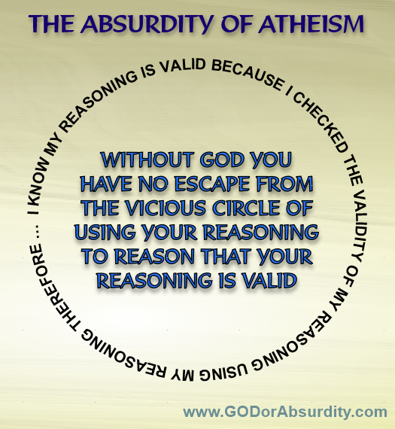
Begging The Question
Real World Examples
Using the bible to prove the bible
The question of suffering

Slide 10
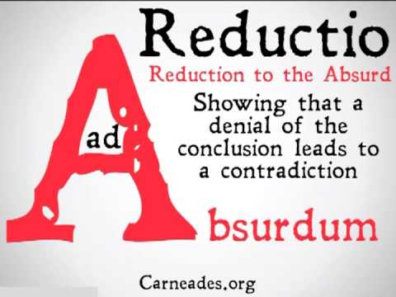
Argument From Absurdity
Trying to approve or disprove a proposition by following its implications logically to an absurd conclusion
Arguments which use universals such as, “always”, “never”, “everyone”, “nobody”, etc., are prone to being reduced to absurd conclusions
Often used in the form of religious hypotheticals

Slide 11
Argument From Absurdity
Biblical Example
Matt 22:23-30 – “On that day some Sadducees (who say there is no resurrection) came to Jesus and questioned Him, asking, ‘Teacher, Moses said, “If a man dies having no children, his brother as next of kin shall marry his wife, and raise up children for his brother.” Now there were seven brothers with us; and the first married and died, and having no children left his wife to his brother; so also the second, and the third, down to the seventh. Last of all, the woman died. In the resurrection, therefore, whose wife of the seven will she be? For they all had married her.’ But Jesus answered and said to them, ‘You are mistaken, not understanding the Scriptures nor the power of God. For in the resurrection they neither marry nor are given in marriage, but are like angels in heaven.”

Slide 12
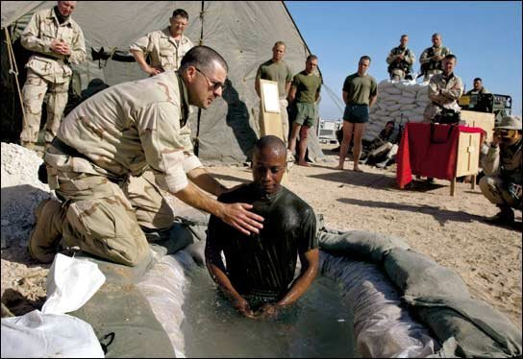
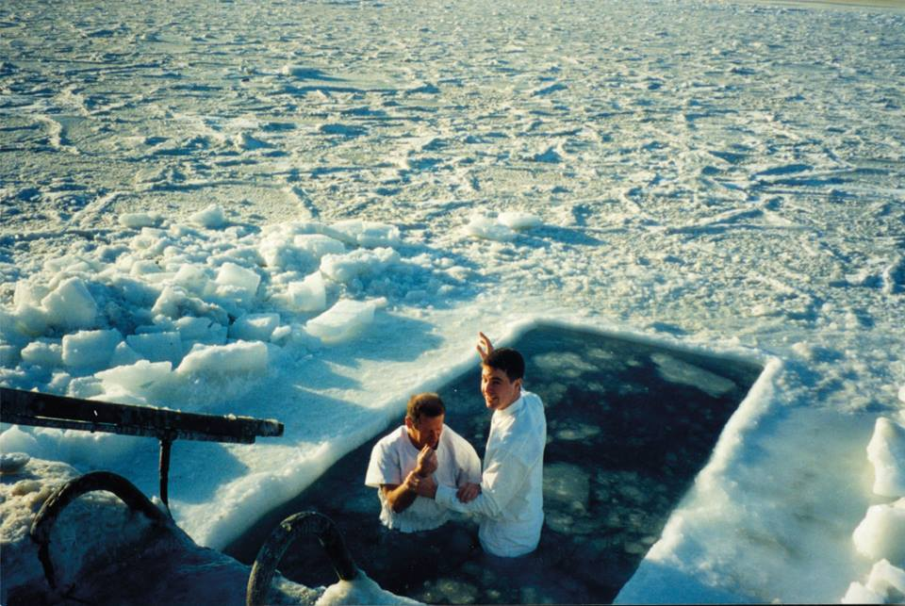
Argument From Absurdity
Real World Examples
Baptizing Eskimos
Baptizing people in the desert
What if the water pipes break?
What if I have a heart attack on the way to be baptized?

