Slide 3
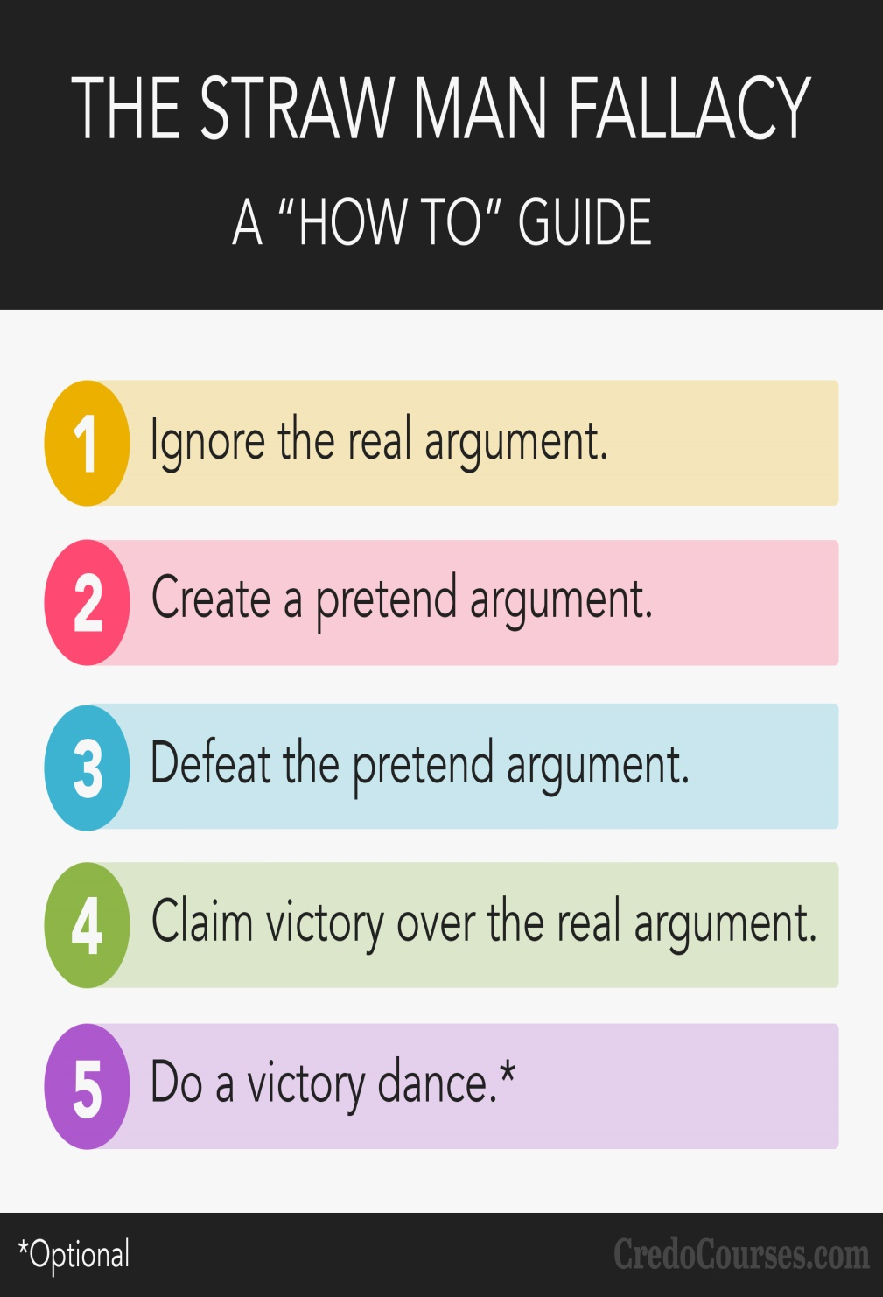
Straw Man
When a person simply ignores the other person's actual position and substitutes a distorted, exaggerated, or misrepresented version of that position
By misrepresenting someone's argument, it's much easier to present your own position as being reasonable. But this serves to undermine honest rational debate

Slide 4
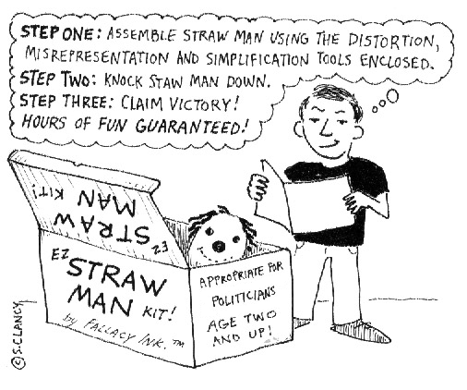
Straw Man
Biblical Example
John 2:19-21 – “Jesus answered them, ‘Destroy this temple, and in three days I will raise it up.’ The Jews then said, ‘It took forty-six years to build this temple, and will You raise it up in three days?’ But He was speaking of the temple of His body.”
Matt 27:39-40 – “And those passing by were hurling abuse at Him, wagging their heads and saying, ‘You who are going to destroy the temple and rebuild it in three days, save Yourself! If You are the Son of God, come down from the cross.’”

Slide 5
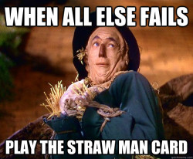
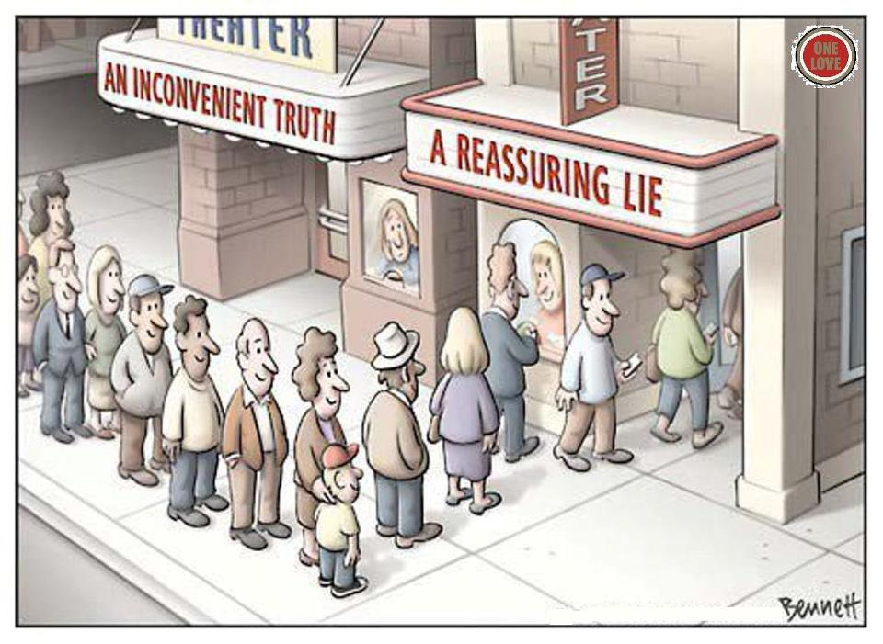
Straw Man
Real World Examples
Faith Only Advocates:
“Baptism doesn’t save, Jesus saves!”
Atheists:
“Believing in God is just as ridicules as believing in the flying spaghetti monster!”

Slide 6
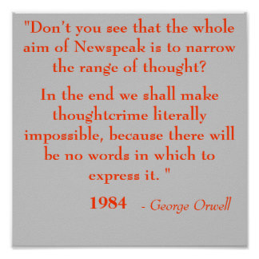
Newspeak
Using the power of language to manipulate and control the way people think about issues
Intentionally reassigning meaning to ordinary words and phrases to promote an agenda
Stigmatizes moral issues and destigmatizes immoral issues

Slide 7
Newspeak
Biblical Example
Isa 5:20 – “Woe to those who call evil good, and good evil; who substitute darkness for light and light for darkness; who substitute bitter for sweet and sweet for bitter!”

Slide 8
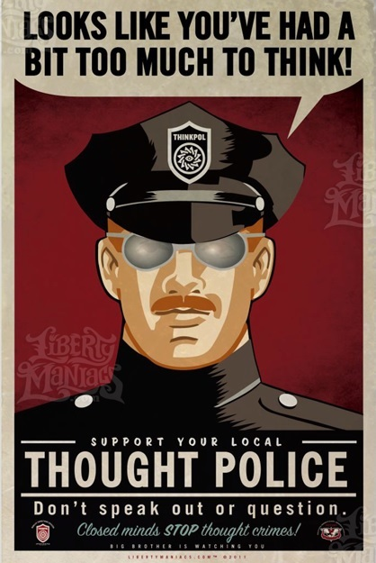
Newspeak
Real World Examples
Fornication = “extra-marital affair”
Homosexuality = “alternative lifestyle”
Covetousness = “ambition”
Pornography = “freedom of expression”
Disagreement = “hate speech”
Rebuke = “judgmental”
Love = “hate”
Equality = “acceptance”

Slide 9
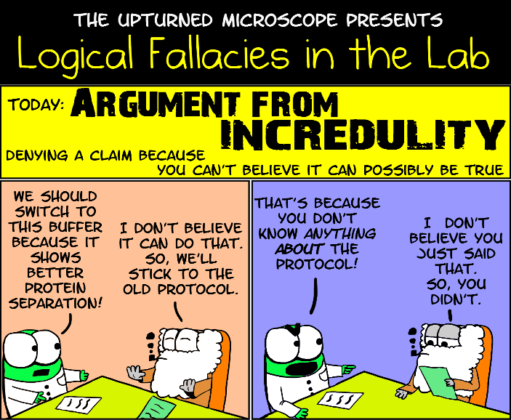
Argument From Incredulity
Believing something can’t be true simply because you find it difficult to understand
Based on lack of understanding, not lack of information
If we cannot imagine it, that doesn’t mean its false. It could mean our imagination is limited

Slide 10
Argument From Incredulity
Biblical Example
John 3:3-9 – “Jesus answered and said to him, ‘Truly, truly, I say to you, unless one is born again he cannot see the kingdom of God.’ Nicodemus said to Him, ‘How can a man be born when he is old? He cannot enter a second time into his mother’s womb and be born, can he?’ Jesus answered, ‘Truly, truly, I say to you, unless one is born of water and the Spirit he cannot enter into the kingdom of God. That which is born of the flesh is flesh, and that which is born of the Spirit is spirit. Do not be amazed that I said to you, “You must be born again.” The wind blows where it wishes and you hear the sound of it, but do not know where it comes from and where it is going; so is everyone who is born of the Spirit.’ Nicodemus said to Him, ‘How can these things be?’”

Slide 11
Argument From Incredulity
Biblical Example
John 6:53-58 – “So Jesus said to them, ‘Truly, truly, I say to you, unless you eat the flesh of the Son of Man and drink His blood, you have no life in yourselves. He who eats My flesh and drinks My blood has eternal life, and I will raise him up on the last day. For My flesh is true food, and My blood is true drink. He who eats My flesh and drinks My blood abides in Me, and I in him. As the living Father sent Me, and I live because of the Father, so he who eats Me, he also will live because of Me. This is the bread which came down out of heaven; not as the fathers ate and died; he who eats this bread will live forever.’”
John 6:60 – “Therefore many of His disciples, when they heard this said, ‘This is a difficult statement; who can listen to it?’”

Slide 12
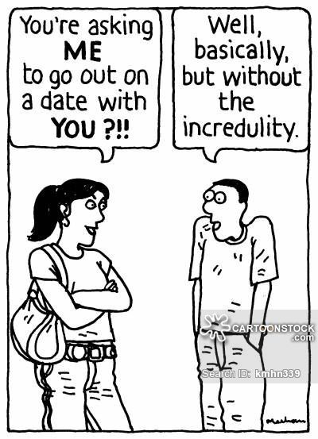
Argument From Incredulity
Real World Examples
The Atheist
The question of suffering
The Sinner
“God could never forgive me”
The Muslim
“How can a spiritual God have a fleshly Son?”

