Slide 2
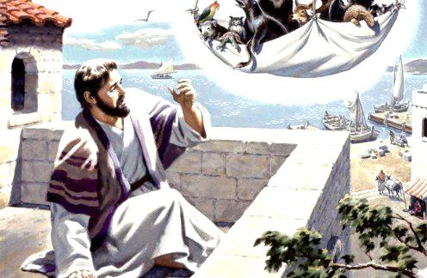
The Problem of Partiality Your Race & Your Religion
Notes:
While our culture is caught up in ethnic division and racial tension, the Christian is called to shine the light of the gospel to all in this world, with no partiality. We are to “honor all men” as we share Christ’s love.

Slide 3
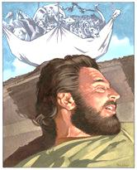
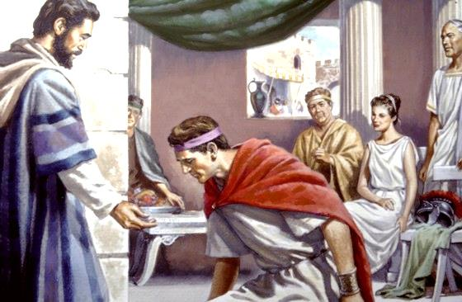
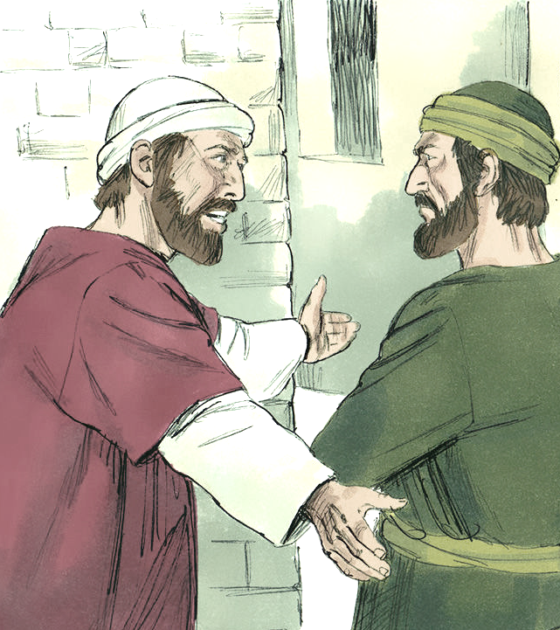
The Problem of Partiality Your Race & Your Religion
Jesus died for all. The gospel is for all nations. (Matthew 28:19; Mark 16:15; Luke 24:46-48)
Consider Peter’s journey from partiality (Acts 10:9-35; Galatians 2:11-16)

Slide 4
The Problem of Partiality Your Race & Your Religion
Partiality based on race or ethnicity is sin
It’s not new (John 4:9; Acts 22:21-22)
But Jesus broke through ethnic barriers (Luke 10:29-37; 17:11-19; John 4)
Disciples of Jesus must not show partiality (1 Timothy 5:21; James 2:1; Acts 10:34-35; Galatians 3:27-29; 1 Thess. 5:15; 1 Peter 2:17)
Our speech should demean none and persuade all (Titus 1:12; 1 Cor. 9:19-22; Eph. 4:29)

Slide 5
The Problem of Partiality Your Race & Your Religion
“Do all things without grumbling or disputing, that you may be blameless and innocent, children of God without blemish in the midst of a crooked and twisted generation, among whom you shine as lights in the world.” (Philippians 2:14-15)

