Slide 2
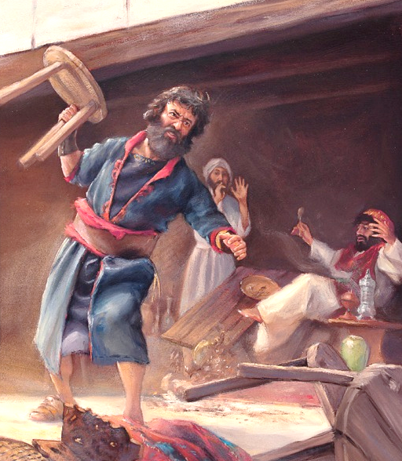
Working to be Remembered
Nehemiah
Notes:
Nehemiah’s dedication to God’s work was fueled by a passionate love for God and for the welfare of God’s people; that passion is clearly manifested in his prayer life. It can truly be said that Nehemiah rebuilt the walls of Jerusalem on his knees. We too can do extraordinary work for God, when we start with a heart filled with passion and a life filled with prayer.

Slide 3
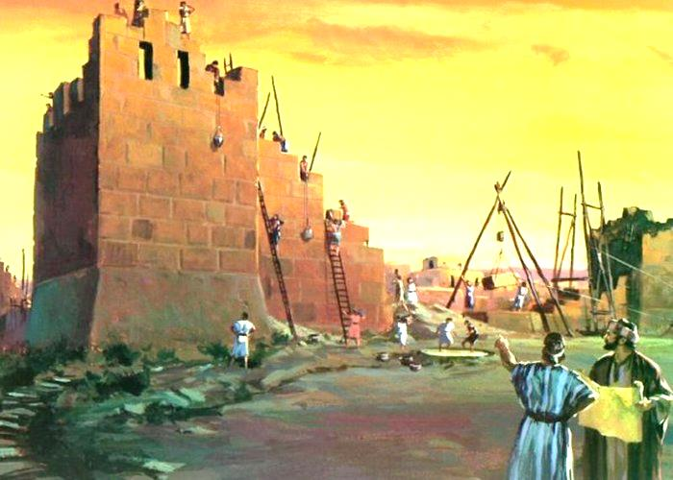
Nehemiah Worked in View of Eternity Nehemiah 5:19; Ecclesiastes 2:16

Slide 4
God’s Work Must Not Be Sullied Nehemiah 13:1-9
Tobiah the Ammonite had moved into a room adjacent to the Temple (Deut. 23:3-5)
Nehemiah was grieved. He evicted Tobiah! (cf. John 2:14-16; Eph. 5:27)

Slide 5
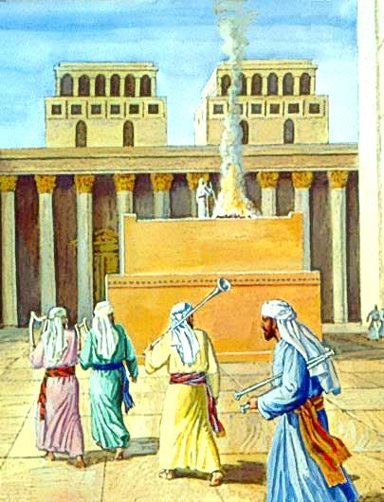
Workers Must Be Supported Nehemiah 13:1-32
The Law of Moses required the Israelites to provide for the Levites (Deuteronomy 12:19)
We are to provide for gospel preachers (1 Cor. 9:7-14; Acts 20:34; 2 Thess. 3:7-8)
Nehemiah’s support of God’s workers made him a fellow-worker (13:14; 3 John 8)
The same principle applies today – the Lord credits our account (Phil. 4:15-18)

Slide 6
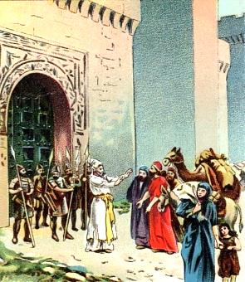
Work Must be Approved by God Nehemiah 13:15-22
Under the Law, the Lord did not approve of working on the Sabbath (Exodus 20:8-10; 34:21; Jer. 17:21; Deut. 5:14)
Nehemiah stopped people from working on the Sabbath.
This principle applies today
Giving & Lord’s Supper (Acts 20:7; 1 Cor. 16:1-2)
Eating common meals (1 Cor. 11:34)

Slide 7
Purity Must be Maintained Nehemiah 13:23-31
The Jews had intermarried with the people of the land.
Foreign influences caused their children to be unable to speak the language of Judah
Do we speak the language of Ashdod? (Eph. 5:3-4)
Nehemiah rebuked them, reminding them of the evil influence of foreign women on Solomon (cf. Proverbs 24:25)

Slide 8
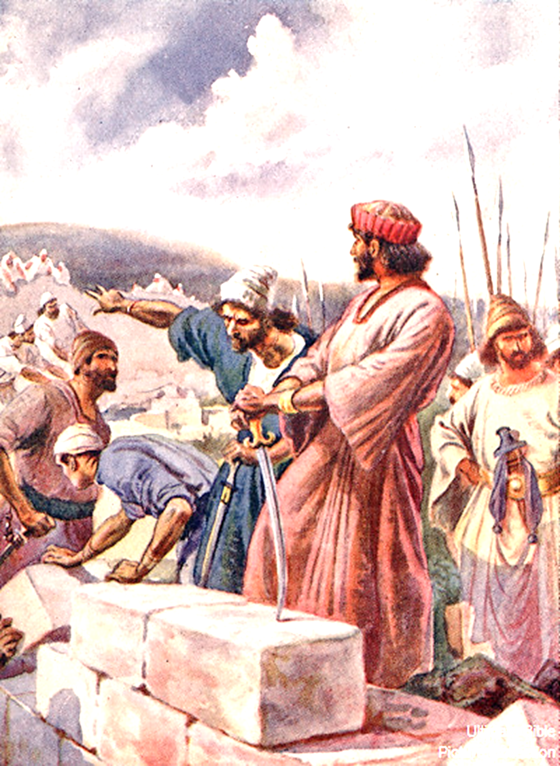
“Remember Me, oh My God” Nehemiah 13:14, 22, 31
Every person will be judged by their works (Revelation 20:12-13; 14:13)
God will not forget! (Hebrews 6:10; Malachi 3:16-18)
Let’s do works to be remembered! (Luke 23:42; Matthew 7:21-23)

