Slide 2
1) Casual, Quick, Convenient
a) 1 Kings 12:28
McChurch
1 Kings 12:28 – So the king consulted, and made two golden calves, and he said to them, “It is too much for you to go up to Jerusalem; behold your gods, O Israel, that brought you up from the land of Egypt.”

Slide 3
1) Casual, Quick, Convenient
a) 1 Kings 12:28
b) Ex 19:10-15a
McChurch
Ex 19:10-15a – The Lord also said to Moses, “Go to the people and consecrate them today and tomorrow, and let them wash their garments; and let them be ready for the third day, for on the third day the Lord will come down on Mount Sinai in the sight of all the people. You shall set bounds for the people all around, saying, ‘Beware that you do not go up on the mountain or touch the border of it; whoever touches the mountain shall surely be put to death. No hand shall touch him, but he shall surely be stoned or shot through; whether beast or man, he shall not live.’ When the ram’s horn sounds a long blast, they shall come up to the mountain.” So Moses went down from the mountain to the people and consecrated the people, and they washed their garments. He said to the people, ‘Be ready for the third day; do not go near a woman…’

Slide 4
1) Casual, Quick, Convenient
a) 1 Kings 12:28
b) Ex 19:10-15a
c) Psa 95:6
McChurch
Psa 95:6 – Come, let us worship and bow down, let us kneel before the Lord our Maker.

Slide 5
1) Casual, Quick, Convenient
2) Consumer Mentality
a) Heb 10:24
McChurch
Heb 10:24 – Let us consider how to stimulate one another to love and good deeds.

Slide 6
1) Casual, Quick, Convenient
2) Consumer Mentality
a) Heb 10:24
McChurch
b) 1 Cor 14:40
1 Cor 14:40 – But all things must be done properly and in an orderly manner.

Slide 7
1) Casual, Quick, Convenient
2) Consumer Mentality
a) Heb 10:24
McChurch
b) 1 Cor 14:40
c) Heb 12:28-29
Heb 12:28-29 – Therefore, since we receive a kingdom which cannot be shaken, let us show gratitude, by which we may offer to God an acceptable service with reverence and awe; for our God is a consuming fire.

Slide 8
1) Casual, Quick, Convenient
2) Consumer Mentality
a) Heb 10:24
McChurch
b) 1 Cor 14:40
c) Heb 12:28-29
d) 1 Cor 1:17; 2:1-2, 4
1 Cor 1:17 – For Christ did not send me to baptize, but to preach the gospel, not in cleverness of speech, so that the cross of Christ would not be made void.
1 Cor 2:1-2 – And when I came to you, brethren, I did not come with superiority of speech or of wisdom, proclaiming to you the testimony of God. For I determined to know nothing among you except Jesus Christ, and Him crucified.
1 Cor 2:4 – And my message and my preaching were not in persuasive words of wisdom, but in demonstration of the Spirit and of power

Slide 9
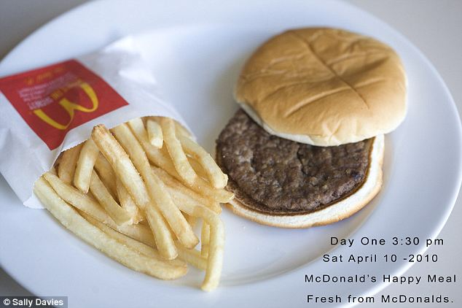
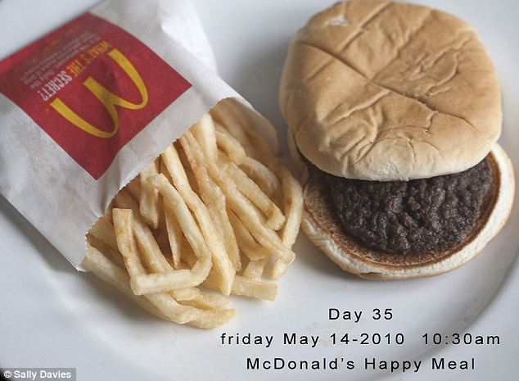
1) Casual, Quick, Convenient
2) Consumer Mentality
3) Junk Food
McChurch

Slide 10
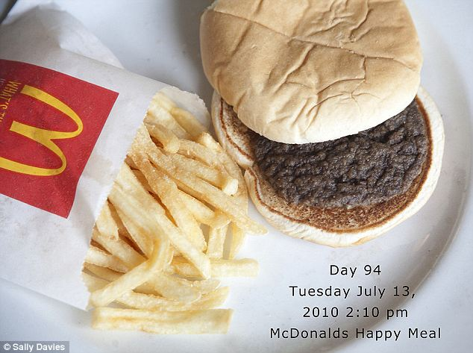
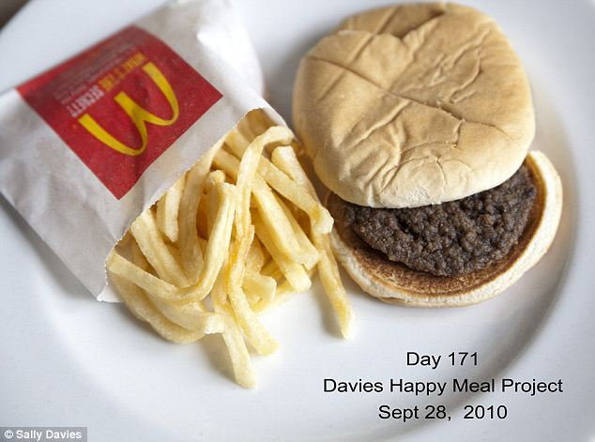
1) Casual, Quick, Convenient
2) Consumer Mentality
3) Junk Food
McChurch

Slide 11
1) Casual, Quick, Convenient
2) Consumer Mentality
3) Junk Food
McChurch
a) 2 Tim 4:3-4
2 Tim 4:3-4 – For the time will come when they will not endure sound doctrine; but wanting to have their ears tickled, they will accumulate for themselves teachers in accordance to their own desires, and will turn away their ears from the truth and will turn aside to myths.

Slide 12
1) Casual, Quick, Convenient
2) Consumer Mentality
3) Junk Food
McChurch
a) 2 Tim 4:3-4
b) Num 11:4-6
Num 11:4-6 – The rabble who were among them had greedy desires; and also the sons of Israel wept again and said, “Who will give us meat to eat? We remember the fish which we used to eat free in Egypt, the cucumbers and the melons and the leeks and the onions and the garlic, but now our appetite is gone. There is nothing at all to look at except this manna.”

Slide 13
1) Casual, Quick, Convenient
2) Consumer Mentality
3) Junk Food
McChurch
a) 2 Tim 4:3-4
b) Num 11:4-6
c) 1 Pet 2:2
1 Pet 2:2 – Like newborn babies, long for the pure milk of the word, so that by it you may grow.

