Slide 3
Hebrew
Roman

Slide 4
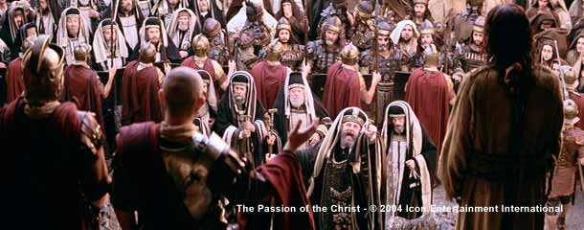
Pontius Pilate
Luke 23:5 – “But they kept on insisting, saying, ‘He stirs up the people, teaching all over Judea, starting from Galilee even as far as this place.’”

Slide 5
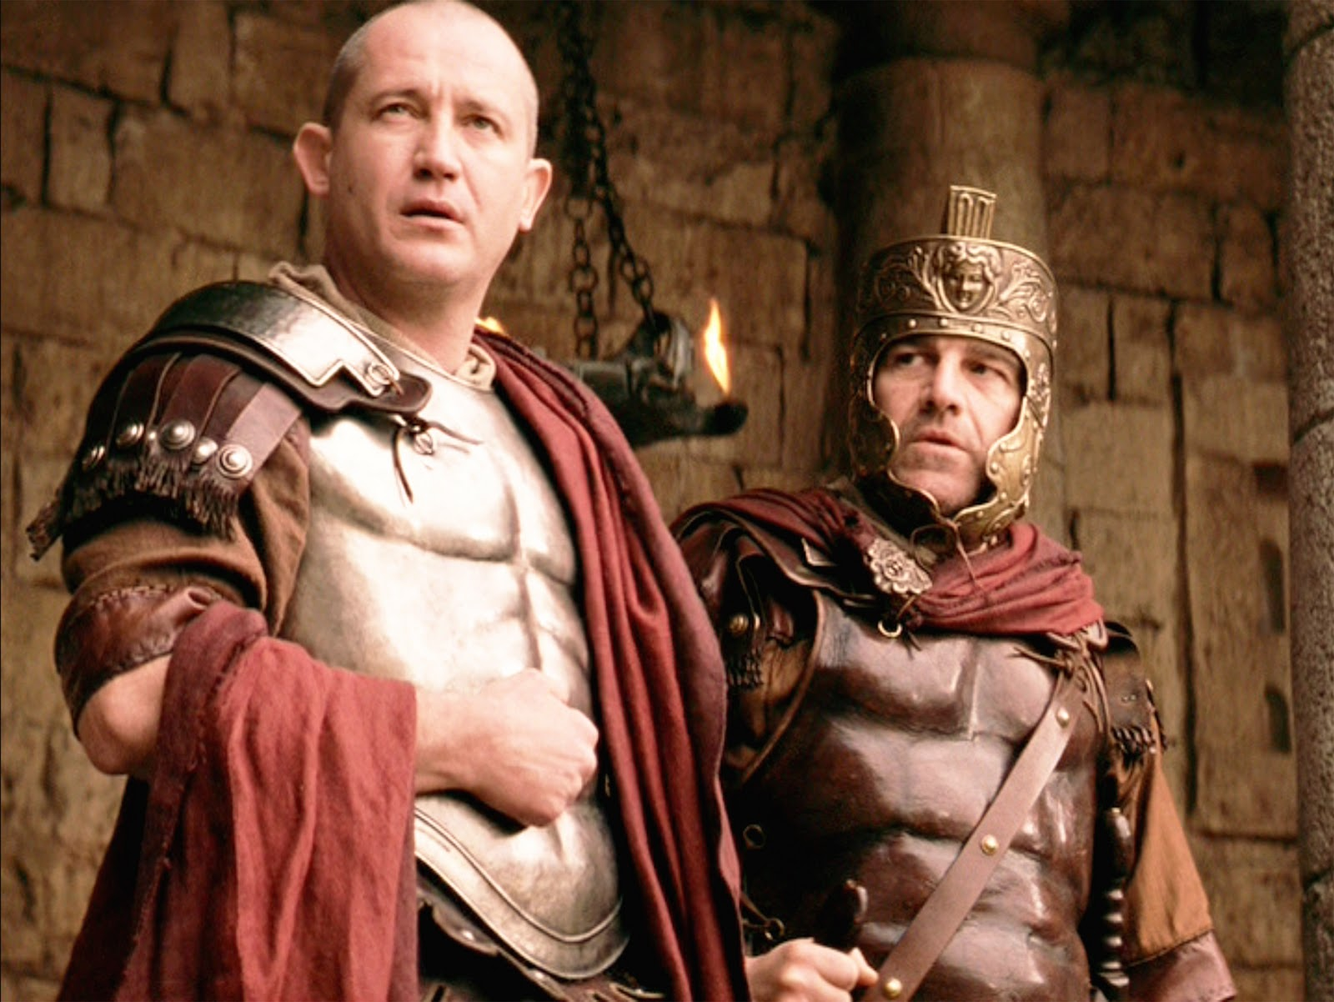
Pontius Pilate
Luke 23:6-7 – “When Pilate heard it, he asked whether the man was a Galilean. And when he learned that He belonged to Herod’s jurisdiction, he sent Him to Herod, who himself also was in Jerusalem at that time.”

Slide 6
Antipater
Herod the Great
(Matt 2:1-19)
Mariamme I
(Jew/Hasmonean)
Mariamme II
(Jew/Priestly)
Malthace
(Samaritan)
Cleopatra
(Jew)
Aristobulus
Philip
(Mark 6:17)
Archelaus
(Matt 2:22)
Herod Antipas
(Mark 6:14-29; Luke 3:1; 23:6-12)
Philip
(Luke 3:1)
Herod Agrippa I
(Acts 12:1-4, 20-23)
Herodias
(Mark 6:14-29)
Bernice
(Acts 25:13)
Herod Agrippa II
(Acts 25:13-26:32)
Drusilla
(Acts 24:24)
Salome
(Mark 6:14-29)

Slide 7
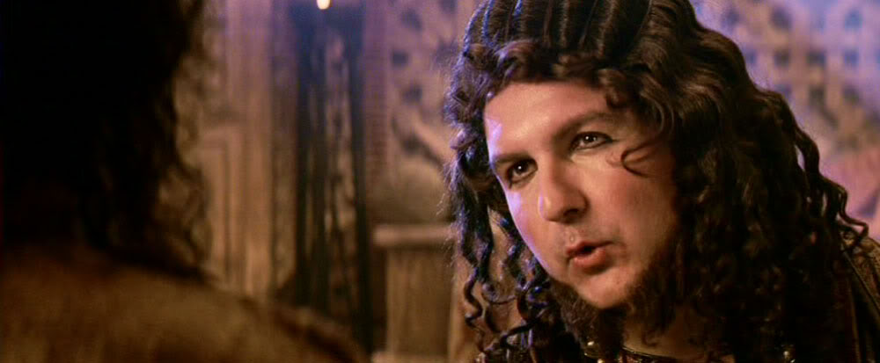
Herod Antipas
Luke 23:8 – “Now Herod was very glad when he saw Jesus; for he had wanted to see Him for a long time, because he had been hearing about Him and was hoping to see some sign performed by Him.”

Slide 8
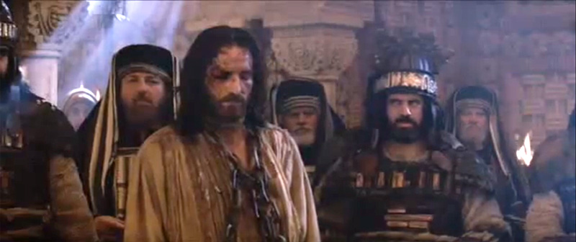
Herod Antipas
Luke 23:9 – “And he questioned Him at some length; but He answered him nothing.”
Luke 23:10 – “And the chief priests and the scribes were standing there, accusing Him vehemently.”

Slide 9
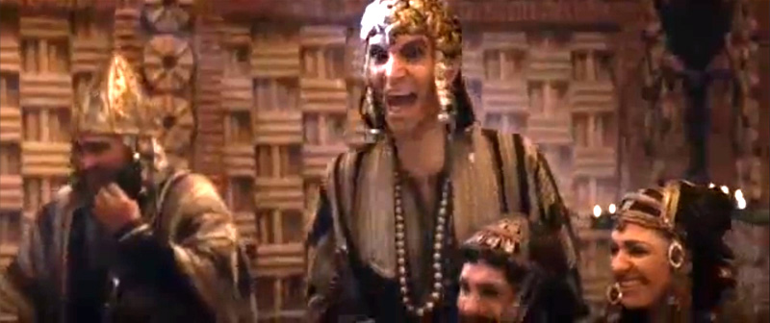
Herod Antipas
Luke 23:11 – “And Herod with his soldiers, after treating Him with contempt and mocking Him, dressed Him in a gorgeous robe and sent Him back to Pilate.”
Luke 23:12 – “Now Herod and Pilate became friends with one another that very day; for before they had been enemies with each other.”

Slide 10
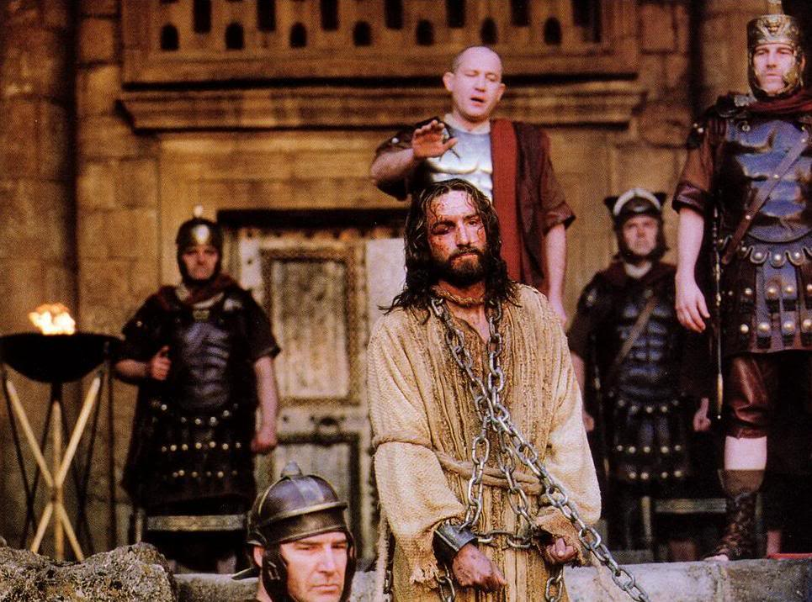
Pontius Pilate
Luke 23:13-15 – “Pilate summoned the chief priests and the rulers and the people, and said to them, ‘You brought this man to me as one who incites the people to rebellion, and behold, having examined Him before you, I have found no guilt in this man regarding the charges which you make against Him. No, nor has Herod, for he sent Him back to us; and behold, nothing deserving death has been done by Him.’”

Slide 12
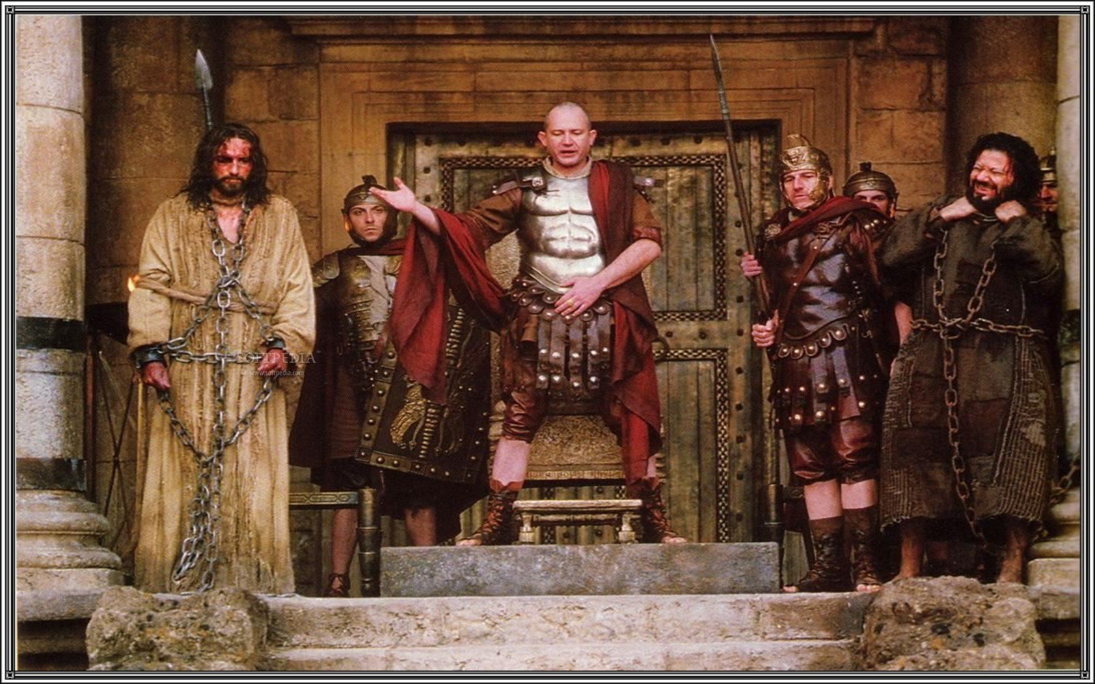
Pontius Pilate
John 18:39 – “But you have a custom that I release someone for you at the Passover; do you wish then that I release for you the King of the Jews?”
Luke 23:18-19 – “But they cried out all together, saying, ‘Away with this man, and release for us Barabbas!’ (He was one who had been thrown into prison for an insurrection made in the city, and for murder.)”

Slide 13
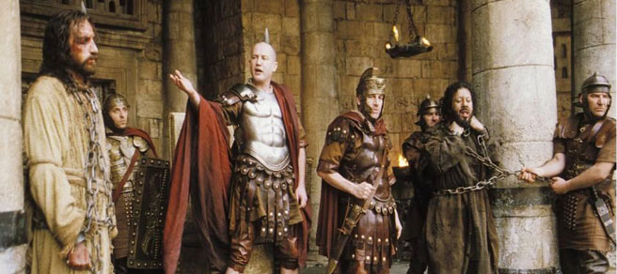
Pontius Pilate
Matt 27:22-23 – “Pilate said to them, ‘Then what shall I do with Jesus who is called Christ?’ They all said, ‘Crucify Him!’ And he said, ‘Why, what evil has He done?’ But they kept shouting all the more, saying, ‘Crucify Him!’”

Slide 14
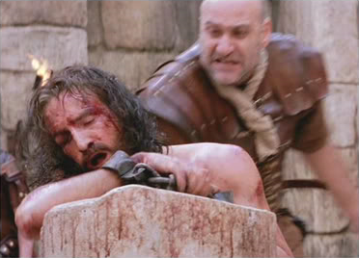
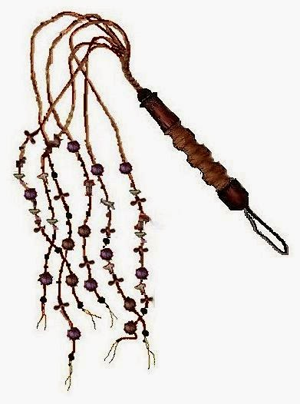
Pontius Pilate
John 19:1 – Pilate then took Jesus and scourged Him

Slide 15
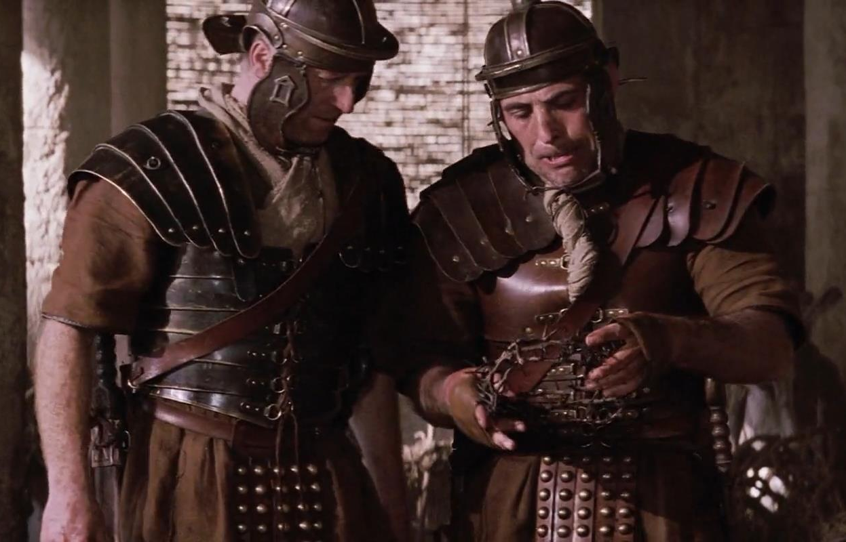
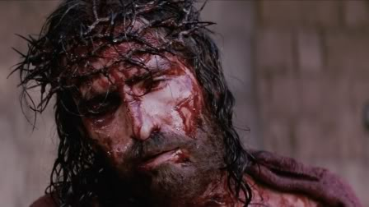
Pontius Pilate
John 19:2-5 – “And the soldiers twisted together a crown of thorns and put it on His head, and put a purple robe on Him; and they began to come up to Him and say, ‘Hail, King of the Jews!’ and to give Him slaps in the face. Pilate came out again and said to them, ‘Behold, I am bringing Him out to you so that you may know that I find no guilt in Him.’ Jesus then came out, wearing the crown of thorns and the purple robe. Pilate said to them, ‘Behold, the Man!”’

Slide 16
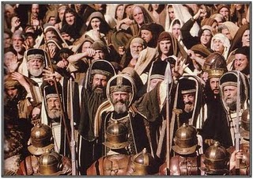
Pontius Pilate
John 19:6a – “So when the chief priests and the officers saw Him, they cried out saying, ‘Crucify, crucify!’”
John 19:6b – “Pilate said to them, ‘Take Him yourselves and crucify Him, for I find no guilt in Him.’”

Slide 17
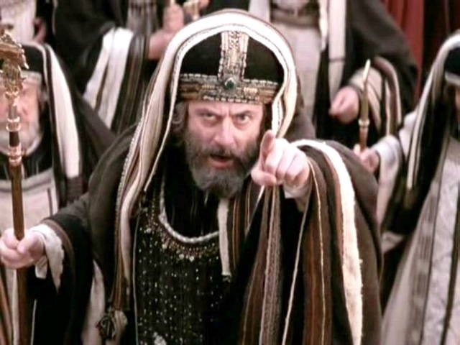
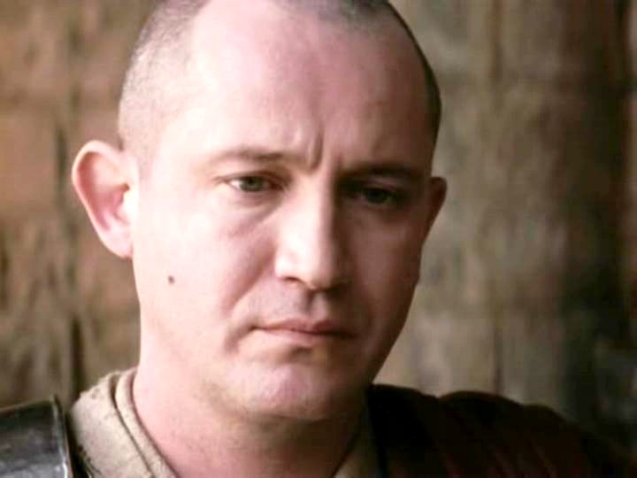
Pontius Pilate
John 19:7 – “The Jews answered him, ‘We have a law, and by that law He ought to die because He made Himself out to be the Son of God.’”
John 19:8 – “Therefore when Pilate heard this statement, he was even more afraid.”

Slide 18
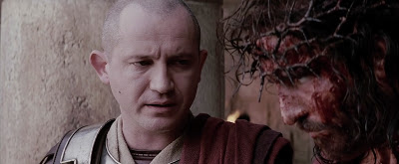
Pontius Pilate
John 19:9-10 – “And he entered into the Praetorium again and said to Jesus, ‘Where are You from?’ But Jesus gave him no answer. So Pilate said to Him, ‘You do not speak to me? Do You not know that I have authority to release You, and I have authority to crucify You?’”
John 19:11 – “Jesus answered, ‘You would have no authority over Me, unless it had been given you from above; for this reason he who delivered Me to you has the greater sin.’”

Slide 19
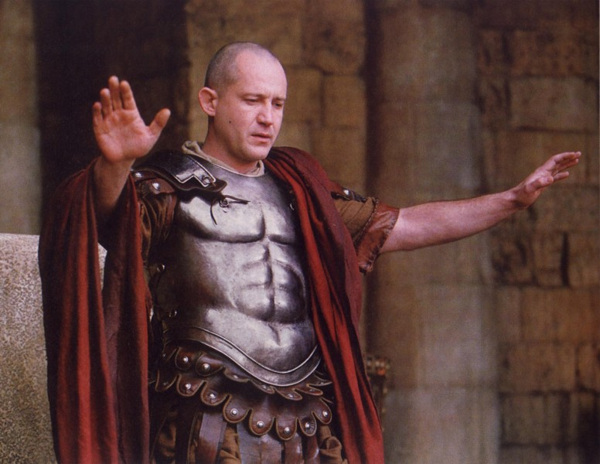
Pontius Pilate
John 19:12a – “As a result of this Pilate made efforts to release Him”
John 19:12b – “But the Jews cried out saying, ‘If you release this Man, you are no friend of Caesar; everyone who makes himself out to be a king opposes Caesar.’”

Slide 20
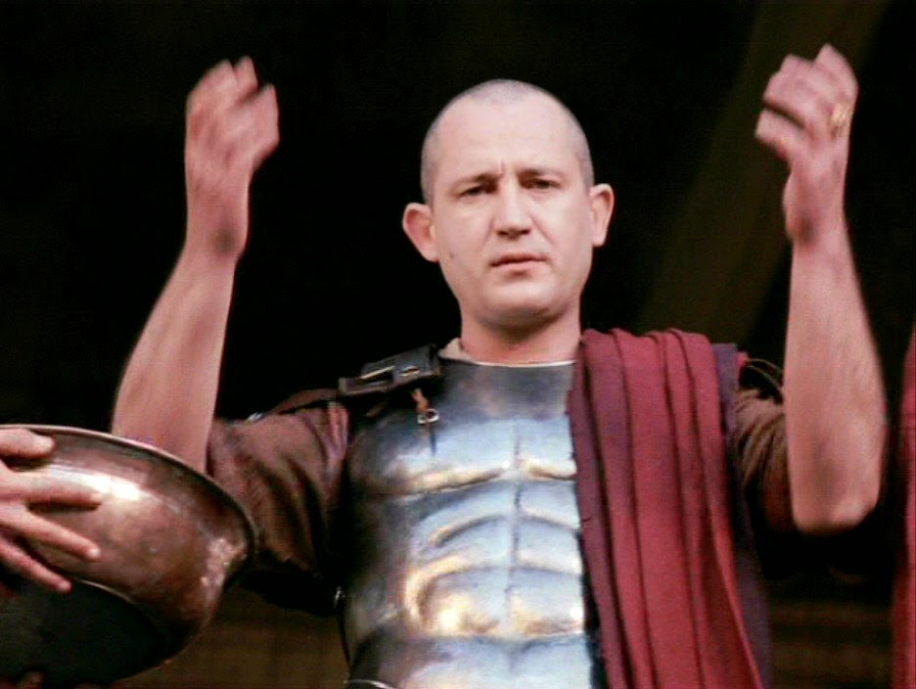
Pontius Pilate
Matt 27:24-25 – “When Pilate saw that he was accomplishing nothing, but rather that a riot was starting, he took water and washed his hands in front of the crowd, saying, ‘I am innocent of this Man’s blood; see to that yourselves.’ And all the people said, ‘His blood shall be on us and on our children!’”

Slide 21
Hebrew
Roman
Annas?
Guilty
Pilate?
Innocent
Caiaphas?
Guilty
Antipas?
Innocent
Sanhedin?
Guilty
Pilate?
Innocent

Slide 22
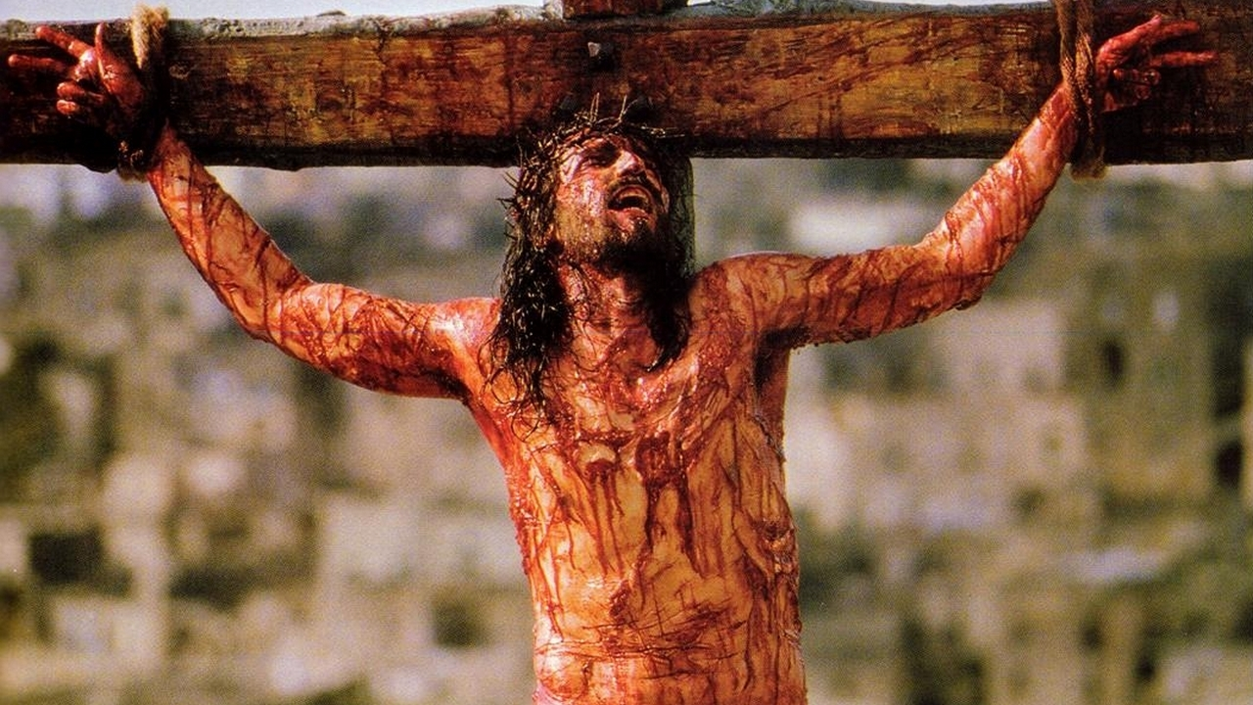
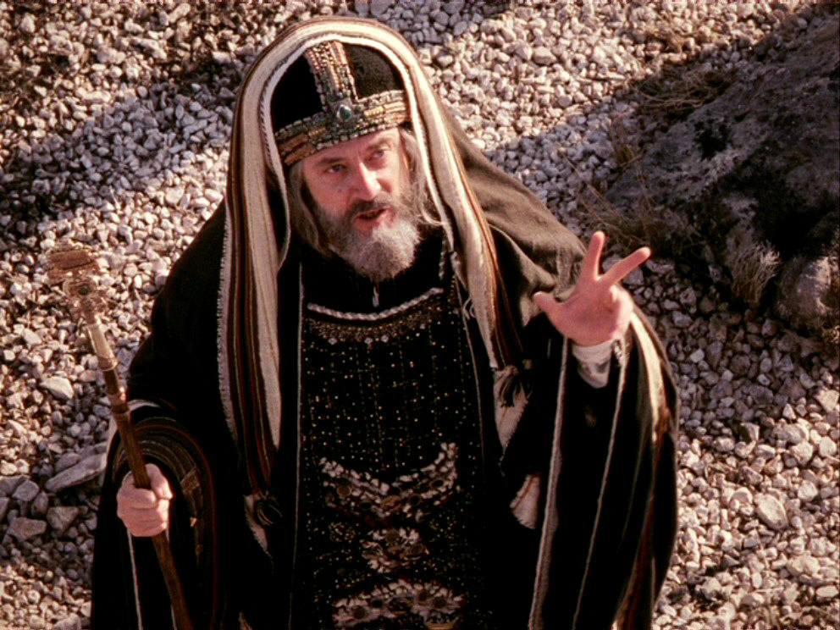
John 1:11 – “He came to His own, and those who were His own did not receive Him.”
William Blackstone – “It is better that ten guilty persons escape than that one innocent suffer.”
1 Pet 3:18a – “For Christ also died for sins once for all, the just for the unjust, so that He might bring us to God…”

