Slide 2
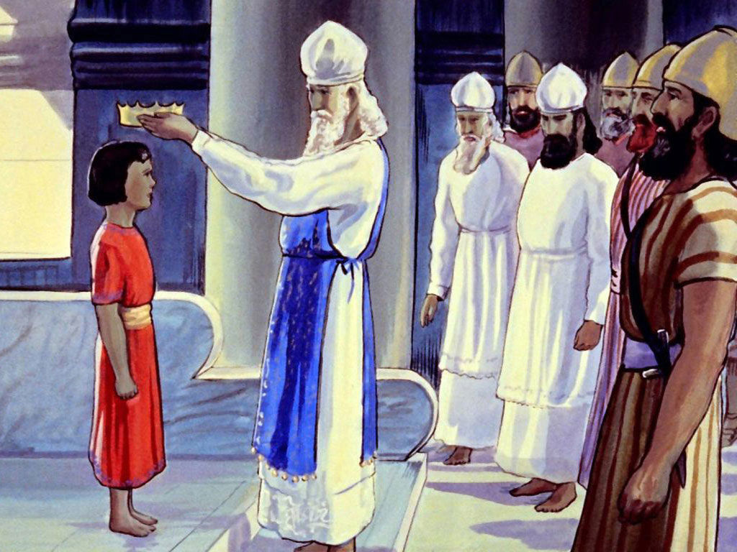
Josiah
Seeks The Lord
2 Chron 34:1-2

Slide 3
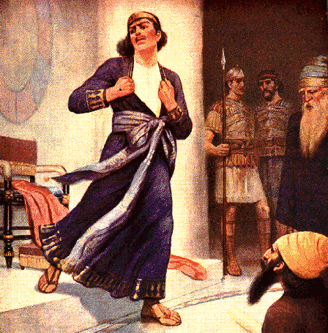
Josiah
Seeks The Lord
2 Chron 34:1-2
Respected God’s Law
2 Chron 34:14-19
2 Chron 34:29-31
2 Chron 34:32-33

Slide 4
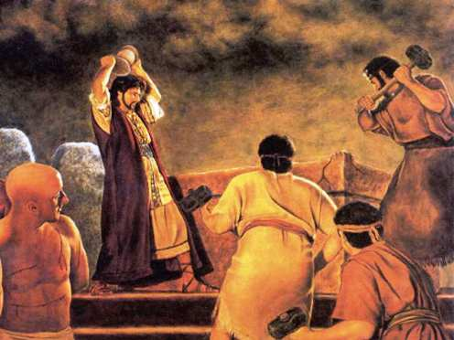
Josiah
Seeks The Lord
2 Chron 34:1-2
Respected God’s Law
2 Chron 34:14-19
2 Chron 34:29-31
2 Chron 34:32-33
Total Obedience
2 Chron 34:4-6
2 Chron 34:32
2 Chron 35:18
Deut 4:2; 6:5

Slide 5
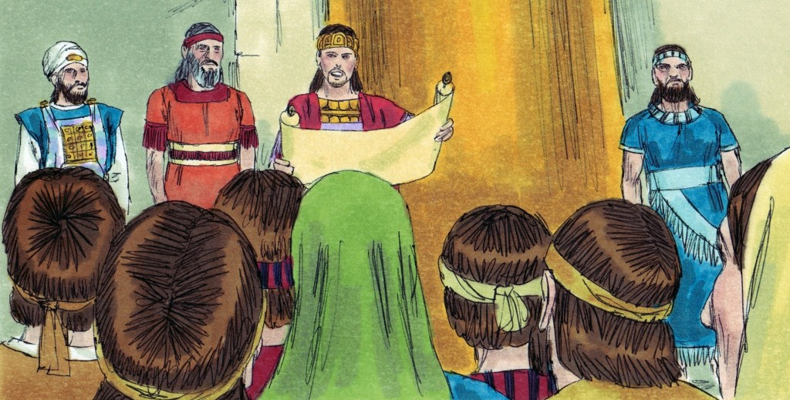
Josiah
Seeks The Lord
2 Chron 34:1-2
Respected God’s Law
2 Chron 34:14-19
2 Chron 34:29-31
2 Chron 34:32-33
Complete Obedience
2 Chron 34:4-6
2 Chron 34:32
2 Chron 35:18
Deut 4:2; 6:5
Did What He Could
2 Chron 34:23-28

