Slide 2
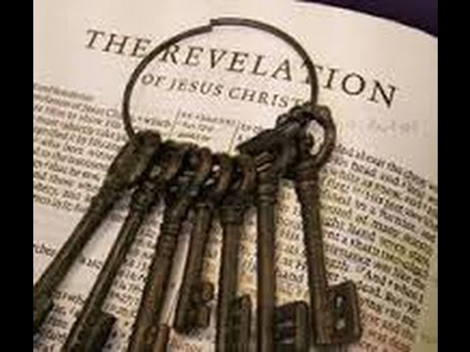
Unlocking Revelation
1) Must Soon Take Place
Rev 1:1a,3; 22:6,10
2) Signs & Symbols
Rev 1:1b, 10-20
3) Meaning of Numbers
Rev 1:11; 4:4; 7:4; 13:18
4) Overcome
Rev 2:7,11,17,26; 3:5,12,21

Slide 3
Unlocking Revelation
Church’s Struggle On Earth (ch. 1 – 11)
Christ In The Midst Of The Lampstands (1 – 3)
The Book w/7 Seals (4 – 7)
The 7 Trumpet Judgments (8 – 11 )
Deeper Spiritual Background (ch. 12 – 23)
The Woman, Child, Dragon, & Beasts (12 – 14)
The 7 Bowls of Wrath (15 – 16)
Fall Of The Harlot, Beasts, & Dragon (17 – 20)
New Heaven & Earth (21 – 22)

Slide 4
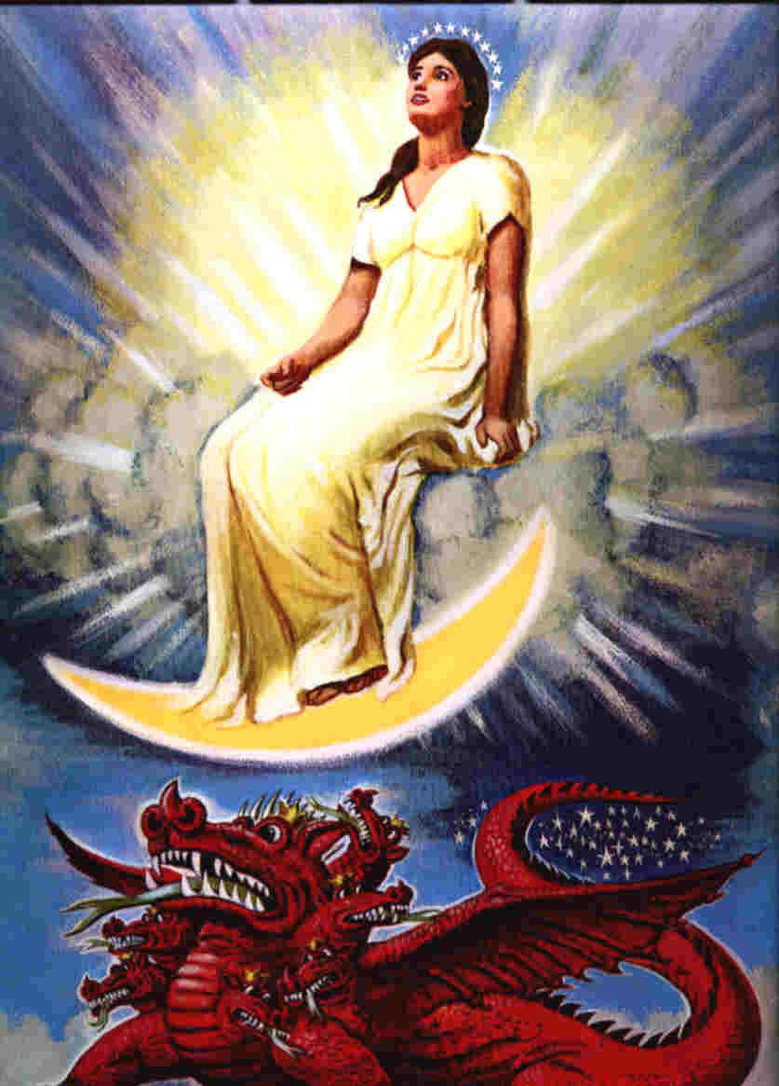
Unlocking Revelation
Rev 12:1-5 – “Now a great sign appeared in heaven: a woman clothed with the sun, with the moon under her feet, and on her head a garland of twelve stars. Then being with child, she cried out in labor and in pain to give birth. And another sign appeared in heaven: behold, a great, fiery red dragon having seven heads and ten horns, and seven diadems on his heads. His tail drew a third of the stars of heaven and threw them to the earth. And the dragon stood before the woman who was ready to give birth, to devour her Child as soon as it was born. She bore a male Child who was to rule all nations with a rod of iron. And her Child was caught up to God and His throne.”

Slide 5
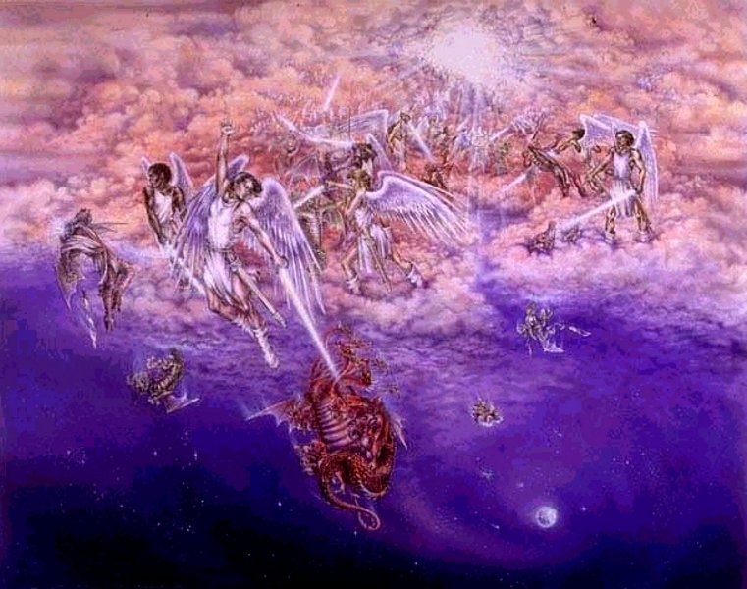
Unlocking Revelation
Rev 12:7-8 – “And war broke out in heaven: Michael and his angels fought with the dragon; and the dragon and his angels fought, but they did not prevail, nor was a place found for them in heaven any longer.”
Rev 12:10 – “Then I heard a loud voice saying in heaven, ‘Now salvation, and strength, and the kingdom of our God, and the power of His Christ have come, for the accuser of our brethren, who accused them before our God day and night, has been cast down.’”
Rev 12:13 – “Now when the dragon saw that he had been cast to the earth, he persecuted the woman who gave birth to the male Child.”

Slide 6
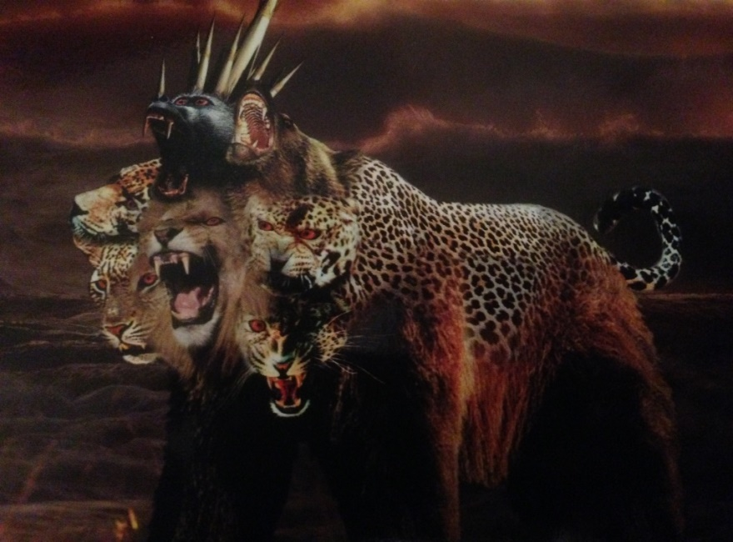
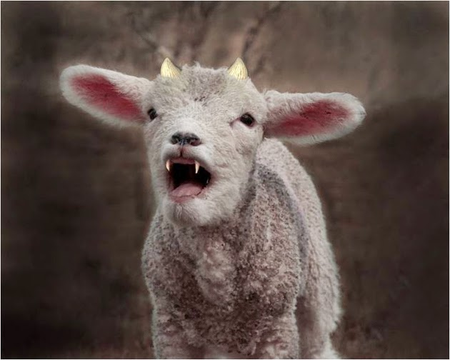
Unlocking Revelation
Rev 13:1 – “Then I stood on the sand of the sea. And I saw a beast rising up out of the sea, having seven heads and ten horns, and on his horns ten crowns, and on his heads a blasphemous name.”
Rev 13:11 – “Then I saw another beast coming up out of the earth, and he had two horns like a lamb and spoke like a dragon.”

Slide 7
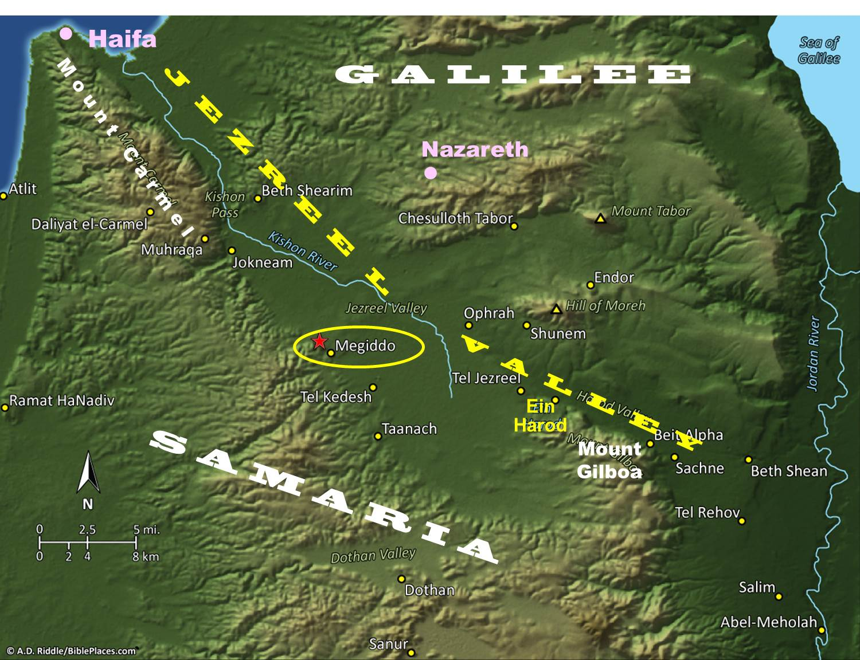
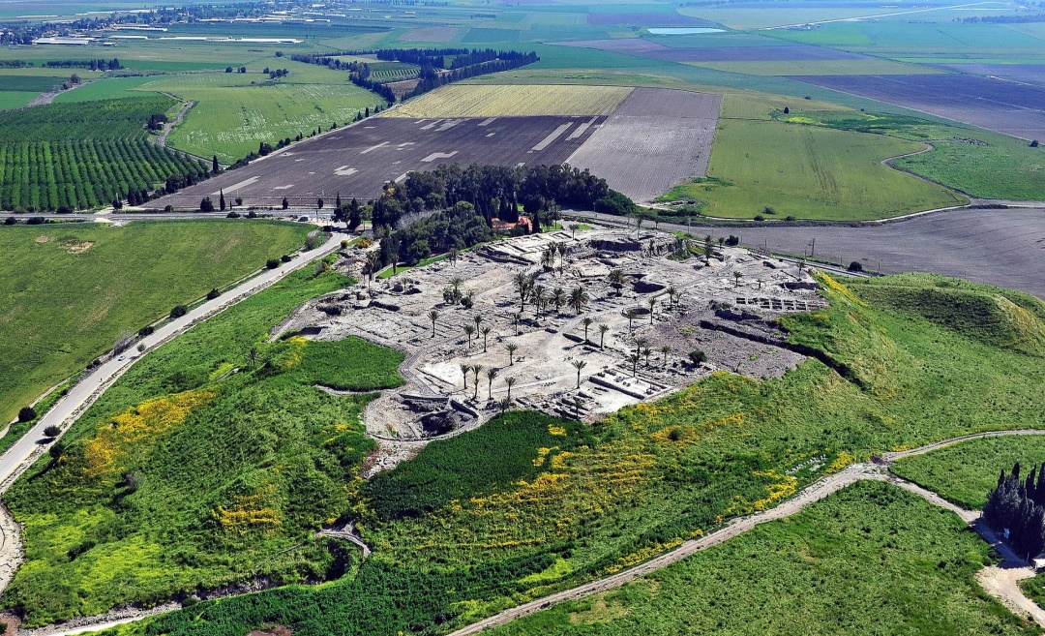
Unlocking Revelation
Rev 16:13-16 – “And I saw coming out of the mouth of the dragon and out of the mouth of the beast and out of the mouth of the false prophet, three unclean spirits like frogs; for they are spirits of demons, performing signs, which go out to the kings of the whole world, to gather them together for the war of the great day of God, the Almighty. (“Behold, I am coming like a thief. Blessed is the one who stays awake and keeps his clothes, so that he will not walk about naked and men will not see his shame.”) And they gathered them together to the place which in Hebrew is called Har-Magedon.”

Slide 8
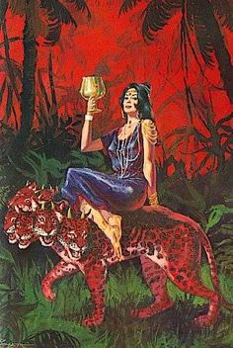
Unlocking Revelation
Rev 17:3-5 – “And he carried me away in the Spirit into a wilderness; and I saw a woman sitting on a scarlet beast, full of blasphemous names, having seven heads and ten horns. The woman was clothed in purple and scarlet, and adorned with gold and precious stones and pearls, having in her hand a gold cup full of abominations and of the unclean things of her immorality, and on her forehead a name was written, a mystery, ‘BABYLON THE GREAT, THE MOTHER OF HARLOTS AND OF THE ABOMINATIONS OF THE EARTH.’”

Slide 9
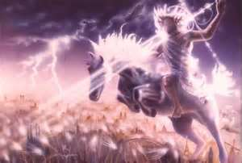
Unlocking Revelation
Rev 19:1-2 – “After these things I heard something like a loud voice of a great multitude in heaven, saying, “Hallelujah! Salvation and glory and power belong to our God; because His judgments are true and righteous; for He has judged the great harlot who was corrupting the earth with her immorality, and He has avenged the blood of His bond-servants on her.”
Rev 19:19-20 – “And I saw the beast, the kings of the earth, and their armies, gathered together to make war against Him who sat on the horse and against His army. Then the beast was captured, and with him the false prophet who worked signs in his presence, by which he deceived those who received the mark of the beast and those who worshiped his image. These two were cast alive into the lake of fire burning with brimstone.”

Slide 10
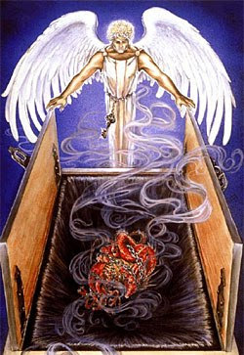
Unlocking Revelation
Rev 20:1-2 – “Then I saw an angel coming down from heaven, having the key to the bottomless pit and a great chain in his hand. He laid hold of the dragon, that serpent of old, who is the Devil and Satan, and bound him for a thousand years”

Slide 11
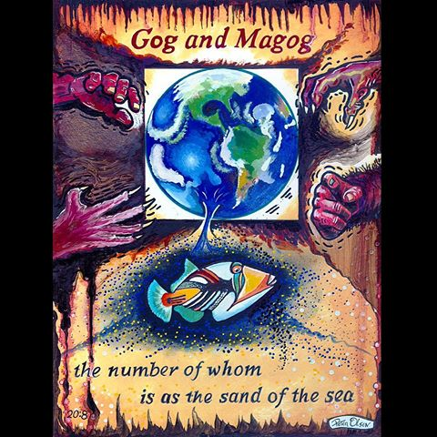
Unlocking Revelation
Rev 20:7-8 – “Now when the thousand years have expired, Satan will be released from his prison and will go out to deceive the nations which are in the four corners of the earth, Gog and Magog, to gather them together to battle, whose number is as the sand of the sea.”
Rev 20:9-10 – “They went up on the breadth of the earth and surrounded the camp of the saints and the beloved city. And fire came down from God out of heaven and devoured them. The devil, who deceived them, was cast into the lake of fire and brimstone where the beast and the false prophet are. And they will be tormented day and night forever and ever.”

Slide 12
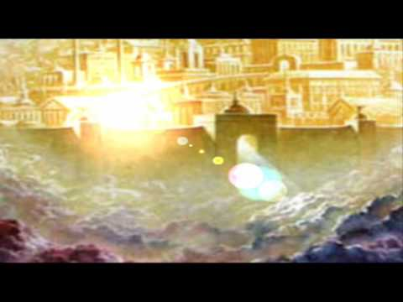
Unlocking Revelation
Rev 21:1-7 – “Then I saw a new heaven and a new earth, for the first heaven and the first earth had passed away, and the sea was no more. And I saw the holy city, new Jerusalem, coming down out of heaven from God, prepared as a bride adorned for her husband. And I heard a loud voice from the throne saying, ‘Behold, the dwelling place of God is with man. He will dwell with them, and they will be his people, and God himself will be with them as their God. He will wipe away every tear from their eyes, and death shall be no more, neither shall there be mourning, nor crying, nor pain anymore, for the former things have passed away.’ And he who was seated on the throne said, ‘Behold, I am making all things new.’ Also he said, ‘Write this down, for these words are trustworthy and true.’ And he said to me, ‘It is done! I am the Alpha and the Omega, the beginning and the end. To the thirsty I will give from the spring of the water of life without payment. The one who conquers will have this heritage, and I will be his God and he will be my son.’”

