Slide 2
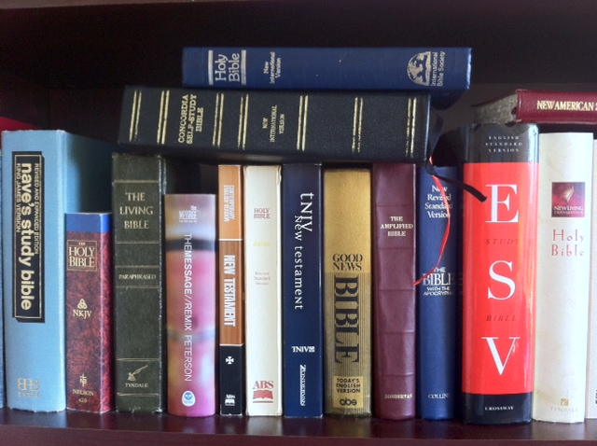

Slide 3
Bible Version Philosophies
Essentially Literal
“The goal of such translation is to render the original text in the receptor language as much as possible, and to make the receptor text as transparent to the syntax, imagery, word usage, ambiguities, etc. as possible.”
Dynamic Equivalence
“Emphasizes the reaction of the reader to the translated text, rather than the translation of the words and phrases themselves. In simplest terms, dynamic equivalence is often referred to as thought for thought, translation as compared to essentially literal translation.”

Slide 5
God’s Words
Matt 10:19-20 – “But when they hand you over, do not worry about how or what you are to say; for it will be given you in that hour what you are to say. For it is not you who speak, but it is the Spirit of your Father who speaks in you.”
1 Cor 2:10-13 – “For to us God revealed them through the Spirit; for the Spirit searches all things, even the depths of God. For who among men knows the thoughts of a man except the spirit of the man which is in him? Even so the thoughts of God no one knows except the Spirit of God. Now we have received, not the spirit of the world, but the Spirit who is from God, so that we may know the things freely given to us by God, which things we also speak, not in words taught by human wisdom, but in those taught by the Spirit, combining spiritual thoughts with spiritual words.”
2 Tim 3:16-17 – “All Scripture is inspired by God and profitable for teaching, for reproof, for correction, for training in righteousness; so that the man of God may be adequate, equipped for every good work.”
1 Pet 1:20-21 – “But know this first of all, that no prophecy of Scripture is a matter of one’s own interpretation, for no prophecy was ever made by an act of human will, but men moved by the Holy Spirit spoke from God.”

Slide 6
Comparisons – 1 Cor 2:13
Greek to English – “Which also we speak not in taught of human wisdom words but in [those] taught of [the] Spirit by spiritual [means] spiritual thing communicating”
Essentially Literal
NKJV – “These things we also speak, not in words which man’s wisdom teaches but which the Holy Spirit teaches, comparing spiritual things with spiritual.”
NASB – “Which things we also speak, not in words taught by human wisdom, but in those taught by the Spirit, combining spiritual thoughts with spiritual words.”
ESV – “And we impart this in words not taught by human wisdom but taught by the Spirit, interpreting spiritual truths to those who are spiritual.”
Dynamic Equivalence
NIV – “This is what we speak, not in words taught us by human wisdom but in words taught by the Spirit, explaining spiritual realities with Spirit-taught words.”
CEV – “Every word we speak was taught to us by God’s Spirit, not by human wisdom. And this same Spirit helps us teach spiritual things to spiritual people.”
Point #1: Not all versions are equal

Slide 7
Comparisons – 2 Tim 3:16
Greek to English – “Every Scripture [is] God-breathed and profitable for teaching for reproof for correction [and] for training in righteousness”
Essentially Literal
NKJV – “All Scripture is given by inspiration of God, and is profitable for doctrine, for reproof, for correction, for instruction in righteousness”
NASB – “All Scripture is inspired by God and profitable for teaching, for reproof, for correction, for training in righteousness”
ESV – “All Scripture is breathed out by God and profitable for teaching, for reproof, for correction, and for training in righteousness”
Dynamic Equivalence
NIV – “All Scripture is God-breathed and is useful for teaching, rebuking, correcting and training in righteousness”
CEV – “Everything in the Scriptures is God’s Word. All of it is useful for teaching and helping people and for correcting them and showing them how to live”
Point #2: Watch out for translators that add commentary

Slide 8
Comparisons – 2 Pet 1:20-21
Greek to English – “this first knowing that any prophecy of Scripture of its own interpretation not is not indeed by [the] will of man was brought prophecy at any time but by [the] Spirit Holy being carried spoke from God men”
Essentially Literal
NKJV – “knowing this first, that no prophecy of Scripture is of any private interpretation, for prophecy never came by the will of man, but holy men of God spoke as they were moved by the Holy Spirit”
NASB – “but know this first of all, that no prophecy of Scripture is a matter of one’s own interpretation, for no prophecy was ever made by an act of human will, but men moved by the Holy Spirit spoke from God”
ESV – “knowing this first of all, that no prophecy of Scripture comes from someone's own interpretation. For no prophecy was ever produced by the will of man, but men spoke from God as they were carried along by the Holy Spirit”
Dynamic Equivalence
NIV – “Above all, you must understand that no prophecy of Scripture came about by the prophet’s own interpretation of things. For prophecy never had its origin in the human will, but prophets, though human, spoke from God as they were carried along by the Holy Spirit”
CEV – “But you need to realize that no one alone can understand any of the prophecies in the Scriptures. The prophets did not think these things up on their own, but they were guided by the Spirit of God”
Point #3: False teachers take advantage of bad translations

Slide 9
Comparisons – 1 Cor 4:9
Greek to English – “I think indeed God us apostles last has exhibited as appointed to death that a spectacle we have become to the world both to angels and to men”
Essentially Literal
NKJV – “For I think that God has displayed us, the apostles, last, as men condemned to death; for we have been made a spectacle to the world, both to angels and to men”
NASB – “For, I think, God has exhibited us apostles last of all, as men condemned to death; because we have become a spectacle to the world, both to angels and to men”
ESV – “For I think that God has exhibited us apostles as last of all, like men sentenced to death, because we have become a spectacle to the world, to angels, and to men”
Dynamic Equivalence
NIV – “For it seems to me that God has put us apostles on display at the end of the procession, like those condemned to die in the arena. We have been made a spectacle to the whole universe, to angels as well as to human beings”
CEV – “It seems to me that God has put us apostles in the worst possible place. We are like prisoners on their way to death. Angels and the people of this world just laugh at us”
Point #4: Translators can add commentary that exaggerates/minimizes

Slide 10
Comparisons – Rom 7:18
Greek to English – “I know indeed that nothing there dwells in me that is in the flesh of me good the indeed to wish is present with me but to the right not”
Essentially Literal
NKJV – “For I know that in me (that is, in my flesh) nothing good dwells; for to will is present with me, but how to perform what is good I do not find”
NASB – “For I know that nothing good dwells in me, that is, in my flesh; for the willing is present in me, but the doing of the good is not”
ESV – “For I know that nothing good dwells in me, that is, in my flesh. For I have the desire to do what is right, but not the ability to carry it out”
Dynamic Equivalence
NIV – “For I know that good itself does not dwell in me, that is, in my sinful nature. For I have the desire to do what is good, but I cannot carry it out”
CEV – “I know that my selfish desires won’t let me do anything that is good. Even when I want to do right, I cannot”
Point #5: Translators can inject doctrinal prejudices

Slide 11
Practical Applications
One version is not as good as another
Use software programs to study multiple versions together
“Dynamic Equivalence” translations are slippery slopes
“Dynamic Equivalence” translations have “some” profit
“Essentially Literal” translations faithfully preserve the native text

