Slide 2
Gen 1:26a – Then God said, “Let Us make man in Our image…”

Slide 3
Gen 2:18 – Then the Lord God said, “It is not good for the man to be alone; I will make him a helper suitable for him.”

Slide 4
Matt 16:18 – “I also say to you that you are Peter, and upon this rock I will build My church; and the gates of Hades will not overpower it.”
2 Thes 2:14 – “ It was for this He called you through our gospel, that you may gain the glory of our Lord Jesus Christ.”

Slide 5
The
Work
of
the
Church

Slide 6
Evangelism
Benevolence
Edification

Slide 7
“Edification” – οἰκοδομή (oikodomé)
Thayer’s Greek Lexicon – “(the act of) building, building up”
Vine’s Greek Dictionary – “spiritual growth and development of character of believers, by teaching or by example, suggesting such spiritual progress as the result of patient labor.”

Slide 8
1 Thes 5:11 – “Therefore encourage one another and build up one another, just as you also are doing.”
Rom 14:19 – “So then we pursue the things which make for peace and the building up of one another.”

Slide 11
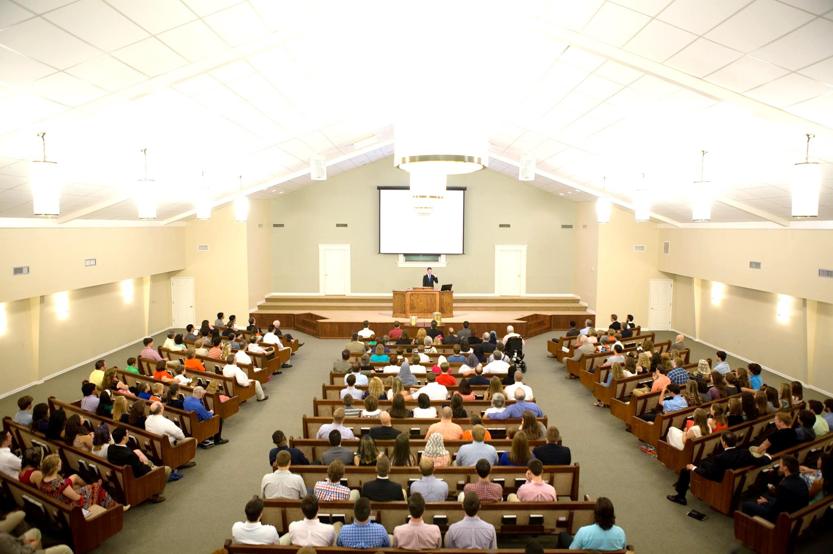
Heb 10:24-25 – “and let us consider how to stimulate one another to love and good deeds, not forsaking our own assembling together, as is the habit of some, but encouraging one another; and all the more as you see the day drawing near.”

Slide 12
The Assembly of the Local Church
Singing (Eph 5:19; Col 3:16; 1 Cor 14:15)
Lord’s Supper (1 Cor 11:23-34; Acts 20:7)
Lay By In Store (1 Cor 16:1-2)
Teaching (Acts 20:7,28; 1 Cor 14:26 )
Prayer (1 Cor 14:15; Acts 12:5,12)

Slide 13
Heb 3:12-13 – “Take care, brethren, that there not be in any one of you an evil, unbelieving heart that falls away from the living God. But encourage one another day after day, as long as it is still called “Today,” so that none of you will be hardened by the deceitfulness of sin.”
Beware/Take Care – “To see, watch out for, pay very close attention”
Gal 6:1 – “…if anyone is caught in any trespass, you who are spiritual, restore such a one in a spirit of gentleness…”
Active vs. Preventative Edification
The danger of developing an evil, unbelieving, hardened heart
Begins long before it appears on the surface
Must be daily
Heb 3:7a – “Therefore, just as the Holy Spirit says, ‘Today if you hear His voice’”
Listen when someone is concerned for me
We’re often the last ones to notice that we’re drifting (Prov 8:33)
Brethren can mistakenly hurt one another when trying to help
Emotion often usurps judgment (Jer 17:9)
Give priority toward your local church family
Gal 6:10 – “So then, while we have opportunity, let us do good to all people, and especially to those who are of the household of the faith.”

Slide 14
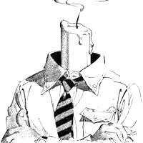
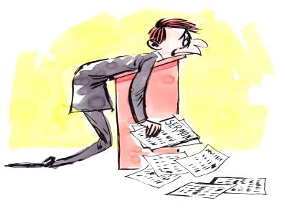
Edification
Entertainment
1 Tim 5:16 – “If any woman who is a believer has dependent widows, she must assist them and the church must not be burdened, so that it may assist those who are widows indeed.”
Elders
shepherd the flock (1 Pet 5:2a)
exercise oversight (1 Pet 5:2b)
guard the flock (Acts 20:28a)
keeping alert (Acts 20:31a)
Preachers
Pay close attention to the word (1 Tim 4:16)
Reprove, rebuke, exhort (2 Tim 4:2)
Do the work of an evangelist (2 Tim 4:5)
Reading, exhortation, teaching (1 Tim 4:13)

