Slide 2
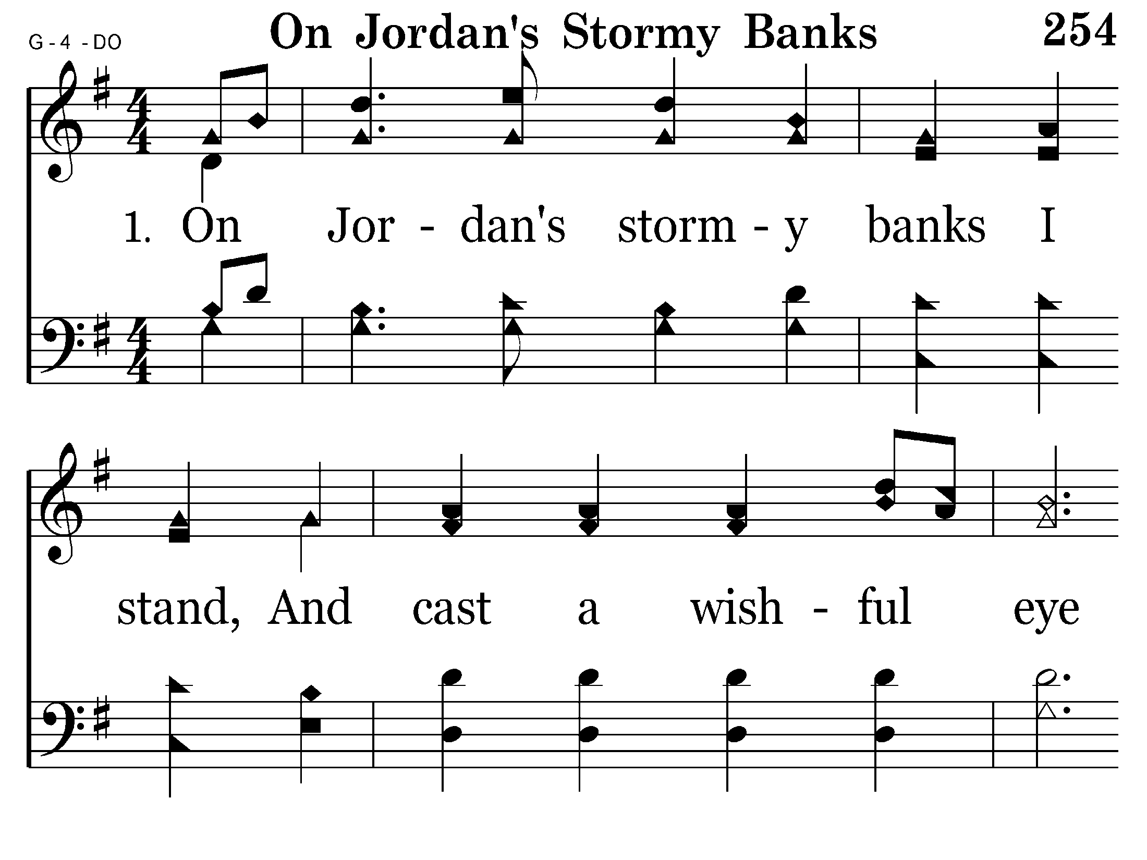

Slide 3
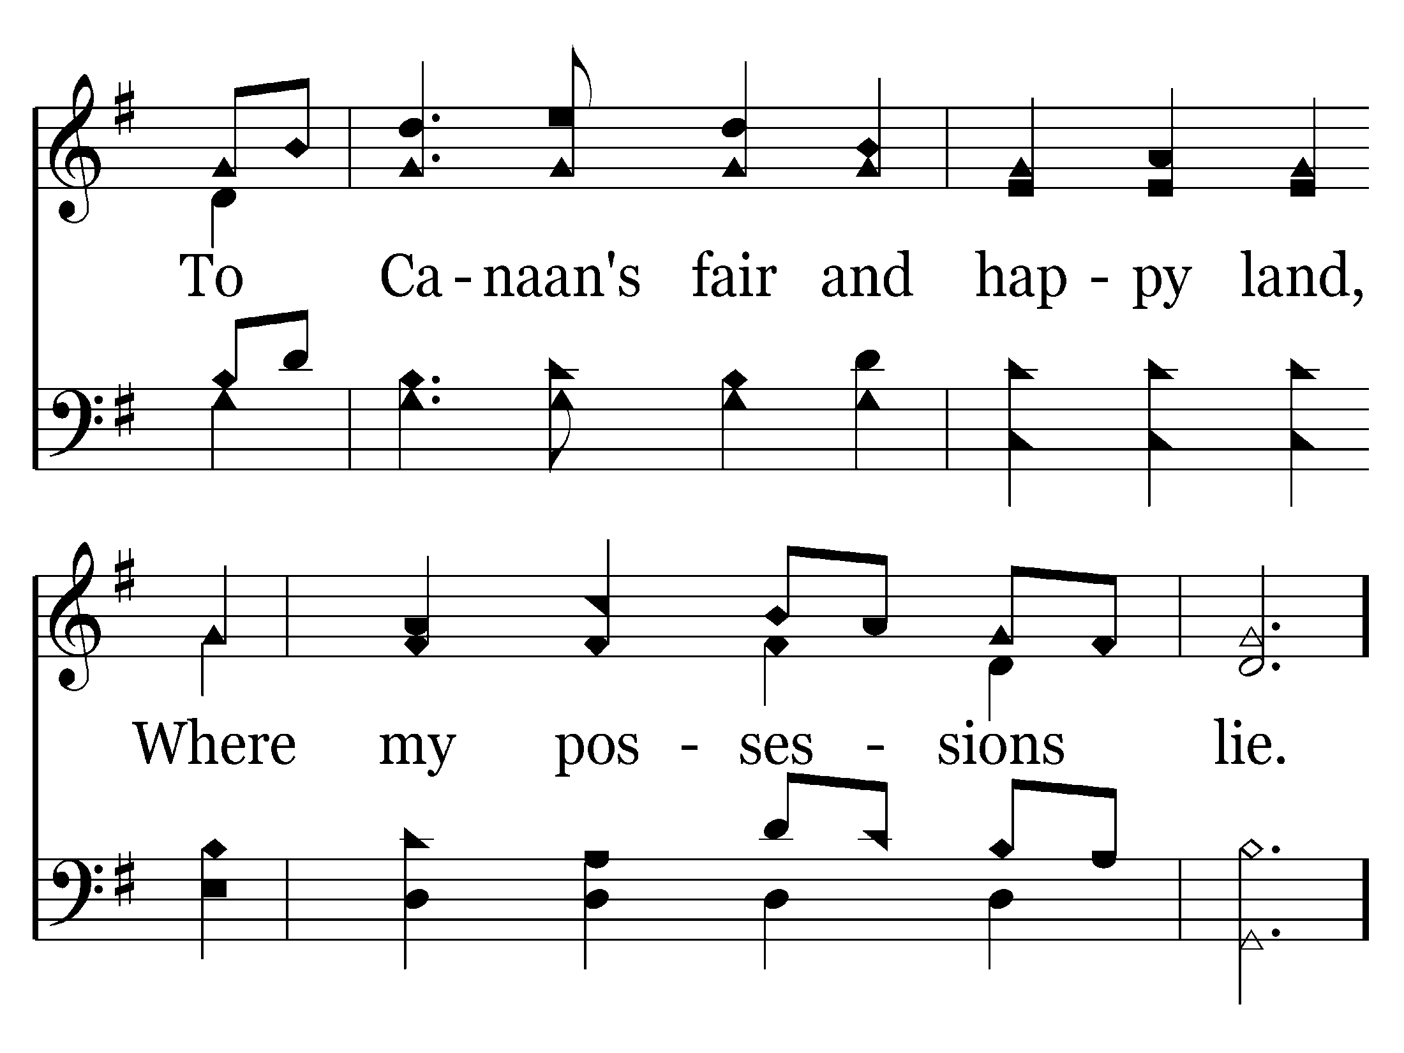

Slide 4
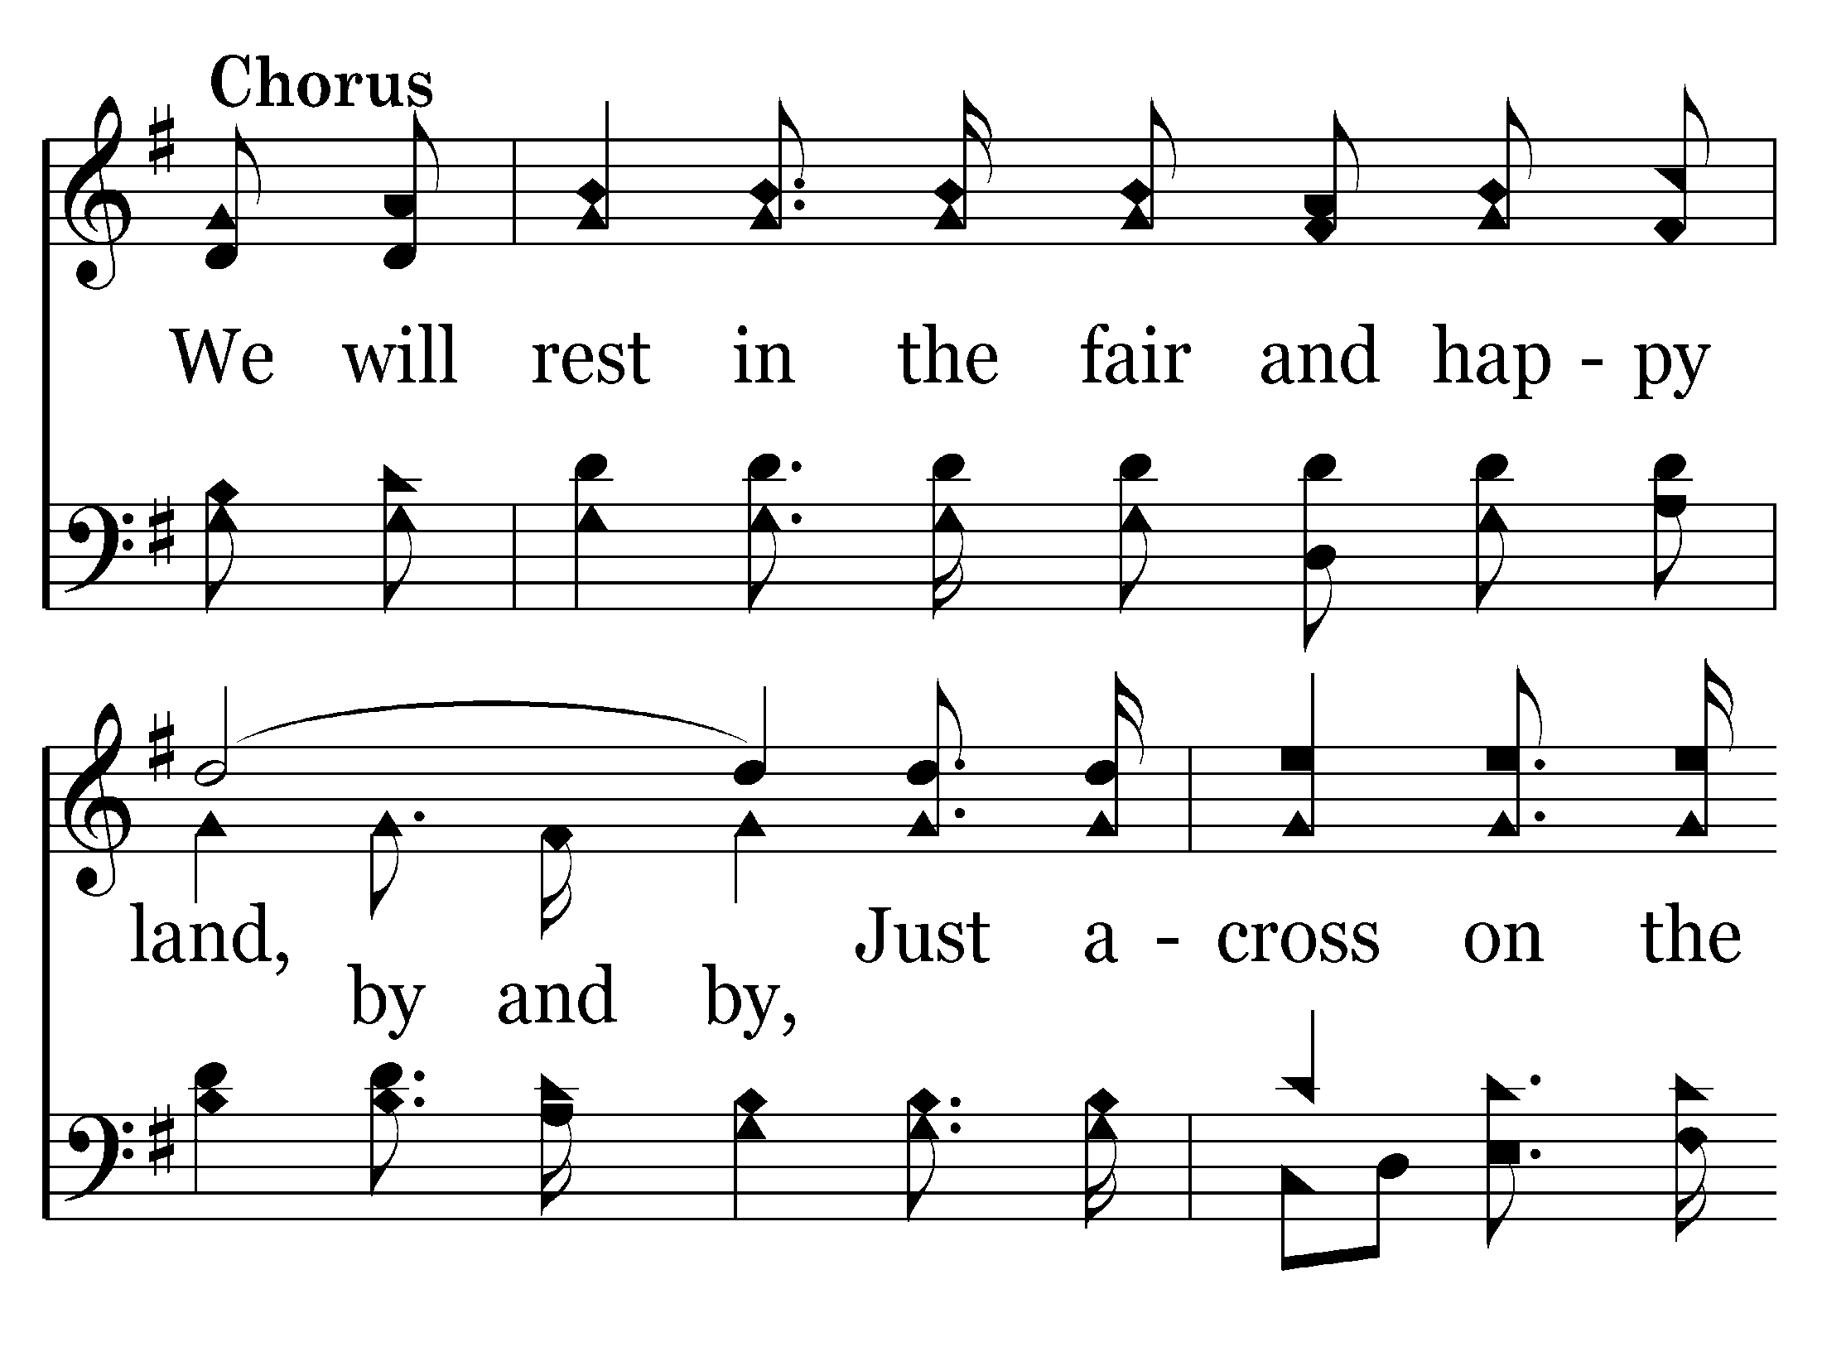

Slide 5
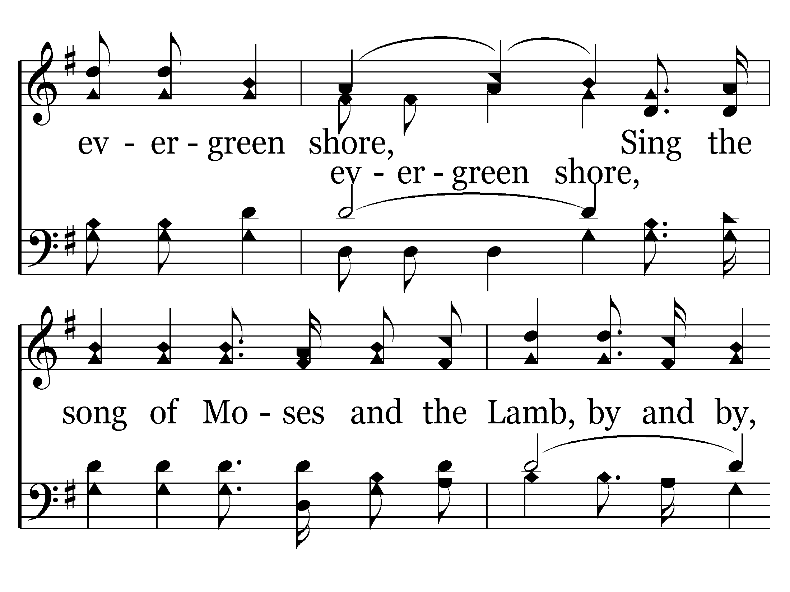

Slide 6
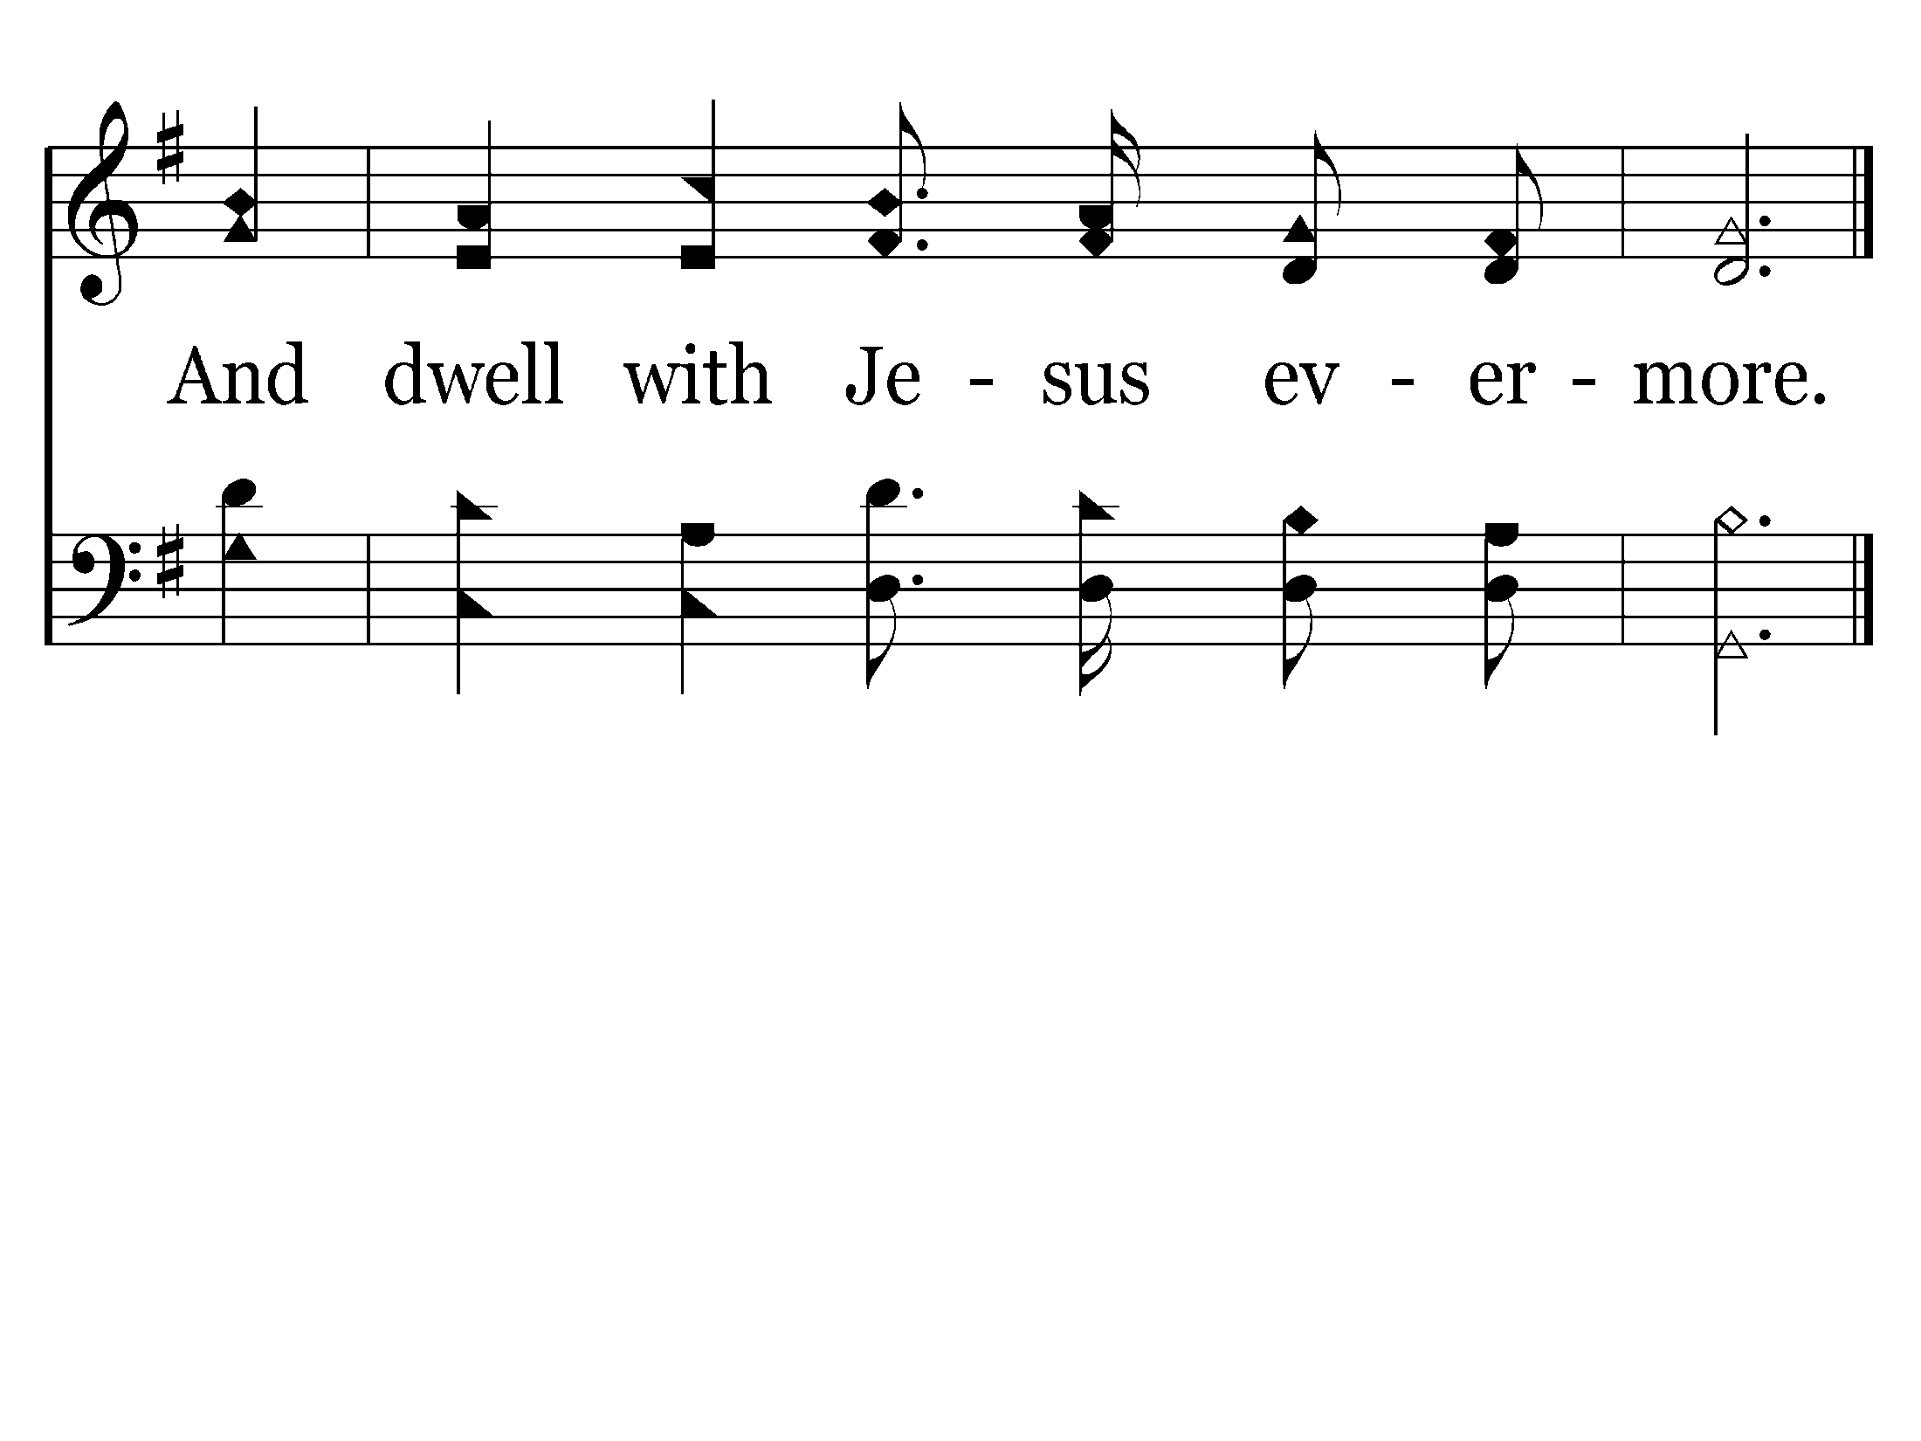
End of Verse 1

Slide 8
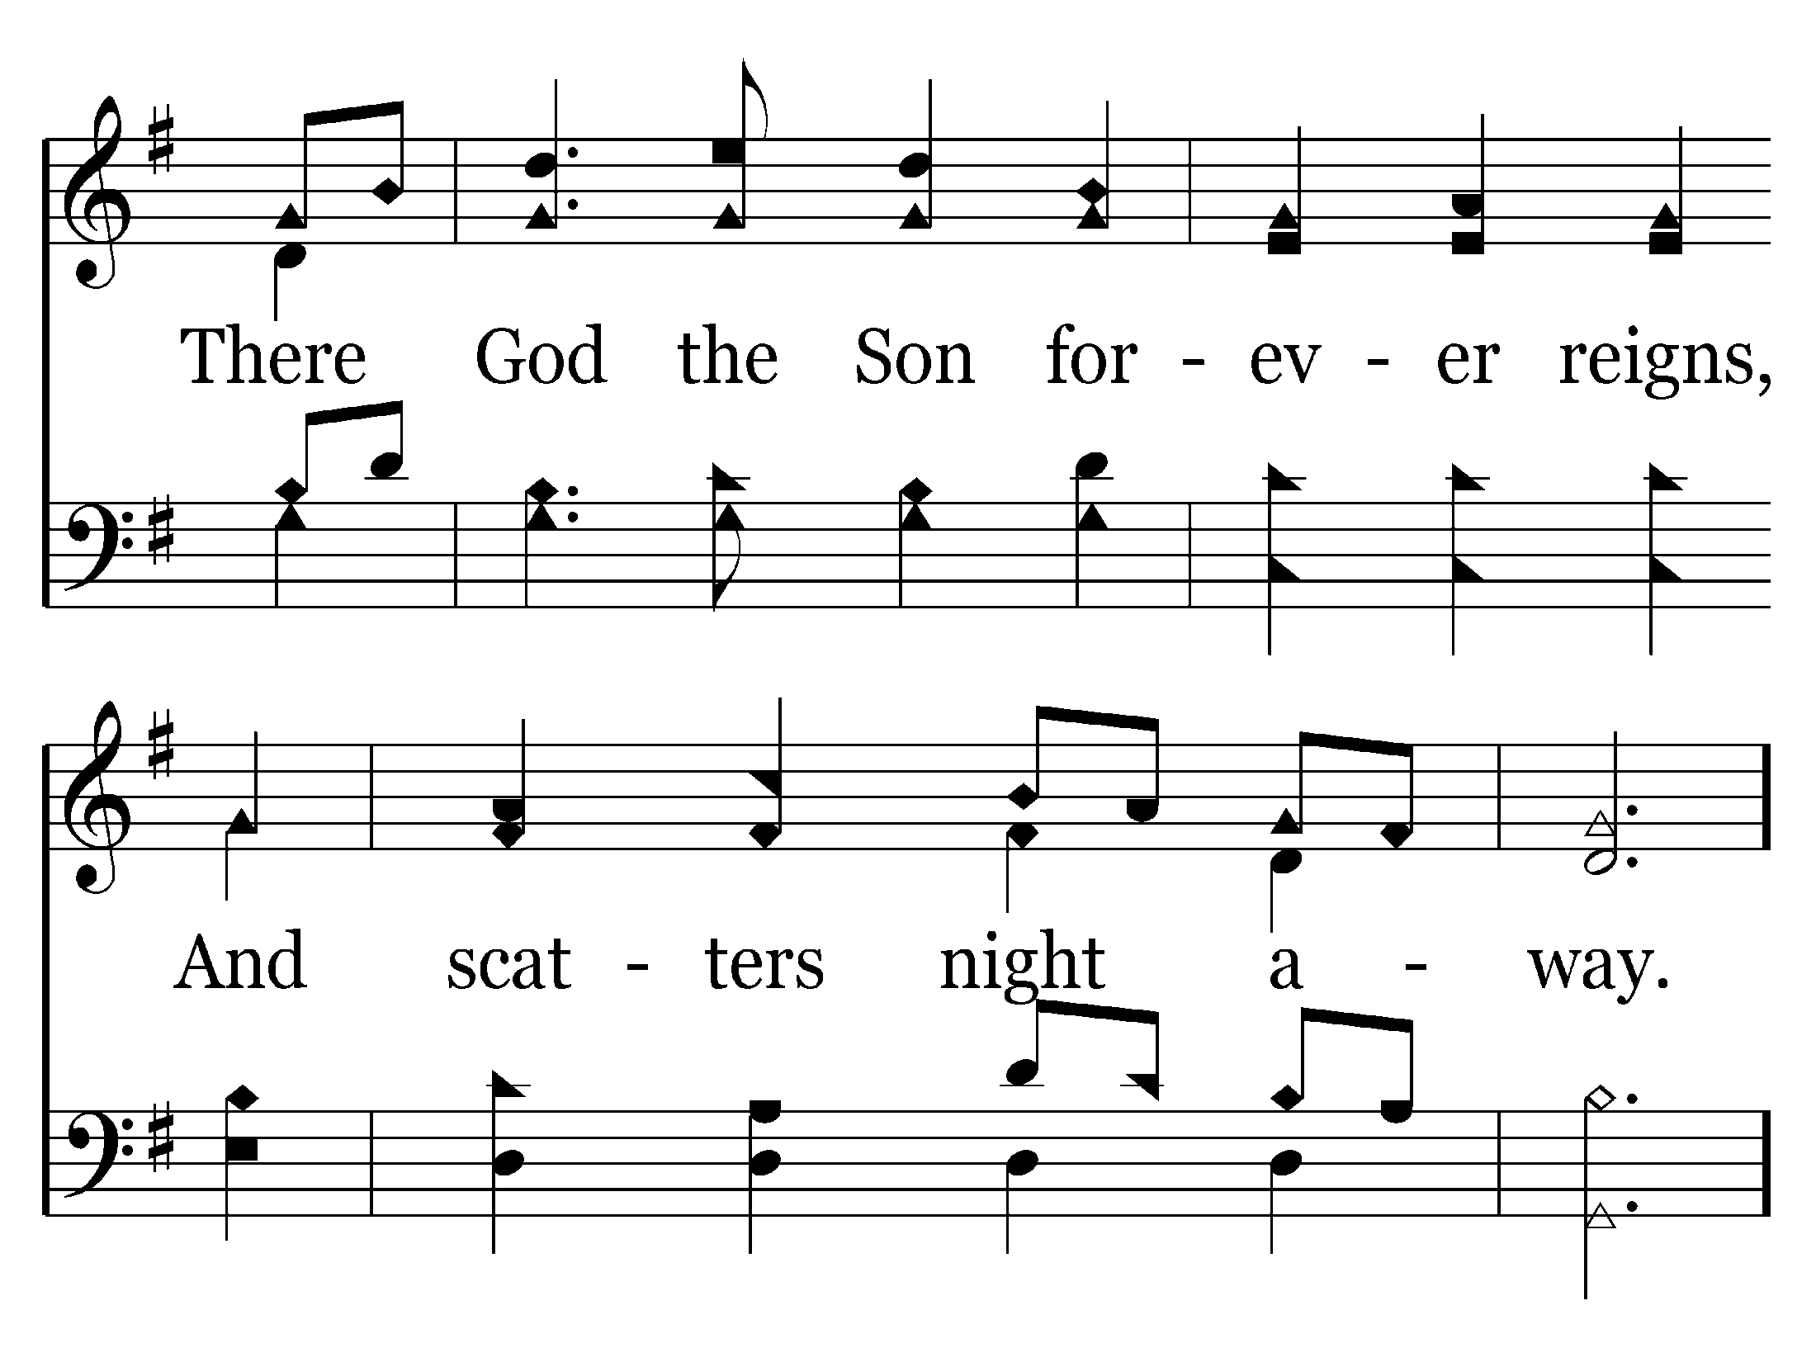

Slide 11
End of Verse 2

Slide 13
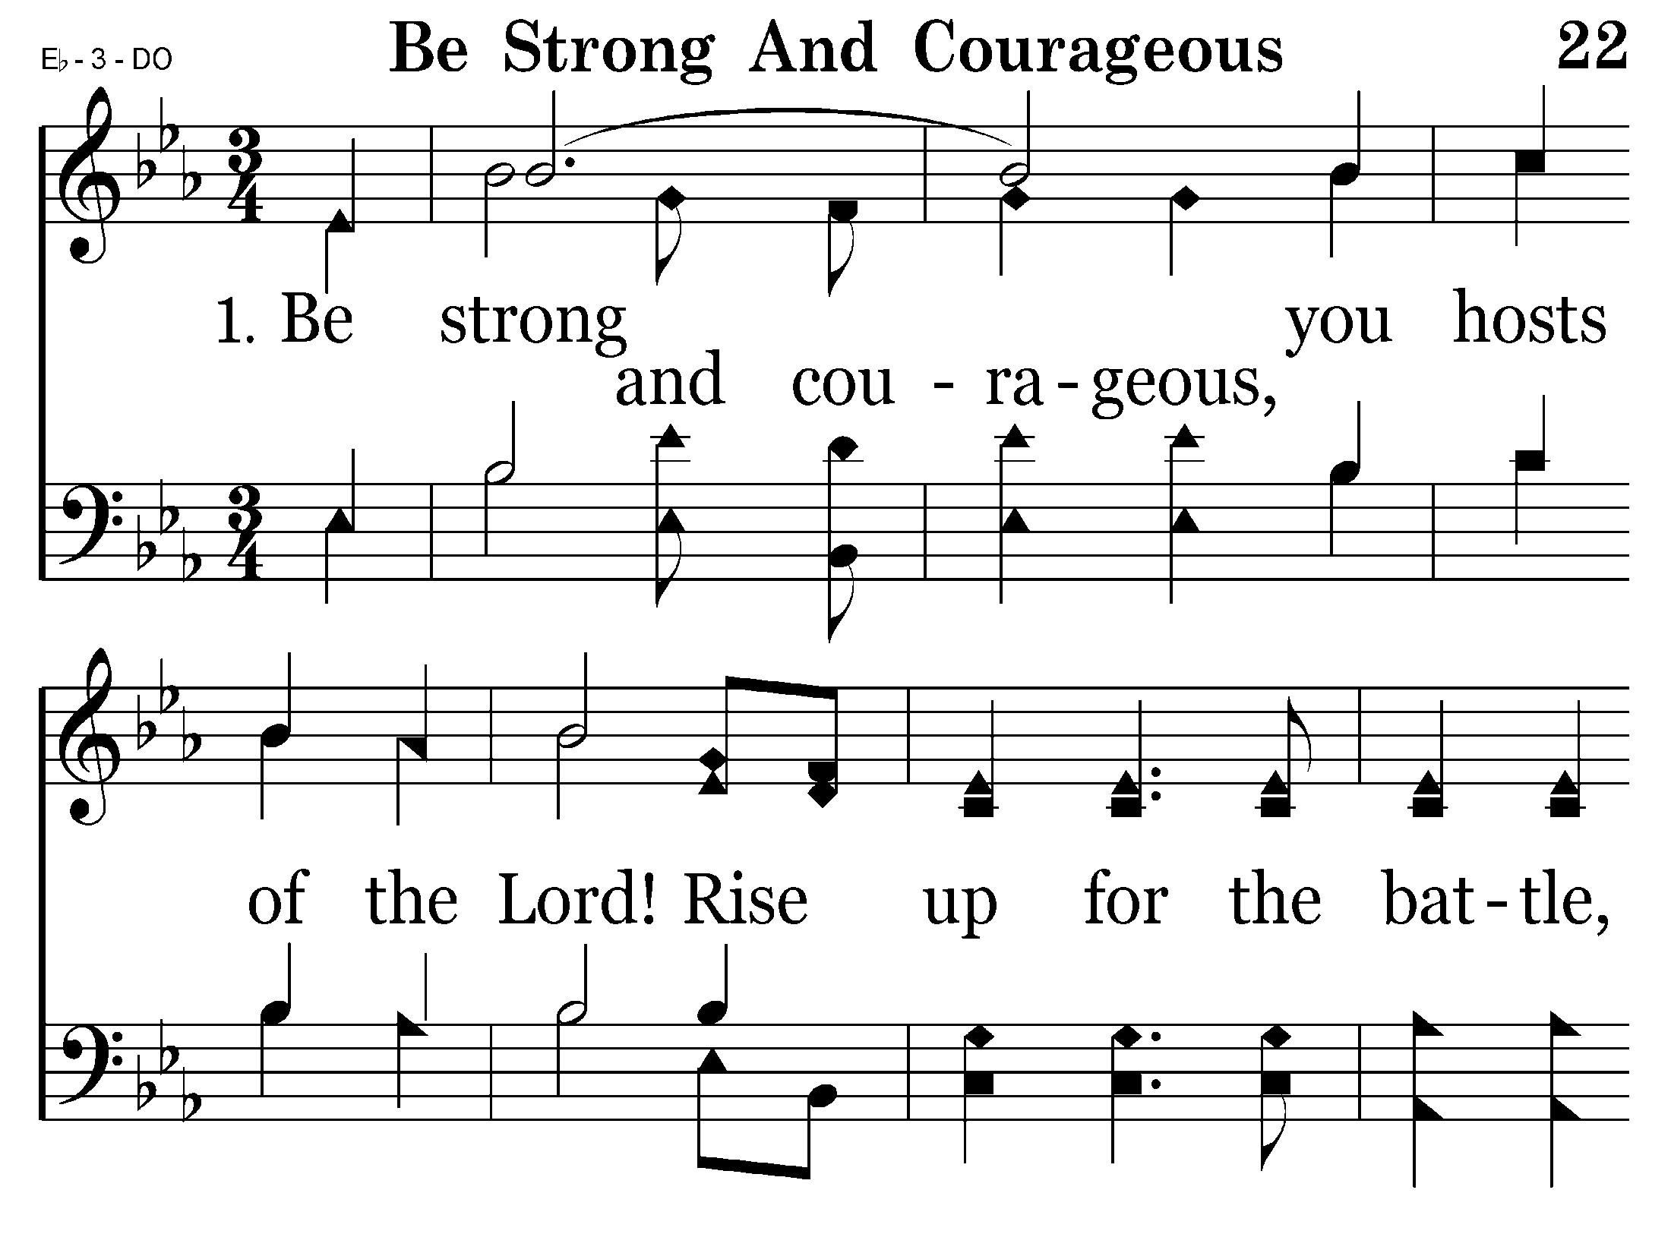

Slide 14
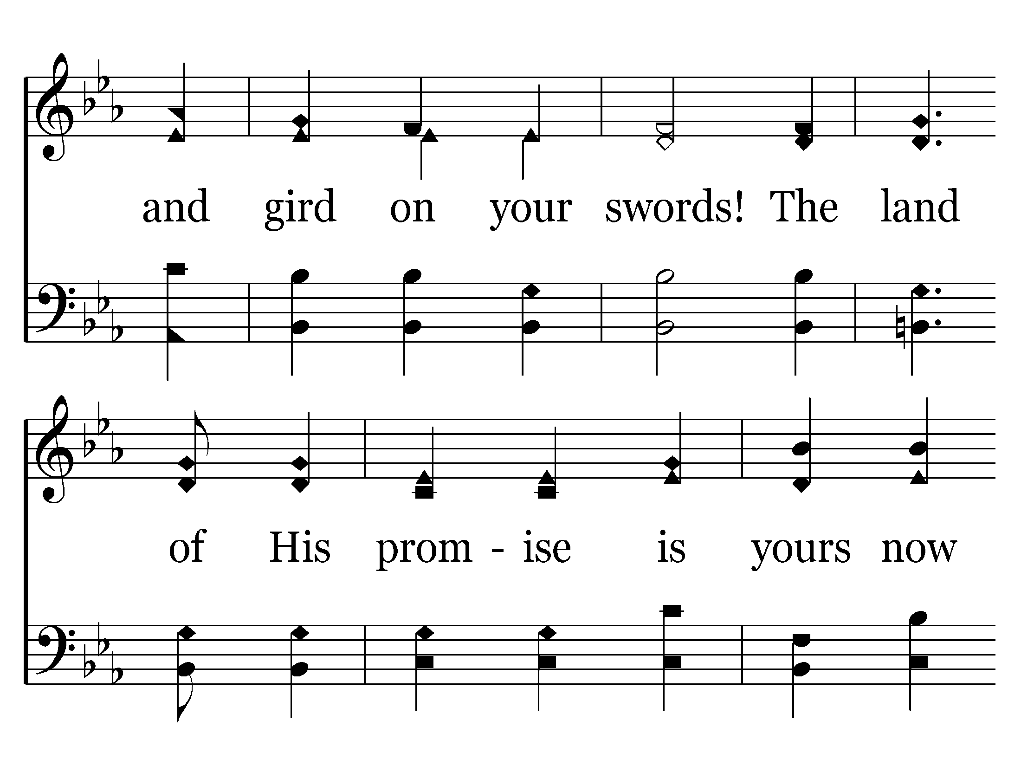

Slide 15
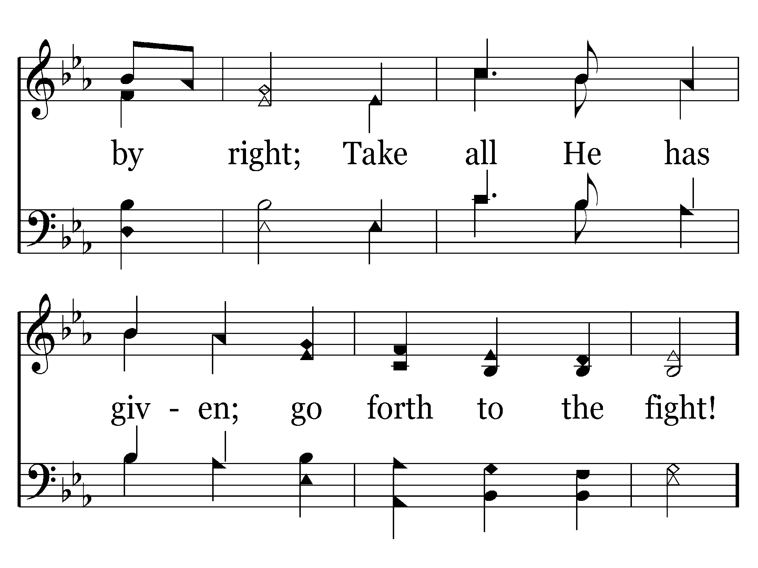

Slide 16
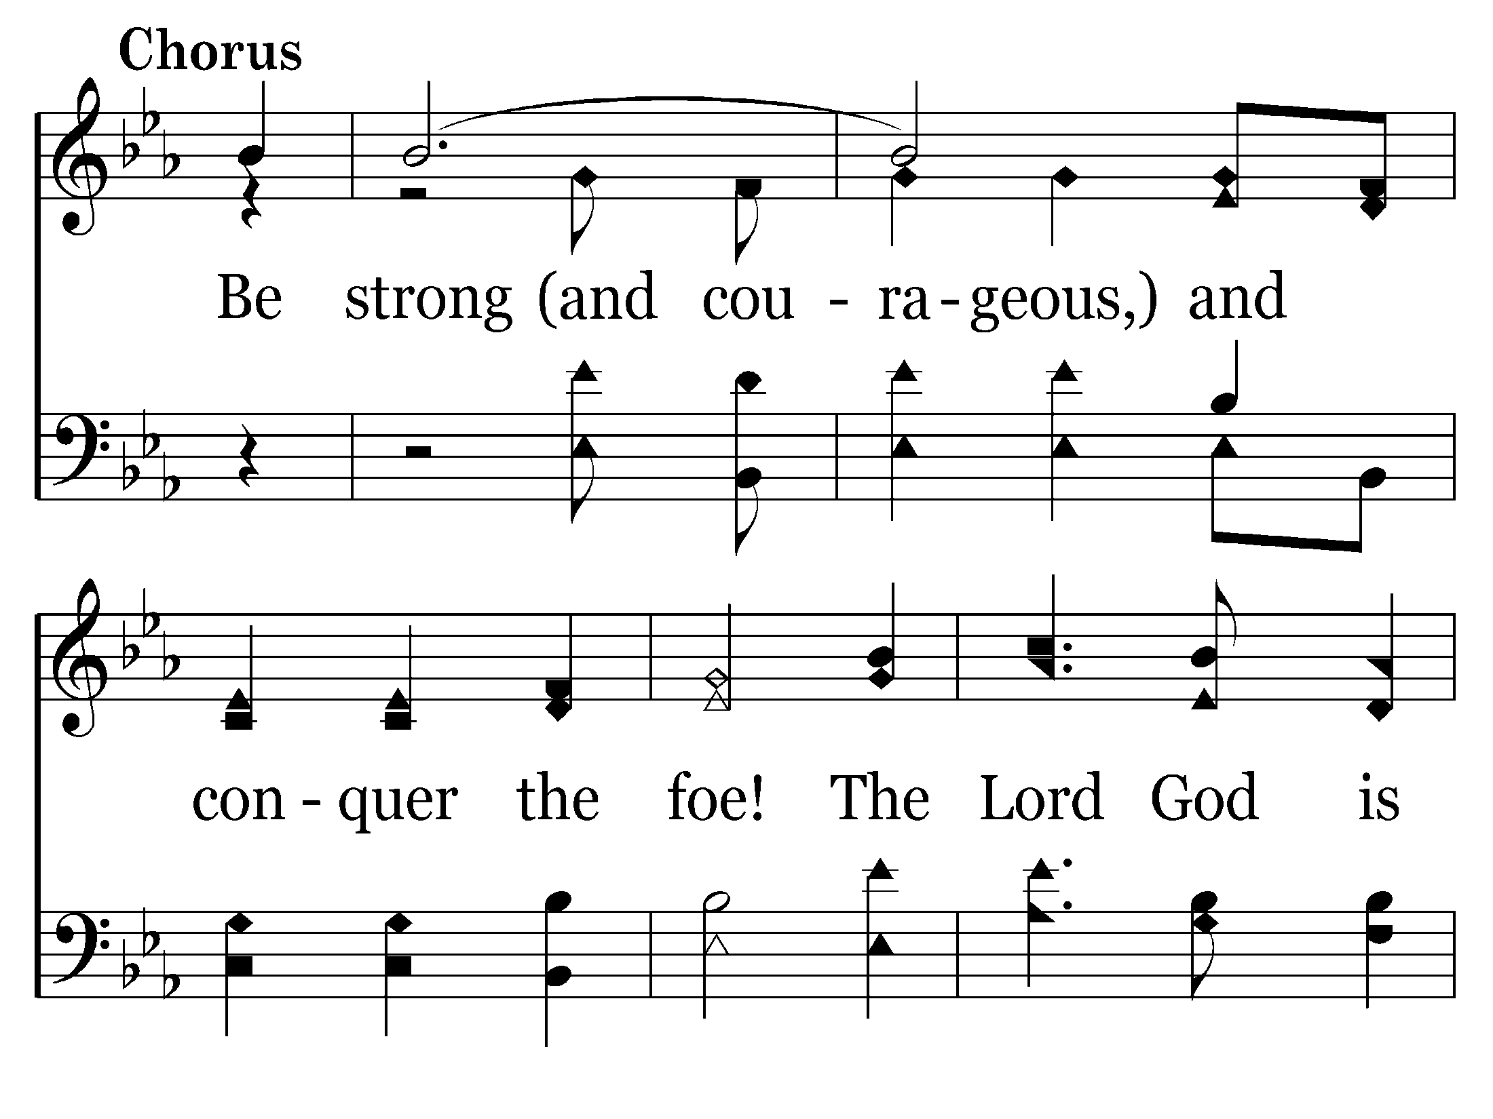

Slide 17
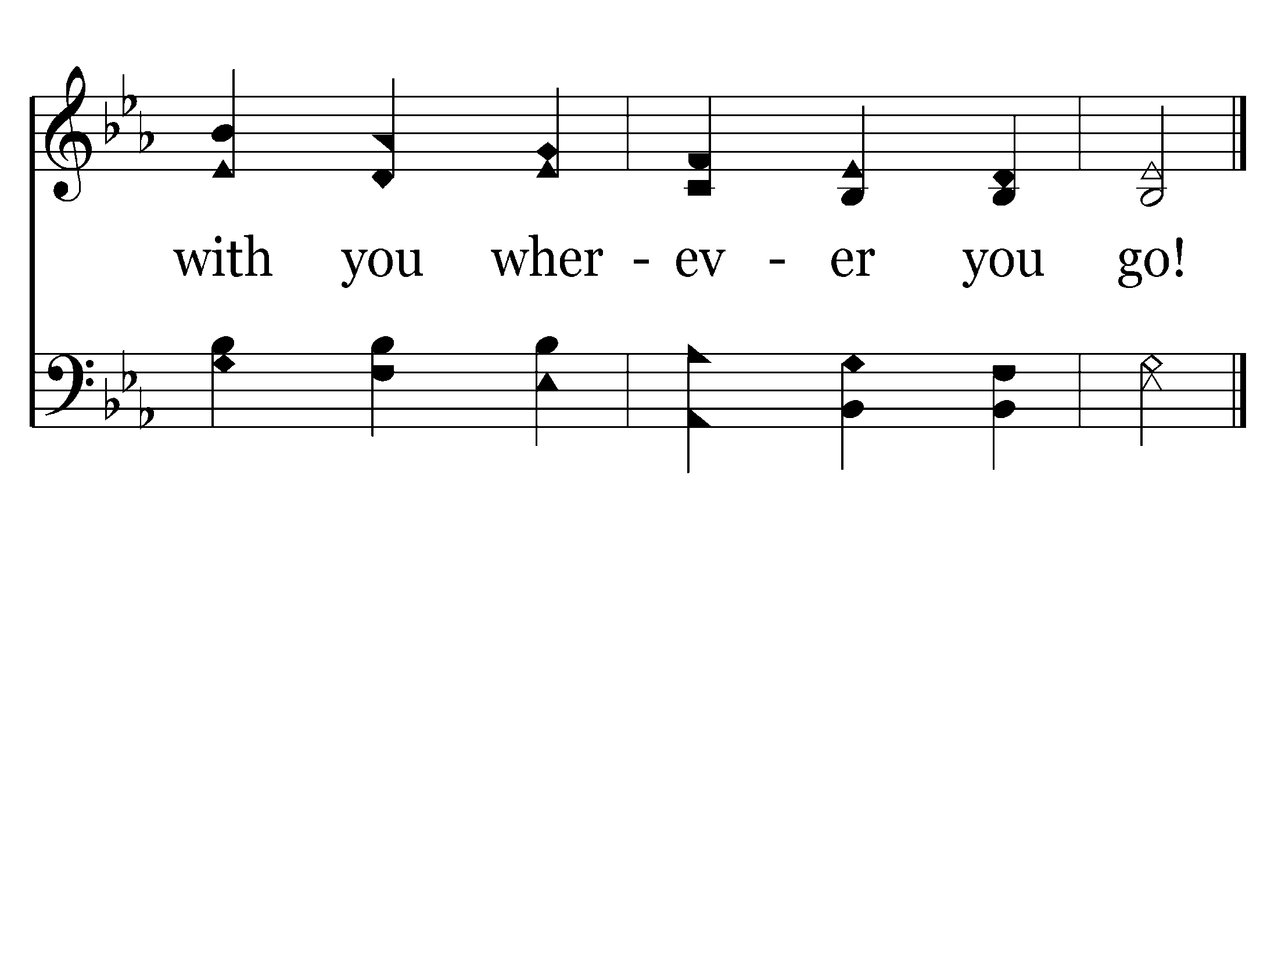
End of Verse 1

Slide 18
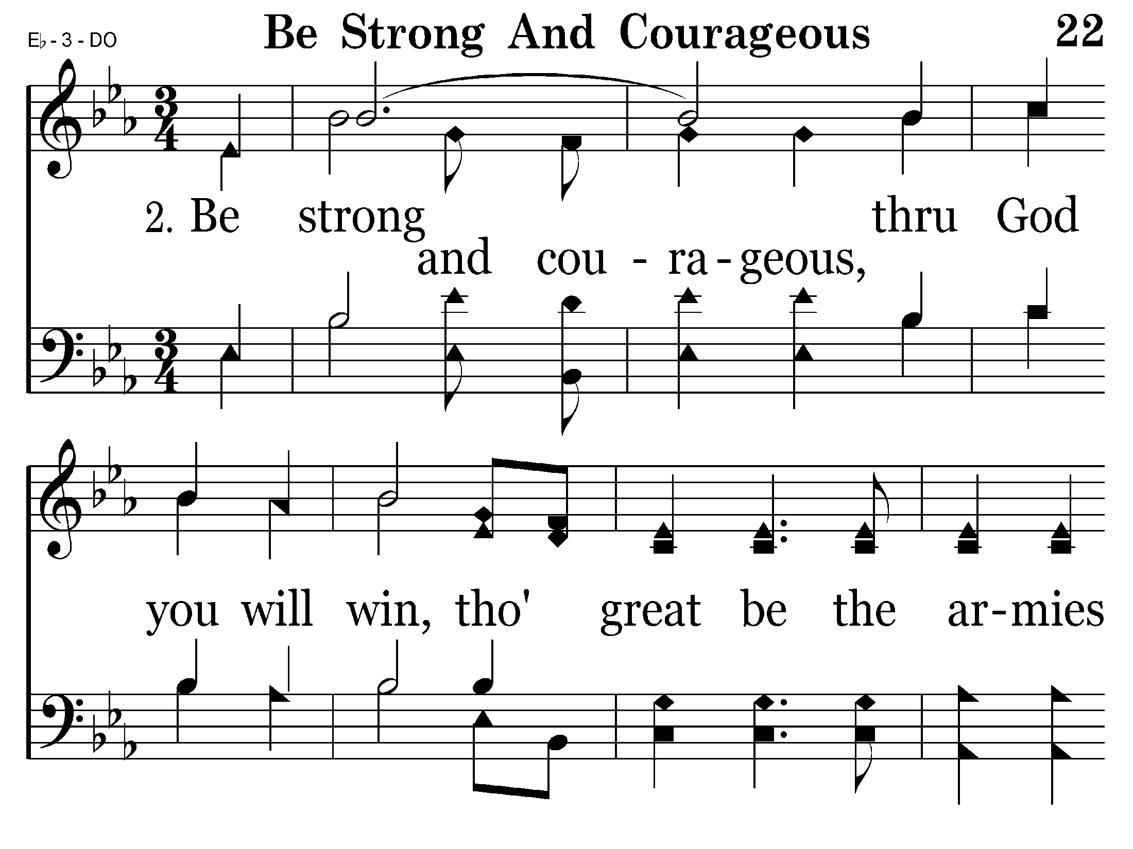

Slide 19
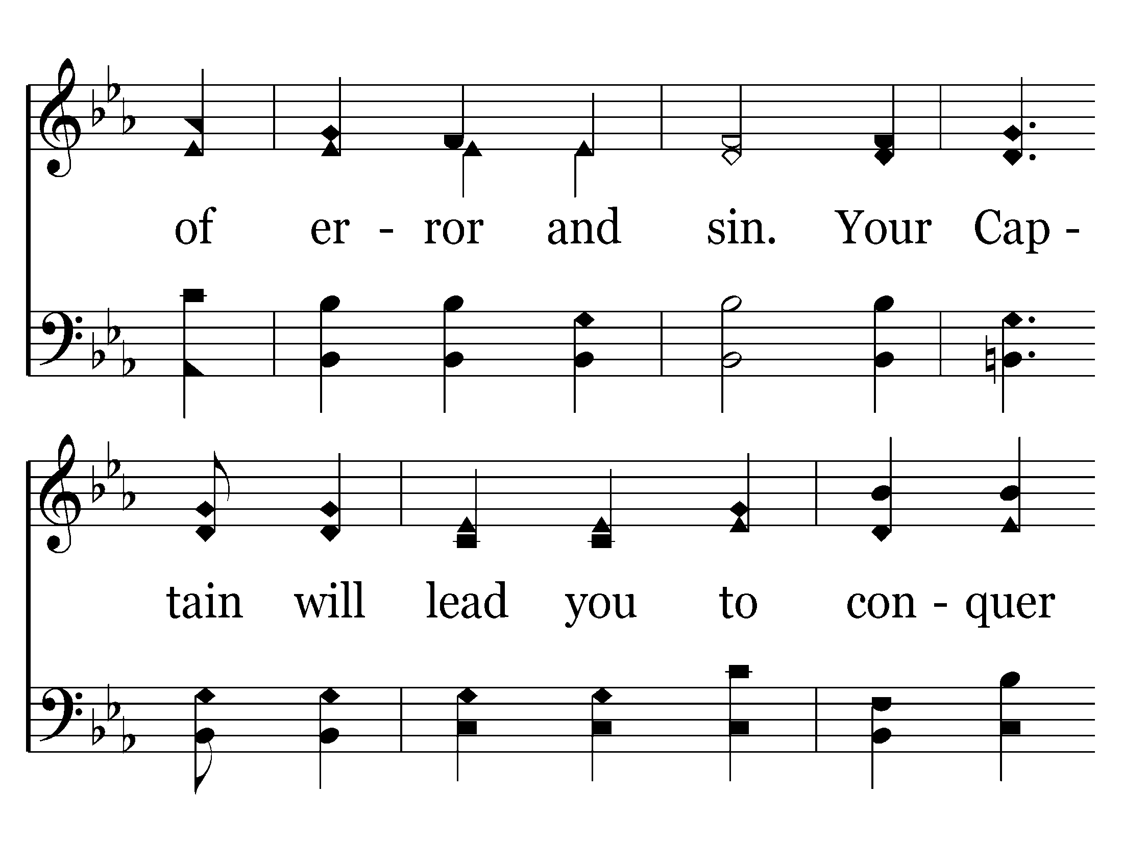

Slide 20
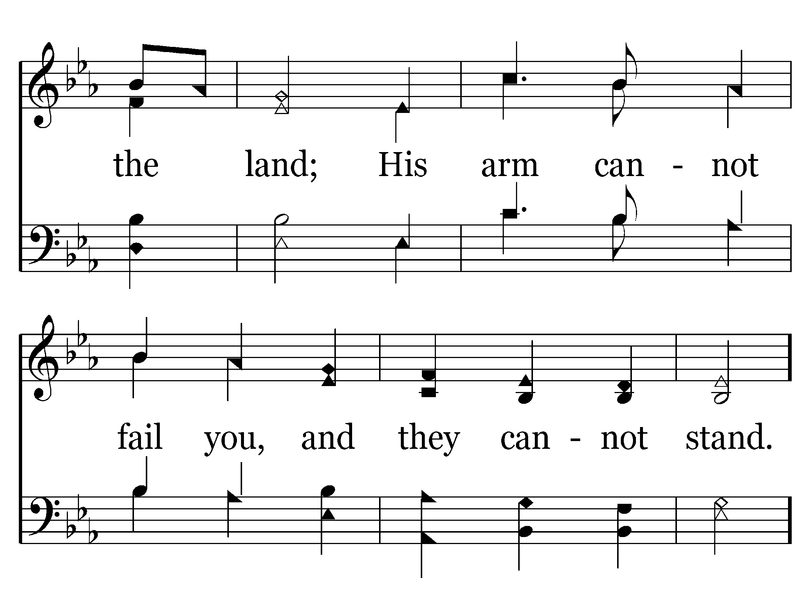

Slide 22
End of Verse 2

Slide 25
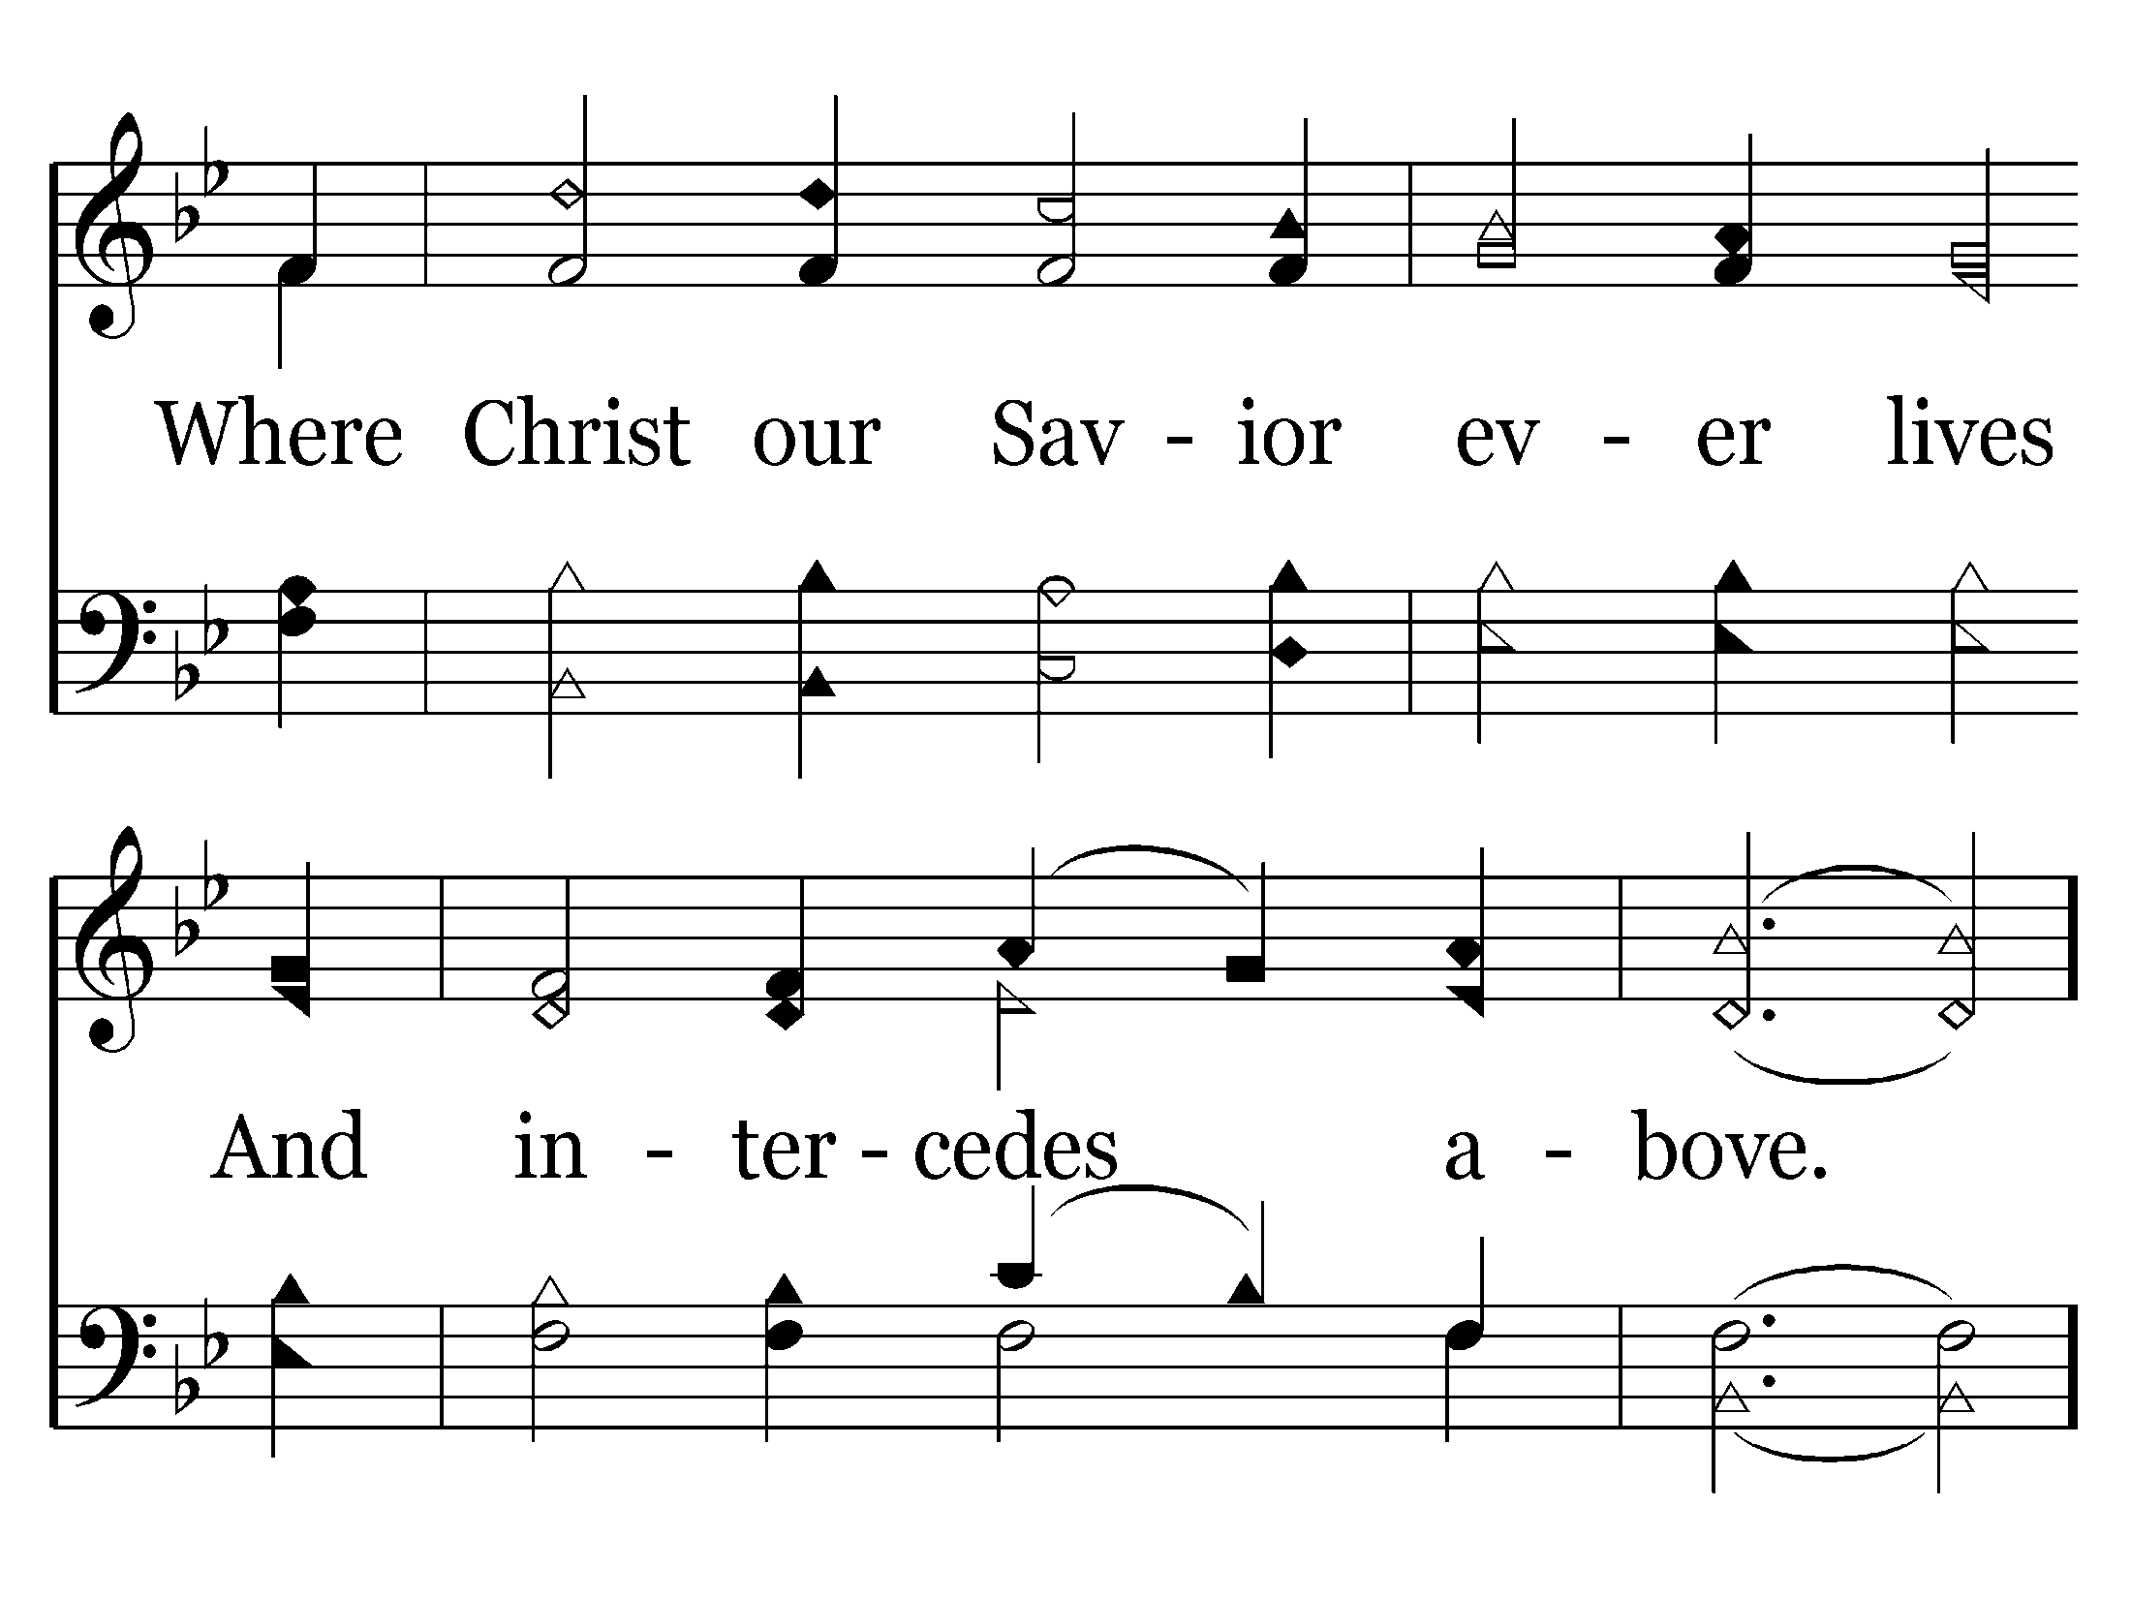

Slide 26
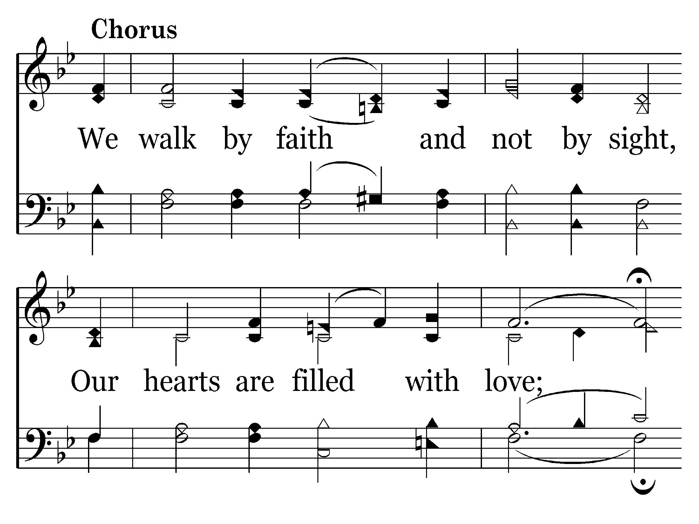

Slide 27
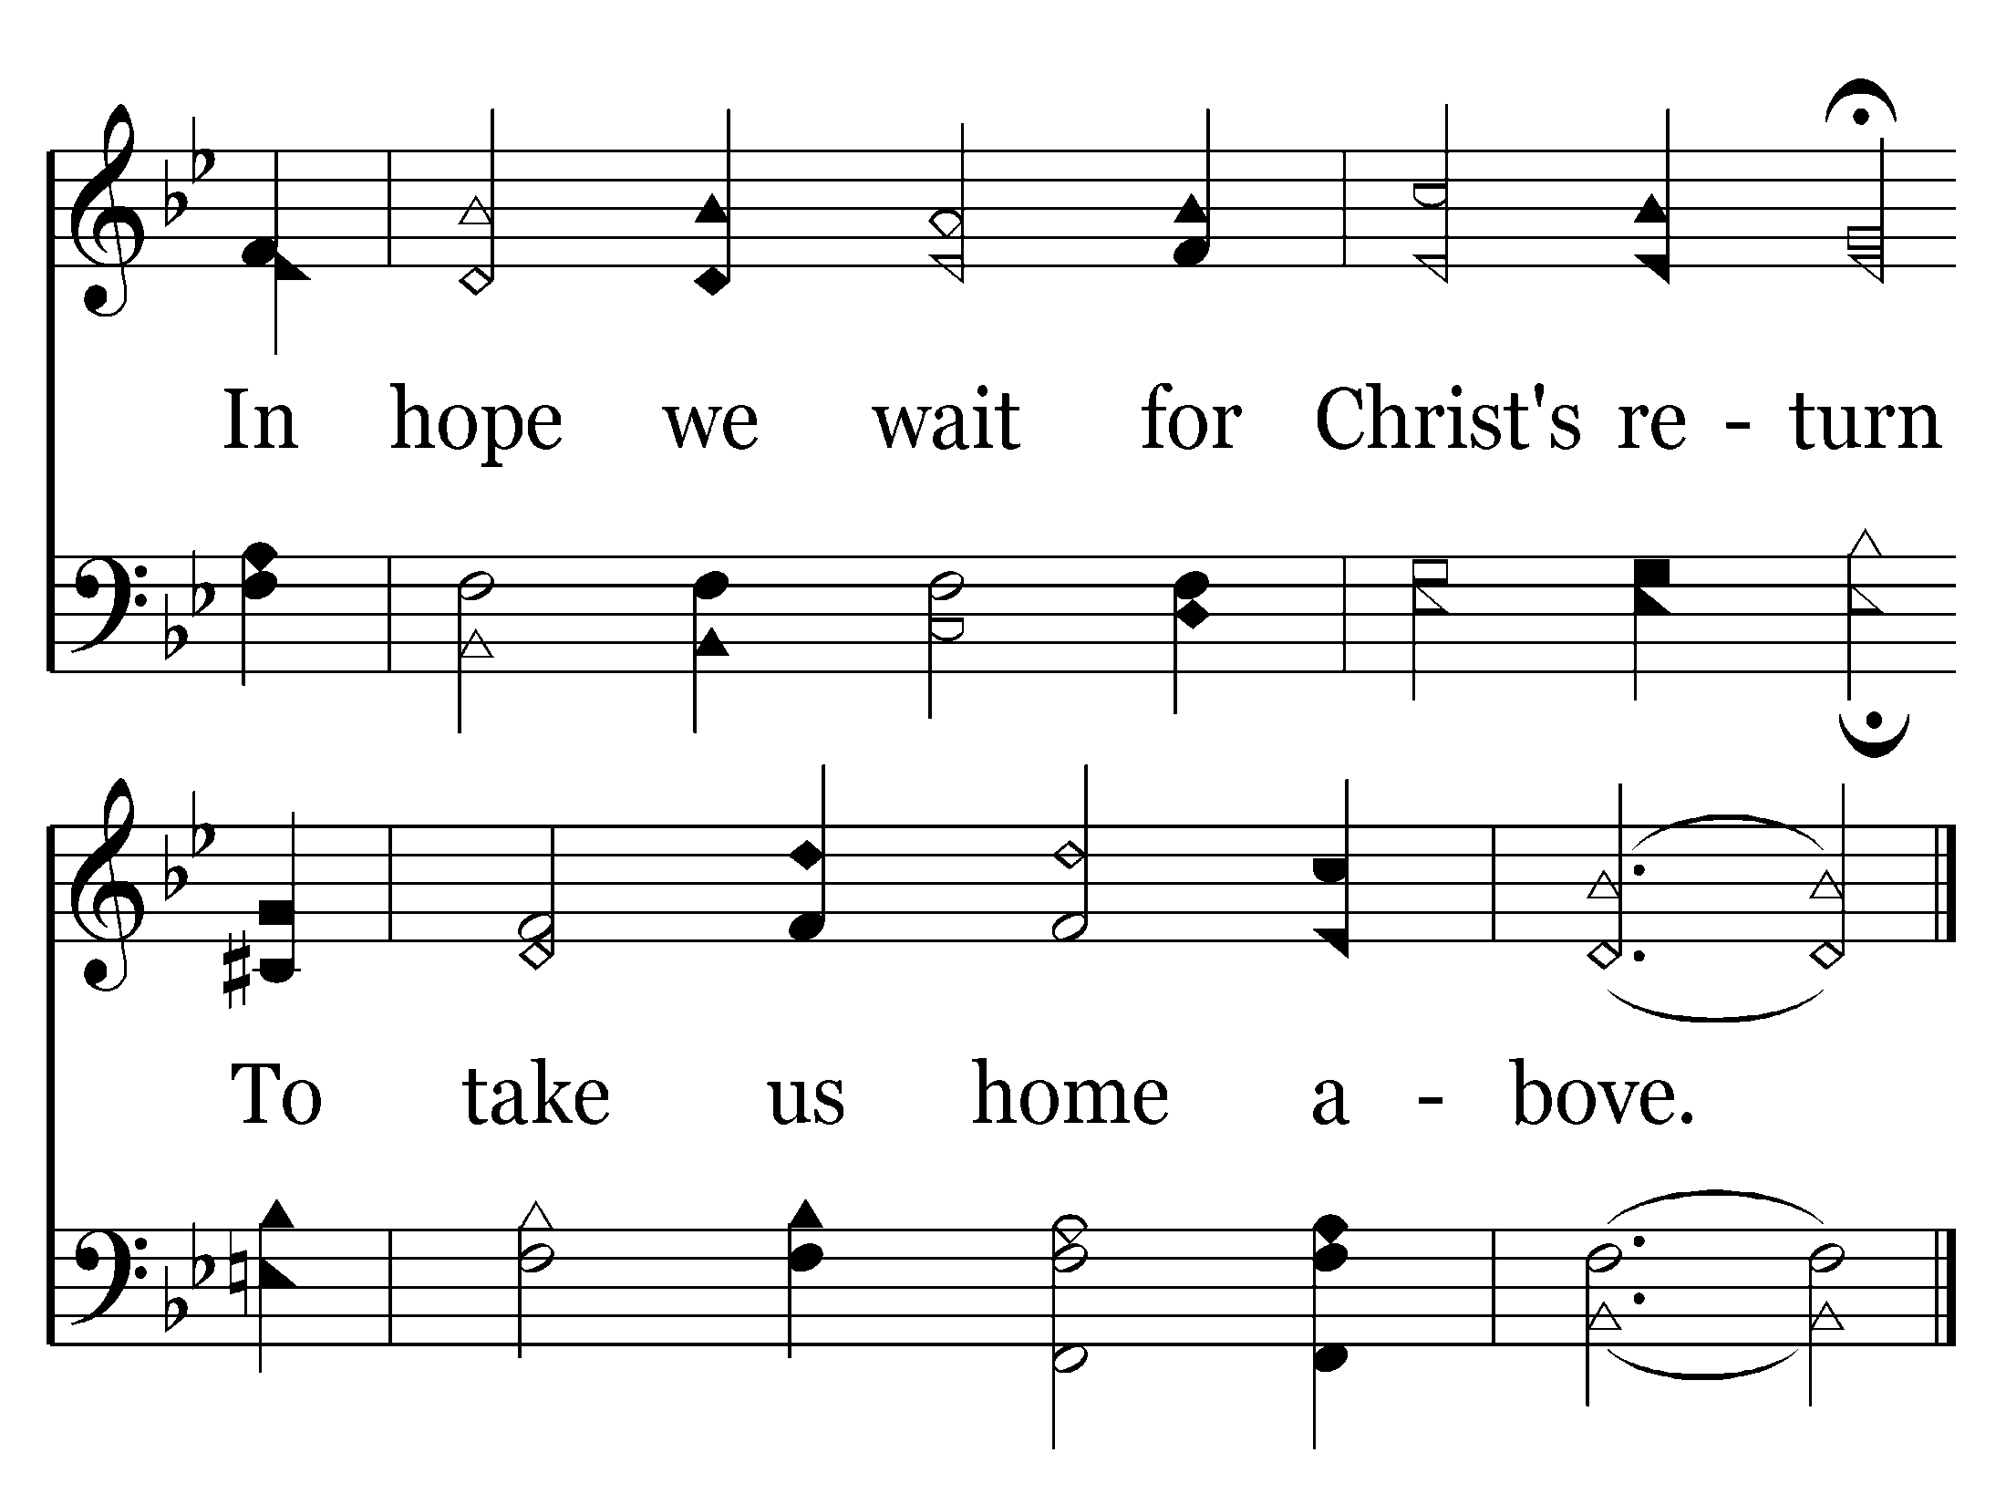
End of Verse 1

Slide 31
End of Verse 2

Slide 33
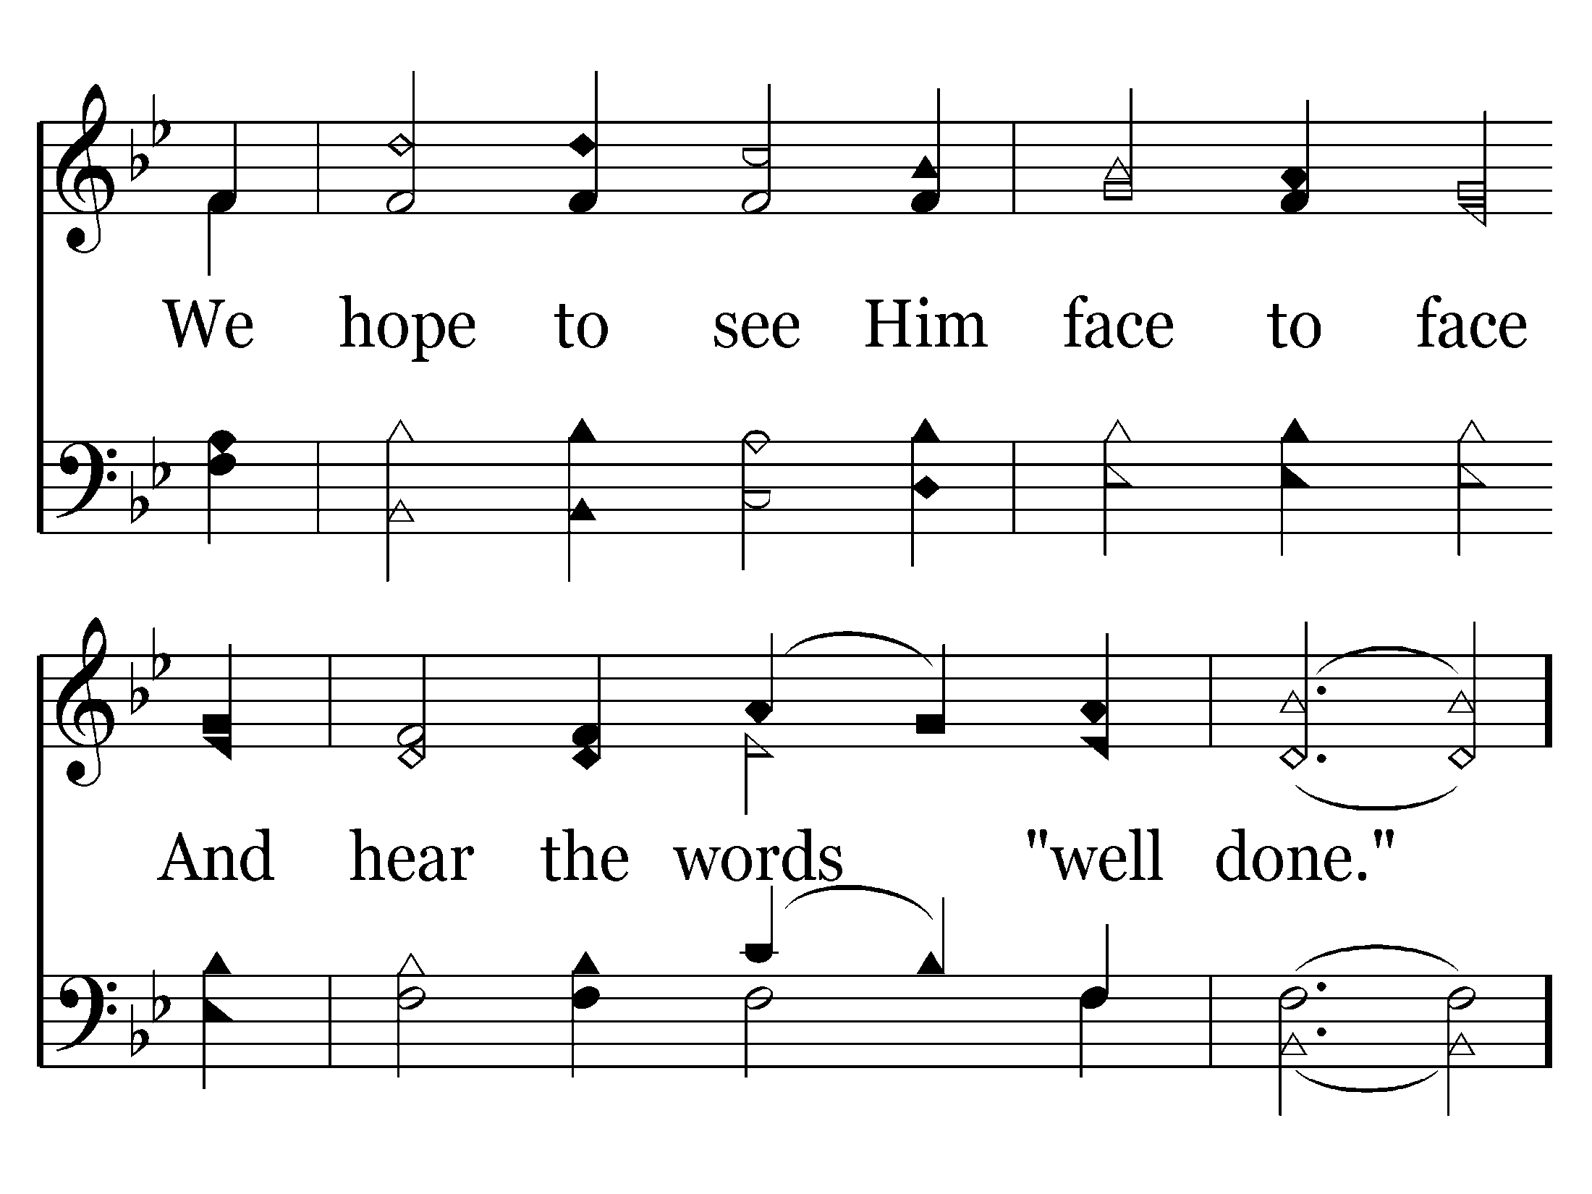

Slide 35
End of Song

Slide 37
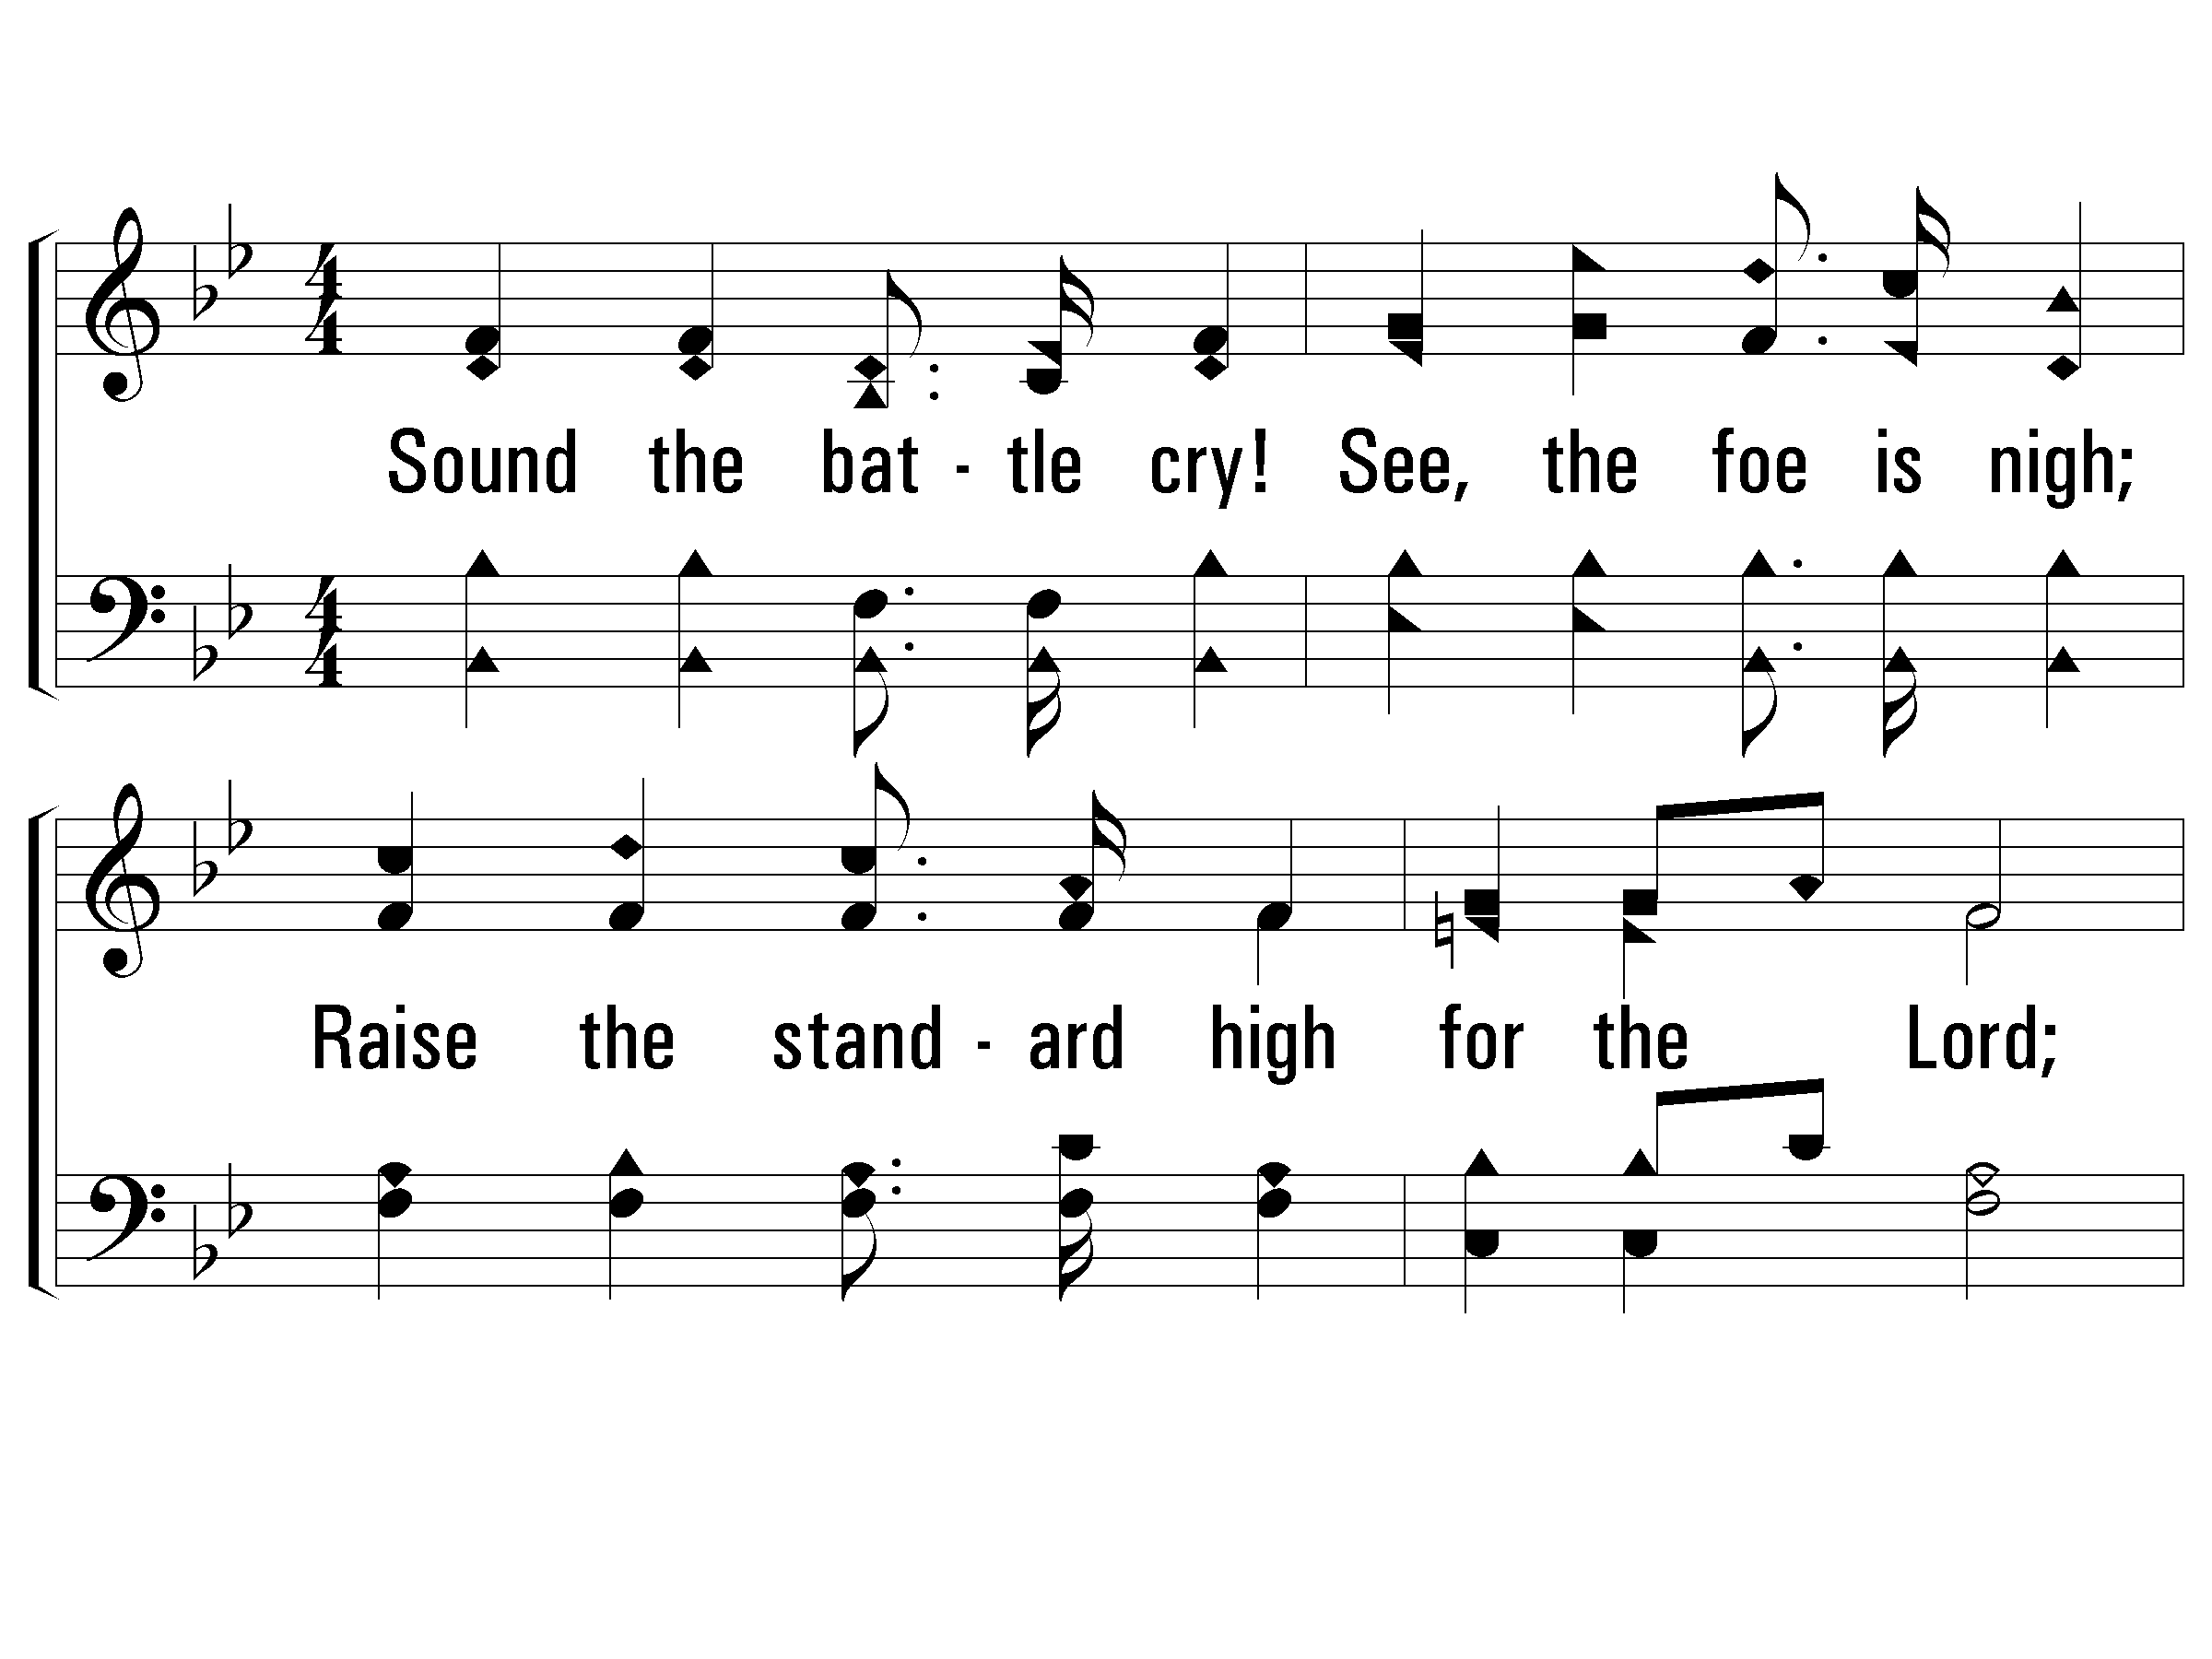
1 - Sound the Battle Cry
1.
Sound the battle cry! See, the foe is nigh;
Raise the standard high for the Lord;
Gird your armor on, stand firm, every one,
Rest your cause upon His holy Word.
Words & Music: William F. Sherwin
© 2007 The Paperless Hymnal®

Slide 38
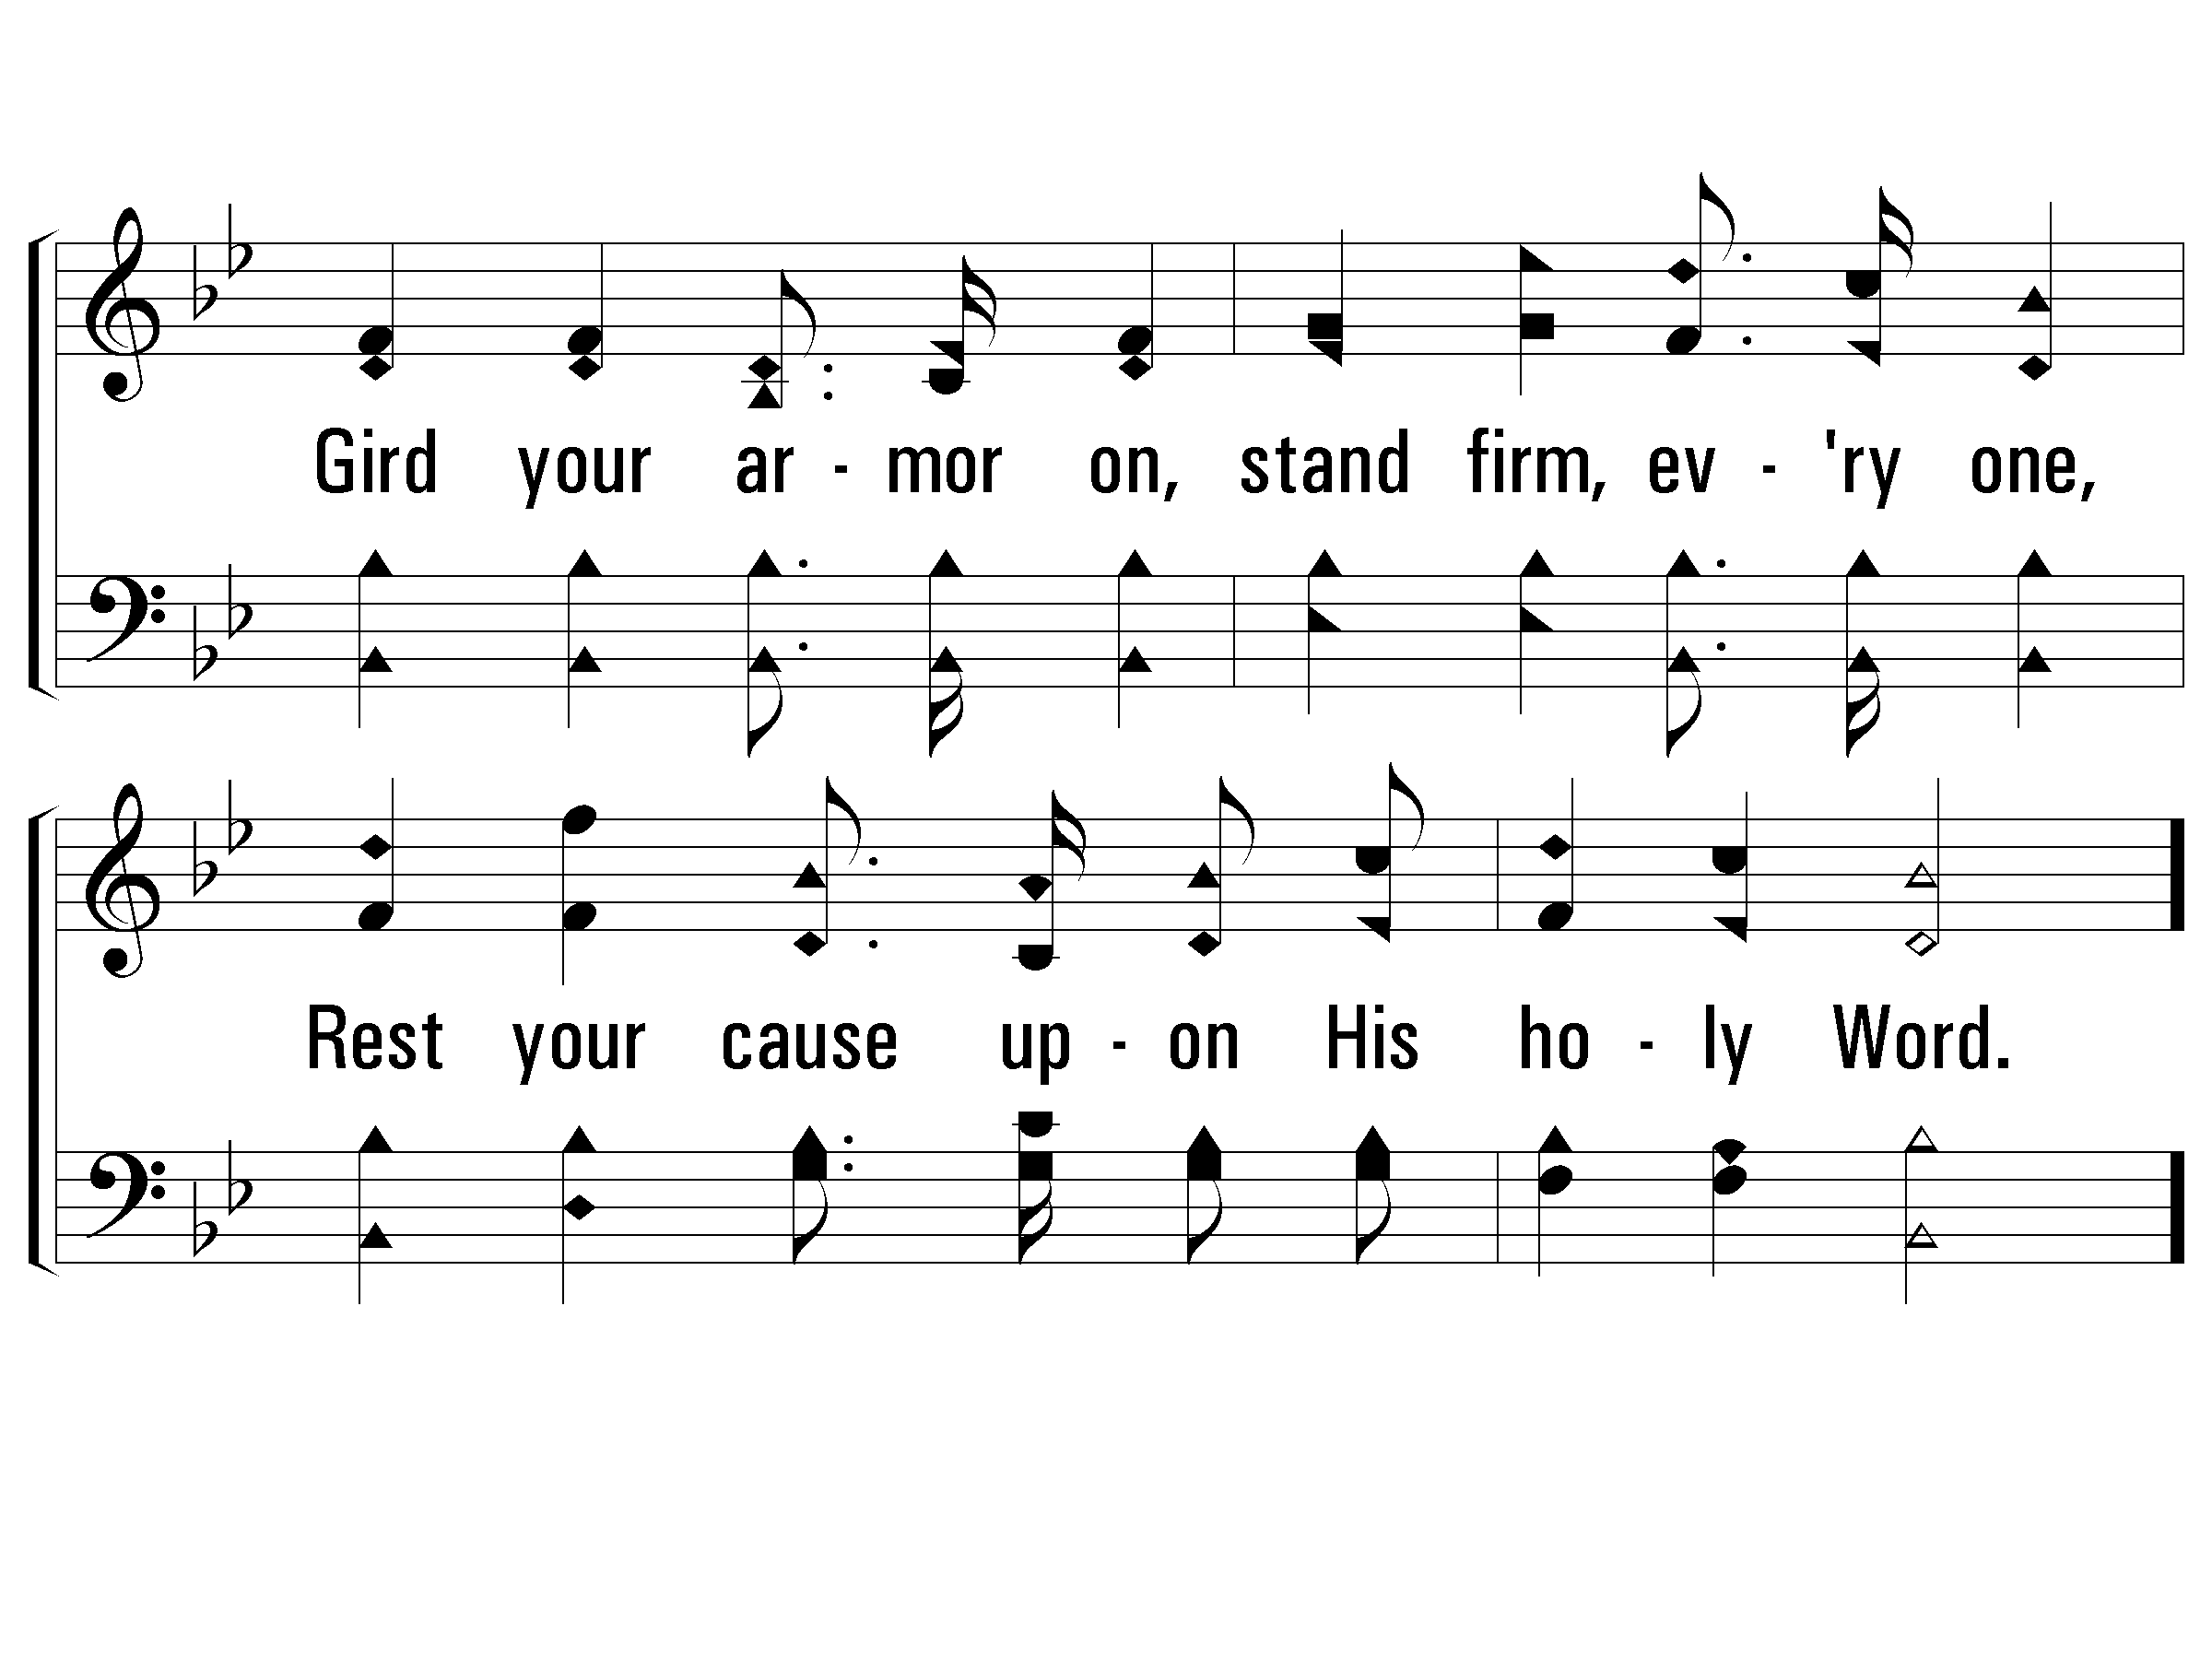
1 - Sound the Battle Cry
© 2007 The Paperless Hymnal®

Slide 39
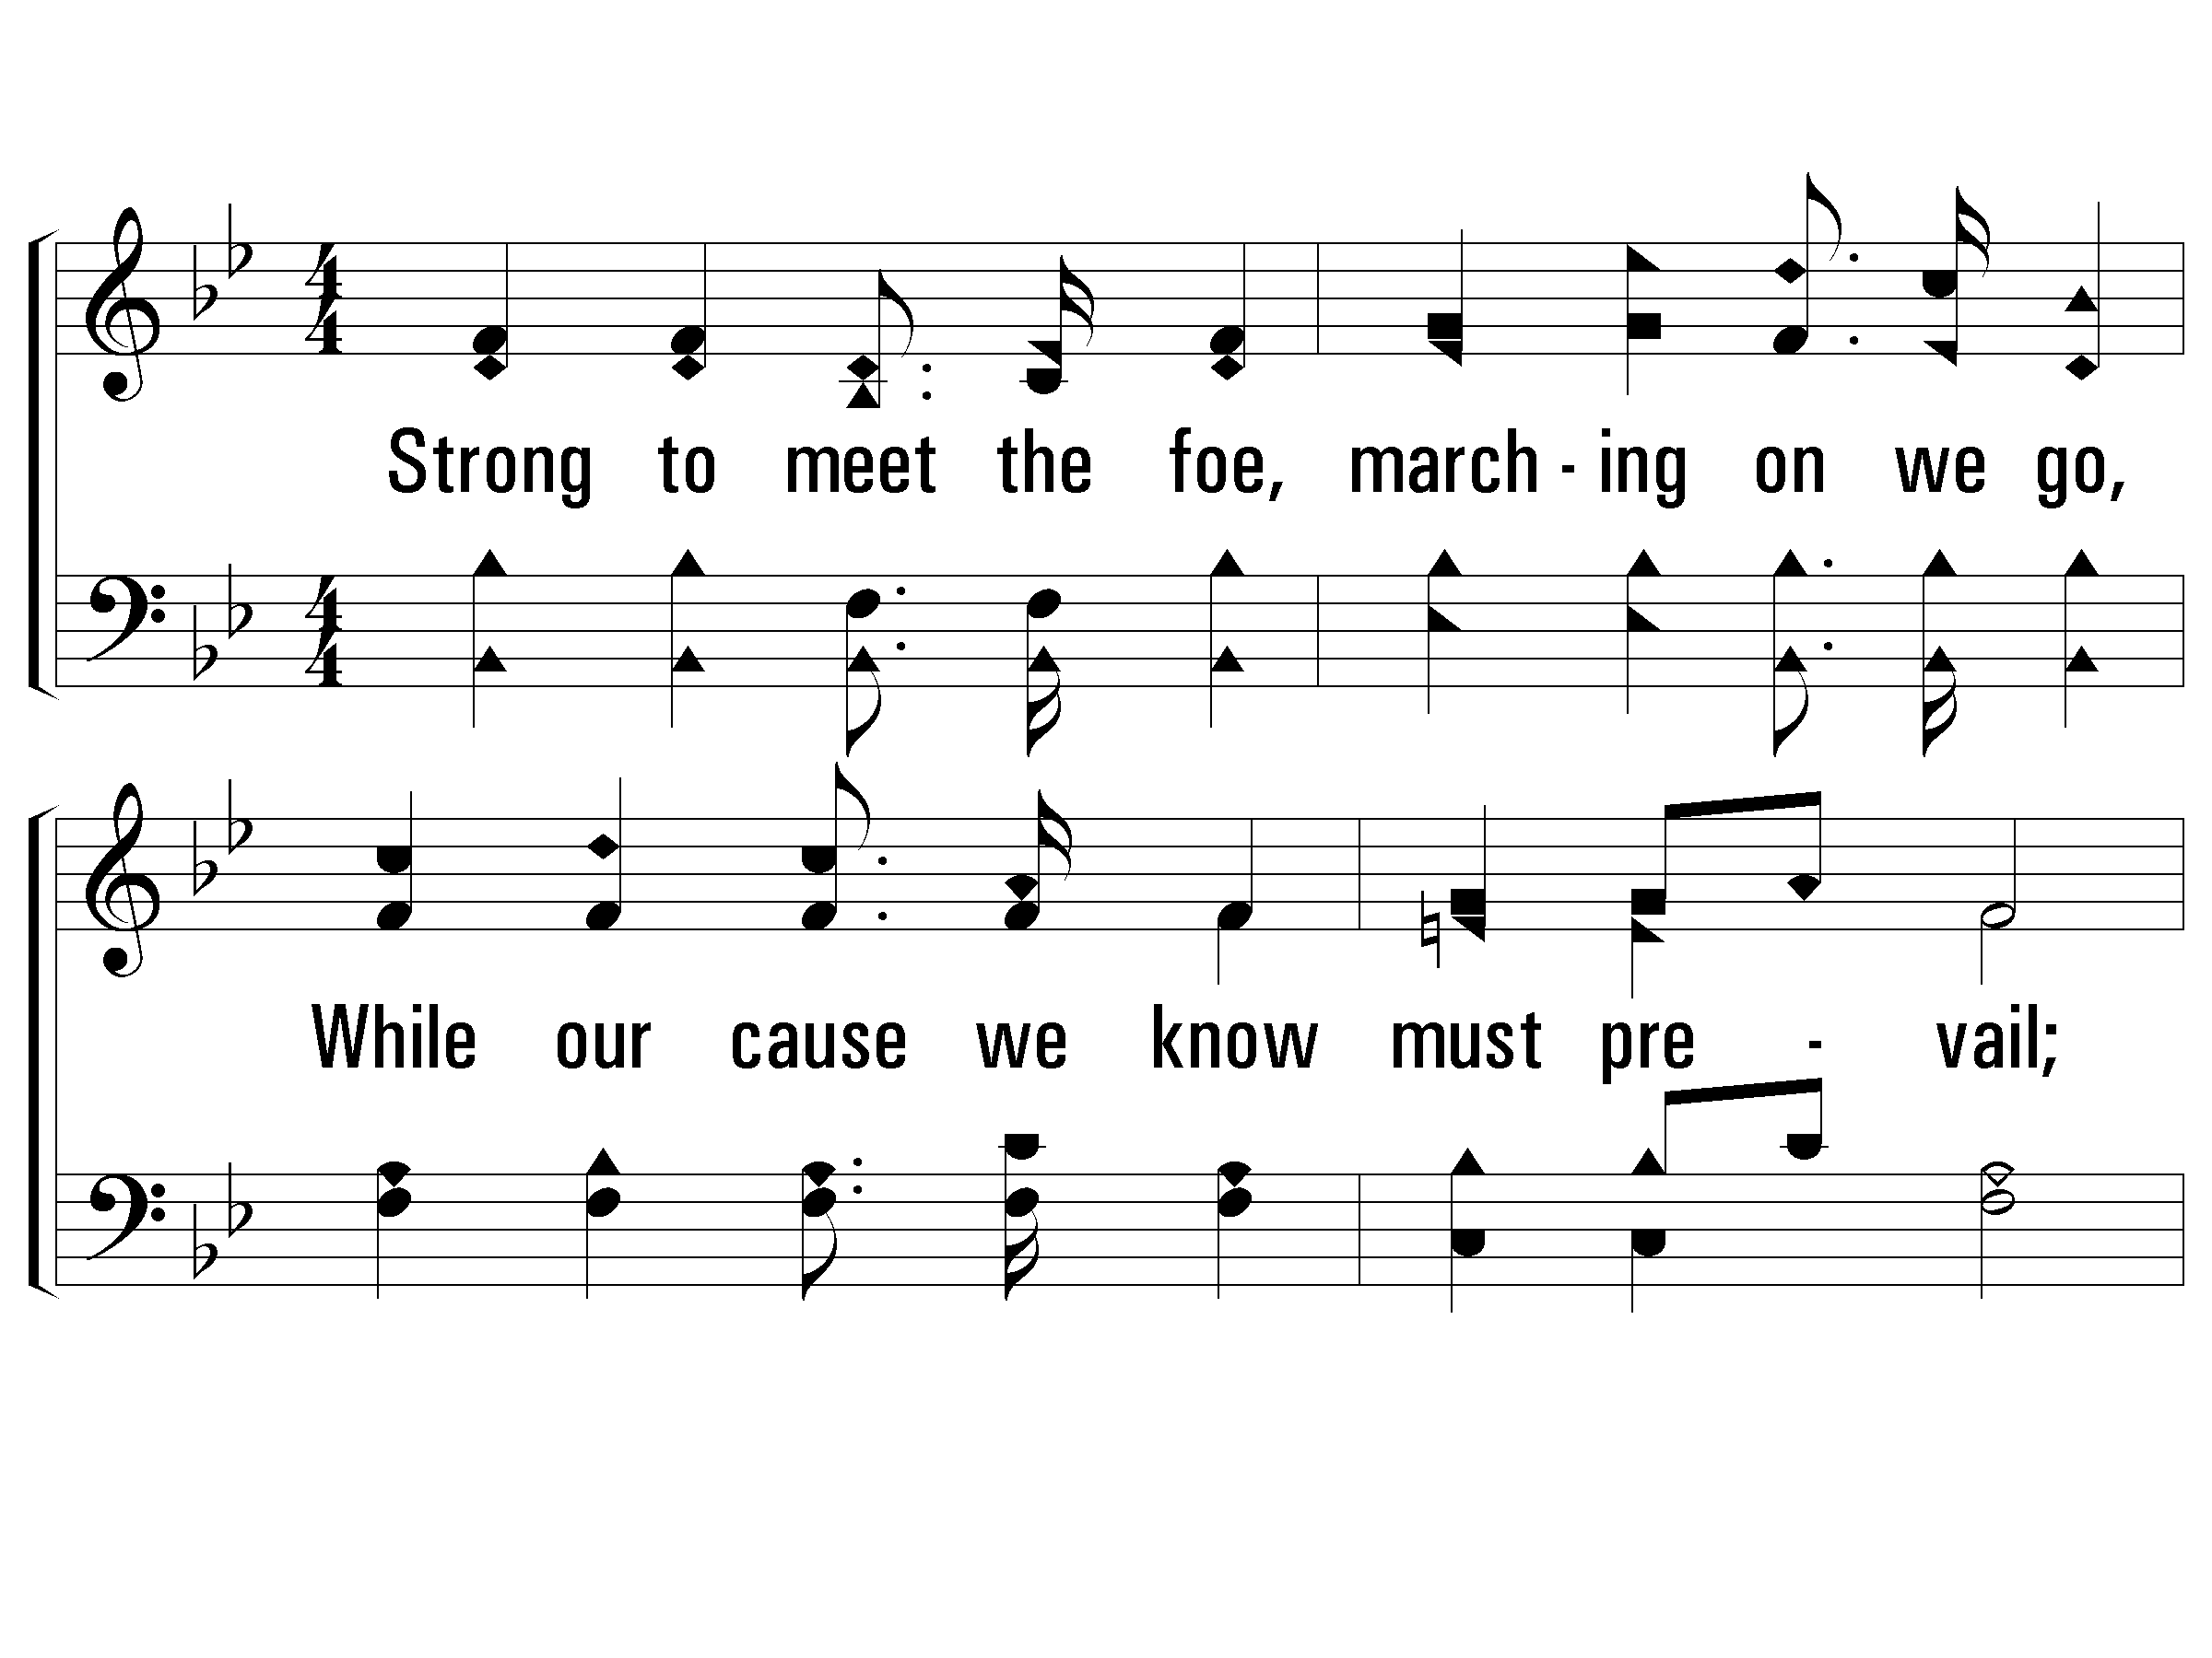
2 - Sound the Battle Cry
2.
Strong to meet the foe, marching on we go,
While our cause we know must prevail;
Shield and banner bright gleaming in the light,
Battling for the right, we never can fail.
Words & Music: William F. Sherwin
© 2007 The Paperless Hymnal®

Slide 40
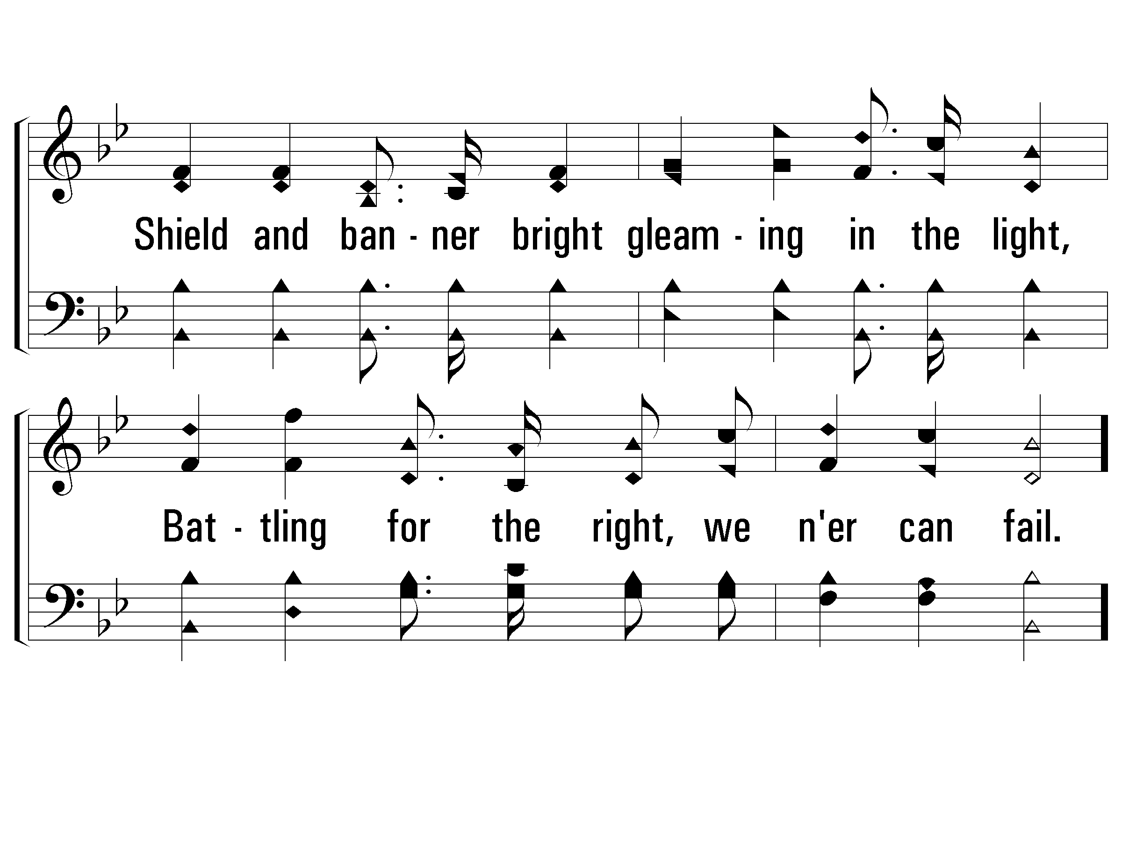
2 - Sound the Battle Cry
© 2007 The Paperless Hymnal®

Slide 41
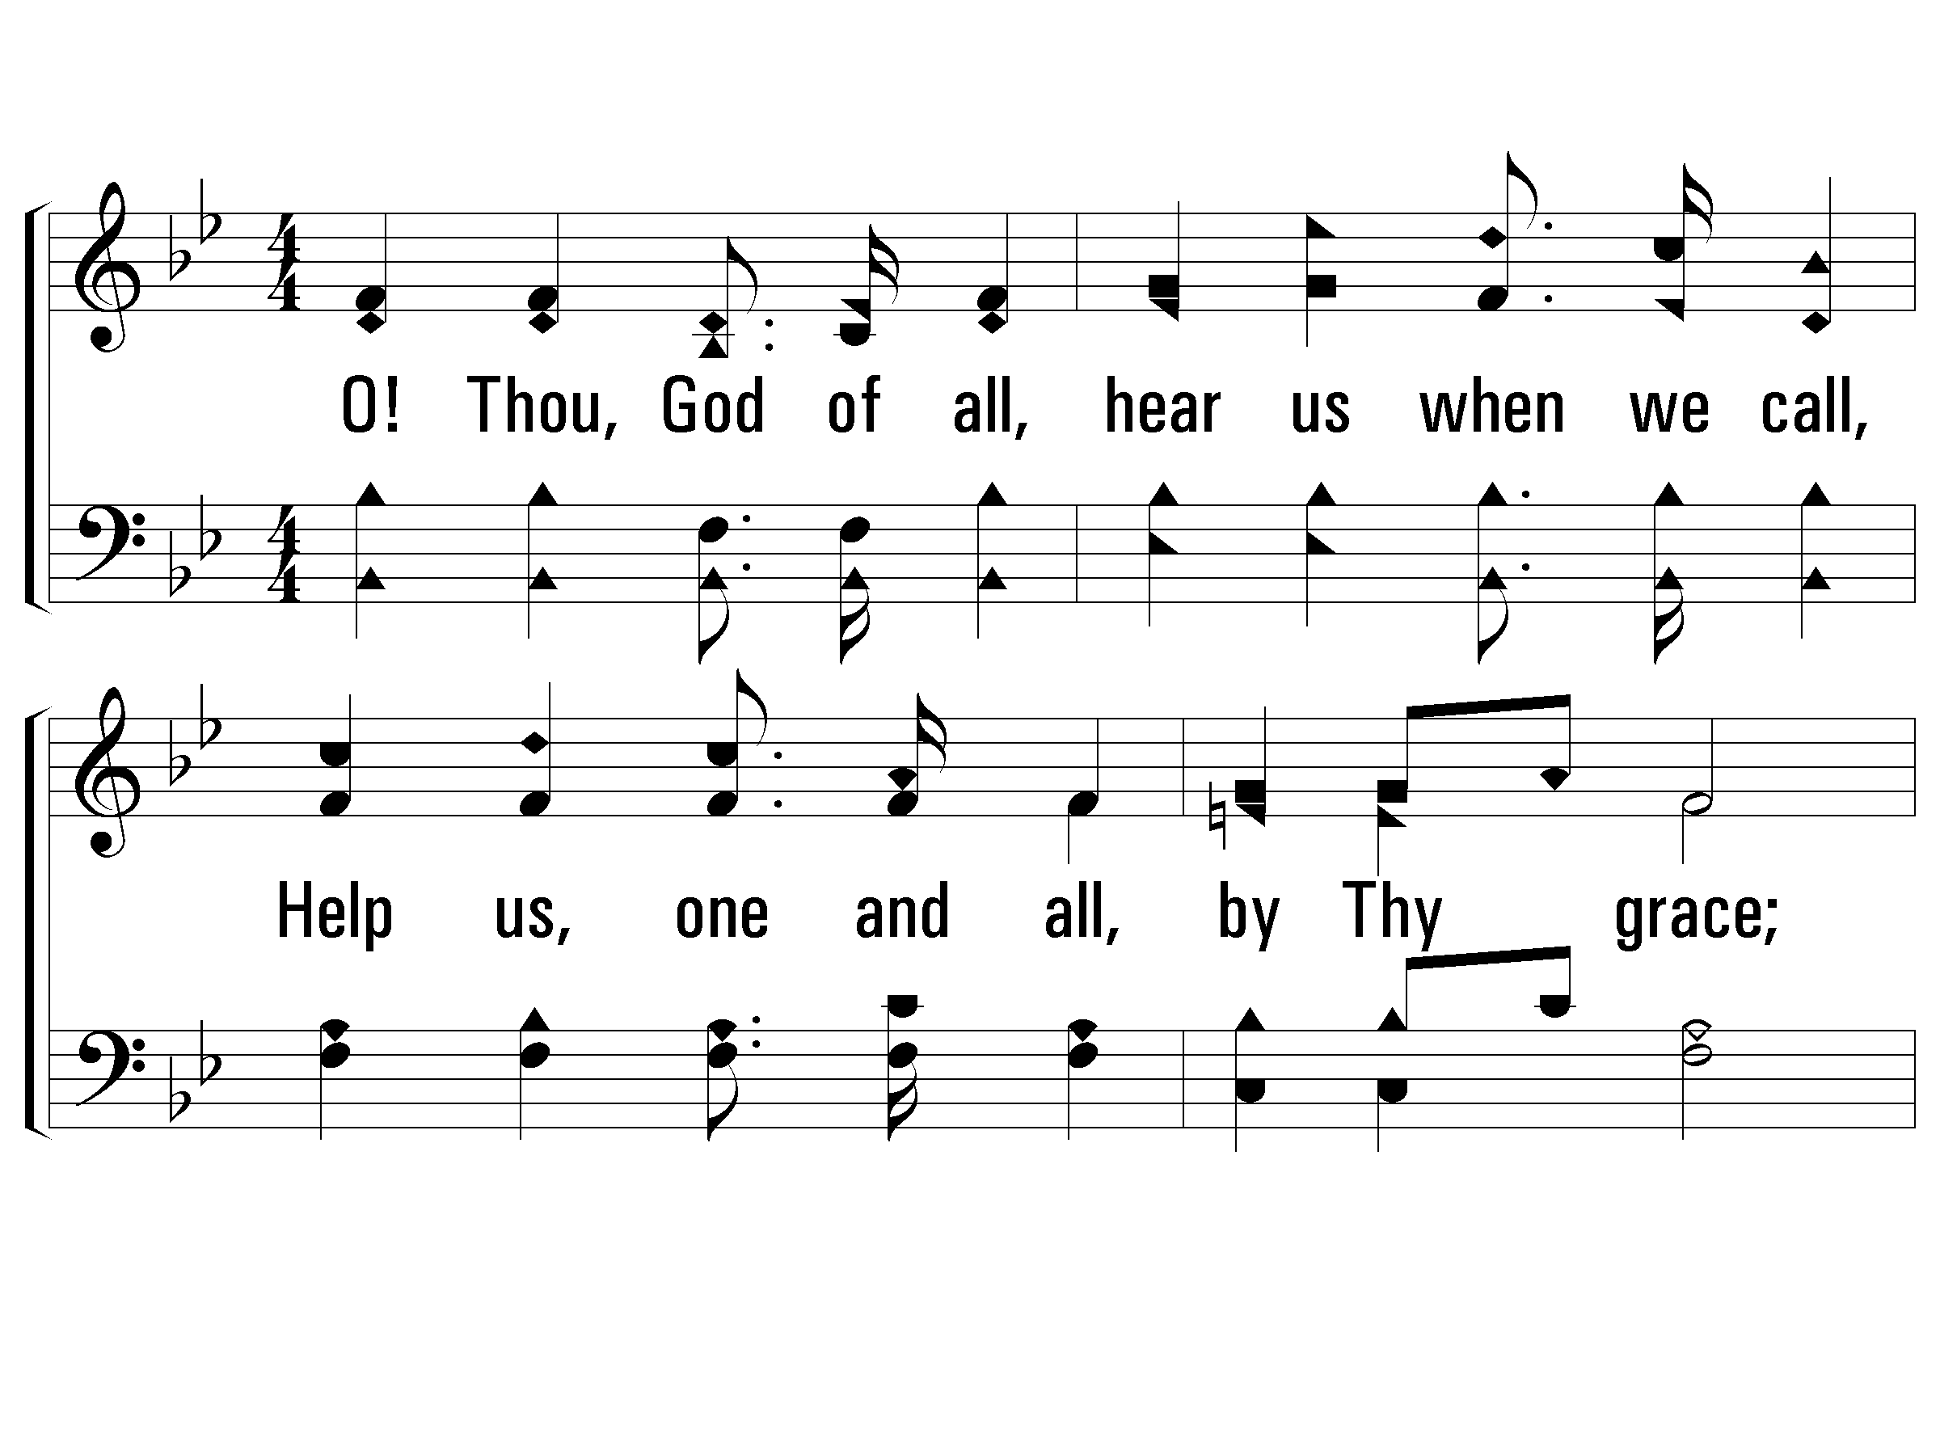
3 - Sound the Battle Cry
3.
O! Thou, God of all, hear us when we call,
Help us, one and all, by Thy grace;
When the battle's done, and the victory won,
May we wear the crown before Thy face.
Words & Music: William F. Sherwin
© 2007 The Paperless Hymnal®

Slide 42
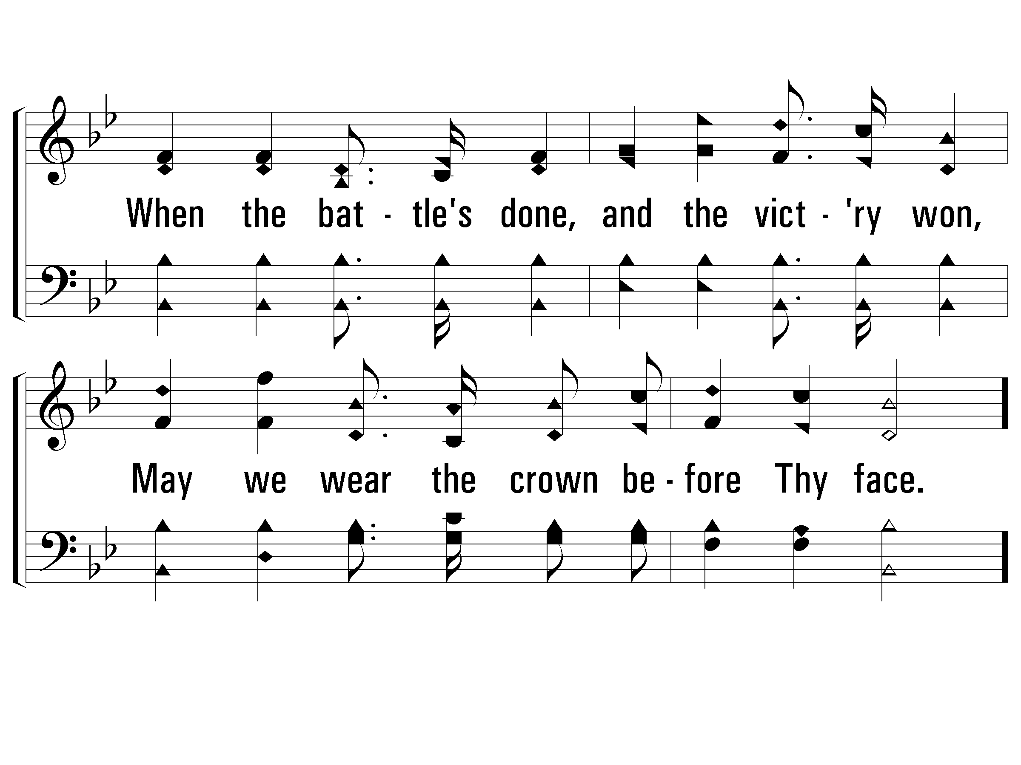
3 - Sound the Battle Cry
© 2007 The Paperless Hymnal®

Slide 43
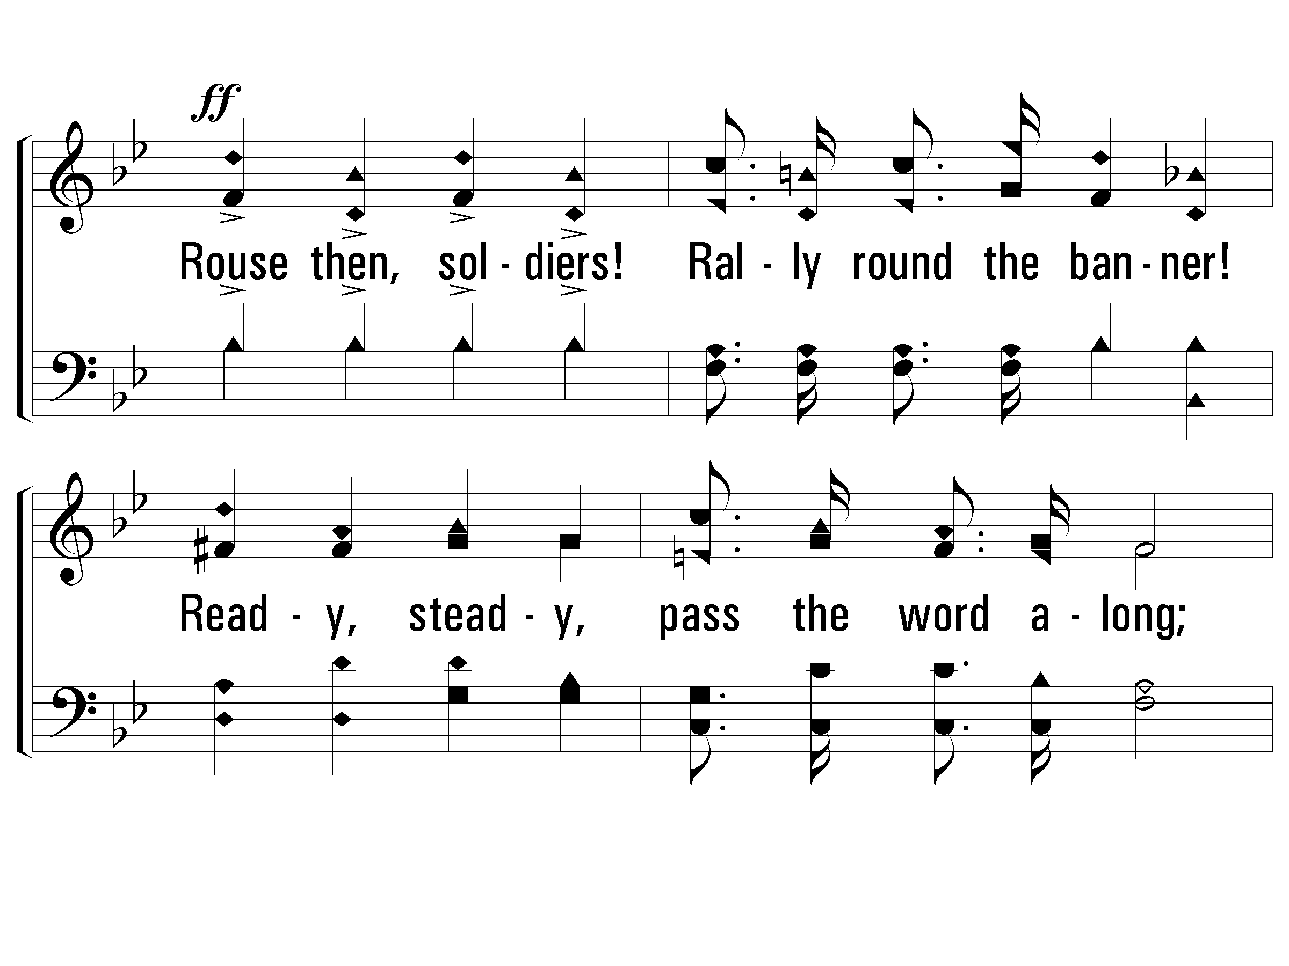
c - Sound the Battle Cry
Rouse then, soldiers! Rally round the banner!
Ready, steady, pass the word along;
Onward, forward, shout aloud, "Hosanna!"
Christ is Captain of the mighty throng.
© 2007 The Paperless Hymnal®

Slide 44
c - Sound the Battle Cry
© 2007 The Paperless Hymnal®

Slide 47
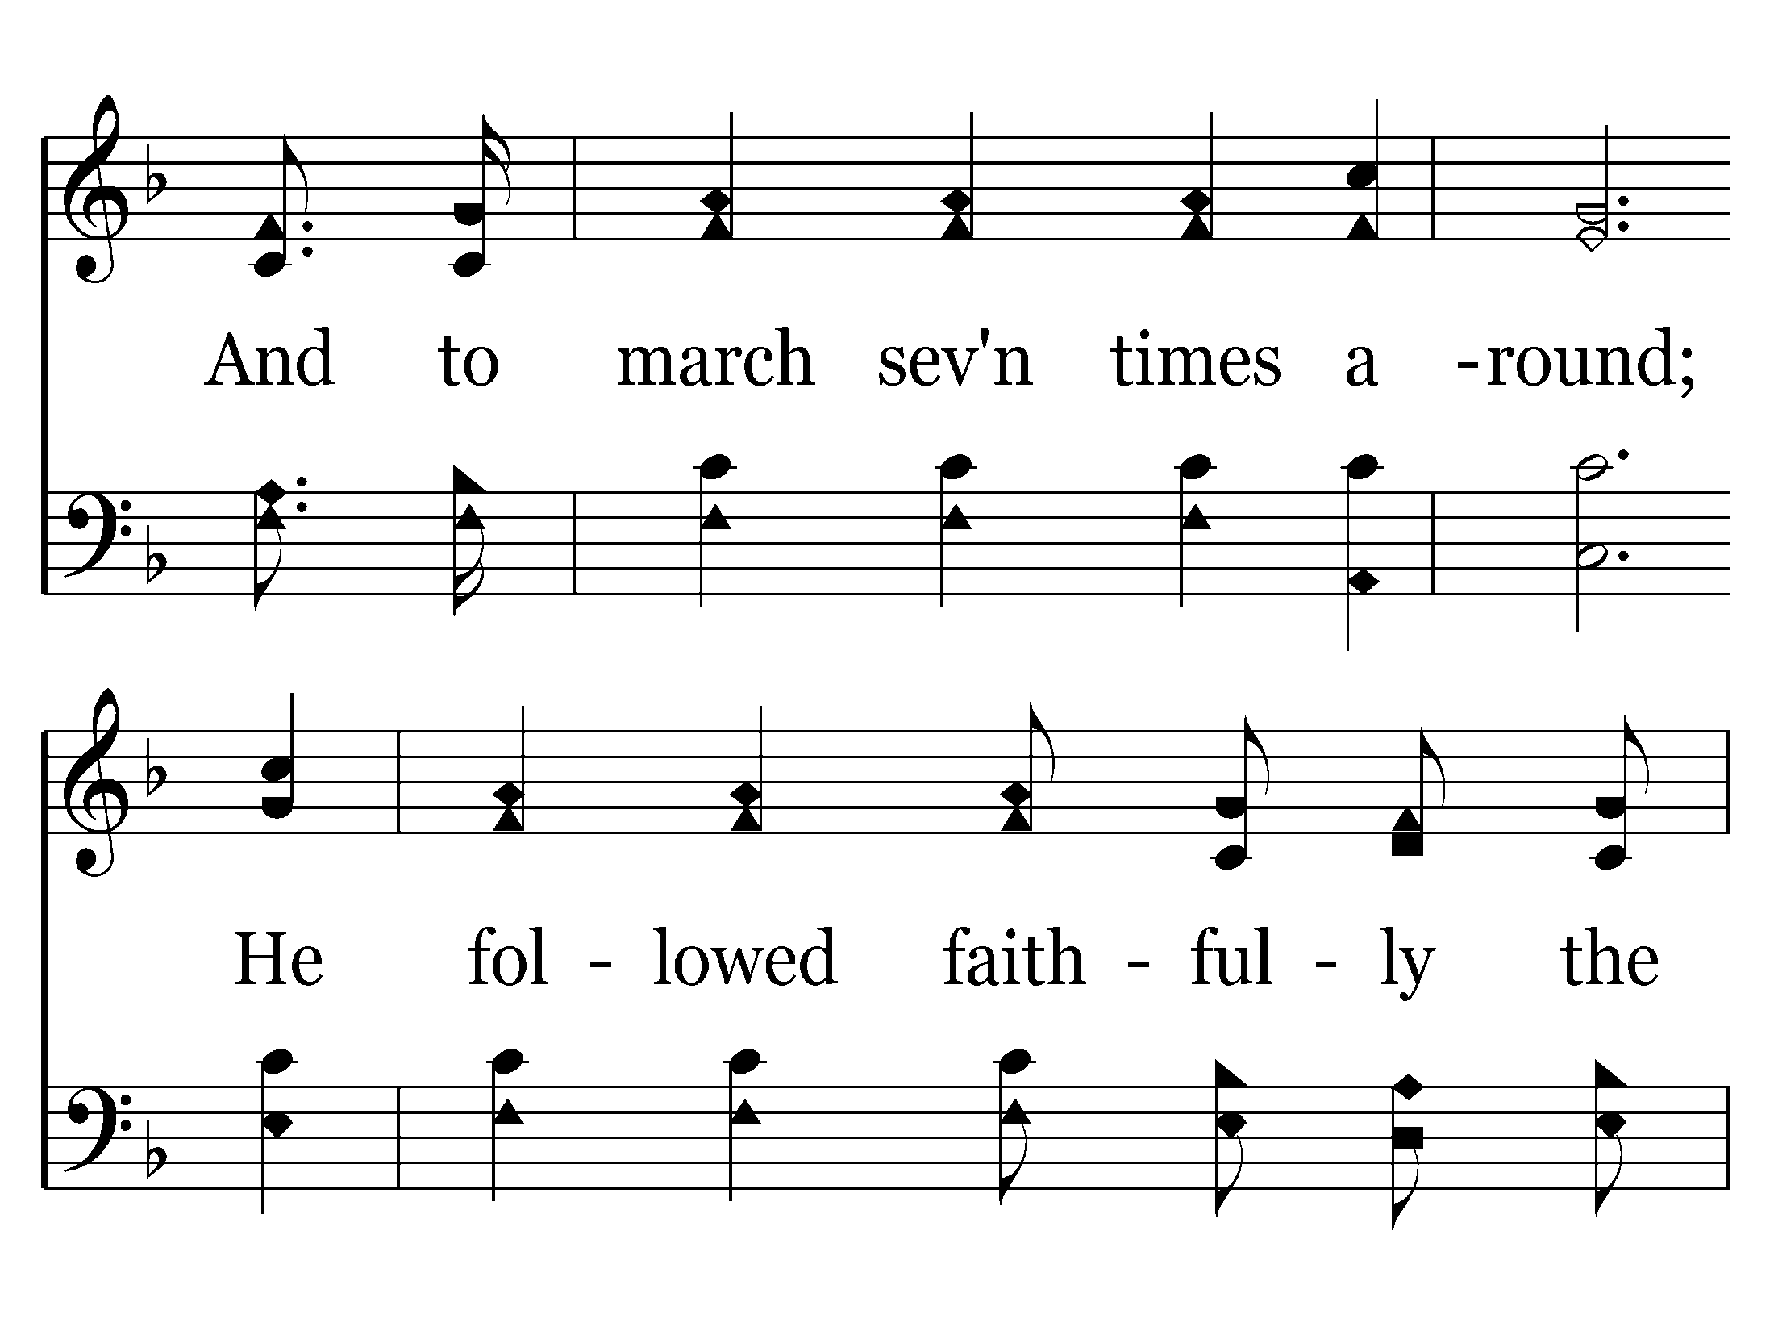

Slide 49
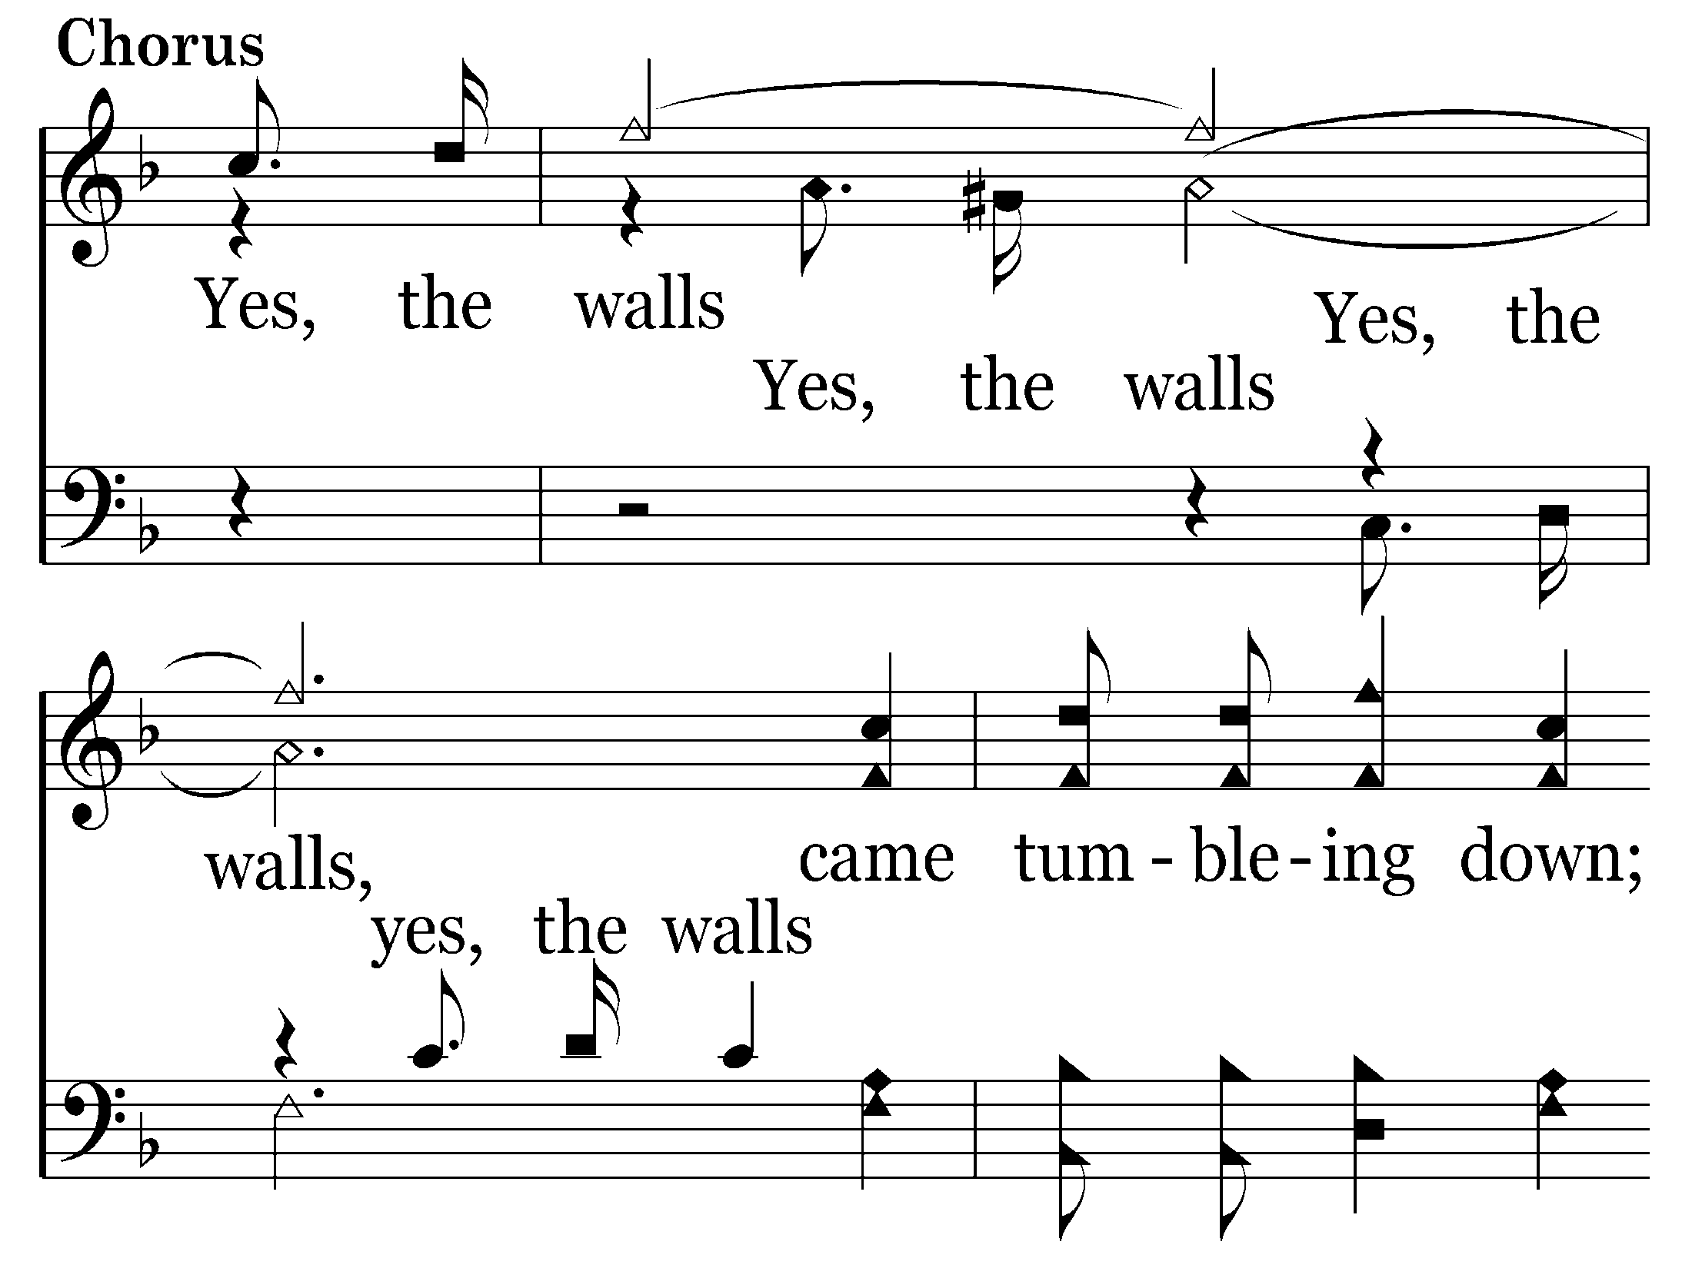

Slide 50
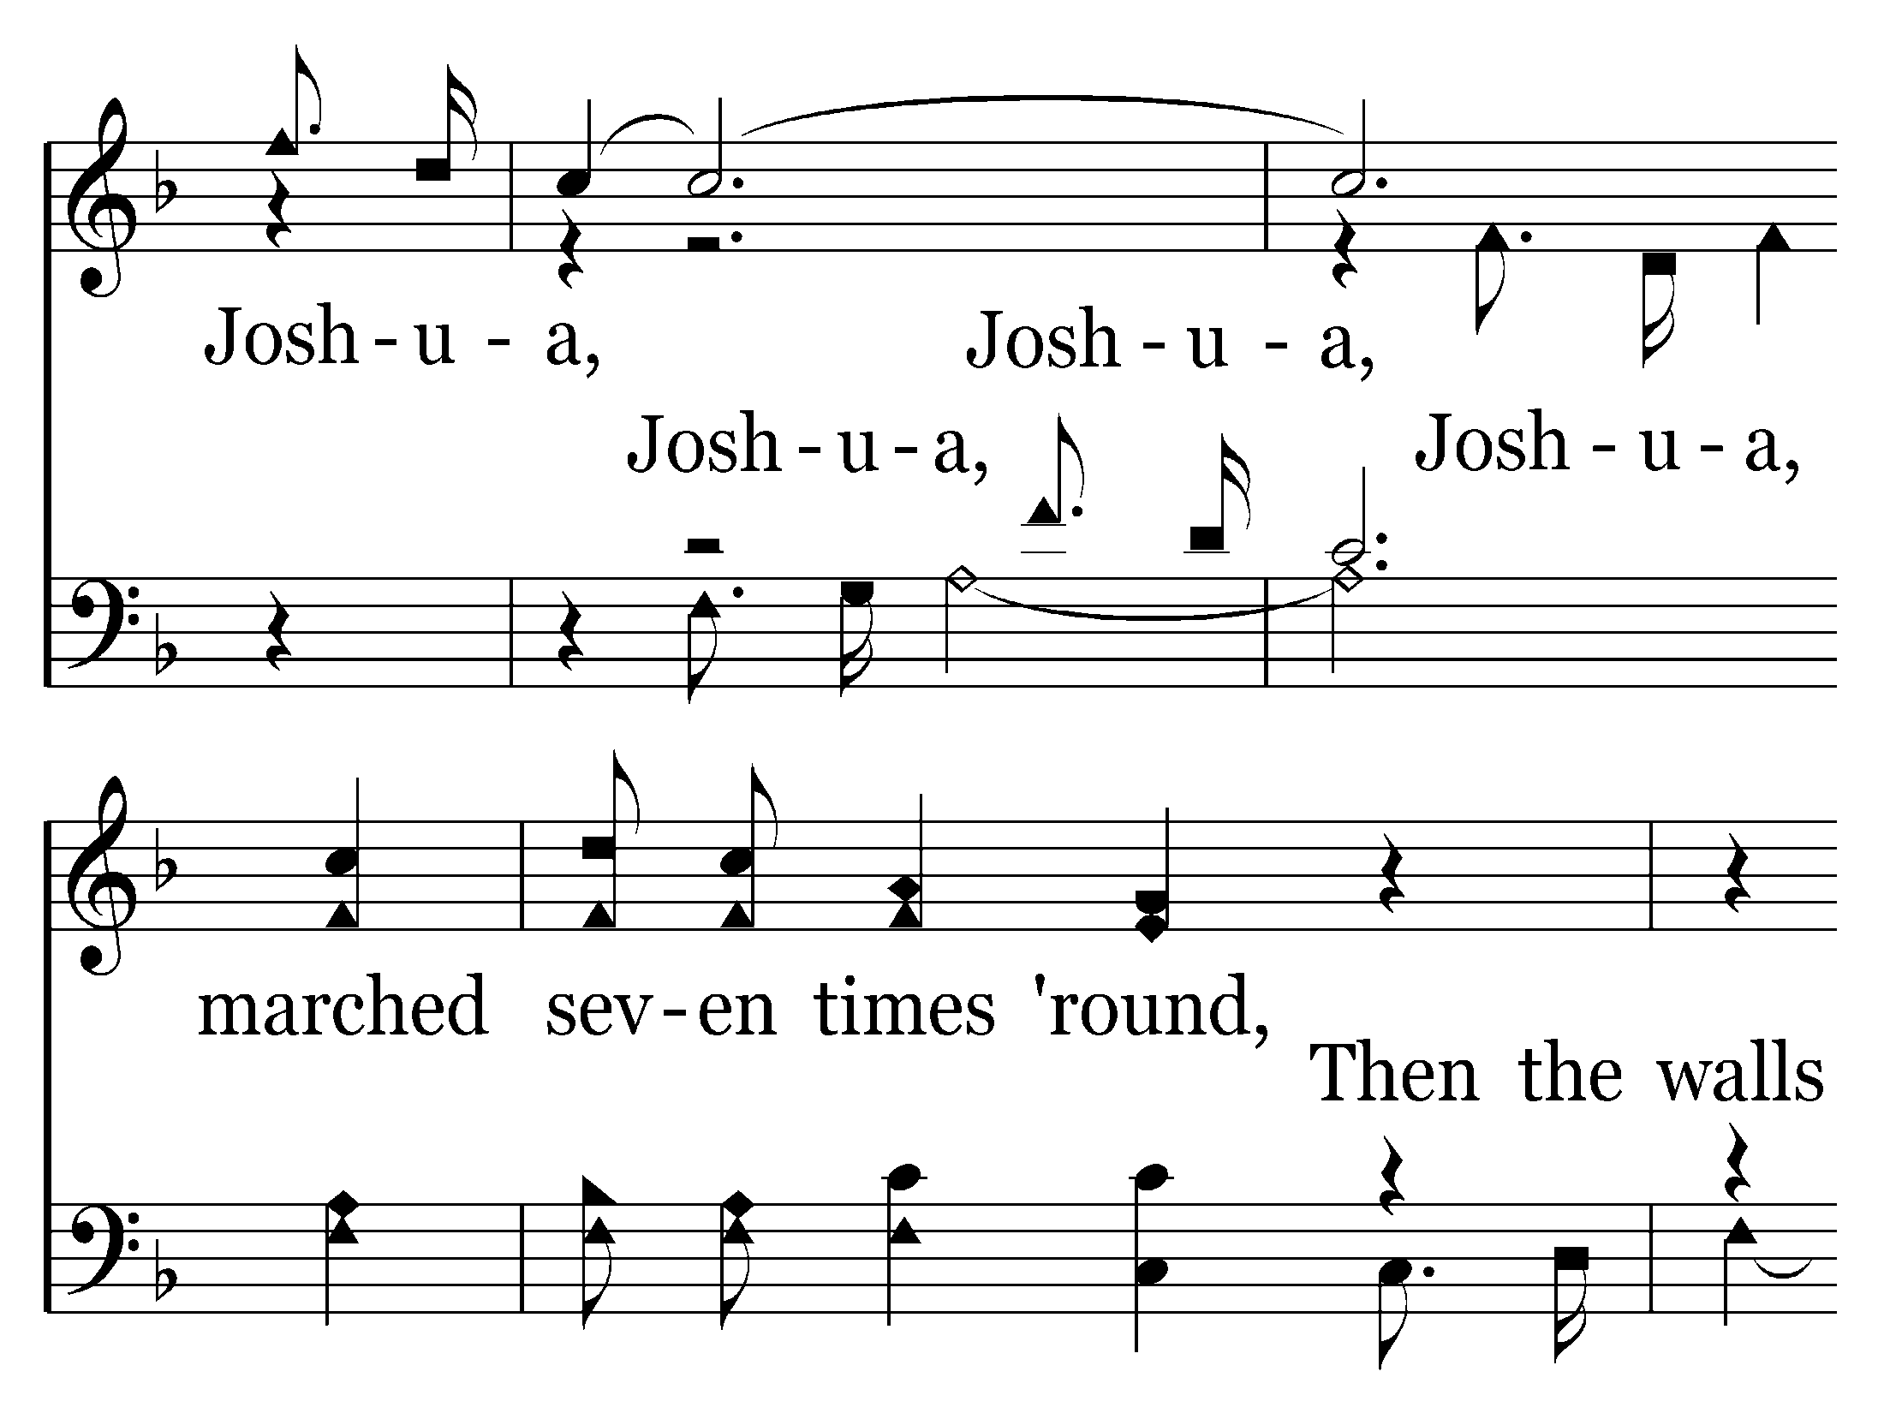

Slide 51
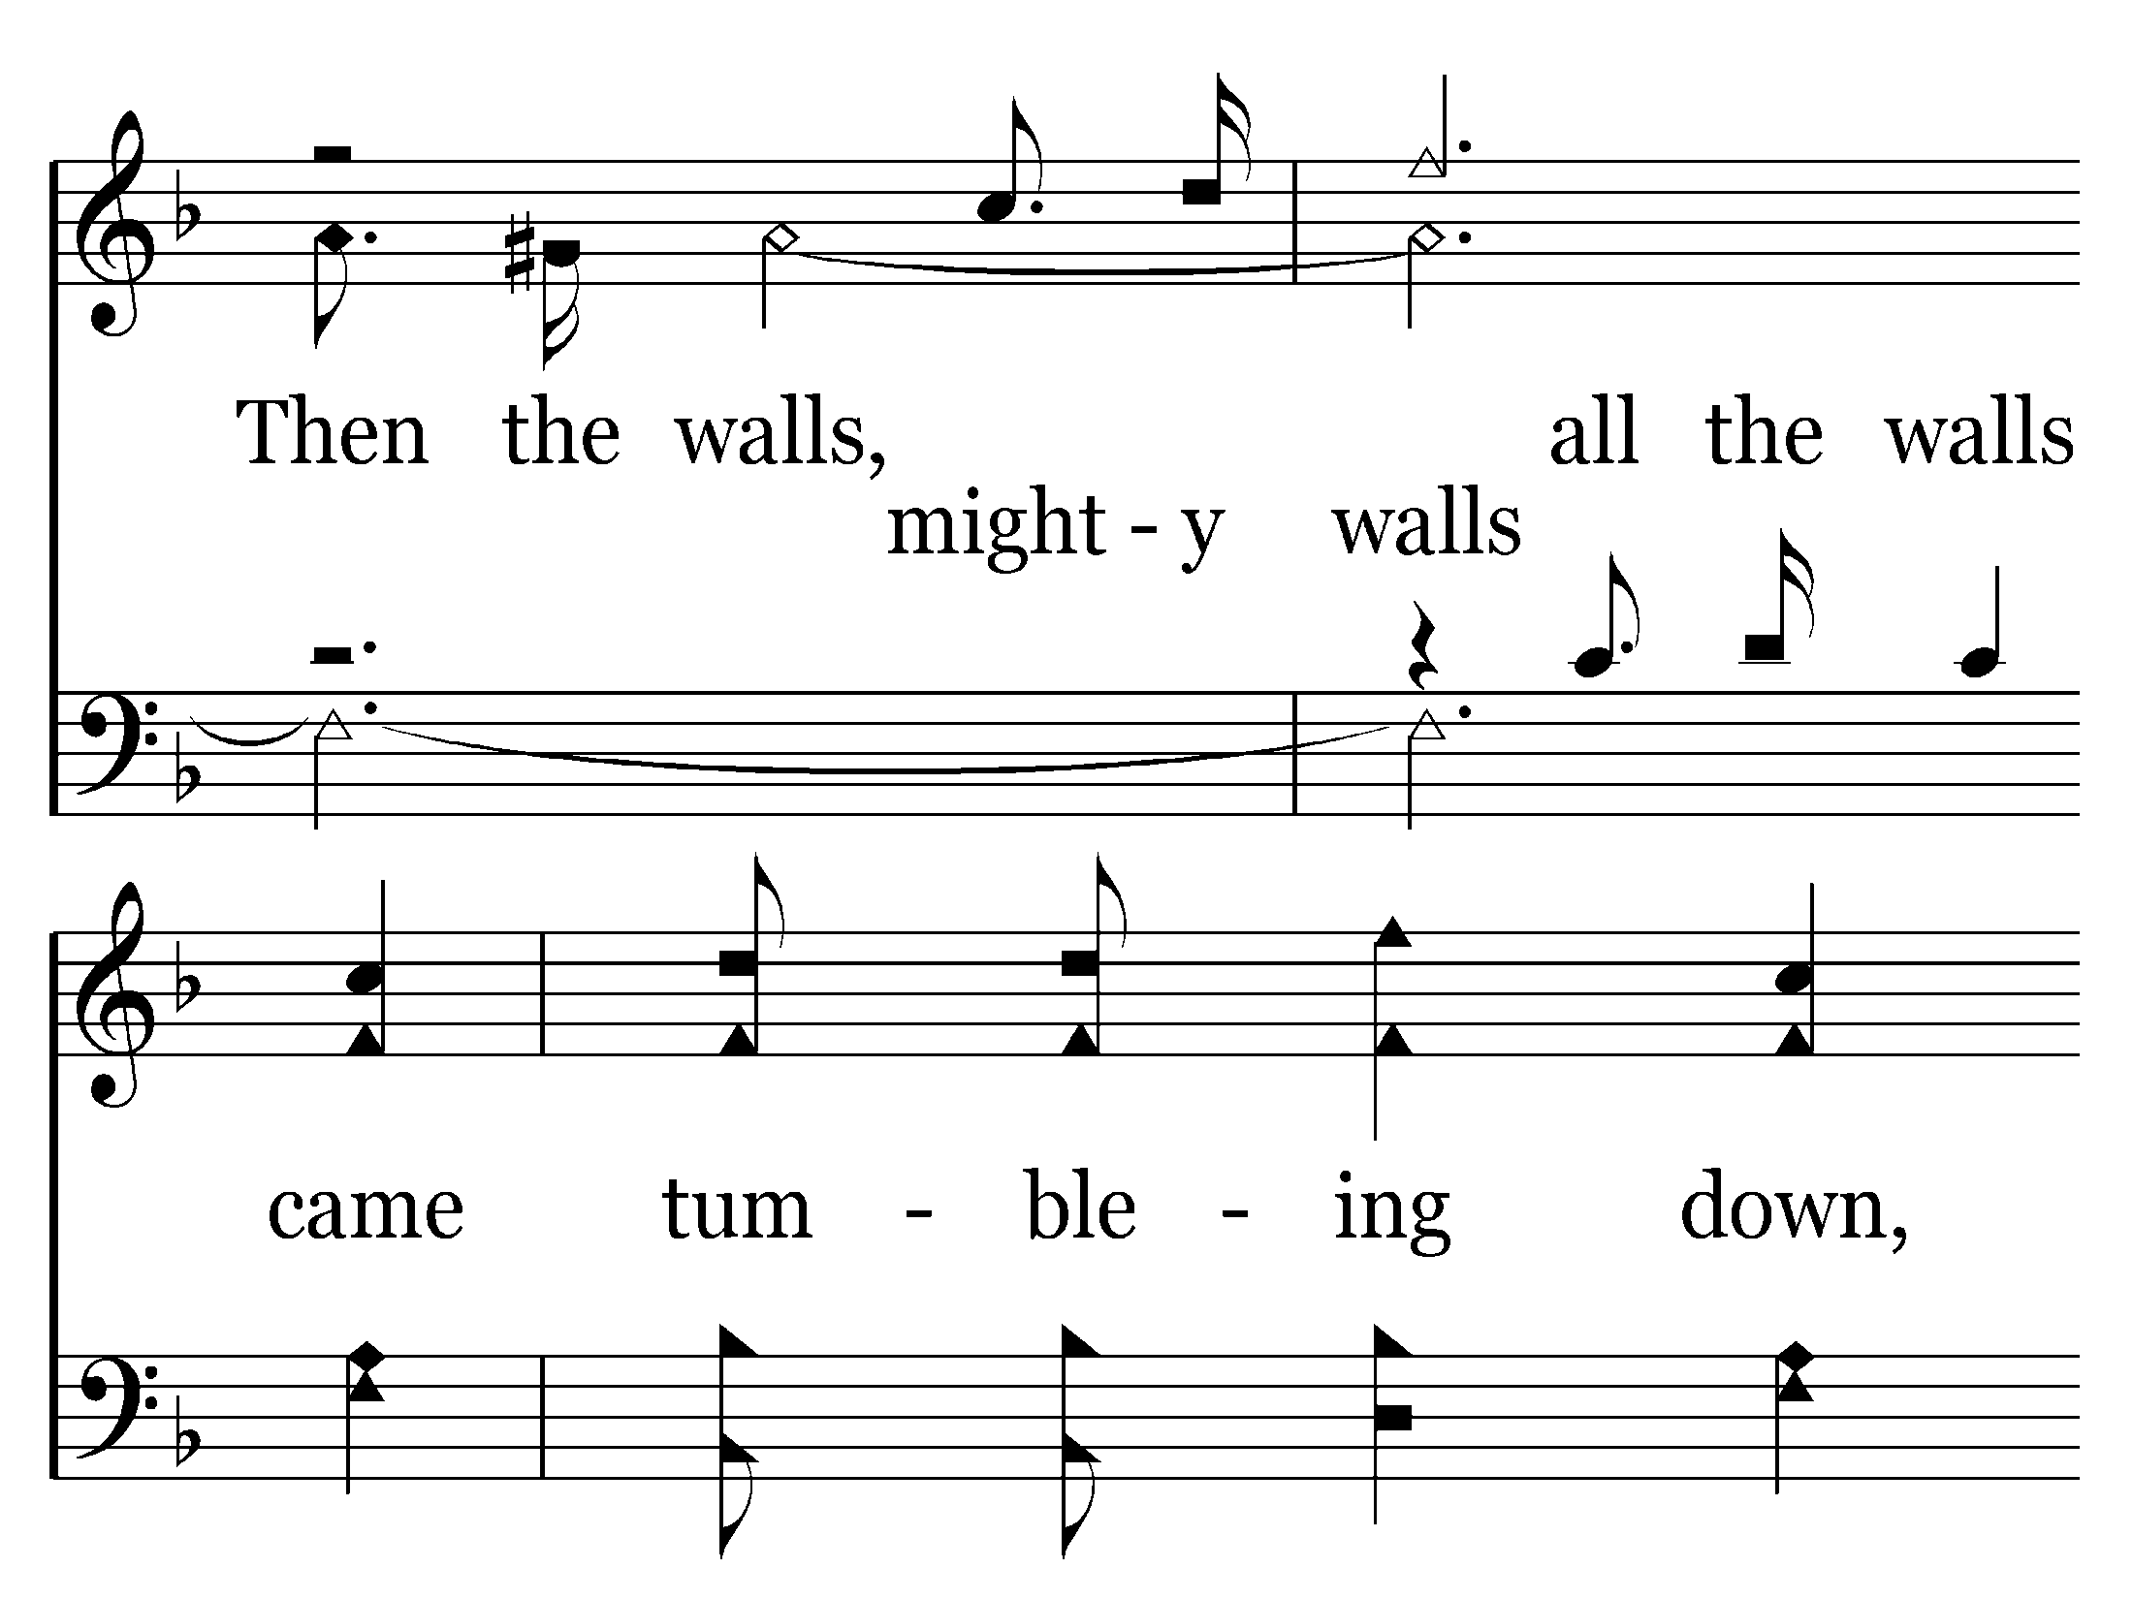

Slide 52
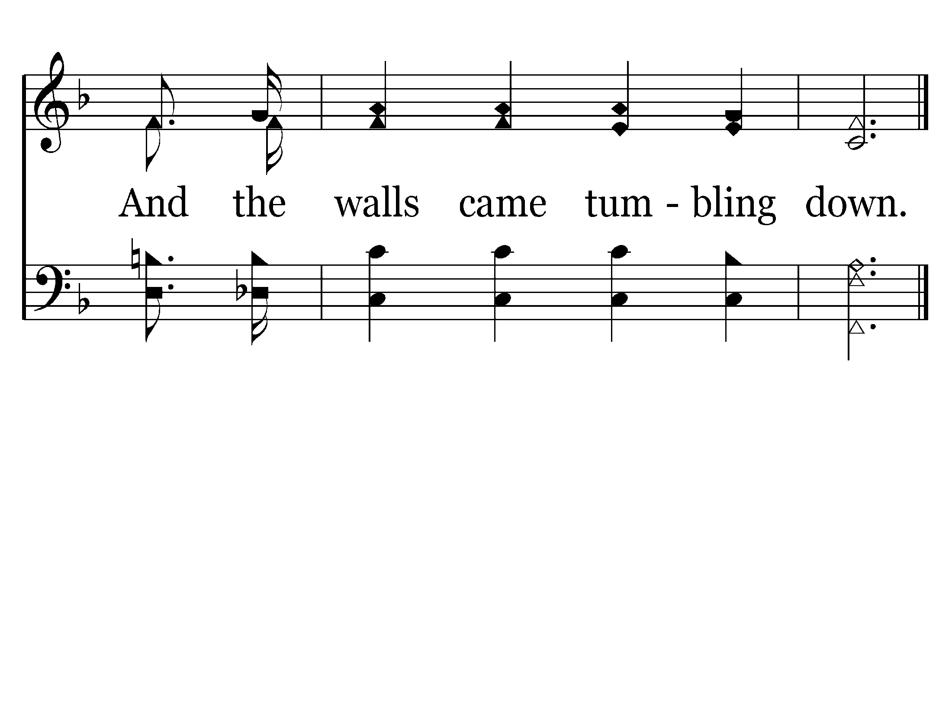
End of Verse 1

Slide 54
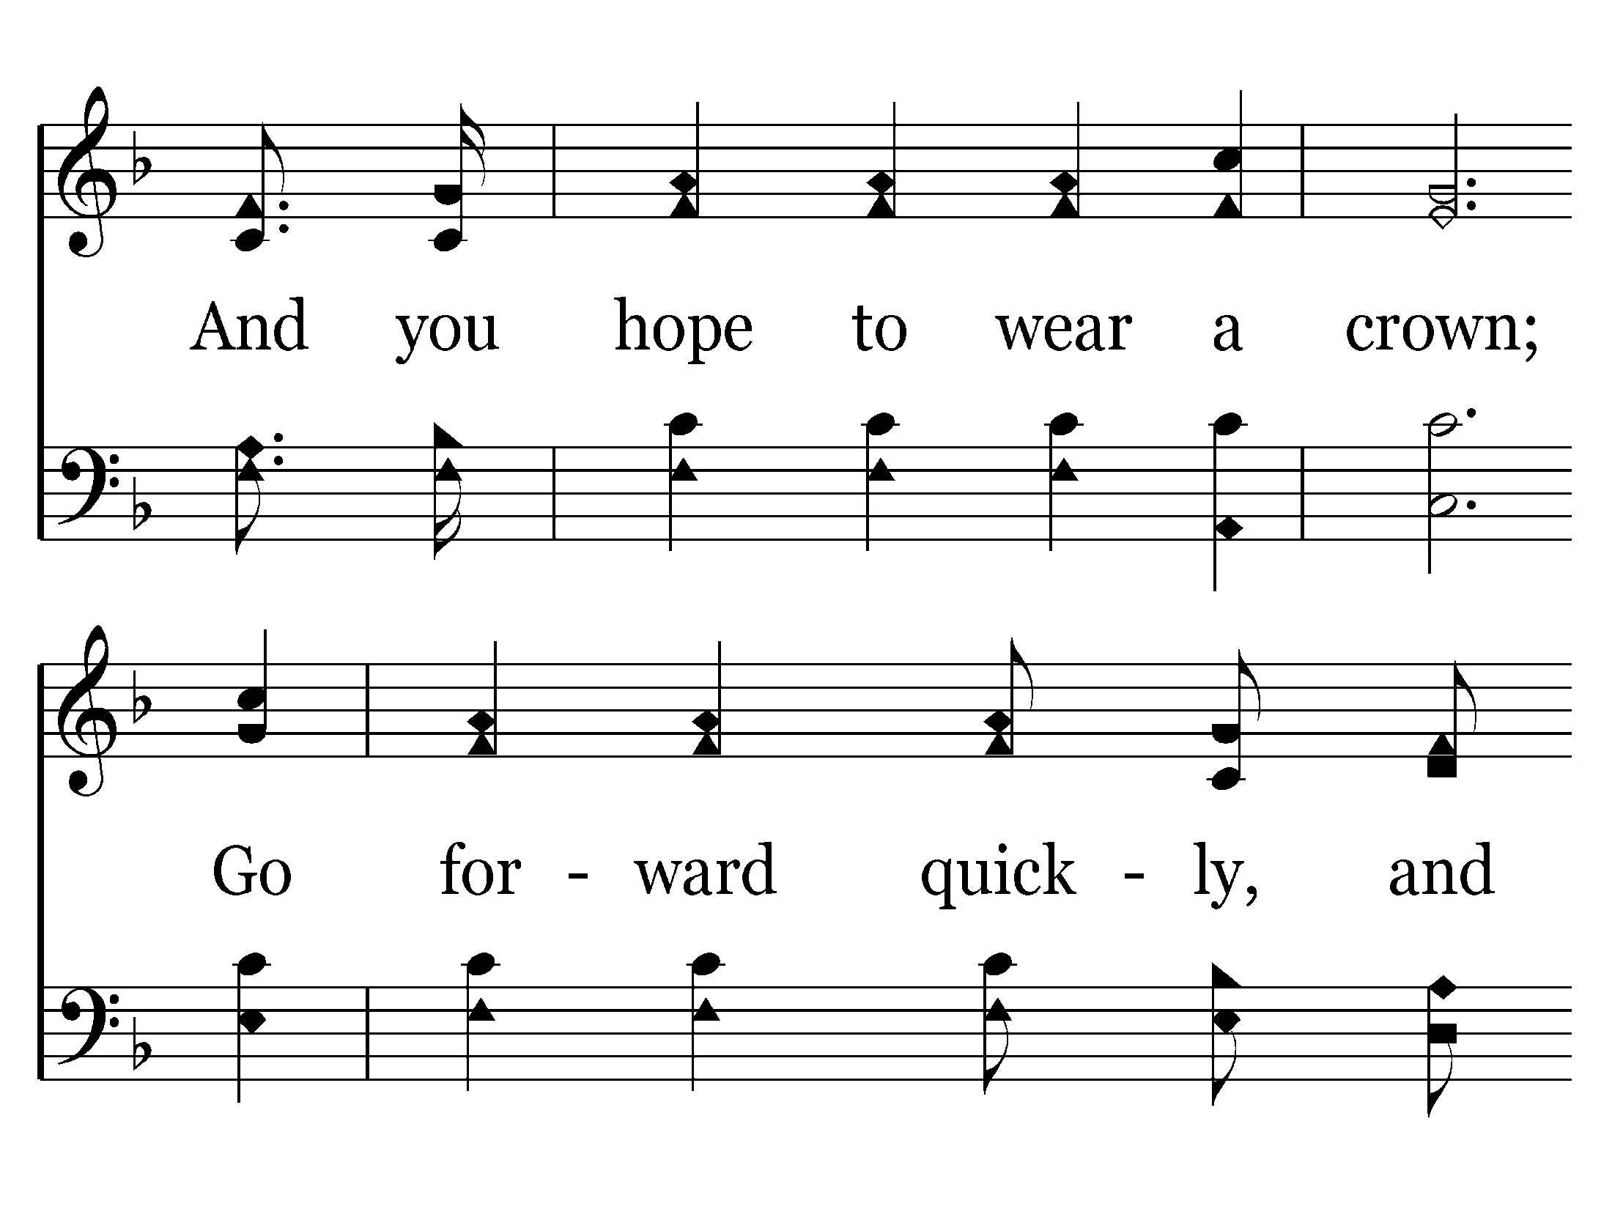

Slide 55
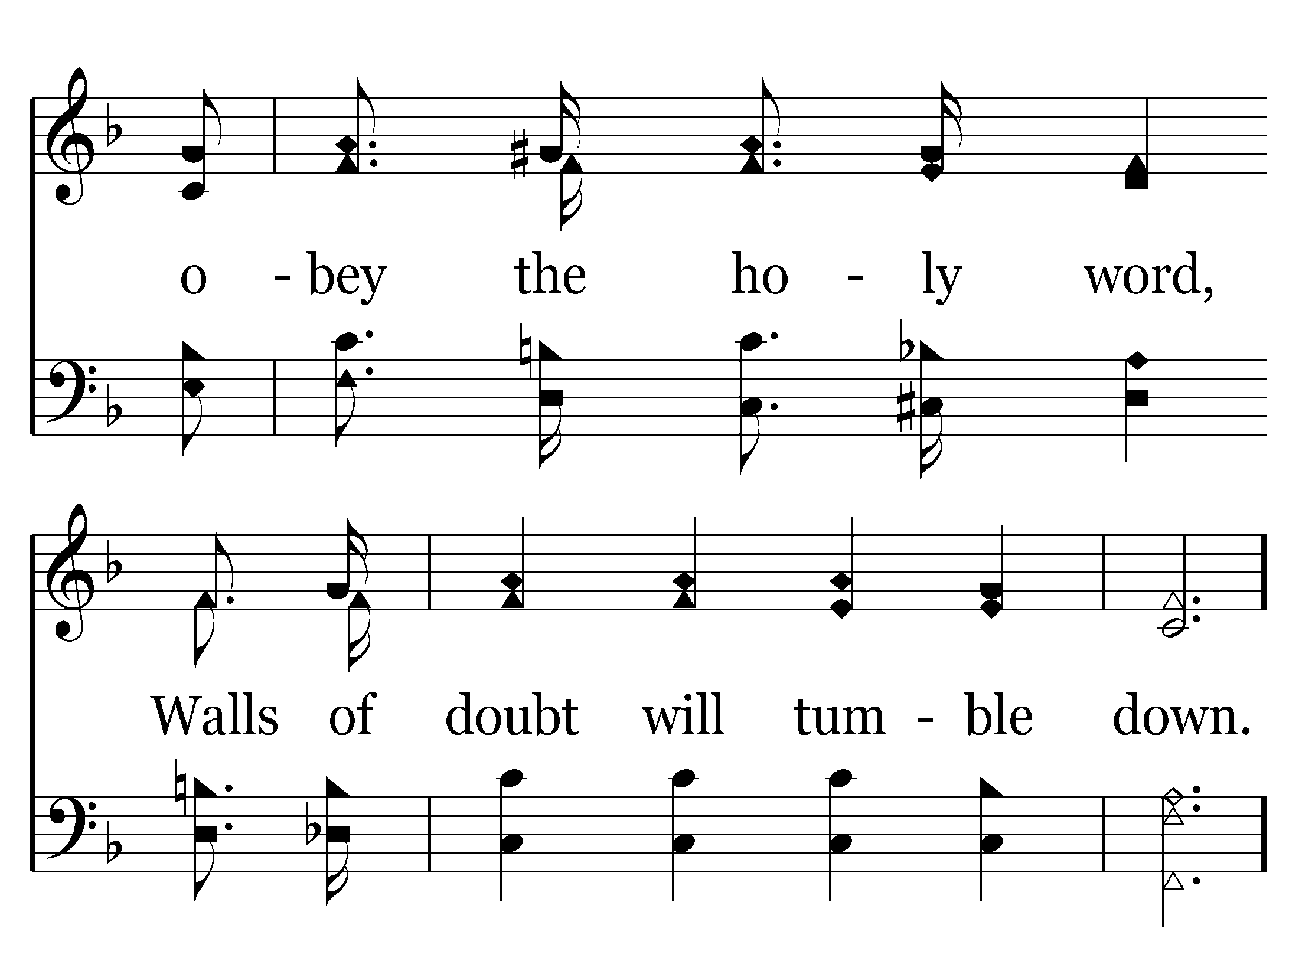

Slide 59
End of Verse 2

Slide 61
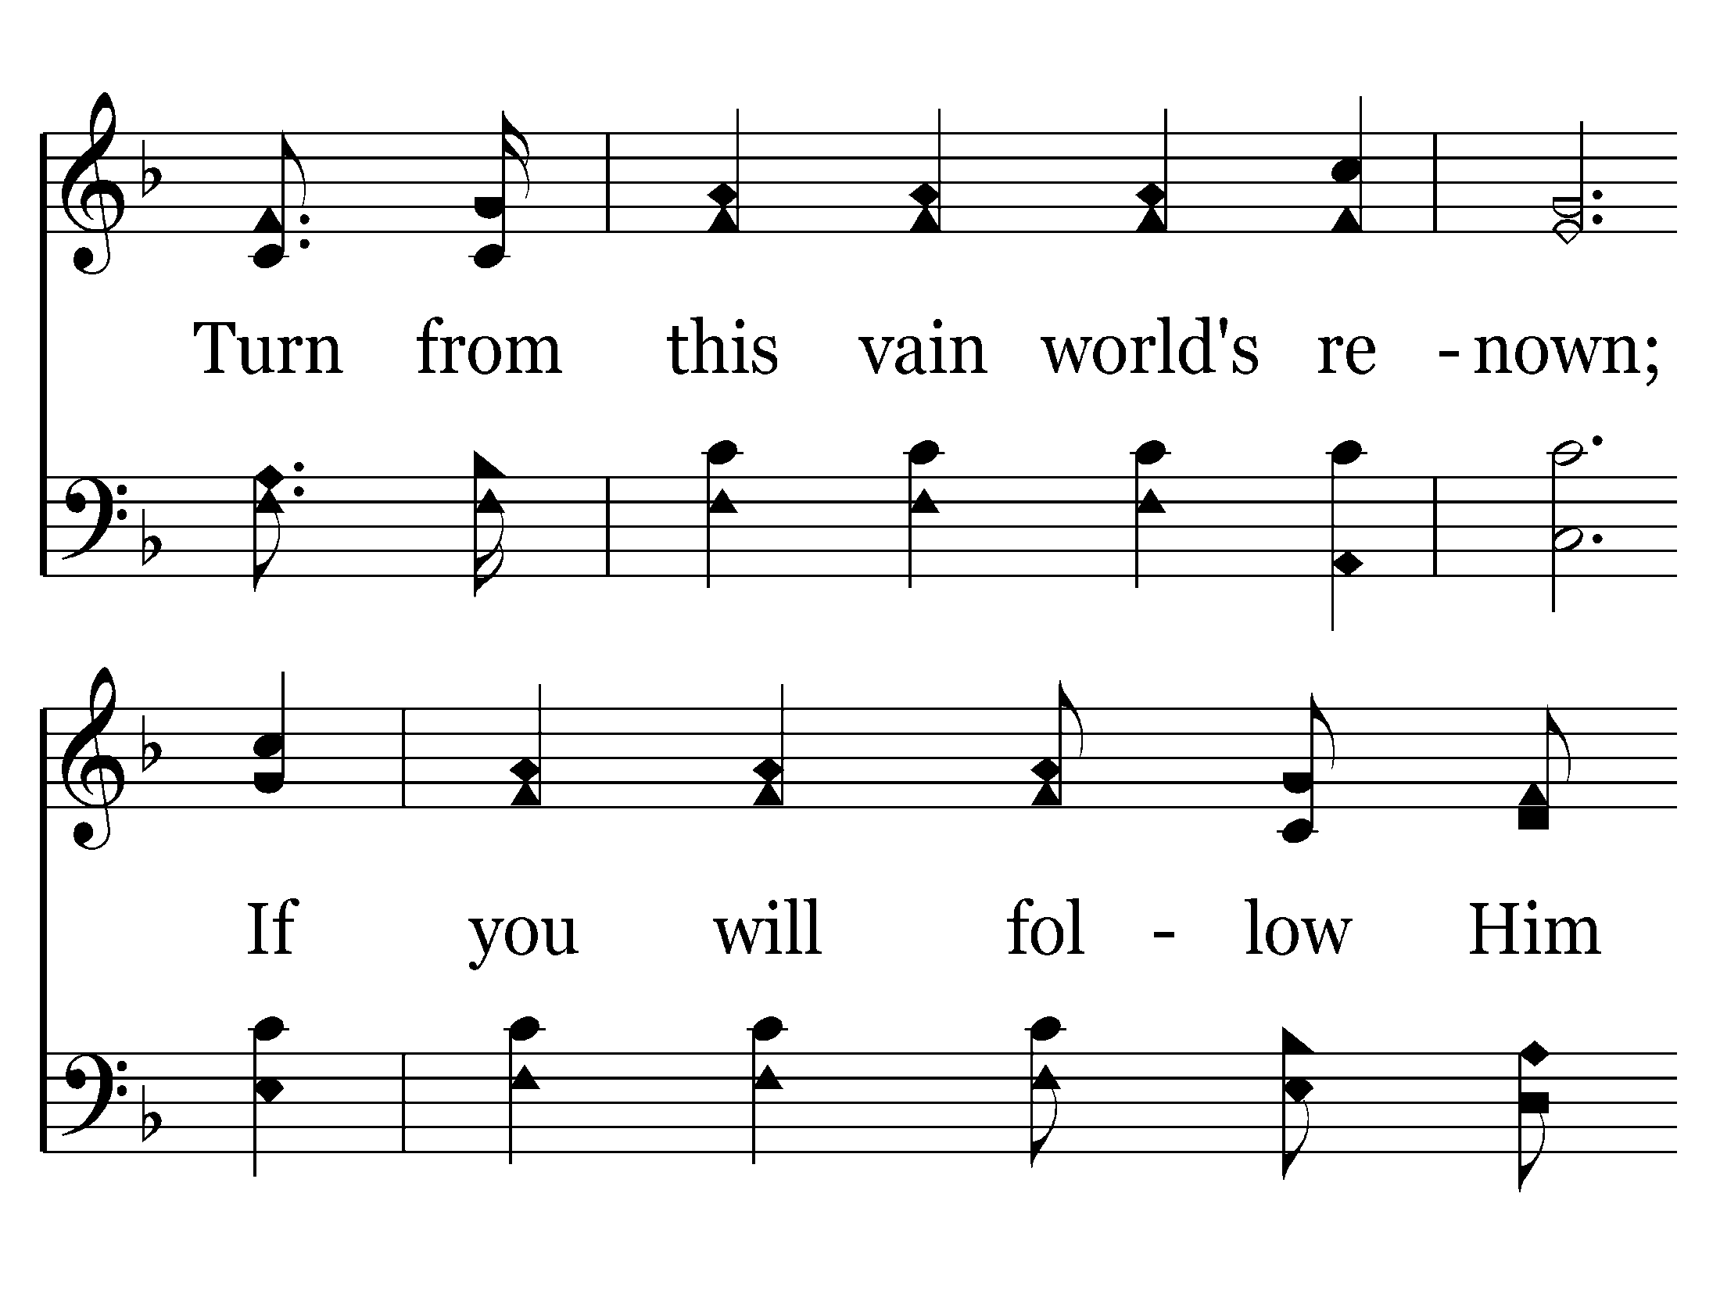

Slide 62
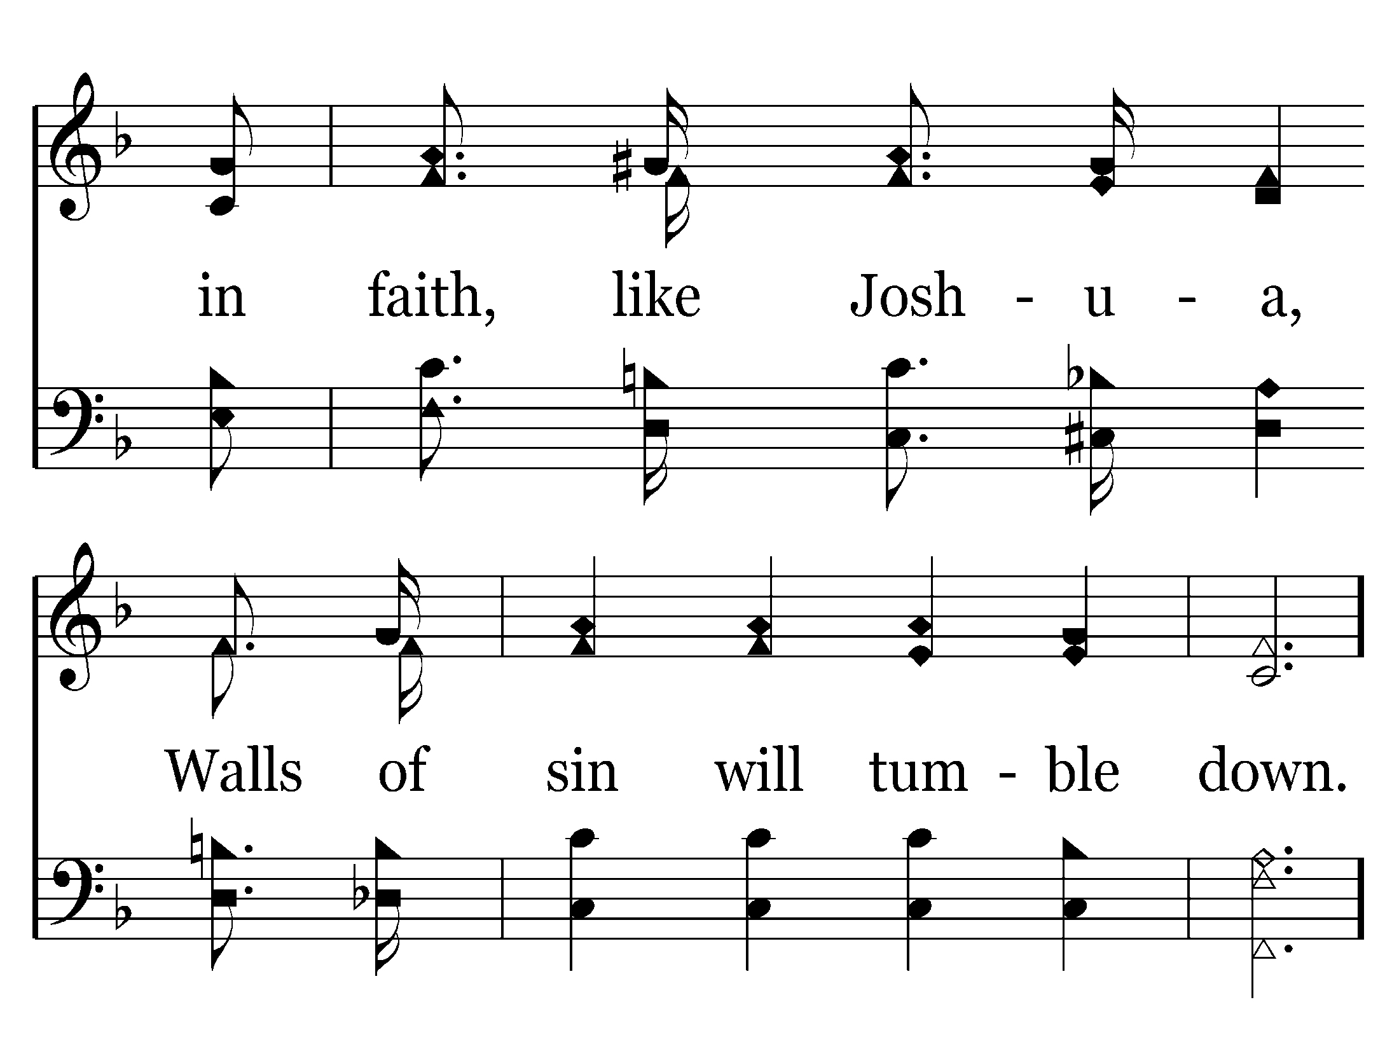

Slide 66
End of Song

Slide 68
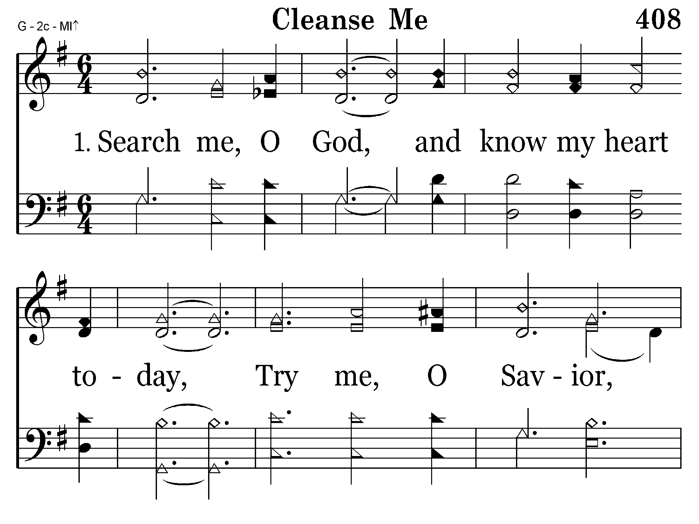

Slide 69
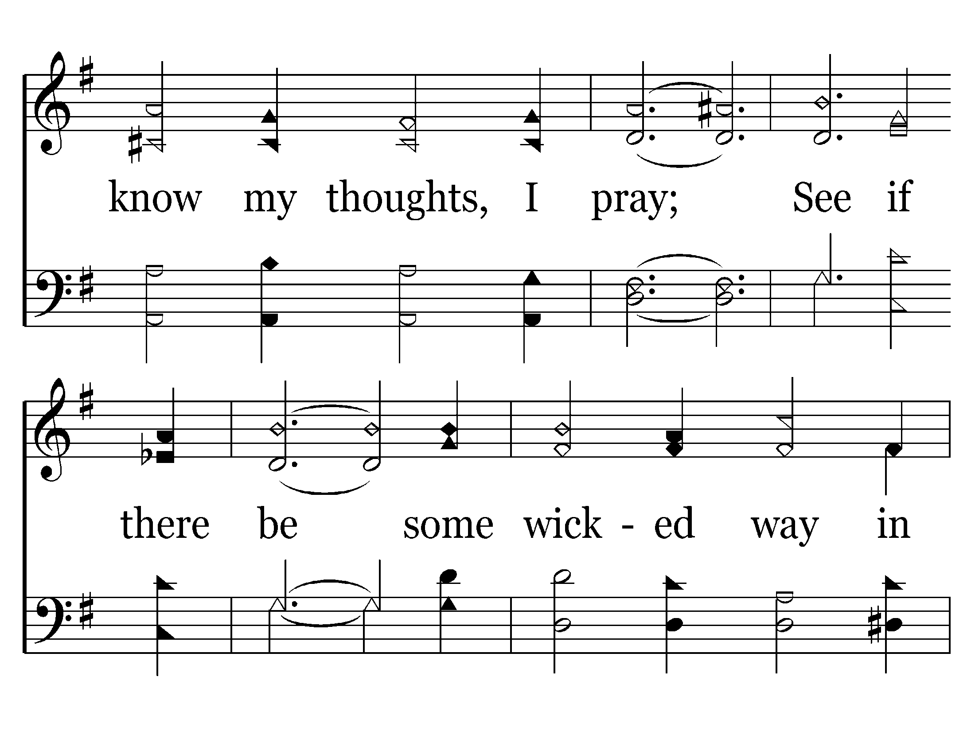

Slide 70
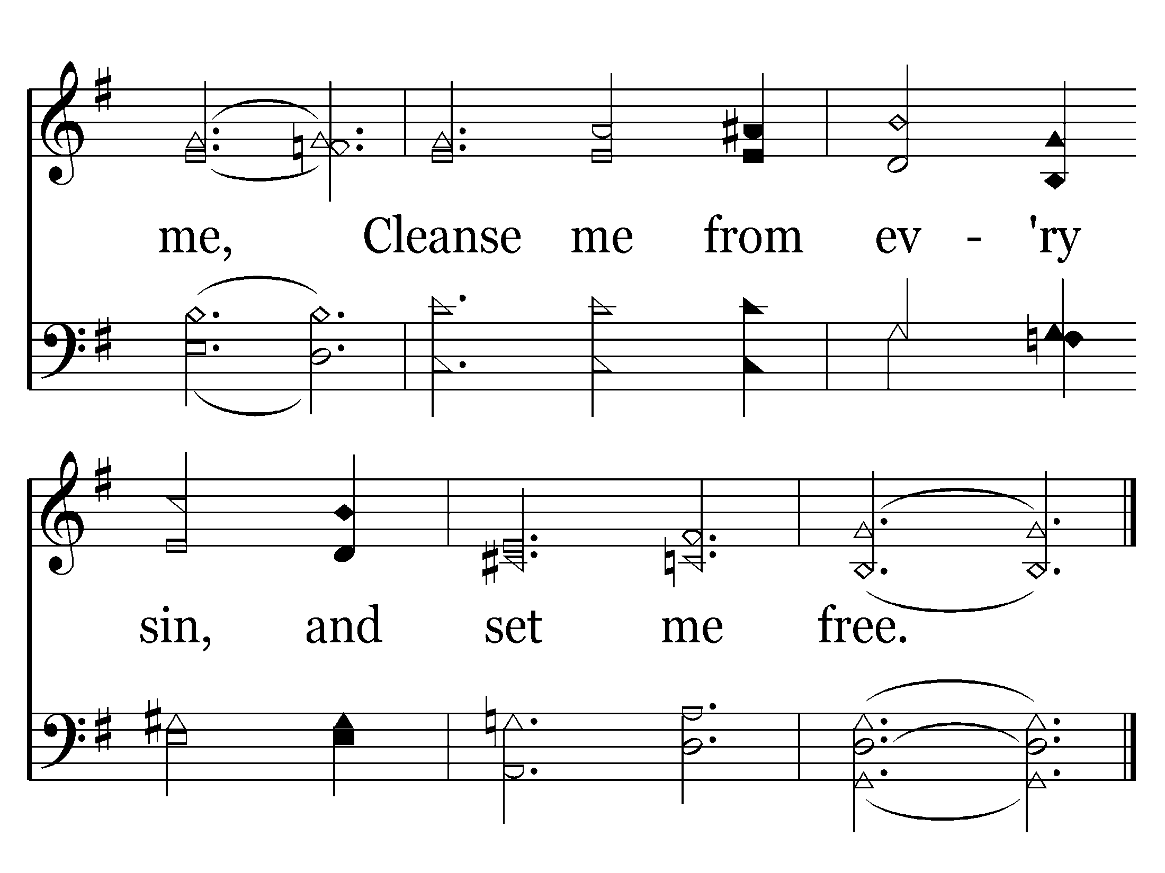
End of Verse 1

Slide 71
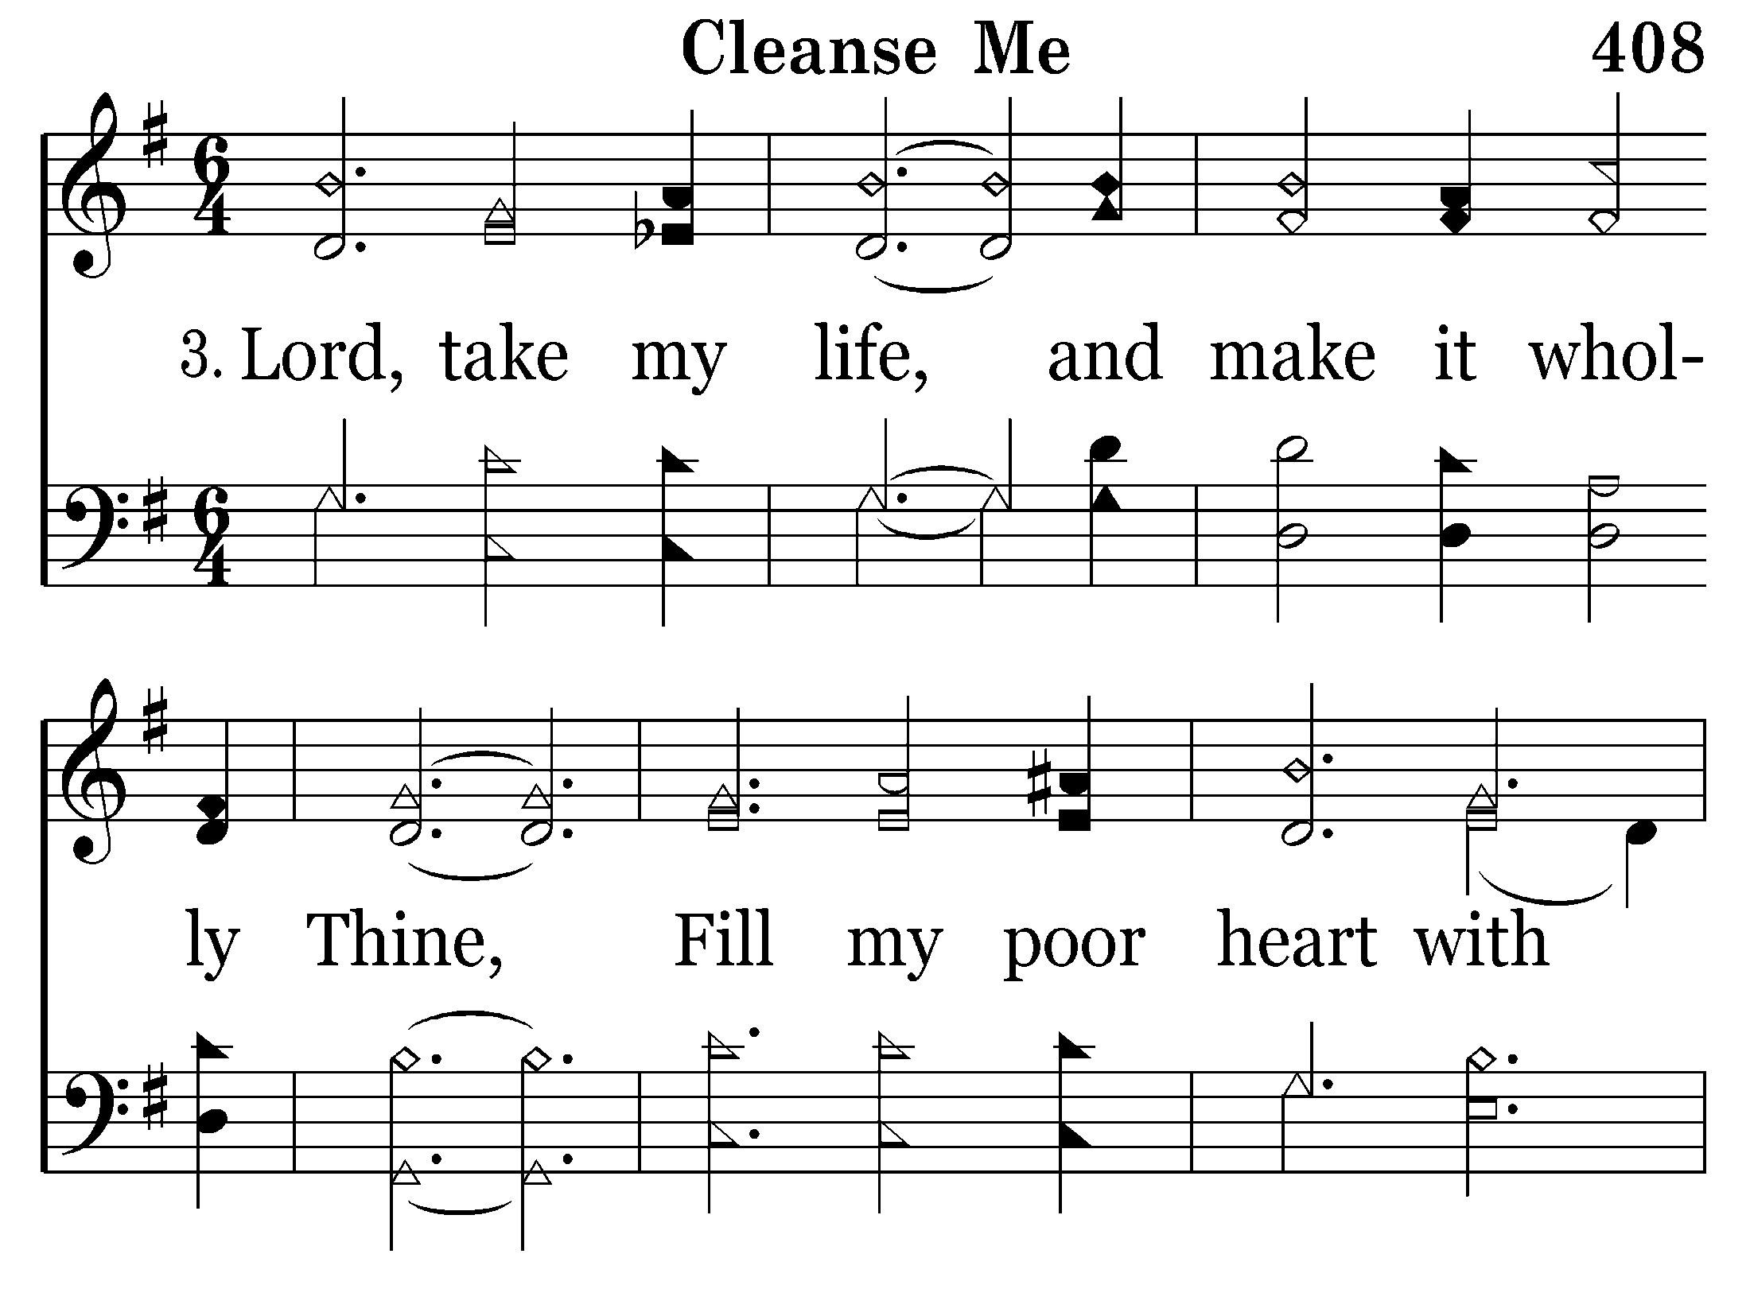

Slide 72
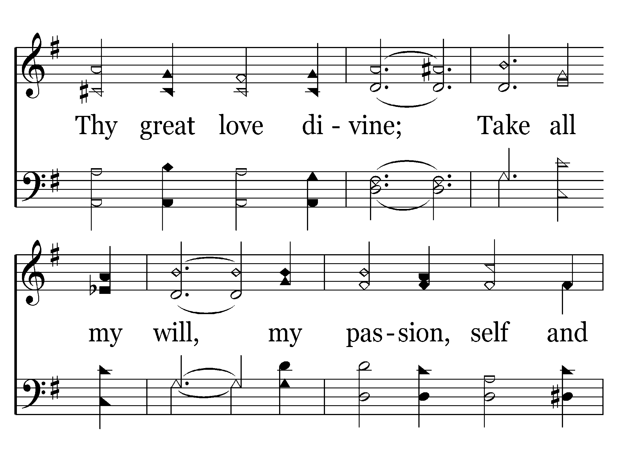

Slide 73
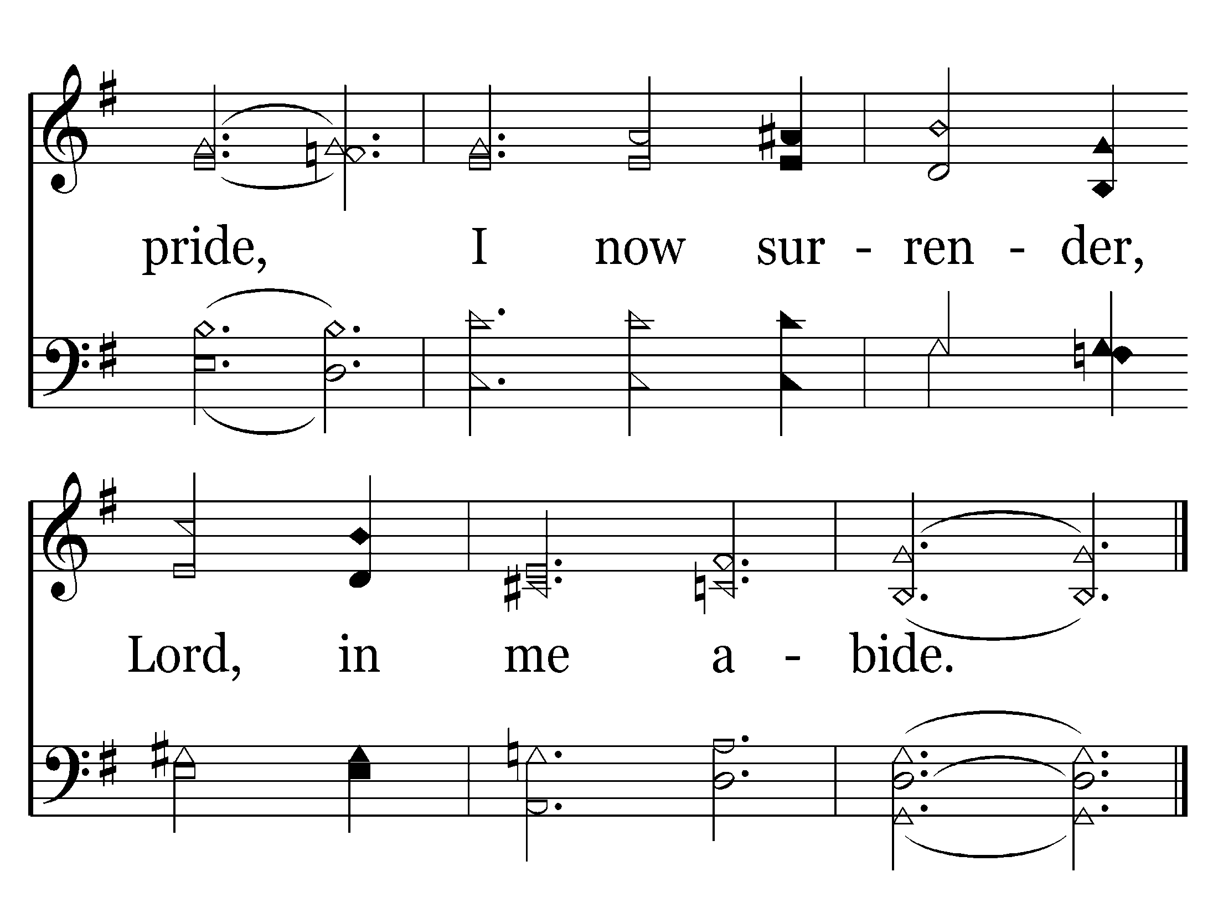
End of Verse 3

Slide 74
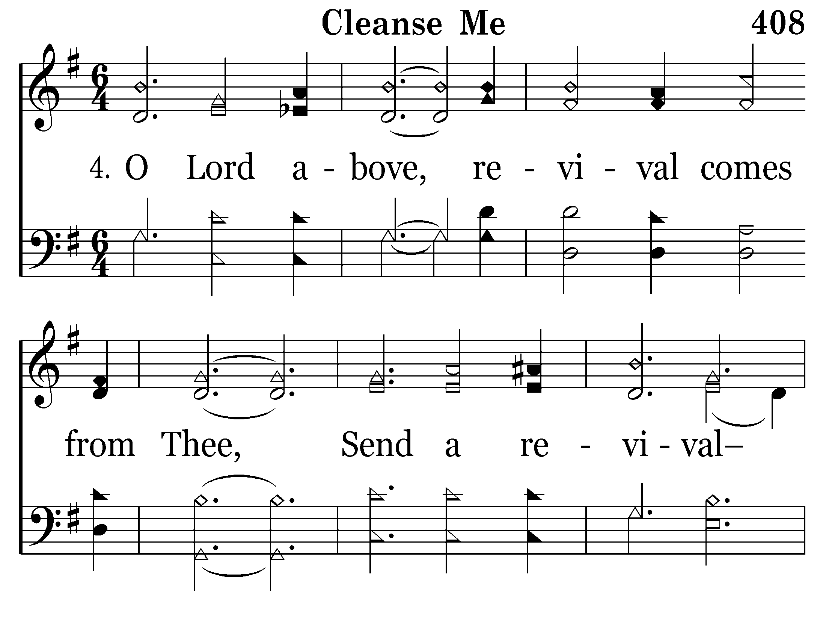

Slide 75
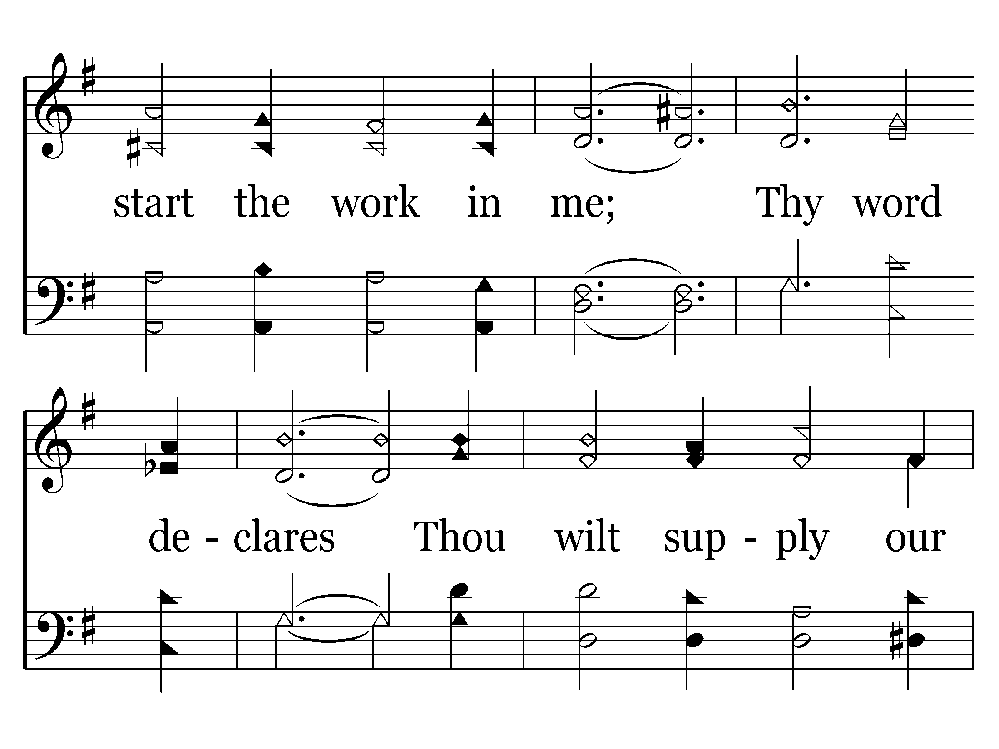

Slide 76
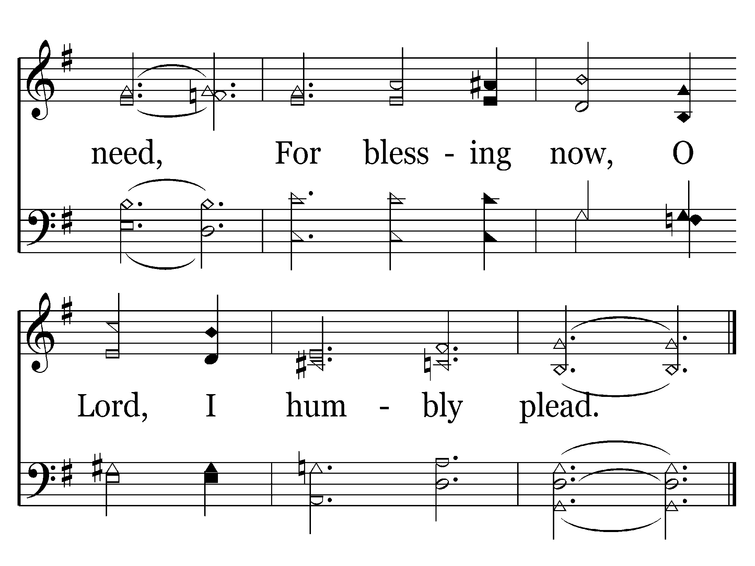
End of Song

Slide 78
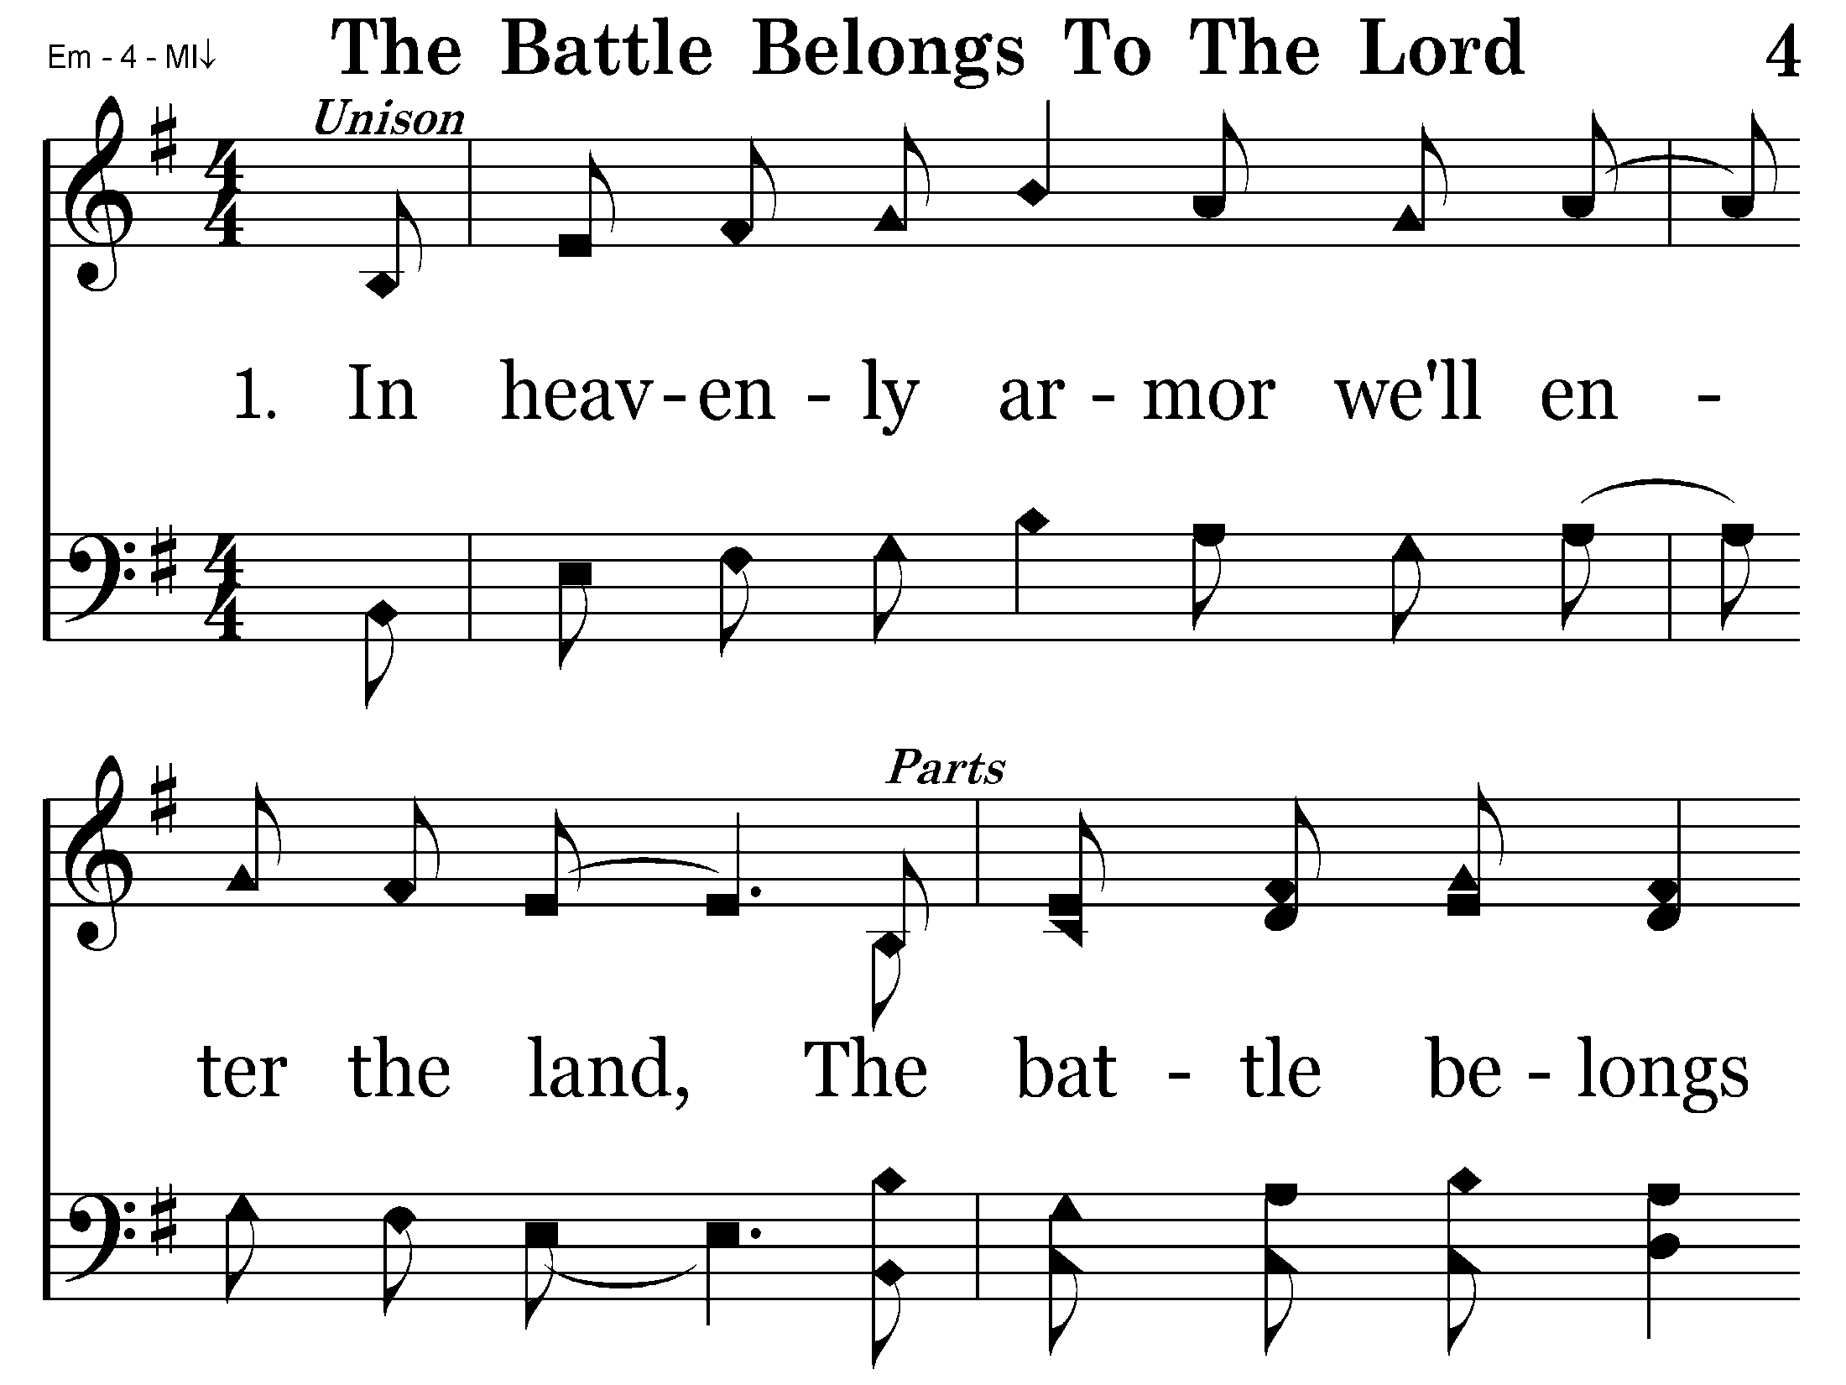

Slide 79
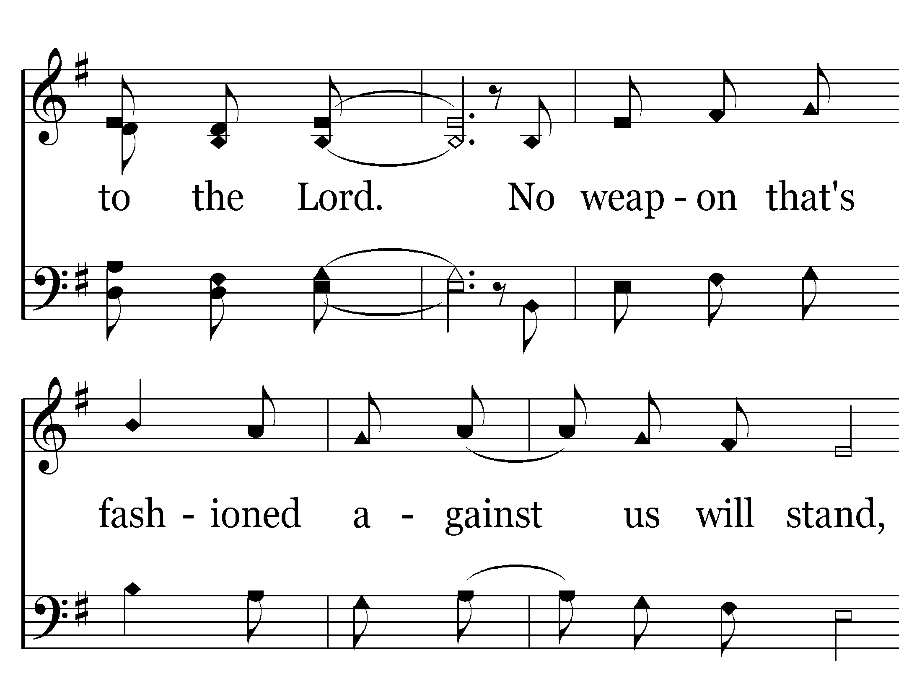

Slide 80
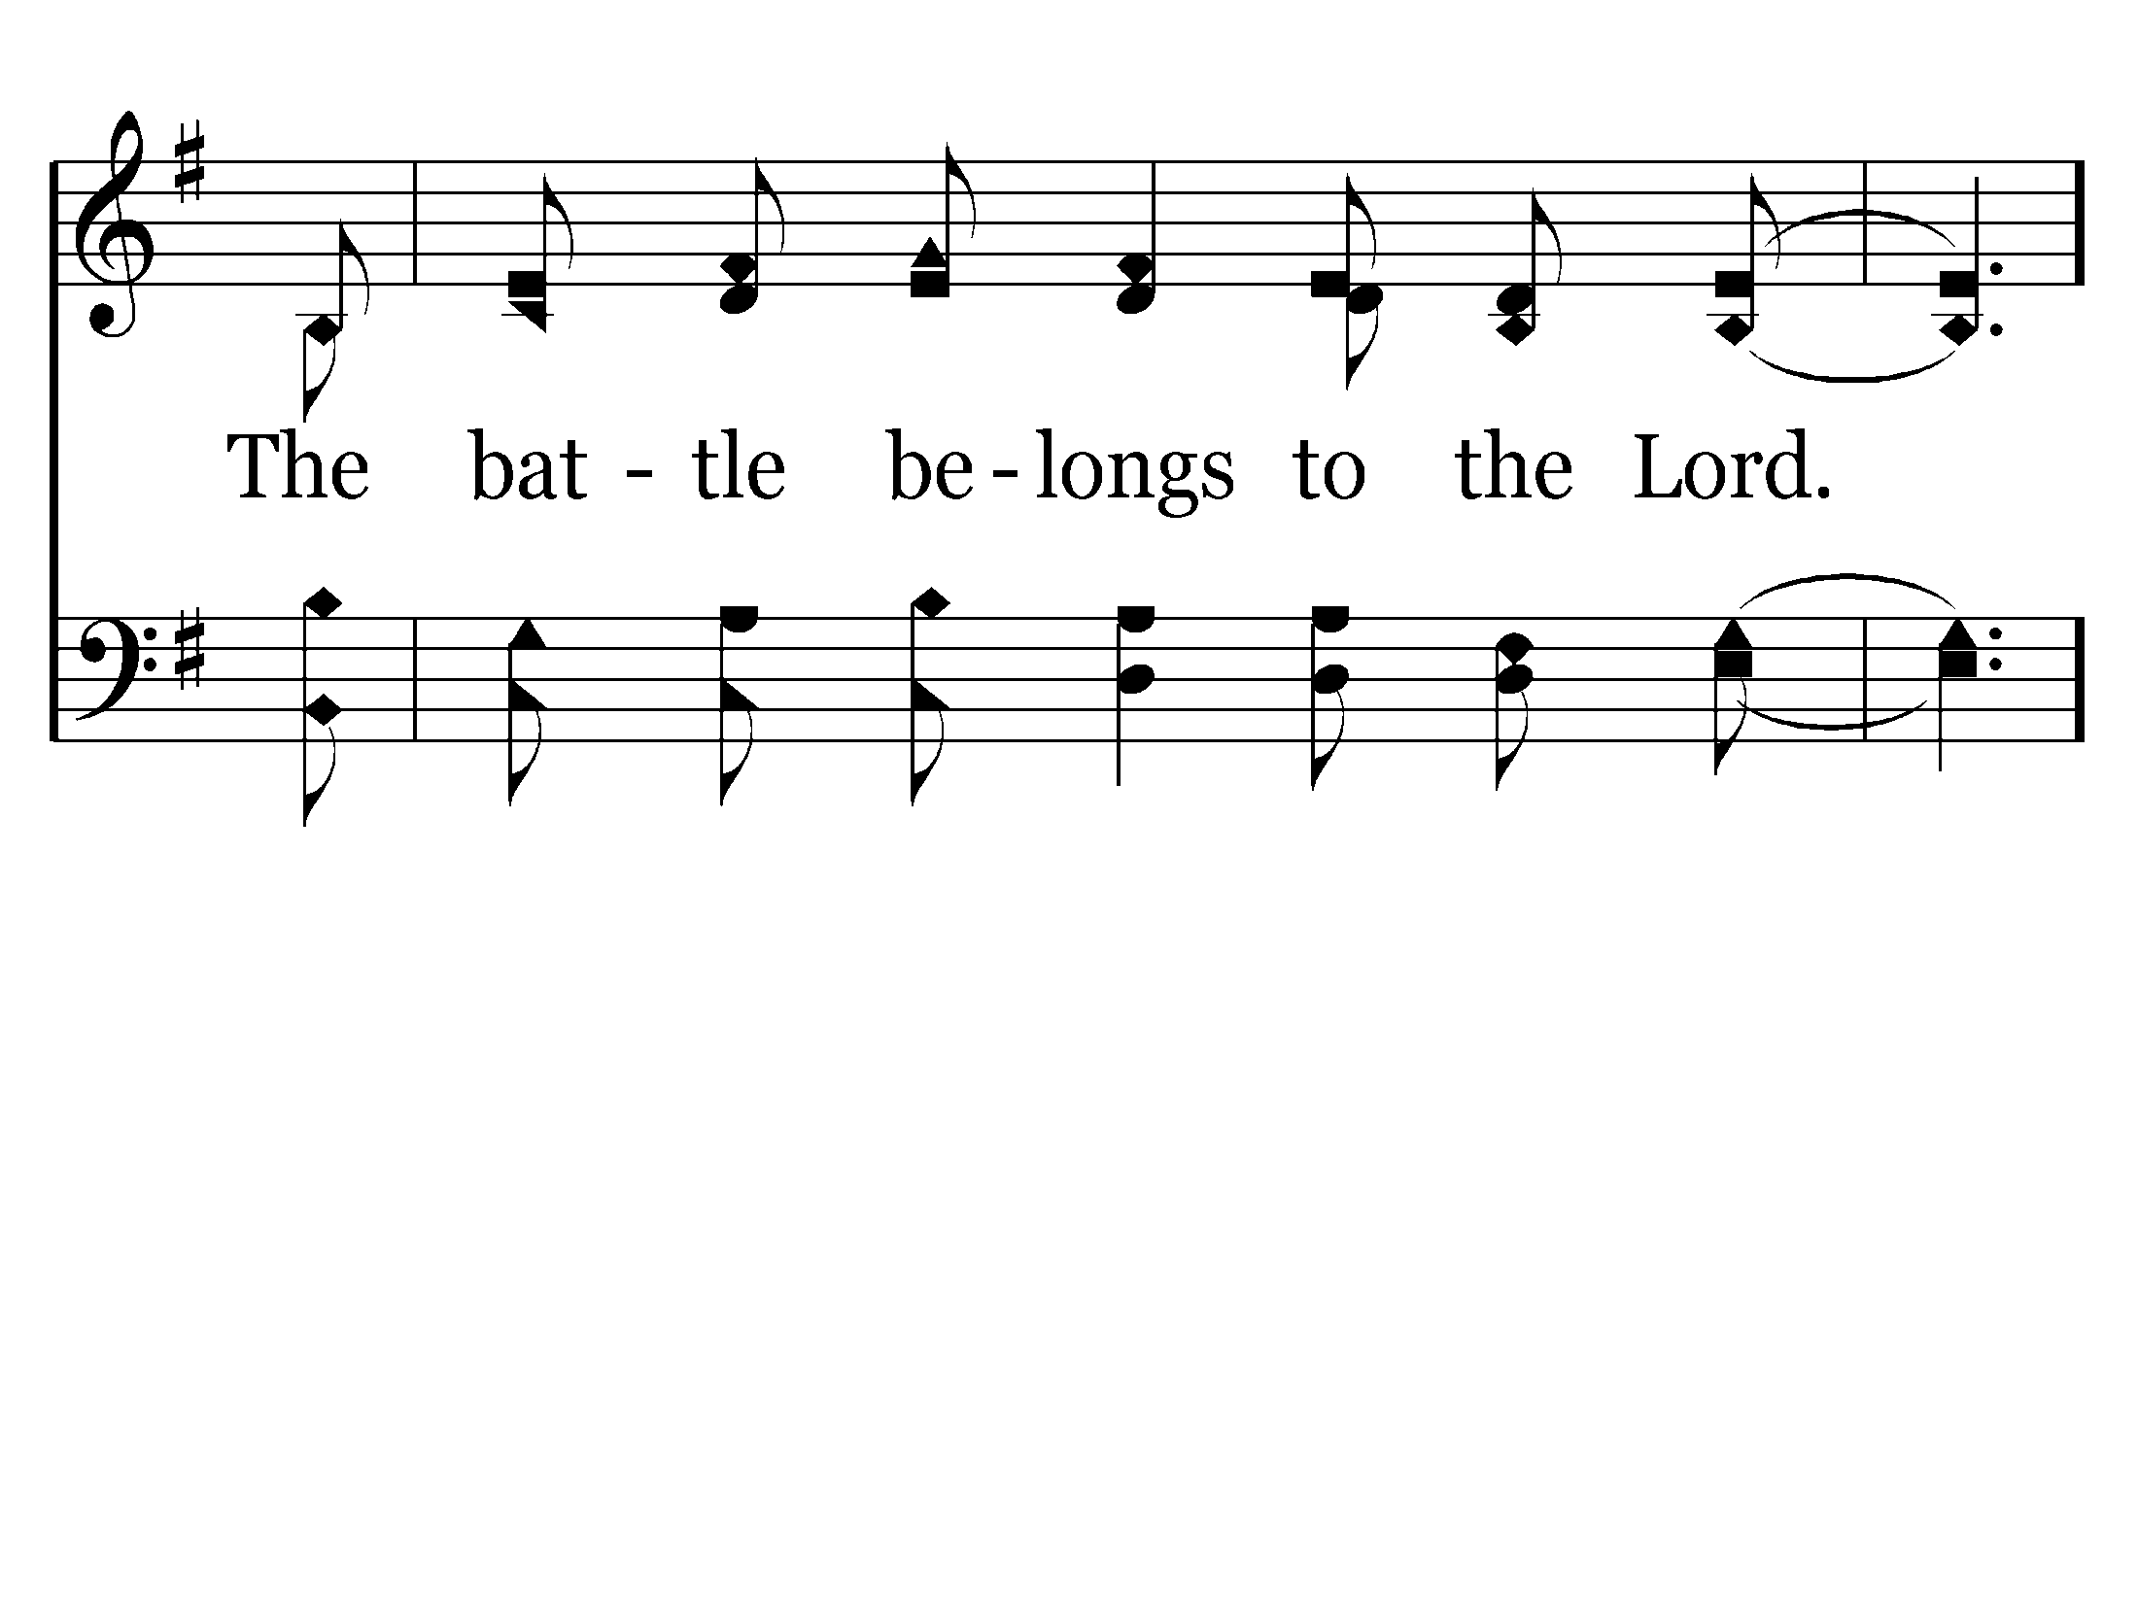

Slide 81
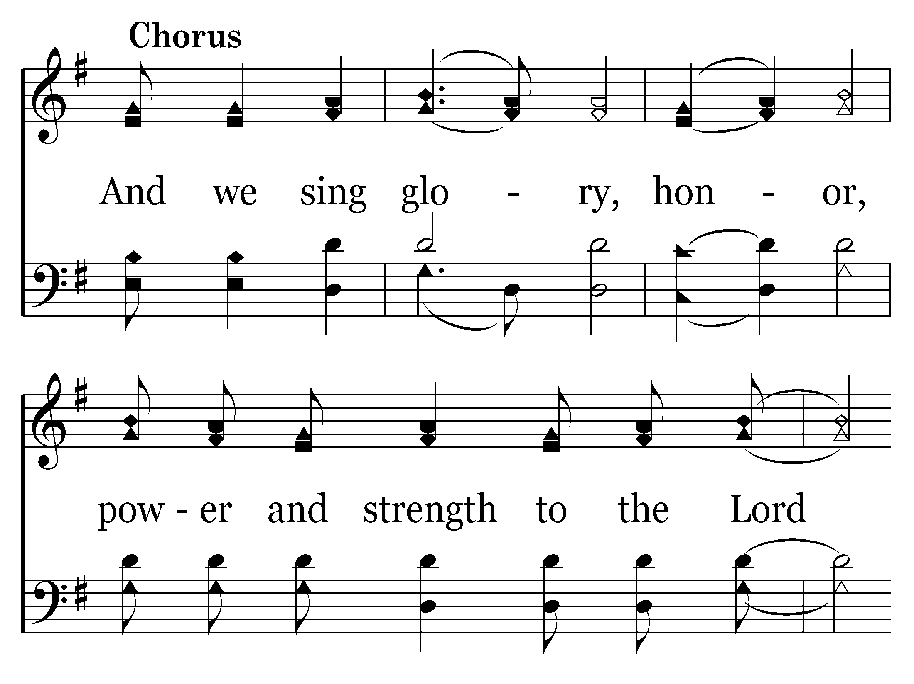

Slide 82
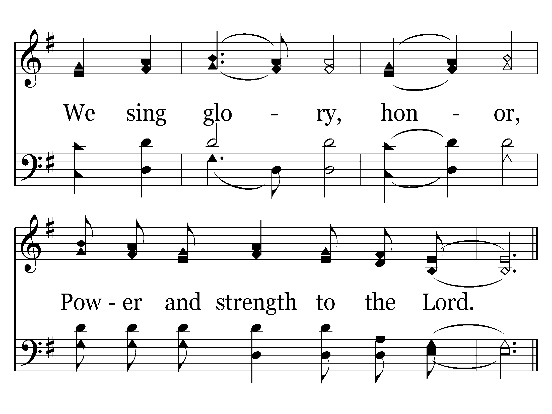
End of Verse 1

Slide 83
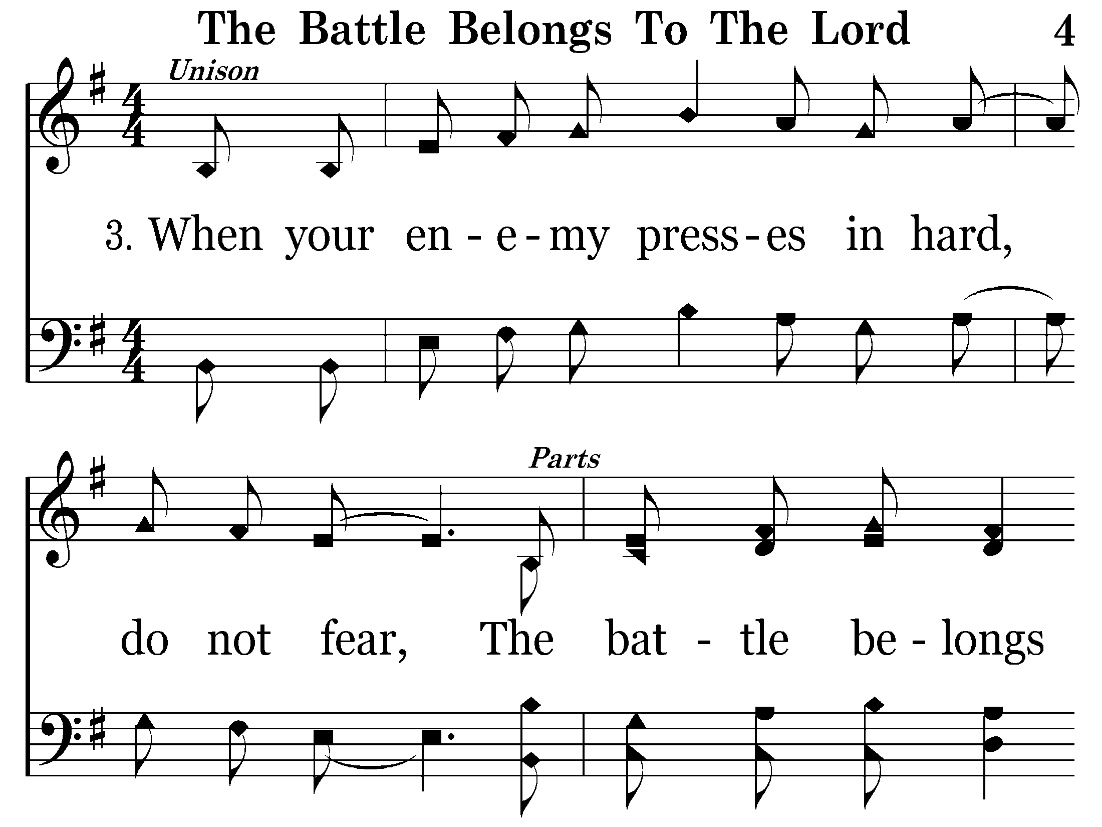

Slide 84
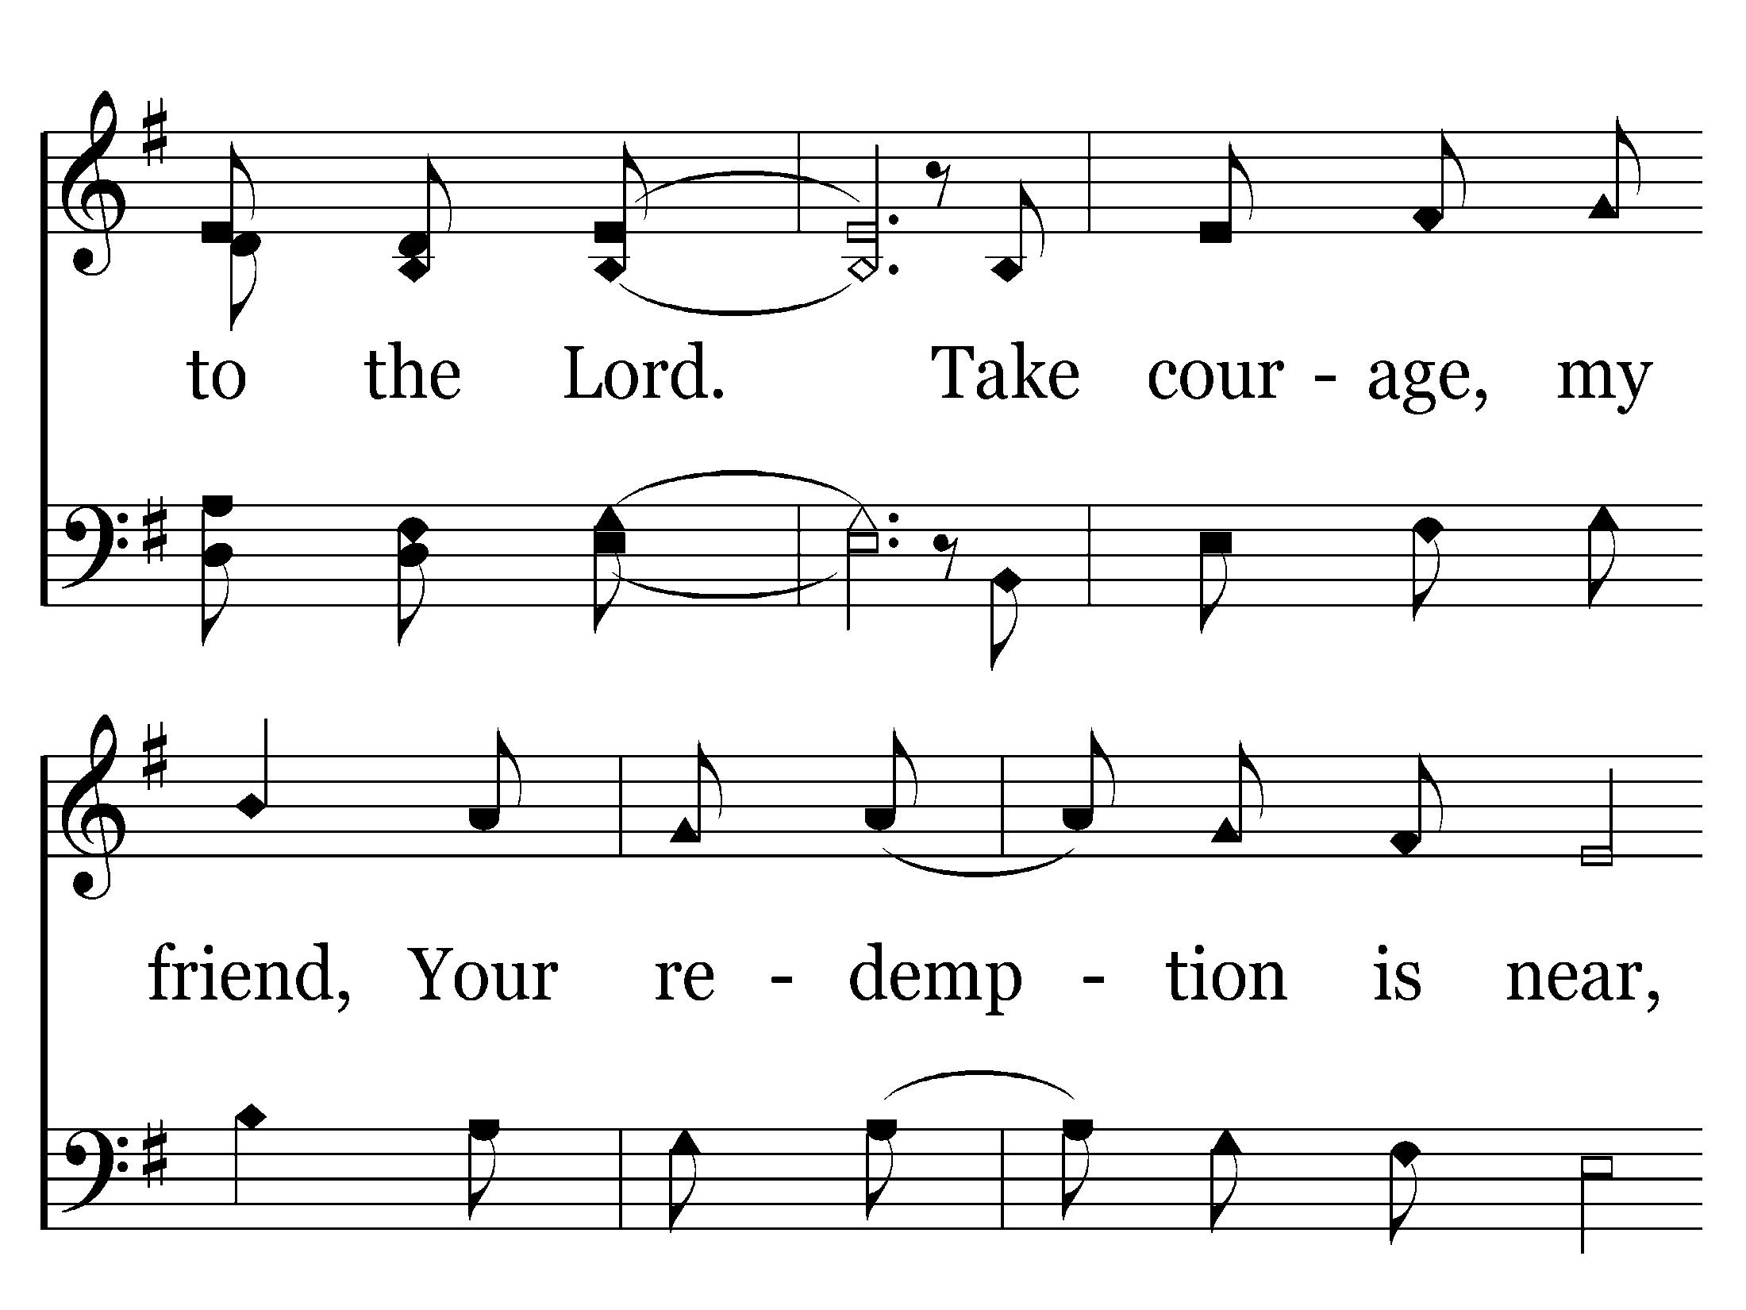

Slide 87
End of Song

Slide 90
End of Verse 1

Slide 92
End of Verse 2

Slide 94
End of Song

Slide 99
End of Verse 1

Slide 103
End of Song

Slide 107
End of Verse 1

Slide 110
End of Verse 2

Slide 113
End of Song

Slide 125
End of Song

Slide 135
End of Verse 2

Slide 140
End of Verse 1

Slide 144
End of Verse 2

Slide 148
End of Song

