Slide 3
Day Age Theory
EON
What Man Says:
Days Are Long Periods of Time
Animals Created Before Humans
Suffering & Death Before First Sin
EON
EON
EON
What God Says:
Hebrew word for day: “yom”
Qualifiers (“Morning/Evening”)
Gen 1:29; Rom 8:20-22
EON
EON

Slide 4
General Gap Theory
What Man Says:
EON
Gen 1:1-2 (NATEB) – “In the beginning God created the heavens and the earth. ²[Then billions and billions of years pass and] the earth was formless and void, and darkness was over the surface of the deep, and the Spirit of God was moving over the surface of the waters.”
What God Says:
Gen 1:1-2 (NASB) – “In the beginning God created the heavens and the earth. ²The earth was formless and void, and darkness was over the surface of the deep, and the Spirit of God was moving over the surface of the waters.”
Rom 6:23a – “For the wages of sin is death…”
Rom 5:14a – “Nevertheless death reigned from Adam until Moses…”

Slide 5
Soft Gap Theory
What Man Says:
EON
Gen 1:2-3 (NATEB) – “²The earth was formless and void, and darkness was over the surface of the deep, and the Spirit of God was moving over the surface of the waters. ³Then [billions and billions of years later,] God said, ‘Let there be light’; and there was light.”
Gorman Gray – “Earth lay in total darkness…for an undefined length of time before the first day until God began to clear the envelope of thick darkness” (A biblical solution to starlight and other problems, hal-pc.org, 22 January 2004.)
What God/Logic Says:
Gen 1:2-3 (NASB) – “²The earth was formless and void, and darkness was over the surface of the deep, and the Spirit of God was moving over the surface of the waters. ³Then God said, ‘Let there be light’; and there was light.”
Differences in God creating vs. sustaining universe
Theory is based on unsubstantiated assumptions

Slide 6
Modified Gap Theory
What Man Says:
Gen 1:3 (NATEB) – “Then [billions and billions of years later, after cold blooded animals were dead and the geologic column was full of fossil fuels,] God said, ‘Let there be light’; and there was light.”
EON
What God Says:
Gen 1:3 (NASB) – “God said, ‘Let there be light’; and there was light.”
Fish were created on Day 5 – Gen 1:20-21
Reptiles were created on Day 6 – Gen 1:24-25

Slide 7
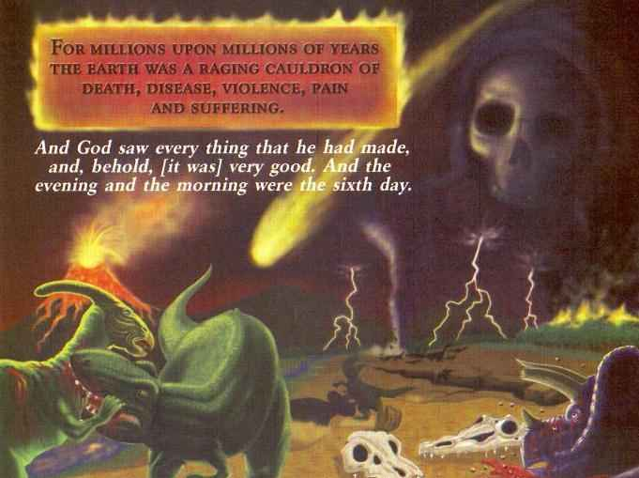
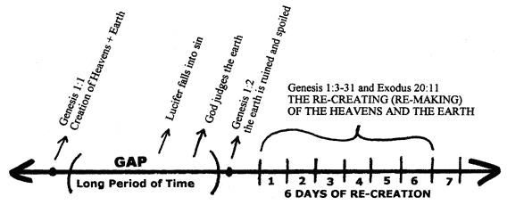
Ruin Reconstruction Theory
}
What Man Says:
EONS
What God Says:
Rom 5:12 – “Therefore, just as through one man sin entered the world, and death through sin, and thus death spread to all men, because all sinned.”
1 Cor 15:45 – “So also it is written, ‘The first man, Adam, became a living soul.’”
Gen 1:29-30 – “²⁹Then God said, ‘Behold, I have given you every plant yielding seed that is on the surface of all the earth, and every tree which has fruit yielding seed; it shall be food for you; ³⁰and to every beast of the earth and to every bird of the sky and to every thing that moves on the earth which has life, I have given every green plant for food’; and it was so.”

Slide 8
Late Gap Theory
What Man Says:
Gen 5:5 (NATEB) – “So all the days that Adam lived [after he had already lived billions of years] were nine hundred and thirty years, and he died.
What God Says:
Gen 5:5 (NASB) – “So all the days that Adam lived were nine hundred and thirty years, and he died.”
“Be fruitful and multiply (Gen 1:28) vs. first child (Gen 4:1; 5:3)
EON

Slide 9
Literal w/Gaps Theory
What Man Says:
EON
Donald England – “The days could easily have been 24-hour days and the earth still date to great antiquity provided that indefinite periods of time separated six creation days.” (A Christian View of Origins, Grand Rapids, MI: Baker Books, 1972, 111.)
EON
EON
What God Says:
Biblical Narrative Suggests Continuity
Gen Sequence ≠ Orthodox Geology Sequence
Ex 20:11a – “For in six days the Lord made the heavens and the earth, the sea and all that is in them, and rested on the seventh day…”
EON
EON

Slide 10
}
Framework Hypothesis
What Man Says:
L
I
T
E
R
A
R
Y
D
E
V
I
C
E
Meredith Kline – “To rebut the literalist interpretation of the Genesis creation week propounded by the young-earth theorists is a central concern of this article…The conclusion is that as far as the time frame is concerned, with respect to both the duration and sequence of events, the scientist is left free of biblical constraints in hypothesizing about cosmic origins.”(Space and Time in the Genesis Cosmogony, Perspectives on Science and Christian Faith, 48:2-15 (1996)
What God Says:
Gen 1 (Preterit Verbs) vs. Psa 104 (Perfect/Imperfect Verbs)

Slide 11
}
Revelatory Day Theory
What Man Says:
Bernard Ramm – “We believe…that creation was revealed in six days, not performed in six days. We believe that the six days are pictorial-revelatory days, not literal days nor age-days. The days are means of communicating to man the great fact that God is Creator, and that He is Creator of all” (A Christian View Of Science And Scripture, Grand Rapids, Eerdmans, 1954, p. 151).
V
I
S
I
O
N
What God Says:
Gen 1’s natural reading is historical narrative
Hebrew “asah” = “made”, not “reveal/show”
Num 12:6-8 – “Hear now My words: if there is a prophet among you, I, the Lord, shall make Myself known to him in a vision. I shall speak with him in a dream. Not so, with My servant Moses, he is faithful in all My household; with him I speak mouth to mouth, even openly, and not in dark sayings, and he beholds the form of the Lord. Why then were you not afraid to speak against My servant, against Moses?”

Slide 12
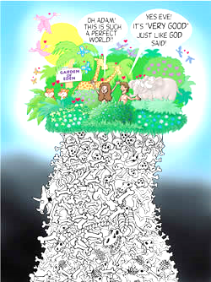
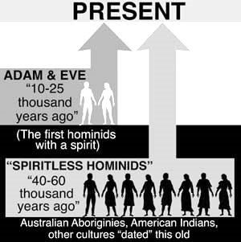
Progressive Creationism
What Man Says:
What God Says:
Rom 8:20-22 – “For the creation was subjected to futility, not willingly, but because of Him who subjected it, in hope that the creation itself also will be set free from its slavery to corruption into the freedom of the glory of the children of God. For we know that the whole creation groans and suffers the pains of childbirth together until now.”

Slide 13
Conclusion
Psa 11:3 – “If the foundations are destroyed, what can the righteous do?”

