Slide 3
The great commission
Matt 28:18-20
Mark 16:15-16
Luke 24:46-47
Summary
Acts 2:36-42
Go
Go
Preach
Go
Make Disciples
Preach
Repentance
Preach
Baptize
Believe
Forgiveness of Sins
Believe
Teach
Baptized
Repent
Saved
Baptized
Forgiveness of Sins
Teaching

Slide 4
WHAT IS FAITH?
Heb 11:1 – “Now faith is the assurance of things hoped for, the conviction of things not seen.”
Heb 11:6 – “And without faith it is impossible to please Him, for he who comes to God must believe that He is and that He is a rewarder of those who seek Him.”
3 Tiers of Faith
Conviction of the Mind
Trust of the Heart
Surrender of the Will

Slide 5
DEGREES OF FAITH
Faith-o-meter
“Great” – Luke 7:9
“Little” – Matt 8:26; 14:31
“Increase” – Luke 17:5
“Fall Away” – Heb 3:12
“Weak” – Rom 14:1
“Full” – Acts 11:24
“Turn” – Acts 11:21
May Not “Save” – Jas 2:14

Slide 6
EVIDENCE FOR GOD
Existence
Intelligent Design
Moral Law/Conscience
Law of Rationality
General Revelation
Dead Sea Scrolls
Hand-Written Copies
Fulfilled Prophecy
Prophecies of Jesus
Archeology
Scientific Foreknowledge
Resurrection of Jesus

Slide 7
KNOWN FACT
Acts 2:22 – “Men of Israel, listen to these words: Jesus the Nazarene, a man attested to you by God with miracles and wonders and signs which God performed through Him in your midst, just as you yourselves know.”
Acts 10:37-38 – ‘you yourselves know the thing which took place throughout all Judea, starting from Galilee, after the baptism which John proclaimed. You know of Jesus of Nazareth, how God anointed Him with the Holy Spirit and with power, and how He went about doing good and healing all who were oppressed by the devil, for God was with Him.”
Acts 26:24-26 – “While Paul was saying this in his defense, Festus said in a loud voice, ‘Paul, you are out of your mind! Your great learning is driving you mad.’ But Paul said, ‘I am not out of my mind, most excellent Festus, but I utter words of sober truth. For the king knows about these matters, and I speak to him also with confidence, since I am persuaded that none of these things escape his notice; for this has not been done in a corner.”

Slide 8
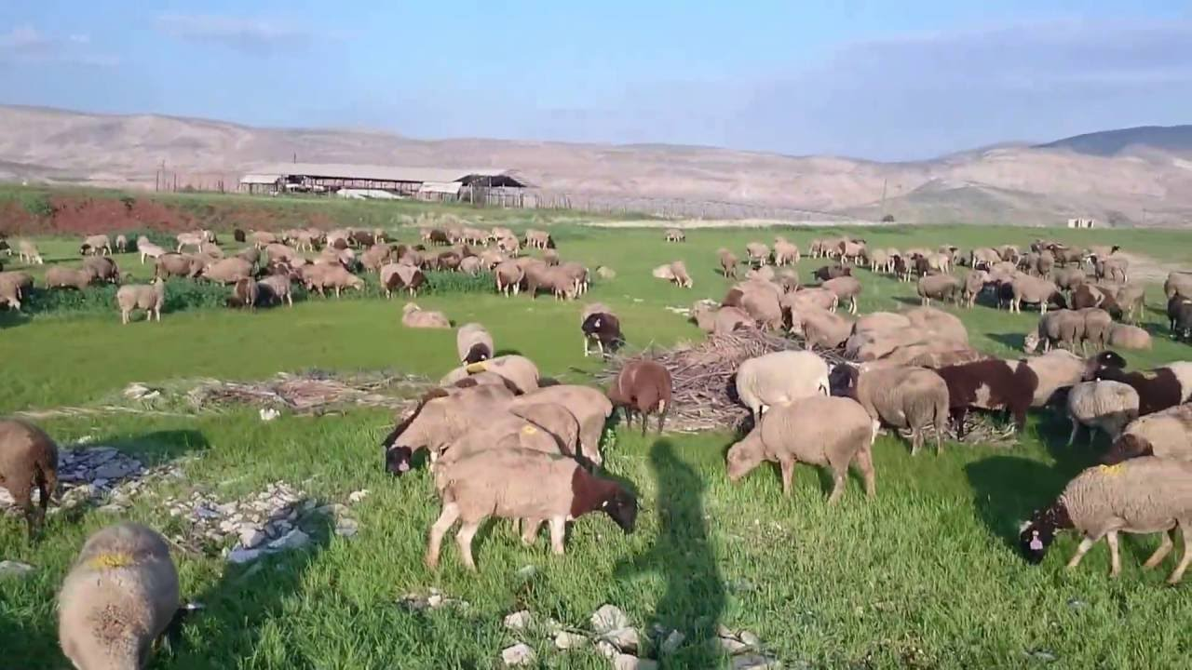
CONVICTION ALONE?
Israel Saw…
The 10 Plagues (Ex 7 – 12)
Parting of the Red Sea (Ex 14)
Water (Ex 15:22-27; 17:1-7)
Manna (Ex 16:1-8, 14-36)
Quail (Ex 16:9-13)
Mt. Sinai (Ex 19:16-20-21)
Israel Falls
The Golden Calf (Ex 32)
The Ten Spies (Num 14:1-4)
Reminder to Christians
1 Cor 10:6, 11-12; Heb 3:19
Trust is Essential
Deut 1:29-32
But for all this, you did not trust the Lord your God.
Deut 1:32

Slide 9
FAITH COMES BY HEARING
Josh 2:8b-11 – “I know that the Lord has given you the land, and that the terror of you has fallen on us, and that all the inhabitants of the land have melted away before you. For we have heard how the Lord dried up the water of the Red Sea before you when you came out of Egypt, and what you did to the two kings of the Amorites who were beyond the Jordan, to Sihon and Og, whom you utterly destroyed. When we heard it, our hearts melted and no courage remained in any man any longer because of you; for the Lord your God, He is God in heaven above and on earth beneath.”
Rom 10:17 – “So faith comes from hearing, and hearing by the word of Christ.”

