Slide 1
THROUGH
TEACHING
HYMNS
PART 1
Unless otherwise indicated, all Scripture quotations are from The ESV® Bible (The Holy Bible, English Standard Version®), copyright © 2001 by Crossway, a publishing ministry of Good News Publishers. Used by permission. All rights reserved.

Slide 2
STARTING IN UNITY
What part do I sing?
Women: Soprano (higher) (& song leader) Alto (lower)
Men: Tenor (higher) Bass (lower)
Holy, Holy, Holy - 2x
Comfortable 1st time - Soprano or Tenor
Comfortable 2nd time - Alto or Bass

Slide 5
STARTING IN UNITY
Everyone can start together on their note
Learn 3 shapes: DO, MI, and SOL
Find your starting note:
(Dare to Stand Like Joshua)
We are bound… for…
I have de - ci - ded
(to follow Jesus)

Slide 6
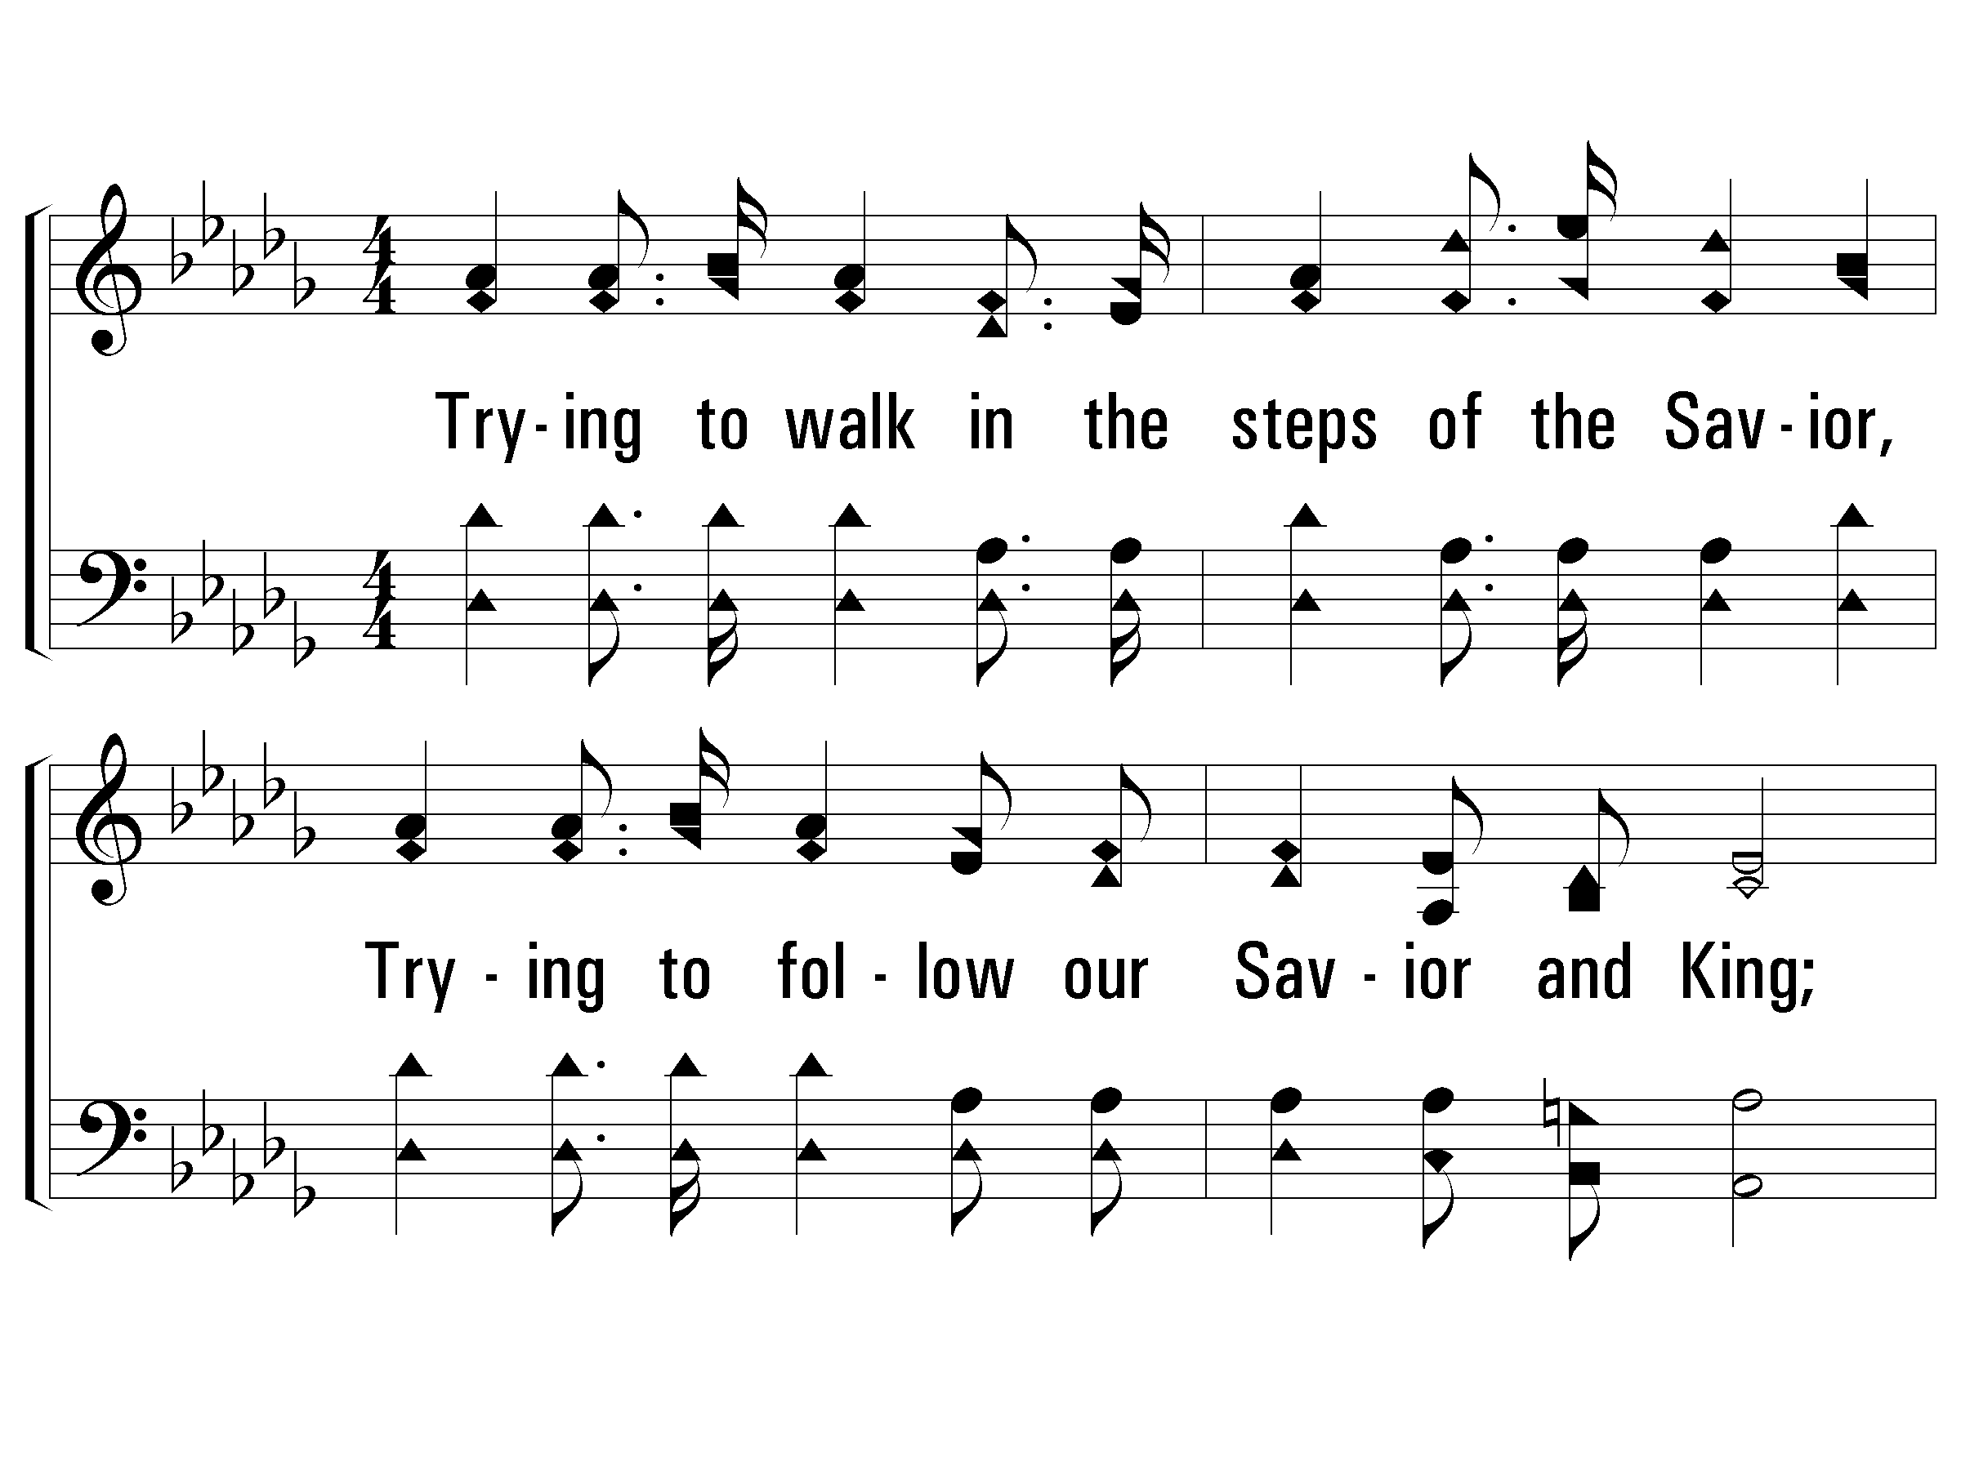
1 – Stepping in the Light
Soprano (& Leader)
Alto
1.
Trying to walk in the steps of the Savior,
Trying to follow our Savior and King;
Shaping our lives by His blessed example,
Happy, how happy, the songs that we bring.
Tenor
Bass
Words: Eliza E. Hewitt
Music: William J. Kirkpatrick
© 2004 The Paperless Hymnal™

Slide 7
1 – Stepping in the Light
Soprano (& Leader)
SOL
Alto
MI
1.
Trying to walk in the steps of the Savior,
Trying to follow our Savior and King;
Shaping our lives by His blessed example,
Happy, how happy, the songs that we bring.
Tenor
DO
DO
Bass
Words: Eliza E. Hewitt
Music: William J. Kirkpatrick
© 2004 The Paperless Hymnal™

Slide 8
1 - We’re Marching to Zion
Soprano
DO
Alto
SOL
1.
Come, we that love the Lord,
And let our joys be known;
Join in a song with sweet accord,
Join in a song with sweet accord,
And thus surround the throne,
And thus surround the throne.
Tenor
MI
Bass
DO
Words by: Isaac Watts
Music by: Robert Lowry
© 2001 The Paperless Hymnal™

Slide 9
159 - WHEN MY LOVE TO CHRIST GROWS WEAK
When my love to Christ grows weak,
When for deeper faith I seek,
Then in thought I go to thee,
Garden of Gethsemane!
There I walk amid the shades
While the lingering twilight fades,
See that suffering, friendless One
Weeping, praying there alone.

Slide 10
159 - WHEN MY LOVE TO CHRIST GROWS WEAK
When my love for man grows weak,
When for stronger faith I seek,
Hill of Calvary! I go
To thy scenes of fear and woe.
There behold His agony
Suffered on the bitter tree;
See His anguish, see His faith—
Love triumphant still in death.

Slide 11
159 - WHEN MY LOVE TO CHRIST GROWS WEAK
Then to life I turn again,
Learning all the worth of pain;
Learning all the might that lies
In a full self-sacrifice.

Slide 15
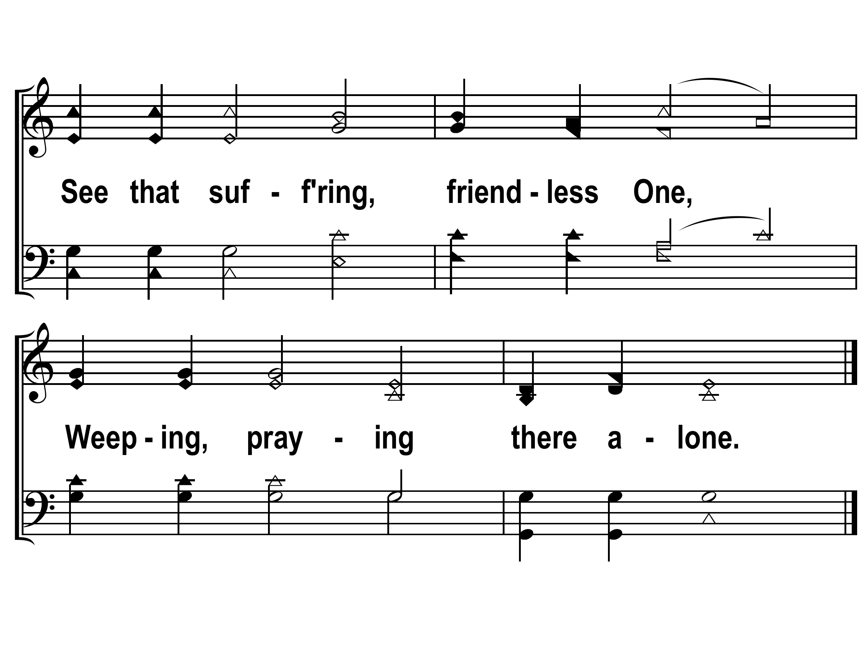

Slide 17
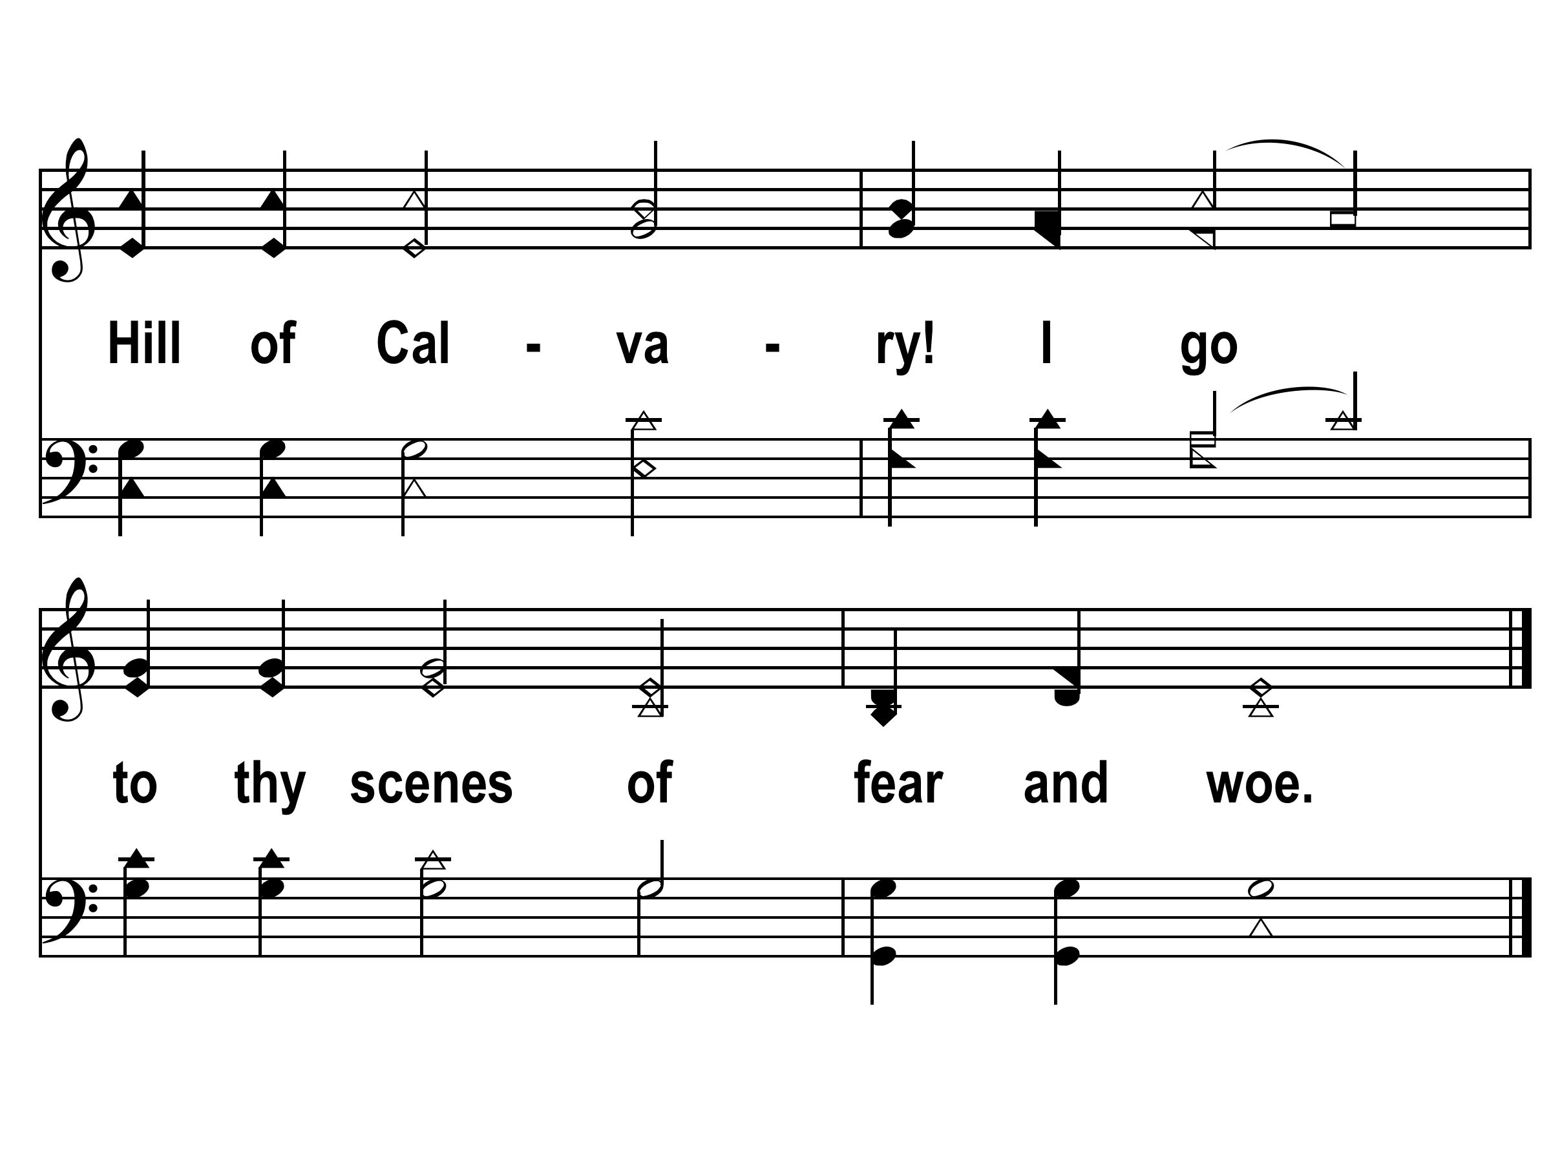

Slide 18
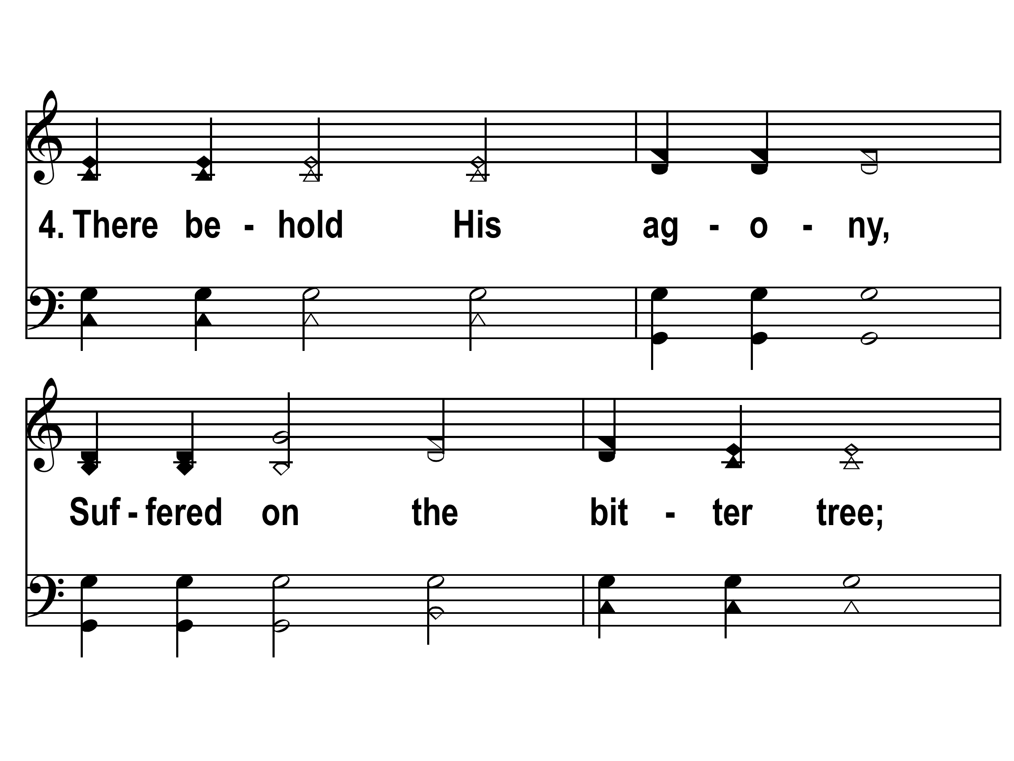

Slide 20
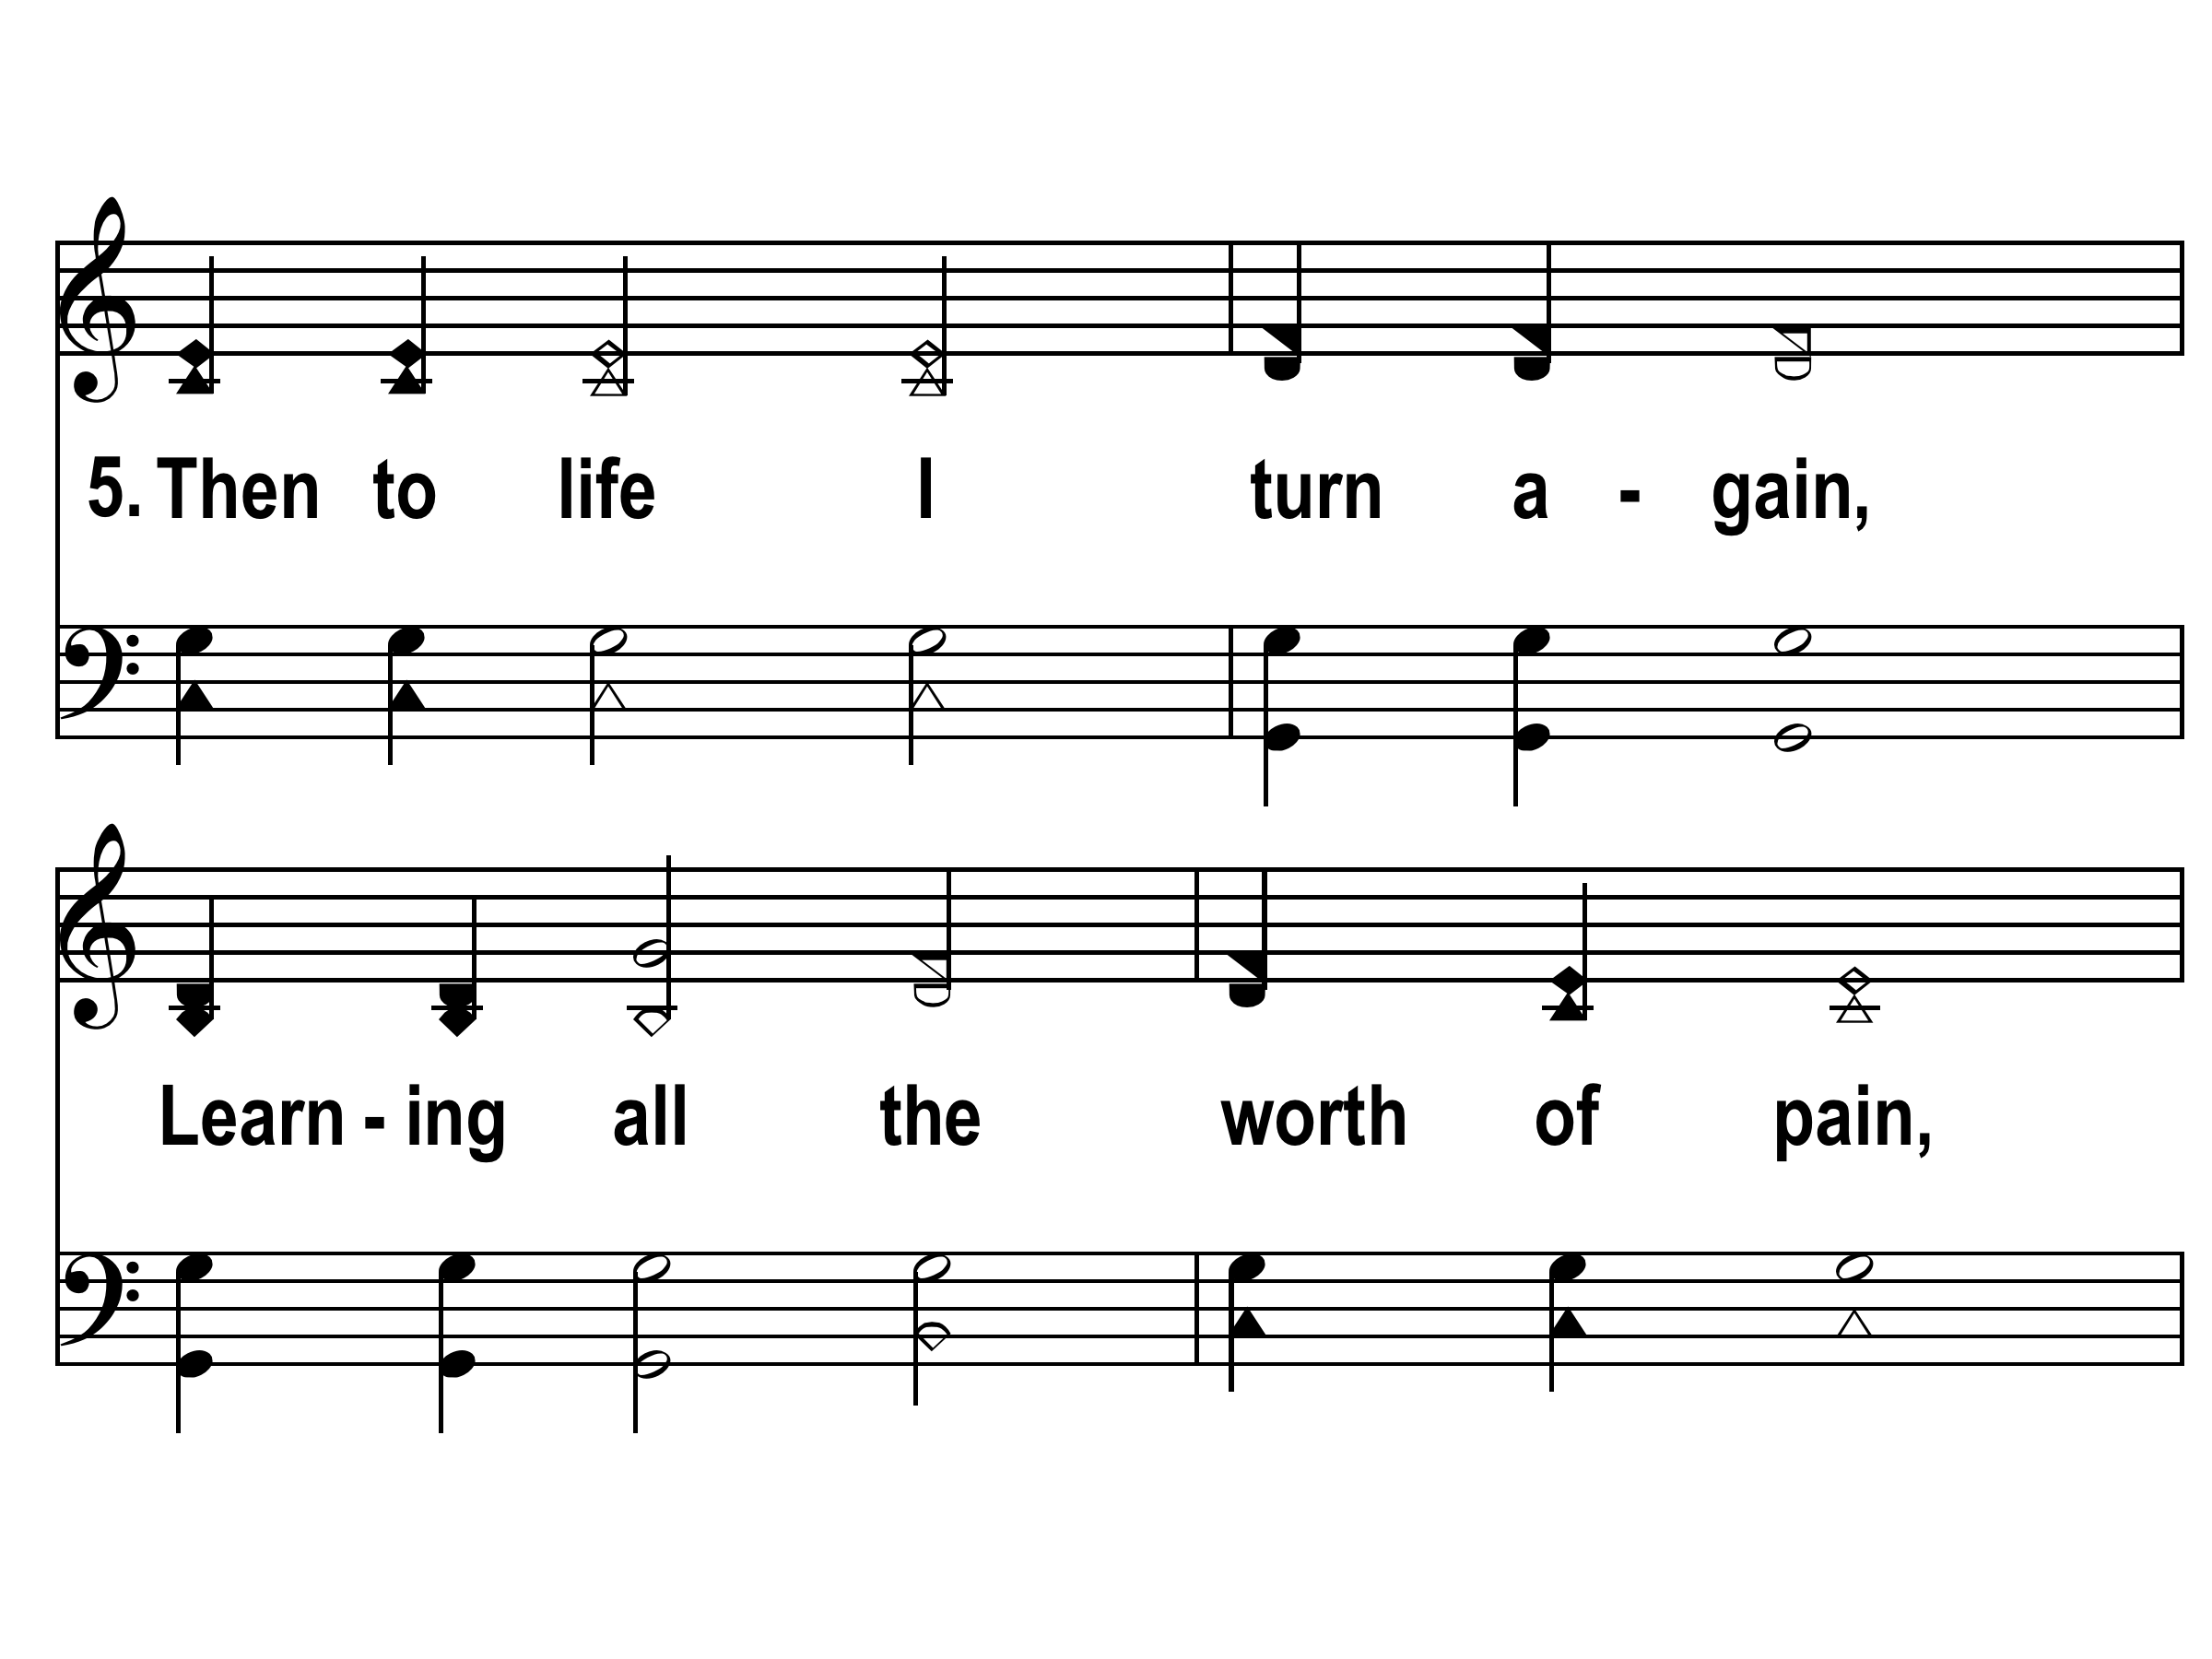

Slide 21
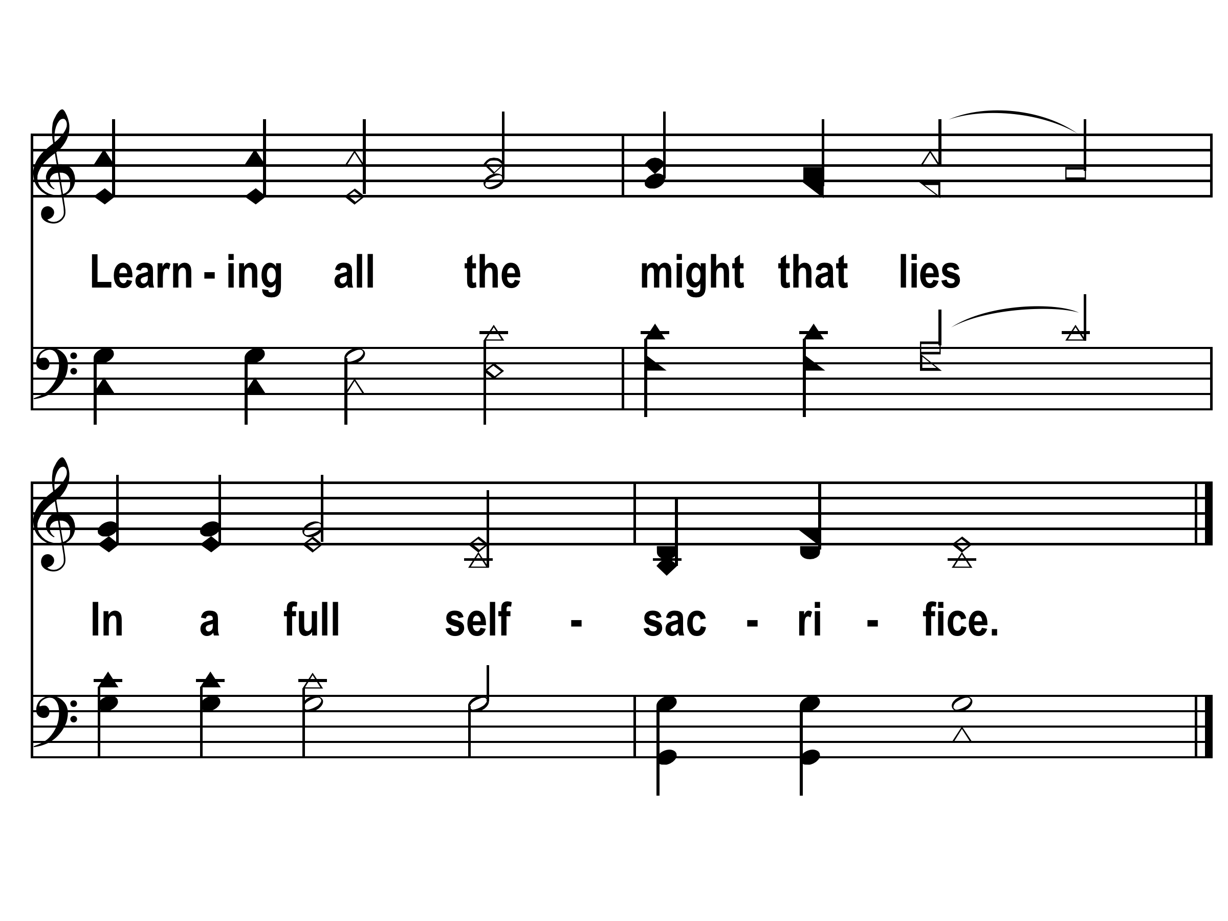

Slide 22
189 - WHEN I SURVEY THE WONDROUS CROSS
When I survey the wondrous cross
On which the Prince of Glory died.
My richest gain I count but loss
And pour contempt on all my pride.
Forbid it, Lord, that I should boast,
Save in the death of Christ my Lord;
All the vain things that charm me most,
I sacrifice them to His blood.

Slide 23
189 - WHEN I SURVEY THE WONDROUS CROSS
See, from His head, His hands, His feet,
Sorrow and love flow mingled down;
Did e’er such love and sorrow meet,
Or thorns compose so rich a crown?
Were the whole realm of nature mine,
That were a present far too small;
Love so amazing, so divine,
Demands my soul, my life, my all.

Slide 25
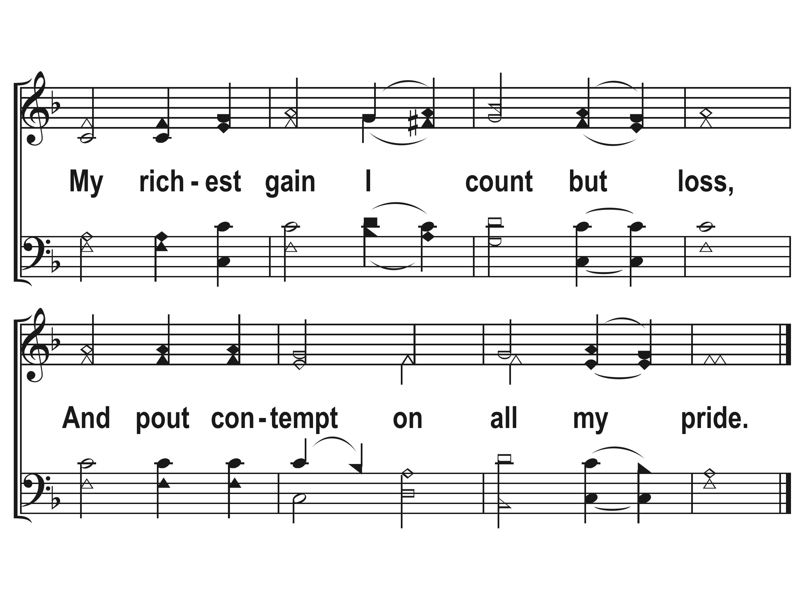

Slide 27
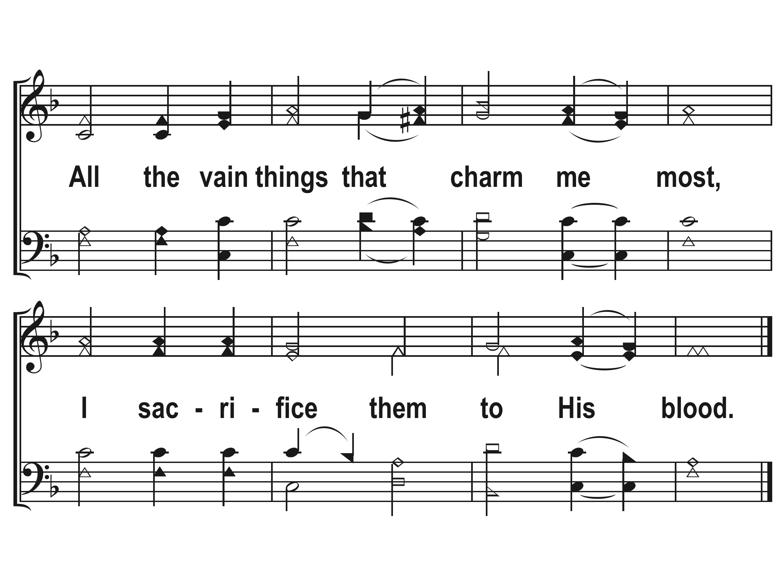

Slide 28
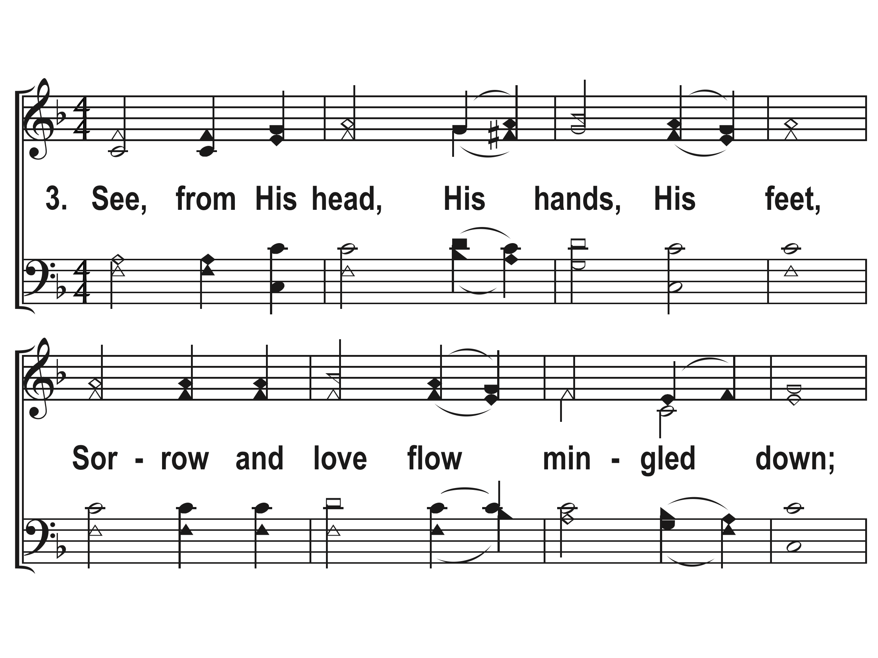

Slide 29
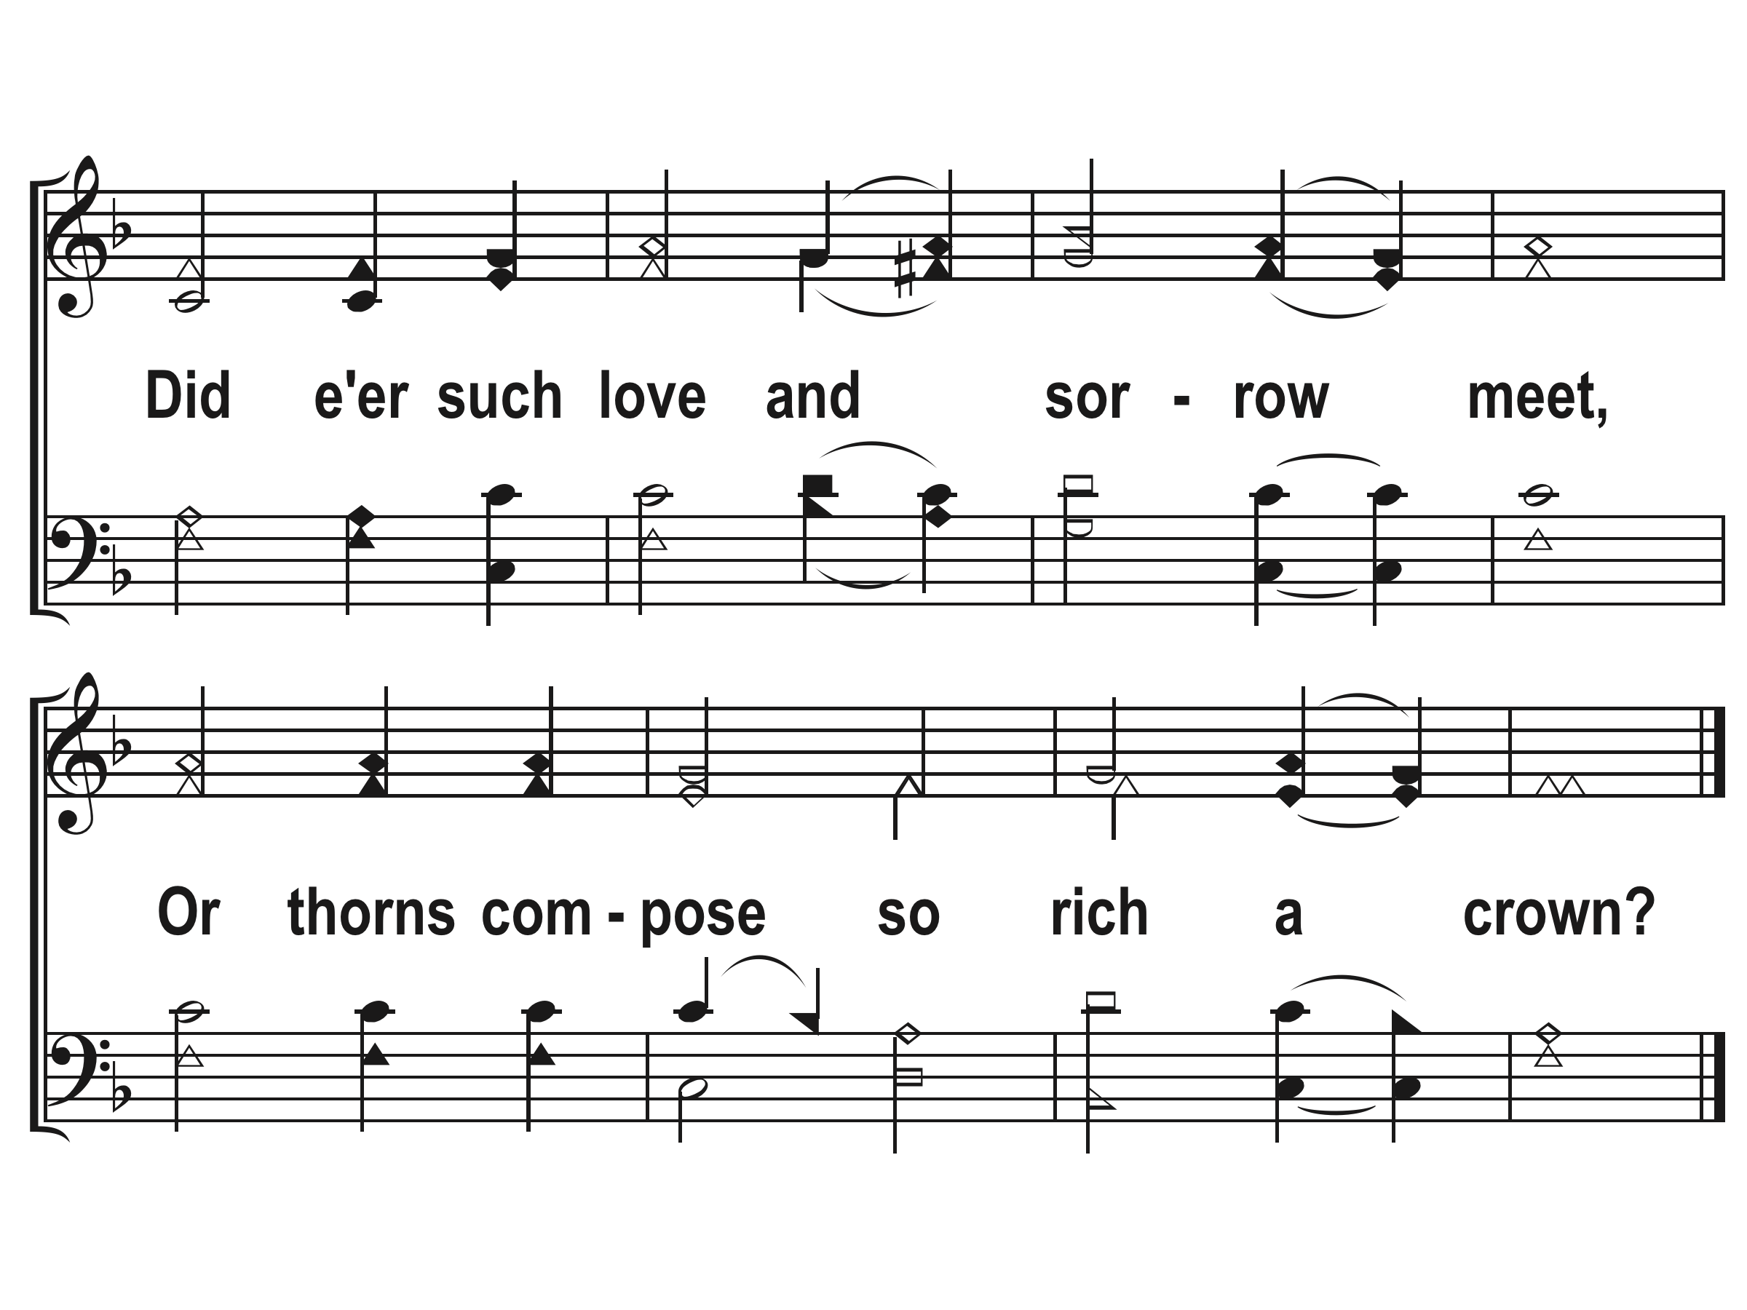

Slide 30
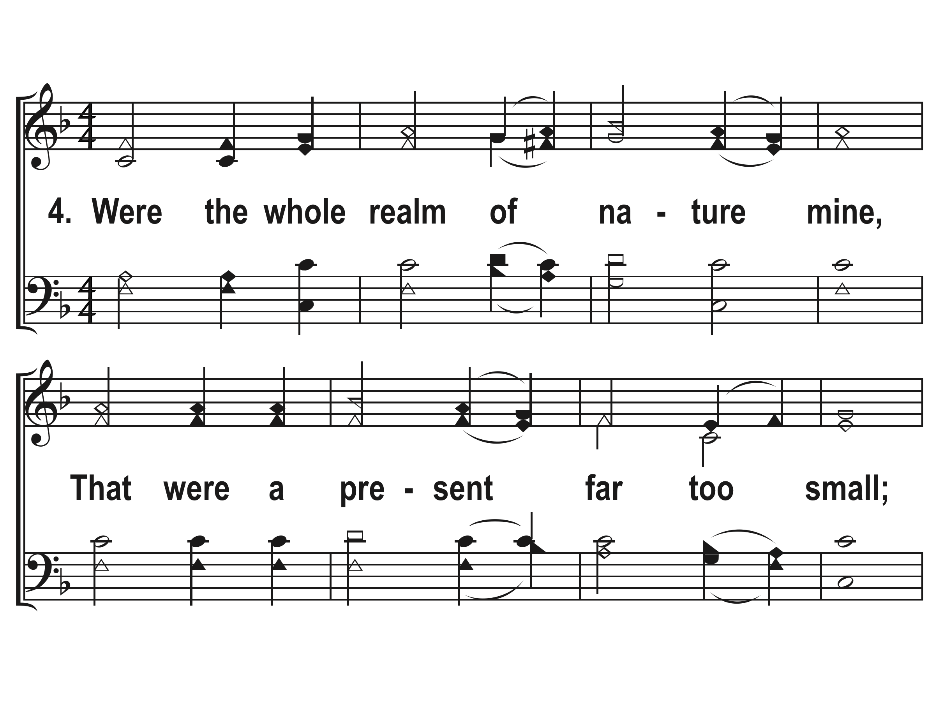

Slide 31
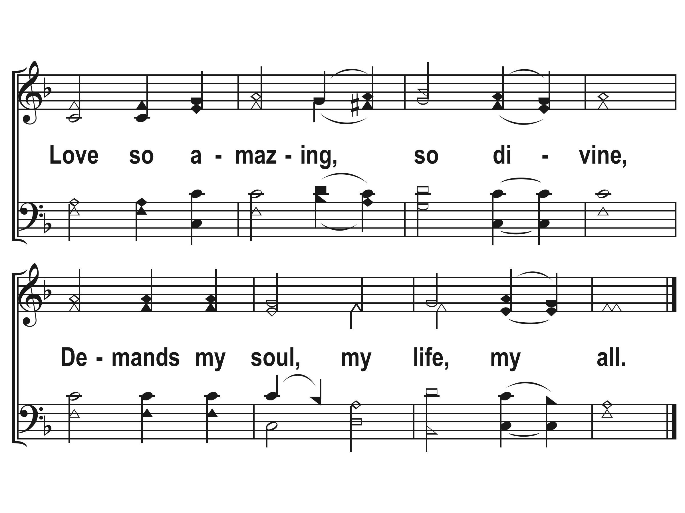

Slide 32
JESUS, DRAW ME EVER NEARER
Jesus, draw me ever nearer
As I labor through the storm.
You have called me to this passage,
And I’ll follow, though I’m worn.
Jesus, guide me through the tempest;
Keep my spirit staid and sure.
When the midnight meets the morning,
Let me love You even more.

Slide 33
JESUS, DRAW ME EVER NEARER
Let the treasures of the trial
Form within me as I go.
At the end of this long passage,
Let me leave them at Your throne.
CHORUS:
May this journey bring a blessing;
May I rise on wings of faith.
At the end of my heart’s testing,
With Your likeness let me wake.

Slide 35
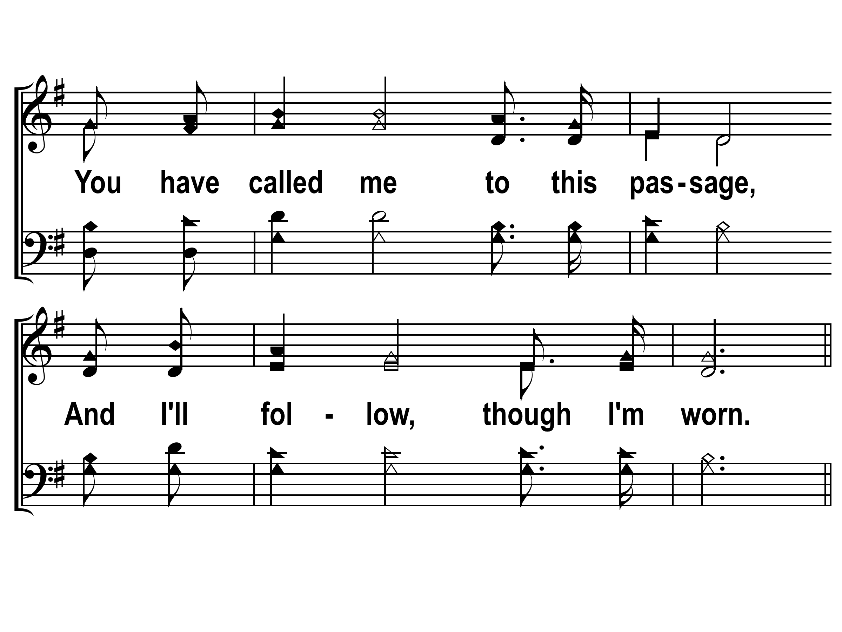

Slide 37
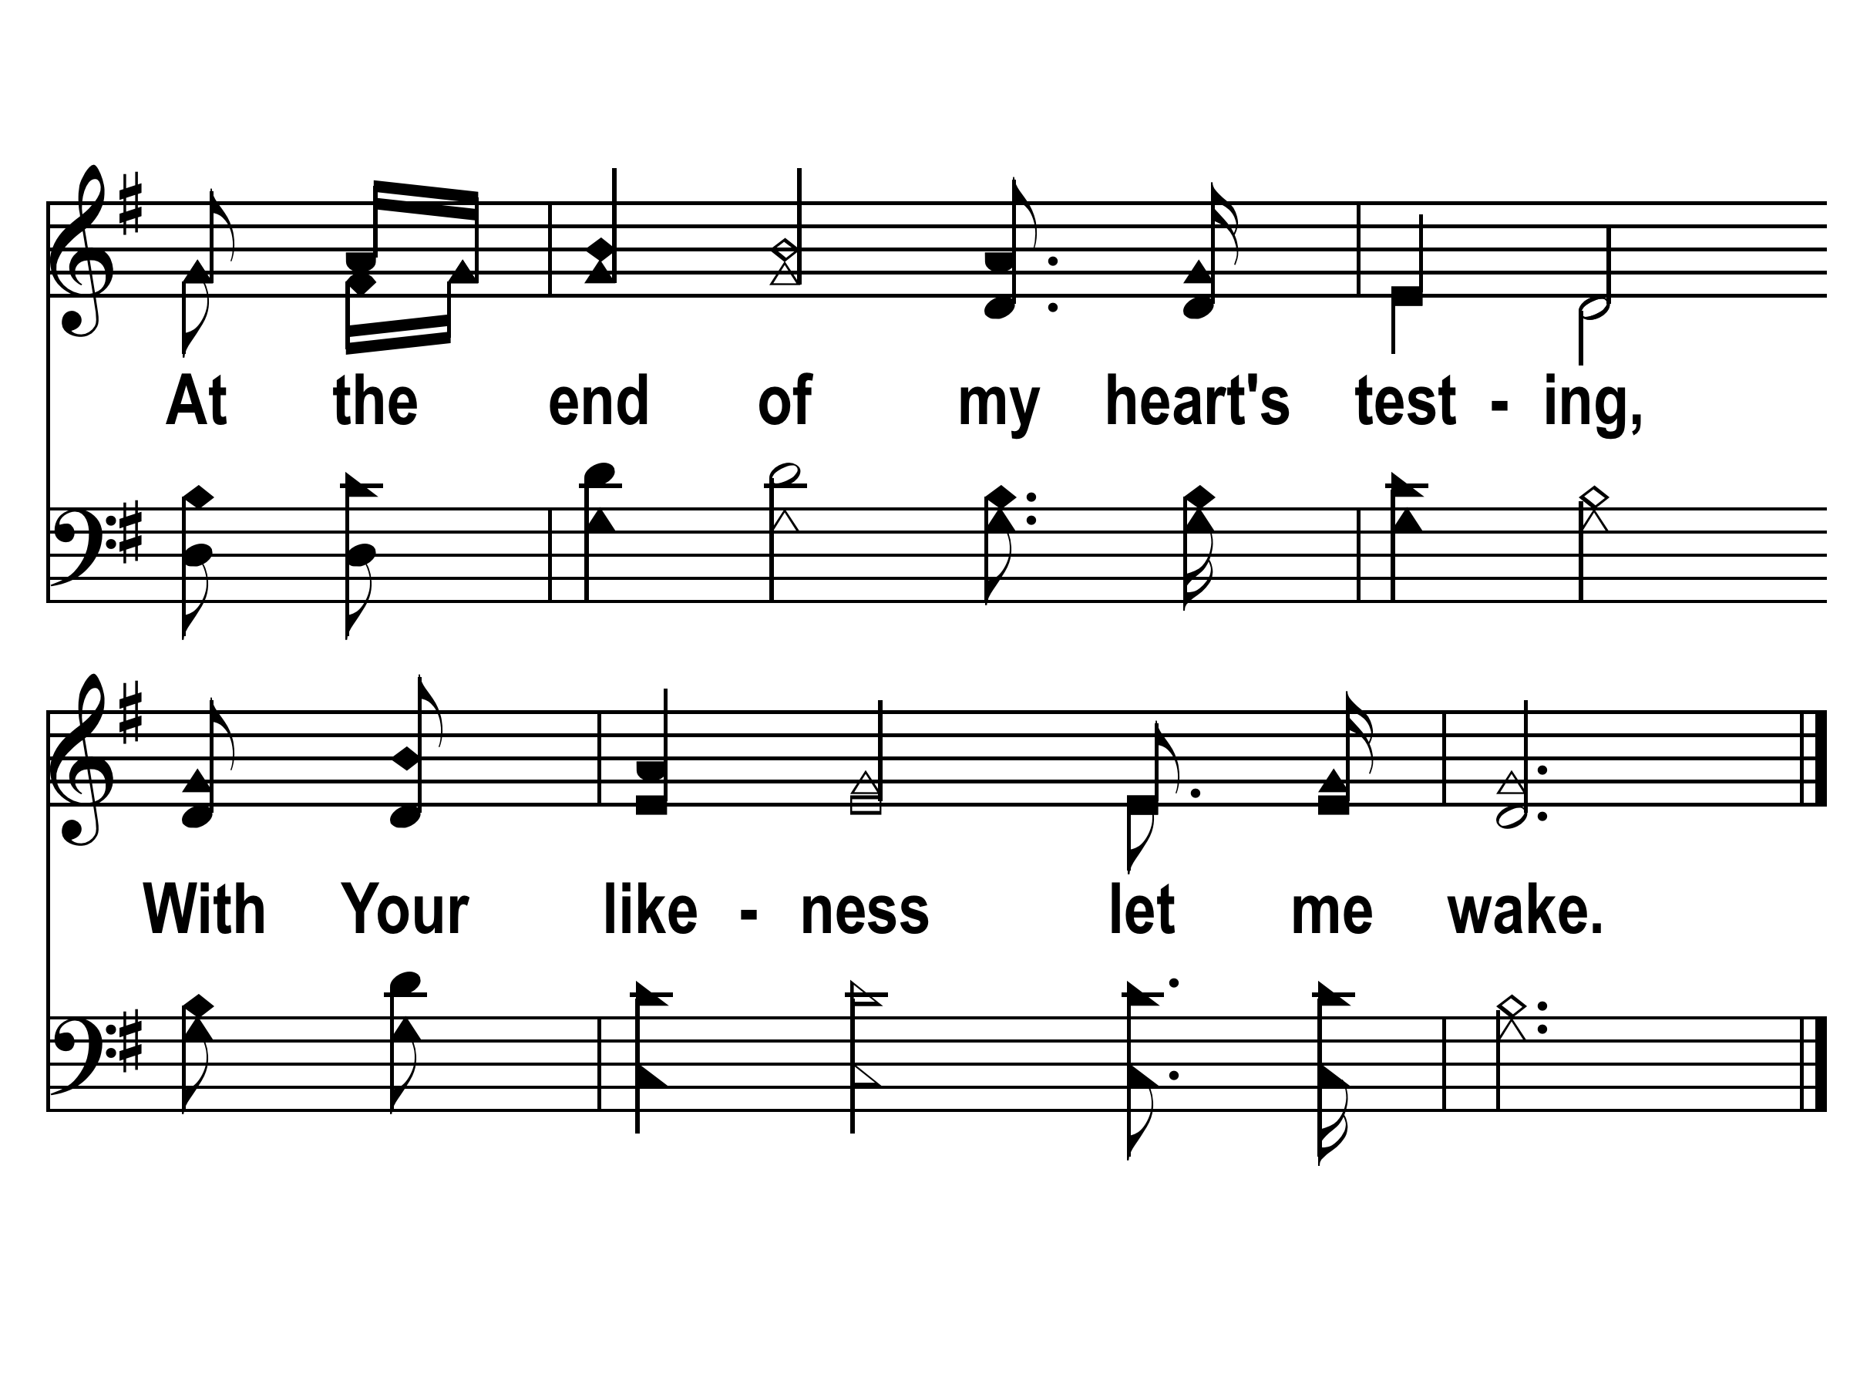

Slide 38
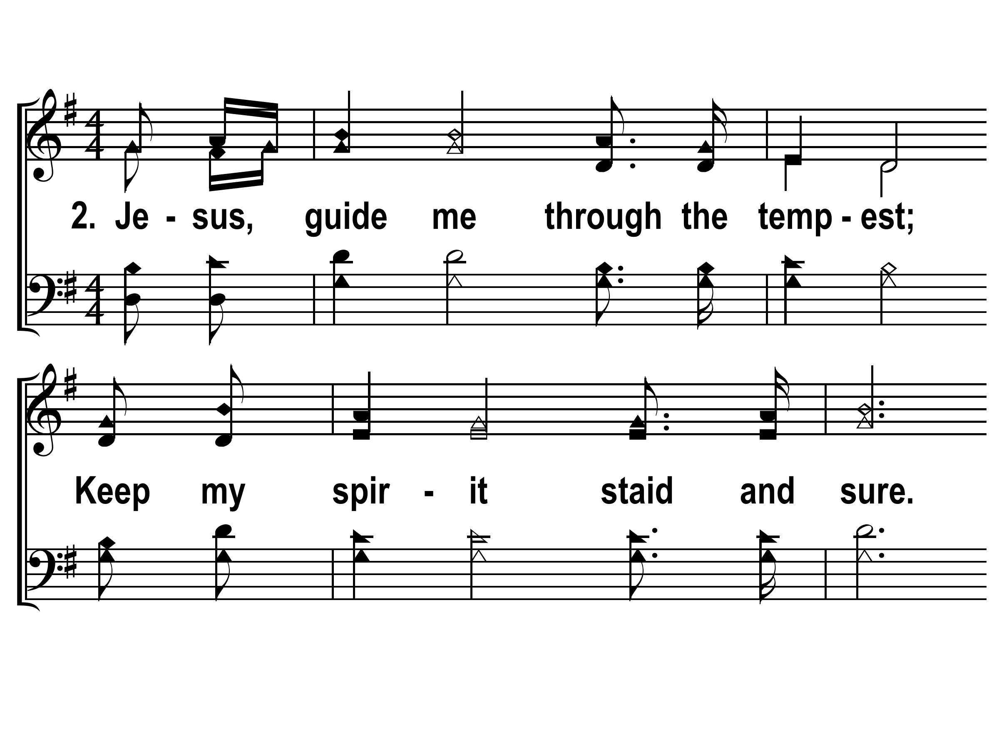

Slide 39
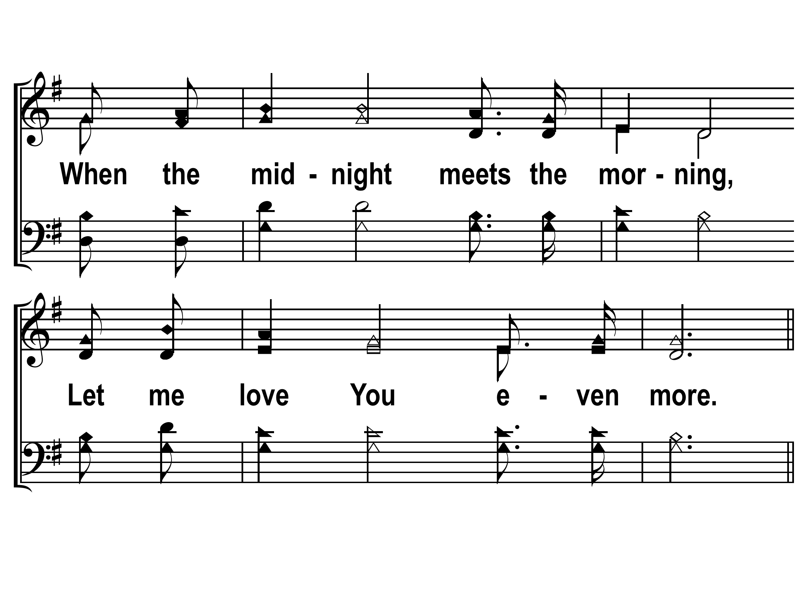

Slide 42
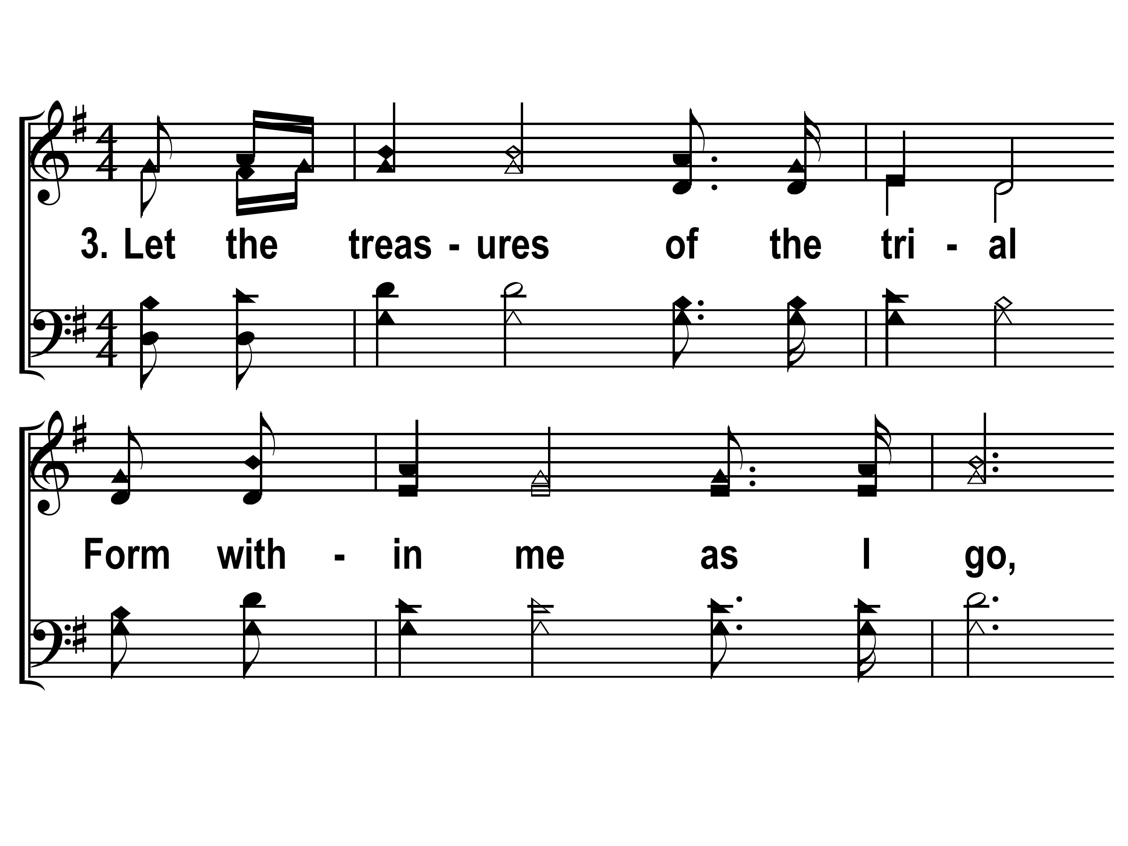

Slide 43
