Slide 1
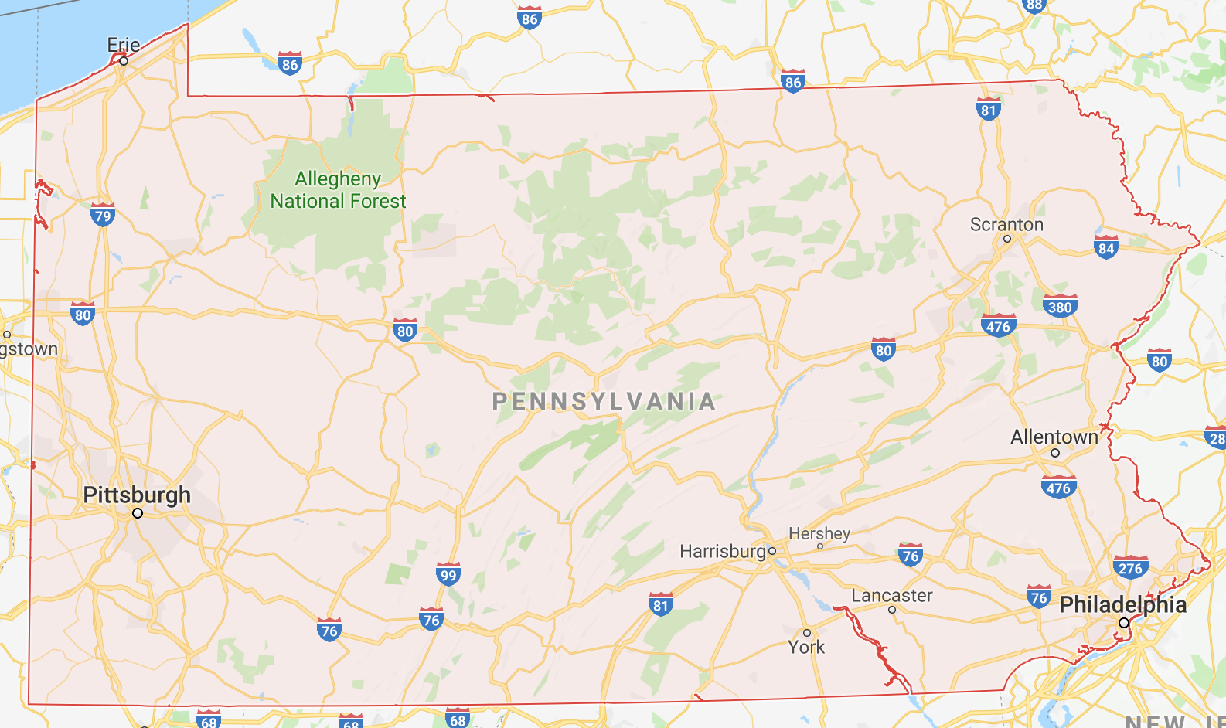

Slide 2
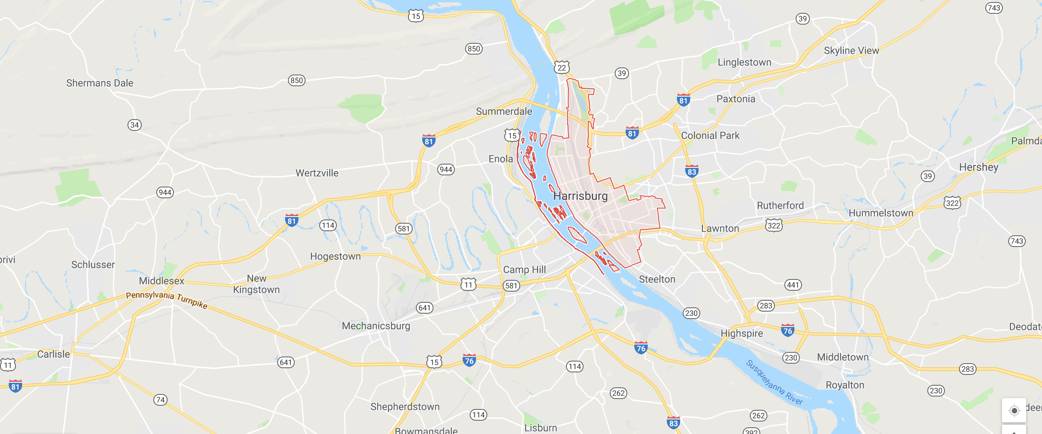

Slide 3
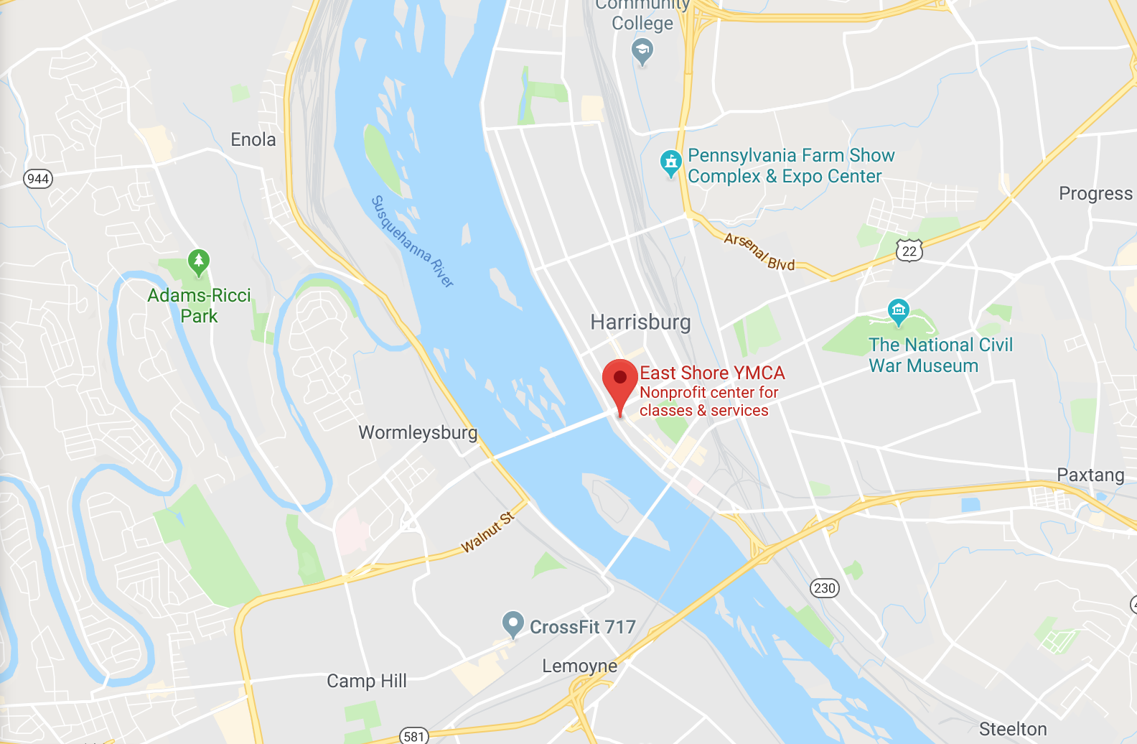

Slide 4
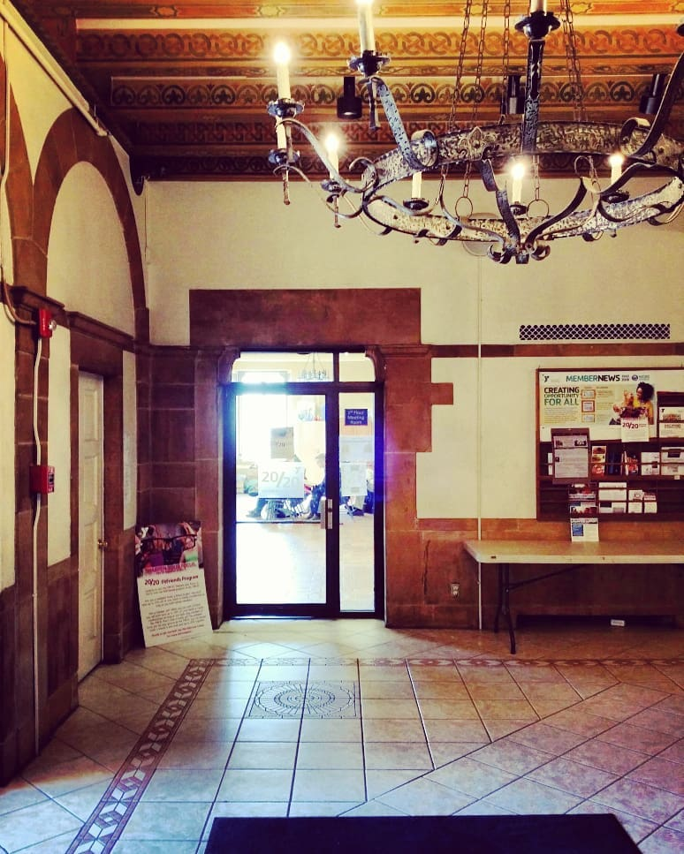
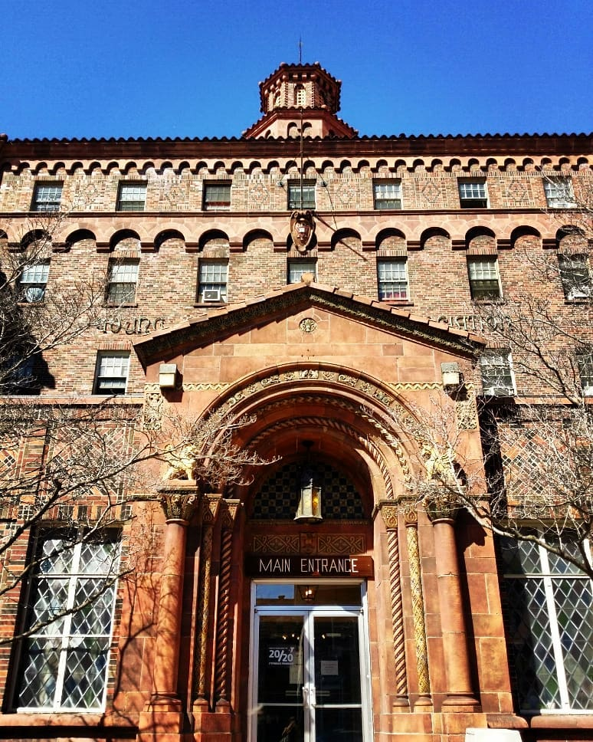
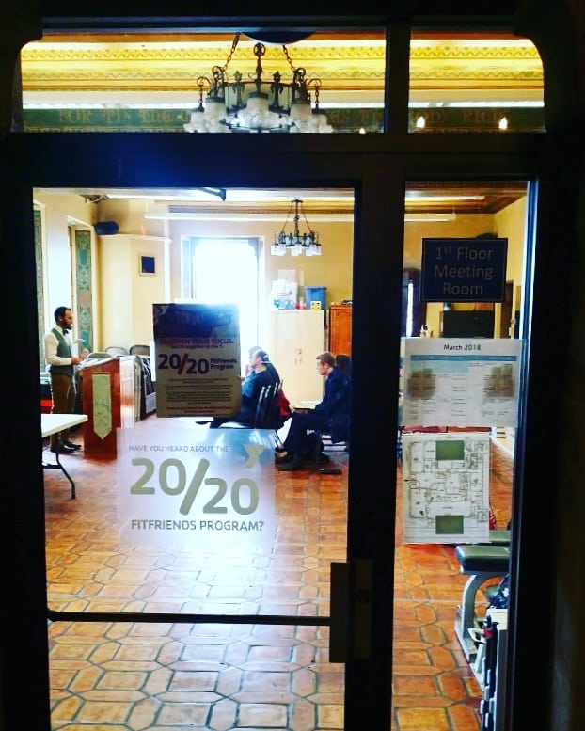

Slide 5
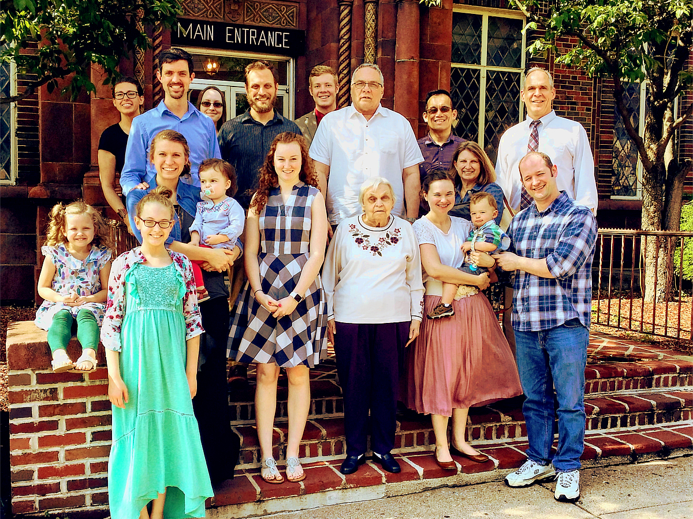

Slide 6
SONG WORSHIP
WORKSHOP
Sun 10:20 am - Worship Within the Veil
Sun 6:00 pm - The Sacrifice of Praise
Mon 7 pm - Asaph, Heman, & Jeduthun
Tue 7 pm - Teaching through Hymns, Part 1
Wed 7 pm - Teaching through Hymns, Part 2
University church of Christ
Sept 16-19, 2018

Slide 7
WORSHIP
WITHIN THE VEIL
HEB 10:19
Unless otherwise indicated, all Scripture quotations are from The ESV® Bible (The Holy Bible, English Standard Version®), copyright © 2001 by Crossway, a publishing ministry of Good News Publishers. Used by permission. All rights reserved.

Slide 8
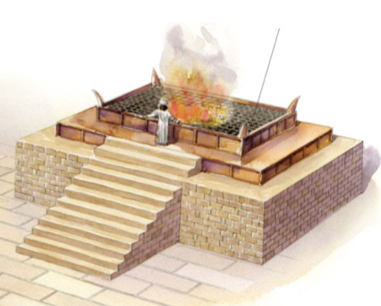
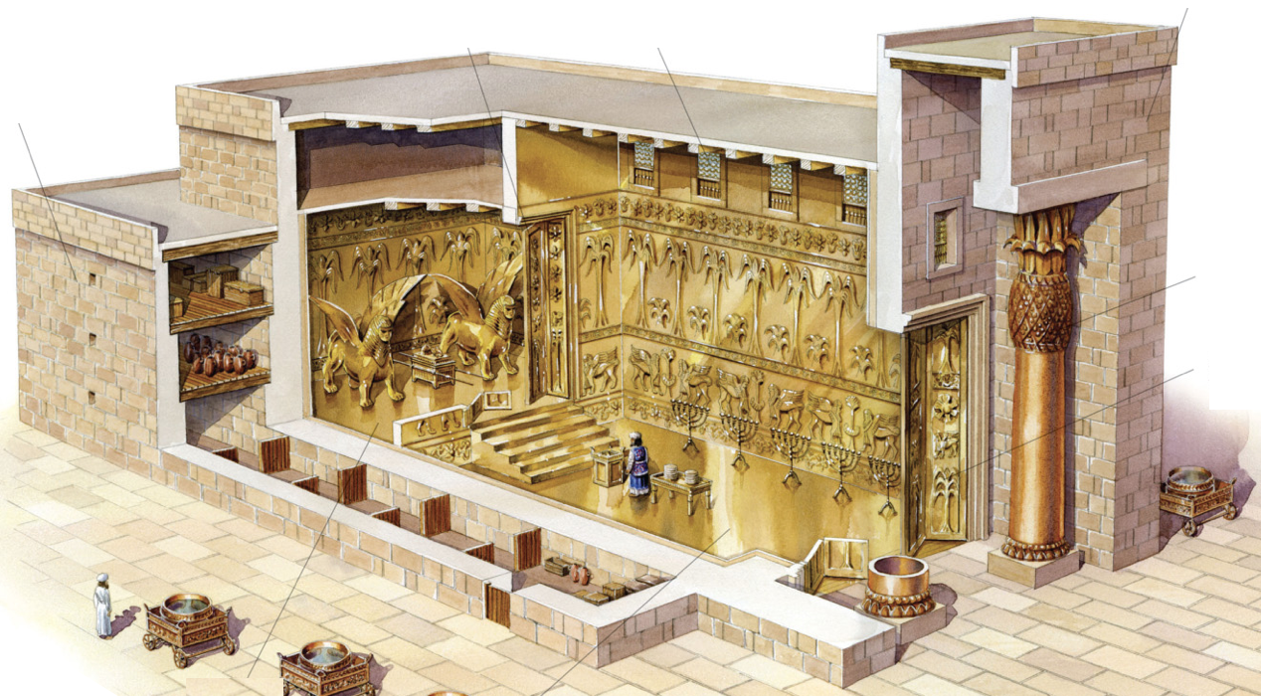
A NATION OF PRIESTS
If you are a Christian,
you are a priest of God Almighty!
The priesthood: showing what holiness looks like
Ex 19:6 - Israel: “a kingdom of priests and a holy nation”
1 Pt 2:5,9 - Christians: “a holy priesthood… a royal priesthood”

Slide 9
A NATION OF PRIESTS
The role of priest had 2 dimensions:
Represent the people to God (draw near, offer sacrifices, intercede, etc.)
Represent God to the people (holy clothing, conduct, teaching about holiness [Lv 10:8ff; Dt 17:8ff])
God

Slide 10
APPROACHING GOD
God
Ex 25:8 - Lessons from the tabernacle:
I must have clean hands & a pure heart
A death occurred to allow me to come near
I still cannot see God Himself
The tabernacle/temple said:
- God is with you
- …But keep your distance!

Slide 11
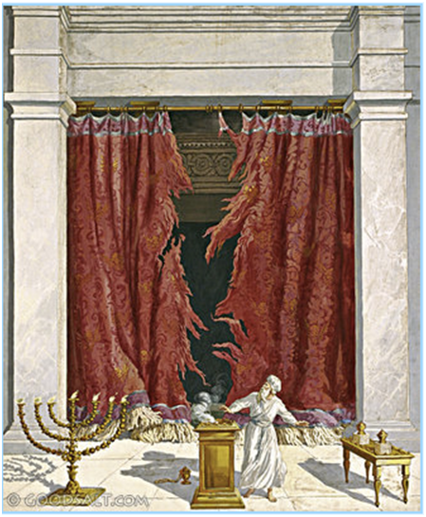
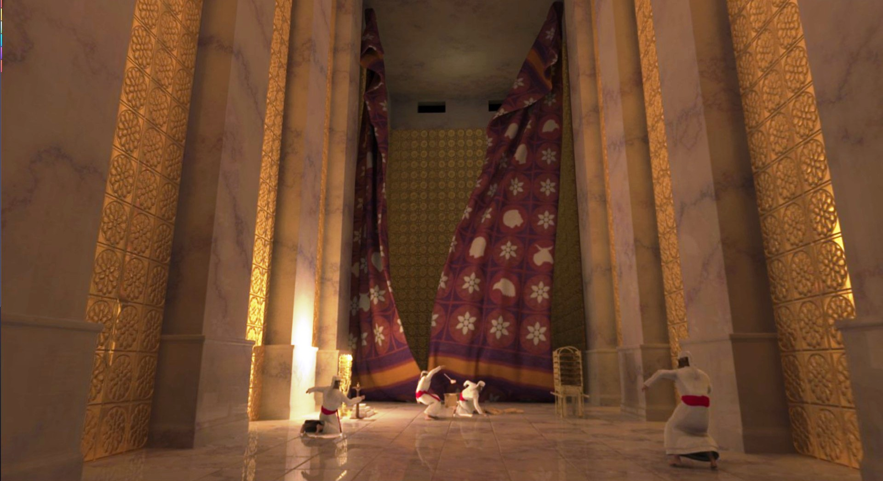
APPROACHING GOD

Slide 12
WORSHIP WITHIN THE VEIL
God
Mk 15:38 - When Jesus died, the veil was torn open.
Heb 10:19-20 - We now have an unbelievable privilege:
By the blood of Jesus, we can enter the most holy place!

Slide 13
WORSHIP WITHIN THE VEIL
God
Heb 4:16 - Because we have this unspeakable privilege, how should we react?
Heb 10:19-25 - Draw near, hold fast, consider each other
Heb 12:28-29 - Worship with reverence and awe
Heb 13:15 - Offer the sacrifice of praise

