Slide 2
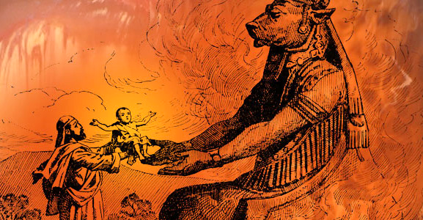
Is God Immoral For Killing
The Canaanites?

Slide 3
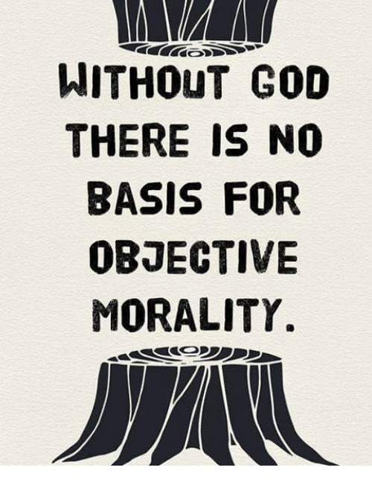
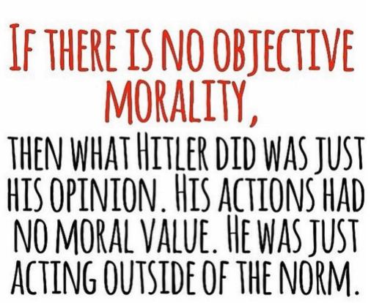
1) Where Do You Get Your Standard Of Morality?

Slide 4
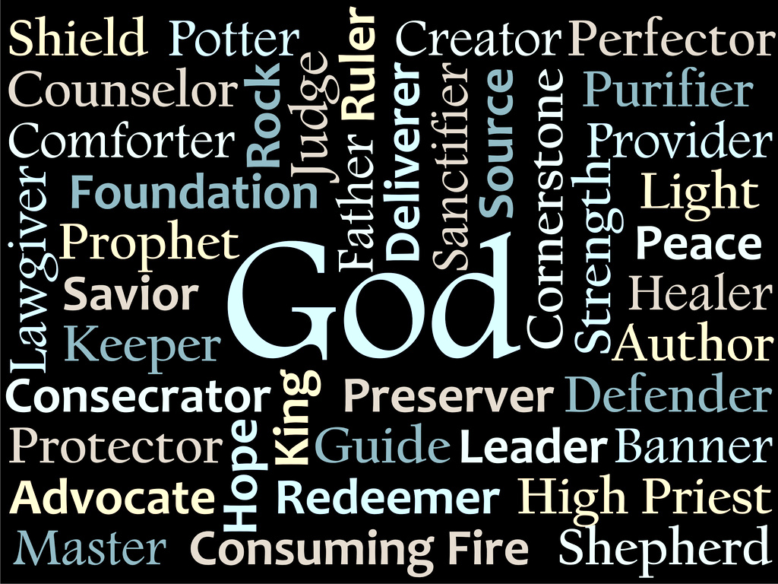
2) We Must Assume Everything We Know About God

Slide 5
3) God Is Our Sovereign Creator
Isa 64:8 – “But now, O Lord, You are our Father, we are the clay, and You our potter; and all of us are the work of Your hand.”
Psa 24:1 – “The earth is the Lord’s, and all it contains, the world, and those who dwell in it.”
Psa 115:1-3 – “Not to us, O Lord, not to us, but to Your name give glory because of Your lovingkindness, because of Your truth. Why should the nations say, ‘Where, now, is their God?’ But our God is in the heavens; He does whatever He pleases.”

Slide 6
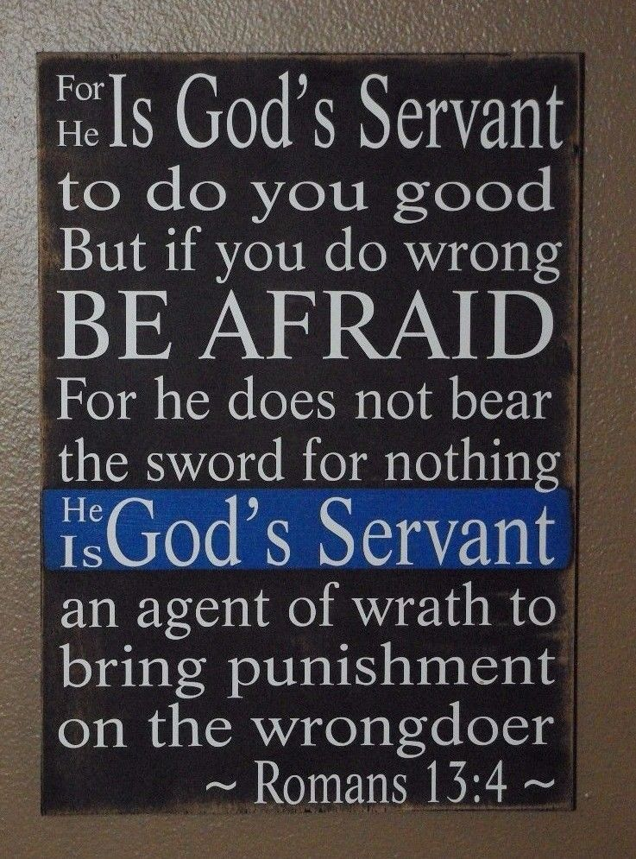
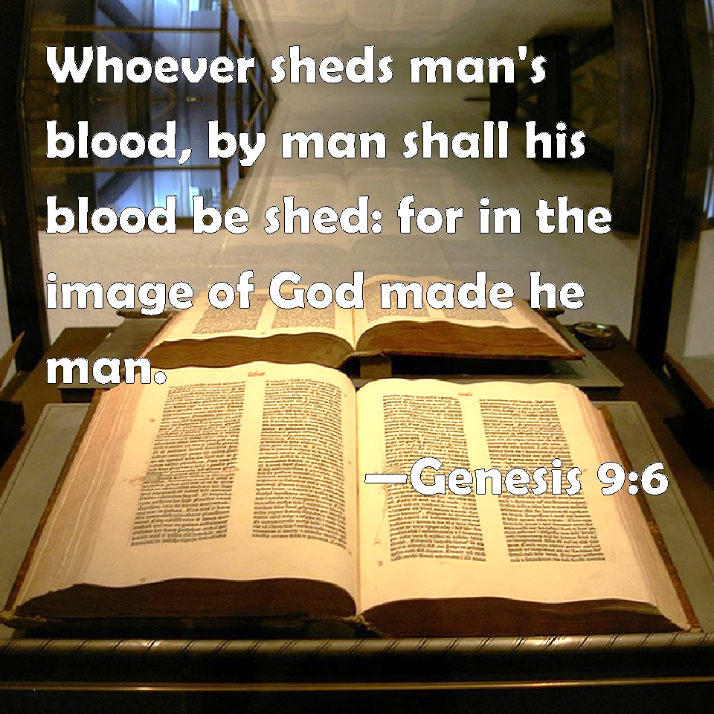
3) God Is Our Sovereign Creator
“Love your enemies…” – Matt 5:44a
“Pray for those who persecute you…” – Matt 5:44b
“Lord, do not hold this sin against them!” – Acts 7:60b
“Pursue peace with all men…” – Heb 12:14

Slide 7
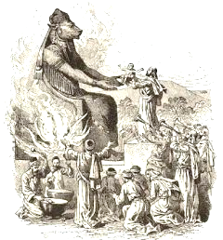
4) Does God Give Reasons For Killing People?
Gen 15:16b – “…the iniquity of the Amorite is not yet complete.”
Deut 9:5 – “It is not for your righteousness or for the uprightness of your heart that you are going to possess their land, but it is because of the wickedness of these nations that the Lord your God is driving them out before you, in order to confirm the oath which the Lord swore to your fathers, to Abraham, Isaac and Jacob.”

Slide 8
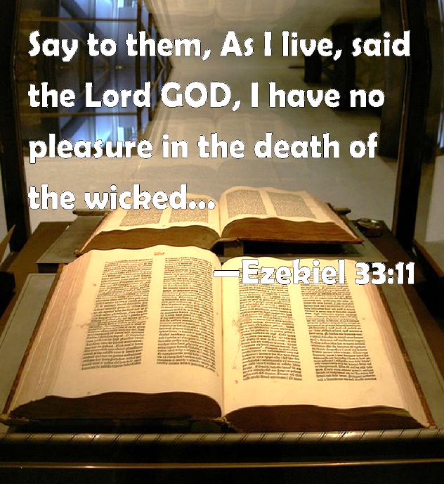
5) What If God Left Canaan To Dwell With Israel?
Ex 23:31-33 – “I will fix your boundary from the Red Sea to the sea of the Philistines, and from the wilderness to the River Euphrates; for I will deliver the inhabitants of the land into your hand, and you will drive them out before you. You shall make no covenant with them or with their gods. They shall not live in your land, because they will make you sin against Me; for if you serve their gods, it will surely be a snare to you.”
Judg 2:11-13 – “Then the sons of Israel did evil in the sight of the Lord and served the Baals, and they forsook the Lord, the God of their fathers, who had brought them out of the land of Egypt, and followed other gods from among the gods of the peoples who were around them, and bowed themselves down to them; thus they provoked the Lord to anger. So they forsook the Lord and served Baal and the Ashtaroth.”
2 Chron 33:9 – “Thus Manasseh misled Judah and the inhabitants of Jerusalem to do more evil than the nations whom the Lord destroyed before the sons of Israel.”

Slide 9
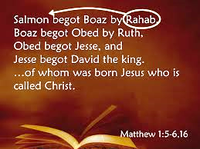
6) Did Everyone In Canaan Die?
Josh 2:9-13 – “I know that the Lord has given you the land, and that the terror of you has fallen on us, and that all the inhabitants of the land have melted away before you. For we have heard how the Lord dried up the water of the Red Sea before you when you came out of Egypt, and what you did to the two kings of the Amorites who were beyond the Jordan, to Sihon and Og, whom you utterly destroyed. When we heard it, our hearts melted and no courage remained in any man any longer because of you; for the Lord your God, He is God in heaven above and on earth beneath. Now therefore, please swear to me by the Lord, since I have dealt kindly with you, that you also will deal kindly with my father’s household, and give me a pledge of truth, and spare my father and my mother and my brothers and my sisters, with all who belong to them, and deliver our lives from death.”

Slide 10
7) Why Kill The Women?
Deut 7:3d-4a – “…nor shall you take their daughters for your sons. For they will turn your sons away from following Me to serve other gods…”
Judg 3:5-6 – “The sons of Israel lived among the Canaanites, the Hittites, the Amorites, the Perizzites, the Hivites, and the Jebusites; and they took their daughters for themselves as wives, and gave their own daughters to their sons, and served their gods.”
1 Kings 4:1-4a – “Now King Solomon loved many foreign women along with the daughter of Pharaoh: Moabite, Ammonite, Edomite, Sidonian, and Hittite women, from the nations concerning which the Lord had said to the sons of Israel, ‘You shall not associate with them, nor shall they associate with you, for they will surely turn your heart away after their gods.’ Solomon held fast to these in love. He had seven hundred wives, princesses, and three hundred concubines, and his wives turned his heart away. For when Solomon was old, his wives turned his heart away after other gods”
Neh 13:23-24 – “In those days I also saw that the Jews had married women from Ashdod, Ammon, and Moab. As for their children, half spoke in the language of Ashdod, and none of them was able to speak the language of Judah, but the language of his own people.”

Slide 11
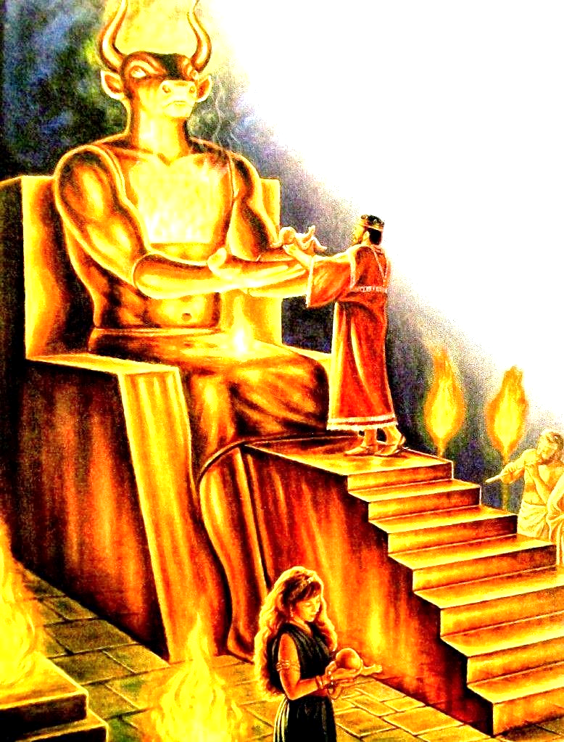
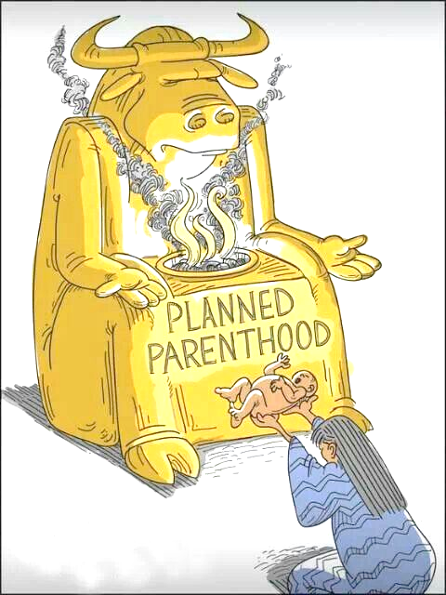
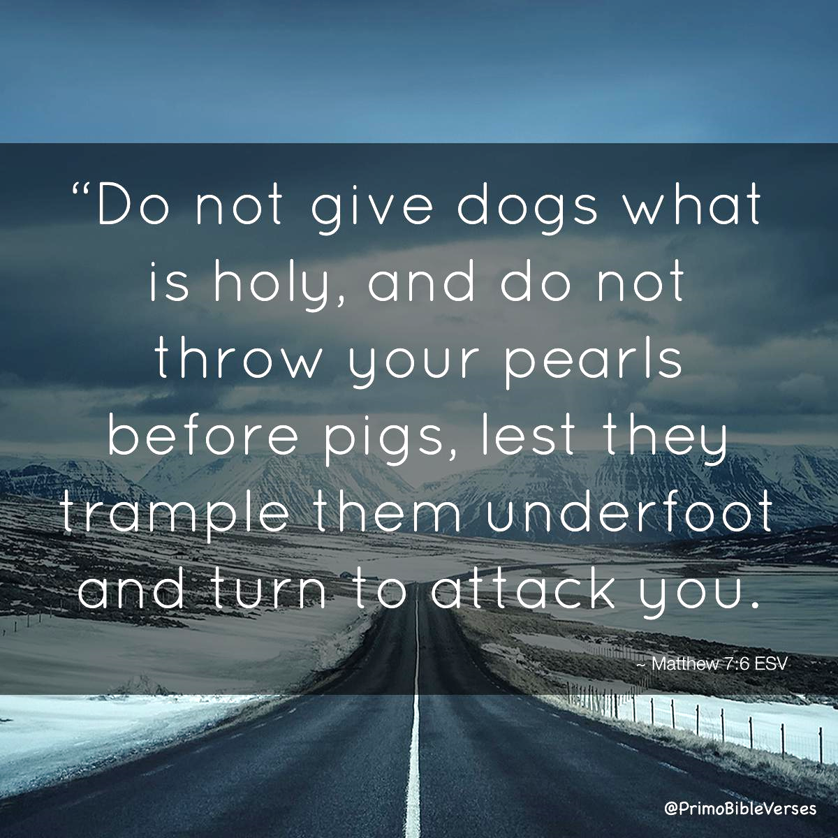
8) Why Kill The Children?

Slide 12
8) Why Kill The Children?
Canaanite perversion left their children physically diseased
Lev 18:24 – “Do not defile yourselves by any of these things; for by all these the nations which I am casting out before you have become defiled.”
What if they grew up clinging to their “national pride”?
Heb 11:24-25 – “By faith Moses, when he had grown up, refused to be called the son of Pharaoh’s daughter, choosing rather to endure ill-treatment with the people of God than to enjoy the passing pleasures of sin”
To satisfy God’s wrath and justice toward Canaanite sin
Rom 1:18 – “ For the wrath of God is revealed from heaven against all ungodliness and unrighteousness of men who suppress the truth in unrighteousness”
God Is Holy
God Is Holy
JUSTICE
LOVE
JUSTICE
LOVE

