Slide 3
1 Tim 2:9-10
“⁹Likewise, I want women to adorn themselves with proper clothing, modestly and discreetly, not with braided hair and gold or pearls or costly garments, ¹⁰but rather by means of good works, as is proper for women making a claim to godliness.”

Slide 4
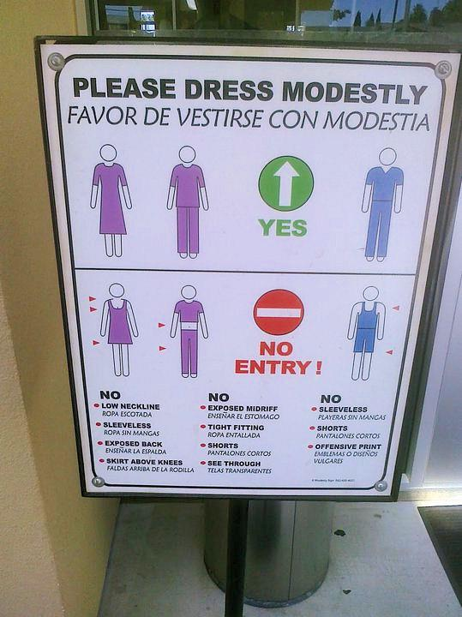
WHY THE DIFFICULTY?

Slide 5
WHY THE DIFFICULTY?
“Where does the bible say…”
“…thou shall not wear a two piece bikini?”
“…thou shall not wear tight jeans?”
“…thou shall not wear short shorts?”
“…thou shall not wear mini skirts?”
“…thou shall not wear a tube top?”
“…thou shall not wear spandex?”

Slide 6
WHY THE DIFFICULTY?

Slide 7
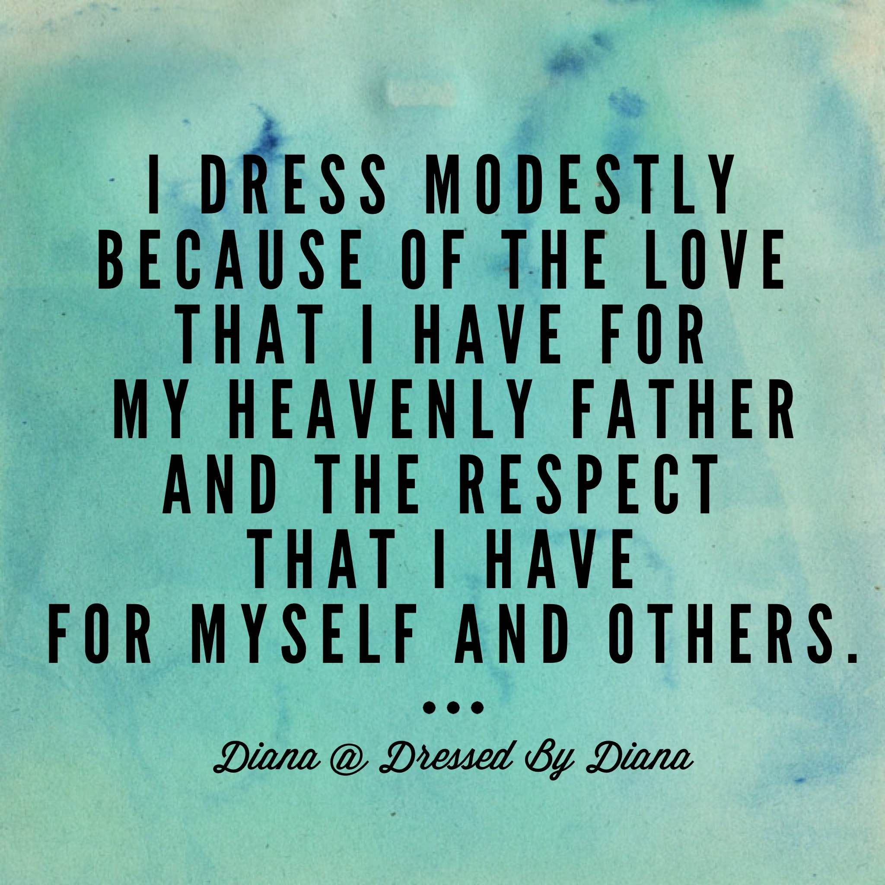
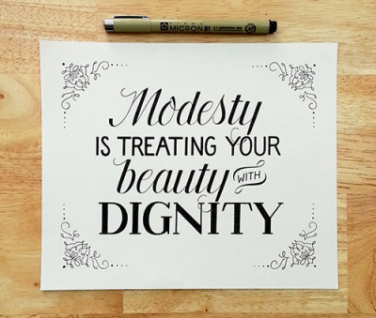
WHY THE DIFFICULTY?

Slide 9
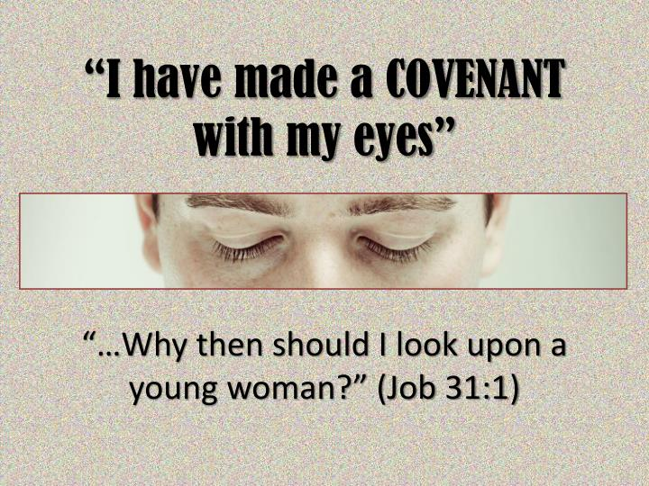
General observations
Addressed To Women
1 Tim 2:9-10 – “⁹Likewise, I want women to adorn themselves with proper clothing, modestly and discreetly, not with braided hair and gold or pearls or costly garments, ¹⁰but rather by means of good works, as is proper for women making a claim to godliness.”
Matt 5:28 – “but I say to you that everyone who looks at a woman with lust for her has already committed adultery with her in his heart.”

Slide 10
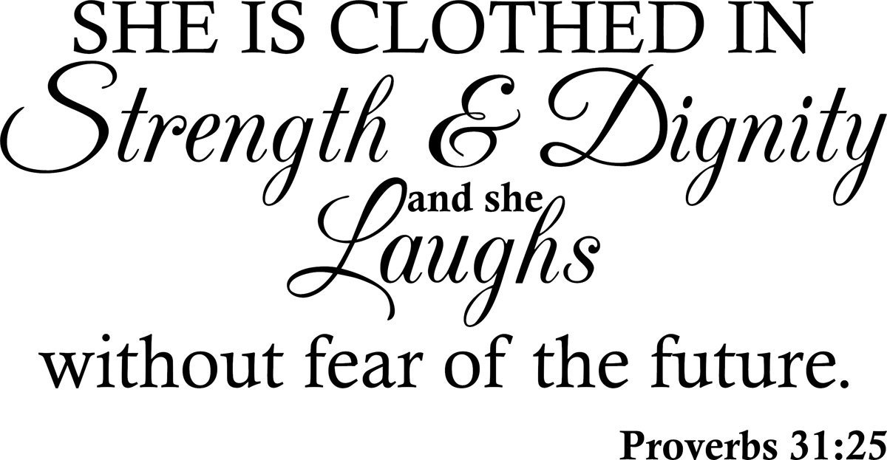
General observations
Clothing Sends Signals
Jennifer Love Hewitt – “Nudity…[is] not something that I feel particularly comfortable with. I also think that it's [better] not to show everything. I feel like imaginations can do way more.”
Mary Quaint – “Mini-clothes are symbolic of those women who want to seduce a man.”

Slide 11
General observations
Meaning Of The Words In 1 Tim 2:9
…with proper clothing, modestly and discreetly…
Baptism = baptizmo
“to immerse”
Church = ekklesia
“called out of”
Saint = hagios
“set apart”
Disciple = manthano
“learner”

Slide 12
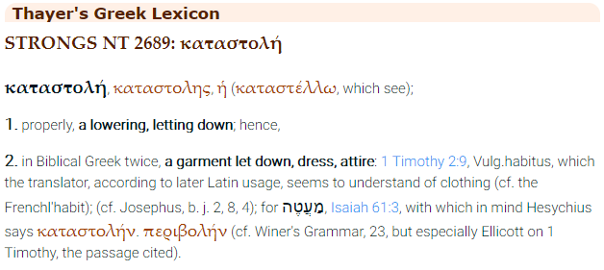
“CLOTHING” (NASB)
ESV,KJV,NKJV: “apparel”
Greek: “katastelló”
Vine’s Greek Dictionary
“to send or let down, to lower”
“kata” = down
“stello” = to send
Acts 19:35-36 – “After quieting the crowd, the town clerk said, ‘Men of Ephesus, what man is there after all who does not know that the city of the Ephesians is guardian of the temple of the great Artemis and of the image which fell down from heaven? So, since these are undeniable facts, you ought to keep calm and to do nothing rash.’”

Slide 13
Pattern of gen 3
Gen 3:7 – “Then the eyes of both of them were opened, and they knew that they were naked; and they sewed fig leaves together and made themselves loin coverings.”
Sequence
Gen 3:8-11 – “They heard the sound of the Lord God walking in the garden in the cool of the day, and the man and his wife hid themselves from the presence of the Lord God among the trees of the garden. Then the Lord God called to the man, and said to him, ‘Where are you?’ He said, ‘I heard the sound of You in the garden, and I was afraid because I was naked; so I hid myself.’ And He said, ‘Who told you that you were naked? Have you eaten from the tree of which I commanded you not to eat?’”
Naked (vs. 7a)
Loin Coverings (vs. 7b)
Naked (vs. 10 & 11)
Garments of Skin (vs. 32)
Gen 3:21 – “The Lord God made garments of skin for Adam and his wife, and clothed them.”

Slide 14
Pattern of gen 3
Garment/Tunic = “Kethoneth” (Hebrew)
The International Standard Bible Encyclopedia – “It resembled the Roman ‘tunic’, corresponding most nearly to our ‘long shirt’, reaching below the knees always, and, in case it was designed for dress occasions, reaching almost to the ground.”
The Revel Bible Dictionary – “An outer garment. In biblical times, this important garment was typically a large square of cloth with armholes. It fell to or below the knee.”
McClintock and Strong Bible Cyclopedia – “The more important personages wear a double tunic, the upper one constructed so as to pass over the left shoulder and under the right arm, leaving the right shoulder exposed: the servants wear nothing more than a skirt or kilt, reaching from the loins to the knee.”
H.W. F. Gesenius, Gesenius’ Hebrew-Chaldee Lexicon to the Old Testament – “A tunic, an inner garment next to the skin (Lev. 16:4); also worn by women (SOS 5:3; 2 Sam. 13:18); generally with sleeves, coming down to the knees, rarely to the ankles.”
Wilson’s Old Testament Word Studies, 81 – “a tunic, worn next to the skin…generally with sleeves, to the knees, but seldom to the ankles.”
Handbook of Life in Bible Times, by J. A. Thompson – “During the whole of Bible history…men and women dressed similarly. People throughout Bible times would have worn some kind of tunic, usually from shoulder to knee or ankle.”

Slide 15
Pattern of gen 3
Garment/Tunic = “Kethoneth” (Hebrew)
The Bible Almanac, p. 484 – “This undergarment covered the priest’s body from the waist to the knees. Rather than being trousers, “breeches” were probably a double apron.”
The UPCI book, “The Girl In The Dress, p. 95” – “In Bible days men and women wore long robes and men sometimes wore shorter ones over breeches that went down to the knees.”
Encarta Dictionary – “A knee-length garment with sleeves, a round neck, and a loose body worn by men in ancient Rome, or a similar garment worn during the Middle Ages”
Jewish Encyclopedia – Emil G. Hirsch & Gerson B. Levi – “In course of time this developed into a short shirt, with an aperture for the head to pass through, and was gradually lengthened to the knees (especially when used by women), and sometimes to the ankles.”
Thompson’s Hebrew Word History Third Edition – “Hebrew word translated coats is Strong’s number 3801 “kethoneth” which means to cover. This would be a garment that reaches the knee”

Slide 16
“PROPER” (NASB)
ESV: “respectable”
KJV,NKJV: “modest”
Greek: “kosmio”
Vine’s Greek Dictionary
orderly, well-arranged, decent, modest" (akin to kosmos, in its primary sense as “harmonious arrangement, adornment;” cp. kosmikos, of the world, which is related to kosmos in its secondary sense as the world), is used in 1 Tim 2:9 of the apparel with which Christian women are to adorn themselves; in 1 Tim 3:2 (RV, “orderly;” AV, “of good behavior”), of one of the qualifications essential for a bishop or overseer. “The well-ordering is not of dress and demeanor only, but of the inner life, uttering indeed and expressing itself in the outward conversation” (Trench, Syn., xcii). In the Sept., Eccl 12:9.

Slide 17
“MODESTLY” (NASB)
ESV: “modestly”
NKJV: “propriety”
KJV: “shamefacedness”
Greek: “aidious”
Vine’s Greek Dictionary
“a sense of shame, modesty,” is used regarding the demeanor of women in the church, 1 Tim 2:9 (some mss. have it in Heb 12:28 for deos, “awe:” here only in NT). “Shamefastness is that modesty which is ‘fast’ or rooted in the character...The change to ‘shamefacedness’ is the more to be regretted because shamefacedness...has come rather to describe an awkward diffidence, such as we sometimes call sheepishness” (Davies; Bible English, p. 12).
Jer 6:15 – “Were they ashamed because of the abomination they have done? They were not even ashamed at all; they did not even know how to blush.”
Rom 12:2 – “And do not be conformed to this world, but be transformed by the renewing of your mind, so that you may prove what the will of God is, that which is good and acceptable and perfect.”
Eph 4:23 – “and that you be renewed in the spirit of your mind”

Slide 18
“DISCREETLY” (NASB)
ESV: “self-control”
NKJV: “moderation”
KJV: “sobriety”
Greek: “sophrosune”
Vine’s Greek Dictionary
denotes “soundness of mind” (See SOBER, A), Acts 26:25, “soberness;” 1 Tim 2:9, 1 Tim 2:15, “sobriety;” “sound judgment” practically expresses the meaning; “it is that habitual inner self-government, with its constant rein on all the passions and desires, which would hinder the temptation to these from arising, or at all events from arising in such strength as would overbear the checks and barriers which aidos (shamefastness) opposed to it” (Trench Syn. xx, end).
Acts 26:25 – “But Paul said, ‘I am not out of my mind, most excellent Festus, but I utter words of sober truth.’”
Ex 20:26 – “And you shall not go up by steps to My altar, so that your nakedness will not be exposed on it.”
Ex 28:42 – “You shall make for them linen breeches to cover their bare flesh; they shall reach from the loins even to the thighs.”

Slide 19
