Slide 3
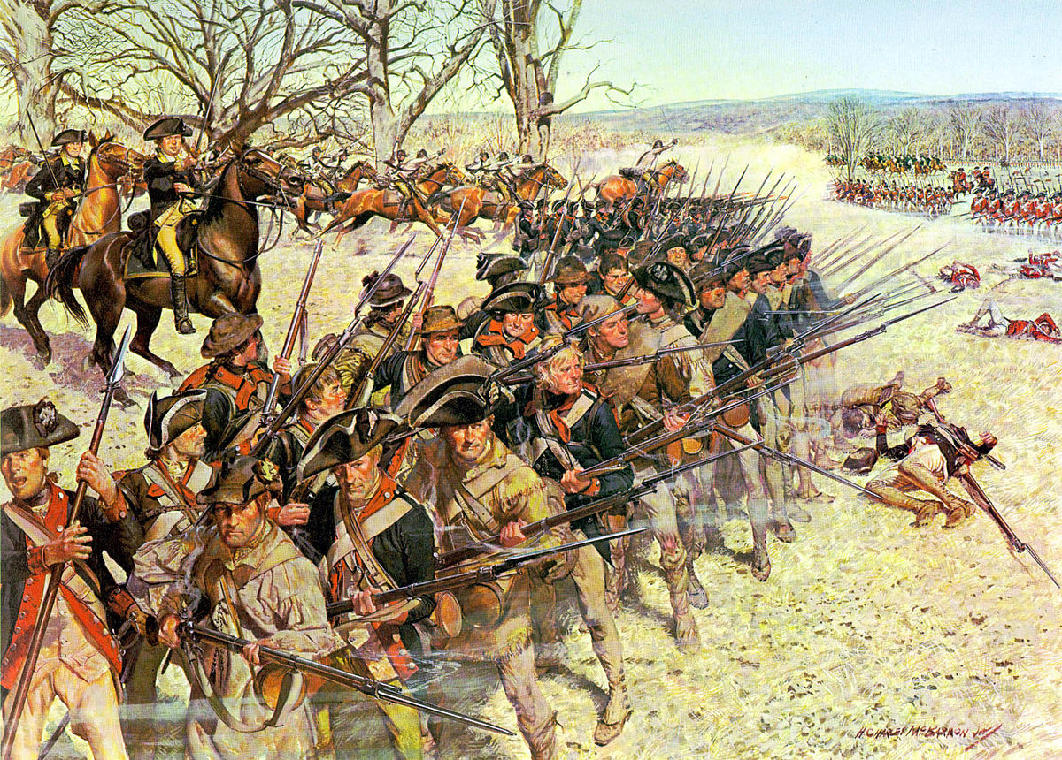
What is wisdom?
FACTUAL KNOWLEDGE
SITUATIONAL INSIGHT
NECESSARY RESOLVE
Righteous goal

Slide 4
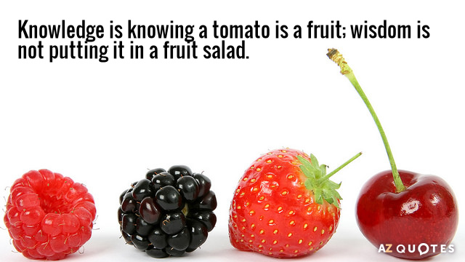
Prov 26:4 – “Do not answer a fool according to his folly, or you will also be like him.”
Mark 9:40 – “For he who is not against us is for us.”
“He who hesitates is lost.”
Prov 26:5 – “Answer a fool as his folly deserves, that he not be wise in his own eyes.”
Matt 12:30a – “He who is not with Me is against Me.”
“Haste makes waste”

Slide 5
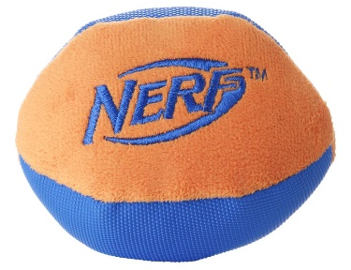
Is It Sinful?
Is It Wise?
Eph 5:15-16 – “Therefore be careful how you walk, not as unwise men but as wise, making the most of your time, because the days are evil.”

Slide 6
Prov 4:7a – “The beginning of wisdom is: acquire wisdom”
Ask God
Jas 1:5 – “But if any of you lacks wisdom, let him ask of God, who gives to all generously and without reproach, and it will be given to him.”
1 Kings 3:9-10 – “So give Your servant an understanding heart to judge Your people to discern between good and evil. For who is able to judge this great people of Yours? It was pleasing in the sight of the Lord that Solomon had asked this thing.”
1 Kings 3:12 – “behold, I have done according to your words. Behold, I have given you a wise and discerning heart, so that there has been no one like you before you, nor shall one like you arise after you.”

Slide 7
Prov 4:7a – “The beginning of wisdom is: acquire wisdom”
Ask God
DESIRE
1 Kings 3:8-9 – “Your servant is in the midst of Your people which You have chosen, a great people who are too many to be numbered or counted. So give Your servant an understanding heart to judge Your people to discern between good and evil. For who is able to judge this great people of Yours?”
Prov 3:13-15 – “How blessed is the man who finds wisdom and the man who gains understanding. For her profit is better than the profit of silver and her gain better than fine gold. She is more precious than jewels; and nothing you desire compares with her.”
Prov 8:11 – “For wisdom is better than jewels; and all desirable things cannot compare with her.”
Prov 16:16 – “How much better it is to get wisdom than gold! And to get understanding is to be chosen above silver.”
1 Kings 3:11-13 – “God said to him, ‘Because you have asked this thing and have not asked for yourself long life, nor have asked riches for yourself, nor have you asked for the life of your enemies, but have asked for yourself discernment to understand justice, behold, I have done according to your words. Behold, I have given you a wise and discerning heart, so that there has been no one like you before you, nor shall one like you arise after you. I have also given you what you have not asked, both riches and honor, so that there will not be any among the kings like you all your days.”

Slide 8
Prov 4:7a – “The beginning of wisdom is: acquire wisdom”
Ask God
DESIRE
Humility
1 Cor 3:18 – “Let no man deceive himself. If any man among you thinks that he is wise in this age, he must become foolish, so that he may become wise.”
Prov 11:2 – “When pride comes, then comes dishonor, but with the humble is wisdom.”
1 Kings 3:7-9 – “Now, O Lord my God, You have made Your servant king in place of my father David, yet I am but a little child; I do not know how to go out or come in. Your servant is in the midst of Your people which You have chosen, a great people who are too many to be numbered or counted. So give Your servant an understanding heart to judge Your people to discern between good and evil. For who is able to judge this great people of Yours?”

Slide 9
“The fear of the Lord is the beginning of knowledge”
(Prov 1:7a)
“The knowledge of the Holy One is understanding”
(Prov 9:10b)
“For if you cry for discernment, lift your voice for understanding”
(Prov 2:3)
“The fear of the Lord is the beginning of wisdom” (Prov 9:10a)
“The fear of the Lord is the instruction for wisdom” (Prov 15:33a)
Understanding
Formerly spelled “rightwiseness”
Fear
Instruction
Knowledge
Discernment
Righteousness
Trust
“The mouth of the righteous flows with wisdom”
(Prov 10:31a)
“Trust in the Lord with all your heart and do not lean on your own understanding.”
(Prov 3:5)
Wisdom
…has built her house, she has hewn out her seven pillars. (Prov 9:1)

