Slide 3
The Church
Ek + klesia
1 Pet 2:9 – “But you are a chosen race, a royal priesthood, a holy nation, a people for God’s own possession, so that you may proclaim the excellencies of Him who has called you out of darkness into His marvelous light.”
2 Thes 2:14 – “It was for this He called you through our gospel, that you may gain the glory of our Lord Jesus Christ.”
Rom 1:16 – “For I am not ashamed of the gospel, for it is the power of God for salvation to everyone who believes, to the Jew first and also to the Greek.”
“out of” + “called”

Slide 4
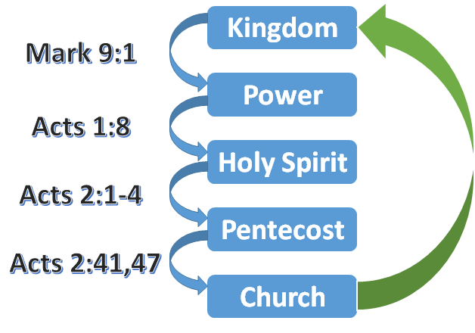
The Kingdom of God
Col 1:13 – “For He rescued us from the domain of darkness, and transferred us to the kingdom of His beloved Son.”
John 18:37 – “Therefore Pilate said to Him, ‘So You are a king?’ Jesus answered, ‘You say correctly that I am a king. For this I have been born, and for this I have come into the world, to testify to the truth. Everyone who is of the truth hears My voice.’”
John 3:5 – “Jesus answered, ‘Truly, truly, I say to you, unless one is born of water and the Spirit he cannot enter into the kingdom of God.’”
Acts 2:42 – “They were continually devoting themselves to the apostles’ teaching and to fellowship, to the breaking of bread and to prayer.”
Luke 17:21 – “nor will they say, ‘Look, here it is!’ or, ‘There it is!’ For behold, the kingdom of God is in your midst.”
Rev 1:9a – “I, John, your brother and fellow partaker in the tribulation and kingdom and perseverance which are in Jesus”

Slide 5
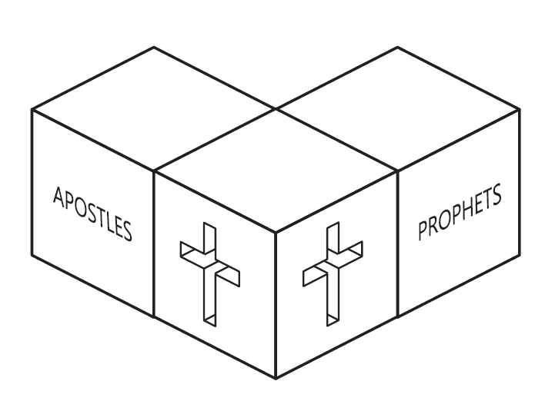
The Temple of God
Eph 2:19-22 – “So then you are no longer strangers and aliens, but you are fellow citizens with the saints, and are of God’s household, having been built on the foundation of the apostles and prophets, Christ Jesus Himself being the corner stone, in whom the whole building, being fitted together, is growing into a holy temple in the Lord, in whom you also are being built together into a dwelling of God in the Spirit.”
1 Pet 2:5 – “you also, as living stones, are being built up as a spiritual house for a holy priesthood, to offer up spiritual sacrifices acceptable to God through Jesus Christ.”
1 Cor 3:16-17 – “Do you not know that you are a temple of God and that the Spirit of God dwells in you? If any man destroys the temple of God, God will destroy him, for the temple of God is holy, and that is what you are.”

Slide 6
The Body of Christ
Eph 1:22-23 – “And He put all things in subjection under His feet, and gave Him as head over all things to the church, which is His body, the fullness of Him who fills all in all.”
Col 2:19 – “[hold] fast to the head, from whom the entire body, being supplied and held together by the joints and ligaments, grows with a growth which is from God.”
Rom 12:5 – “so we, who are many, are one body in Christ, and individually members one of another.”
Eph 4:11-12 – “And He gave some as apostles, and some as prophets, and some as evangelists, and some as pastors and teachers, for the equipping of the saints for the work of service, to the building up of the body of Christ”
Eph 4:13-16 – “until we all attain to the unity of the faith, and of the knowledge of the Son of God, to a mature man, to the measure of the stature belongs to the fullness of Christ. As a result, we are no longer to be children, tossed here and there by waves and carried about by every wind of doctrine, by the trickery of men, by craftiness in deceitful scheming; but speaking the truth in love, we are to grow up in all aspects into Him who is the head, even Christ, from whom the whole body, being fitted and held together by what every joint supplies, according to the proper working of each individual part, causes the growth of the body for the building up of itself in love.”

Slide 7
The Vineyard of the Lord
John 15:5 – “I am the vine, you are the branches; he who abides in Me and I in him, he bears much fruit, for apart from Me you can do nothing.”
John 15:1-4 – “I am the true vine, and My Father is the vinedresser. Every branch in Me that does not bear fruit, He takes away; and every branch that bears fruit, He prunes it so that it may bear more fruit. You are already clean because of the word which I have spoken to you. Abide in Me, and I in you. As the branch cannot bear fruit of itself unless it abides in the vine, so neither can you unless you abide in Me.”
John 15:16 – “You did not choose Me but I chose you, and appointed you that you would go and bear fruit, and that your fruit would remain, so that whatever you ask of the Father in My name He may give to you.”
Prov 11:30 – “The fruit of the righteous is a tree of life, and he who is wise wins souls.”

Slide 8
The Household of God
1 Tim 3:15 – “but in case I am delayed, I write so that you will know how one ought to conduct himself in the household of God, which is the church of the living God, the pillar and support of the truth.”
Gal 4:4-6 – “But when the fullness of the time came, God sent forth His Son, born of a woman, born under the Law, so that He might redeem those who were under the Law, that we might receive the adoption as sons. Because you are sons, God has sent forth the Spirit of His Son into our hearts, crying, ‘Abba! Father!’”
Heb 2:11 – “For both He who sanctifies and those who are sanctified are all from one Father; for which reason He is not ashamed to call them brethren”
1 Tim 5:1-2 – “Do not sharply rebuke an older man, but rather appeal to him as a father, to the younger men as brothers, the older women as mothers, and the younger women as sisters, in all purity.”
Matt 12:46-50 – “While He was still speaking to the crowds, behold, His mother and brothers were standing outside, seeking to speak to Him. Someone said to Him, ‘Behold, Your mother and Your brothers are standing outside seeking to speak to You.’ But Jesus answered the one who was telling Him and said, ‘Who is My mother and who are My brothers?’ And stretching out His hand toward His disciples, He said, ‘Behold My mother and My brothers! For whoever does the will of My Father who is in heaven, he is My brother and sister and mother.’”
Mark 10:29-30 – “Truly I say to you, there is no one who has left house or brothers or sisters or mother or father or children or farms, for My sake and for the gospel’s sake, but that he will receive a hundred times as much now in the present age, houses and brothers and sisters and mothers and children and farms, along with persecutions; and in the age to come, eternal life.”

Slide 9
The Bride of Christ
2 Cor 11:2 – “For I am jealous for you with a godly jealousy; for I betrothed you to one husband, so that to Christ I might present you as a pure virgin.”
Eph 5:25-27 – “Husbands, love your wives, just as Christ also loved the church and gave Himself up for her, so that He might sanctify her, having cleansed her by the washing of water with the word, that He might present to Himself the church in all her glory, having no spot or wrinkle or any such thing; but that she would be holy and blameless.”
Rev 19:7-8 – “‘Let us rejoice and be glad and give the glory to Him, for the marriage of the Lamb has come and His bride has made herself ready.’ It was given to her to clothe herself in fine linen, bright and clean; for the fine linen is the righteous acts of the saints.”

