Slide 1
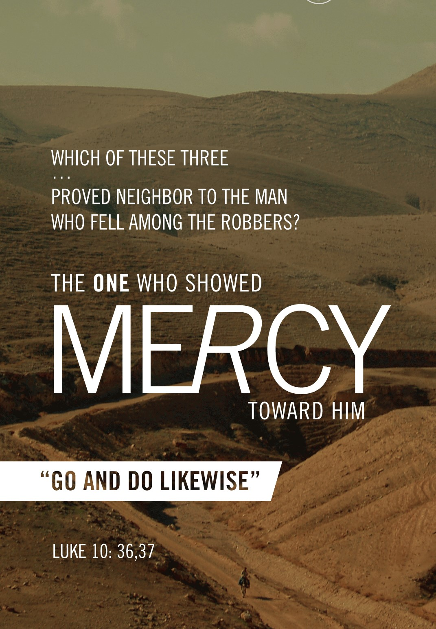
Notes:
We live in an unmerciful world….
Last week we studied the Good Samaritan, answering the question of the lawyer, ‘Who is my neighbor?’ Once Jesus told the parable, the answer was obvious to the lawyer…Jesus lead him to the conclusion. In Luke 10:36, Jesus turns his question around on him and asks a little differently. Not, “who is my neighbor?” but rather “which PROVED to be a neighbor”. The Lawyer says “the one who showed MERCY toward him.” Jesus said, GO and DO the same/likewise.
What do we learn about mercy from this parable? Mercy pays attention to the needs of others, has compassion, is willing to help, is willing to be inconvenienced, willing to pay the price.
What is mercy? Not giving to another what they do deserve. Compassion, pity and in a Godly sense mercy=compassion that leads to forgiveness!
This is an interesting concept. My early remembrance of understanding mercy was playing the game ‘MERCY’…you remember this? You would lock arms with someone and then the one that ‘gained a position of strength or advantage’ would be asked to relent. Another early memory from the Karate Kid. “We do not train to be merciful here! Mercy is for the weak, an enemy deserves NO mercy!” Wow what a messed up concept of mercy. We in our lives, in our church and in our hearts ‘TRAIN’ ourselves to be merciful!
*Read Matthew 23:23-24 – What do we learn about mercy here? It is a “weightier” matter of the law. What’s that mean? It is a priority! How can justice and mercy work together? Two sides of the same coin right! At times mercy demands I relinquish justice or at minimum postpone it for another (GOD) to handle. See 1 Peter 2:23: ²³ and while being reviled, He did not revile in return; while suffering, He uttered no threats, but kept entrusting Himself to Him who judges righteously;
Romans 12: 17-19 ¹⁷ Never pay back evil for evil to anyone. Respect what is right in the sight of all men. ¹⁸ If possible, so far as it depends on you, be at peace with all men. ¹⁹ Never take your own revenge, beloved, but leave room for the wrath of God, for it is written, “Vengeance is Mine, I will repay,” says the Lord.
Hebrews 4:15-16 ¹⁵ For we do not have a high priest who cannot sympathize with our weaknesses, but One who has been tempted in all things as we are, yet without sin. ¹⁶ Therefore let us draw near with confidence to the throne of grace, so that we may receive mercy and find grace to help in time of need.
*If you imagine stepping up to the throne of God with Jesus on His right hand…and we are suppose to CONFIDENT? WHY? HOW? Because of God’s grace and mercy. God’s mercy is the foundation of our ability to have a relationship with Him. Remember what was the top of the Ark of the Covenant called? The MERCY seat! Eph 2: 4 “But God being rich in mercy, because of His great love with which He loved us… When reading Psalm 136, we understand that the mercy of God endures forever.

Slide 2
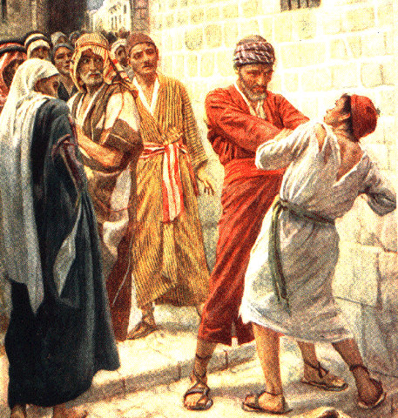
Notes:
Read the parable in Matthew 18: 21-35
The context is when Jesus had been speaking to His disciples about the proper way to handle someone sinning against you. Matt. 18:15-18. The merciful and just thing is NOT to just ignore this sin. The world has told us it is not merciful to tell someone they are sinning or they need to make something right. Here Jesus clearly says that you should, first show you brother his fault in private and if he listens you have ‘WON YOUR BROTHER!’ That is the purpose of following any of the God given commands.
Peter though goes on to ask in 18:21, shall I forgive my brother up to 7 times? You can almost sense the pride in Peter’s question. Jews historically thought 3 was the amount of times you should forgive. Let me ask you husbands…how many of you would be in a forgiven state by your wife, if she only was willing to forgive you 3 times? Some days I wouldn’t even make it through breakfast? ☺
Jesus clears things up and tells him 70 X 7 = 490. So, Jesus is teaching us to keep a record and when we get to the 491 time of forgiveness we are relented from needing to offer forgiveness! NO! NO! NO!
Picture the story!!
18:23 – King is settling the accounts. The king is God and we are the slaves. This also can be a picture of judgement.
18:24 – A talent is worth roughly 15 YEARS wages. Also, 10,000 was the highest Greek number and the talent was the largest denomination of money. The point is the debt was incredibly high. The king also can now be compared to American Express. JK!
18:25 – Couldn’t be repaid, demand to sell: him, his wife and children and all positions for repayment. Rom 3:23 All have sinned and fall short of the Glory of God. Rom 6:23 The wages of sin is death. The nature of human debt towards God – UNPAYABLE! Eph 2:8 “for by grace you have been saved through faith.”
18:26 – The slave throws himself down, asks for patience and says he ‘will repay everything’
18:27 – The king 1. Felt compassion 2. Released/forgave him the debt. What a beautiful picture of God’s compassion, grace, mercy or us!
18:28 – the dreaded word BUT, this SAME slave who received so much from the king, went out found someone owing him 100 denarius (one day wage), seized him, choked him, and demanded repayment.
18:29 – Notice this one asks for the exact same thing and he had in 18:26 (He wanted patience to repay).
18:30 – UNWILLING! Threw into prison until he could pay it back. The irony of this is how could he work to repay if in prison!? I hope you feel disgusted right now. But let me quickly make this application point….If you are unwilling to work to provide forgiveness and mercy to someone that is seeking it from you…you are this slave. I don’t know about you but that scares me!
18:31-32 – The other slaves tell the king and called him a WICKED slave.
18:33 – The MAIN Point: “Should you not also have had mercy on your fellow slave, in the same way I have mercy on you?” It’s a rhetorical questions…Of course he should have shown mercy!!!
18:34-35 – Judgement came on the slave who showed NO mercy. 18:35 Read again…. “does not forgive his brother FROM YOUR HEART!” This is scary. How do we forgive sometimes? It is most difficult to truly forgive from the heart….We say I will forgive but NOT forget. And truly can we forget? (call to remembrance?) No, but rather in forgive and forget we must be wiling to move forward.
Consider Joseph, Paul, Jesus and Stephen.
See Matthew 5: 23-25. Also, Jesus was an example! In Luke 23:34 “Father forgive them for they know not what they do” Stephen in Acts 7:60 “Lord, do not hold this sin against them…”

Slide 3
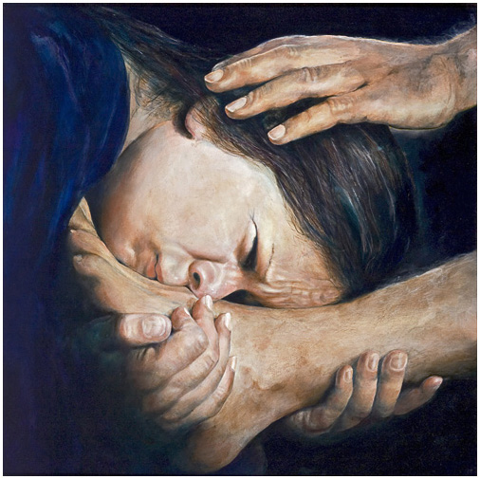
Notes:
Read Luke 7:36-50

Slide 4
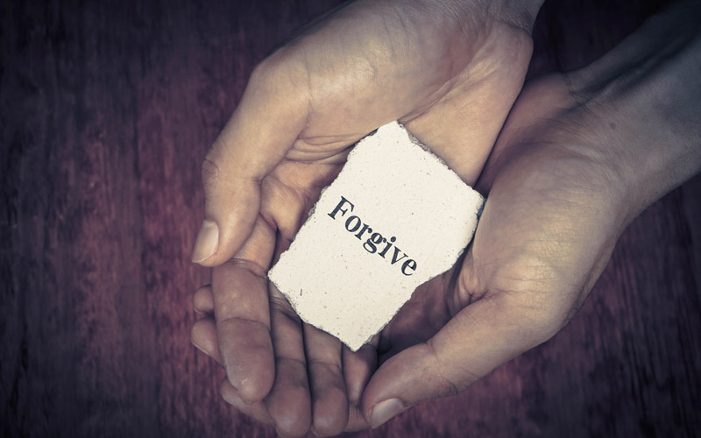
Lessons!
God forgives MORE!
Forgiveness takes FAITH!
You can not afford being unforgiving to others!
Notes:
1. 18:27 – The king 1. Felt compassion 2. Released/forgave him the debt. STOP and note what the slave asked for. Patience to repay…what does he receive? MORE than he even asks….total and complete release and forgiveness. What a beautiful picture of God’s compassion, grace, mercy or us!
Eph. 3:20-21 ²⁰ Now to Him who is able to do far more abundantly beyond all that we ask or think, according to the power that works within us, ²¹ to Him be the glory in the church and in Christ Jesus to all generations forever and ever. Amen.
Psalm 103: 10-12 ¹⁰ He has not dealt with us according to our sins, Nor rewarded us according to our iniquities. ¹¹ For as high as the heavens are above the earth, So great is His lovingkindness toward those who fear Him. ¹² As far as the east is from the west, So far has He removed our transgressions from us.
2. Forgiveness takes Faith. It takes us away from our comforts and it opens us up pain, suffering, hurt ego/pride.
Being able to give mercy and grace to others, will be the basis of our relationships. It is what will make us develop stronger ones! Why is this so hard? BC it makes us vulnerable to be hurt again. See Luke 17: 3-5
³ Be on your guard! If your brother sins, rebuke him; and if he repents, forgive him. ⁴ And if he sins against you seven times a day, and returns to you seven times, saying, ‘I repent,’ forgive him.” ⁵ The apostles said to the Lord, “Increase our faith!”
*I love the apostles response….”INCREASE OUR FAITH!” Let me say if I have to forgive someone seven times in ONE day, it would be a great test of my faith. I hope this study tonight, increased your faith to be merciful, compassionate, ready to forgive and reunite any broken relationship you have in your ability to mend, first with God, then each other.
Eph. 4:32- “Be kind to one another, tenderhearted, forgiving one another, as God in Christ forgave you.”
3. You can not afford being unforgiving to others! Forgiveness is conditional!
Matthew 6:12 “And forgive us our debts, as we also have forgiven our debtors!” This parable teaches us that God expects, no demands of us to be forgiving to others. It is the natural outcome of someone that has been forgiven.
Matthew 6:12, 14-15, ¹⁴ For if you forgive others for their transgressions, your heavenly Father will also forgive you. ¹⁵ But if you do not forgive others, then your Father will not forgive your transgressions.
Matthew 5:7
NEXT SLIDE – Blessed are the merciful, for they shall obtain mercy!

Slide 5
Notes:
In Luke 10:37 – Jesus gives the lawyer and us with the BEST application of the parable.
GO AND DO THE SAME! SHOW MERCY!
PSALM 37:3 “TRUST IN THE LORD and DO GOOD!”

